Slide 1
AI/ML Healthcare System And Prediction System
🩺 Bridging the gap between symptoms and accurate diagnosis through real-time AI-powered healthcare prediction and drug safety system.
Priyansu Dhami
B.Tech CSE
Graphic Era Hill University

Slide 2
The Healthcare Problem Is Growing Early diagnosis is critical, yet millions still lack access to timely and safe healthcare solutions.
Delayed Diagnosis
Many patients rely on self-medication or late consultations, leading to incorrect treatment and worsening conditions.
No Intelligent Support System
Existing systems do not provide real-time disease prediction or personalized healthcare recommendations based on symptoms.
Unsafe Medication Is Common
Lack of awareness about drug interactions can lead to harmful or even life-threatening consequences.

Slide 3
Our Objective
The Smart Healthcare System aims to build a seamless, AI-driven pipeline that predicts diseases from symptoms and ensures safe medication — in real time, using an accessible and user-friendly interface.
1) Capture Symptoms
Collect and process user-input symptoms through an intuitive interface.
2) Predict Disease
Analyze symptoms using machine learning models to identify the most probable disease with high accuracy.
3) Recommend Medicines
Suggest important and relevant medicines based on the predicted disease.
4) Check Drug Safety
Detect harmful drug interactions using existing medication data to ensure safe treatment.
5) Provide Advice & Store History
Offer precautionary advice and store user history for personalized healthcare support.

Slide 4
Working Pipeline A real-time AI-powered healthcare system that analyzes user symptoms and provides disease prediction, medicine recommendation, and safety checks through sequential stages.
01. Input Symptoms
User selects symptoms through an interactive interface.
02. Data Processing
Symptoms are cleaned, normalized, and converted into a machine-readable format.
03. Feature Mapping
Symptoms are mapped with severity weights to create a structured input vector.
04. Disease Prediction
Machine learning model analyzes the input and predicts the most probable disease.
05. Medicine Recommendation
Relevant and important medicines are suggested based on prediction.
06. Drug Safety & Advice
System checks drug interactions and provides precautions and health advice.

Slide 5
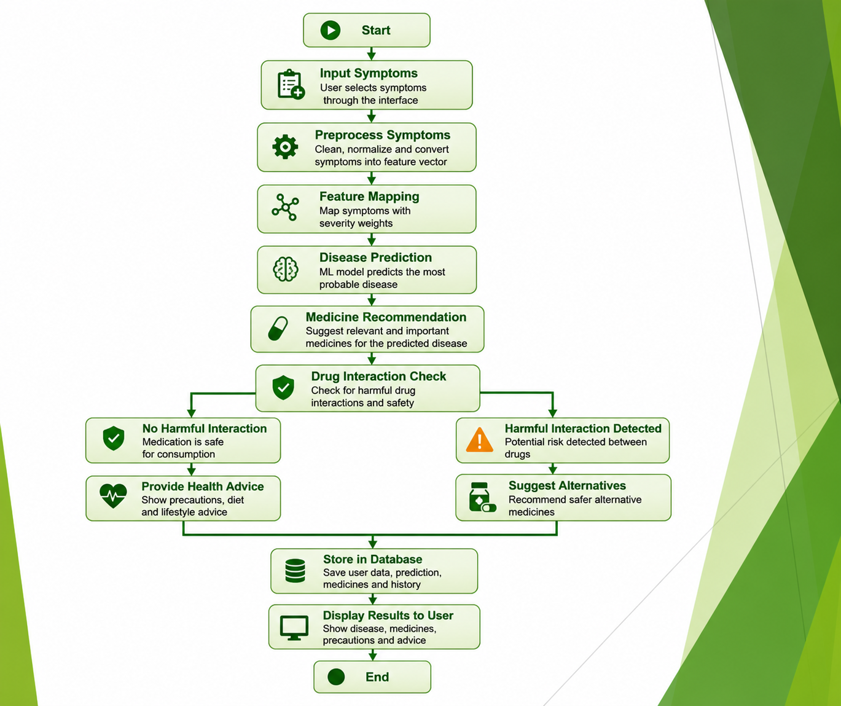

Slide 6
Technologies Powering AI/ML Healthcare Management And Prediction System
1. Python
Core programming language used for model development, data processing, and system integration.
2. Streamlit
Used to build an interactive and user-friendly web interface for real-time symptom input and prediction.
3. Pandas & NumPy
Libraries used for data handling, preprocessing, and numerical computations.
4. Machine Learning (Scikit-learn)
Implements models like Naive Bayes, Logistic Regression, and SVM for disease prediction.
5. SQLite / MySQL
Database system used to store user data, feedback, and prediction history.
6. Joblib
Used for saving and loading trained machine learning models efficiently.

Slide 7
Methodology: From Data to Deployment
1. Data Collection
Collected datasets containing symptoms, diseases, medicines, and drug interactions from reliable sources.
2. Data Preprocessing
Cleaned, normalized, and transformed symptom data into structured format for machine learning models.
3. Feature Engineering
Mapped symptoms with severity weights and created feature vectors for accurate prediction.
4. Model Training
Trained multiple machine learning models such as Naive Bayes, Logistic Regression, and SVM for disease classification.
5. Real-Time Prediction & Deployment
Deployed the trained model using Streamlit for real-time disease prediction, medicine recommendation, and drug safety checks.

Slide 8
Why Machine Learning? The Intelligence Behind the System
Machine Learning Models (Naive Bayes & Others)
Unlike traditional rule-based systems, machine learning models can learn patterns from data — making them ideal for disease prediction where symptoms vary in importance.
Understand relationships between multiple symptoms
Handle uncertainty and incomplete inputs
Provide probabilistic predictions (confidence-based)
Reduce misdiagnosis by learning from real datasets
Deliver high accuracy with fast prediction

Slide 9
Algorithms Used: The Intelligence Behind Prediction
Naive Bayes (Primary Model)
Fast and efficient probabilistic model used for disease prediction.
Logistic Regression
Used for classification and comparison with other models.
Support Vector Machine (SVM)
Handles complex data patterns and improves prediction accuracy.
Decision Tree & Random Forest
Used for performance comparison and robustness analysis.
👉 Naive Bayes selected for best performance and speed

Slide 10
Applications & The Road Ahead
🏥 Healthcare
Helps users get early disease prediction and safe medication recommendations without immediate doctor consultation.
🌍 Rural Areas
Provides accessible healthcare support in areas with limited medical facilities.
💻 Personal Health Monitoring
Allows users to track symptoms, history, and receive personalized health advice.
🚀 What’s Next
Mobile Application
Deploy the system on smartphones for easy, on-the-go healthcare assistance
Real-Time Health Data Integration
Integrate wearable devices for continuous health monitoring and prediction.
Advanced AI Models
Use deep learning for more accurate and complex disease prediction.

Slide 11
Conclusion: AI as a Healthcare Bridge Smart Healthcare System demonstrates how AI can be a powerful tool for improving early diagnosis and ensuring safe medication. By predicting diseases from symptoms and checking drug interactions in real time, the system reduces risks and supports better healthcare decisions.
Built
A complete AI-based disease prediction system using machine learning models, integrated with medicine recommendation and drug interaction detection.
Impact
Enables early diagnosis ,reduces risk of harmful medication ,improves healthcare accessibility ,supports users in making informed decisions
Potential
Scalable to mobile platforms ,integration with real-time health data (wearables) ,advanced AI models for higher accuracy ,personalized healthcare recommendations

