Slide 1

Project Title -Stegnography in action
NAME – Priyansu Panda
COLLEGE- GITA Autonomous College, Bhubaneswar
AICTE Internship Student Registration ID) : STU658aed558a50a1703603541

Slide 2

PROBLEM STATEMENT
Introduction to Data Security
Increasing threats to data privacy and security.
Traditional encryption methods are often targeted and decrypted.
Need for Stealth Communication
Ensuring confidential data is hidden within ordinary files.
Preventing detection of the existence of secret communication.
.

Slide 3
Project Description
Objective
To develop a steganography system that embeds secret data within digital media files.
Methodology
Hiding information within image, audio, or video files.
Ensuring the cover media retains its original appearance or sound quality.
Scope
Applicable for secure communication in various fields such as government, military, and private sectors.

Slide 4

WHO ARE THE END USERS?
Government Agencies
Secure transmission of classified information.
Military
Covert operations and communications.
Corporations
Protection of intellectual property and sensitive data.
Individuals
Personal privacy and data security.
Journalists and Activists
Protecting sources and sensitive information.

Slide 5

Technology Used
Programming Languages
Python for implementing algorithms.
Libraries and Tools
PIL (Python Imaging Library) for image processing.
PyAudio for audio steganography.
OpenCV for video steganography.
Techniques
LSB (Least Significant Bit) for image steganography.
Phase coding for audio steganography.

Slide 6
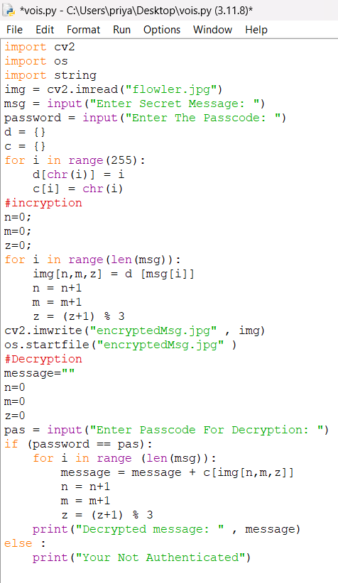
RESULTS
Efficiency
High capacity of data embedding with minimal impact on the cover media.
Stealth
Low detectability by common steganalysis techniques.
Quality
Preservation of the quality and integrity of the cover media.
Applications
Successful implementation in test scenarios for secure communication.
Link-https://drive.google.com/file/d/1vb9kW3EoZJHtzUTdzMtF1nCR5oXTGGhN/view?usp=sharing

Slide 7
Thank you
.
.

