Slide 1

INTERNSHALA

Slide 2
Contents
Problem Statement
Business Requirement
Web UI and Design of Internshala Application
Tools and Technologies
Conclusion

Slide 3


THBS Batch-99
Team Members
Priya P Shetty
UI Design,
Backend Developer
Shashank Rao s
UI Design,
Backend Developer

Slide 4
Problem Statement
The main objective of the Job Portal (InternShala) is to manage the details of Internships, Jobs.
Job Portal (InternShala) is a friendly to Enroll for internship or Apply for Jobs. Users can search internships and jobs in this application.
This application mainly concentrates on maintaining and managing the details of internships and jobs .

Slide 5

Business Requirements
The application have the login and register option for Users.
To View the details of Internships and Jobs.
To allow users to apply for Internships and Jobs.

Slide 6
Design of Job Portal InternShala Application
Controller(Accepts the user details and transfer the request to database
Register view
Login view
Job View
Internship View
User
Server
Front-end
Database Model
( responds to server queries)
Backend

Slide 7
Job Portal (Internshala)
Home Page
Register
Login
Internships
Jobs
View Details
View Details
Enroll
Apply
Log out

Slide 8



TOOLS AND TECHNOLOGIES
CSS
HTML
JavaScript
MYSQL WORKBENCH
Bootstrap
Angular
Express Js
Node Js

Slide 9
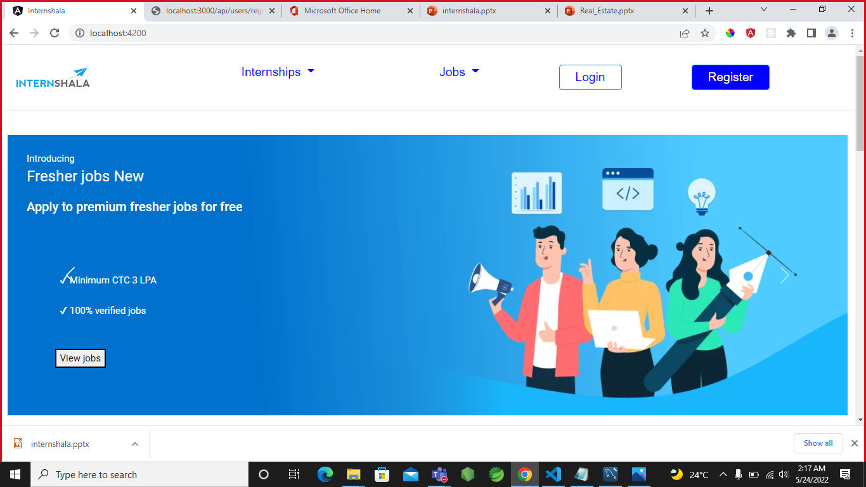
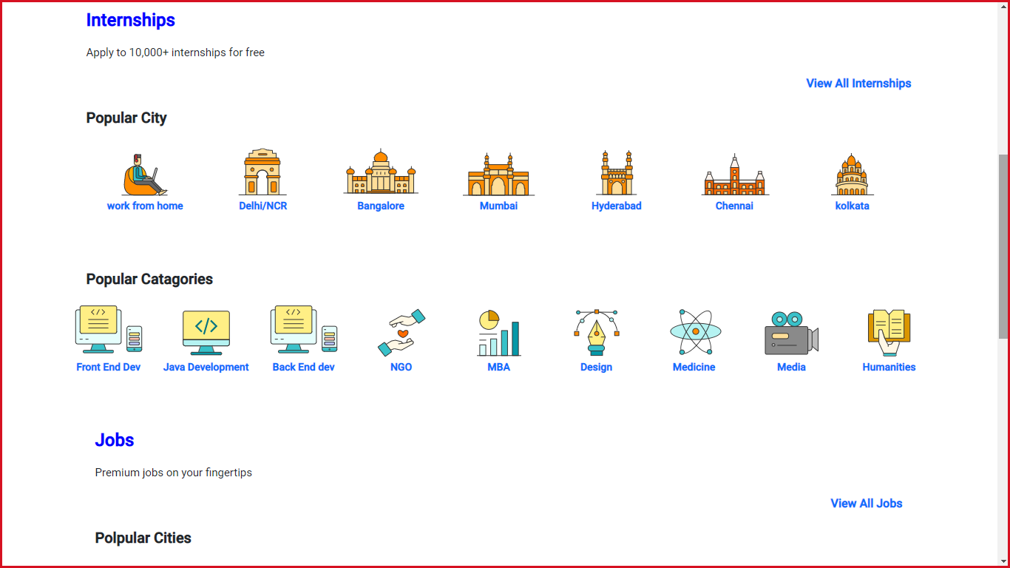
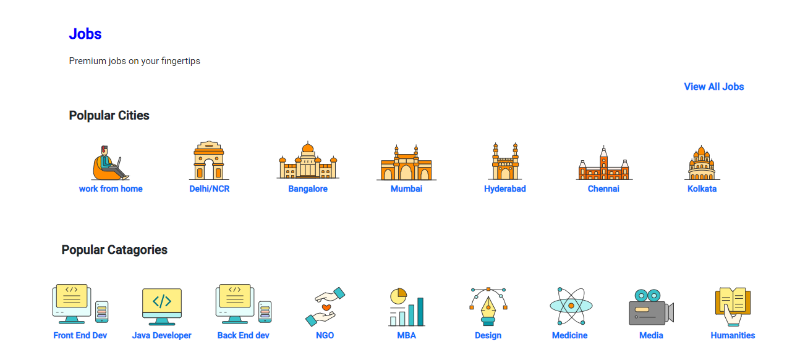
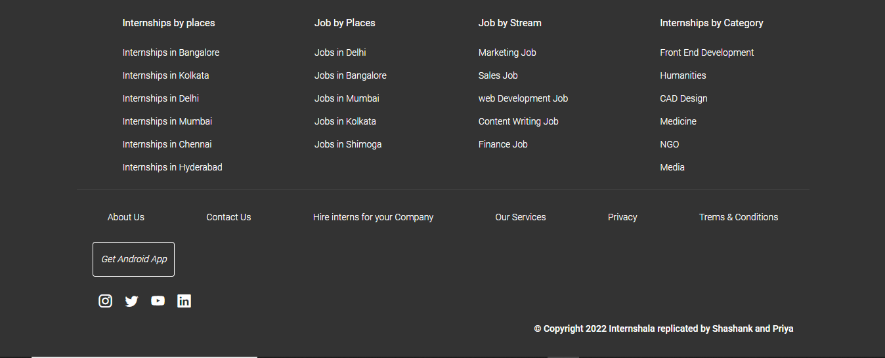
Screenshot
Home Page

Slide 10
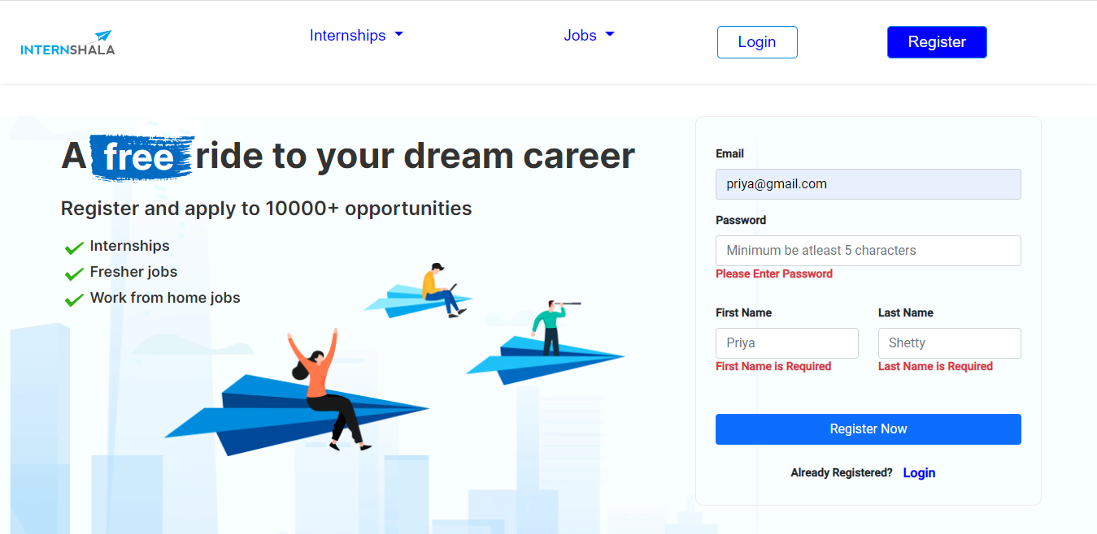
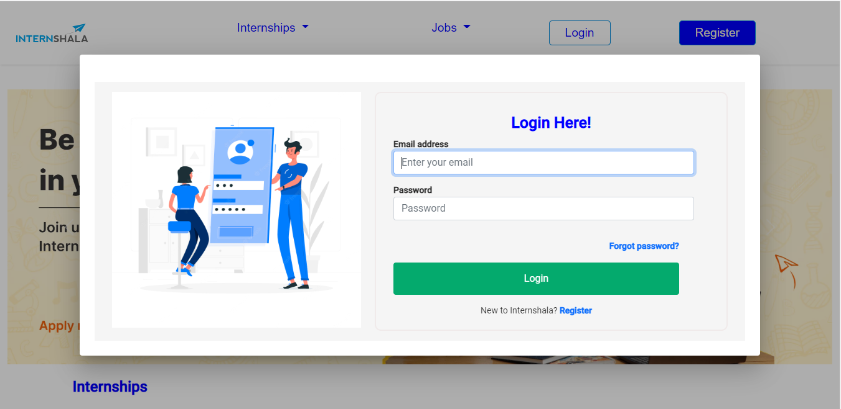
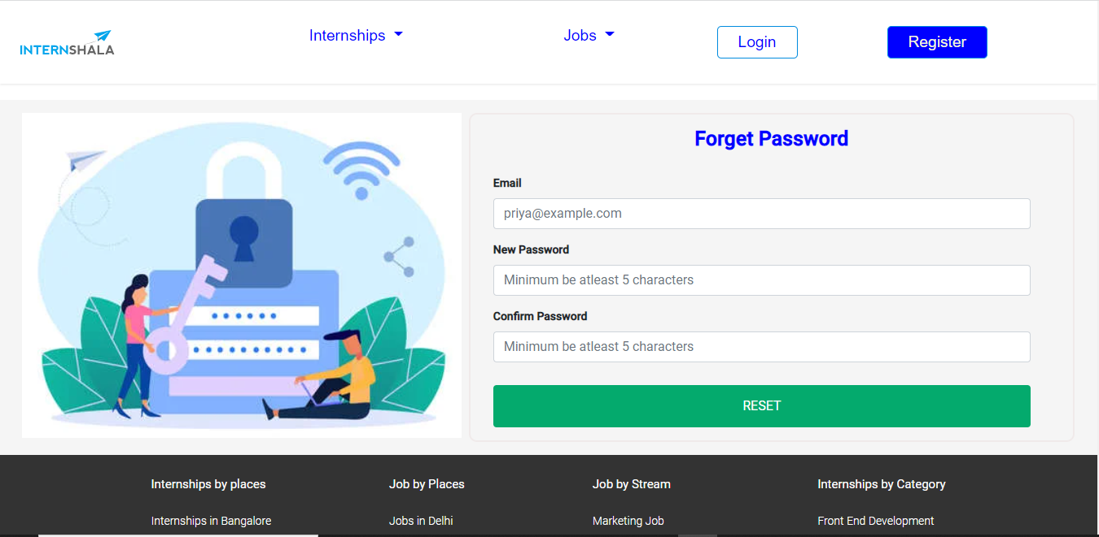
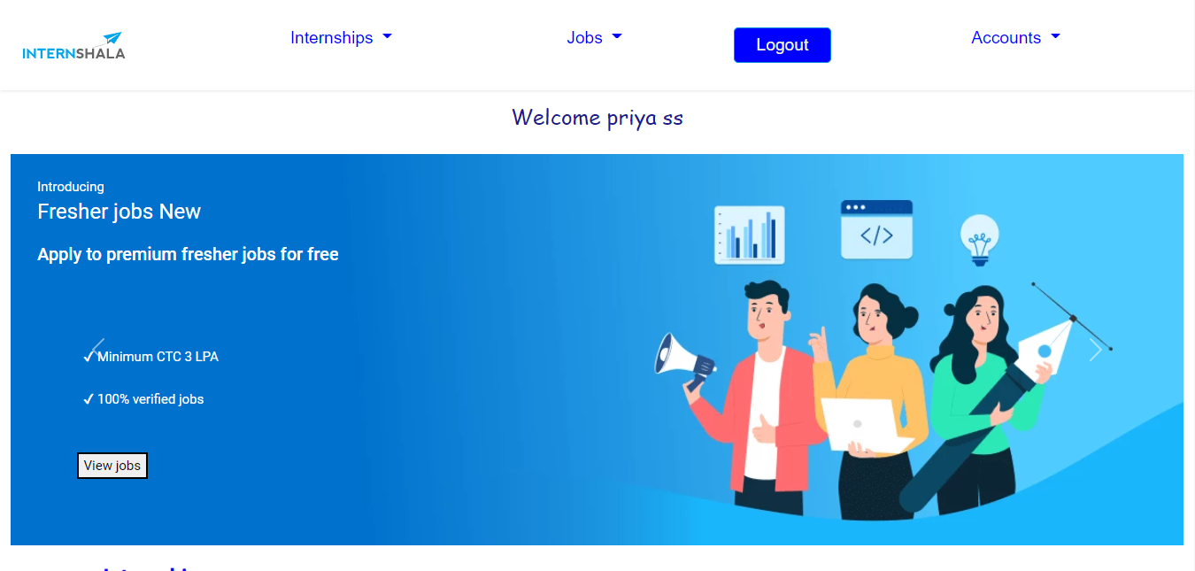
Register page, Login page and Forget password

Slide 11
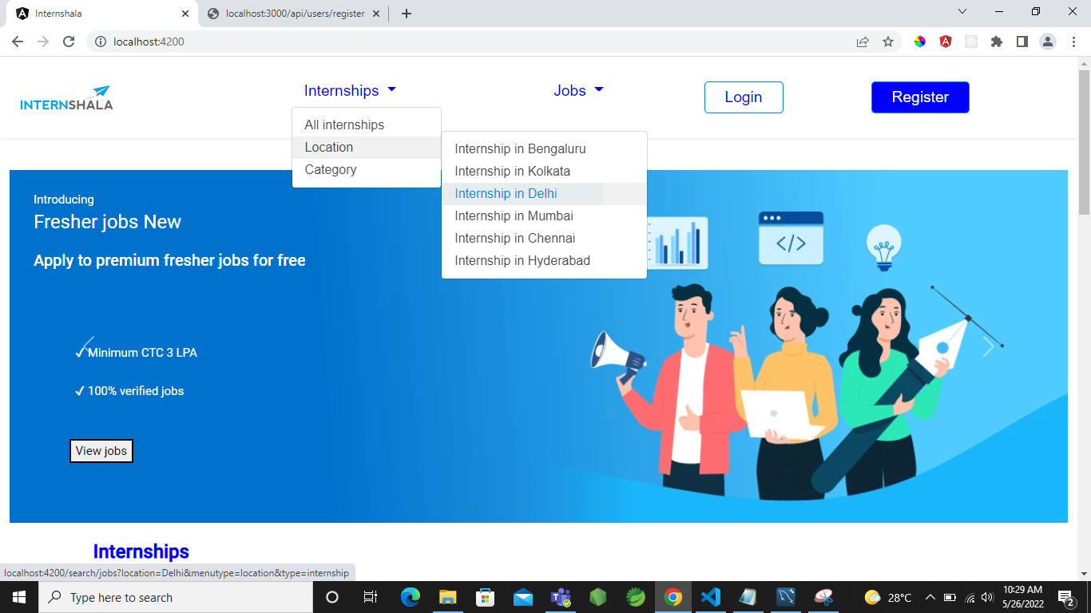
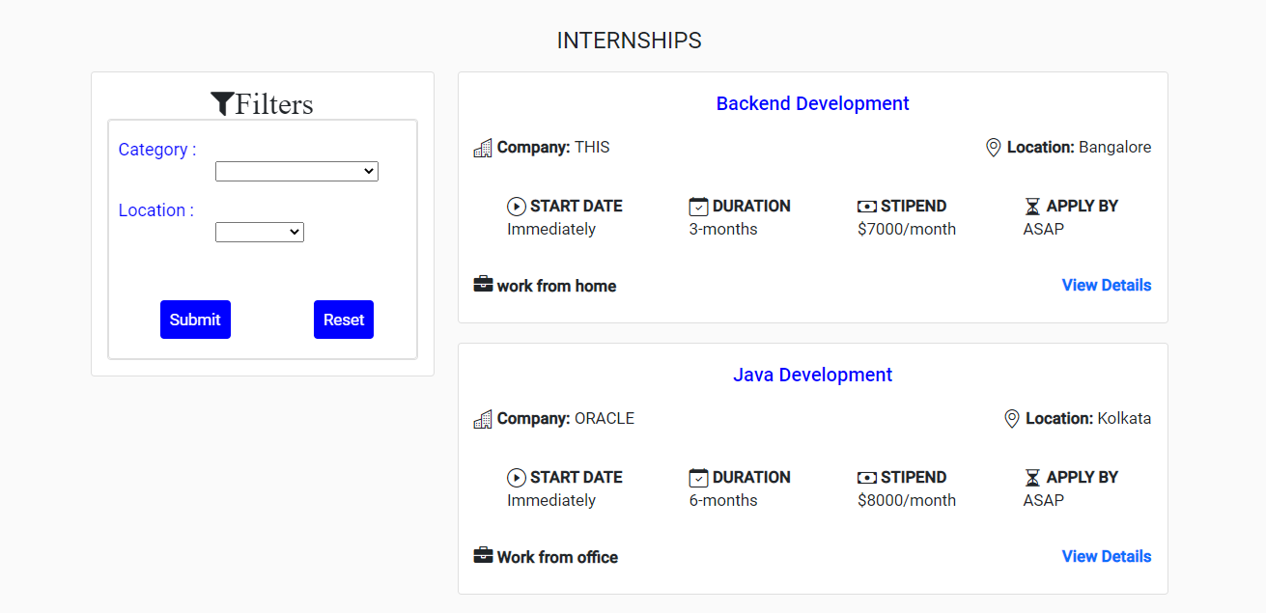
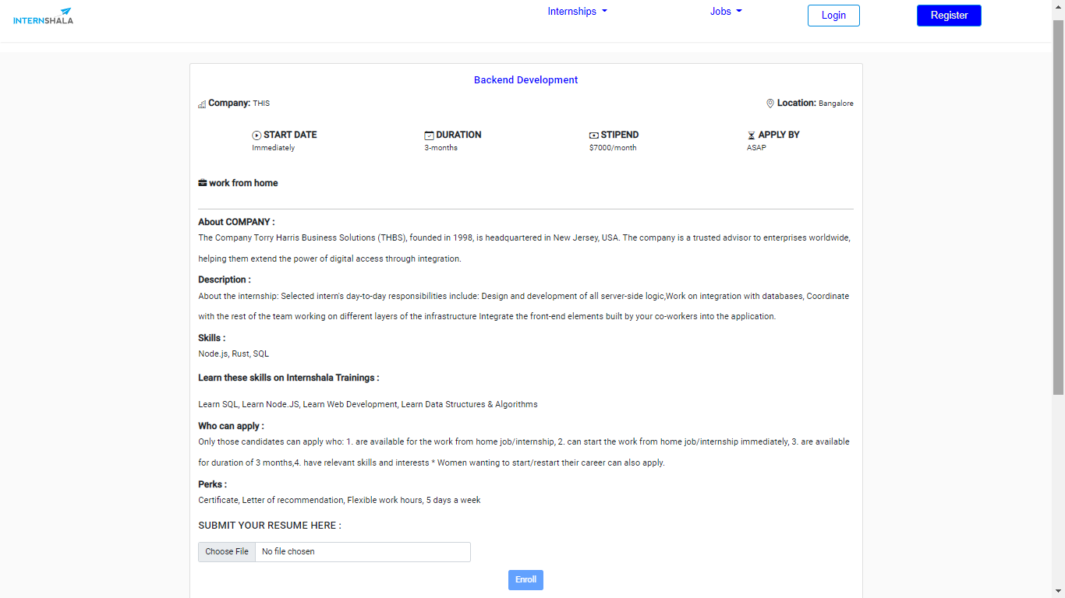
Internship Module

Slide 12
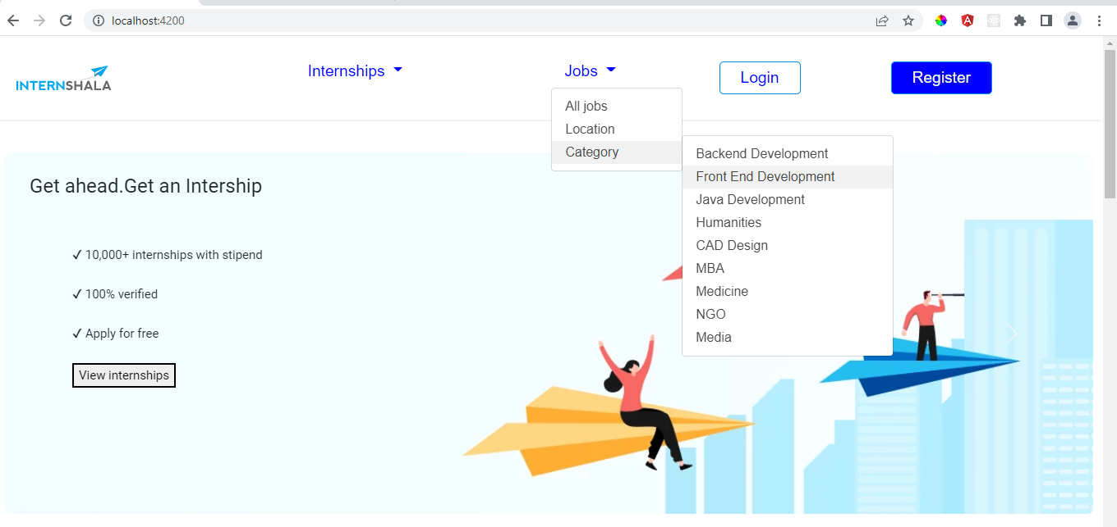
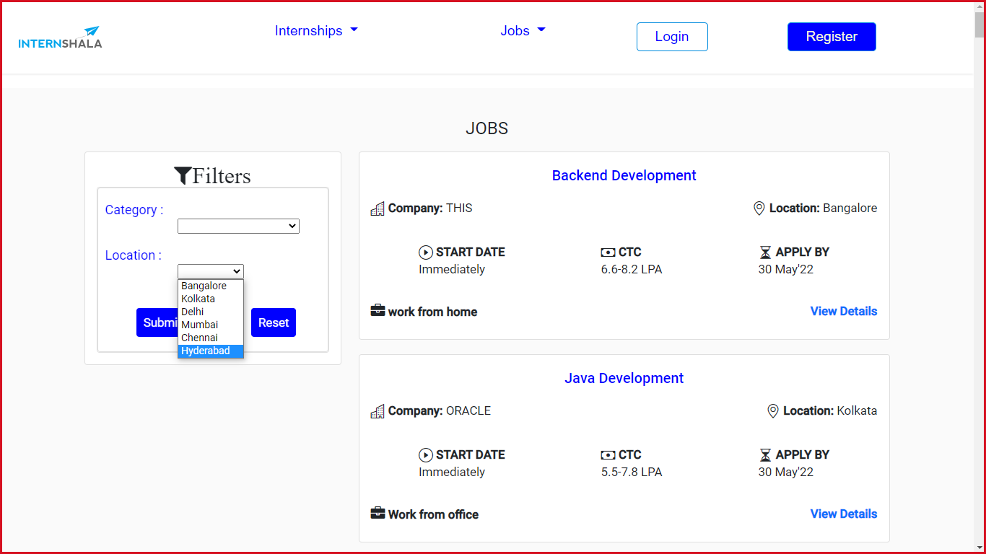
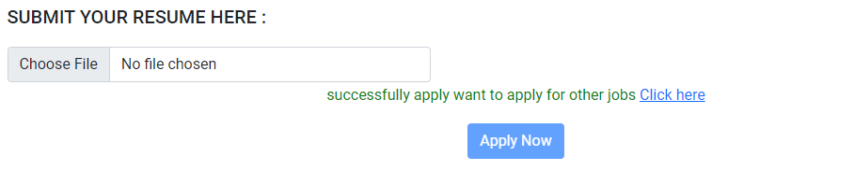
Job Module

Slide 13
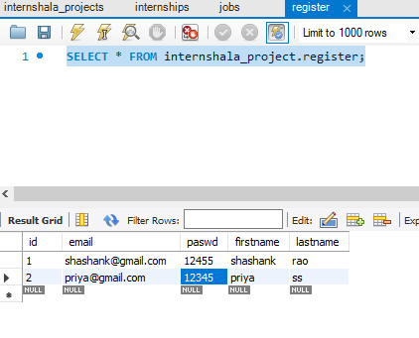
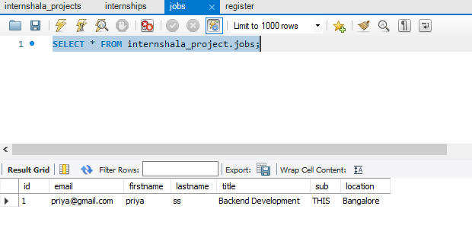
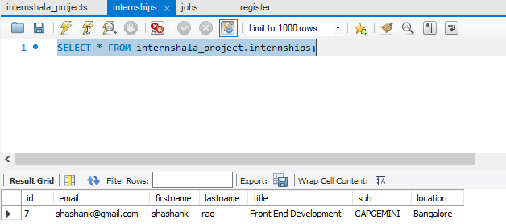
Database Connection

Slide 14
CONCLUSION
The main purpose of Job Portal is used to applying for the Jobs, internships by providing the user friendly application to use.
This avoids unauthorized users from accessing the application.
Helps to find the desired Jobs and Internships easily.

Slide 15
Thank You
Git Repository Link :
https://github.com/Priyapshetty07/internshala_angular_express_project

