Slide 1
PRESENTATION
ON
MICRO-CREDIT DEFAULTER PROJECT
Submitted to: Submitted by:
Flip Robo Technologies Priya Rajput

Slide 2
INTRODUCTION
Business Problem Framing
Conceptual Background Of Domain Knowledge
Problem Statement
ANALYTICAL PROBLEM FRAMING
EXPLORATORY DATA ANALYSIS
CONCLUSION WITH FUTURE SCOPE

Slide 3
Business Problem Framing
A Microfinance Institution (MFI) is an organization that offers financial services to low income populations. MFS becomes very useful when targeting especially the unbanked poor families living in remote areas with not much sources of income.
They understand the importance of communication and how it effects a person’s life and lack of communication can cause lot of uncertain problems, thus, focusing on providing their services and products to low income families and poor customers that can help them in the need of hour.

Slide 4

The goal of this project is to create a regression model that is able to accurately estimate the price of the house given the features.
This model can be useful for potential buyers in deciding the characteristics of a house they wantthat best fits their budget and will be of tremendous benefit, especially to housing developers and researchers, to ascertain the most significant attributes to determine house prices and to acknowledge the best machine learning model to be used to conduct a study in this field.

Slide 5
CONCEPTUAL BACKGROUND OF THE DOMAIN PROBLEM
Check whether the problem is supervised or not.
Check whether model is regression or classification type.
Perform various mathematical and statistical analysis which include description or statistical
summary of the data, correlation using corr() and data visualization . Then we have used zscore to plot outliers and remove them.
Check whether our dataset is balanced or imbalanced. If data is imbalanced, then we apply sampling techniques to balance the dataset.
Building the model and check its accuracy.
Selecting the model, hyperparameter tuning would be done.

Slide 6
Problem Statement
Our main objective of doing this project is to build a model to predict whether the users are paying the loan within the due date or not. We are going to predict by using Machine Learning algorithms.
The sample data is provided to us from our client database. In order to improve the selection of customers for the credit, the client wants some predictions that could help them in further investment and improvement in selection of customers

Slide 7
import numpy as np
import pandas as pd
import matplotlib.pyplot as plt
import seaborn as sns

Slide 8
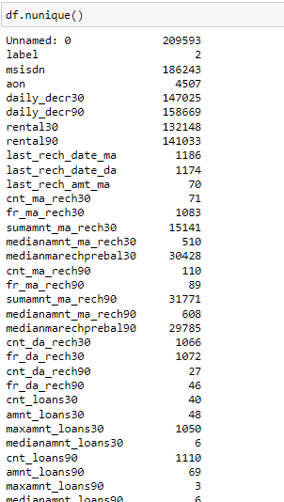
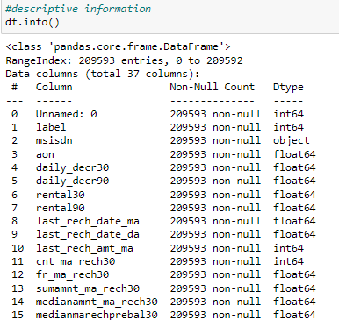
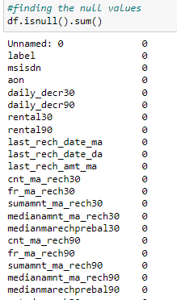

Slide 9

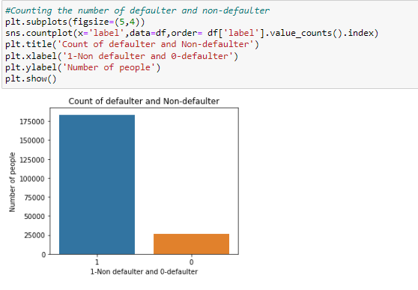
Feature: label
Observation: From above we see 183431 people had payed their loan amount whereas 26162 people didnot pay the amount.

Slide 10
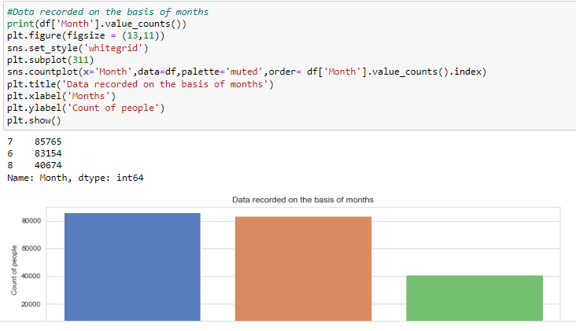
Feature: Month
Observation: Maximum number of people records have been recorded in the month of July with a value of 85765 whereas least number of records have been recorded in the month of August with a value of 40674.

Slide 11
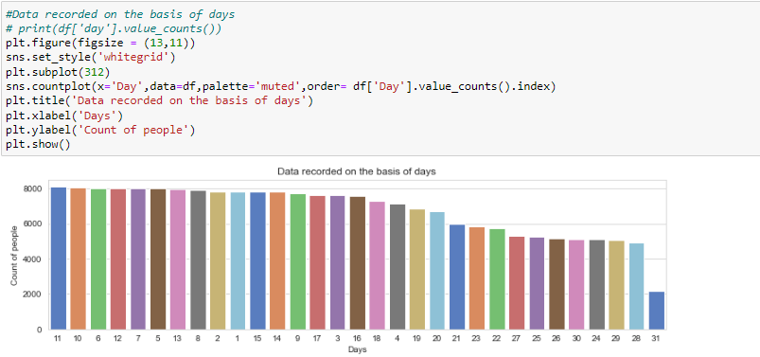
Feature: Day
Observation: On 11th day, maximum number of people either took the loans or repayed the loan amount. The number of people is 8092.On 31st day, minimum number of people either took the loans or repayed the loan amount. The number of people is 2178

Slide 12

Dropped the column ‘Unnamed:0’ :as it is of no use, it is only giving serial numbers starting from 1 , ’ msisdn’: it tells us about the mobile number of the user which is not so important.
Checked the value counts of the target variable ’Label’ whether the dataset is balanced or imbalanced.
Also dropped ‘pcircle’ and ‘pdate’, pcircle is telling us about the telecom circle and pdate is giving us some dates, but these two columns are not playing any significant role.
Checked the correlation between dependant and independent variables using heatmap. I have seen many columns which are 0% correlated with the target variable. So, I also have dropped all those columns which are not correlated with the target variable ‘Label’.
Visualization using distribution plots where I can clearly see some outliers and skewness from the plots.

Slide 13
Checked outliers using boxplots and also removed them using zscore.
Splitted the dependant and independent variables into x and y.
Scaled the data using StandardScaler method and made my data ready for model building.

Slide 14
Interpretation of the Results
In the visualization part, we have seen how my data looks like using heatmap, boxplot, distribution plots. In the pre-processing part, we have cleaned data using zscore.
In the modeling part, we have designed our model using algorithms like Random Forest Classifier. The accuracy score, confusion_matrix, classification_report are achieved for each model.

Slide 15
Conclusion
Loan lending has been proven very substantial in the stability of any country’s economy in this century such a huge amount of loan defaults is also very critical. To cope up with this problem a comprehensive amount of literature was reviewed to study the significant factors that lead to such problems.
Future scope of this work is we can try different algorithms like Extra tree classifier, Gaussian NB etc. for model building and try to achieve a good accuracy and f1-score.

Slide 16
Thank You

