Slide 1

EXECUTIVE SUMMARY
TVK's Emergence and Tamil Nadu's Changing Political Landscape by 2026
Regional electoral shifts, vote share changes, and turnout growth across Tamil Nadu.
TVK emerged as a major competitive force, disrupting DMK's regional dominance
Urban constituencies — especially Chennai Metro — drove the strongest electoral realignment
Higher voter turnout correlated with stronger TVK growth across regions

Slide 2
Objective & Methodology
Regional Seat Shifts
Vote Share Realignment
Turnout Dynamics
Seat allocation changes across regions.
Vote share shift across parties and
Regions.
Turnout Growth patterns across constituencies.

Slide 3
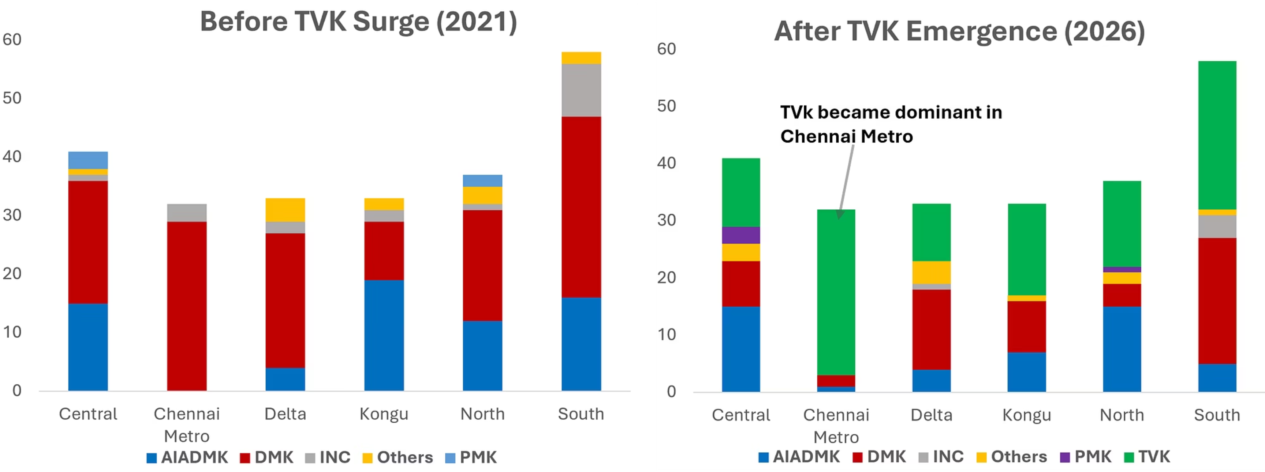
Seat Distribution Shift Across Tamil Nadu
Chennai Metro saw the sharpest shift
Key insight: TVK’s growth in Chennai Metro weakened DMK’s regional lead by 2026.

Slide 4
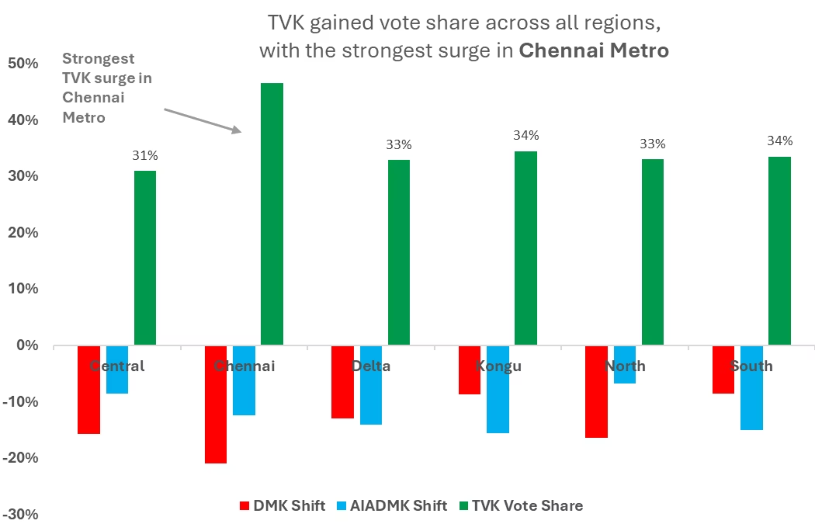
TVK Gained Vote Share Across All Regions, Led by Chennai Metro
Key Findings
TVK gained vote share in every region.
Chennai Metro drove the sharpest shift.
Urban voters shifted most toward TVK.

Slide 5
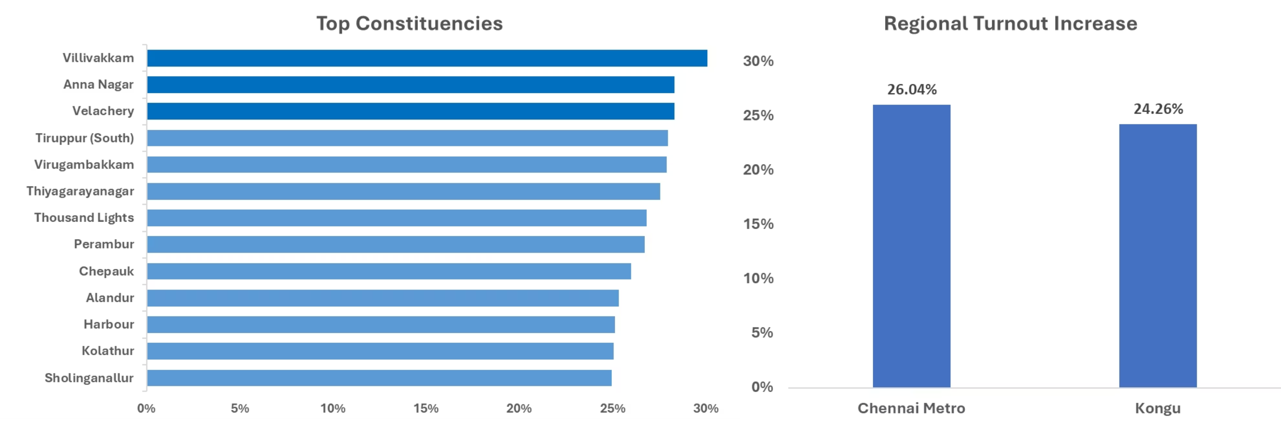
Executive takeaway: Chennai Metro led turnout growth, with urban constituencies showing the clearest surge and reinforcing TVK’s strongest momentum in the region.
Turnout Growth Was Strongest in Chennai Metro Constituencies

Slide 6
Three Signals That Defined the Election
Key regional shifts across Tamil Nadu.
1
2
3
Urban Strength
DMK Decline
Turnout Impact
TVK was strongest in urban areas, led by Chennai Metro.
DMK lost ground across several regions as TVK advanced.
Higher turnout aligned closely with the shift toward TVK.

Slide 7
Strategic Implications for Urban Voter Engagement
1
2
3
4
Prioritize Urban Clusters
Track Turnout Shifts
Reach Emerging Blocs
Monitor Regional Fragmentation
Use turnout patterns as an early indicator of momentum.
Concentrate resources on Chennai Metro and other dense constituencies.
Engage first-time voters and newly mobilized urban groups.
Watch how traditional party dominance continues to split across regions.

Slide 8
Data Limitations & Closing
Important Caveats
Key Takeaway
Regional Aggregation
Directional Interpretation
Tamil Nadu's Political landscape is becoming increasingly competitive across regions.
The analysis is synthesized at the regional level, so constituency-level dynamics may vary meaningfully within each cluster.
The patterns identified are directional and comparative, highlighting relative shifts rather than point forecasts.
Data Scope & Timeframe
The findings reflect the elections and time periods included in the dataset; later developments and local events are outside the scope of this review.
Source: Election Commission of India (ECI) publicly available constituency-level data.
Urban voter engagement is emerging as the decisive force shaping this transition.

