Slide 1
DATA EXPLORATION
In [1]:
import pandas as pd import numpy as np import matplotlib.pyplot as plt import seaborn as sns In [2]:
# Load the dataset
data = pd.read_csv('health care diabetes.csv')
In [3]:
# Display the first few rows print(data.head())
Pregnancies Glucose BloodPressure SkinThickness Insulin BMI \
0 | 6 | 148 | 72 |  | 35 | 0 33.6
1 | 1 | 85 | 66 |  | 29 | 0 26.6
2 | 8 | 183 | 64 |  | 0 | 0 23.3
3 | 1 | 89 | 66 |  | 23 | 94 28.1
4 | 0 | 137 | 40 |  | 35 | 168 43.1
 | DiabetesPedigreeFunction |  |  | Age | Outcome
0 |  | 0.627 | 50 | 1
1 |  | 0.351 | 31 | 0
2 |  | 0.672 | 32 | 1
3 |  | 0.167 | 21 | 0
4 |  | 2.288 | 33 | 1
In [4]:
# Summary statistics print(data.describe())
Pregnancies Glucose BloodPressure SkinThickness Insulin \ count 768.000000 768.000000 768.000000 768.000000 768.000000
mean 3.845052 120.894531 69.105469 20.536458 79.799479
std 3.369578 31.972618 19.355807 15.952218 115.244002
min 0.000000 0.000000 0.000000 0.000000 0.000000
25% 1.000000 99.000000 62.000000 0.000000 0.000000
50% 3.000000 117.000000 72.000000 23.000000 30.500000
75% 6.000000 140.250000 80.000000 32.000000 127.250000
max 17.000000 199.000000 122.000000 99.000000 846.000000
BMI DiabetesPedigreeFunction Age Outcome
count 768.000000 mean 31.992578 std 7.884160 min 0.000000 25% 27.300000
50% 32.000000
75% 36.600000
max 67.100000
768.000000 768.000000 768.000000 0.471876 33.240885 0.348958 0.331329 11.760232 0.476951 0.078000 21.000000 0.000000 0.243750 24.000000 0.000000 0.372500 29.000000 0.000000 0.626250 41.000000 1.000000
2.420000 81.000000 1.000000
In [5]:
# Columns where 0 does not make sense (indicating missing values) columns_with_zero = ['Glucose', 'BloodPressure', 'SkinThickness', 'Insulin', 'BMI'] In [6]:
# Replace 0 with NaN
data[columns_with_zero] = data[columns_with_zero].replace(0, np.nan)
In [7]:
# Handle missing values (filling with mean for simplicity) data.fiHna(data.mean(), inplace=True)
In [8]:
# Check for missing values print(data.isnuHQ.sumO)
Pregnancies 0
Glucose 0
BloodPressure 0
SkinThickness 0
Insulin 0
BMI 0
DiabetesPedigreeFunction 0 Age 0
Outcome 0
dtype: int64
In [11]:
# Visual exploration using histograms data.hist(figsize=(10, 10), color='green') plt.tight_layout() plt.show()

Slide 2
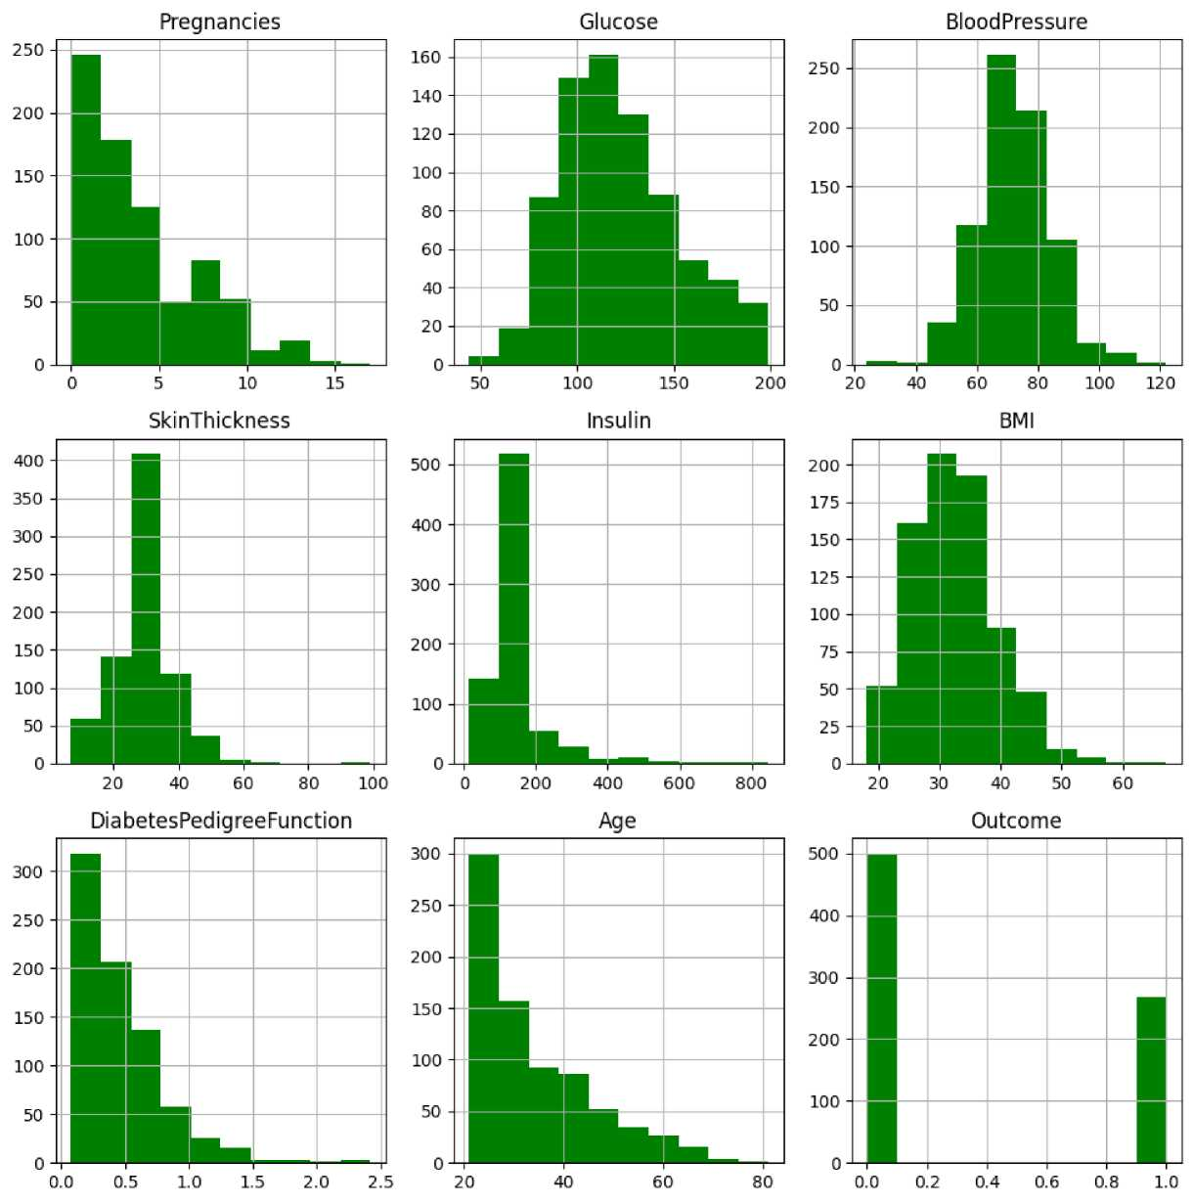
In [12]:
# Visual exploration using histograms with different colors import matplotlib.colors as mcolors
# Define a list of colors
colors = list(mcolors.TABLEAU_COLORS.values())
# Create histograms with different colors
fig, axes = plt.subplots(nrows=3, ncols=3, figsize=(15, 15))
axes = axes.flatten()
for i, col in enumerate(data.columns): ax = axes[i]
data[col].hist(ax=ax, color=colors[i % len(colors)]) ax.set_title(col)
plt.tight_layout()
plt.show()

Slide 3
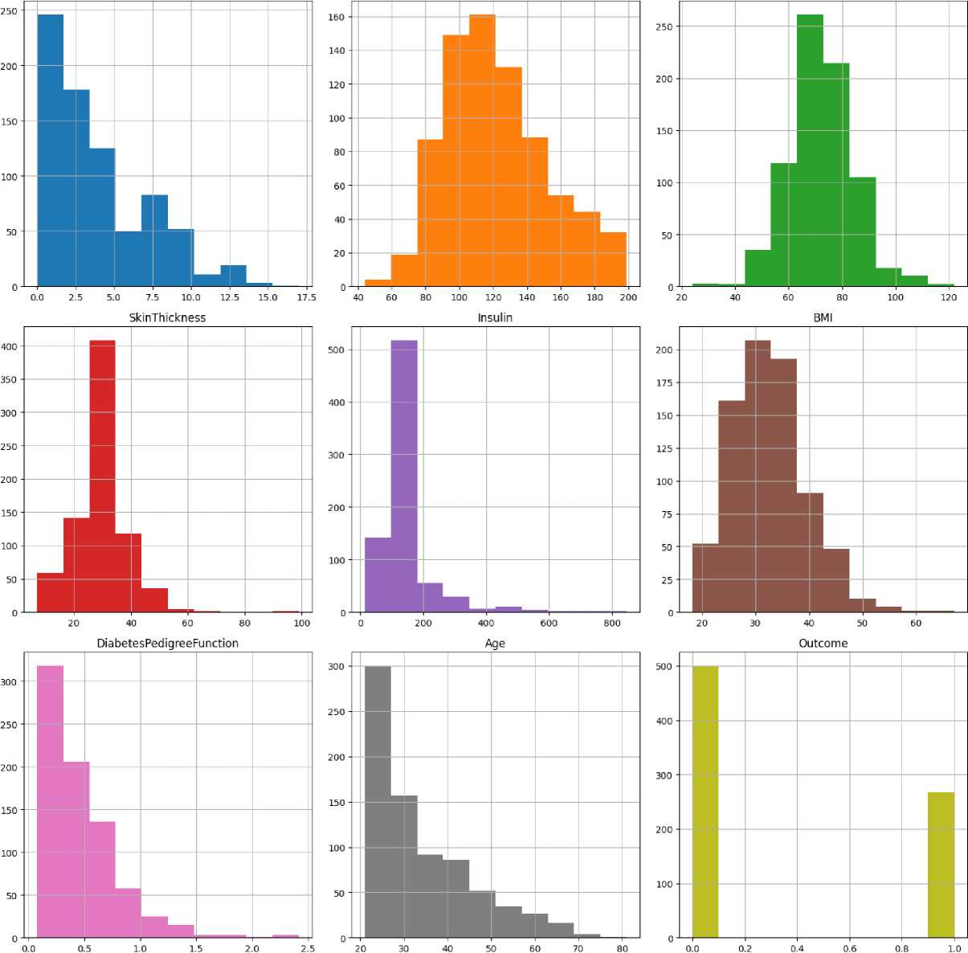
Pregnancies Glucose BloodPressure
In [13]:
import seaborn as sns
# Visual exploration using histograms with Seaborn fig, axes = plt.subplots(nrows=3, ncols=3, figsize=(15, 15)) axes = axes.flatten()
for i, col in enumerate(data.columns): ax = axes[i]
sns.histplot(data[col], ax=ax, kde=True, color=colors[i % len(colors)]) ax.set_title(col)
plt.tight_layout()
plt.show()

Slide 4
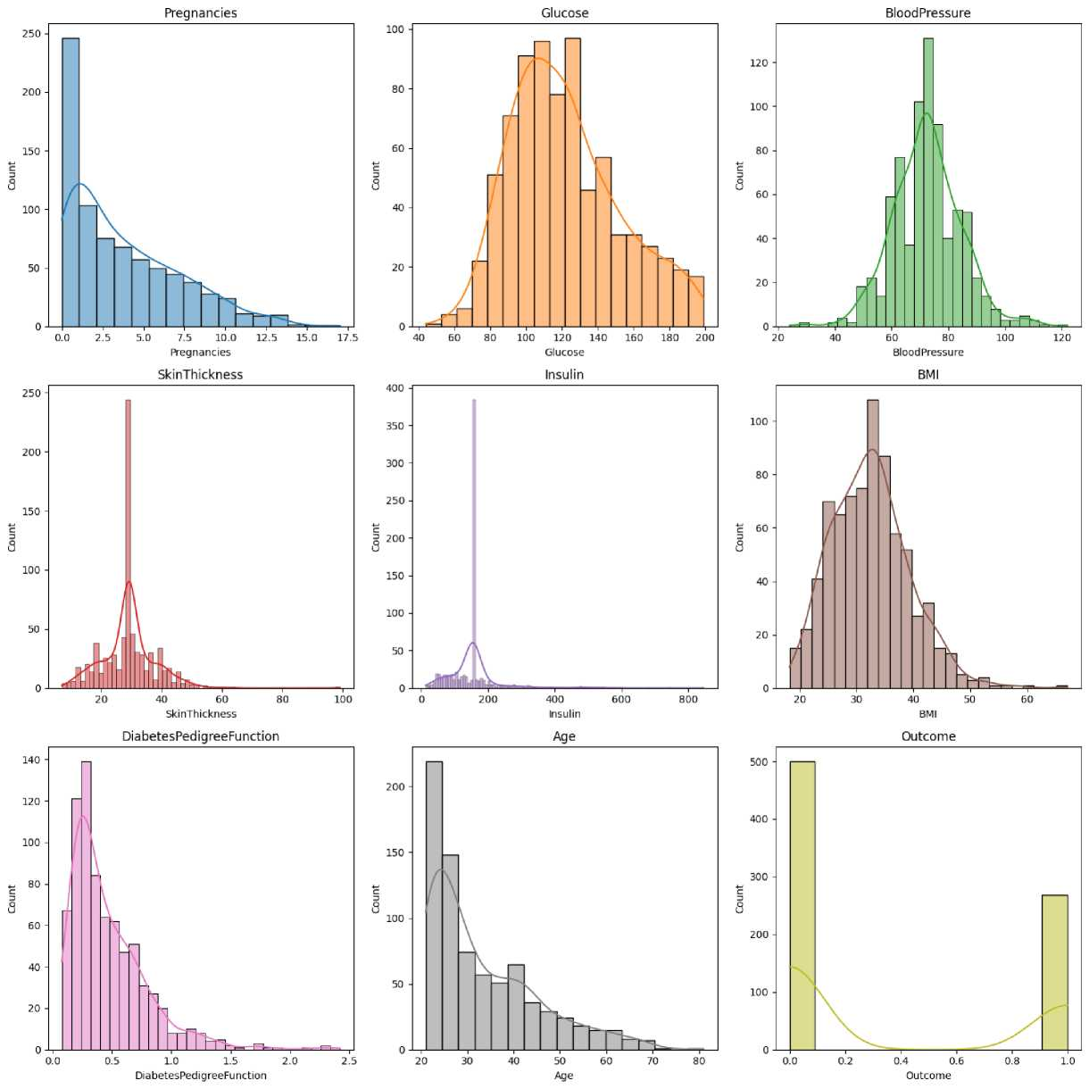
DATA TYPE COUNT PLOT In [14]:
# Data type count plot
data_types = data.dtypes.value_counts()
data_types.plot(kind='bar')
plt.xlabel('Data Type')
plt.ylabel('Count')
plt.title('Count of Variables by Data Type') plt.show()

Slide 5
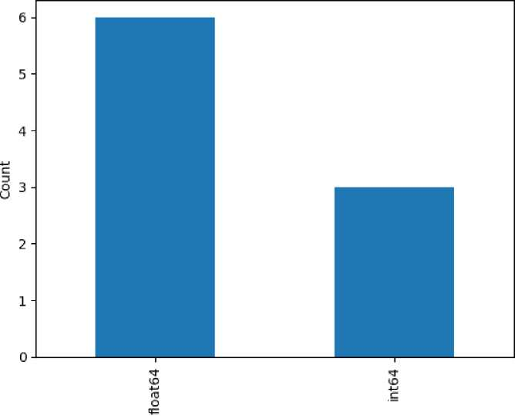
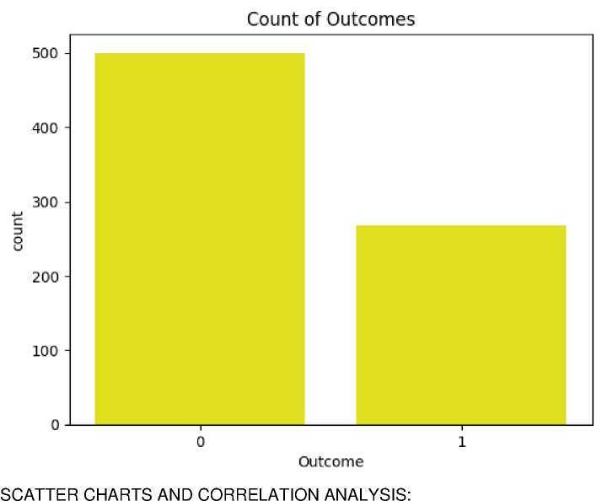


Count of Variables by Data Type
Data Type
BALANCE OF THE DATA In [21]:
# Plotting the count of outcomes with different colors sns.countplot(x='Outcome', data=data, color= 'yellow') plt.title('Count of Outcomes') plt.show()
In [25]:
# Scatter charts
sns.pairplot(data, hue='Outcome') plt.show()
# Correlation analysis correlation = data.corr()
# Heatmap of the correlation matrix plt.figure(figsize=(12, 8))
sns.heatmap(correlation, annot=True, cmap='coolwarm', linewidths=0.8)
plt.title('Correlation Heatmap')
plt.show()

Slide 6
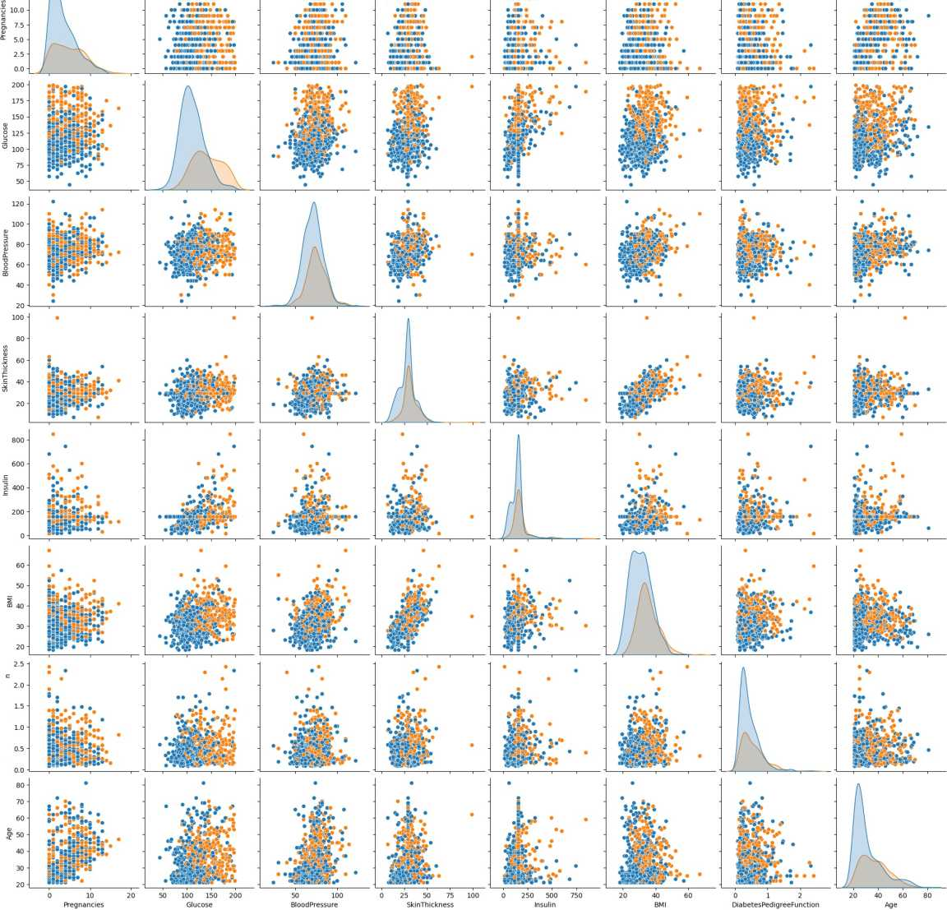
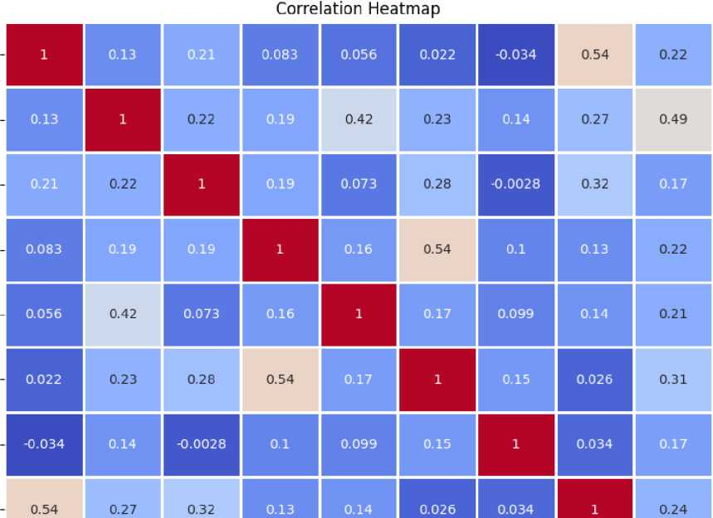
1.0
Pregnancies
Glucose
Blood Pressure
SkinThickness
0.6
Insulin
BMI
0.4
DiabetesPedigreeFunction
0.2
Age

Slide 7
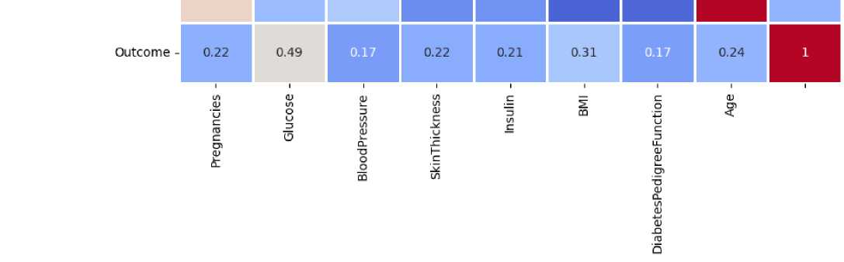


DATA MODELING
In [27]:
pip install sklearn
Collecting sklearnNote: you may need to restart the kernel to use updated packages. error: subprocess-exited-with-error
python setup.py egg_info did not run successfully. exit code: 1
[15 lines of output]
The 'sklearn' PyPI package is deprecated, use 'scikit-learn' rather than 'sklearn' for pip commands.
Here is how to fix this error in the main use cases:
- use 'pip install scikit-learn' rather than 'pip install sklearn'
- replace 'sklearn' by 'scikit-learn' in your pip requirements files (requirements.txt, setup.py, setup.cfg, Pipfile, etc ...)
- if the 'sklearn' package is used by one of your dependencies,
it would be great if you take some time to track which package uses 'sklearn' instead of 'scikit-learn' and report it to their issue tracker
- as a last resort, set the environment variable
SKLEARN_ALLOW_DEPRECATED_SKLEARN_PACKAGE_INSTALL=True to avoid this error
More information is available at https://github.com/scikit-learn/sklearn-pypi-package [end of output]
note: This error originates from a subprocess, and is likely not a problem with pip. error: metadata-generation-failed
Encountered error while generating package metadata.
See above for output.
note: This is an issue with the package mentioned above, not pip. hint: See above for details.
[notice] A new release of pip is available: 24.0 -> 24.1.1 [notice] To update, run: python.exe -m pip install --upgrade pip Downloading sklearn-0.0.post12.tar.gz (2.6 kB)
Preparing metadata (setup.py): started
Preparing metadata (setup.py): finished with status 'error'
In [29]:
import pandas as pd import numpy as np
from sklearn.model_selection import train_test_split, cross_val_score from sklearn.preprocessing import StandardScaler from sklearn.neighbors import KNeighborsClassifier from sklearn.linear_model import LogisticRegression from sklearn.ensemble import RandomForestClassifier
from sklearn.metrics import classification_report, roc_auc_score, roc_curve, confusion_matrix In [30]:
# Split data into features and target variable X = data.drop('Outcome', axis=1) y = data['Outcome']
# Split the data into training and testing sets
X_train, X_test, y_train, y_test = train_test_split(X, y, test_size=0.2, random_state=42) In [31]:
# Standardize the features scaler = StandardScaler()
X_train_scaled = scaler.fit_transform(X_train)
X_test_scaled = scaler.transform(X_test)
In [32]:

Slide 8
knn = KNeighborsClassifier(n_neighbors=5) knn.fit(X_train_scaled, y_train) y_pred_knn = knn.predict(X_test_scaled)
In [33]:
# Classification report and ROC AUC for KNN
print(''KNN Classification ReportAn", classification_report(y_test, y_pred_knn)) knn_roc_auc = roc_auc_score(y_test, knn.predict_proba(X_test_scaled)[:, 1]) printfKNN ROC AUC: ", knn_roc_auc)
KNN Classification Report:
precision recall f1-score support
0 | 0.84 | 0.75 | 0.79 | 99
1 | 0.62 | 0.75 | 0.68 | 55
accuracy |  |  | 0.75 | 154
macro avg 0.73 0.75 0.73 154
weighted avg 0.76 0.75 0.75 154
KNN ROC AUC: 0.7818181818181817
In [34]:
# Compare with Logistic Regression and Random Forest models = {
'Logistic Regression': LogisticRegression(),
'Random Forest': RandomForestClassifier()
}
In [35]:
for name, model in models.itemsO: model.fit(X_train_scaled, y_train) y_pred = model.predict(X_test_scaled)
print(f"{name} Classification ReportAn", classification_report(y_test, y_pred)) roc_auc = roc_auc_score(y_test, model.predict_proba(X_test_scaled)[:, 1]) print(f"{name} ROC AUC: ", roc_auc)
Logistic Regression Classification Report:
precision recall f1-score support
0 | 0.80 | 0.83 | 0.81 | 99
1 | 0.67 | 0.62 | 0.64 | 55
accuracy |  |  | 0.75 | 154
macro avg 0.73 0.72 0.73 154
weighted avg 0.75 0.75 0.75 154
Logistic Regression ROC AUC: 0.8242424242424242 Random Forest Classification Report:
precision recall f1-score support
0 0.80 0.77 0.78 99
1 0.61 0.65 0.63 55
accuracy 0.73 154
macro avg 0.71 0.71 0.71 154
weighted avg 0.73 0.73 0.73 154
Random Forest ROC AUC: 0.831864095500459
In [36]:

Slide 9
import numpy as np
from sklearn.metrics import roc_auc_score, classification_report, roc_curve, confusion_matrix, auc
# Function to calculate sensitivity and specificity def calculate_sensitivity_specificity(y_true, y_pred):
cm = confusion_matrix(y_true, y_pred) tn, fp, fn, tp = cm.ravel() sensitivity = tp / (tp + fn) specificity = tn / (tn + fp) return sensitivity, specificity
# Train and predict with KNN model
knn = KNeighborsClassifier(n_neighbors=5) knn.fit(X_train_scaled, y_train) y_pred_knn = knn.predict(X_test_scaled) y_proba_knn = knn.predict_proba(X_test_scaled)[:, 1]
# Calculate sensitivity and specificity
sensitivity_knn, specificity_knn = calculate_sensitivity_specificity(y_test, y_pred_knn)
# Calculate ROC AUC
roc_auc_knn = roc_auc_score(y_test, y_proba_knn)
# Plot ROC curve
fpr, tpr, _ = roc_curve(y_test, y_proba_knn) roc_auc = auc(fpr, tpr)
# Print classification report, sensitivity, specificity, and ROC AUC print("KNN Classification ReportAn", classification_report(y_test, y_pred_knn)) print(f"KNN Sensitivity: {sensitivity_knn}")
print(f"KNN Specificity: {specificity_knn}") print(f"KNN ROC AUC: {roc_auc_knn}")
# Plot ROC curve plt.figure()
plt.plot(fpr, tpr, color='darkorange', lw=2, label='ROC curve (area = %0.2f)' % roc_auc)
plt.plot([0, 1], [0, 1], color='navy', lw=2, linestyle='--')
plt.xlim([0.0, 1.0])
plt.ylim([0.0, 1.05])
plt.xlabel('False Positive Rate')
plt.ylabel('True Positive Rate')
plt.title('Receiver Operating Characteristic')
plt.legend(loc="lower right")
plt.show()

Slide 10
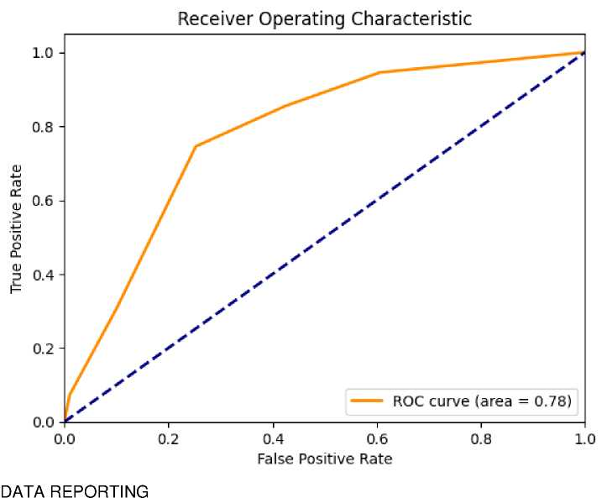
KNN Classification Report:
precision recall f1-score support
0 0.84 0.75 0.79 99
1 0.62 0.75 0.68 55
accuracy 0.75 154
macro avg 0.73 0.75 0.73 154
weighted avg 0.76 0.75 0.75 154
KNN Sensitivity: 0.7454545454545455 KNN Specificity: 0.7474747474747475 KNN ROC AUC: 0.7818181818181817
In [38]:
# Load dataset
data = pd.read_csv('health care diabetes.csv')
# Replace 0 with NaN for specific columns
columns_with_zero = ['Glucose', 'BloodPressure', 'SkinThickness', 'Insulin', 'BMI'] data[columns_with_zero] = data[columns_with_zero].replace(0, np.nan)
# Fill missing values with mean for simplicity data.fiNna(data.mean(), inplace=True)
In [40]:
# Pie chart for diabetic vs non-diabetic population plt.figure(figsize=(8, 8))
data['Outcome'].value_counts().plot.pie(autopct='%1.1f%%', colors=['blue', 'red'], labels=['Non-Diabetic', 'Diabetic'])
plt.title('Diabetic vs Non-Diabetic Population')
plt.ylabel('')
plt.show()

Slide 11
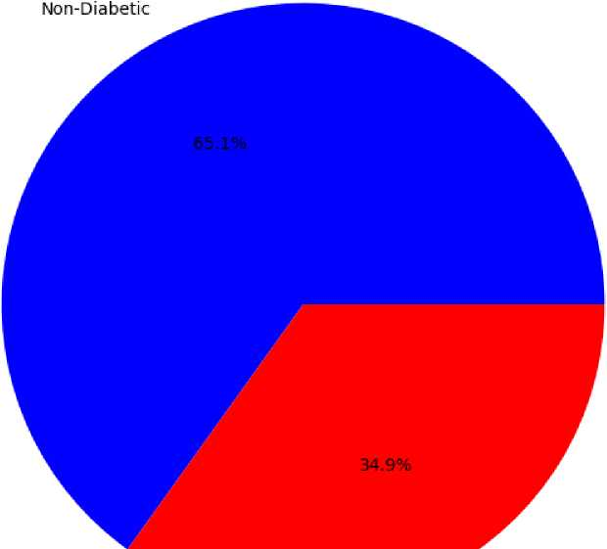
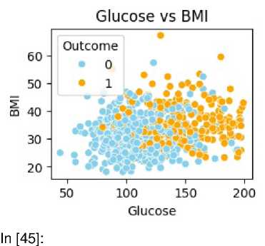
Diabetic vs Non-Diabetic Population
Diabetic
In [41]:
# Scatter plots between relevant variables plt.figure(figsize=(15, 10))
Out[41]:
<Figure size 1500x1000 with 0 Axes>
<Figure size 1500x1000 with 0 Axes>
In [44]:
# Glucose vs. BMI plt.subplot(2, 2, 1)
sns.scatterplot(x='Glucose', y='BMI', hue='Outcome', data=data, palette=['skyblue', 'orange']) plt.title('Glucose vs BMI')
Out[44]:
Text(0.5, 1.0, 'Glucose vs BMI')
# Age vs. Glucose plt.subplot(2, 2, 2)
sns.scatterplot(x='Age', y='Glucose', hue='Outcome', data=data, palette=['skyblue', 'salmon']) plt.title('Age vs Glucose')

Slide 12
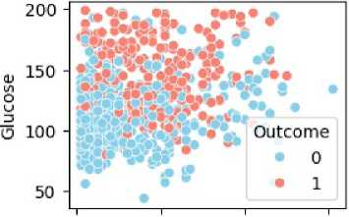
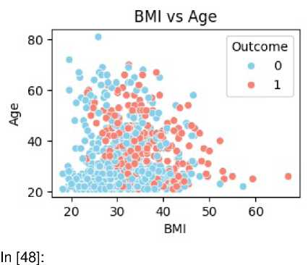
Out[45]:
Text(0.5, 1.0, 'Age vs Glucose')
Age vs Glucose
20 40 60 80
Age
In [46]:
# BMI vs. Age plt.subplot(2, 2, 3)
sns.scatterplot(x='BMI', y='Age', hue='Outcome', data=data, palette=['skyblue', 'salmon']) plt.title('BMI vs Age')
plt.tight_layout()
plt.show()
# Histograms for the distribution of each predictor variable data.hist(figsize=(15, 15), color='pink', edgecolor='black', bins=15) plt.tight_layout() plt.show()

Slide 13
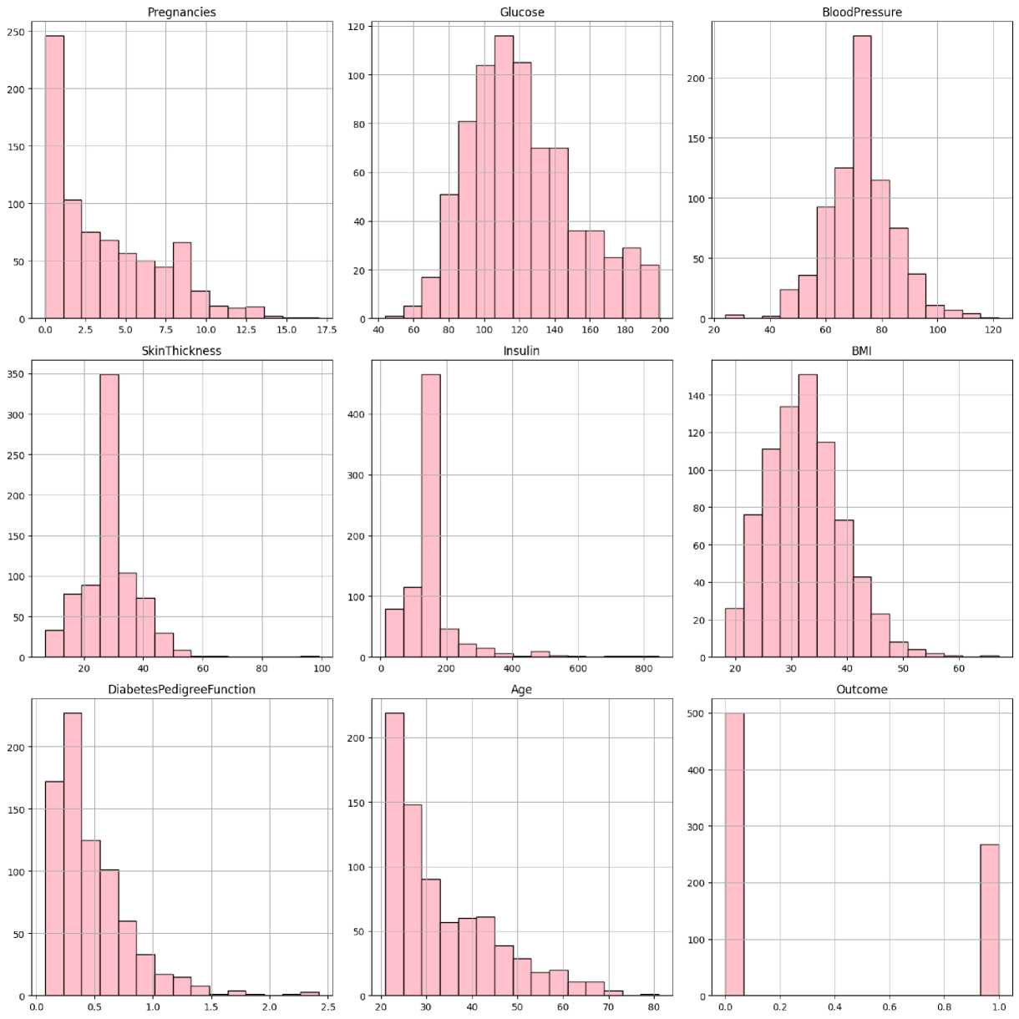
In [49]:
# Heatmap of correlation analysis plt.figure(figsize=(12, 8))
sns.heatmap(data.corr(), annot=True, cmap='coolwarm', fmt='.2f', linewidths=0.5)
plt.title('Correlation Heatmap')
plt.show()

Slide 14
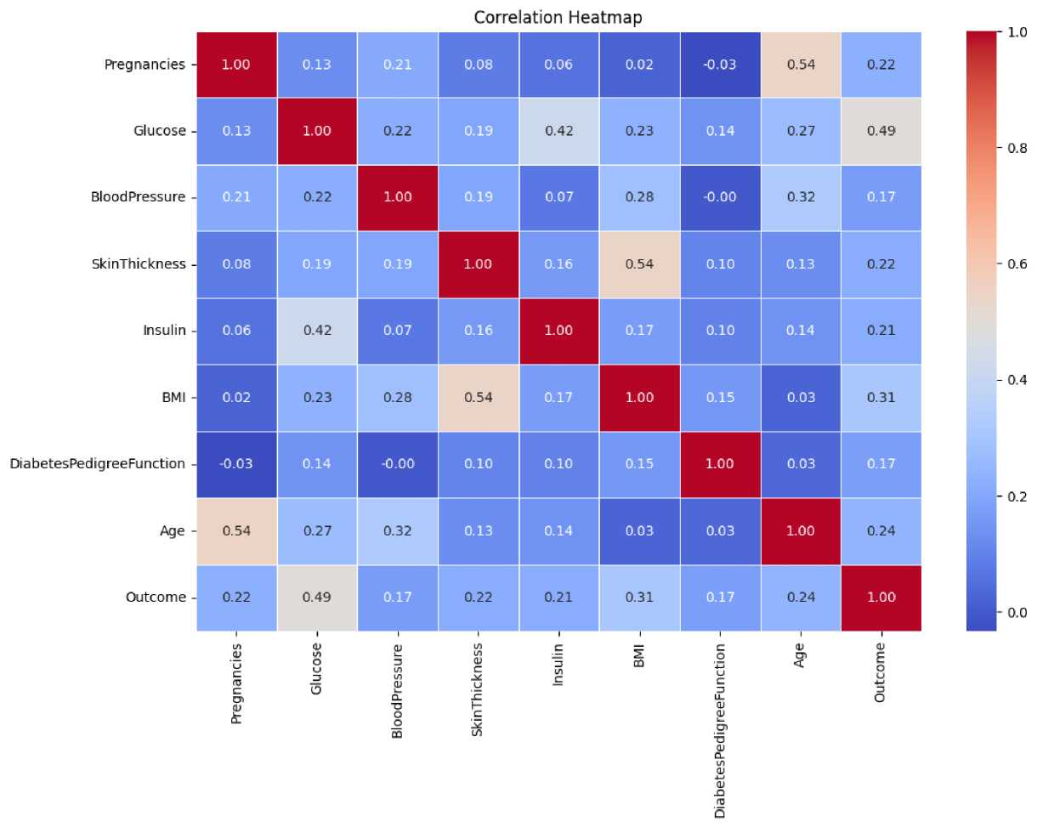
In [51]:
# Create age bins and analyze different variables using a bubble chart
data['AgeBins'] = pd.cut(data['Age'], bins=[20, 25, 30, 35, 40, 45, 50, 55, 60, 65, 70, 75, 80, 85, 90], labels=['20-25', '25-30', '30-35', '35-40', '4 plt.figure(figsize=(10, 8))
sns.scatterplot(x='AgeBins', y='BMI', size='Glucose', hue='Outcome', data=data, sizes=(40, 400), palette=['red', 'green'], legend=False, alph
plt.title('BMI vs Age Bins')
plt.xlabel('Age Bins')
plt.ylabel('BMI')
plt.xticks(rotation=45)
plt.show()

Slide 15
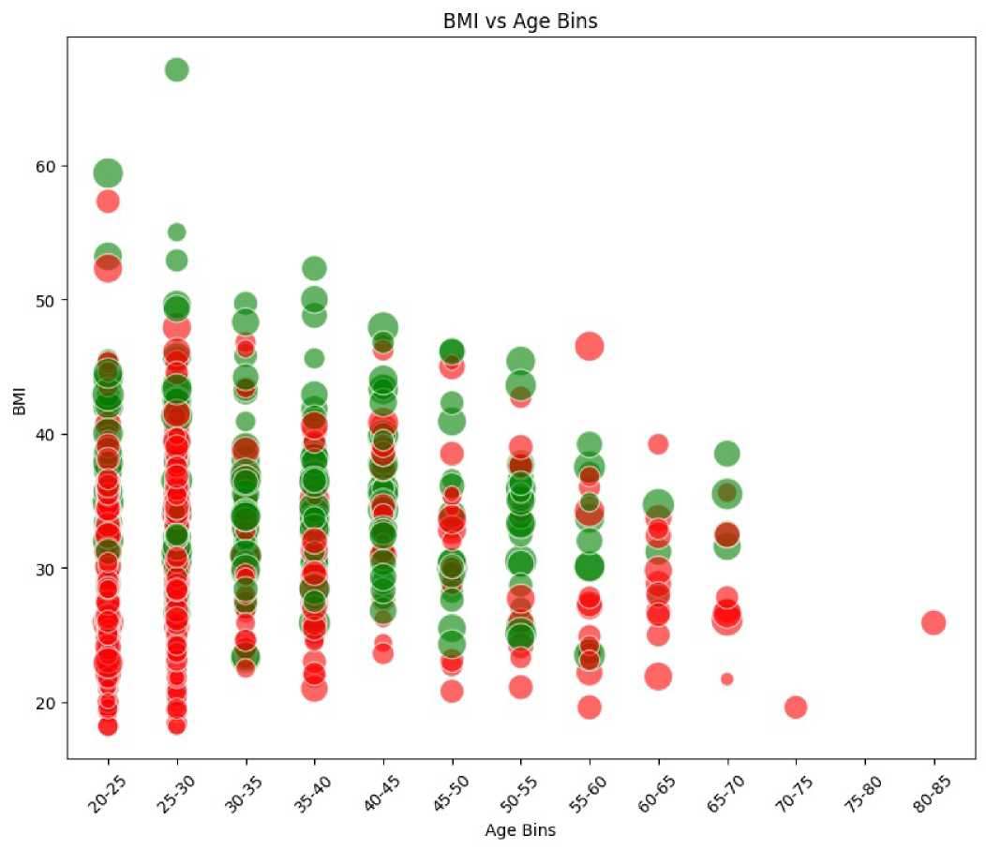
In [ ]:
Loading [MathJax]/extensions/Safe.js

