Slide 1
Decentralized Chat Application
RNS INSTITUTE OF TECHNOLOGY
BENGALURU - 98
DEPARTMENT OF INFORMATION SCIENCE & ENGINEERING
Final Year Project Work Presentation
PRIYANSHU KUMAR SINGH 1RN19IS108
PRIYASHA PARNAVI 1RN19IS109 SHAILJA BHASKAR 1RN19IS139
SHRISTY BHARDWAJ 1RN19IS149
Panel 1
Ms. Kavitha
Asst. Prof, Dept of ISE, RNSIT
Panel 2
Dr./Mr. /Ms. Guide Name
Prof./Asso. Prof./Asst. Prof, Dept of ISE, RNSIT
Internal Guide
Dr. R Rajkumar
Asso. Prof. Dept of ISE, RNSIT

Slide 2
AGENDA
Abstract
Introduction
Literature Review
Analysis
System Design
Implementation
Testing
Discussion of Results
National Conference Paper
Conclusion and Future Enhancements
References
Q & A

Slide 3
ABSTRACT
Use of unsecured and unsafe applications in workplaces pose enormous security risks.
Most publicly available communication platforms do not empower organizations to regulate, track and scale their communication and does not provide compliance with data protection frameworks, which can result in cross industry system risks.
Using new technologies such as block chain, which operate on a decentralized model, the drawbacks of traditional messaging applications can be surmounted, thereby ensuring confidentiality, integrity and availability of official data, along with advanced auditing features.
Decentralized application makes use of peer-to-peer networks, this ensures that no network failure can occur due to central node failure. Blockchain serves as an immutable ledger which allows messaging to take place in a decentralized manner.

Slide 4
INTRODUCTION
BACKGROUND
In the traditional architecture there existed only the server and the client. In most cases the server was only a data base server that can only offer data. Therefore majority of the business logic i.e., validations etc. had to be placed on the clients system. This makes maintenance expensive.
EXISTING SYSTEM
If a person sends sensitive data over the insecure channels of the system then there may be a chance of hacking it, they can alter the information and sends it over the net.
This problem has been solved be the proposed system

Slide 5
INTRODUCTION
PROPOSED SYSTEM
In our application all the user data is stored on a block which is connected to other blocks forming a chain. As the name suggests, a decentralized application does not have a centralized server.
It is basically a peer-to-peer network.
Also the data that is stored in block is almost impossible to view as a very secure encryption and hashing functions (256 bits) are used.
Also if a hacker tries to make changes to the information in block then, he/she will have to make changes to all the copies of that block on whole blockchain network and that can be quite impossible. Though block are on all nodes, they cannot access the information in it, only the person for whom the information if can access it.

Slide 6
LITERATURE SURVEY
SL No | Title of the paper | Authors | Abstract
1. | “Act natural!” Having a Private Chat on a Public Blockchain | Thore Tiemann, SebastianBerndt, ThomasEisenbarth | The knowledge of communication patterns can itself reveal too much, as happened e. g., in the context of the Arab Spring. The subliminal channel in cryptographic systems – as introduced by Simmons in his pioneering works – enables untraceable private communication in plain sight.
2. | Take Back your Friends with DCS. | NikosChondros, Michalis Konstantopoulos | the authors have observed that friends and associates with in personal and working lives is a fundamental part of one’s identity. On the Internet, this part of the identity is in the hands of others. P

Slide 7
SL.No | Title of the Paper | Authors | Abstract
3. | Brain-Computer Interaction and Silent Speech Recognition on Decentralized Messaging Application. | Luís Arteiro, Fábio Lourenço, Paula Escudeiro & Carlos Ferreira | it is observed that within the inclusivity paradigm, this paper aims to showcase an alternative on human-computer interaction with support for the aforementioned .
4. | A Decentralized Approach to Messaging Using Blockchain Technology. | Mahzad Stearns, Doctoral dissertation | The main motivation to develop the ChatApp project was to increase message privacy. Many mainstream chat applications claim that, the applications are end to end encrypted. However, this claim is not verified.

Slide 8
SL.No | Title of the Paper | Authors | Abstract
5. | Decentralized Chat Application using Blockchain Techno-logy. | Abhishek P. Takale, Chaitanya V. Vaidya, Suresh S. Kolekar. | The authors have observed that traditional chat applications are centralized i.e., all the data is stored on a centralized server. Therefore, major problem of this structure is, if the central server fails then whole network collapses.
6. | Blockchain Based SecureCommunicat-ion Application Proposal. | Cryptouch, Recep Ahmet Sarıtekin, Eren Karabacak, Zübeyir Dur˘gay, Enis Karaarslan, Sarıtekin. | It is observed that the convergence which brought with the globalizing world, highly affects the network and the communication sectors.

Slide 9
SL.No | Title of the Paper | Authors | Abstract
7. | Secure Communications Using BlockchainTechnology. | Peter Menegay, Jason Salyers. | This work illustrates the viability of blockchain-based communications and transactions beyond their obvious cryptocurrency application.
8. | A Decentralized Application for Secure Messaging in a Trustless Environment. | MohamedAbdulaziz, Davut Culha, Ali Yazic. | The authors have observed that the blockchain technology has been seeing widespread interest as a means to ensure the integrity,confidentiality and availability of data in an environment.

Slide 10
SL.No | Title of the Paper | Authors | Abstract
9. | Applications of Blockchain Technology beyond Cryptocurrency. | Mahdi HMiraz, Maaruf Ali | It is observed that Blockchain (BC), the technology behind the Bitcoin crypto-currency system, is considered to be both alluring and critical for ensuring enhanced security and (in some implementations, non-traceable) privacy for diverse applications .
10. | aO Enhanced Chat Application. | AvinashBamane, Parikshit Bhoyar, Ashish Dugar. | Authors have come across various chat applications to instantly communicate with people. Authors have emphasised on using various types of chat application in web-based applications.

Slide 11
PROBLEM IDENTIFICATION
Loss of data if the server collapses.
The information shared can be hacked which is stored on the centralized server.
Also, there are countless counterfeit information and product publishing on social networking without any known root transgressor (like on WhatsApp, signal).
Current chatting software is not reliable as the manufacturers demand. Sometimes the buyers of these software become victim of hackers.
Centralized E2EE messengers are also highly vulnerable to censorship. Although the app encrypts all messages, making them unreadable by the central authority - this means the authority can’t ban or block messages about specific topics - central authorities can still ban users, groups, or even regions from using the app. This problem is worsened if the app uses an identifier tied to your real-world identity, like a phone number or email address.

Slide 12
OBJECTIVES
Data immutability: The inability to make adjustments to the data after they are recorded in a distributed database.
Censorship resistance: It implies that everyone can transact with the network on the same terms, regardless of their personal identifying characteristics. If true censorship-resistance is to be achieved, then users should not be able to exclude others from information.
Decentralized storage: It is a model of network online storage where data is stored on multiple nodes (computer), which is hosted by the participants in the cloud.
Data Security: It means protecting digital privacy measures that are applied to prevent unauthorized access to the nodes.

Slide 13
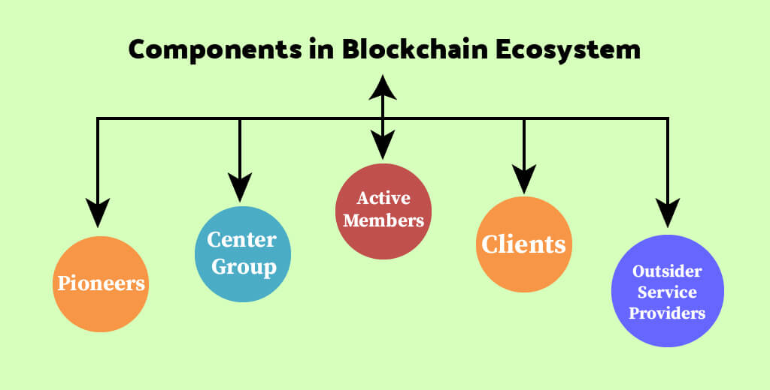
METHODOLOGY
BLOCKCHAIN ECOSYSTEM
Blockchain Ecosystem

Slide 14
METHODOLOGY
Pioneers are the forerunners in blockchain ecosystems are for the most part the makers of the venture and essential recipients of the work in ecosystems.
Center Group addresses a gathering of dynamic or driving associations liable for controlling, smoothing out and enhancing functional exercises.
Active Members in the blockchain ecosystem refer to the assortment of essential members in the organization. Who are liable for contributing and overseeing work process and information.
Clients in blockchain ecosystems are the members getting benefits from the organization with the capacity for getting to their own information.
Outsider Service Providers could incorporate IT support, framework, or application support administrations alongside many other services, particularly with a charge.

Slide 15
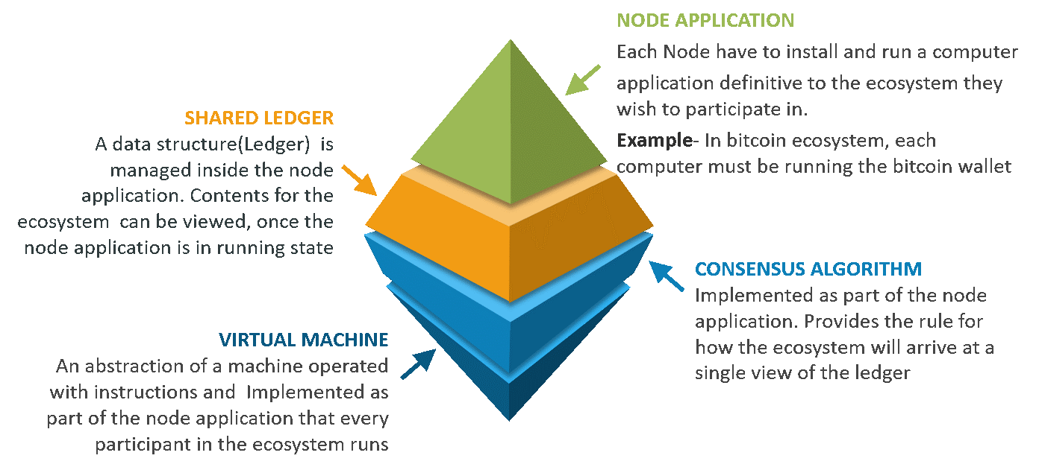
METHODOLOGY
COMPONENTS OF BLOCKCHAIN

Slide 16
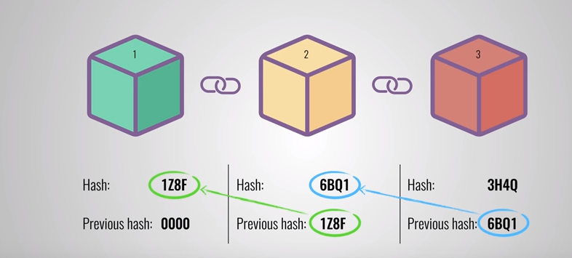
SYSTEM DESIGN
HASH FUNCTIONS IN BLOCKCHAIN
Each block in the blockchain contains the hash of the previous block’s header within its own header as shown above.
By incorporating a previous block hash into each block, the blockchain makes it harder to forge blocks in the digital ledger. Changing the contents of one block changes the value of its header. This would change the hash of that header, which changes the value of the next block’s header (and so on).

Slide 17
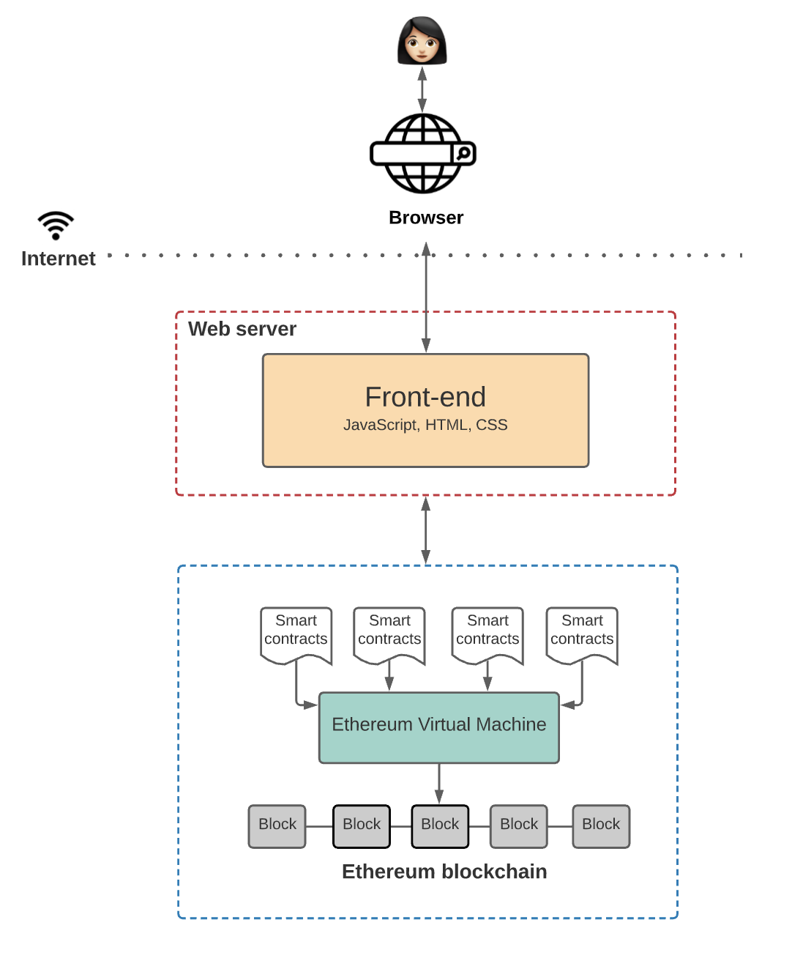
SYSTEM DESIGN
ARCHITECTURE OF DECENTRALIZED CHAT APP
1. Ethereum blockchain: Ethereum is a decentralized and open-source blockchain platform that establishes a peer-to-peer network that securely executes and verifies application code, called smart contracts.
2. Smart Contracts: DApps use smart contracts to define the state changes happening on the blockchain.
3. Ethereum Virtual Machine(EVM): It is the global virtual computer that executes the logic defined in the smart contracts and processes the state changes that happen on this Ethereum network.
4. Front-end: The part of the Dapps that users can see and interact with such as the graphical user interface(GUI) and also communicates with the application logic defined in smart contracts.

Slide 18
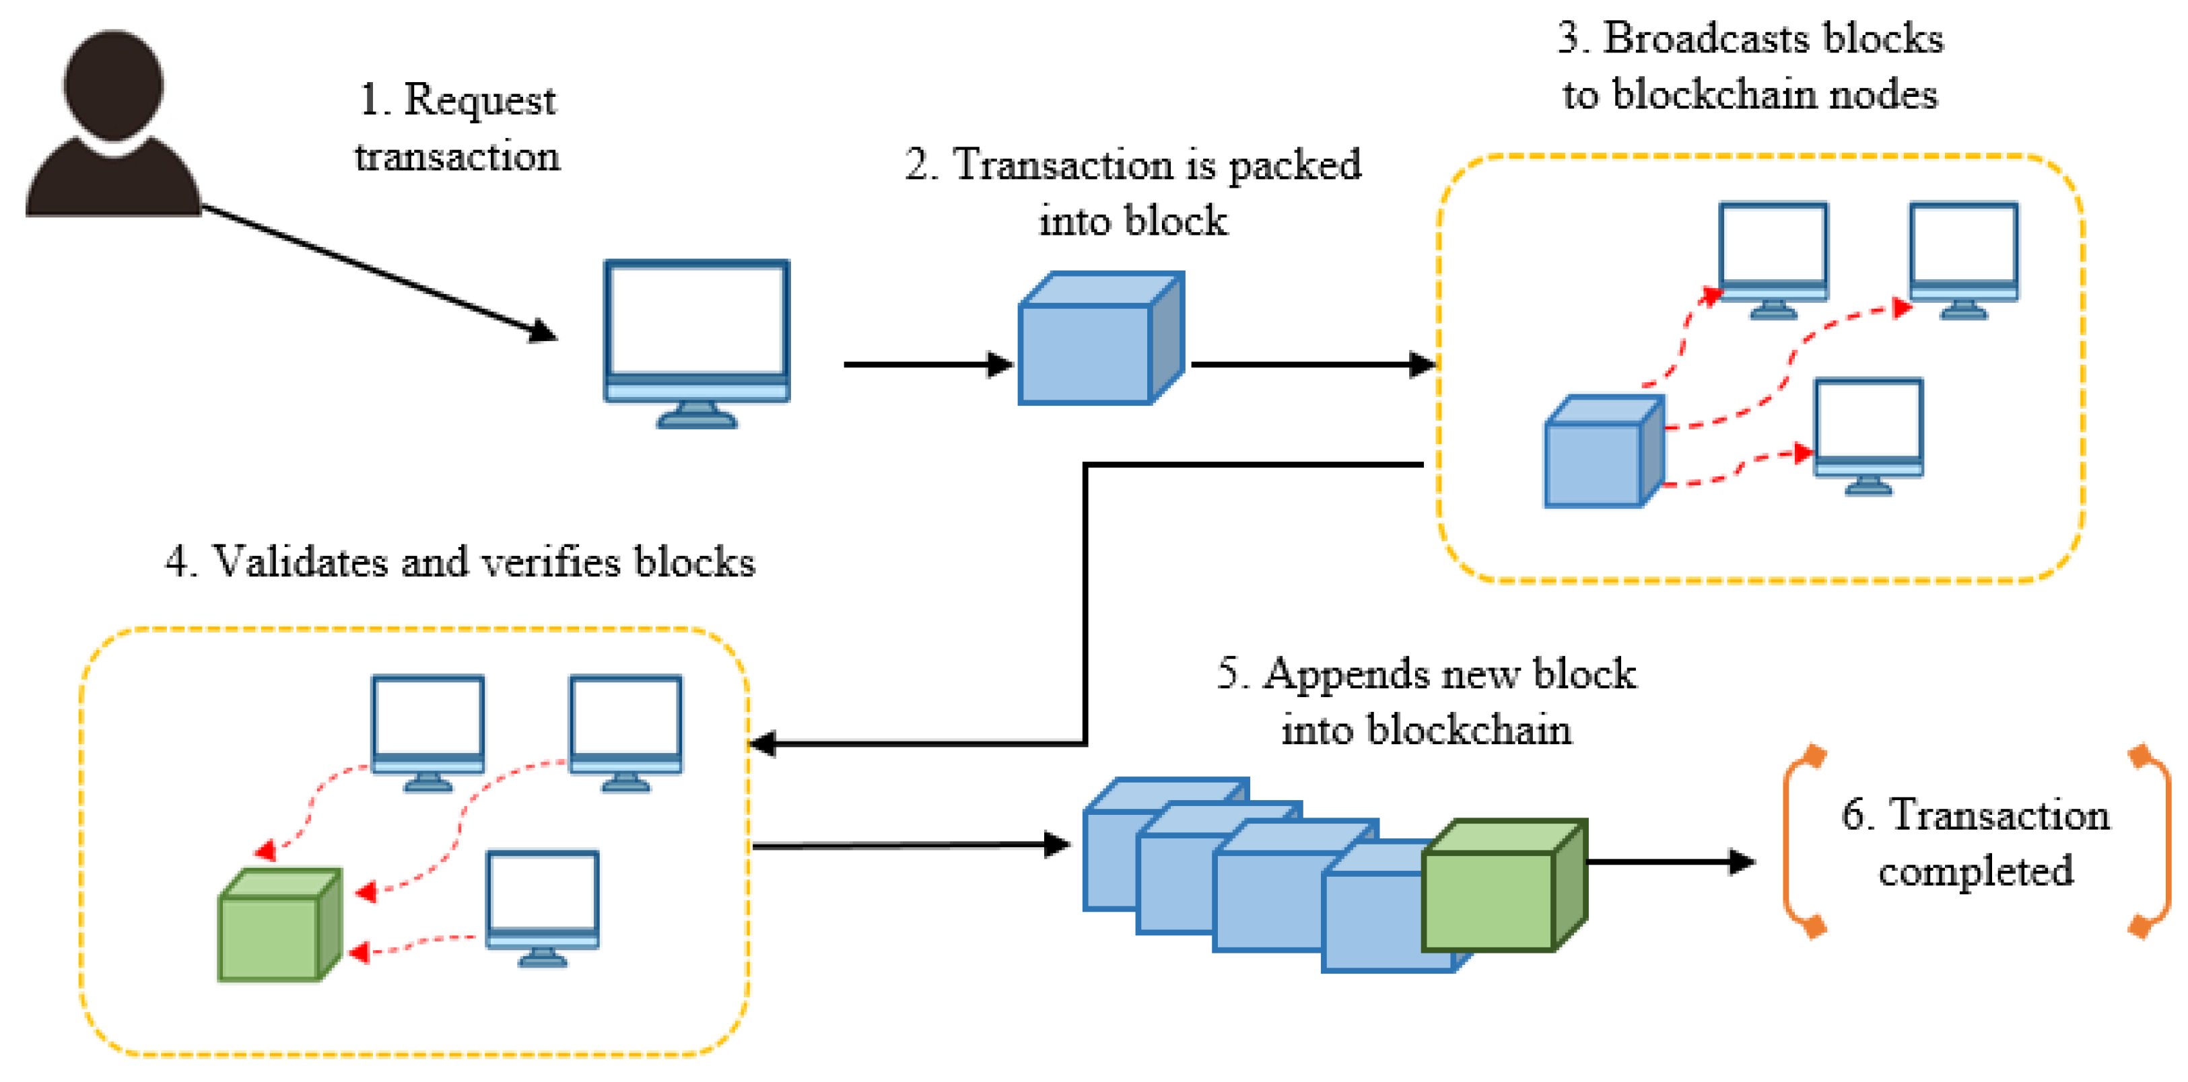
IMPLEMENTATION
WORKFLOW OF DECENTRALIZED APP

Slide 19
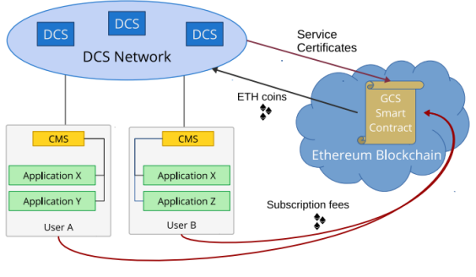
IMPLEMENTATION
Validation in Blockchain
• Users: each one holds a public key which identifies the user.
• A structured network of DCS nodes: this network mediates connection establishment among different
users.
• A Contact Management Service (CMS): it is running on a user’s device to allow managing the user’s friends- list, and to allow compatible applications to use DCS.
• Application: a compatible application that uses DCS via CMS.
• The DCS smart contract: it collects subscription fees from the users of the service, and distributes them to the participating DCS nodes, as a reward.

Slide 20
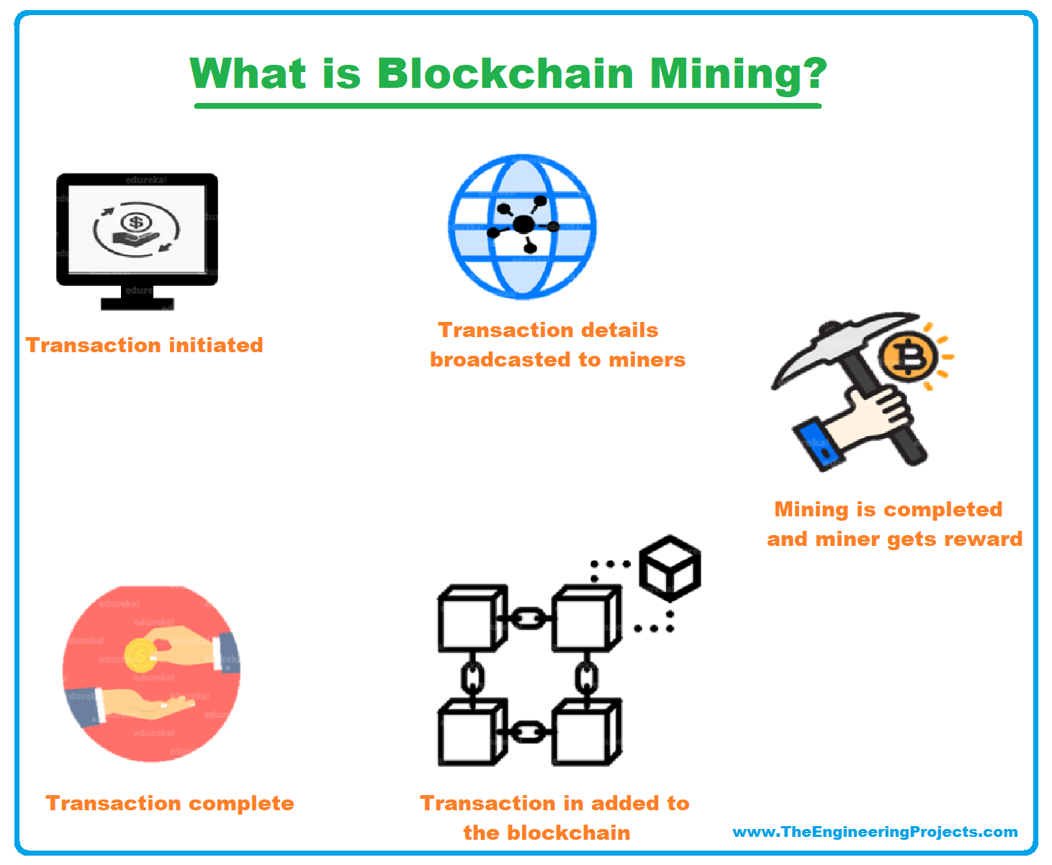
IMPLEMENTATION
Transaction in Blockchain
Blockchain Mining

Slide 21
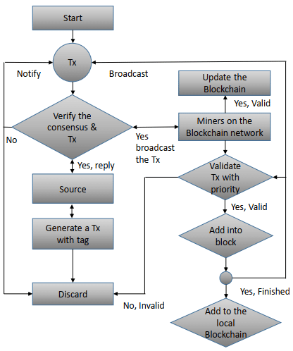
IMPLEMENTATION
Flow chart of Decentralized Chat App

Slide 22
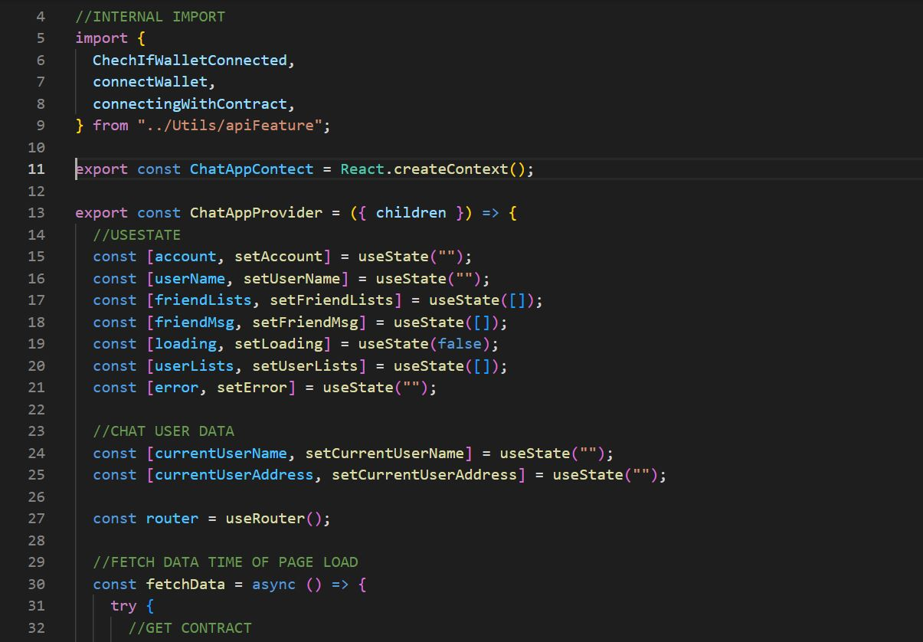
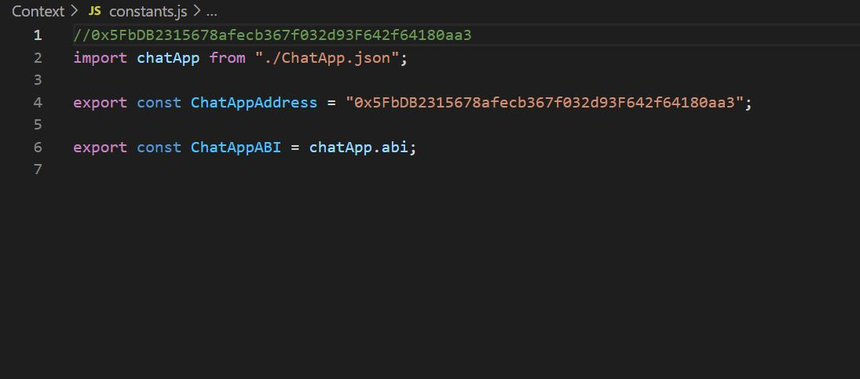
IMPLEMENTATION
ChatAppContext.js
constants.js

Slide 23
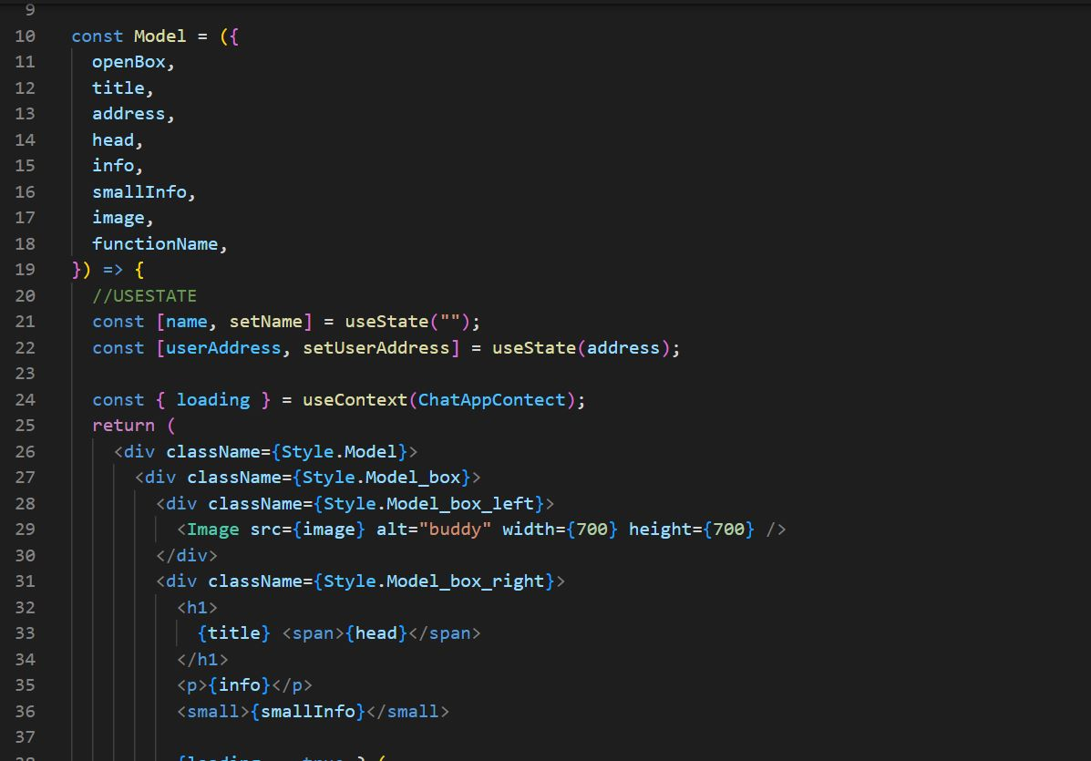
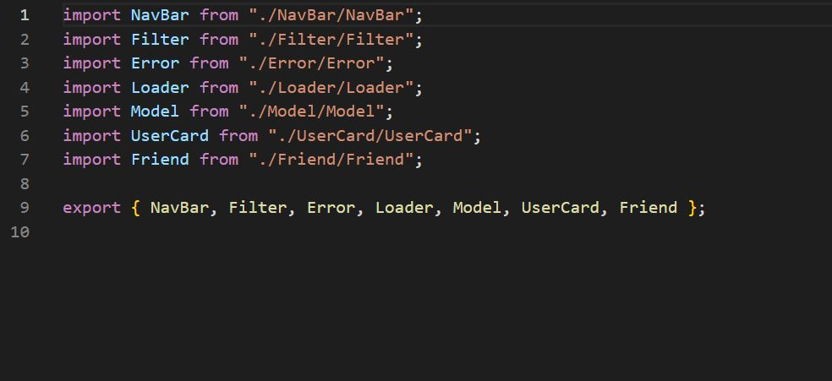
IMPLEMENTATION
Model.jsx
index.js

Slide 24
TESTING
Unit testing is defined as a testing where individual components of a software are tested.
Test Case No. | Description | Test Steps | Expected Results | Actual Results | Pass / Fail
1. | Checking the feature of logging into account. | Logging to our account using correct and wrong credentials | Logged in or Wrong credentials. | Logged or Error | Pass
2. | Checking the functionality of add new user as a friend. | Add new user as a friend in order to start a conversation with them. | New friend gets added | New friend added | Pass
3. | Checking the functionality of sending button. | Checking if the button is sending the message or throwing a error. | Sent or Failed based on address | Sent or Failed | Pass
4. | Checking whether the message got delivered to the right person or not. | Message sent received by the person where it is intended to be. | Message received by correct recipient. | Message received by correct person. | Pass

Slide 25
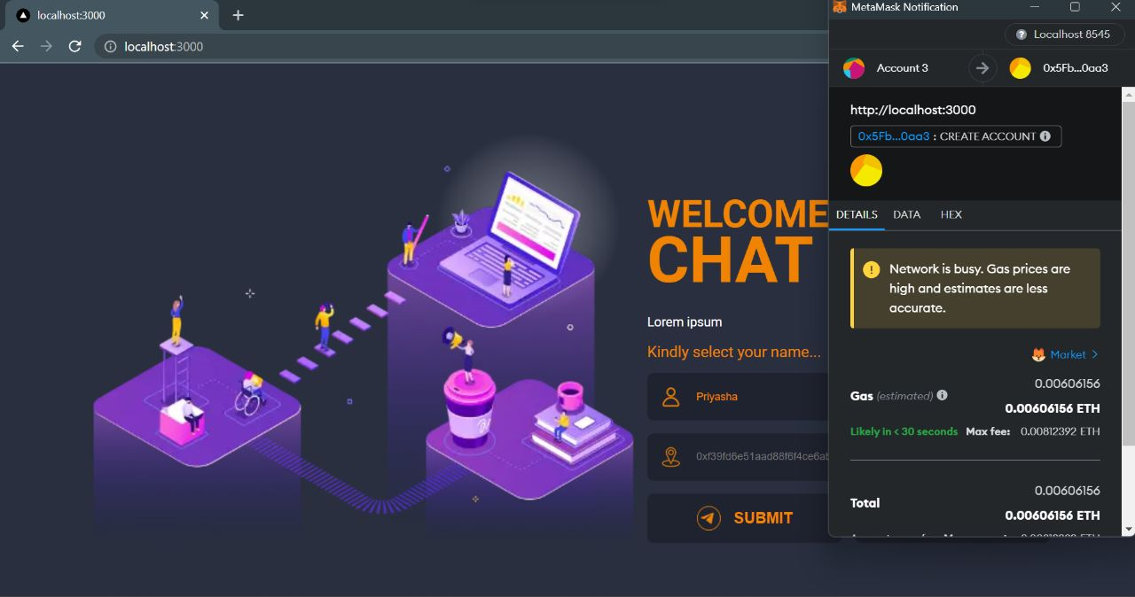
TESTING
Logging into account

Slide 26
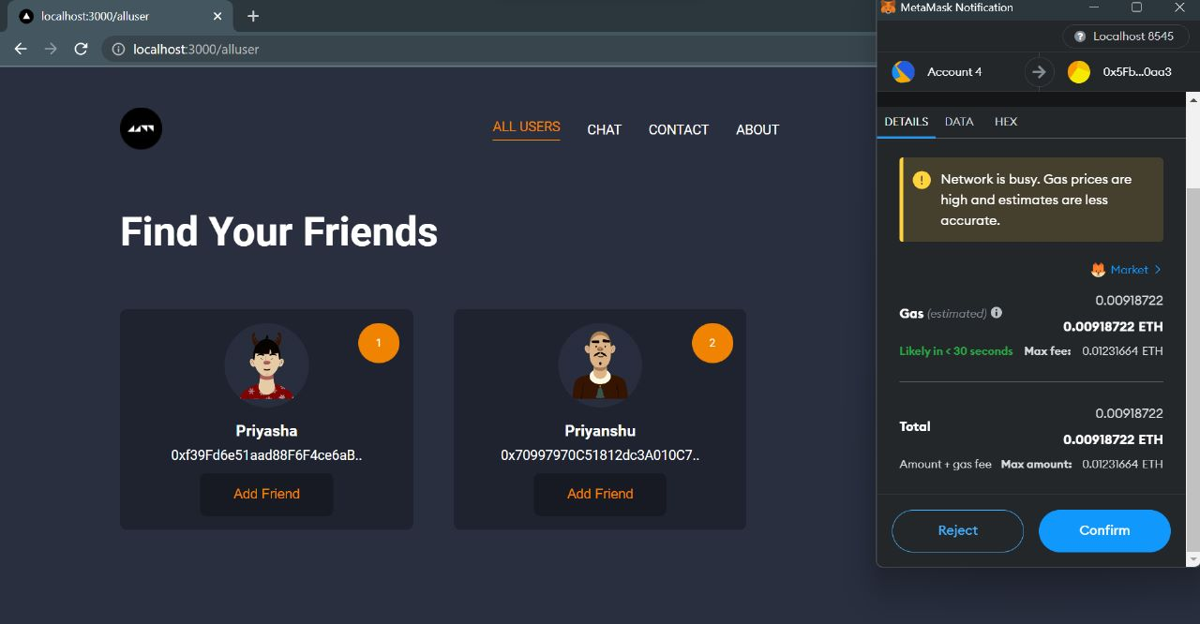
TESTING
Functionality of add new user as a friend.

Slide 27
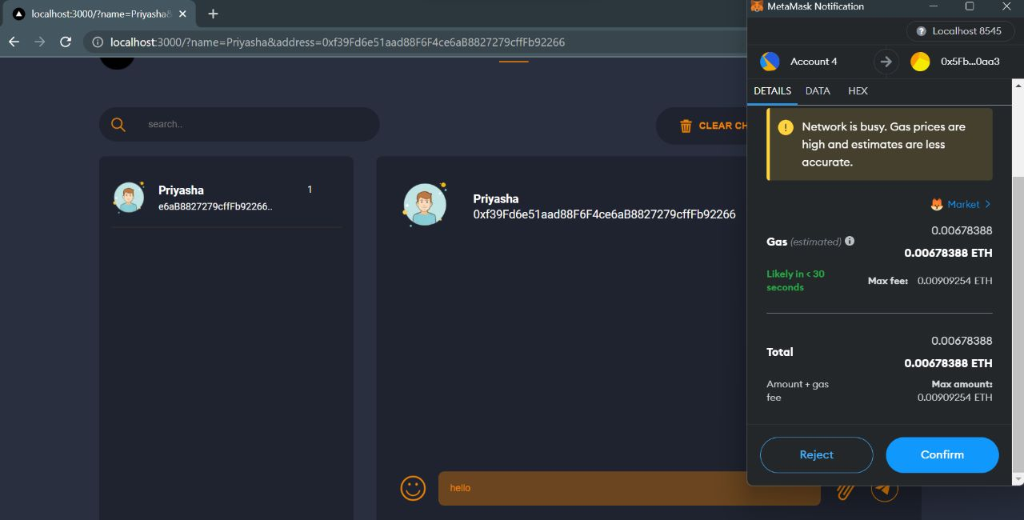
TESTING
Functionality of sending button

Slide 28
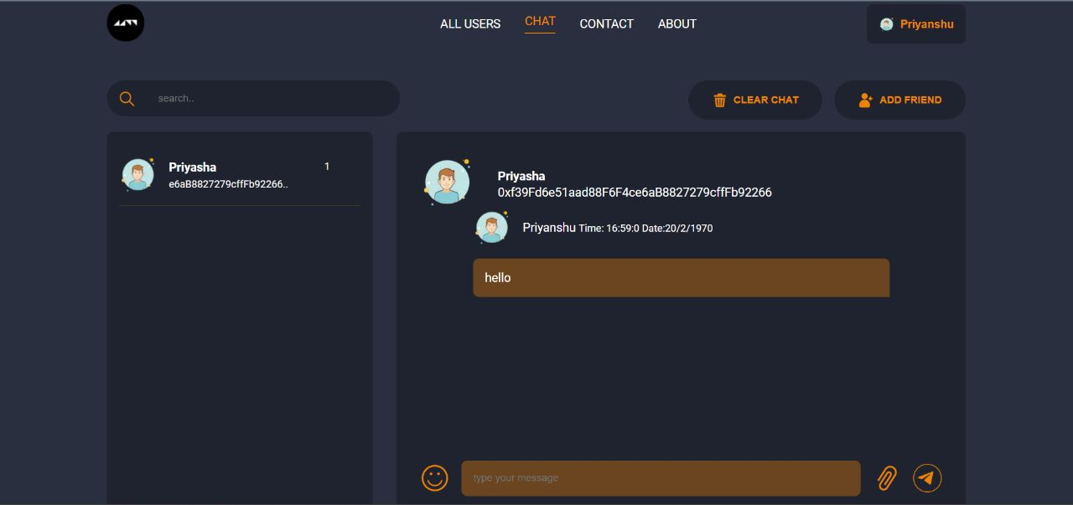
TESTING
Checking whether the message got delivered to the right person or not.

Slide 29
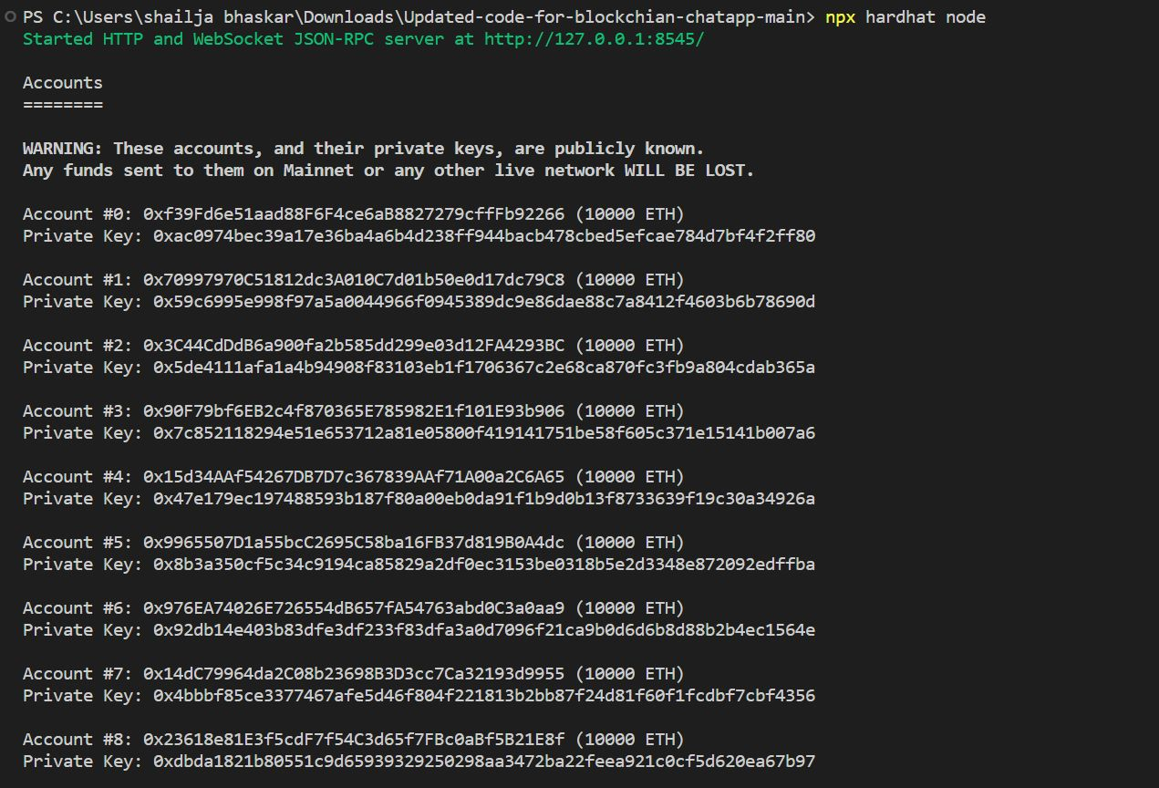
RESULTS AND DISCUSSIONS

Slide 30
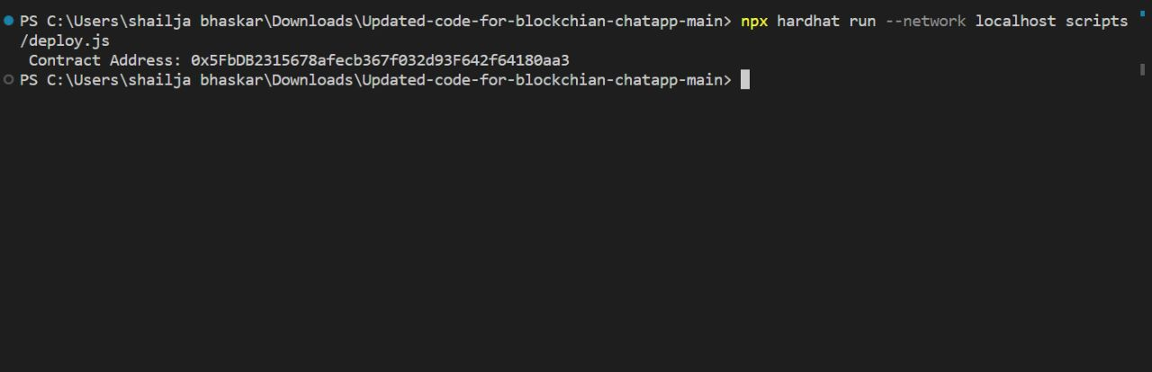
RESULTS AND DISCUSSIONS

Slide 31
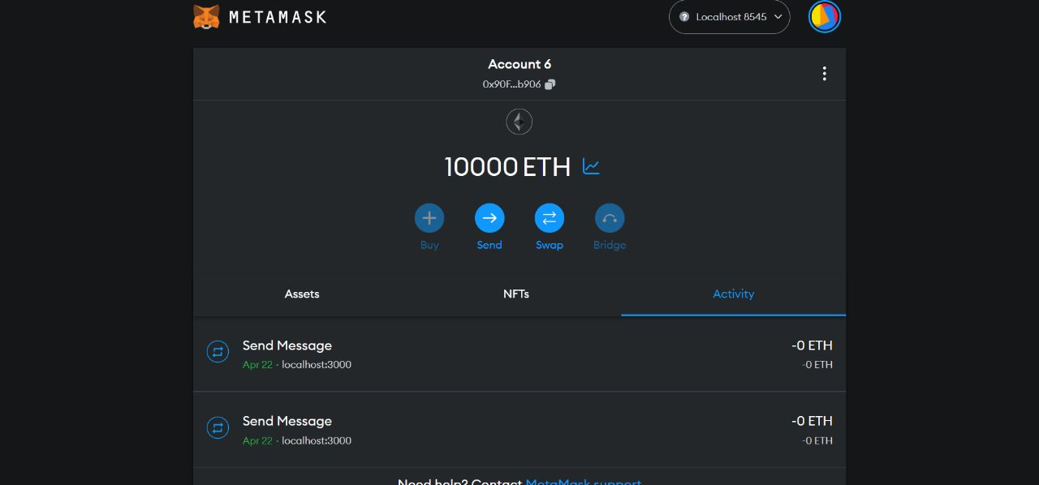
Results and Discussions

Slide 32
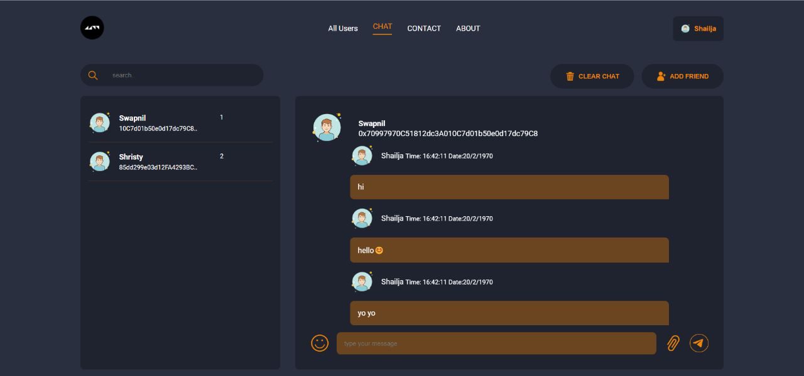
Results and Discussions

Slide 33
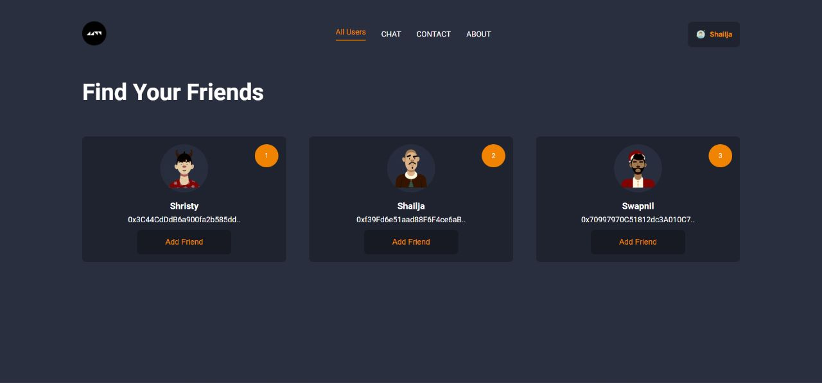
Results and Discussions

Slide 34
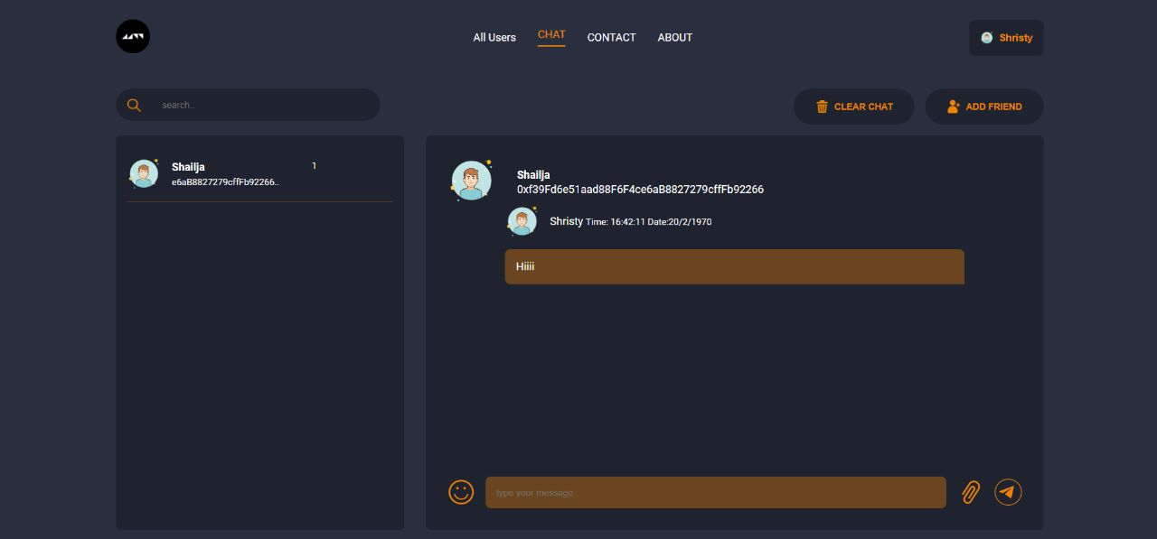
Results and Discussions

Slide 35
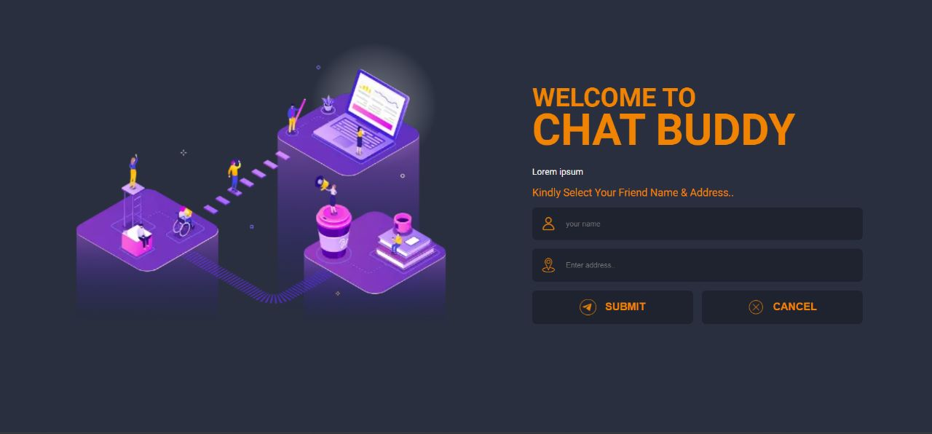
Results and Discussions

Slide 36
CONCLUSIONS
In this project, we are developing an application that makes use of blockchain in a very efficient way.
Blockchain has shown its potential for transforming traditional industry.
Also, by eliminating the centralized approach, we can assure the safety and availability of data
and communication.
Decentralized applications tend to make the interaction between two people more efficient and simple.
The chatting process nowadays have a mediating node, while our software does not have any mediating
device/node i.e., every person is connected by peer-to-peer network.

Slide 37
FUTURE ENHANCEMENTS
Decentralized Storage can be implemented.
Immutable Messaging can be enabled.
Cryptographic Authentication can be enabled.
Encrypted Messaging could be used.
Micropayments can be implemented.

Slide 38
REFERENCES
[1] “Act natural!”: Having a Private Chat on a Public Blockchain, Thore Tiemann, Sebastian Berndt ,Thomas Eisenbarth, Maciej Li´skiewicz, Cryptology ePrint Archive, 2021.
[2] Take Back your Friends with DCS: A Decentralized Connectivity Service for private social communication apps, Christos Aslanoglou, Michalis Konstantopoulos, Nikos Chondros, MemaRoussopoulos, In 2020 IEEE International Conference on Decentralized Applications and Infrastructures (DAPPS) (pp. 133-138), IEEE, 2020.
[3] Brain-Computer Interaction and Silent Speech Recognition on Decentralized Messaging Applications, Luís Arteiro, Fábio Lourenço, Paula Escudeiro & Carlos Ferreira, In International Conference on Human-Computer Interaction (pp. 3-11). Springer, Cham, 2020.
[4] Decentralized Chat Application using Blockchain Technology, Abhishek P. Takale, Chaitanya V. Vaidya, Suresh S. Kolekar,3rd National Conference on "Changing Technology and Rural Development", 2018.
[5] Decentralized Chat Application using Blockchain Technology, Abhishek P. Takale, Chaitanya V. Vaidya, Suresh S. Kolekar, 3rd National Conference on "Changing Technology and Rural Development", 2018.

Slide 39
REFERENCES
[6] Blockchain Based Secure Communication Application Proposal: Cryptouch, Recep Ahmet Sarıtekin, Eren Karabacak, Zübeyir Dur˘gay, Enis Karaarslan, Sarıtekin, In 2018 6th International Symposium on Digital Forensic and Security (ISDFS) (pp. 1-4), IEEE, 2018 .
[7] Secure Communications Using Blockchain Technology, Peter Menegay, Jason Salyers, Griffin College, In MILCOM 2018-2018 IEEE Military Communications Conference (MILCOM) (pp. 599-604), IEEE, 2018.
[8] A Decentralized Application for Secure Messaging in a Trustless Environment, Mohamed Abdulaziz, Davut Culha, Ali Yazici, In 2018 International Congress on Big Data, Deep Learning and Fighting Cyber Terrorism (IBIGDELFT) (pp. 1-5), IEEE, 2018.
[9] Applications of Blockchain Technology beyond Cryptocurrency, Mahdi H. Miraz, Maaruf Ali, arXiv preprint arXiv:1801.03528, 2018.
[10] aO Enhanced Chat Applications, Avinash Bamane, Parikshit Bhoyar, Ashish Dugar & Lineesh Antony, Global Journal of Computer Science and Technology, 2012.

Slide 40
Question and Answer

Slide 41
THANK YOU

