Slide 1
INTRODUCTION
E-commerce Website:
Shri Manjunatha Shamiyana & Events

Slide 2
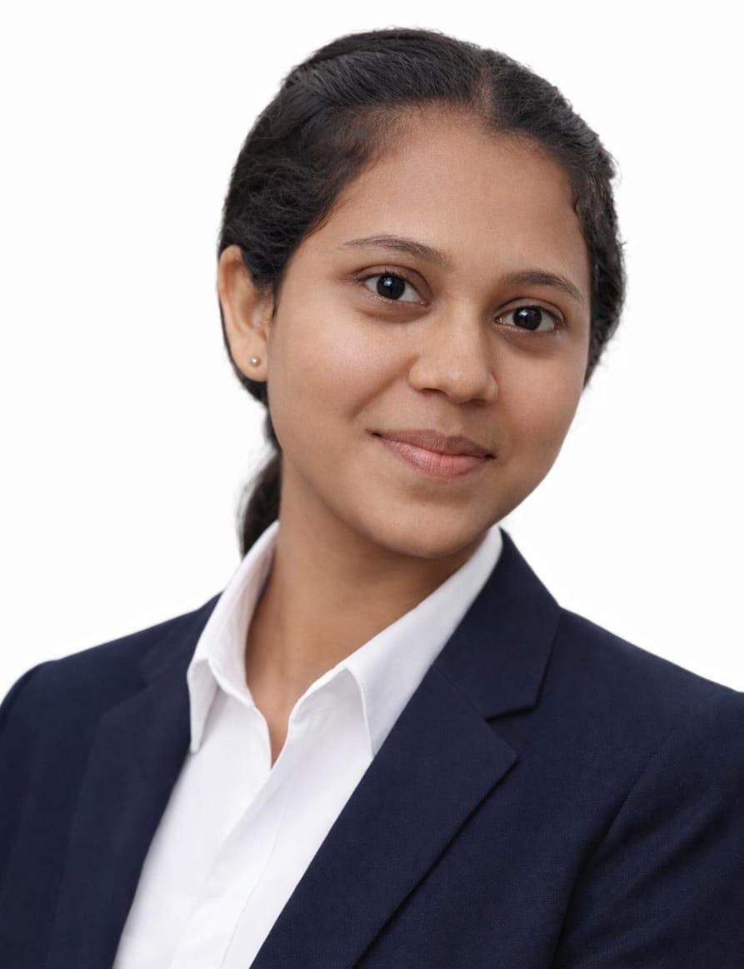

Profile Details:
Name: Gayatri Sanjay Bandivdekar
Class: TYBCA-B
Role: Business Analyst
Email: gayatribandivdekar22@gmail.com

Slide 3
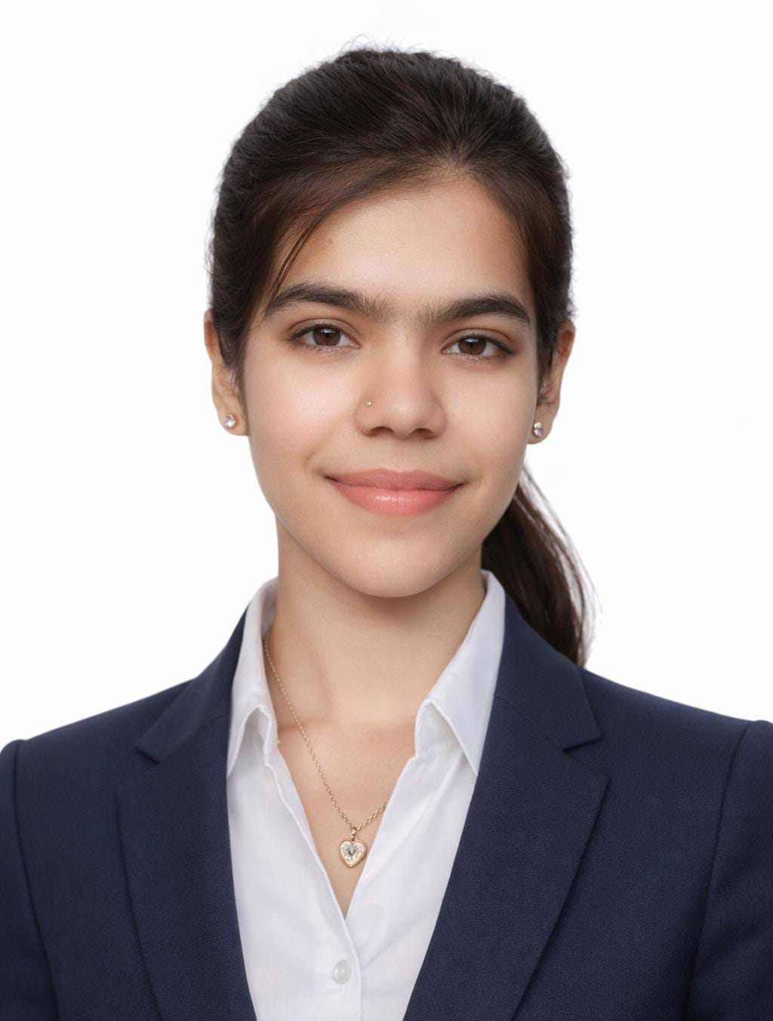
Profile Details:
Name: Khushboo Jaglal Yadav
Class: TYBCA-B
Role: Product Manager
Email: khushboojaglalyadav@gmail.com

Slide 4
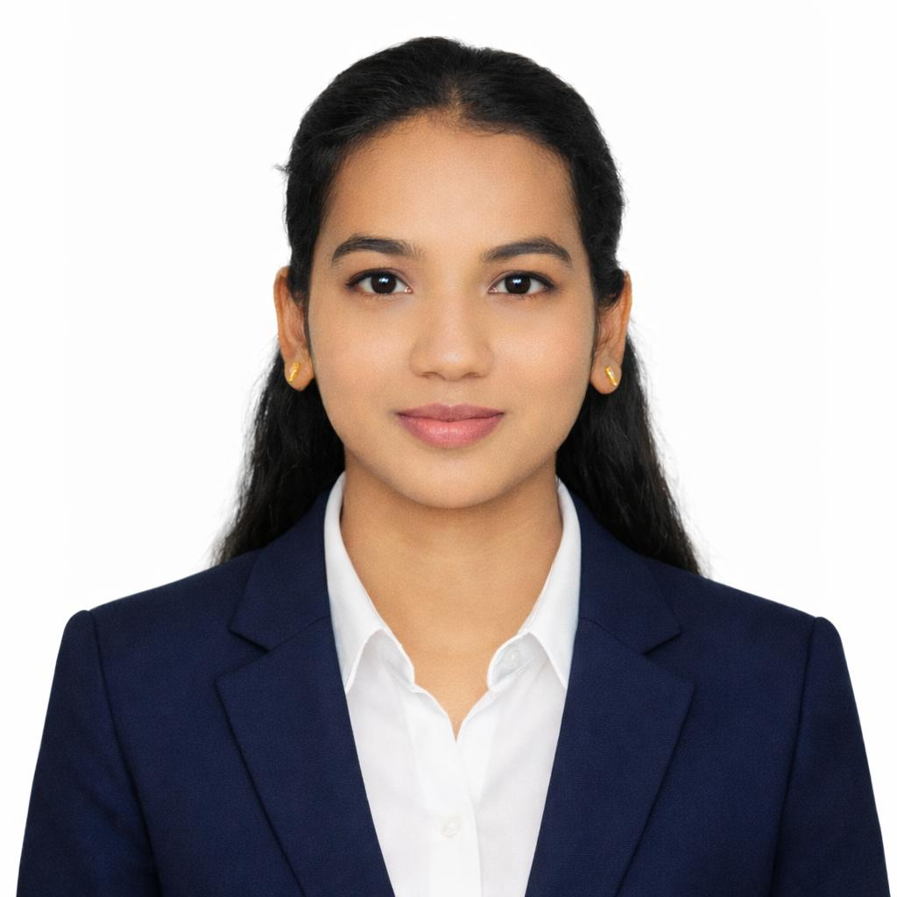
Profile Details:
Name: Aarti Shivdas Jadhav
Class: TYBCA-B
Role: Front-end Developer
Email: aartijadhav371@gmail.com

Slide 5
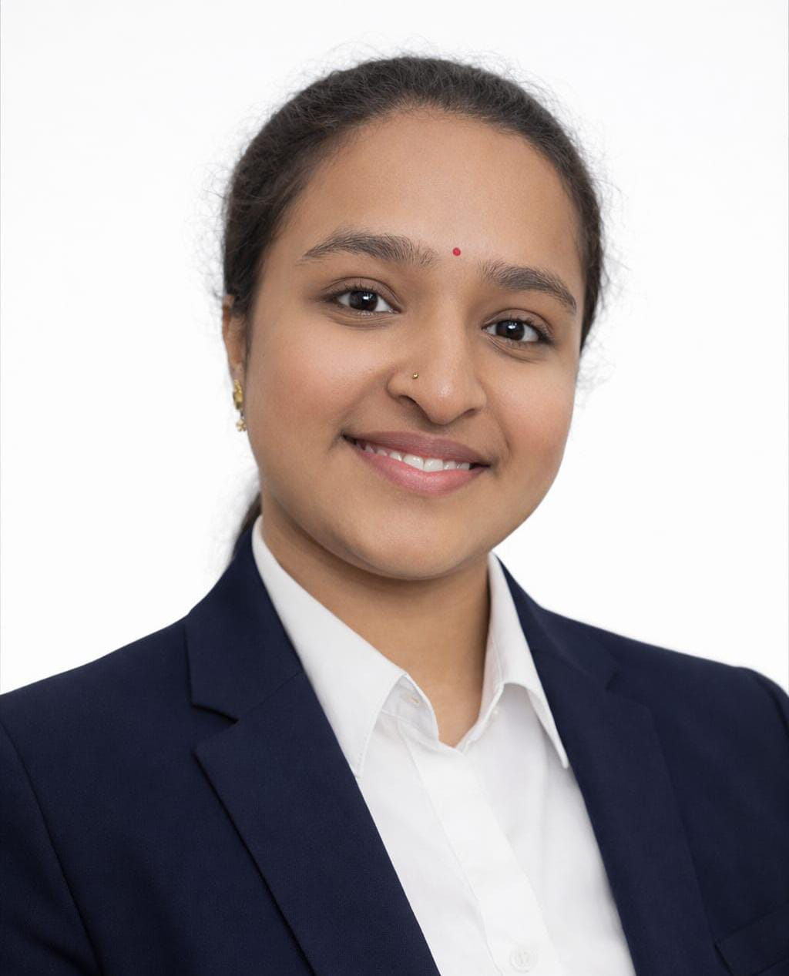
Profile Details:
Name: Bm Bhanupriya
Class: TYBCA-B
Role: Backend Developer
Email: bhanupriya388@gmail.com

Slide 6
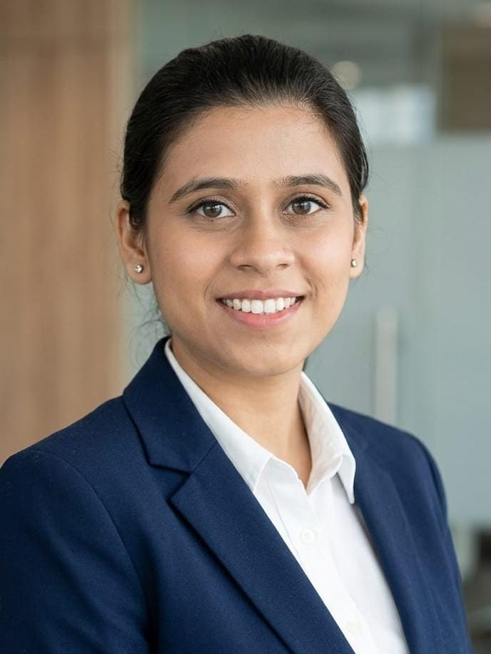
Profile Details:
Name: Roshan Chand Shaikh
Class: TYBCA-B
Role: Tester/QA
Email: x441roshan@gmail.com

Slide 7
THANK YOU!

