Slide 1
Duplicate Question Detection
Predicting which question pairs mean the same thing (Quora Question Pairs)
Project results and recommendations
Priyashree | AI Engineer Trainee, Rubixe
1
Notes:
Introduce the project: a model that decides whether two questions ask the same thing, built on the Quora Question Pairs dataset.

Slide 2
The business problem
Decide whether two questions carry the same meaning. Labels come from human experts, so they are a reasonable consensus, not perfect truth.
404,290
36.9%
537,929
labelled question pairs
of pairs are duplicates
unique questions
Goal: build a model that predicts which pairs are duplicates.
2
Notes:
Labels are noisy and subjective, so accuracy has a natural ceiling. 63% of pairs are non-duplicates, 37% duplicates.

Slide 3
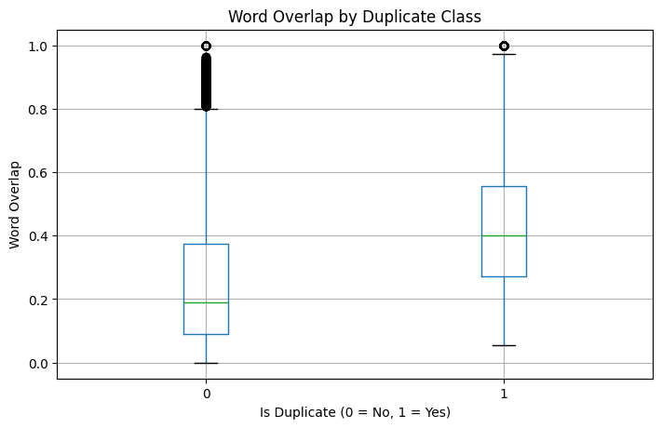
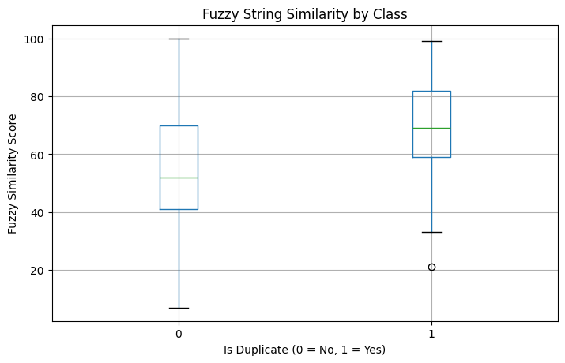
What the data shows
Duplicates vs non-duplicates
Signal | Duplicate | Not duplicate
Word overlap | 0.43 | 0.26
Fuzzy similarity | 70.1 | 56.3
Avg. characters | 52.9 | 63.5
Word overlap (left) and fuzzy similarity (right) by class
Data audit: 3 rows with a missing question were dropped; no exact duplicate rows. Class split is 63 / 37.
Duplicates are shorter and share more words, but the two classes overlap heavily, so surface text alone is not enough.
3
Notes:
Boxplots show the separation between classes, but also the large overlap. Average characters: duplicates about 52.9, non-duplicates about 63.5 to 64.3.

Slide 4





What I did
1
2
3
4
5
Audit and clean
Engineer features
Split the data
Build 3 models
Evaluate
Checked types, balance, missing values
7 features: length, words, overlap, fuzzy
80/20 stratified: 323K train, 81K test
Baseline, TF-IDF, Sentence Transformer
Metrics, errors, threshold sweep
Every model uses Logistic Regression with balanced class weights and is tested on the same 80,858 pairs.
4
Notes:
Also explored TF-IDF over concatenated text and a 5,000-pair transformer test early on, then moved to a structured three-model comparison.

Slide 5
Three approaches compared
1. Baseline
2. TF-IDF
3. Sentence Transformer
Engineered features only
Engineered features + TF-IDF cosine
Engineered features + semantic similarity
Length, word counts, word overlap, fuzzy ratios
Word and bigram vectors, 100K features
all-MiniLM-L6-v2 embeddings (384-d) computed on a Tesla T4 GPU
Idea: the same words can mean different things, and different words the same thing. Embeddings measure meaning.
5
Notes:
Only the third model measures meaning rather than word overlap.

Slide 6
Semantic similarity wins clearly
+14.31
F1 points over the baseline
+17.88
recall points: far fewer duplicates missed
6
Notes:
TF-IDF added only about 0.7 points of accuracy. The semantic model reached 78.42% accuracy, 65.94% precision, 85.93% recall and 74.62% F1.

Slide 7
Fewer mistakes where it matters
Model | True neg. | False pos. | False neg. | True pos.
Baseline | 33,806 | 17,199 | 9,537 | 20,316
TF-IDF | 34,013 | 16,992 | 9,186 | 20,667
Sentence Transformer | 37,752 | 13,253 | 4,199 | 25,654
9,537 to 4,199
17,199 to 13,253
missed duplicates cut by more than half
false alarms fell too, but remain the main error
7
Notes:
Test set of 80,858 pairs. Total errors for the final model: 13,253 false positives and 4,199 false negatives.

Slide 8
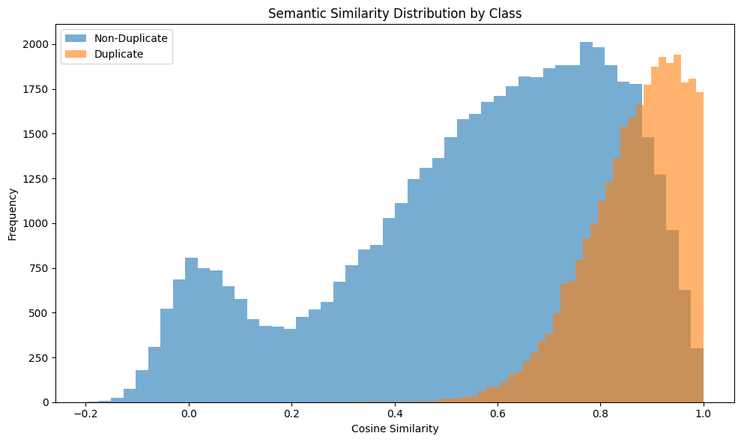


Why false alarms happen
Duplicates cluster high: mean 0.865, tightly spread.
Non-duplicates are spread wide (mean 0.561), and many still score above 0.8.
That overlap is why one similarity feature caps out around 75% F1.
Semantic similarity by class
8
Notes:
Duplicate std is 0.095 vs 0.271 for non-duplicates.

Slide 9
Same topic, different intent
False positives (13,253)
False negatives (4,199)
"How can I make a billion dollars?" vs "...ways to make 1,000 dollars?"
"How can I get Android Nougat?" vs "What is Android Nougat?"
Phone-choice questions that share the same product names but ask different things
True duplicates worded very differently, such as "Which are the best books to learn C++?" paired with a long, context-heavy question
Very short vs very long paraphrases score low when two embeddings are compared independently
Fix: intent, entity and number features
Fix: cross-encoder reads both together
9
Notes:
Some errors are really label disagreements: certain near-paraphrases are labelled non-duplicate in the ground truth.

Slide 10
Choose the threshold for the use case
0.35 to 0.40
Suggest candidates for review
91 to 93% recall
0.50
Balanced screening (best F1)
74.62% F1
0.65 to 0.70
Wrong merges are costly
71 to 74% precision
10
Notes:
The default 0.50 maximises F1, but the right threshold depends on how costly a wrong merge is versus a missed duplicate.

Slide 11




Advice to the client: how to use it now
Keep a human in the loop
Set the threshold by goal
About 66% precision means roughly 1 in 3 flags is wrong. Suggest duplicates; do not auto-merge.
0.35 to 0.40 to surface candidates, 0.50 balanced, 0.65+ when wrong merges are costly.
Adopt the semantic model
Plan for label noise
Clearly better than lexical methods, small and cheap to run, no heavy infrastructure.
Labels are subjective, so some errors are disagreements. Treat high-70s accuracy as a starting point.
11
Notes:
Bottom line: use the model as a duplicate-suggestion engine with human review.

Slide 12
Advice: improvements in priority order
1
Cross-encoder
2
Fine-tune the embeddings
3
Hard-negative mining
Reads both questions together; targets same-topic, different-intent errors.
Teach the model what "duplicate" means on Quora pairs.
Train on non-duplicates that look very similar.
4
Intent, entity, number features
5
Stronger classifier
6
Deploy as an API
Catch "billion" vs "1,000" and "how to get" vs "what is".
XGBoost or LightGBM, plus probability calibration.
Two questions in; flag and score out. Reviewer feedback becomes training data.
12
Notes:
Cross-encoder first: it directly attacks the main failure mode. Fine-tuning and hard negatives come next.

Slide 13




Advice: validate before production
Split by question, not only by pair
537,929 unique questions sit in 404K pairs, so the same question can appear in train and test. A grouped split gives an honest estimate.
Tune on a validation set
The threshold sweep used the test set. Hold out a third set for the final threshold.
Use several splits
Report a performance range from cross-validation, not one number.
Monitor after launch
Track precision from reviewer decisions and retrain as topics drift.
13
Notes:
These points make sure the reported 78% accuracy holds up in real use.

Slide 14
Conclusion
78.42%
85.93%
74.62%
accuracy
recall
F1 score
Semantic embeddings beat lexical features by +14.31 F1 points.
Remaining errors are same-topic questions with different intent.
Deploy now as a reviewer-assist tool; fund a cross-encoder and fine-tuning next.
14
Notes:
Close by recommending deployment as a suggestion engine with an adjustable threshold, then the next-phase work.

