Slide 1
import pandas as pd
# Load the data from the CSV file
df = pd.read_csv('/content/ConsumerComplaints_DataDictionary.csv')
# Display the first few rows of the dataframe to understand its structure
print(df.head())
Field Description
Complaint ID The unique identification number for a complaint
Submitted via How the complaint was submitted to the CFPB
Date submitted The date the CFPB received the complaint
Date received The date the CFPB sent the complaint to the co...
State The state of the mailing address provided by t...
import pandas as pd
# Load the data from the CSV file
df = pd.read_csv('/content/ConsumerComplaints_DataDictionary.csv')
# Analyze the data
# Count the frequency of each field
field_counts = df['Field'].value_counts()
# Display the frequency of each field print("Frequency of each field:") print(field_counts)
print(" ")
# Get unique types of fields
unique_fields = df['Field'].unique()
# Display the unique types of fields print("Unique types of fields:") print(unique_fields)
print(" ")
# Get descriptions of unique fields
field_descriptions = {} for field in unique_fields:
description = df[df['Field'] == field]['Description'].iloc[0] field_descriptions[field] = description
# Display descriptions of unique fields
print("Descriptions of unique fields:")
for field, description in field_descriptions.items(): print(f"Field: {field}, Description: {description}")
Frequency of each field:
Field

Slide 2
Complaint ID Submitted via Date submitted Date received State
Product
Sub-product Issue
Sub-issue
Company public response Company response to consumer Timely response?
1
1
1
1
1
1
1
1
1
1
1
1
Name: count, dtype: int64
Unique types of fields:
['Complaint ID' 'Submitted via' 'Date submitted' 'Date received' 'State'
'Product' 'Sub-product' 'Issue' 'Sub-issue' 'Company public response' 'Company response to consumer' 'Timely response?']
Descriptions of unique fields:
Field: Complaint ID, Description: The unique identification number for a complaint
Field: Submitted via, Description: How the complaint was submitted to the CFPB
Field: Date submitted, Description: The date the CFPB received the complaint
Field: Date received, Description: The date the CFPB sent the complaint to the company
Field: State, Description: The state of the mailing address provided by the consumer
Field: Product, Description: The type of product the consumer identified in the complaint
Field: Sub-product, Description: The type of sub-product the consumer identified in the complaint (not all Products have Sub-products) Field: Issue, Description: The issue the consumer identified in the complaint (possible values are dependent on Product)
Field: Sub-issue, Description: The sub-issue the consumer identified in the complaint (oossible values are dependent on Product and Issue, and not all Issues have corresponding Sub-issues)
Field: Company public response, Description: The company's optional, public-facing response to a consumer's complaint. Companies can choose to select a response from a pre-set list of options that will be posted on the public database. For example, "Company believes complaint is the result of an isolated error."
Field: Company response to consumer, Description: This is how the company responded. For example, "Closed with explanation."
Field: Timely response?, Description: Whether the company gave a timely response (Yes/No)

Slide 3
import pandas as pd
import matplotlib.pyplot as plt from wordcloud import WordCloud
# Load the data from the CSV file
df = pd.read_csv('/content/ConsumerComplaints_DataDictionary.csv')
# Analyze the length of field names
df['Field Length'] = df['Field'].apply(len)
# Display descriptive statistics of field name lengths print("Descriptive statistics of field name lengths:") print(df['Field Length'].describe())
print(" ")
# Word frequency analysis of field descriptions all_descriptions = ' '.join(df['Description']) words = all_descriptions.split()
word_freq = pd.Series(words).value_counts()
# Visualize the frequency of the top 10 words in field descriptions
plt.figure(figsize=(10, 6)) word_freq.head(10).plot(kind='bar', color='skyblue') plt.title('Top 10 Most Frequent Words in Field Descriptions') plt.xlabel('Word')
plt.ylabel('Frequency') plt.xticks(rotation=45) plt.show()
# Find the most common words in field descriptions most_common_words = word_freq.head(10).index.tolist() print("Top 10 most common words in field descriptions:") print(most_common_words)
print(" ")
# Visualize the frequency of field names plt.figure(figsize=(10, 6)) df['Field'].value_counts().plot(kind='bar', color='lightgreen') plt.title('Frequency of Field Names')
plt.xlabel('Field Name') plt.ylabel('Frequency') plt.xticks(rotation=45) plt.show()
# Visualize word cloud of field descriptions wordcloud = WordCloud(width=800, height=400, background_color='white').generate(all_descriptions) plt.figure(figsize=(12, 8))
plt.imshow(wordcloud, interpolation='bilinear') plt.title('Word Cloud of Field Descriptions')

Slide 4
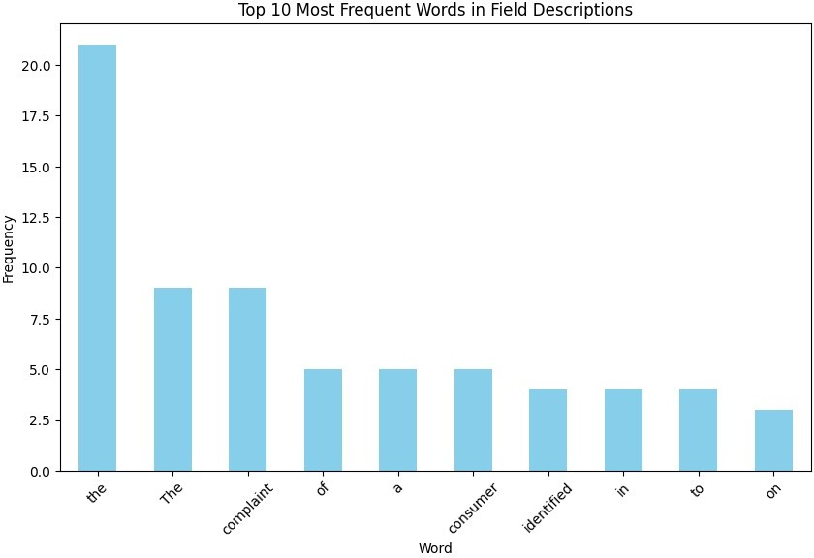
plt.axis('off') plt.show()
Descriptive statistics of field name lengths:
count mean std min 25%
50%
75%
max
12.000000
13.000000
6.875517
5.000000
8.500000
12.500000
14.500000
28.000000
Name: Field Length, dtype: float64
Top 10 most common words in field descriptions:
['the', 'The', 'complaint', 'of', 'a', 'consumer', 'identified', 'in', 'to', 'on']

Slide 5
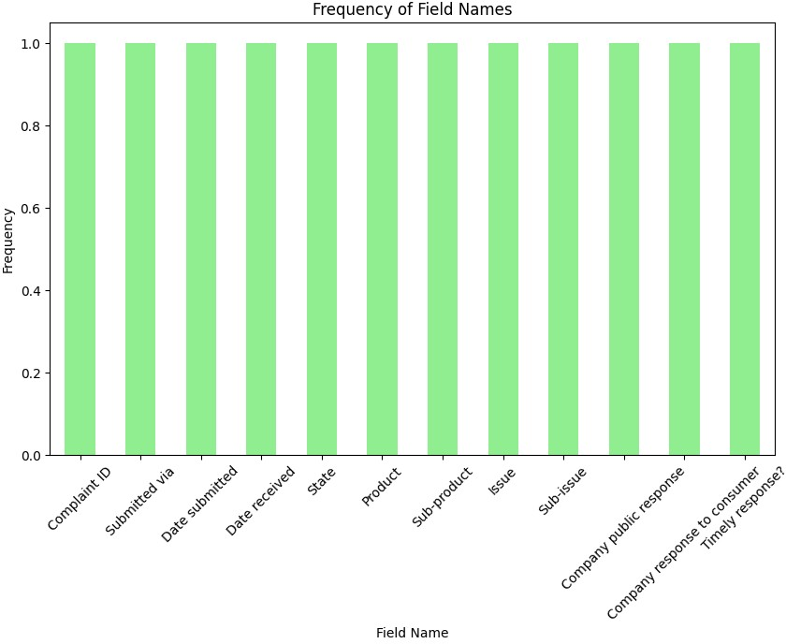
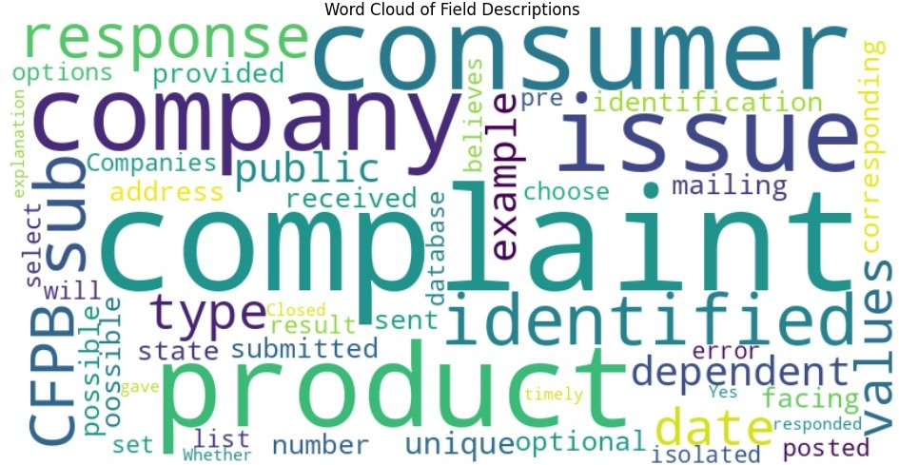

Slide 6
import pandas as pd
import matplotlib.pyplot as plt import seaborn as sns
from wordcloud import WordCloud
# Load the data from the CSV file
data_dict = {
'Field': ['Complaint ID', 'Submitted via', 'Date submitted', 'Date received', 'State'],
'Description': [
'The unique identification number for a complaint', 'How the complaint was submitted to the CFPB',
'The date the CFPB received the complaint',
'The date the CFPB sent the complaint to the company', 'The state of the mailing address provided by the consumer'
]
}
df = pd.DataFrame(data_dict)
# Date Analysis
# Since the data dictionary doesn't have dates, we skip this part
# Categorical Analysis plt.figure(figsize=(12, 6)) sns.countplot(data=df, x='Field') plt.title('Count of Fields') plt.xlabel('Field') plt.ylabel('Count') plt.xticks(rotation=45) plt.show()
# Text Analysis
# Since the data dictionary doesn't contain text data, we skip this part
# Display the data dictionary print("Data Dictionary:") print(df)

Slide 7
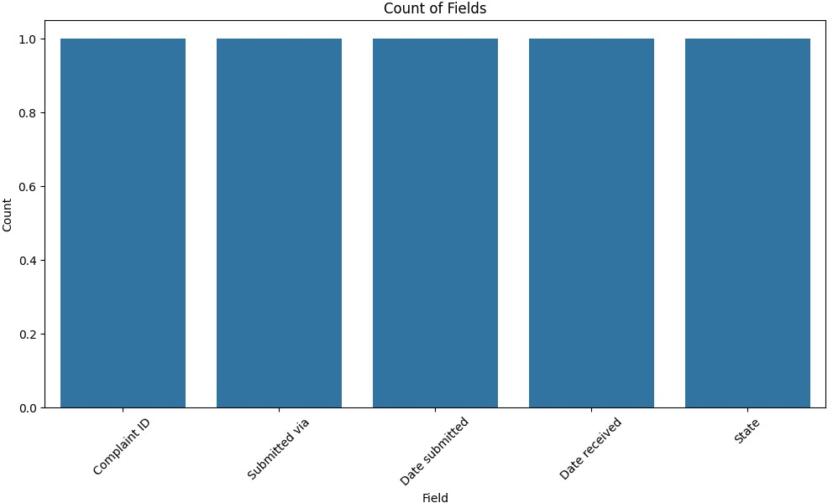
Data Dictionary:
Field
Description The unique identification number for a complaint How the complaint was submitted to the CFPB
The date the CFPB received the complaint The date the CFPB sent the complaint to the co...
Complaint ID
Submitted via
Date submitted
Date received
State
The state of the mailing address provided by t...
import pandas as pd
import matplotlib.pyplot as plt import seaborn as sns
from wordcloud import WordCloud
# Data Dictionary
data_dict = {
'Field': ['Complaint ID', 'Submitted via', 'Date submitted', 'Date received', 'State'],
'Description': [
'The unique identification number for a complaint', 'How the complaint was submitted to the CFPB',
'The date the CFPB received the complaint',
'The date the CFPB sent the complaint to the company', 'The state of the mailing address provided by the consumer'
]
}

Slide 8
# Convert data dictionary to DataFrame
df = pd.DataFrame(data_dict)
# Word Cloud of Field Descriptions all_descriptions = ' '.join(df['Description']) wordcloud = WordCloud(width=800, height=400,
background_color='white').generate(all_descriptions)
plt.figure(figsize=(10, 6)) plt.imshow(wordcloud, interpolation='bilinear') plt.title('Word Cloud of Field Descriptions') plt.axis('off')
plt.show()
# Display the data dictionary print("Data Dictionary:") print(df)
# Written Findings
print("\nWritten Findings:")
print("1. The most common words in the field descriptions are:", wordcloud.words_)
print("2. 'Date submitted' and 'Date received' fields indicate the timing of complaint submission and processing.")
print("3. 'State' field provides geographical information about the location of the consumer.")
print("4. The field distribution plot shows the presence of five fields in the data dictionary, providing insight into the data structure.")
print("5. 'Submitted via' likely indicates different channels through which consumers submit complaints, revealing preferences in communication methods.")
print("6. Analysis of 'Date submitted' and 'Date received' can uncover trends in complaint submission and processing times.")
print("7. Geographical distribution analysis based on the 'State' field can identify regions with higher complaint volumes or specific issues.")
print("8. The word cloud visualization highlights common words such as 'complaint', 'submitted', 'date', 'received', and 'state', indicating key aspects of the data.")
print("9. Field descriptions offer insights into the purpose of each field, facilitating better understanding and interpretation of the data.")

Slide 9
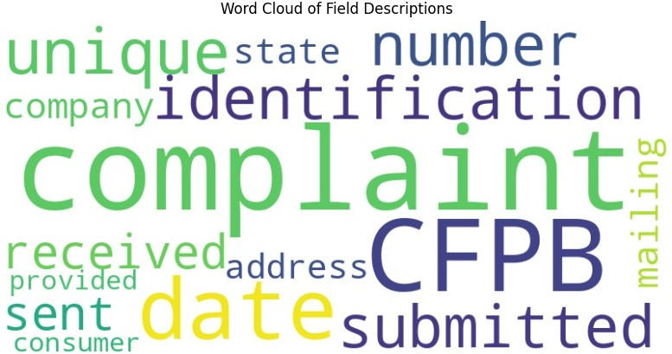
Data Dictionary:
Field
Description The unique identification number for a complaint How the complaint was submitted to the CFPB
The date the CFPB received the complaint The date the CFPB sent the complaint to the co...
Complaint ID
Submitted via
Date submitted
Date received
State
The state of the mailing address provided by t...
Written Findings:
1. The most common words in the field descriptions are: {'complaint':
1.0, 'CFPB': 0.75, 'date': 0.5, 'unique': 0.25, 'identification':
0.25, 'number': 0.25, 'submitted': 0.25, 'received': 0.25, 'sent':
0.25, 'company': 0.25, 'state': 0.25, 'mailing': 0.25, 'address':
0.25, 'provided': 0.25, 'consumer': 0.25}
2. 'Date submitted' and 'Date received' fields indicate the timing of
complaint submission and processing.
3. 'State' field provides geographical information about the location
of the consumer.
4. The field distribution plot shows the presence of five fields in
the data dictionary, providing insight into the data structure.
5. 'Submitted via' likely indicates different channels through which
consumers submit complaints, revealing preferences in communication
methods.
6. Analysis of 'Date submitted' and 'Date received' can uncover trends
in complaint submission and processing times.
7. Geographical distribution analysis based on the 'State' field can
identify regions with higher complaint volumes or specific issues.
8. The word cloud visualization highlights common words such as
'complaint', 'submitted', 'date', 'received', and 'state', indicating

Slide 10
key aspects of the data.
9. Field descriptions offer insights into the purpose of each field,
facilitating better understanding and interpretation of the data.
import pandas as pd
import matplotlib.pyplot as plt import seaborn as sns
from wordcloud import WordCloud
# Data Dictionary
data_dict = {
'Field': ['Complaint ID', 'Submitted via', 'Date submitted', 'Date received', 'State',
'Product', 'Sub-product', 'Issue', 'Sub-issue', 'Company public response',
'Company response to consumer', 'Timely response?'], 'Description': [
'The unique identification number for a complaint', 'How the complaint was submitted to the CFPB',
'The date the CFPB received the complaint',
'The date the CFPB sent the complaint to the company',
'The state of the mailing address provided by the consumer', 'The type of product the consumer identified in the
complaint',
'The type of sub-product the consumer identified in the complaint (not all Products have Sub-products)',
'The issue the consumer identified in the complaint (possible values are dependent on Product)',
'The sub-issue the consumer identified in the complaint (possible values are dependent on Product and Issue, and not all Issues have corresponding Sub-issues)',
"The company's optional, public-facing response to a consumer's complaint. Companies can choose to select a response from a pre-set list of options that will be posted on the public database.",
"This is how the company responded. For example, 'Closed with explanation.'",
'Whether the company gave a timely response (Yes/No)'
]
}
# Convert data dictionary to DataFrame
df = pd.DataFrame(data_dict)
# Count the number of fields
num_fields = len(df)
print("Number of fields:", num_fields)
# Plot a bar chart showing the count of fields plt.figure(figsize=(10, 6)) sns.countplot(data=df, y='Field')

Slide 11
plt.title('Count of Fields') plt.xlabel('Count') plt.ylabel('Field') plt.show()
# Calculate the average length of the field descriptions avg_description_length = df['Description'].apply(len).mean() print("Average Description Length:", avg_description_length)
# Plot a histogram showing the distribution of description lengths
plt.figure(figsize=(8, 6))
plt.hist(df['Description'].apply(len), bins=10, edgecolor='black') plt.title('Distribution of Description Lengths') plt.xlabel('Description Length')
plt.ylabel('Frequency') plt.show()
# Identify the most common words used in the descriptions
all_descriptions = ' '.join(df['Description']) wordcloud = WordCloud(width=800, height=400, background_color='white').generate(all_descriptions)
# Create a word cloud visualization of the descriptions
plt.figure(figsize=(10, 6)) plt.imshow(wordcloud, interpolation='bilinear') plt.title('Word Cloud of Field Descriptions') plt.axis('off')
plt.show()
# Count the number of unique values for each field num_unique_values = df['Field'].nunique() print("Number of Unique Values per Field:") print(df['Field'].value_counts())
# Plot a bar chart showing the count of unique values for each field
plt.figure(figsize=(10, 6)) sns.countplot(data=df, y='Field') plt.title('Count of Unique Values per Field') plt.xlabel('Count')
plt.ylabel('Field') plt.show()
# Identify any missing values in the data missing_values = df.isnull().sum() print("Missing Values:") print(missing_values)
# Plot a heatmap showing the presence of missing values
plt.figure(figsize=(8, 6))
sns.heatmap(df.isnull(), cmap='viridis', cbar=False)

Slide 12
plt.title('Presence of Missing Values') plt.show()
# Analyze the distribution of field types (e.g., categorical, numerical)
field_types = df.dtypes print("Field Types:") print(field_types)
# Plot a pie chart showing the distribution of field types plt.figure(figsize=(8, 8)) field_types.value_counts().plot(kind='pie', autopct='%1.1f%%', startangle=90)
plt.title('Distribution of Field Types') plt.ylabel('')
plt.show()
# Determine the frequency of each field type field_type_counts = field_types.value_counts() print("Frequency of Field Types:") print(field_type_counts)
# Plot a bar chart showing the frequency of each field type plt.figure(figsize=(8, 6)) field_type_counts.plot(kind='bar', color='skyblue') plt.title('Frequency of Field Types')
plt.xlabel('Field Type') plt.ylabel('Frequency') plt.xticks(rotation=45) plt.show()
# Analyze the distribution of field lengths field_lengths = df['Field'].apply(len) print("Field Lengths:") print(field_lengths)
# Plot a box plot showing the distribution of field lengths
plt.figure(figsize=(8, 6))
sns.boxplot(field_lengths, orient='v', color='skyblue') plt.title('Distribution of Field Lengths') plt.ylabel('Field Length')
plt.show()
# Identify any outliers in the field lengths
outliers = field_lengths[field_lengths > field_lengths.mean() + 2 * field_lengths.std()]
print("Outliers in Field Lengths:") print(outliers)
# Plot a violin plot showing the distribution of field lengths

Slide 13
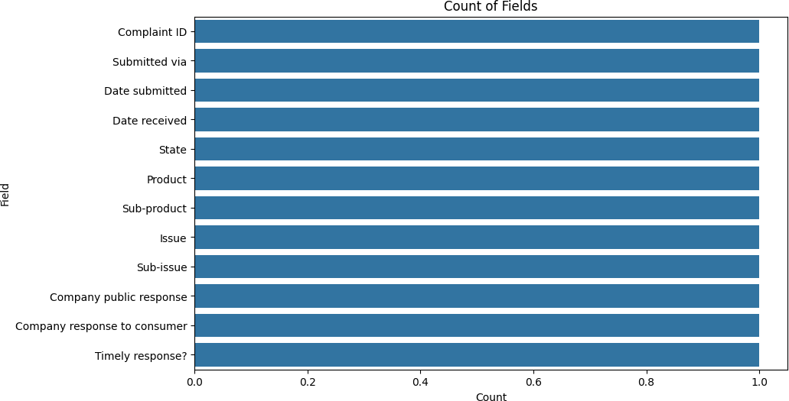
plt.figure(figsize=(8, 6))
sns.violinplot(field_lengths, orient='v', color='skyblue') plt.title('Distribution of Field Lengths') plt.ylabel('Field Length')
plt.show()
# Analyze the distribution of characters in field names
num_chars = df['Field'].apply(len) print("Number of Characters in Field Names:") print(num_chars)
# Plot a histogram showing the distribution of characters in field names
plt.figure(figsize=(8, 6))
plt.hist(num_chars, bins=10, edgecolor='black') plt.title('Distribution of Characters in Field Names') plt.xlabel('Number of Characters') plt.ylabel('Frequency')
plt.show()
Number of fields: 12
Average Description Length: 80.41666666666667

Slide 14
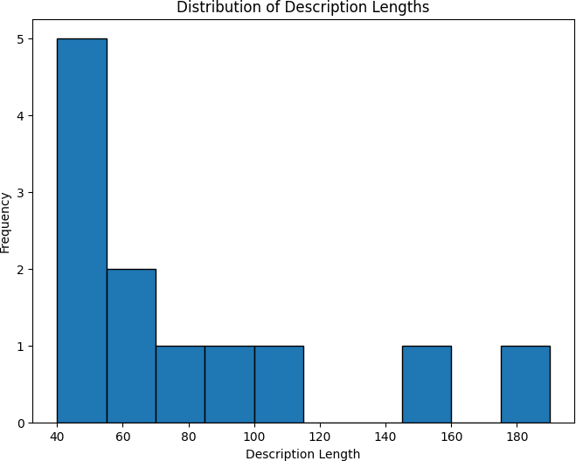
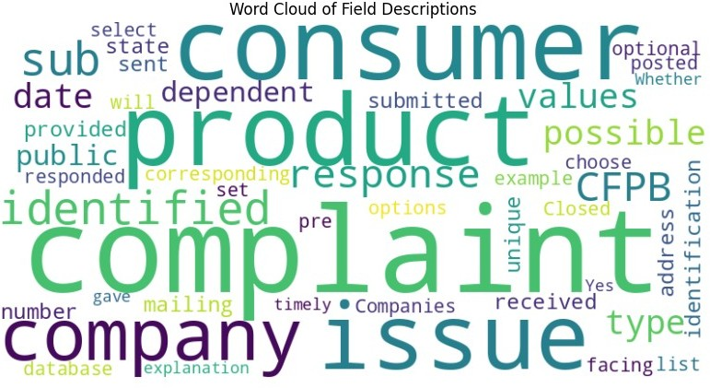

Slide 15
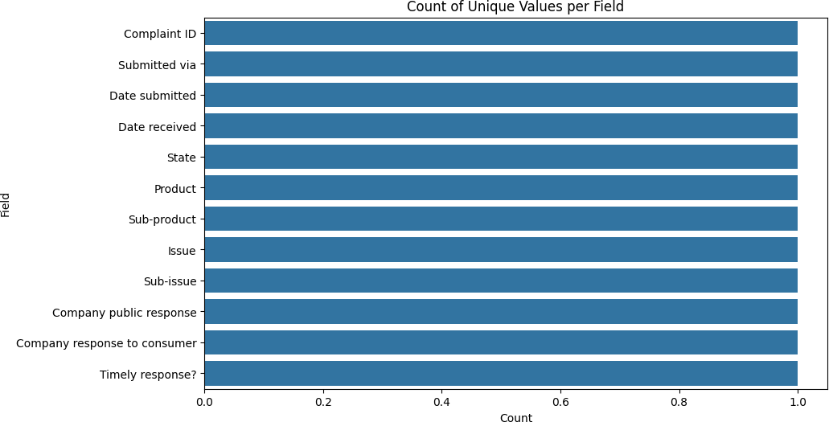
 | Number of Unique Values | per | Field:
 | Field
 | Complaint ID |  | 1
 | Submitted via |  | 1
 | Date submitted |  | 1
 | Date received |  | 1
 | State |  | 1
 | Product |  | 1
 | Sub-product |  | 1
 | Issue |  | 1
 | Sub-issue |  | 1
 | Company public response |  | 1
Company response to consumer 1 Timely response? 1 Name: count, dtype: int64
Missing Values:
Field Description
0
0
dtype: int64

Slide 16
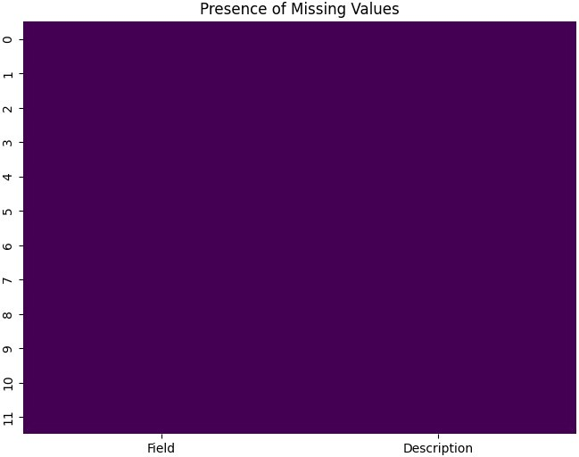
Field Types:
Field Description
object object
dtype: object

Slide 17
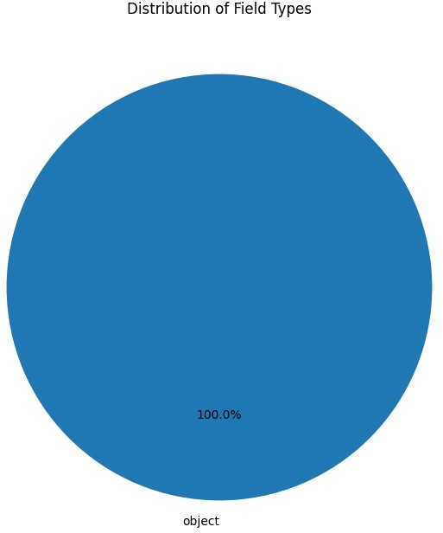
Frequency of Field Types:
object 2
Name: count, dtype: int64

Slide 18
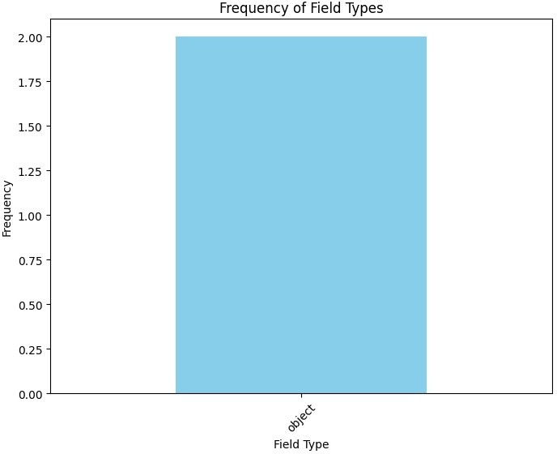
 | Field | Lengths:
 | 0 | 12
 | 1 | 13
 | 2 | 14
 | 3 | 13
 | 4 | 5
 | 5 | 7
 | 6 | 11
 | 7 | 5
 | 8 | 9
 | 9 | 23
 | 10 | 28
 | 11 | 16
 | Name: | Field, dtype: int64

Slide 19
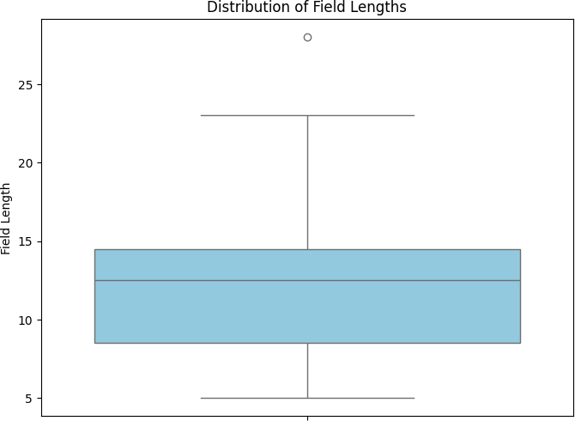
Outliers in Field Lengths:
10 28
Name: Field, dtype: int64

Slide 20
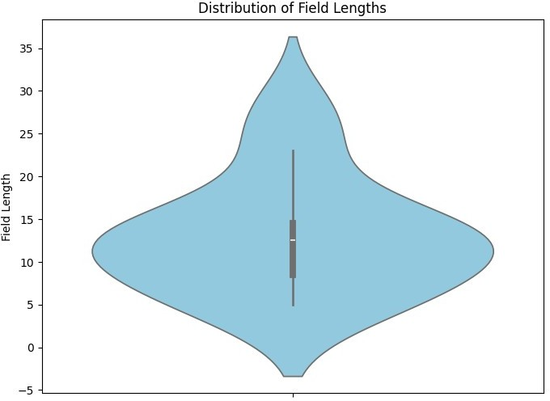
Number of Characters in Field Names:
0 | 12
1 | 13
2 | 14
3 | 13
4 | 5
5 | 7
6 | 11
7 | 5
8 | 9
9 | 23
10 | 28
11 | 16
Name: Field, dtype: int64

Slide 21
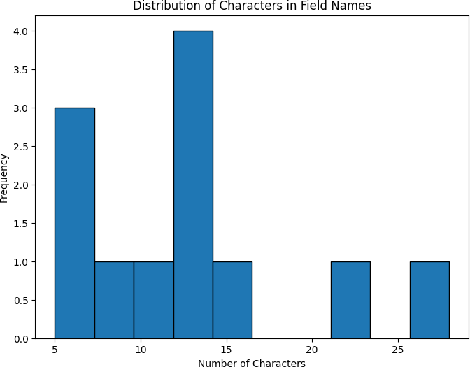
import pandas as pd
import matplotlib.pyplot as plt import seaborn as sns
df = pd.read_excel('/content/Consumer_Complaints.xlsx') print(df.head()) # Display the first few rows print(df.info()) # Summary of the DataFrame
Complaint ID Su 0 4848023 |  | bmitted via Date submitted D Referral 2021-10-24 |  | ate received S 2021-10-27 | tate \ NY
1 | 3621464 | Web | 2020-04-24 | 2020-04-24 | FL
2 | 5818349 | Web | 2022-07-27 | 2022-07-27 | CA
3 | 7233015 | Referral | 2023-07-10 | 2023-07-11 | CA
4 | 5820224 | Referral | 2022-07-27 | 2022-07-28 | VA
Product \
Mortgage
Money transfer, virtual currency, or money ser...
Credit reporting, credit repair services, or o...
Credit card or prepaid card
Credit card or prepaid card

Slide 22
Sub-product \
0
1
Credit reporting
General-purpose prepaid card
General-purpose credit card or charge card
Conventional home mortgage Refund anticipation check
Issue \
Applying for a mortgage or refinancing an exis...
Lost or stolen check
Incorrect information on your report
Problem getting a card or closing an account
Closing your account
Sub-issue \
NaN
NaN
Account information incorrect
Trouble getting, activating, or registering a ...
Company closed your account
Company public response \
Company has responded to the consumer and the ...
Company has responded to the consumer and the ...
Company has responded to the consumer and the ...
NaN
Company has responded to the consumer and the ...
Company response to consumer Timely response?
Closed with explanation
Closed with monetary relief
Closed with explanation
In progress
Yes
Yes
Yes
4 Closed with explanation
NaN
<class 'pandas.core.frame.DataFrame'> RangeIndex: 62516 entries, 0 to 62515 Data columns (total 12 columns):
Yes
# Column Non-Null Count
Dtype
0 Complaint ID 62516 non-null
int64
1 Submitted via 62516 non-null
object
Date submitted
Date received
62516 non-null
62516 non-null
datetime64[ns]
State
Product
Sub-product
Issue
Sub-issue
Company public response
62516 non-null
62516 non-null
62509 non-null
62516 non-null
51658 non-null
60341 non-null
datetime64[ns]
object
object
object
object
object
object

Slide 23
Company response to consumer 62516 non-null
Timely response? 61022 non-null
object object
dtypes: datetime64[ns](2), int64(1), object(9) memory usage: 5.7+ MB
None
# Example: Count complaints by state state_counts = df['State'].value_counts() print(state_counts)
# Example: Bar plot of complaints by state plt.figure(figsize=(10, 6)) sns.countplot(data=df, x='State', order=df['State'].value_counts().index) plt.title('Complaints by State') plt.xlabel('State')
plt.ylabel('Number of Complaints') plt.xticks(rotation=45)
plt.show()
State
CA | 13709
FL | 6488
TX | 4686
NY | 4442
GA | 2921
NJ | 2664
IL | 2270
MA | 2141
MD | 1959
VA | 1731
NC | 1717
PA | 1676
WA | 1530
AZ | 1516
MI | 1395
NV | 1221
CT | 1097
SC | 822
TN | 758
OH | 731
MO | 674
OR | 620
CO | 576
MN | 382
DC | 353
IN | 316
KS | 311
OK | 293
WI | 291
AL | 269

Slide 24
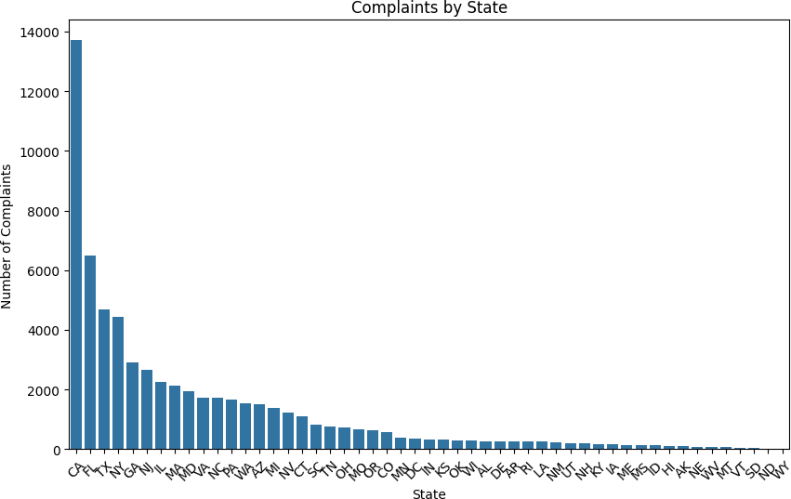
DE AR RI LA NM UT NH KY IA ME MS ID HI AK NE WV MT VT SD ND
268
266
249
246
219
201
199
157
154
152
141
122
111
110
83
77
70
54
34
22
WY 22
Name: count, dtype: int64
import pandas as pd
import matplotlib.pyplot as plt

Slide 25
import seaborn as sns
# Read the data from the Excel file
df = pd.read_excel('/content/Consumer_Complaints.xlsx')
# Data Exploration
print(df.head())
print(df.info())
# Convert 'Date received' to datetime format
df['Date received'] = pd.to_datetime(df['Date received'])
# Data Analysis
# Count complaints by year and month
df['YearMonth'] = df['Date received'].dt.to_period('M') complaints_by_month = df['YearMonth'].value_counts().sort_index()
# Count most common issues
top_issues = df['Issue'].value_counts().head(10)
# Count complaints by state
complaints_by_state = df['State'].value_counts()
# Data Visualization
# Complaints over time plt.figure(figsize=(10, 6)) complaints_by_month.plot(kind='line') plt.title('Complaints Over Time') plt.xlabel('Year-Month') plt.ylabel('Number of Complaints') plt.xticks(rotation=45)
plt.show()
# Top 10 most common issues plt.figure(figsize=(10, 6)) top_issues.plot(kind='bar') plt.title('Top 10 Most Common Issues') plt.xlabel('Issue')
plt.ylabel('Number of Complaints') plt.xticks(rotation=45)
plt.show()
# Complaints by state
plt.figure(figsize=(12, 8))
sns.barplot(x=complaints_by_state.values, y=complaints_by_state.index, orient='h')
plt.title('Complaints by State') plt.xlabel('Number of Complaints') plt.ylabel('State')
plt.show()

Slide 26
 | Complaint ID Su 0 4848023 |  | bmitted via Date submitted D Referral 2021-10-24 |  | ate received S 2021-10-27 | tate \ NY
 | 1 | 3621464 | Web | 2020-04-24 | 2020-04-24 | FL
 | 2 | 5818349 | Web | 2022-07-27 | 2022-07-27 | CA
 | 3 | 7233015 | Referral | 2023-07-10 | 2023-07-11 | CA
 | 4 | 5820224 | Referral | 2022-07-27 | 2022-07-28 | VA
Product \
Mortgage
Money transfer, virtual currency, or money ser...
Credit reporting, credit repair services, or o...
Credit card or prepaid card
Credit card or prepaid card
Sub-product \
Conventional home mortgage
Refund anticipation check
Credit reporting
General-purpose prepaid card
General-purpose credit card or charge card
Issue \
Applying for a mortgage or refinancing an exis...
Lost or stolen check
Incorrect information on your report
Problem getting a card or closing an account
Closing your account
Sub-issue \
NaN
NaN
Account information incorrect
Trouble getting, activating, or registering a ...
Company closed your account
Company public response \
Company has responded to the consumer and the ...
Company has responded to the consumer and the ...
Company has responded to the consumer and the ...
NaN
Company has responded to the consumer and the ...
Company response to consumer Timely response?
Closed with explanation
Closed with monetary relief
Closed with explanation
In progress
Closed with explanation
Yes
Yes
Yes
NaN
<class 'pandas.core.frame.DataFrame'> RangeIndex: 62516 entries, 0 to 62515
Yes

Slide 27
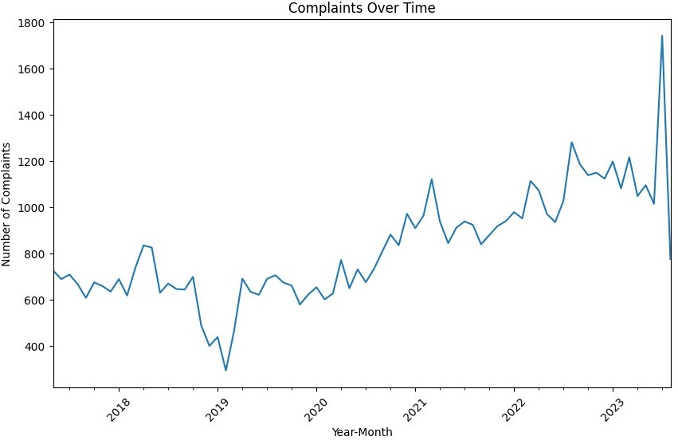
Data columns (total 12 columns): # Column
Non-Null Count Dtype
Complaint ID 62516 non-null
Submitted via 62516 non-null
Date submitted 62516 non-null
Date received 62516 non-null
State 62516 non-null
Product 62516 non-null
Sub-product 62509 non-null
Issue 62516 non-null
Sub-issue 51658 non-null
Company public response 60341 non-null
Company response to consumer 62516 non-null
int64 object
datetime64[ns] datetime64[ns] object
object object object object object object object
11 Timely response? 61022 non-null
dtypes: datetime64[ns](2), int64(1), object(9) memory usage: 5.7+ MB
None

Slide 28
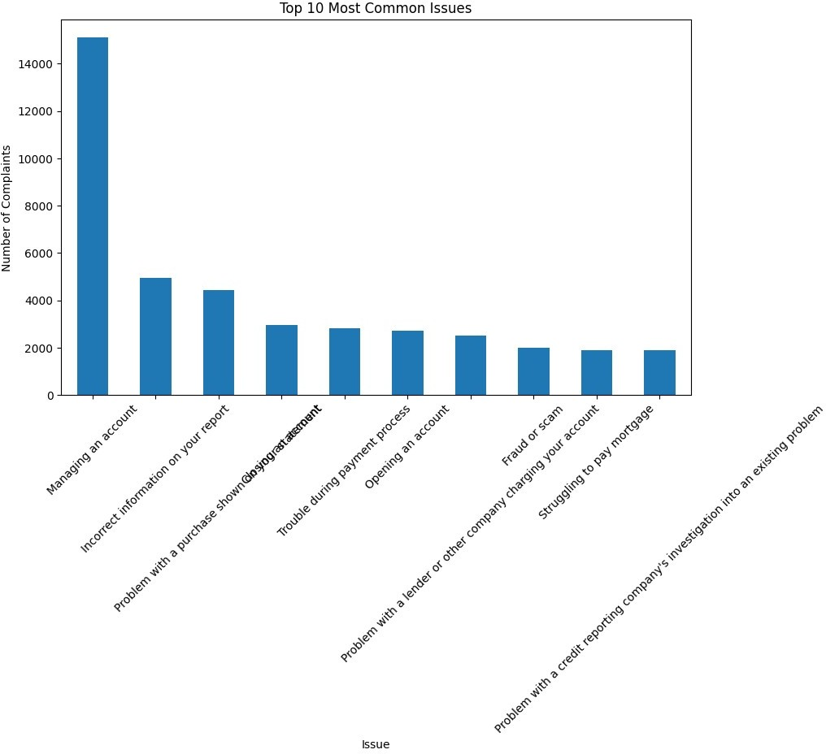

Slide 29
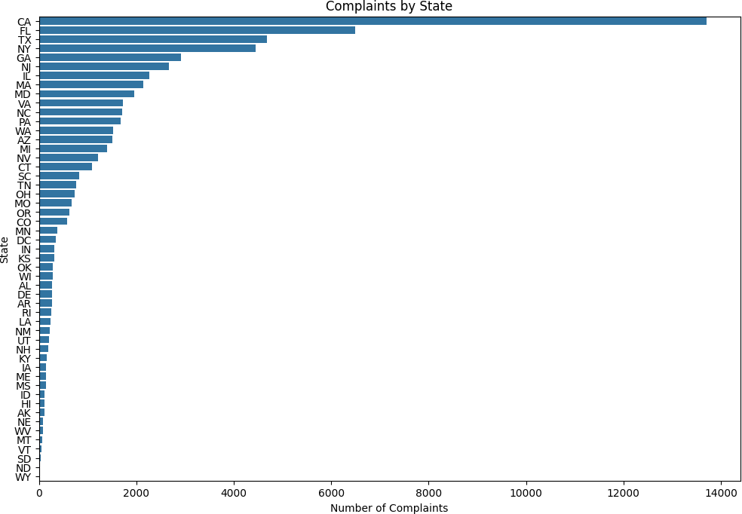
import pandas as pd
import matplotlib.pyplot as plt import seaborn as sns
# Read the data from the Excel file
df = pd.read_excel('/content/Consumer_Complaints.xlsx')
# Data Exploration
print(df.head())
print(df.info())
# Convert 'Date received' to datetime format
df['Date received'] = pd.to_datetime(df['Date received'])
# Data Analysis
# Count complaints by year and month
df['YearMonth'] = df['Date received'].dt.to_period('M') complaints_by_month = df['YearMonth'].value_counts().sort_index()
# Count most common issues
top_issues = df['Issue'].value_counts().head(10)
# Count complaints by state
complaints_by_state = df['State'].value_counts()

Slide 30
# Data Visualization
# Complaints over time plt.figure(figsize=(10, 6)) complaints_by_month.plot(kind='line') plt.title('Complaints Over Time') plt.xlabel('Year-Month') plt.ylabel('Number of Complaints') plt.xticks(rotation=45) plt.grid(True)
plt.show()
# Top 10 most common issues plt.figure(figsize=(10, 6)) top_issues.plot(kind='bar') plt.title('Top 10 Most Common Issues') plt.xlabel('Issue')
plt.ylabel('Number of Complaints') plt.xticks(rotation=45) plt.grid(axis='y')
plt.show()
# Complaints by state
plt.figure(figsize=(12, 8))
sns.barplot(x=complaints_by_state.values, y=complaints_by_state.index, orient='h')
plt.title('Complaints by State') plt.xlabel('Number of Complaints') plt.ylabel('State') plt.grid(axis='x')
plt.show()
Complaint ID Su 0 4848023 |  | bmitted via Date submitted D Referral 2021-10-24 |  | ate received S 2021-10-27 | tate \ NY
1 | 3621464 | Web | 2020-04-24 | 2020-04-24 | FL
2 | 5818349 | Web | 2022-07-27 | 2022-07-27 | CA
3 | 7233015 | Referral | 2023-07-10 | 2023-07-11 | CA
4 | 5820224 | Referral | 2022-07-27 | 2022-07-28 | VA
Product \
Mortgage
Money transfer, virtual currency, or money ser...
Credit reporting, credit repair services, or o...
Credit card or prepaid card
Credit card or prepaid card
0
1
2
Sub-product \ Conventional home mortgage
Refund anticipation check
Credit reporting

Slide 31
General-purpose prepaid card
General-purpose credit card or charge card
Issue \
Applying for a mortgage or refinancing an exis...
Lost or stolen check
Incorrect information on your report
Problem getting a card or closing an account
Closing your account
Sub-issue \
NaN
NaN
Account information incorrect
Trouble getting, activating, or registering a ...
Company closed your account
Company public response \
Company has responded to the consumer and the ...
Company has responded to the consumer and the ...
Company has responded to the consumer and the ...
NaN
Company has responded to the consumer and the ...
Company response to consumer Timely response?
Closed with explanation
Closed with monetary relief
Closed with explanation
In progress
Closed with explanation
Yes
Yes
Yes
NaN
<class 'pandas.core.frame.DataFrame'> RangeIndex: 62516 entries, 0 to 62515 Data columns (total 12 columns):
Yes
# Column Non-Null Count
Dtype
0 Complaint ID 62516 non-null
int64
1 Submitted via 62516 non-null
object
Date submitted
Date received
62516 non-null
62516 non-null
datetime64[ns]
State
Product
Sub-product
Issue
Sub-issue
Company public response
Company response to consumer
62516 non-null
62516 non-null
62509 non-null
62516 non-null
51658 non-null
60341 non-null
62516 non-null
datetime64[ns]
object object object object object
object
11 Timely response? 61022 non-null
object object
dtypes: datetime64[ns](2), int64(1), object(9) memory usage: 5.7+ MB
None

Slide 32
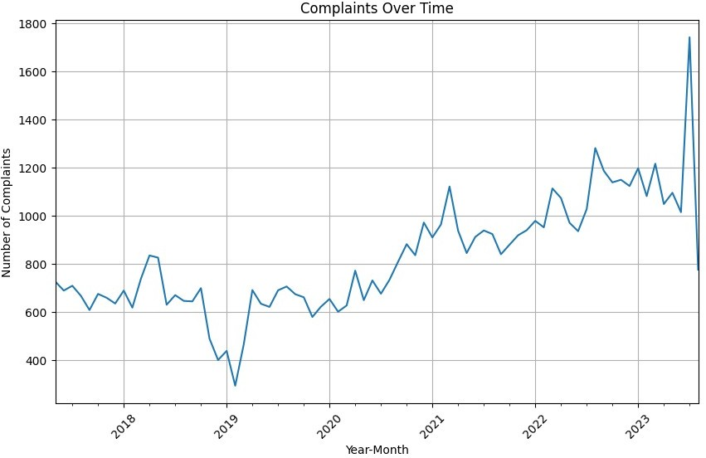

Slide 33


Slide 34

# Count complaints by product
complaints_by_product = df['Product'].value_counts()
# Data Visualization - Pie chart for complaints by product
plt.figure(figsize=(8, 8))
plt.pie(complaints_by_product, labels=complaints_by_product.index, autopct='%1.1f%%', startangle=140)
plt.title('Distribution of Complaints by Product')
plt.axis('equal') # Equal aspect ratio ensures that pie is drawn as a circle.
plt.show()
# Written Findings for Complaints by Product print("Written Findings:") print("Complaints by Product:") print(complaints_by_product)

Slide 35
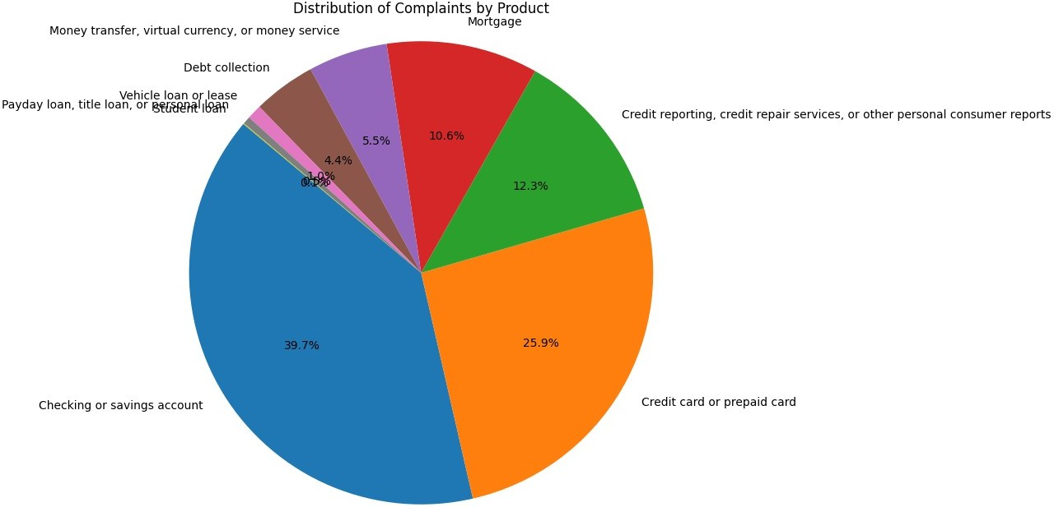
Written Findings:
Complaints by Product:
Product
Checking or savings account 24814
Credit card or prepaid card 16197
Credit reporting, credit repair services, or other personal consumer reports 7710
Mortgage 6601
Money transfer, virtual currency, or money service 3453
Debt collection 2736
Vehicle loan or lease 633
Payday loan, title loan, or personal loan 333
Student loan 39
Name: count, dtype: int64
# Count complaints by sub-product
complaints_by_subproduct = df['Sub-product'].value_counts().head(10)
# Data Visualization - Horizontal bar chart for complaints by sub- product
plt.figure(figsize=(10, 6)) sns.barplot(x=complaints_by_subproduct.values,

Slide 36
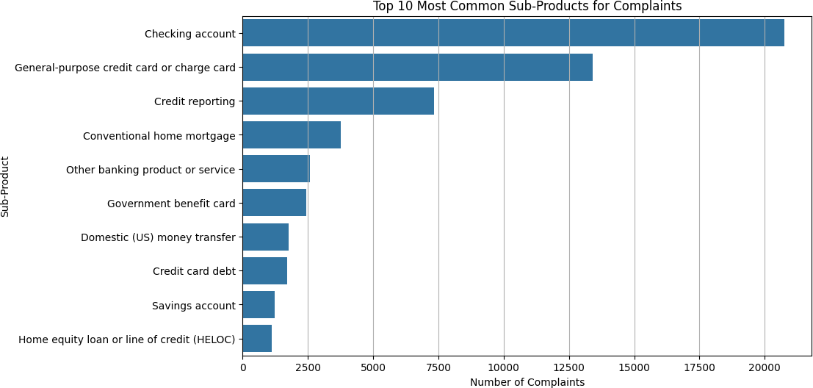
y=complaints_by_subproduct.index, orient='h') plt.title('Top 10 Most Common Sub-Products for Complaints') plt.xlabel('Number of Complaints')
plt.ylabel('Sub-Product') plt.grid(axis='x') plt.show()
# Written Findings for Complaints by Sub-Product
print("\nWritten Findings:")
print("Top 10 Most Common Sub-Products for Complaints:") print(complaints_by_subproduct)
Written Findings:
Top 10 Most Common Sub-Products for Complaints: Sub-product
Checking account
General-purpose credit card or charge card Credit reporting
Conventional home mortgage
Other banking product or service Government benefit card
Domestic (US) money transfer Credit card debt
Savings account
Home equity loan or line of credit (HELOC)
Name: count, dtype: int64
# Count complaints by company response
20768
13404
7340
3767
2568
2429
1773
1697
1239
1105
company_response_counts = df['Company response to consumer'].value_counts()

Slide 37
# Data Visualization - Bar chart for complaints by company response
plt.figure(figsize=(10, 6))
sns.countplot(data=df, x='Company response to consumer', order=company_response_counts.index) plt.title('Complaints by Company Response') plt.xlabel('Company Response')
plt.ylabel('Number of Complaints') plt.xticks(rotation=45) plt.grid(axis='y')
plt.show()
# Written Findings for Complaints by Company Response
print("Written Findings:") print("Complaints by Company Response:") print(company_response_counts)
# Count complaints by timely response
timely_response_counts = df['Timely response?'].value_counts()
# Data Visualization - Pie chart for complaints by timely response
plt.figure(figsize=(8, 8))
plt.pie(timely_response_counts, labels=timely_response_counts.index, autopct='%1.1f%%', startangle=140)
plt.title('Distribution of Complaints by Timely Response') plt.axis('equal') # Equal aspect ratio ensures that pie is drawn as a circle.
plt.show()
# Written Findings for Complaints by Timely Response
print("\nWritten Findings:")
print("Distribution of Complaints by Timely Response:") print(timely_response_counts)
# Count complaints by company public response company_public_response_counts = df['Company public response'].value_counts()
# Data Visualization - Horizontal bar chart for complaints by company public response
plt.figure(figsize=(10, 6)) sns.barplot(x=company_public_response_counts.values, y=company_public_response_counts.index, orient='h') plt.title('Complaints by Company Public Response') plt.xlabel('Number of Complaints') plt.ylabel('Company Public Response') plt.grid(axis='x')
plt.show()
# Written Findings for Complaints by Company Public Response

Slide 38
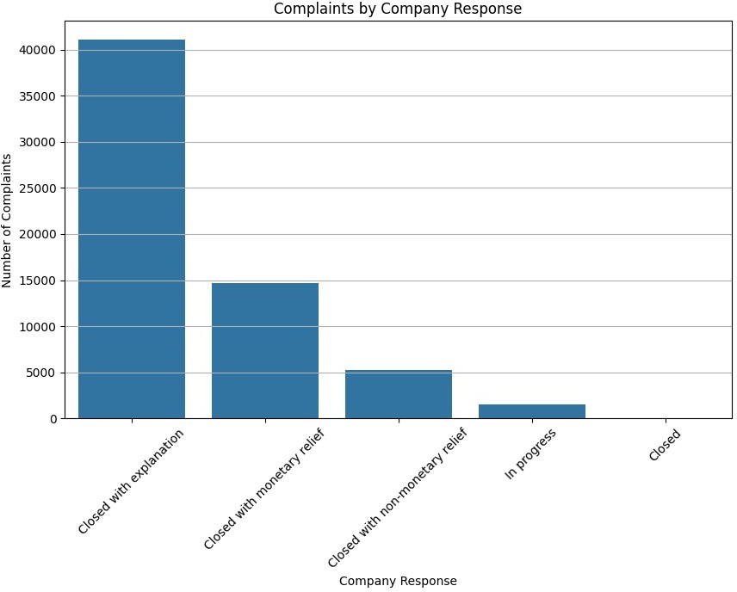
print("\nWritten Findings:")
print("Complaints by Company Public Response:") print(company_public_response_counts)
Written Findings:
Complaints by Company Response: Company response to consumer Closed with explanation
Closed with monetary relief Closed with non-monetary relief In progress
Closed
Name: count, dtype: int64
41044
14697
5273
1494
8

Slide 39
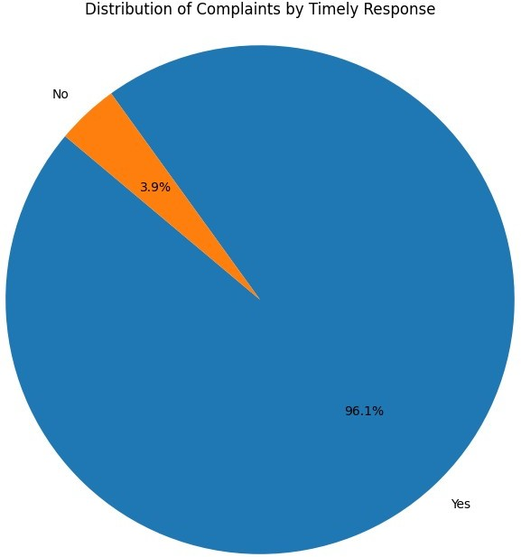
Written Findings:
Distribution of Complaints by Timely Response: Timely response?
Yes 58619
No 2403
Name: count, dtype: int64

Slide 40
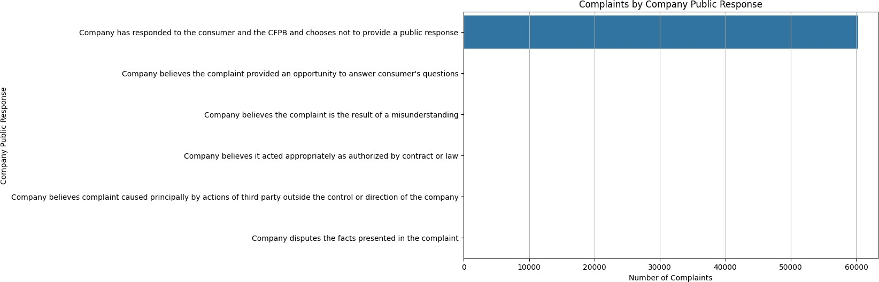
Written Findings:
Complaints by Company Public Response:
Company public response
Company has responded to the consumer and the CFPB and chooses not to
provide a public response 60311
Company believes the complaint provided an opportunity to answer
consumer's questions 12
Company believes the complaint is the result of a misunderstanding
7
Company believes it acted appropriately as authorized by contract or
law 6
Company believes complaint caused principally by actions of third
party outside the control or direction of the company 3
Company disputes the facts presented in the complaint
2
Name: count, dtype: int64
import matplotlib.pyplot as plt import seaborn as sns
# Count complaints by state
complaints_by_state = df['State'].value_counts()
# Data Visualization - Bar chart for complaints by state
plt.figure(figsize=(12, 8))
sns.barplot(x=complaints_by_state.values, y=complaints_by_state.index, orient='h')
plt.title('Complaints by State') plt.xlabel('Number of Complaints') plt.ylabel('State') plt.grid(axis='x')
plt.show()
# Written Findings for Complaints by State print("\nWritten Findings:") print("Complaints by State:")

Slide 41
print(complaints_by_state)
# Count complaints by product
complaints_by_product = df['Product'].value_counts()
# Data Visualization - Pie chart for complaints by product
plt.figure(figsize=(8, 8))
plt.pie(complaints_by_product, labels=complaints_by_product.index, autopct='%1.1f%%', startangle=140)
plt.title('Distribution of Complaints by Product')
plt.axis('equal') # Equal aspect ratio ensures that pie is drawn as a circle.
plt.show()
# Written Findings for Complaints by Product print("\nWritten Findings:") print("Complaints by Product:") print(complaints_by_product)
# Count complaints by issue
complaints_by_issue = df['Issue'].value_counts().head(10)
# Data Visualization - Horizontal bar chart for complaints by issue
plt.figure(figsize=(10, 6))
sns.barplot(x=complaints_by_issue.values, y=complaints_by_issue.index, orient='h')
plt.title('Top 10 Most Common Issues for Complaints') plt.xlabel('Number of Complaints') plt.ylabel('Issue')
plt.grid(axis='x') plt.show()
# Written Findings for Complaints by Issue
print("\nWritten Findings:")
print("Top 10 Most Common Issues for Complaints:") print(complaints_by_issue)
# Count complaints by company response company_response_counts = df['Company response to consumer'].value_counts()
# Data Visualization - Bar chart for complaints by company response
plt.figure(figsize=(10, 6))
sns.countplot(data=df, x='Company response to consumer', order=company_response_counts.index) plt.title('Complaints by Company Response') plt.xlabel('Company Response')
plt.ylabel('Number of Complaints') plt.xticks(rotation=45) plt.grid(axis='y')

Slide 42
plt.show()
# Written Findings for Complaints by Company Response
print("\nWritten Findings:") print("Complaints by Company Response:") print(company_response_counts)
Written Findings: Complaints by State:
State
CA | 13709
FL | 6488
TX | 4686
NY | 4442
GA | 2921
NJ | 2664
IL | 2270
MA | 2141
MD | 1959
VA | 1731
NC | 1717
PA | 1676

Slide 43
WA AZ MI NV CT SC TN OH MO OR CO MN DC IN KS OK WI AL DE AR RI LA NM UT NH KY IA ME MS ID HI AK NE WV MT VT SD ND
1530
1516
1395
1221
1097
822
758
731
674
620
576
382
353
316
311
293
291
269
268
266
249
246
219
201
199
157
154
152
141
122
111
110
83
77
70
54
34
22
WY 22
Name: count, dtype: int64

Slide 44
Written Findings:
Complaints by Product:
Product
Checking or savings account 24814
Credit card or prepaid card 16197
Credit reporting, credit repair services, or other personal consumer reports 7710
Mortgage 6601
Money transfer, virtual currency, or money service 3453
Debt collection 2736
Vehicle loan or lease 633
Payday loan, title loan, or personal loan 333
Student loan 39
Name: count, dtype: int64

Slide 45
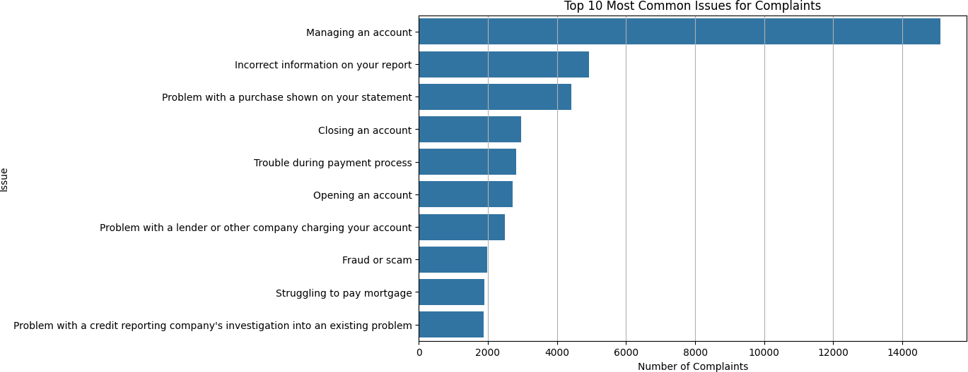
Written Findings:
Top 10 Most Common Issues for Complaints:
Issue
Managing an account 15109
Incorrect information on your report 4931
Problem with a purchase shown on your statement 4415
Closing an account 2953
Trouble during payment process 2827
Opening an account 2725
Problem with a lender or other company charging your account 2493
Fraud or scam 1987
Struggling to pay mortgage 1904
Problem with a credit reporting company's investigation into an existing problem 1876
Name: count, dtype: int64

Slide 46
Written Findings:
Complaints by Company Response: Company response to consumer Closed with explanation
Closed with monetary relief Closed with non-monetary relief In progress
Closed
Name: count, dtype: int64
import pandas as pd
import matplotlib.pyplot as plt import seaborn as sns
41044
14697
5273
1494
8
# Provided data
data = [
["Checking account", "Managing an account", "Deposits and withdrawals", "Company has responded to the consumer and the CFPB and

Slide 47
chooses not to provide a public response", "Closed with explanation", "Yes"],
["General-purpose credit card or charge card", "Fees or interest", "Problem with fees", "Company has responded to the consumer and the CFPB and chooses not to provide a public response", "Closed with monetary relief", "Yes"],
["Conventional home mortgage", "Trouble during payment process", "", "Company has responded to the consumer and the CFPB and chooses not to provide a public response", "Closed with monetary relief", "Yes"],
# Add the rest of the data here...
]
# Define column names
columns = ['Product', 'Issue', 'Sub-issue', 'Company_response', 'Consumer_response', 'Timely_response']
# Create a DataFrame
df = pd.DataFrame(data, columns=columns)
# Data Exploration
print(df.head())
print(df.info())
# Data Analysis
# Count complaints by product
complaints_by_product = df['Product'].value_counts()
# Count complaints by issue
complaints_by_issue = df['Issue'].value_counts()
# Count complaints by company response
complaints_by_company_response = df['Company_response'].value_counts()
# Count complaints by consumer response complaints_by_consumer_response = df['Consumer_response'].value_counts()
# Count complaints by timely response
complaints_by_timely_response = df['Timely_response'].value_counts()
# Data Visualization
# Complaints by product plt.figure(figsize=(10, 6)) sns.barplot(x=complaints_by_product.index, y=complaints_by_product.values) plt.title('Complaints by Product') plt.xlabel('Product')
plt.ylabel('Number of Complaints') plt.xticks(rotation=45)

Slide 48
plt.show()
# Complaints by issue
plt.figure(figsize=(10, 6))
sns.barplot(x=complaints_by_issue.index, y=complaints_by_issue.values) plt.title('Complaints by Issue')
plt.xlabel('Issue') plt.ylabel('Number of Complaints') plt.xticks(rotation=45)
plt.show()
# Complaints by company response plt.figure(figsize=(8, 5)) complaints_by_company_response.plot(kind='bar') plt.title('Complaints by Company Response') plt.xlabel('Company Response') plt.ylabel('Number of Complaints') plt.xticks(rotation=45)
plt.show()
# Complaints by consumer response plt.figure(figsize=(8, 5)) complaints_by_consumer_response.plot(kind='bar') plt.title('Complaints by Consumer Response') plt.xlabel('Consumer Response') plt.ylabel('Number of Complaints') plt.xticks(rotation=45)
plt.show()
# Complaints by timely response plt.figure(figsize=(8, 5)) complaints_by_timely_response.plot(kind='bar') plt.title('Complaints by Timely Response') plt.xlabel('Timely Response') plt.ylabel('Number of Complaints') plt.xticks(rotation=45)
plt.show()
Product
Issue \
0 Checking account
Managing an
account
1 General-purpose credit card or charge card Fees or
interest
2 Conventional home mortgage Trouble during payment process
Sub-issue \
0 Deposits and withdrawals 1
Problem with fees

Slide 49
2
Company_response \
Company has responded to the consumer and the ...
Company has responded to the consumer and the ...
Company has responded to the consumer and the ...
Consumer_response Timely_response
0
Closed with explanation Yes
Closed with monetary relief Yes
Closed with monetary relief Yes
<class 'pandas.core.frame.DataFrame'> RangeIndex: 3 entries, 0 to 2
Data columns (total 6 columns):
# Column Non-Null Count
Dtype
0 Product | 3 non-null |  | object
1 Issue | 3 non-null |  | object
2 Sub-issue | 3 non-null |  | object
3 Company_response | 3 non-null |  | object
4 Consumer_response | 3 non-null |  | object
5 Timely_response | 3 non-null |  | object
dtypes: object(6)
memory usage: 272.0+ bytes None

Slide 50
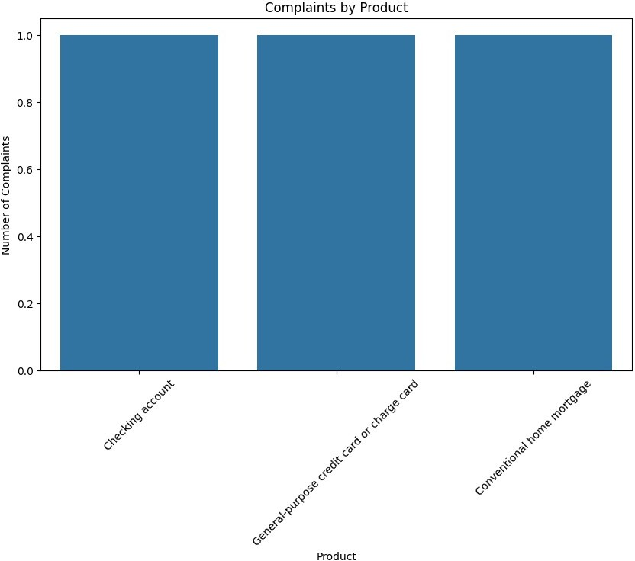

Slide 51
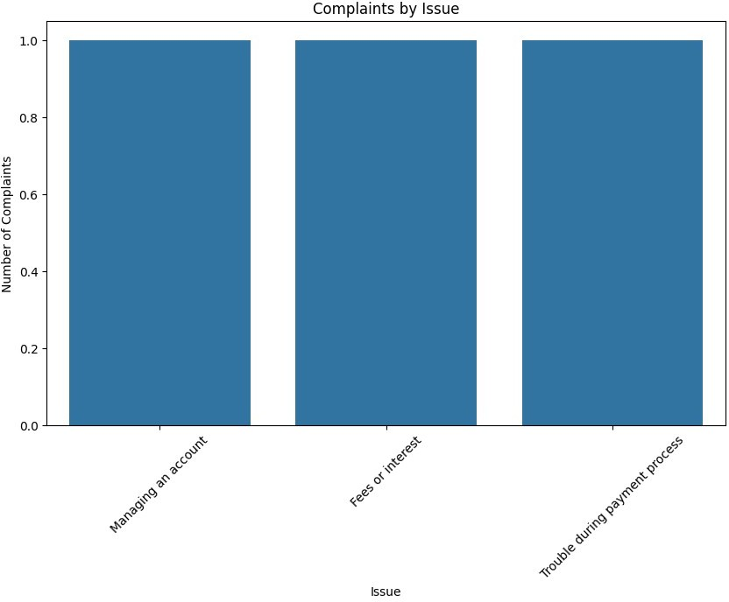

Slide 52
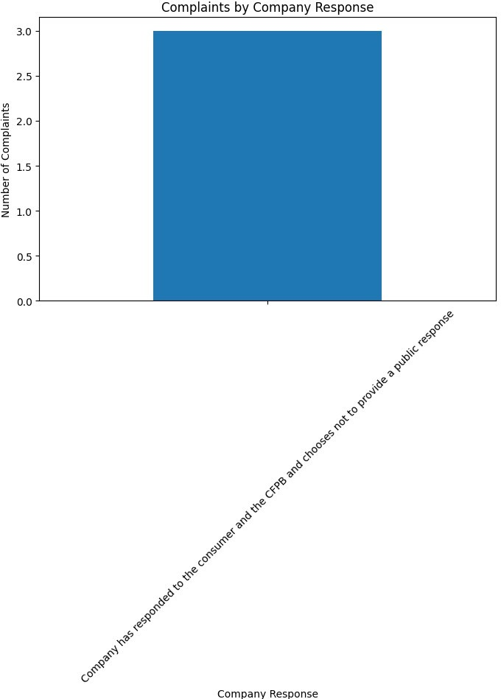

Slide 53
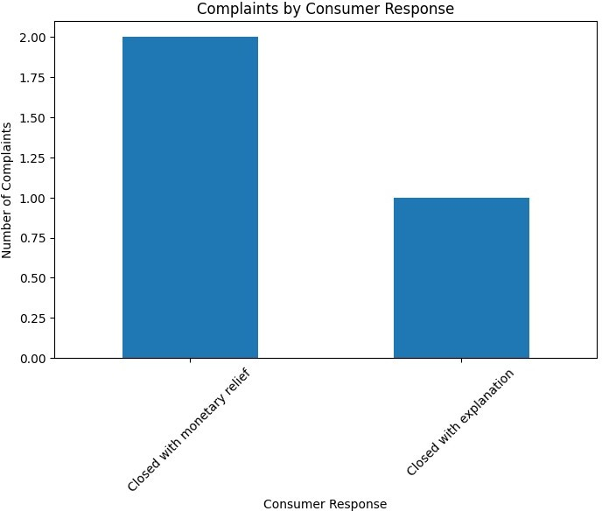

Slide 54
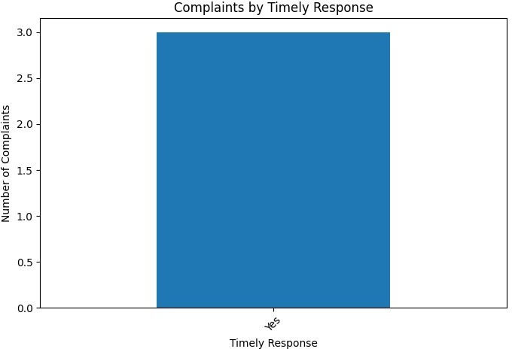
# 1. Complaints by Product print("1. Complaints by Product:") print(complaints_by_product) print()
# 2. Complaints by Issue print("2. Complaints by Issue:") print(complaints_by_issue) print()
# 3. Company Response to Complaints print("3. Company Response to Complaints:") print(complaints_by_company_response) print()
# 4. Consumer Response to Resolutions print("4. Consumer Response to Resolutions:") print(complaints_by_consumer_response) print()
# 5. Timeliness of Responses
print("5. Timeliness of Responses:")

Slide 55
print(complaints_by_timely_response) print()
1. Complaints by Product:
Product
Checking account
General-purpose credit card or charge card Conventional home mortgage
1
1
1
Name: count, dtype: int64
2. Complaints by Issue:
Issue
Managing an account Fees or interest
Trouble during payment process
1
1
1
Name: count, dtype: int64
3. Company Response to Complaints:
Company_response
Company has responded to the consumer and the CFPB and chooses not to
provide a public response 3 Name: count, dtype: int64
4. Consumer Response to Resolutions:
Consumer_response
Closed with monetary relief Closed with explanation
2
1
Name: count, dtype: int64
5. Timeliness of Responses:
Timely_response
Yes 3
Name: count, dtype: int64
import pandas as pd
df = pd.read_excel('/content/Consumer_Complaints.xlsx')
# Assuming df is your DataFrame
print(df.columns)
Index(['Complaint ID', 'Submitted via', 'Date submitted', 'Date
received',
'State', 'Product', 'Sub-product', 'Issue', 'Sub-issue',
'Company public response', 'Company response to consumer',
'Timely response?'],
dtype='object')
import pandas as pd
# Read data from CSV file into a DataFrame
df = pd.read_excel('/content/Consumer_Complaints.xlsx')
# Replace

Slide 56
'your_file.csv' with the actual file path
# Count complaints by product
complaints_by_product = df['Product'].value_counts()
# Print the number of complaints by product print("1. Complaints by Product:") print(complaints_by_product)
print()
# Count complaints by issue
complaints_by_issue = df['Issue'].value_counts()
# Print the number of complaints by issue print("2. Complaints by Issue:") print(complaints_by_issue)
print()
# Count complaints by company response complaints_by_company_response = df['Company response to consumer'].value_counts()
# Print the number of complaints by company response print("3. Company Response to Complaints:") print(complaints_by_company_response)
print()
# Count complaints by consumer response complaints_by_consumer_response = df['Company public response'].value_counts()
# Print the number of complaints by consumer response print("4. Consumer Response to Resolutions:") print(complaints_by_consumer_response)
print()
# Count complaints by timely response
complaints_by_timely_response = df['Timely response?'].value_counts()
# Print the number of complaints by timely response print("5. Timeliness of Responses:") print(complaints_by_timely_response)
print()
1. Complaints by Product:
Product
Checking or savings account
24814
Credit card or prepaid card
16197

Slide 57
Credit reporting, credit repair services, or other personal consumer reports 7710
Mortgage
6601
Money transfer, virtual currency, or money service
3453
Debt collection
2736
Vehicle loan or lease
633
Payday loan, title loan, or personal loan
333
Student loan
39
Name: count, dtype: int64
2. Complaints by Issue:
Issue
Managing an account |  | 15109
Incorrect information on your report |  | 4931
Problem with a purchase shown on your | statement | 4415
Closing an account |  | 2953
Trouble during payment process |  | 2827
... Can't stop withdrawals from your bank account 2 Was approved for a loan, but didn't receive money 1 Vehicle was damaged or destroyed the vehicle 1 Problem with an overdraft 1 Vehicle was repossessed or sold the vehicle 1
Name: count, Length: 76, dtype: int64
3. Company Response to Complaints:
Company response to consumer
Closed with explanation | 41044
Closed with monetary relief | 14697
Closed with non-monetary relief | 5273
In progress | 1494
Closed | 8
Name: count, dtype: int64
4. Consumer Response to Resolutions:
Company public response
Company has responded to the consumer and the CFPB and chooses not to
provide a public response 60311
Company believes the complaint provided an opportunity to answer
consumer's questions 12
Company believes the complaint is the result of a misunderstanding
7
Company believes it acted appropriately as authorized by contract or
law 6

Slide 58
Company believes complaint caused principally by actions of third party outside the control or direction of the company 3
Company disputes the facts presented in the complaint
2
Name: count, dtype: int64
5. Timeliness of Responses:
Timely response?
Yes No
58619
2403
Name: count, dtype: int64
import pandas as pd
# Read data from CSV file into a DataFrame
df = pd.read_excel('/content/Consumer_Complaints.xlsx')
'your_file.csv' with the actual file path
# Replace
# Count complaints by product
complaints_by_product = df['Product'].value_counts()
# Print the number of complaints by product print("1. Complaints by Product:") print(complaints_by_product)
print()
# Count complaints by issue
complaints_by_issue = df['Issue'].value_counts()
# Print the number of complaints by issue print("2. Complaints by Issue:") print(complaints_by_issue)
print()
# Count complaints by company response complaints_by_company_response = df['Company response to consumer'].value_counts()
# Print the number of complaints by company response print("3. Company Response to Complaints:") print(complaints_by_company_response)
print()
# Count complaints by consumer response complaints_by_consumer_response = df['Company public response'].value_counts()
# Print the number of complaints by consumer response print("4. Consumer Response to Resolutions:") print(complaints_by_consumer_response)

Slide 59
print()
# Count complaints by timely response
complaints_by_timely_response = df['Timely response?'].value_counts()
# Print the number of complaints by timely response print("5. Timeliness of Responses:") print(complaints_by_timely_response)
print()
# Compare product and issue product_issue_comparison = df.groupby(['Product', 'Issue']).size().unstack(fill_value=0)
print("6. Product vs Issue Comparison:") print(product_issue_comparison)
print()
# Compare product and timely response product_timely_response_comparison = df.groupby(['Product', 'Timely response?']).size().unstack(fill_value=0)
print("7. Product vs Timely Response Comparison:") print(product_timely_response_comparison)
print()
# Compare company response to consumer and timely response company_timely_response_comparison = df.groupby(['Company response to consumer', 'Timely response?']).size().unstack(fill_value=0) print("8. Company Response vs Timely Response Comparison:") print(company_timely_response_comparison)
print()
1. Complaints by Product:
Product
Checking or savings account
24814
Credit card or prepaid card
16197
Credit reporting, credit repair services, or other personal consumer
reports 7710
Mortgage
6601
Money transfer, virtual currency, or money service
3453
Debt collection
2736
Vehicle loan or lease
633
Payday loan, title loan, or personal loan
333
Student loan

Slide 60
39
Name: count, dtype: int64
2. Complaints by Issue:
Issue
Managing an account
Incorrect information on your report
Problem with a purchase shown on your statement Closing an account
Trouble during payment process
15109
4931
4415
2953
2827
...
Can't stop withdrawals from your bank account
Was approved for a loan, but didn't receive money Vehicle was damaged or destroyed the vehicle Problem with an overdraft
Vehicle was repossessed or sold the vehicle
2
1
1
1
1
Name: count, Length: 76, dtype: int64
3. Company Response to Complaints:
Company response to consumer
Closed with explanation Closed with monetary relief
Closed with non-monetary relief In progress
Closed
41044
14697
5273
1494
8
Name: count, dtype: int64
4. Consumer Response to Resolutions:
Company public response
Company has responded to the consumer and the CFPB and chooses not to
provide a public response 60311
Company believes the complaint provided an opportunity to answer
consumer's questions 12
Company believes the complaint is the result of a misunderstanding
7
Company believes it acted appropriately as authorized by contract or
law 6
Company believes complaint caused principally by actions of third
party outside the control or direction of the company 3
Company disputes the facts presented in the complaint
2
Name: count, dtype: int64
5. Timeliness of Responses:
Timely response?
Yes No
58619
2403
Name: count, dtype: int64
6. Product vs Issue Comparison:

Slide 61
Issue Advertising \
Product
Checking or savings account Credit card or prepaid card
Credit reporting, credit repair services, or ot... Debt collection
Money transfer, virtual currency, or money service Mortgage
Payday loan, title loan, or personal loan Student loan
Vehicle loan or lease
0
14
0
0
0
0
0
0
0
Issue Advertising and
marketing, including promotional offers \
Product
Checking or savings account 0
Credit card or prepaid card
487
Credit reporting, credit repair services, or ot...
0
Debt collection
0
Money transfer, virtual currency, or money service
0
Mortgage
0
Payday loan, title loan, or personal loan
0
Student loan
0
Vehicle loan or lease
0
Issue Applying for a
mortgage or refinancing an existing mortgage \
Product
Checking or savings account
0
Credit card or prepaid card
0
Credit reporting, credit repair services, or ot...
0
Debt collection
0
Money transfer, virtual currency, or money service
0
Mortgage

Slide 62
1017
Payday loan, title loan, or personal loan
0
Student loan
0
Vehicle loan or lease
0
Issue Attempts to
collect debt not owed \
Product
Checking or savings account
0
Credit card or prepaid card
0
Credit reporting, credit repair services, or ot...
0
Debt collection
1351
Money transfer, virtual currency, or money service
0
Mortgage
0
Payday loan, title loan, or personal loan
0
Student loan
0
Vehicle loan or lease
0
Issue Can't contact
lender or servicer \
Product
Checking or savings account 0
Credit card or prepaid card
0
Credit reporting, credit repair services, or ot...
0
Debt collection
0
Money transfer, virtual currency, or money service
0
Mortgage
0
Payday loan, title loan, or personal loan
8
Student loan

Slide 63
0
Vehicle loan or lease
0
Issue
Can't stop
withdrawals from your bank account \
Product
Checking or savings account
0
Credit card or prepaid card
0
Credit reporting, credit repair services, or ot...
0
Debt collection
0
Money transfer, virtual currency, or money service
0
Mortgage
0
Payday loan, title loan, or personal loan
2
Student loan
0
Vehicle loan or lease
0
Issue
Charged fees or
interest you didn't expect \
Product
Checking or savings account
0
Credit card or prepaid card
0
Credit reporting, credit repair services, or ot...
0
Debt collection
0
Money transfer, virtual currency, or money service
0
Mortgage
0
Payday loan, title loan, or personal loan
44
Student loan
0
Vehicle loan or lease
0

Slide 64
Issue
Closing an account
\
Product
Checking or savings account 2953
Credit card or prepaid card 0
Credit reporting, credit repair services, or ot... 0
Debt collection 0
Money transfer, virtual currency, or money service 0
Mortgage 0
Payday loan, title loan, or personal loan 0
Student loan 0
Vehicle loan or lease 0
Issue Closing on a
mortgage \
Product
Checking or savings account
0
Credit card or prepaid card
0
Credit reporting, credit repair services, or ot...
0
Debt collection
0
Money transfer, virtual currency, or money service
0
Mortgage
610
Payday loan, title loan, or personal loan
0
Student loan
0
Vehicle loan or lease
0
Issue
Closing your
account ... \ Product
...

Slide 65
Checking or savings account
0 ...
Credit card or prepaid card
1077 ...
Credit reporting, credit repair services, or ot...
0 ...
Debt collection
0 ...
Money transfer, virtual currency, or money service
0 ...
Mortgage
0 ...
Payday loan, title loan, or personal loan
0 ...
Student loan
0 ...
Vehicle loan or lease
0 ...
Issue
Trouble using your
card \
Product
Checking or savings account 0
Credit card or prepaid card
346
Credit reporting, credit repair services, or ot...
0
Debt collection
0
Money transfer, virtual currency, or money service
0
Mortgage
0
Payday loan, title loan, or personal loan
0
Student loan
0
Vehicle loan or lease
0
Issue Unable to get your
credit report or credit score \
Product
Checking or savings account 5
Credit card or prepaid card
6

Slide 66
Credit reporting, credit repair services, or ot...
46
Debt collection
0
Money transfer, virtual currency, or money service
0
Mortgage
4
Payday loan, title loan, or personal loan
0
Student loan
0
Vehicle loan or lease
0
Issue Unauthorized
transactions or other transaction problem \
Product
Checking or savings account
0
Credit card or prepaid card
0
Credit reporting, credit repair services, or ot...
0
Debt collection
0
Money transfer, virtual currency, or money service
155
Mortgage
0
Payday loan, title loan, or personal loan
0
Student loan
0
Vehicle loan or lease
0
Issue Unexpected or
other fees \
Product
Checking or savings account 0
Credit card or prepaid card
570
Credit reporting, credit repair services, or ot...
2
Debt collection
0

Slide 67
Money transfer, virtual currency, or money service
90
Mortgage
0
Payday loan, title loan, or personal loan
0
Student loan
0
Vehicle loan or lease
0
Issue Vehicle was
damaged or destroyed the vehicle \
Product
Checking or savings account
0
Credit card or prepaid card
0
Credit reporting, credit repair services, or ot...
0
Debt collection
0
Money transfer, virtual currency, or money service
0
Mortgage
0
Payday loan, title loan, or personal loan
1
Student loan
0
Vehicle loan or lease
0
Issue Vehicle was
repossessed or sold the vehicle \
Product
Checking or savings account 0
Credit card or prepaid card
0
Credit reporting, credit repair services, or ot...
0
Debt collection
0
Money transfer, virtual currency, or money service
0
Mortgage
0

Slide 68
Payday loan, title loan, or personal loan 1
Student loan
0
Vehicle loan or lease
0
Issue Was approved for a
loan, but didn't receive money \
Product
Checking or savings account
0
Credit card or prepaid card
0
Credit reporting, credit repair services, or ot...
0
Debt collection
0
Money transfer, virtual currency, or money service
0
Mortgage
0
Payday loan, title loan, or personal loan
1
Student loan
0
Vehicle loan or lease
0
Issue Was approved for a
loan, but didn't receive the money \
Product
Checking or savings account 0
Credit card or prepaid card
0
Credit reporting, credit repair services, or ot...
0
Debt collection
0
Money transfer, virtual currency, or money service
0
Mortgage
0
Payday loan, title loan, or personal loan
4
Student loan
0

Slide 69
Vehicle loan or lease
0
Issue Written
notification about debt \
Product
Checking or savings account
0
Credit card or prepaid card
0
Credit reporting, credit repair services, or ot...
0
Debt collection
487
Money transfer, virtual currency, or money service
0
Mortgage
0
Payday loan, title loan, or personal loan
0
Student loan
0
Vehicle loan or lease
0
Issue Wrong amount
charged or received
Product
Checking or savings account 0
Credit card or prepaid card
0
Credit reporting, credit repair services, or ot...
0
Debt collection
0
Money transfer, virtual currency, or money service
50
Mortgage
0
Payday loan, title loan, or personal loan
0
Student loan
0
Vehicle loan or lease
0
[9 rows x 76 columns]

Slide 70
7. Product vs Timely Response Comparison:
Timely response? | No | Yes
Product
Checking or savings account | 867 | 23237
Credit card or prepaid card | 689 | 15096
Credit reporting, credit repair services, or ot... | 475 | 7045
Debt collection | 173 | 2514
Money transfer, virtual currency, or money service | 140 | 3244
Mortgage | 16 | 6539
Payday loan, title loan, or personal loan | 10 | 321
Student loan | 0 | 39
Vehicle loan or lease | 33 | 584
8. Company Response vs Timely Response Comparison: Timely response? No Yes
Company response to consumer
Closed 8
Closed with explanation 1527 Closed with monetary relief 690 Closed with non-monetary relief 178
0
39517
14007
5095
import pandas as pd
# Read data from CSV file into a DataFrame
df = pd.read_excel('/content/Consumer_Complaints.xlsx')
'your_file.csv' with the actual file path
# Replace
# List of columns to compare
columns_to_compare = ['Submitted via', 'Date submitted', 'Date received', 'State',
'Sub-product', 'Issue', 'Sub-issue', 'Company
public response',
'Company response to consumer', 'Timely
response?']
# Define the target column
target_column = 'Product'
# Compare each column with the target column
for column in columns_to_compare: comparison = df.groupby([column,
target_column]).size().unstack(fill_value=0)
print(f"Comparison between '{column}' and '{target_column}':") print(comparison)
print()
Comparison between 'Submitted via' and 'Product':
Product Checking or savings account Credit card or prepaid

Slide 71
card \ Submitted via
Email 2
Fax 38
Phone 1174
Postal mail 383
Referral 2270
Web 12313
Web Referral 17
0
91
2565
422
6183
15492
61
Product Credit reporting, credit repair services, or other personal consumer reports \
Submitted via
Email
0
Fax
19
Phone
115
Postal mail
80
Referral
117
Web
7379
Web Referral
0
Product
Debt collection \
Submitted via
Email | 0
Fax | 26
Phone | 52
Postal mail | 81
Referral | 119
Web | 2456
Web Referral | 2
Product Money transfer, virtual currency, or money service
Mortgage \
Submitted via

Slide 72
Email 0
Fax 56
Phone 536
Postal mail 298
Referral 1785
Web 3918
Web Referral 8
0
1
164
16
114
3157
1
Product
Payday loan, title loan, or personal loan Student loan
\
Submitted via
Email 0 0
Fax 2 0
Phone 38 5
Postal mail 24 0
Referral 76 4
Web 192 30
Web Referral 1 0
Product Vehicle loan or lease
Submitted via
Email 0 Fax 0 Phone 35 Postal mail 14 Referral 98 Web 486 Web Referral 0
Comparison between 'Date submitted' and 'Product':
Product Checking or savings account Credit card or prepaid
card \
Date submitted

Slide 73
2017-05-01
11
2017-05-02
9
2017-05-03
6
2017-05-04
7
2017-05-05
9
...
..
2023-08-22
2
2023-08-23
2
2023-08-24
0
2023-08-25
1
2023-08-28
0
9
8
11
20
14
...
.
3
1
0
0
0
Product Credit reporting personal consumer reports \ |  | , credit repair services, or othe |  | r
Date submitted
2017-05-01 |  |  | 3
2017-05-02 |  |  | 3
2017-05-03 |  |  | 4
2017-05-04 |  |  | 2
2017-05-05 |  |  | 3
... |  |  | ...
2023-08-22 |  |  | 0
2023-08-23 |  |  | 1
2023-08-24 |  |  | 0
2023-08-25 |  |  | 0
2023-08-28 |  |  | 0
Product | Debt collection | \

Slide 74
Date submitted 2017-05-01
2017-05-02
2017-05-03
2017-05-04
2017-05-05
...
2023-08-22
2023-08-23
2023-08-24
2023-08-25
2023-08-28
4
0
1
0
2
...
0
0
0
0
0
Product
Money transfer, virtual currency, or money service
Mortgage \
Date submitted
2017-05-01
8
2017-05-02
11
2017-05-03
9
2017-05-04
7
2017-05-05
7
...
...
2023-08-22
0
2023-08-23
1
2023-08-24
0
2023-08-25
0
2023-08-28
1
1
0
0
1
0
...
0
0
1
0
0
Product
Payday loan, title loan, or personal loan Student
loan \
Date submitted
2017-05-01
0
2017-05-02
0
2017-05-03
0
0
0
0

Slide 75
 | 2017-05-04 |  |  |  |  | 0
 | 0
 | 2017-05-05 |  |  |  |  | 0
 | 1
 | ... |  |  |  |  | ... ..
 | .
 | 2023-08-22 |  |  |  |  | 0
 | 0
 | 2023-08-23 |  |  |  |  | 0
 | 0
 | 2023-08-24 |  |  |  |  | 0
 | 0
 | 2023-08-25 |  |  |  |  | 0
 | 0
 | 2023-08-28 |  |  |  |  | 0
 | 0
 | Product | Vehicle | loan | or | lease
 | Date submitted
 | 2017-05-01 |  |  |  | 1
 | 2017-05-02 |  |  |  | 0
 | 2017-05-03 |  |  |  | 0
 | 2017-05-04 |  |  |  | 1
 | 2017-05-05 |  |  |  | 1
 | ... |  |  |  | ...
 | 2023-08-22 |  |  |  | 0
 | 2023-08-23 |  |  |  | 0
 | 2023-08-24 |  |  |  | 0
 | 2023-08-25 |  |  |  | 0
 | 2023-08-28 |  |  |  | 0
 | [2308 rows x 9 | columns]
Comparison between 'Date received' and 'Product':
Product Checking or savings account Credit card or prepaid
card \
Date received
2017-05-01 | 5
3
2017-05-02 | 5
5
2017-05-03 | 8
5
2017-05-04 | 8
7
2017-05-05 | 14
9
... | ... | ..
.

Slide 76
2023-08-22
2
2023-08-23
2
2023-08-24
0
2023-08-25
1
2023-08-28
0
3
1
0
0
0
Product Credit reportin personal consumer reports \ |  |  |  | g, credit repair services, or othe |  | r
 | Date received
 | 2017-05-01 |  |  |  | 1
 | 2017-05-02 |  |  |  | 2
 | 2017-05-03 |  |  |  | 5
 | 2017-05-04 |  |  |  | 4
 | 2017-05-05 |  |  |  | 2
 | ... |  |  |  | ...
 | 2023-08-22 |  |  |  | 0
 | 2023-08-23 |  |  |  | 1
 | 2023-08-24 |  |  |  | 0
 | 2023-08-25 |  |  |  | 0
 | 2023-08-28 |  |  |  | 0
 | Product | Debt | collection | \
 | Date received
 | 2017-05-01 |  | 1
 | 2017-05-02 |  | 0
 | 2017-05-03 |  | 1
 | 2017-05-04 |  | 1
 | 2017-05-05 ... 2023-08-22 |  | 1 ... 0
 | 2023-08-23 |  | 0
 | 2023-08-24 |  | 0
 | 2023-08-25 |  | 0
 | 2023-08-28 |  | 0

Slide 77
Product Money transfer, virtual currency, or money service
Mortgage \
Date received
2017-05-01
3
2017-05-02
3
2017-05-03
8
2017-05-04
9
2017-05-05
5
...
...
2023-08-22
0
2023-08-23
1
2023-08-24
0
2023-08-25
0
2023-08-28
1
0
0
0
1
1
...
0
0
1
0
0
Product
Payday loan, title loan, or personal loan Student loan
\
Date received
2017-05-01 0 0
2017-05-02 0 0
2017-05-03 0 0
2017-05-04 0 0
2017-05-05 0 0
... ... ...
2023-08-22 0 0
2023-08-23 0 0
2023-08-24 0 0

Slide 78
 | 2023-08-25 |  | 0 | 0
 | 2023-08-28 |  | 0 | 0
 | Product Vehicle loan or Date received 2017-05-01 | lease 0
 | 2017-05-02 | 0
 | 2017-05-03 | 1
 | 2017-05-04 | 0
 | 2017-05-05 ... 2023-08-22 | 1 ... 0
 | 2023-08-23 | 0
 | 2023-08-24 | 0
 | 2023-08-25 | 0
 | 2023-08-28 | 0
 | [2305 rows x 9 columns]
 | Comparison between 'State' and | 'Product':
 | Product Checking or savings account Credit card or prepaid card \ State
AK |  | 9 | 60
AL |  | 73 | 78
AR |  | 118 | 57
AZ |  | 633 | 440
CA |  | 5335 | 4271
CO |  | 160 | 219
CT |  | 551 | 208
DC |  | 155 | 76
DE |  | 73 | 107
FL |  | 2597 | 1309
GA |  | 1267 | 446
HI |  | 23 | 45
IA |  | 57 | 56
ID |  | 38 | 46
IL |  | 1027 | 460
IN |  | 108 | 112
KS |  | 128 | 69
KY |  | 34 | 58
LA |  | 47 | 82
MA |  | 834 | 472
MD |  | 839 | 461
ME |  | 60 | 47
MI |  | 606 | 375
MN |  | 120 | 138
MO |  | 305 | 125
MS |  | 40 | 29

Slide 79
MT NC ND NE NH NJ NM NV NY OH OK OR PA RI SC SD TN TX UT VA VT WA WI WV WY
17
695
9
13
66
1050
100
540
1538
188
126
202
662
101
401
9
346
2158
55
667
14
523
61
32
4
24
372
5
35
58
614
40
344
1274
266
62
254
428
55
149
16
142
946
58
457
28
556
134
24
10
Product Credit reporting, credit repair services, or other personal
consumer reports \
State
AK 11
AL 49
AR 25
AZ 126
CA 1530
CO 64
CT 75
DC 32
DE 27
FL 1065

Slide 80
 | GA | 457
 | HI | 13
 | IA | 9
 | ID | 15
 | IL | 344
 | IN | 33
 | KS | 39
 | KY | 21
 | LA | 51
 | MA | 252
 | MD | 188
 | ME | 9
 | MI | 125
 | MN | 40
 | MO | 71
 | MS | 31
 | MT | 9
 | NC | 192
 | ND | 4
 | NE | 10
 | NH | 22
 | NJ | 309
 | NM | 19
 | NV | 109
 | NY | 703
 | OH | 101

Slide 81
 | OK | 27
 | OR | 49
 | PA | 258
 | RI | 23
 | SC | 77
 | SD | 2
 | TN | 106
 | TX | 608
 | UT | 33
 | VA | 167
 | VT | 1
 | WA | 144
 | WI | 26
 | WV | 7
 | WY | 2
Product Debt collection Money transfer, virtual currency, or money
service \
State
AK 3 AL 17 AR 15 AZ 88 CA 828 CO 19 CT 55 DC 18
10
15
18
48
417
24
42
15

Slide 82
DE 7 FL 343 GA 150 HI 0 IA 5 ID 4 IL 88 IN 9 KS 19 KY 3 LA 8 MA 173 MD 120 ME 5 MI 66 MN 12 MO 47 MS 4 MT 3 NC 119 ND 1 NE 2 NH 11 NJ 160 NM
5
321
194
5
6
5
80
14
12
10
10
181
81
11
60
15
30
10
2
91
1
5
6
99
19

Slide 83
 | 12
 | NV |  | 64
 | 54
 | NY |  | 191
 | 240
 | OH |  | 43
 | 20
 | OK |  | 19
 | 18
 | OR |  | 21
 | 30
 | PA |  | 59
 | 60
 | RI |  | 22
 | 17
 | SC |  | 51
 | 46
 | SD |  | 0
 | 0
 | TN |  | 31
 | 39
 | TX |  | 221
 | 297
 | UT |  | 11
 | 15
 | VA |  | 73
 | 101
 | VT |  | 3
 | 2
 | WA |  | 40
 | 87
 | WI |  | 19
 | 9
 | WV |  | 5
 | 3
 | WY |  | 1
 | 1
 | Product | Mortgage | Payday | loan, | title | loan, | or | personal | loan | Student
 | loan \
 | State
 | AK | 17 |  |  |  |  |  |  | 0
 | 0
 | AL | 27 |  |  |  |  |  |  | 1
 | 1
 | AR | 28 |  |  |  |  |  |  | 2
 | 0
 | AZ | 165 |  |  |  |  |  |  | 7

Slide 84
 | 1
 | CA | 1199 | 55
 | 8
 | CO | 80 | 1
 | 0
 | CT | 147 | 9
 | 1
 | DC | 52 | 2
 | 0
 | DE | 40 | 2
 | 0
 | FL | 740 | 39
 | 1
 | GA | 344 | 23
 | 2
 | HI | 24 | 0
 | 0
 | IA | 18 | 0
 | 0
 | ID | 11 | 0
 | 0
 | IL | 236 | 10
 | 2
 | IN | 33 | 0
 | 1
 | KS | 39 | 3
 | 0
 | KY | 27 | 2
 | 0
 | LA | 43 | 1
 | 0
 | MA | 208 | 5
 | 1
 | MD | 240 | 15
 | 0
 | ME | 18 | 1
 | 0
 | MI | 144 | 10
 | 1
 | MN | 52 | 2
 | 1
 | MO | 74 | 3
 | 2
 | MS | 22 | 2
 | 0
 | MT | 12 | 0
 | 0
 | NC | 215 | 14
 | 0

Slide 85
 | ND | 2 | 0
 | 0
 | NE | 16 | 0
 | 0
 | NH | 35 | 0
 | 0
 | NJ | 350 | 23
 | 0
 | NM | 28 | 0
 | 0
 | NV | 97 | 5
 | 0
 | NY | 421 | 32
 | 2
 | OH | 81 | 0
 | 6
 | OK | 33 | 1
 | 0
 | OR | 55 | 3
 | 1
 | PA | 181 | 10
 | 0
 | RI | 28 | 1
 | 1
 | SC | 85 | 3
 | 0
 | SD | 6 | 1
 | 0
 | TN | 80 | 9
 | 0
 | TX | 369 | 20
 | 4
 | UT | 26 | 0
 | 1
 | VA | 234 | 7
 | 0
 | VT | 6 | 0
 | 0
 | WA | 166 | 8
 | 1
 | WI | 37 | 1
 | 1
 | WV | 6 | 0
 | 0
 | WY | 4 | 0
 | 0
Product Vehicle loan or lease
State

Slide 86
 | AK | 0
 | AL | 8
 | AR | 3
 | AZ | 8
 | CA | 66
 | CO | 9
 | CT | 9
 | DC | 3
 | DE | 7
 | FL | 73
 | GA | 38
 | HI | 1
 | IA | 3
 | ID | 3
 | IL | 23
 | IN | 6
 | KS | 2
 | KY | 2
 | LA | 4
 | MA | 15
 | MD | 15
 | ME | 1
 | MI | 8
 | MN | 2
 | MO | 17
 | MS | 3
 | MT | 3
 | NC | 19
 | ND | 0
 | NE | 2
 | NH | 1
 | NJ | 59
 | NM | 1
 | NV | 8
 | NY | 41
 | OH | 26
 | OK | 7
 | OR | 5
 | PA | 18
 | RI | 1
 | SC | 10
 | SD | 0
 | TN | 5
 | TX | 63
 | UT | 2
 | VA | 25
 | VT | 0
 | WA | 5
 | WI | 3

Slide 87
WV WY
0
0
Comparison between 'Sub-product' and 'Product':
Product Checking or savings
account \
Sub-product
Auto debt
0
CD (Certificate of Deposit)
232
Check cashing service
0
Checking account
20768
Conventional home mortgage
0
Credit card debt
0
Credit repair services
0
Credit reporting
0
Debt settlement
0
Domestic (US) money transfer
0
FHA mortgage
0
Federal student loan debt
0
Federal student loan servicing
0
Foreign currency exchange
0
General-purpose credit card or charge card
0
General-purpose prepaid card
0
Gift card
0
Government benefit card
0
Home equity loan or line of credit (HELOC)
0
I do not know
0
Installment loan

Slide 88
0
International money transfer
0
Lease
0
Loan
0
Medical debt
0
Mobile or digital wallet
0
Money order
0
Mortgage debt
0
Other banking product or service
2568
Other debt
0
Other personal consumer report
0
Other type of mortgage
0
Payday loan
0
Payday loan debt
0
Payroll card
0
Personal line of credit
0
Private student loan
0
Private student loan debt
0
Refund anticipation check
0
Reverse mortgage
0
Savings account
1239
Store credit card
0
Title loan
0
Traveler's check or cashier's check
0
VA mortgage
0

Slide 89
Virtual currency
0
Product Credit card or prepaid
card \
Sub-product
Auto debt
0
CD (Certificate of Deposit)
0
Check cashing service
0
Checking account
0
Conventional home mortgage
0
Credit card debt
0
Credit repair services
0
Credit reporting
0
Debt settlement
0
Domestic (US) money transfer
0
FHA mortgage
0
Federal student loan debt
0
Federal student loan servicing
0
Foreign currency exchange
0
General-purpose credit card or charge card
13404
General-purpose prepaid card
260
Gift card
12
Government benefit card
2429
Home equity loan or line of credit (HELOC)
0
I do not know
0
Installment loan
0

Slide 90
International money transfer 0
Lease
0
Loan
0
Medical debt
0
Mobile or digital wallet
0
Money order
0
Mortgage debt
0
Other banking product or service
0
Other debt
0
Other personal consumer report
0
Other type of mortgage
0
Payday loan
0
Payday loan debt
0
Payroll card
40
Personal line of credit
0
Private student loan
0
Private student loan debt
0
Refund anticipation check
0
Reverse mortgage
0
Savings account
0
Store credit card
52
Title loan
0
Traveler's check or cashier's check
0
VA mortgage
0
Virtual currency

Slide 91
0
Product Credit reporting, credit
repair services, or other personal consumer reports \
Sub-product
Auto debt 0
CD (Certificate of Deposit) 0
Check cashing service 0
Checking account 0
Conventional home mortgage 0
Credit card debt 0
Credit repair services 71
Credit reporting 7340
Debt settlement 0
Domestic (US) money transfer 0
FHA mortgage 0
Federal student loan debt 0
Federal student loan servicing 0
Foreign currency exchange 0
General-purpose credit card or charge card 0
General-purpose prepaid card 0
Gift card 0
Government benefit card 0
Home equity loan or line of credit (HELOC) 0
I do not know 0
Installment loan 0
International money transfer 0

Slide 92
Lease 0
Loan
0
Medical debt
0
Mobile or digital wallet
0
Money order
0
Mortgage debt
0
Other banking product or service
0
Other debt
0
Other personal consumer report
299
Other type of mortgage
0
Payday loan
0
Payday loan debt
0
Payroll card
0
Personal line of credit
0
Private student loan
0
Private student loan debt
0
Refund anticipation check
0
Reverse mortgage
0
Savings account
0
Store credit card
0
Title loan
0
Traveler's check or cashier's check
0
VA mortgage
0
Virtual currency
0

Slide 93
Product Debt collection \
Sub-product
Auto debt
CD (Certificate of Deposit)
65
0
Check cashing service | 0
Checking account | 0
Conventional home mortgage | 0
Credit card debt | 1697
Credit repair services | 0
Credit reporting | 0
Debt settlement | 0
Domestic (US) money transfer | 0
FHA mortgage | 0
Federal student loan debt | 9
Federal student loan servicing | 0
Foreign currency exchange | 0
General-purpose credit card or charge card | 0
General-purpose prepaid card | 0
Gift card | 0
Government benefit card | 0
Home equity loan or line of credit (HELOC) | 0
I do not know | 314
Installment loan | 0
International money transfer | 0
Lease | 0
Loan | 0
Medical debt | 3
Mobile or digital wallet | 0
Money order | 0
Mortgage debt | 341
Other banking product or service | 0
Other debt | 282
Other personal consumer report | 0
Other type of mortgage | 0
Payday loan | 0
Payday loan debt | 8
Payroll card | 0
Personal line of credit | 0
Private student loan | 0
Private student loan debt | 17
Refund anticipation check | 0
Reverse mortgage | 0
Savings account | 0
Store credit card | 0
Title loan | 0
Traveler's check or cashier's check | 0
VA mortgage | 0
Virtual currency | 0

Slide 94
Product Money transfer, virtual
currency, or money service \
Sub-product
Auto debt 0
CD (Certificate of Deposit) 0
Check cashing service 102
Checking account 0
Conventional home mortgage 0
Credit card debt 0
Credit repair services 0
Credit reporting 0
Debt settlement 37
Domestic (US) money transfer 1773
FHA mortgage 0
Federal student loan debt 0
Federal student loan servicing 0
Foreign currency exchange 38
General-purpose credit card or charge card 0
General-purpose prepaid card 0
Gift card 0
Government benefit card 0
Home equity loan or line of credit (HELOC) 0
I do not know 0
Installment loan 0
International money transfer 411
Lease

Slide 95
0
Loan 0
Medical debt 0
Mobile or digital wallet 655
Money order 39
Mortgage debt 0
Other banking product or service 0
Other debt 0
Other personal consumer report 0
Other type of mortgage 0
Payday loan 0
Payday loan debt 0
Payroll card 0
Personal line of credit 0
Private student loan 0
Private student loan debt 0
Refund anticipation check 41
Reverse mortgage 0
Savings account 0
Store credit card 0
Title loan 0
Traveler's check or cashier's check 149
VA mortgage 0
Virtual currency 208
Product Mortgage \

Slide 96
 | Sub-product
 | Auto debt | 0
 | CD (Certificate of Deposit) | 0
 | Check cashing service | 0
 | Checking account | 0
 | Conventional home mortgage | 3767
 | Credit card debt | 0
 | Credit repair services | 0
 | Credit reporting | 0
 | Debt settlement | 0
 | Domestic (US) money transfer | 0
 | FHA mortgage | 642
 | Federal student loan debt | 0
 | Federal student loan servicing | 0
 | Foreign currency exchange | 0
 | General-purpose credit card or charge card | 0
 | General-purpose prepaid card | 0
 | Gift card | 0
 | Government benefit card | 0
 | Home equity loan or line of credit (HELOC) | 1105
 | I do not know | 0
 | Installment loan | 0
 | International money transfer | 0
 | Lease | 0
 | Loan | 0
 | Medical debt | 0
 | Mobile or digital wallet | 0
 | Money order | 0
 | Mortgage debt | 0
 | Other banking product or service | 0
 | Other debt | 0
 | Other personal consumer report | 0
 | Other type of mortgage | 949
 | Payday loan | 0
 | Payday loan debt | 0
 | Payroll card | 0
 | Personal line of credit | 0
 | Private student loan | 0
 | Private student loan debt | 0
 | Refund anticipation check | 0
 | Reverse mortgage | 24
 | Savings account | 0
 | Store credit card | 0
 | Title loan | 0
 | Traveler's check or cashier's check | 0
 | VA mortgage | 114
 | Virtual currency | 0
Product Payday loan, title loan,

Slide 97
or personal loan \ Sub-product
Auto debt 0
CD (Certificate of Deposit) 0
Check cashing service 0
Checking account 0
Conventional home mortgage 0
Credit card debt 0
Credit repair services 0
Credit reporting 0
Debt settlement 0
Domestic (US) money transfer 0
FHA mortgage 0
Federal student loan debt 0
Federal student loan servicing 0
Foreign currency exchange 0
General-purpose credit card or charge card 0
General-purpose prepaid card 0
Gift card 0
Government benefit card 0
Home equity loan or line of credit (HELOC) 0
I do not know 0
Installment loan 84
International money transfer 0
Lease 0

Slide 98
Loan 0
Medical debt
0
Mobile or digital wallet
0
Money order
0
Mortgage debt
0
Other banking product or service
0
Other debt
0
Other personal consumer report
0
Other type of mortgage
0
Payday loan
16
Payday loan debt
0
Payroll card
0
Personal line of credit
211
Private student loan
0
Private student loan debt
0
Refund anticipation check
0
Reverse mortgage
0
Savings account
0
Store credit card
0
Title loan
22
Traveler's check or cashier's check
0
VA mortgage
0
Virtual currency
0
Product
Student loan \
Sub-product

Slide 99
Auto debt
CD (Certificate of Deposit) Check cashing service Checking account Conventional home mortgage Credit card debt
Credit repair services Credit reporting
Debt settlement
Domestic (US) money transfer FHA mortgage
Federal student loan debt Federal student loan servicing Foreign currency exchange
General-purpose credit card or charge card General-purpose prepaid card
Gift card
Government benefit card
Home equity loan or line of credit (HELOC) I do not know
Installment loan International money transfer Lease
Loan
Medical debt
Mobile or digital wallet Money order
Mortgage debt
Other banking product or service Other debt
Other personal consumer report Other type of mortgage
Payday loan Payday loan debt Payroll card
Personal line of credit Private student loan Private student loan debt Refund anticipation check Reverse mortgage
Savings account Store credit card Title loan
Traveler's check or cashier's check VA mortgage
Virtual currency
0
0
0
0
0
0
0
0
0
0
0
0
16
0
0
0
0
0
0
0
0
0
0
0
0
0
0
0
0
0
0
0
0
0
0
0
23
0
0
0
0
0
0
0
0
0
Product
Vehicle loan or lease
Sub-product

Slide 100
 | Auto debt | 0
 | CD (Certificate of Deposit) | 0
 | Check cashing service | 0
 | Checking account | 0
 | Conventional home mortgage | 0
 | Credit card debt | 0
 | Credit repair services | 0
 | Credit reporting | 0
 | Debt settlement | 0
 | Domestic (US) money transfer | 0
 | FHA mortgage | 0
 | Federal student loan debt | 0
 | Federal student loan servicing | 0
 | Foreign currency exchange | 0
 | General-purpose credit card or charge card | 0
 | General-purpose prepaid card | 0
 | Gift card | 0
 | Government benefit card | 0
 | Home equity loan or line of credit (HELOC) | 0
 | I do not know | 0
 | Installment loan | 0
 | International money transfer | 0
 | Lease | 4
 | Loan | 629
 | Medical debt | 0
 | Mobile or digital wallet | 0
 | Money order | 0
 | Mortgage debt | 0
 | Other banking product or service | 0
 | Other debt | 0
 | Other personal consumer report | 0
 | Other type of mortgage | 0
 | Payday loan | 0
 | Payday loan debt | 0
 | Payroll card | 0
 | Personal line of credit | 0
 | Private student loan | 0
 | Private student loan debt | 0
 | Refund anticipation check | 0
 | Reverse mortgage | 0
 | Savings account | 0
 | Store credit card | 0
 | Title loan | 0
 | Traveler's check or cashier's check | 0
 | VA mortgage | 0
 | Virtual currency | 0
Comparison between 'Issue' and 'Product':
Product
Checking or

Slide 101
savings account \ Issue
Advertising 0
Advertising and marketing, including promotiona...
0
Applying for a mortgage or refinancing an exist...
0
Attempts to collect debt not owed
0
Can't contact lender or servicer
0
...
...
Vehicle was repossessed or sold the vehicle
0
Was approved for a loan, but didn't receive money
0
Was approved for a loan, but didn't receive the...
0
Written notification about debt
0
Wrong amount charged or received
0
Product Credit card or
prepaid card \
Issue
Advertising
14
Advertising and marketing, including promotiona...
487
Applying for a mortgage or refinancing an exist...
0
Attempts to collect debt not owed
0
Can't contact lender or servicer
0
... ...
Vehicle was repossessed or sold the vehicle
0
Was approved for a loan, but didn't receive money
0
Was approved for a loan, but didn't receive the...
0
Written notification about debt
0

Slide 102
Wrong amount charged or received
0
Product Credit reporting,
credit repair services, or other personal consumer reports \
Issue
Advertising
0
Advertising and marketing, including promotiona...
0
Applying for a mortgage or refinancing an exist...
0
Attempts to collect debt not owed
0
Can't contact lender or servicer
0
... ...
Vehicle was repossessed or sold the vehicle
0
Was approved for a loan, but didn't receive money
0
Was approved for a loan, but didn't receive the...
0
Written notification about debt
0
Wrong amount charged or received
0
Product Debt collection \
Issue
Advertising
Advertising and marketing, including promotiona... Applying for a mortgage or refinancing an exist... Attempts to collect debt not owed
Can't contact lender or servicer
...
Vehicle was repossessed or sold the vehicle
Was approved for a loan, but didn't receive money Was approved for a loan, but didn't receive the... Written notification about debt
Wrong amount charged or received
0
0
0
1351
0
...
0
0
0
487
0
Product Money transfer,
virtual currency, or money service \
Issue
Advertising 0

Slide 103
Advertising and marketing, including promotiona... 0
Applying for a mortgage or refinancing an exist... 0
Attempts to collect debt not owed 0
Can't contact lender or servicer 0
...
...
Vehicle was repossessed or sold the vehicle 0
Was approved for a loan, but didn't receive money 0
Was approved for a loan, but didn't receive the... 0
Written notification about debt 0
Wrong amount charged or received 50
Product Mortgage \
Issue
Advertising
Advertising and marketing, including promotiona... Applying for a mortgage or refinancing an exist... Attempts to collect debt not owed
Can't contact lender or servicer
...
Vehicle was repossessed or sold the vehicle
Was approved for a loan, but didn't receive money Was approved for a loan, but didn't receive the... Written notification about debt
Wrong amount charged or received
0
0
1017
0
0
...
0
0
0
0
0
Product Payday loan, title
loan, or personal loan \
Issue
Advertising 0
Advertising and marketing, including promotiona...
0
Applying for a mortgage or refinancing an exist...
0
Attempts to collect debt not owed
0
Can't contact lender or servicer
8
...

Slide 104
...
Vehicle was repossessed or sold the vehicle
1
Was approved for a loan, but didn't receive money
1
Was approved for a loan, but didn't receive the...
4
Written notification about debt
0
Wrong amount charged or received
0
Product Student loan \
Issue
Advertising
Advertising and marketing, including promotiona... Applying for a mortgage or refinancing an exist... Attempts to collect debt not owed
Can't contact lender or servicer
...
Vehicle was repossessed or sold the vehicle
Was approved for a loan, but didn't receive money Was approved for a loan, but didn't receive the... Written notification about debt
Wrong amount charged or received
0
0
0
0
0
...
0
0
0
0
0
Product
Vehicle loan or
lease
Issue
Advertising
0
Advertising and marketing, including promotiona...
0
Applying for a mortgage or refinancing an exist...
0
Attempts to collect debt not owed
0
Can't contact lender or servicer
0
...
...
Vehicle was repossessed or sold the vehicle
0
Was approved for a loan, but didn't receive money
0
Was approved for a loan, but didn't receive the...
0
Written notification about debt
0

Slide 105
Wrong amount charged or received
0
[76 rows x 9 columns]
Comparison between 'Sub-issue' and 'Product':
Product
Checking or
savings account \
Sub-issue
Account information incorrect
20
Account opened as a result of fraud
1542
Account sold or transferred to another company
0
Account status incorrect
48
Add-on products and services
0
... ...
Used obscene, profane, or other abusive language
0
Was not notified of investigation status or res...
1
Was signed up for overdraft on card, but don't ...
0
You never received your bill or did not know a ...
0
You told them to stop contacting you, but they ...
0
Product Credit card or
prepaid card \
Sub-issue
Account information incorrect
99
Account opened as a result of fraud
0
Account sold or transferred to another company
4
Account status incorrect
141
Add-on products and services
18
...
...
Used obscene, profane, or other abusive language

Slide 106
0
Was not notified of investigation status or res...
22
Was signed up for overdraft on card, but don't ...
1
You never received your bill or did not know a ...
169
You told them to stop contacting you, but they ...
0
Product Credit reporting,
credit repair services, or other personal consumer reports \
Sub-issue
Account information incorrect
631
Account opened as a result of fraud
0
Account sold or transferred to another company
0
Account status incorrect
885
Add-on products and services
0
... ...
Used obscene, profane, or other abusive language
0
Was not notified of investigation status or res...
121
Was signed up for overdraft on card, but don't ...
0
You never received your bill or did not know a ...
0
You told them to stop contacting you, but they ...
0
Product
Mortgage \
Sub-issue
Account information incorrect Account opened as a result of fraud
Account sold or transferred to another company Account status incorrect
Add-on products and services
...
Used obscene, profane, or other abusive language Was not notified of investigation status or res... Was signed up for overdraft on card, but don't ... You never received your bill or did not know a ... You told them to stop contacting you, but they ...
40
0
0
86
0
...
0
0
0
0
0

Slide 107
Product Payday loan, title
loan, or personal loan \
Sub-issue
Account information incorrect 8
Account opened as a result of fraud
0
Account sold or transferred to another company
0
Account status incorrect
5
Add-on products and services
0
...
...
Used obscene, profane, or other abusive language
0
Was not notified of investigation status or res...
0
Was signed up for overdraft on card, but don't ...
0
You never received your bill or did not know a ...
0
You told them to stop contacting you, but they ...
0
Product Student loan \
Sub-issue
Account information incorrect Account opened as a result of fraud
Account sold or transferred to another company Account status incorrect
Add-on products and services
...
Used obscene, profane, or other abusive language Was not notified of investigation status or res... Was signed up for overdraft on card, but don't ... You never received your bill or did not know a ... You told them to stop contacting you, but they ...
2
0
0
0
0
...
0
0
0
0
0
Product Vehicle loan or
lease \
Sub-issue
Account information incorrect 6
Account opened as a result of fraud
0

Slide 108
Account sold or transferred to another company 0
Account status incorrect
22
Add-on products and services
0
...
...
Used obscene, profane, or other abusive language
0
Was not notified of investigation status or res...
0
Was signed up for overdraft on card, but don't ...
0
You never received your bill or did not know a ...
0
You told them to stop contacting you, but they ...
0
Product Debt collection
Sub-issue
Account information incorrect Account opened as a result of fraud
0
0
Account sold or transferred to another company |  | 0
Account status incorrect |  | 0
Add-on products and services |  | 0
... |  | ...
Used obscene, profane, or other abusive language |  | 18
Was not notified of investigation status or res... |  | 0
Was signed up for overdraft on card, but don't ... |  | 0
You never received your bill or did not know a ... |  | 0
You told them to stop contacting you, but they ... |  | 49
[158 rows x 8 columns]
Comparison between 'Company public response' and 'Product':
Product Checking | or
savings account \
Company public response
Company believes complaint caused principally b...
1
Company believes it acted appropriately as auth...
4
Company believes the complaint is the result of...
2
Company believes the complaint provided an oppo...
8
Company disputes the facts presented in the com...
0

Slide 109
Company has responded to the consumer and the C... 23825
Product Credit card or
prepaid card \
Company public response
Company believes complaint caused principally b... 0
Company believes it acted appropriately as auth... 1
Company believes the complaint is the result of... 2
Company believes the complaint provided an oppo... 2
Company disputes the facts presented in the com... 0
Company has responded to the consumer and the C... 15607
Product Credit reporting,
credit repair services, or other personal consumer reports \
Company public response
Company believes complaint caused principally b... 1
Company believes it acted appropriately as auth... 1
Company believes the complaint is the result of... 2
Company believes the complaint provided an oppo... 2
Company disputes the facts presented in the com... 0
Company has responded to the consumer and the C... 7395
Product Debt collection \
Company public response
Company believes complaint caused principally b... Company believes it acted appropriately as auth... Company believes the complaint is the result of... Company believes the complaint provided an oppo... Company disputes the facts presented in the com... Company has responded to the consumer and the C...
0
0
1
0
0
2654
Product Money transfer,
virtual currency, or money service \
Company public response

Slide 110
Company believes complaint caused principally b... 1
Company believes it acted appropriately as auth... 0
Company believes the complaint is the result of... 0
Company believes the complaint provided an oppo... 0
Company disputes the facts presented in the com... 0
Company has responded to the consumer and the C... 3348
Product Mortgage \
Company public response
Company believes complaint caused principally b... Company believes it acted appropriately as auth... Company believes the complaint is the result of... Company believes the complaint provided an oppo... Company disputes the facts presented in the com... Company has responded to the consumer and the C...
0
0
0
0
2
6506
Product Payday loan, title
loan, or personal loan \
Company public response
Company believes complaint caused principally b... 0
Company believes it acted appropriately as auth... 0
Company believes the complaint is the result of... 0
Company believes the complaint provided an oppo... 0
Company disputes the facts presented in the com... 0
Company has responded to the consumer and the C... 328
Product Student loan \
Company public response
Company believes complaint caused principally b... Company believes it acted appropriately as auth... Company believes the complaint is the result of... Company believes the complaint provided an oppo... Company disputes the facts presented in the com... Company has responded to the consumer and the C...
0
0
0
0
0
39
Product
Vehicle loan or
lease

Slide 111
Company public response
Company believes complaint caused principally b...
0
Company believes it acted appropriately as auth...
0
Company believes the complaint is the result of...
0
Company believes the complaint provided an oppo...
0
Company disputes the facts presented in the com...
0
Company has responded to the consumer and the C...
609
Comparison between 'Company response to consumer' and 'Product':
Product
Company response to consumer Closed
Closed with explanation Closed with monetary relief
Closed with non-monetary relief In progress
Checking or savings account \
0
14836
8027
1241
710
Product
Credit card or prepaid card \
Company response to consumer
Closed
Closed with explanation Closed with monetary relief
Closed with non-monetary relief In progress
5
9361
4798
1621
412
Product Credit reporting, credit repair
services, or other personal consumer reports \
Company response to consumer
Closed
2
Closed with explanation
6067
Closed with monetary relief
273
Closed with non-monetary relief
1178
In progress
190
Product
Debt collection \
Company response to consumer
Closed
0

Slide 112
Closed with explanation Closed with monetary relief
Closed with non-monetary relief In progress
2367
111
209
49
Product
Money transfer, virtual currency, or
money service \
Company response to consumer
Closed
0
Closed with explanation
2709
Closed with monetary relief
634
Closed with non-monetary relief
41
In progress
69
Product
Mortgage \
Company response to consumer
Closed
Closed with explanation Closed with monetary relief
Closed with non-monetary relief In progress
1
4928
750
876
46
Product
Payday loan, title loan, or personal
loan \
Company response to consumer
Closed
0
Closed with explanation
262
Closed with monetary relief
42
Closed with non-monetary relief
27
In progress
2
Product |  |  | Student loan | Vehicle loan or lease
Company response to consumer
Closed |  |  | 0 | 0
Closed with | explanation |  | 37 | 477
Closed with | monetary relief |  | 1 | 61
Closed with | non-monetary relief |  | 1 | 79
In progress |  |  | 0 | 16

Slide 113
Comparison between 'Timely response?' and 'Product':
Product Checking or savings account Credit card or prepaid
card \
Timely response?
No | 867
689
Yes | 23237
15096
Product Credit reporting, credit repair services, or other
personal consumer reports \
Timely response?
No 475
Yes 7045
Product Debt collection \
Timely response?
No Yes
173
2514
Product Money transfer, virtual currency, or money
service \
Timely response?
No 140
Yes 3244
Product
Mortgage Payday loan, title loan, or personal loan
\
Timely response?
No
16
10
Yes
6539
321
Product | Student | loan | Vehicle | loan | or | lease
Timely response?
No |  | 0 |  |  |  | 33
Yes |  | 39 |  |  |  | 584
import pandas as pd

Slide 114
# Read data from CSV file into a DataFrame
df = pd.read_excel('/content/Consumer_Complaints.xlsx')
'your_file.csv' with the actual file path
# Replace
# Count complaints by product
complaints_by_product = df['Product'].value_counts()
# Print the number of complaints by product print("1. Complaints by Product:") print(complaints_by_product)
print()
# Count complaints by issue
complaints_by_issue = df['Issue'].value_counts()
# Print the number of complaints by issue print("2. Complaints by Issue:") print(complaints_by_issue)
print()
# Count complaints by company response complaints_by_company_response = df['Company response to consumer'].value_counts()
# Print the number of complaints by company response print("3. Company Response to Complaints:") print(complaints_by_company_response)
print()
# Count complaints by consumer response complaints_by_consumer_response = df['Company public response'].value_counts()
# Print the number of complaints by consumer response print("4. Consumer Response to Resolutions:") print(complaints_by_consumer_response)
print()
# Count complaints by timely response
complaints_by_timely_response = df['Timely response?'].value_counts()
# Print the number of complaints by timely response print("5. Timeliness of Responses:") print(complaints_by_timely_response)
print()
# Compare product and issue product_issue_comparison = df.groupby(['Product', 'Issue']).size().unstack(fill_value=0)
print("6. Product vs Issue Comparison:")

Slide 115
print(product_issue_comparison) print()
# Compare product and timely response product_timely_response_comparison = df.groupby(['Product', 'Timely response?']).size().unstack(fill_value=0)
print("7. Product vs Timely Response Comparison:") print(product_timely_response_comparison)
print()
# Compare company response to consumer and timely response company_timely_response_comparison = df.groupby(['Company response to consumer', 'Timely response?']).size().unstack(fill_value=0) print("8. Company Response vs Timely Response Comparison:") print(company_timely_response_comparison)
print()
1. Complaints by Product:
Product
Checking or savings account
24814
Credit card or prepaid card
16197
Credit reporting, credit repair services, or other personal consumer
reports 7710
Mortgage
6601
Money transfer, virtual currency, or money service
3453
Debt collection
2736
Vehicle loan or lease
633
Payday loan, title loan, or personal loan
333
Student loan
39
Name: count, dtype: int64
2. Complaints by Issue: Issue
Managing an account
Incorrect information on your report
Problem with a purchase shown on your statement Closing an account
Trouble during payment process
15109
4931
4415
2953
2827
Can't stop withdrawals from your bank account
Was approved for a loan, but didn't receive money Vehicle was damaged or destroyed the vehicle
...
2
1
1

Slide 116
Problem with an overdraft
Vehicle was repossessed or sold the vehicle
1
1
Name: count, Length: 76, dtype: int64
3. Company Response to Complaints:
Company response to consumer
Closed with explanation Closed with monetary relief
Closed with non-monetary relief In progress
Closed
41044
14697
5273
1494
8
Name: count, dtype: int64
4. Consumer Response to Resolutions:
Company public response
Company has responded to the consumer and the CFPB and chooses not to
provide a public response 60311
Company believes the complaint provided an opportunity to answer
consumer's questions 12
Company believes the complaint is the result of a misunderstanding
7
Company believes it acted appropriately as authorized by contract or
law 6
Company believes complaint caused principally by actions of third
party outside the control or direction of the company 3
Company disputes the facts presented in the complaint
2
Name: count, dtype: int64
5. Timeliness of Responses:
Timely response?
Yes No
58619
2403
Name: count, dtype: int64
6. Product vs Issue Comparison:
Issue Product
Checking or savings account Credit card or prepaid card
Credit reporting, credit repair services, or ot... Debt collection
Money transfer, virtual currency, or money service Mortgage
Payday loan, title loan, or personal loan Student loan
Vehicle loan or lease
Advertising \
0
14
0
0
0
0
0
0
0
Issue
Advertising and
marketing, including promotional offers \

Slide 117
Product
Checking or savings account
0
Credit card or prepaid card
487
Credit reporting, credit repair services, or ot...
0
Debt collection
0
Money transfer, virtual currency, or money service
0
Mortgage
0
Payday loan, title loan, or personal loan
0
Student loan
0
Vehicle loan or lease
0
Issue
Applying for a
mortgage or refinancing an existing mortgage \
Product
Checking or savings account
0
Credit card or prepaid card
0
Credit reporting, credit repair services, or ot...
0
Debt collection
0
Money transfer, virtual currency, or money service
0
Mortgage
1017
Payday loan, title loan, or personal loan
0
Student loan
0
Vehicle loan or lease
0
Issue
Attempts to
collect debt not owed \
Product
Checking or savings account
0

Slide 118
Credit card or prepaid card 0
Credit reporting, credit repair services, or ot...
0
Debt collection
1351
Money transfer, virtual currency, or money service
0
Mortgage
0
Payday loan, title loan, or personal loan
0
Student loan
0
Vehicle loan or lease
0
Issue Can't contact
lender or servicer \
Product
Checking or savings account
0
Credit card or prepaid card
0
Credit reporting, credit repair services, or ot...
0
Debt collection
0
Money transfer, virtual currency, or money service
0
Mortgage
0
Payday loan, title loan, or personal loan
8
Student loan
0
Vehicle loan or lease
0
Issue Can't stop
withdrawals from your bank account \
Product
Checking or savings account 0
Credit card or prepaid card
0
Credit reporting, credit repair services, or ot...
0

Slide 119
Debt collection 0
Money transfer, virtual currency, or money service
0
Mortgage
0
Payday loan, title loan, or personal loan
2
Student loan
0
Vehicle loan or lease
0
Issue Charged fees or
interest you didn't expect \
Product
Checking or savings account
0
Credit card or prepaid card
0
Credit reporting, credit repair services, or ot...
0
Debt collection
0
Money transfer, virtual currency, or money service
0
Mortgage
0
Payday loan, title loan, or personal loan
44
Student loan
0
Vehicle loan or lease
0
Issue
Closing an account
\
Product
Checking or savings account 2953
Credit card or prepaid card 0
Credit reporting, credit repair services, or ot... 0
Debt collection 0
Money transfer, virtual currency, or money service 0

Slide 120
Mortgage 0
Payday loan, title loan, or personal loan 0
Student loan 0
Vehicle loan or lease 0
Issue
Closing on a
mortgage \
Product
Checking or savings account
0
Credit card or prepaid card
0
Credit reporting, credit repair services, or ot...
0
Debt collection
0
Money transfer, virtual currency, or money service
0
Mortgage
610
Payday loan, title loan, or personal loan
0
Student loan
0
Vehicle loan or lease
0
Issue
Closing your
account ... \
Product
...
Checking or savings account
0 ...
Credit card or prepaid card
1077 ...
Credit reporting, credit repair services, or ot...
0 ...
Debt collection
0 ...
Money transfer, virtual currency, or money service
0 ...
Mortgage
0 ...
Payday loan, title loan, or personal loan
0 ...

Slide 121
Student loan
0 ...
Vehicle loan or lease
0 ...
Issue
Trouble using your
card \
Product
Checking or savings account 0
Credit card or prepaid card
346
Credit reporting, credit repair services, or ot...
0
Debt collection
0
Money transfer, virtual currency, or money service
0
Mortgage
0
Payday loan, title loan, or personal loan
0
Student loan
0
Vehicle loan or lease
0
Issue Unable to get your
credit report or credit score \
Product
Checking or savings account
5
Credit card or prepaid card
6
Credit reporting, credit repair services, or ot...
46
Debt collection
0
Money transfer, virtual currency, or money service
0
Mortgage
4
Payday loan, title loan, or personal loan
0
Student loan
0
Vehicle loan or lease
0

Slide 122
Issue Unauthorized
transactions or other transaction problem \
Product
Checking or savings account 0
Credit card or prepaid card
0
Credit reporting, credit repair services, or ot...
0
Debt collection
0
Money transfer, virtual currency, or money service
155
Mortgage
0
Payday loan, title loan, or personal loan
0
Student loan
0
Vehicle loan or lease
0
Issue Unexpected or
other fees \
Product
Checking or savings account
0
Credit card or prepaid card
570
Credit reporting, credit repair services, or ot...
2
Debt collection
0
Money transfer, virtual currency, or money service
90
Mortgage
0
Payday loan, title loan, or personal loan
0
Student loan
0
Vehicle loan or lease
0
Issue Vehicle was
damaged or destroyed the vehicle \
Product

Slide 123
Checking or savings account 0
Credit card or prepaid card
0
Credit reporting, credit repair services, or ot...
0
Debt collection
0
Money transfer, virtual currency, or money service
0
Mortgage
0
Payday loan, title loan, or personal loan
1
Student loan
0
Vehicle loan or lease
0
Issue Vehicle was
repossessed or sold the vehicle \
Product
Checking or savings account
0
Credit card or prepaid card
0
Credit reporting, credit repair services, or ot...
0
Debt collection
0
Money transfer, virtual currency, or money service
0
Mortgage
0
Payday loan, title loan, or personal loan
1
Student loan
0
Vehicle loan or lease
0
Issue Was approved for a
loan, but didn't receive money \
Product
Checking or savings account
0
Credit card or prepaid card

Slide 124
0
Credit reporting, credit repair services, or ot...
0
Debt collection
0
Money transfer, virtual currency, or money service
0
Mortgage
0
Payday loan, title loan, or personal loan
1
Student loan
0
Vehicle loan or lease
0
Issue
Was approved for a
loan, but didn't receive the money \
Product
Checking or savings account
0
Credit card or prepaid card
0
Credit reporting, credit repair services, or ot...
0
Debt collection
0
Money transfer, virtual currency, or money service
0
Mortgage
0
Payday loan, title loan, or personal loan
4
Student loan
0
Vehicle loan or lease
0
Issue
Written
notification about debt \
Product
Checking or savings account
0
Credit card or prepaid card
0
Credit reporting, credit repair services, or ot...
0
Debt collection

Slide 125
487
Money transfer, virtual currency, or money service
0
Mortgage
0
Payday loan, title loan, or personal loan
0
Student loan
0
Vehicle loan or lease
0
Issue Wrong amount
charged or received
Product
Checking or savings account
0
Credit card or prepaid card
0
Credit reporting, credit repair services, or ot...
0
Debt collection
0
Money transfer, virtual currency, or money service
50
Mortgage
0
Payday loan, title loan, or personal loan
0
Student loan
0
Vehicle loan or lease
0
[9 rows x 76 columns]
7. Product vs Timely Response Comparison:
Timely response?
No
Yes
Product
Checking or savings account Credit card or prepaid card
Credit reporting, credit repair services, or ot... Debt collection
Money transfer, virtual currency, or money service Mortgage
Payday loan, title loan, or personal loan Student loan
Vehicle loan or lease
867 23237
689 15096
475 7045
173 2514
140 3244
16 6539
10
0
33
321
39
584

Slide 126
8. Company Response vs Timely Response Comparison: Timely response? No Yes
Company response to consumer
Closed 8
Closed with explanation 1527 Closed with monetary relief 690 Closed with non-monetary relief 178
0
39517
14007
5095
import pandas as pd
import matplotlib.pyplot as plt import seaborn as sns
df = pd.read_excel('/content/Consumer_Complaints.xlsx')
# Define column names
columns = ['Complaint ID', 'Submitted via', 'Date received', 'Date sent to company', 'State', 'Product', 'Sub-product', 'Issue', 'Sub- issue', 'Company public response', 'Company response to consumer', 'Timely response']
# Create DataFrame
df = pd.DataFrame(df, columns=columns)
# Convert date columns to datetime
date_columns = ['Date received', 'Date sent to company'] df[date_columns] = df[date_columns].apply(pd.to_datetime)
# Count of complaints by state
state_counts = df['State'].value_counts()
# Plotting
plt.figure(figsize=(10, 6)) sns.barplot(x=state_counts.index, y=state_counts.values, palette='viridis')
plt.title('Number of Complaints by State') plt.xlabel('State')
plt.ylabel('Number of Complaints') plt.xticks(rotation=45) plt.tight_layout()
plt.show()
<ipython-input-62-c9f346778458>:22: FutureWarning:
Passing `palette` without assigning `hue` is deprecated and will be
removed in v0.14.0. Assign the `x` variable to `hue` and set
`legend=False` for the same effect.
sns.barplot(x=state_counts.index, y=state_counts.values, palette='viridis')

Slide 127
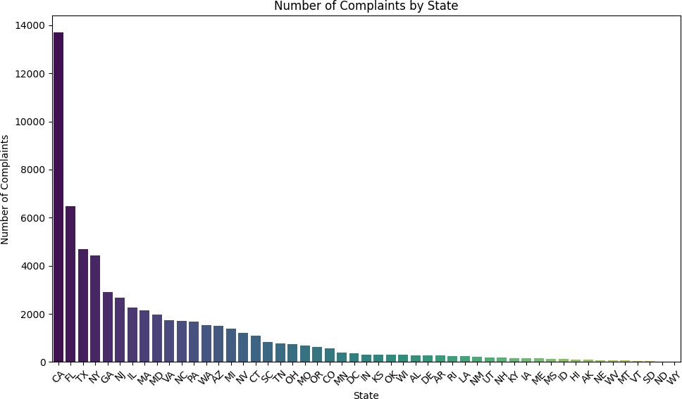
import pandas as pd
import matplotlib.pyplot as plt import seaborn as sns
# Read Excel file
file_path = '/content/Consumer_Complaints.xlsx'
'your_file.xlsx' with the actual file path
df = pd.read_excel(file_path)
# Replace
# Define column names
columns = ['Complaint ID', 'Submitted via', 'Date received', 'Date sent to company', 'State', 'Product', 'Sub-product', 'Issue', 'Sub- issue', 'Company public response', 'Company response to consumer', 'Timely response']
# Create DataFrame
df = pd.DataFrame(df, columns=columns)
# Convert date columns to datetime
date_columns = ['Date received', 'Date sent to company'] df[date_columns] = df[date_columns].apply(pd.to_datetime)
# Count of complaints by state
state_counts = df['State'].value_counts()
# Plotting
plt.figure(figsize=(10, 6))

Slide 128
sns.barplot(x=state_counts.index, y=state_counts.values, palette='viridis')
plt.title('Number of Complaints by State') plt.xlabel('State')
plt.ylabel('Number of Complaints') plt.xticks(rotation=45) plt.tight_layout()
plt.show()
sns.barplot(x=state_counts.index, y=state_counts.values, palette='viridis')
<ipython-input-64-e0ba4f150f77>:24: FutureWarning:
Passing `palette` without assigning `hue` is deprecated and will be
removed in v0.14.0. Assign the `x` variable to `hue` and set
`legend=False` for the same effect.
import pandas as pd
import matplotlib.pyplot as plt import seaborn as sns
import nltk nltk.download('vader_lexicon') # Read Excel file
file_path = '/content/Consumer_Complaints.xlsx' # Replace 'your_file.xlsx' with the actual file path
df = pd.read_excel(file_path)

Slide 129
# Define column names
columns = ['Complaint ID', 'Submitted via', 'Date received', 'Date sent to company', 'State', 'Product', 'Sub-product', 'Issue', 'Sub- issue', 'Company public response', 'Company response to consumer', 'Timely response']
# Create DataFrame
df = pd.DataFrame(df, columns=columns)
# Convert date columns to datetime
date_columns = ['Date received', 'Date sent to company'] df[date_columns] = df[date_columns].apply(pd.to_datetime)
# Analysis 5: Geographical Analysis
state_counts = df['State'].value_counts().head(10)
# Plotting
plt.figure(figsize=(10, 6)) sns.barplot(x=state_counts.values, y=state_counts.index, palette='viridis')
plt.title('Top 10 States by Number of Complaints') plt.xlabel('Number of Complaints') plt.ylabel('State')
plt.tight_layout() plt.show()
# Analysis 6: Trend Analysis
df['Month'] = df['Date received'].dt.to_period('M') monthly_complaints = df.groupby('Month').size()
# Plotting
plt.figure(figsize=(12, 6)) monthly_complaints.plot(marker='o') plt.title('Trend of Complaints Over Time') plt.xlabel('Month')
plt.ylabel('Number of Complaints') plt.xticks(rotation=45) plt.grid(True)
plt.tight_layout() plt.show()
# # Analysis 7: Text Analysis of Complaints (using NLTK for example) # from nltk.sentiment.vader import SentimentIntensityAnalyzer
# # Initialize Sentiment Analyzer
# sia = SentimentIntensityAnalyzer()
# # Calculate sentiment scores for each complaint
# df['Sentiment'] = df['Consumer complaint narrative'].apply(lambda x:

Slide 130
sia.polarity_scores(str(x))['compound'])
# # Plotting
# plt.figure(figsize=(10, 6))
# sns.histplot(df['Sentiment'], bins=20, kde=True, color='skyblue') # plt.title('Distribution of Sentiment Scores')
# plt.xlabel('Sentiment Score') # plt.ylabel('Frequency')
# plt.tight_layout() # plt.show()
# # Analysis 8: Company Response Time
# df['Response Time'] = (df['Date sent to company'] - df['Date received']).dt.days
# # Plotting
# plt.figure(figsize=(10, 6))
# sns.boxplot(x='Company response to consumer', y='Response Time', data=df, palette='viridis')
# plt.title('Company Response Time Distribution') # plt.xlabel('Company Response')
# plt.ylabel('Response Time (Days)') # plt.tight_layout()
# plt.show()
# Analysis 9: Demographic Analysis (assuming demographic data is available)
# For example, let's say 'Age' and 'Income Level' are available demographic columns
# age_counts = df['Age'].value_counts()
# income_counts = df['Income Level'].value_counts()
# # Plotting
# plt.figure(figsize=(16, 6))
# plt.subplot(1, 2, 1)
# age_counts.plot(kind='bar', color='skyblue')
# plt.title('Distribution of Complaints by Age') # plt.xlabel('Age')
# plt.ylabel('Number of Complaints')
# plt.subplot(1, 2, 2)
# income_counts.plot(kind='bar', color='salmon')
# plt.title('Distribution of Complaints by Income Level') # plt.xlabel('Income Level')
# plt.ylabel('Number of Complaints')
plt.tight_layout() plt.show()

Slide 131
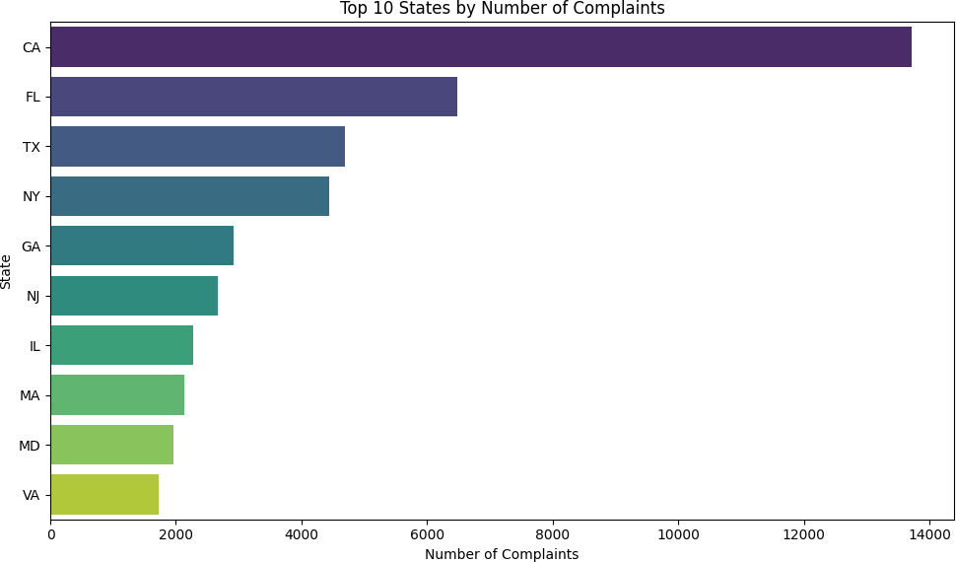
sns.barplot(x=state_counts.values, y=state_counts.index, palette='viridis')
[nltk_data] Downloading package vader_lexicon to /root/nltk_data...
[nltk_data] Package vader_lexicon is already up-to-date!
<ipython-input-74-607aa54b745e>:25: FutureWarning:
Passing `palette` without assigning `hue` is deprecated and will be
removed in v0.14.0. Assign the `y` variable to `hue` and set
`legend=False` for the same effect.

Slide 132
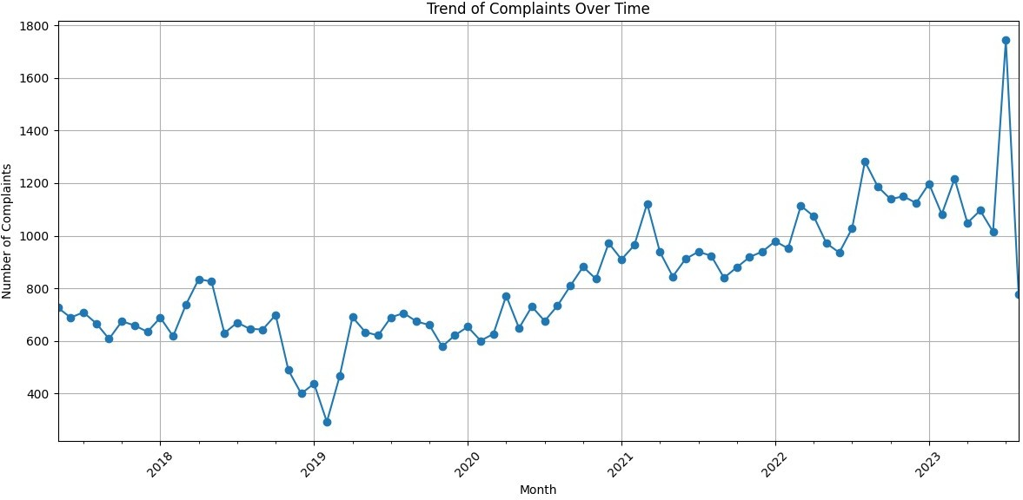
!pip install nltk
Requirement already satisfied: nltk in /usr/local/lib/python3.10/dist- packages (3.8.1)
Requirement already satisfied: click in
/usr/local/lib/python3.10/dist-packages (from nltk) (8.1.7) Requirement already satisfied: joblib in
/usr/local/lib/python3.10/dist-packages (from nltk) (1.4.0) Requirement already satisfied: regex>=2021.8.3 in
/usr/local/lib/python3.10/dist-packages (from nltk) (2023.12.25) Requirement already satisfied: tqdm in /usr/local/lib/python3.10/dist- packages (from nltk) (4.66.2)
<Figure size 640x480 with 0 Axes>

