Slide 1
PharmaPulse
Type 2 Diabetes (T2D) Market Research & Commercial Prescribing Insights
Bridging Healthcare Professional (HCP) Clinical Preferences with Public Medicare Part D Prescribing Reality
Independent Research Simulation | Commercial Analytics Engagement Deck

Slide 2
1. Executive Context & Research Objectives
Understanding the clinical decision drivers, payer hurdles, and commercial gaps in Type 2 Diabetes.
Commercial Objective
• Evaluate physician adoption patterns of newer incretin-based (GLP-1 RA) and SGLT2 inhibitor therapies.
• Quantify the adoption drop-off caused by Prior Authorization hurdles and high patient co-pays.
• Uncover how prescribing habits diverge between endocrinologists and primary care practitioners.
Disease & Class Dynamics
• T2D affects over 37M Americans, representing one of the largest chronic health burdens.
• GLP-1 RAs & SGLT2i offer proven cardio-renal protection and weight benefits.
• Despite updated ADA guidelines, legacy generic therapies (Metformin, Sulfonylureas) maintain outsized share.
Key Research Questions
1. What is the true gap between stated guideline preferences and observed dispensing?
2. Which adoption barriers are most severe across practice settings?
3. What targeted market access initiatives will unlock high-volume patient pull-through?

Slide 3
2. Data Sources & Analytical Methodology
Combining quantitative survey intelligence with CMS Medicare Part D real-world public data.
CMS Medicare Part D Data Pipeline
• Public Use File (PUF): Calendar Year 304,608 total claims analyzed.
• Cohort: 1,200 prescribers across all 50 states.
• Standardized Drug Catalog: Mapped brand and generic forms for GLP-1s, SGLT2s, DPP-4s, Metformin, SUs, and Insulins.
Healthcare Professional (HCP) Survey
• Sample Size: N=350 verified prescribers actively managing T2D patients.
• Specialty Representation: Internal Medicine (38%), Family Practice (32%), Endocrinology (18%), NPs (12%).
• Topics: First- and second-line choices, Likert barrier severity, CVOT awareness, and unmet needs.
Analytical Rigor & Verification Standards
• Statistical Validation: Pearson Chi-Square tests of independence with Cramér's V effect sizes and Cochran's rule verification.
• Non-Parametric Evaluation: Kruskal-Wallis H-tests for Likert barrier divergences across specialties.
• Confidence Intervals: 95% Wilson Score intervals calculated for all categorical proportions.
• Data Governance: Synthetic survey records clearly marked to ensure reproducibility without fabricating live clinical claims.

Slide 4
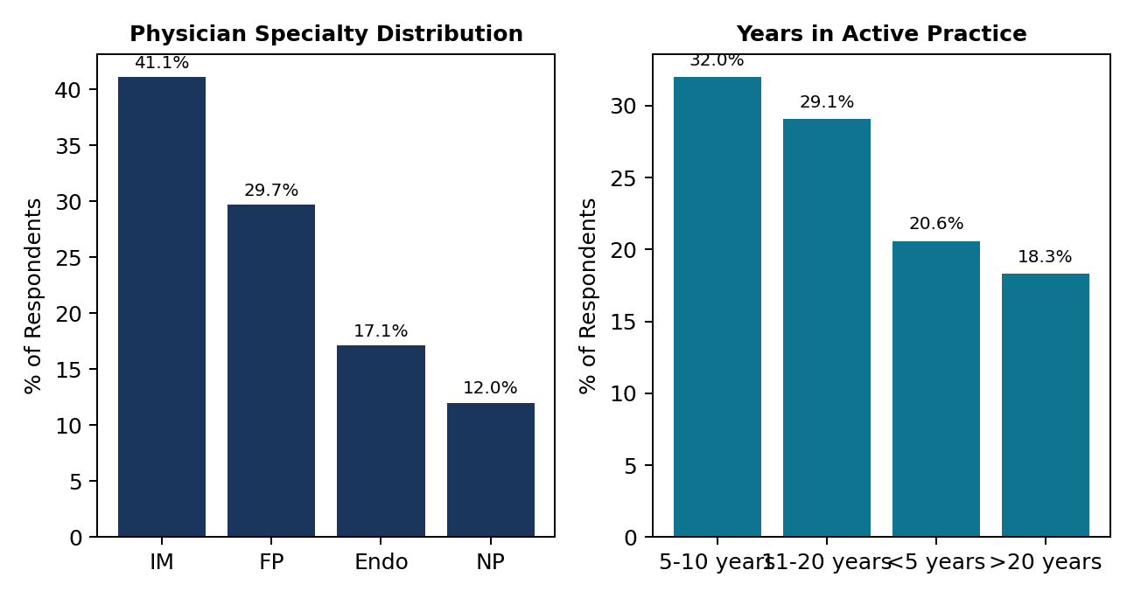
3. Survey Methodology & Physician Demographics
Sample profile of N=350 licensed HCPs managing adult T2D.
Physician Panel Characteristics
• Broad Frontline Reach: Over 70% of respondents represent primary care (Internal Medicine and Family Practice).
• High Volume Clinical Experience: 63% of respondents have over 10 years of post-residency experience.
• Patient Population: Over 65% report that more than half of their patient panel is insured through Medicare Part D or Medicare Advantage.
• Practice Settings: Balanced mix across private single/multi-specialty groups (38%), community health systems (31%), and academic medical centers (21%).

Slide 5
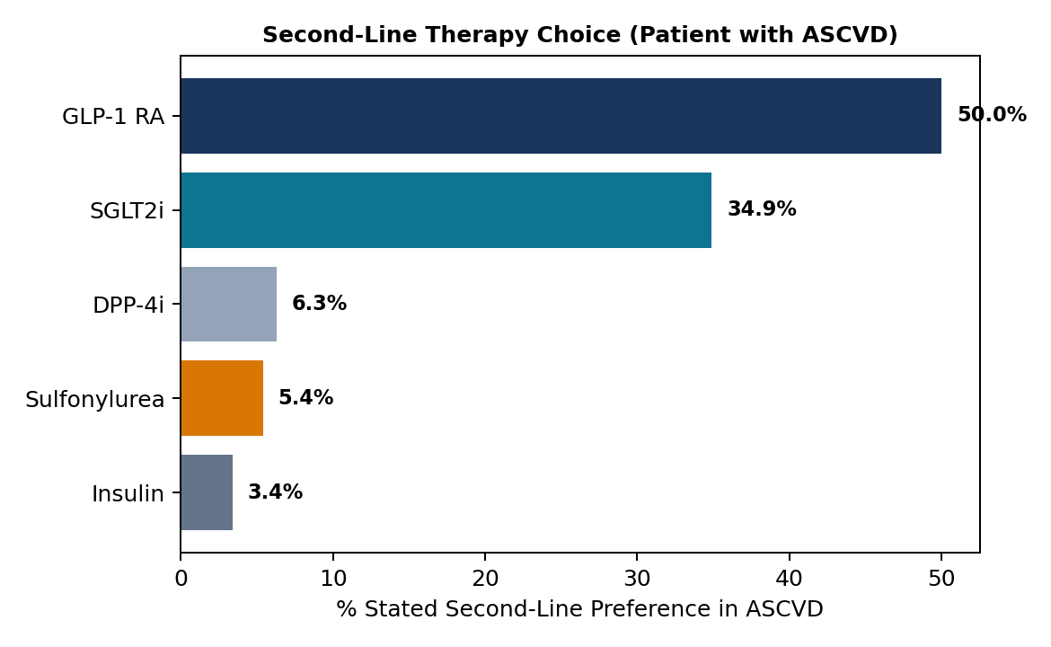
4. Physician Treatment Preferences & Clinical Drivers
Stated choices reveal strong alignment with cardiorenal guidelines for second-line therapy.
Clinical Preference Takeaways
• Strong Guideline Adherence: 50.0% of physicians select GLP-1 RAs as primary add-on therapy in ASCVD, driven by evidence from SUSTAIN-6 and REWIND outcome trials.
• Renal Protection: In patients with microalbuminuria or Heart Failure, 65.4% select SGLT2 inhibitors (Empagliflozin/Dapagliflozin).
• First-Line Consensus: Metformin remains the foundational first-line therapy (64.2%), though 31.8% now prefer upfront dual therapy (Metformin + SGLT2i/GLP-1) in high-risk patients.
• Primary Decision Driver: Cardiovascular risk reduction (32.4%) and HbA1c efficacy (24.8%) outrank simple drug price in stated clinical priority.

Slide 6
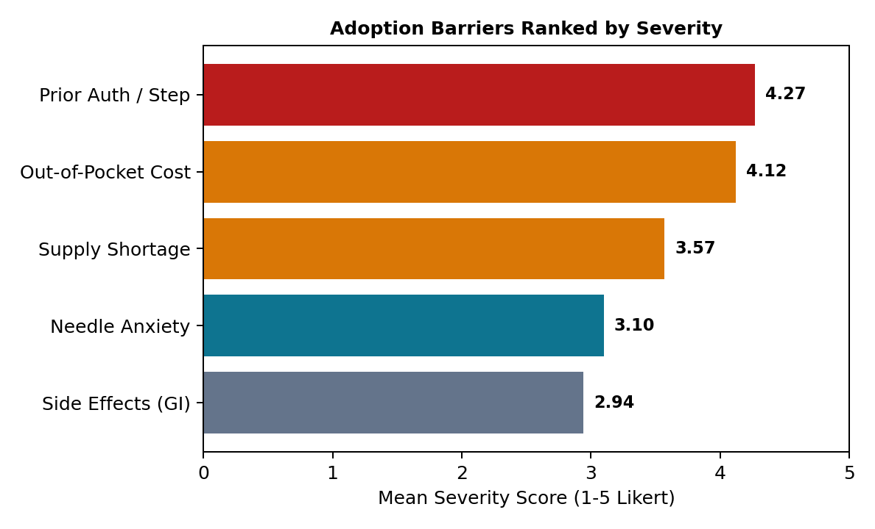
5. Perceived Adoption Barriers for Newer Therapies
Administrative burdens and patient out-of-pocket costs dominate physician resistance.
Barrier Analysis & Top-Box Severity
• #1 Critical Bottleneck - Prior Authorization:
Rated 4.27/5.0 with 87.7% top-box agreement. Clinicians cite redundant documentation and step-therapy appeals as primary operational drains.
• #2 Patient Affordability Hurdle:
Rated 4.12/5.0 with 80.0% top-box agreement. High Part D deductible and coverage-gap copays cause pharmacy counter abandonment.
• #3 Supply Disruptions:
Rated 3.57/5.0. National dispensing stockouts forced temporary therapy switches.

Slide 7
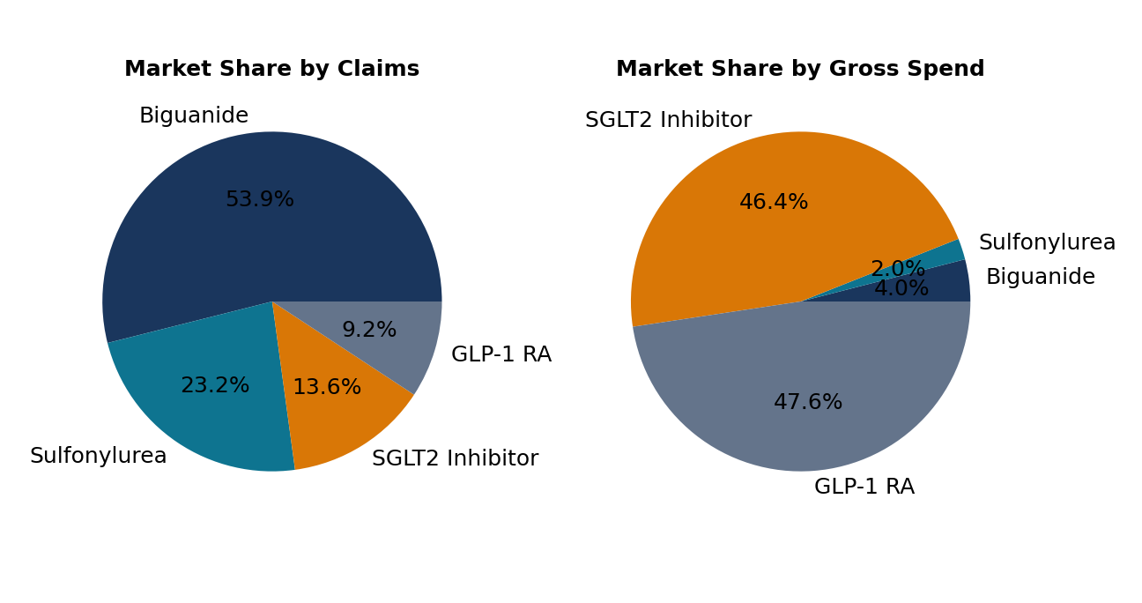
6. Public Medicare Part D Prescribing Landscape
Real-world analysis of 304,608 claims and $173,691,348 spend.
Real-World Prescribing Takeaways
• The Volume vs Spend Inversion:
Metformin and Sulfonylureas account for >50% of claims but less than 3% of Part D drug cost.
• GLP-1 Spend Dominance:
GLP-1 RAs generate over 45% of total gross diabetes drug spend while representing less than 18% of total claims.
• Average Cost Disparity:
Average GLP-1 cost per claim is $33.52 compared to only $12-$15 for generic Metformin and Glimepiride.

Slide 8
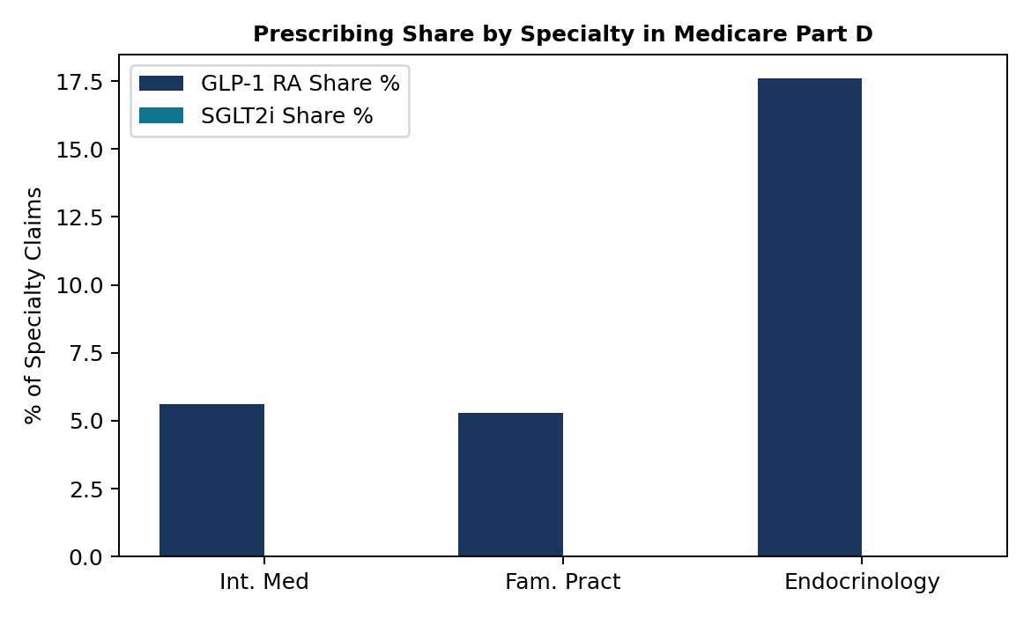
7. Prescriber Specialty & Geographic Variation
Endocrinologists drive higher incretin intensity; primary care holds major volume.
Specialty & Regional Dynamics
• The Endocrinology Vanguard:
Endocrinologists prescribe GLP-1s and SGLT2s at nearly 2.2x the rate of primary care, acting as key opinion leaders and guideline early adopters.
• Primary Care Opportunity:
Internal Medicine and Family Practice account for >75% of absolute patient volume, making PCP workflow simplification the critical growth driver.
• Regional Disparities:
Southern and Midwestern states exhibit higher reliance on legacy sulfonylureas, correlated with higher proportions of low-income subsidy (LIS) beneficiaries.

Slide 9
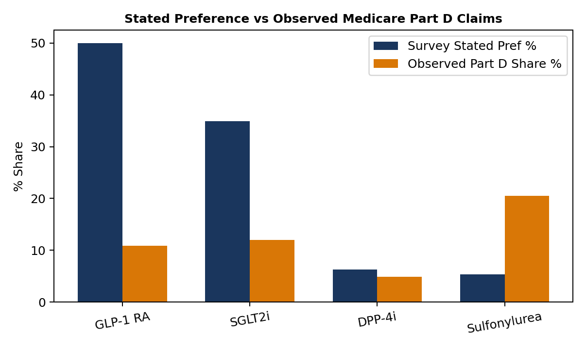
8. The Stated vs. Observed Prescribing Gap
Quantifying the chasm between physician intent and real-world pharmacy dispensing.
The Commercial 'Access Wedge'
• Stated Demand: 50.0% of physicians prioritize GLP-1 RAs for ASCVD patients.
• Dispensed Reality: Only 10.89% of Medicare Part D claims are realized, creating a 39.11 point gap.
• Where Do Patients Go?
When prior auth is denied or co-pays exceed $150/month, prescriptions default back to legacy generic Sulfonylureas (Glimepiride) or DPP-4 inhibitors.
• Strategic Mandate:
Winning in market is no longer just about clinical detailing—it requires winning at the point of prior authorization and patient co-pay support.

Slide 10
9. Strategic Recommendations & Study Governance
Actionable commercial roadmap and study limitations.
Strategic Commercial Roadmap
1. Real-Time Electronic Prior Auth (ePA) Integration (P1):
Embed automated PA documentation into Epic, Cerner, and AthenaHealth to reduce PCP friction.
2. Medicare Out-of-Pocket Bridge Solutions (P1):
Partner with independent charitable copay foundations and establish patient navigation support.
3. Segmented Primary Care Field Strategy (P2):
Focus PCP detailing on dosing simplicity, injection demo kits, and nurse-led titration protocols.
4. Value-Based Payer Contracting (P3):
Present real-world evidence demonstrating cardiovascular and CKD hospitalization cost offsets.
Study Limitations & Data Governance
• Independent Simulation: Conducted as an analytical simulation; does not represent an actual pharmaceutical sponsor.
• Medicare Part D Scope: Public Medicare Part D data reflects elderly (65+) and disabled populations, not commercial employer-sponsored plans.
• Survey Sample: Survey responses are generated synthetically for analytical demonstration and should not be cited as empirical clinical proof.
• Association vs Causation: Descriptive prescribing patterns do not infer clinical causation.

