Slide 1


Identifying the type of weed growing in the farmlands of the Karnataka Region

Slide 2
The code uses various technologies and libraries to accomplish the task of identifying the type of weed growing in the farmlands of the Karnataka Region. Some of the key technologies used in the code :
OpenCv: OpenCV is an open-source software library for computer vision and machine learning. The OpenCV full form is Open Source Computer Vision Library. It provides a wide range of features, including object detection, face recognition, and tracking. OpenCV, as a BSD-licensed software, makes it simple for companies to use and change the code. There are some predefined packages and libraries that make our life simple and OpenCV is one of them.

Slide 3
Tensorflow:TensorFlow is an open-source library for fast numerical computing. It was created and is maintained by Google and was released under the Apache
2.0 open source license. The API is nominally for the Python programming language, although there is access to the underlying C++ API.Unlike other numerical libraries intended for use in Deep Learning like Theano, TensorFlow was designed for use both in research and development and in production systems, not least of which is RankBrain in Google search and the fun DeepDream project.

Slide 4
CNN: A Convolutional Neural Network (CNN) is a type of deep learning algorithm that is particularly well-suited for image recognition and processing tasks. It is made up of multiple layers, including convolutional layers, pooling layers, and fully connected layers. The convolutional layers are the key component of a CNN, where filters are applied to the input image to extract features such as edges, textures, and shapes. The output of the convolutional layers is then passed through pooling layers, which are used to down-sample the feature maps, reducing the spatial dimensions while retaining the most important information. The output of the pooling layers is then passed through one or more fully connected layers, which are used to make a prediction or classify the image.

Slide 5
https://github.com/Priyatham2210/weed_classification. git

Slide 6
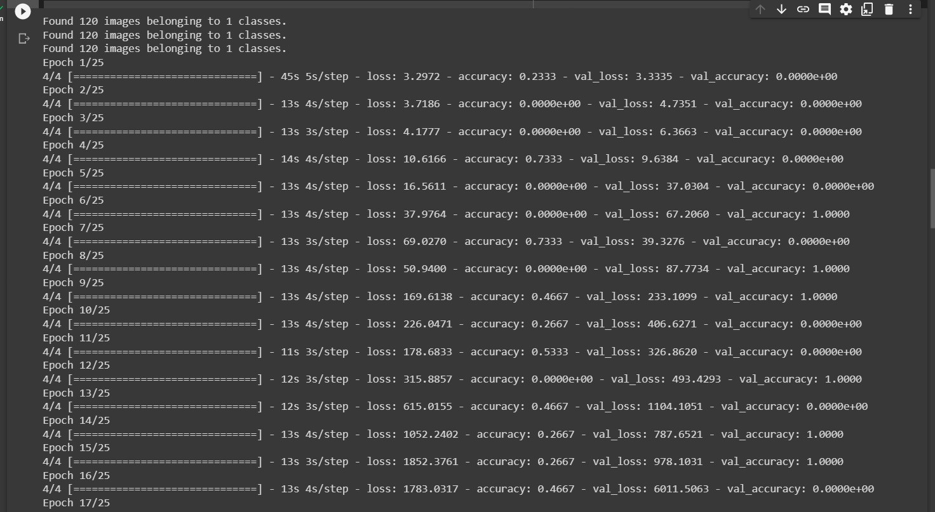

Slide 7
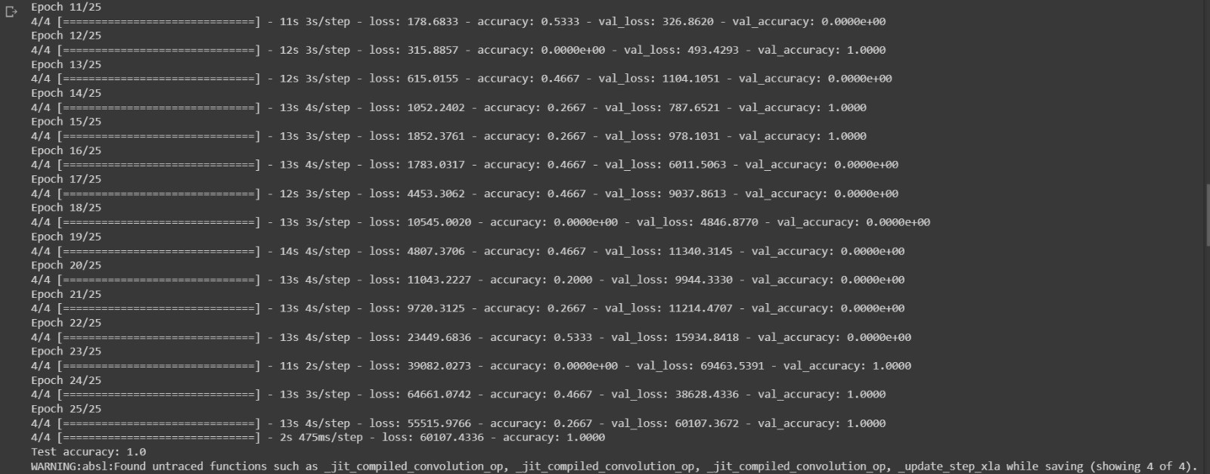

Slide 8
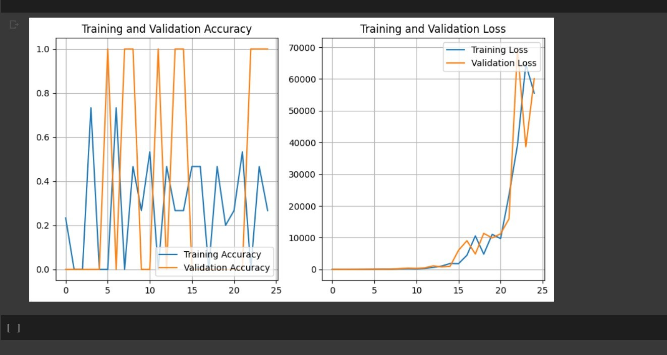

Slide 9
ThankYou
SUBMITTED BY:
B L S PAVAN PRIYATHAM 20BCI7141

