Slide 1

EMBEDDED UNIT TESTING
Mocking in Embedded C
Using CMock to Isolate, Simulate & Test in Ceedling
What is Mocking?
CMock Basics
Mock Variants
Worked Example
Reference: embetronicx.com | Unit Testing in C series

Slide 2


THE CORE IDEA
What is Mocking?
A Controlled Imitation
Why We Need It
Mocking means creating a replica of a real object or function, so its behavior can be simulated in a controlled way.
It replaces real functions with alternate, fake implementations — called “mocks.”
This removes real-world dependencies during a test run.
Code under test often depends on other modules
Mocks break that dependency so code can run in isolation
Ceedling ships an inbuilt mocking tool — CMock
No extra installation is required
Mocking in Embedded C | CMock
2

Slide 3



THE TOOL
What is CMock?
CMock is a framework that generates mock functions automatically from a header file's API — no manual fake-writing needed.
1. Point at a Header
2. CMock Generates It
3. Control the Mock
Add a mock header to your test file, e.g. mock_example.h for example.h.
Ceedling auto-creates mock_example.h and mock_example.c — fully compiled mocks.
Use generated functions to set return values and verify call order & arguments.
Key syntax: #include "mock_adc.h" — generates mocks for every function declared in adc.h
Mocking in Embedded C | CMock
3

Slide 4

WORKED EXAMPLE
Setting Up: What if We Don't Mock?
Scenario: bit_manipulation.c now calls adc_read() from a new adc module, and prints whether temperature is High or Low.
SIMPLE_PROG
▸ build
New source files adc.c / adc.h hold the adc_read() function
do_bit_man() now prints “Temperature is High/Low”
test_bit_manipulation.c is untouched — just adds #include "adc.h"
▾ src
C adc.c
C adc.h
C bit_manipulation.c
C bit_manipulation.h
▾ test
Without a mock, the real adc_read() executes during the test — the module under test is no longer isolated.
▸ support
C test_bit_manipulation.c
! project.yml
adc.c / adc.h → new dependency files
Mocking in Embedded C | CMock
4

Slide 5
Code:
adc.h /* This source is just for understanding purpose.
** There is no logic here. We are not going to use
** this code. This will be used for understand the
** Unit test.
*/
#ifndef ADC_H
#define ADC_H
/* Read ADC value */
int adc_read( void );
#endif // ADC_H

Slide 6
adc.c /* This source is just for understanding purpose.
** There is no logic here. We are not going to use
** this code outside. This will be used for understand the
** Unit test mock.
*/
#include "adc.h"
//We will assume that, ADC value will be updated in this value.
volatile int adc_value = 0;
int adc_read( void )
{
/* We will assume that some other function outside is updating this
** adc_value variable. This variable will have updated adc's value.
** So, Simply return that variable for explain mock test.
*/
return adc_value;
}

Slide 7
bit_manipulation.c #include "bit_manipulation.h"
#include "adc.h"
uint8_t Jill = 0x00;
uint8_t Jung = 0xFF;
uint8_t Jukk = 0x00;
int8_t do_bit_man(int8_t position {
if( ( position < 0 ) || ( position > 7 ) )
{ //positon should be 0 to 7. Because we are going to modify 8 bit value.
return -1; }
//set particular bit
Jill |= ( 1 << position );
//clear particular bit
Jung &= ~( 1 << position );
//toggle particular bit
Jukk ^= ( 1 << position );

Slide 8
//set particular bit
Jill |= ( 1 << position );
//clear particular bit
Jung &= ~( 1 << position );
//toggle particular bit
Jukk ^= ( 1 << position ); int result = adc_read();
if( result >= 30 )
{
printf("Temperature is High\n");
}
else
{
printf("Temperature is Low\n");
}
return 0;
}

Slide 9
bit_manipulation.h
#ifndef BIT_MANIPULATION_H
#define BIT_MANIPULATION_H
#include <stdio.h>
#include <stdint.h>
int8_t do_bit_man(int8_t position);
#endif // BIT_MANIPULATION_H test_bit_manipulation.c #include "unity.h"
#include "bit_manipulation.h"
#include "adc.h"
extern uint8_t Jill;
extern uint8_t Jung;
extern uint8_t Jukk;

Slide 10
void setUp(void)
{
Jill = 0x00;
Jung = 0xFF;
Jukk = 0x00;
}
void tearDown(void)
{
}
//Test Case 0
void test_do_bit_man_0(void)
{
int8_t result;
result = do_bit_man( 15 );
TEST_ASSERT_EQUAL_INT8( -1, result );
TEST_ASSERT_EQUAL_INT8( 0x00, Jill );
TEST_ASSERT_EQUAL_INT8( 0xFF, Jung );
TEST_ASSERT_EQUAL_INT8( 0x00, Jukk );
}

Slide 11
//Test Case 1
void test_do_bit_man_1(void)
{
int8_t result;
result = do_bit_man( -1 );
TEST_ASSERT_EQUAL_INT8( -1, result );
TEST_ASSERT_EQUAL_INT8( 0x00, Jill );
TEST_ASSERT_EQUAL_INT8( 0xFF, Jung );
TEST_ASSERT_EQUAL_INT8( 0x00, Jukk );
}
//Test Case 2
void test_do_bit_man_2(void)
{
int8_t result;
int8_t position = 5;
result = do_bit_man( position );

Slide 12
TEST_ASSERT_EQUAL_INT8( 0, result );
TEST_ASSERT_BIT_HIGH( position, Jill );
TEST_ASSERT_BIT_LOW( position, Jung );
TEST_ASSERT_BIT_HIGH( position, Jukk );
} That’s all. Let’s run the unit test using ceedling test:all. simple_prog>ceedling test:all
Test 'test_bit_manipulation.c'
------------------------------
Generating runner for test_bit_manipulation.c...
Compiling test_bit_manipulation_runner.c...
Compiling test_bit_manipulation.c...
Compiling unity.c...
Compiling bit_manipulation.c...
Compiling adc.c...
Compiling cmock.c...
Linking test_bit_manipulation.out...
Running test_bit_manipulation.out...

Slide 13
-----------
TEST OUTPUT
-----------
[test_bit_manipulation.c]
- "Temperature is Low"
--------------------
OVERALL TEST SUMMARY
--------------------
TESTED: 3
PASSED: 3
FAILED: 0
IGNORED: 0 Generate the report using the below commands. ceedling gcov:all
ceedling utils:gcov
This is the result. Your result will be stored in simple_prog\build\artifacts\gcov.

Slide 14
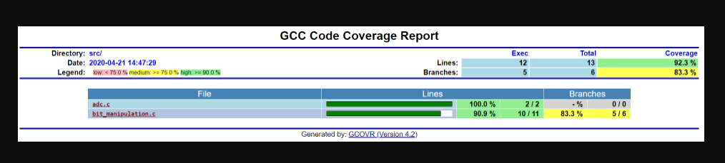
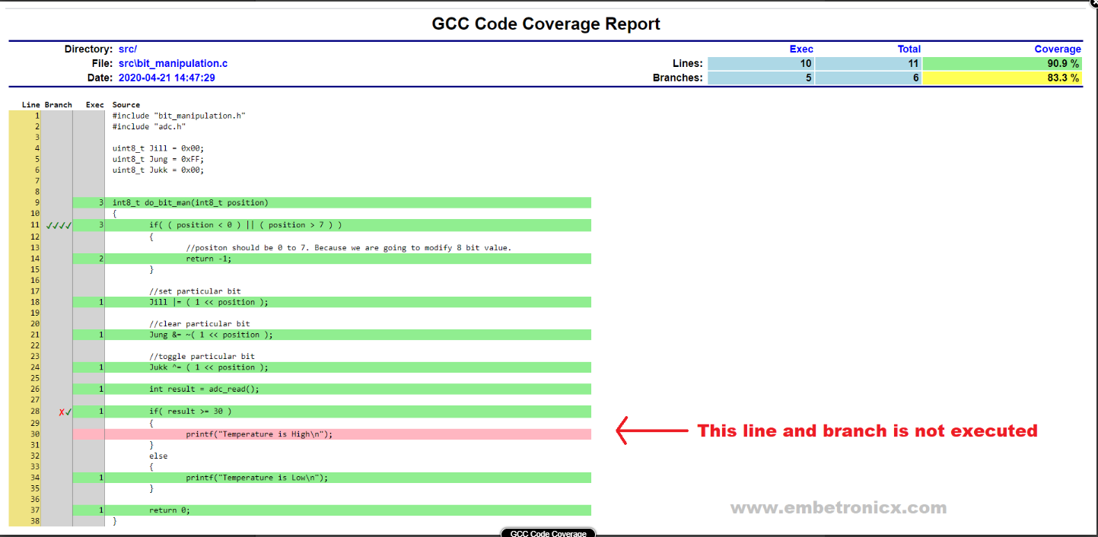
Here, adc.c is 100% but bit_manipulation.c is 90.9%. adc.c is out of scope for us. Because we are testing do_bit_man not adc_read. Why did this 9.1% get reduced in bit_manipulation.c? Let’s see the complete report of bit_manipulation.c.

Slide 15
WORKED EXAMPLE
Running Tests Without a Mock
simple_prog> ceedling test:all
Compiling bit_manipulation.c... Compiling adc.c... Linking test_bit_manipulation.out...
Running test_bit_manipulation.out...
TEST OUTPUT: "Temperature is Low"
TESTED: 3 PASSED: 3 FAILED: 0 IGNORED: 0
The Problem
The test passed — but it silently called the real adc_read() implementation. Nothing verified that the function was called correctly, or let us control its return value. That is exactly what mocking solves.
Mocking in Embedded C | CMock
5

Slide 16
WORKED EXAMPLE
Generating a Mock with CMock
Swap the real header for its mock header in the test file:
Generated for adc_read()
#include "mock_adc.h"
adc_read_ExpectAndReturn(return_value)
Ceedling auto-creates mock_adc.h and mock_adc.c using CMock
For every function in adc.h, a family of control functions is generated
Find every generated function inside build/test/mocks/*.h
adc_read_IgnoreAndReturn(return_value)
adc_read_StubWithCallback(callback)
Exact set of functions varies with your header and project.yml plugin config.
Mocking in Embedded C | CMock
6

Slide 17
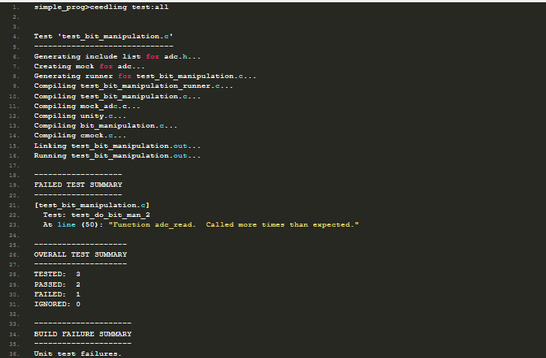

Slide 18






ROADMAP
Six Mock Function Variants
CMock generates several families of control functions. Here is the roadmap we'll walk through.
1. Expect
2. Ignore Arguments
3. Array
Always generated — verifies the call, args & return value
Ignore one argument while still checking the rest
Compare pointer args as arrays with a given depth
4. Ignore
5. ReturnThruPtr
6. Callback
Ignore the call entirely; optionally return a value
Write data back out through a pointer argument
Route the call to your own custom callback function
Mocking in Embedded C | CMock
7

Slide 19
VARIANT 1 OF 6
Expect — Always Generated
Expect functions tell CMock exactly what call to look for — with which arguments, and (optionally) what to return.
Original Function | Generated Mock Function
void func(void) | func_Expect(void)
void func(params) | func_Expect(expected_params)
retval func(void) | func_ExpectAndReturn(retval)
retval func(params) | func_ExpectAndReturn(params, retval)
Example
int gpio_num = 10;
void test_gpio_pass(void) {
gpio_read_ExpectAndReturn(10, 1);
Test_gpio(); // passes
}
void test_gpio_fail(void) {
gpio_read_ExpectAndReturn(12, 1);
Test_gpio(); // fails: arg mismatch
}
Key point: Expect variants exist by default — no plugin configuration required.
Mocking in Embedded C | CMock
8

Slide 20
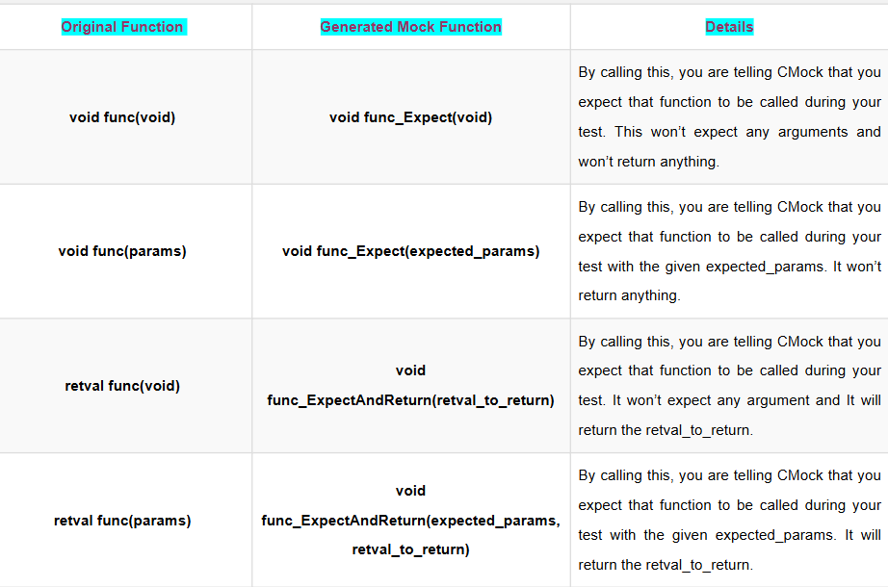
Expect
The expect functions are always generated.

Slide 21
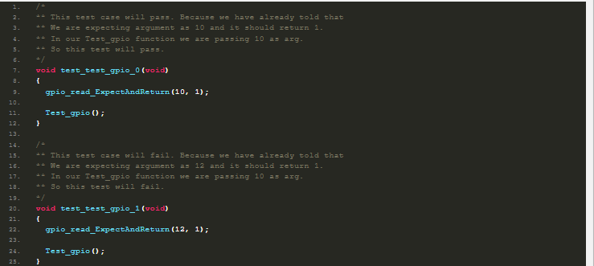
TEST CASE:

Slide 22
VARIANTS 2 & 3 OF 6
Ignore Arguments & Array
Ignore Arguments
Array
Requires ignore_arg plugin in project.yml
Requires array plugin in project.yml
Skips checking one argument while an Expect variant still checks the rest. Useful when an argument is a pointer meant to be filled in by the function.
Adds an ExpectWithArray variant. For every pointer argument, pass an extra depth parameter so CMock can compare each array element.
gpio_read_ExpectAndReturn(15, 1);
gpio_read_IgnoreArg_gpio_num();
Test_gpio(); // passes — arg not checked
int expected[] = {1,2,3,4,5};
gpio_read_ExpectWithArrayAndReturn(
expected, 5, 1);
Test_gpio(); // compares 5 elements
Mocking in Embedded C | CMock
9

Slide 23
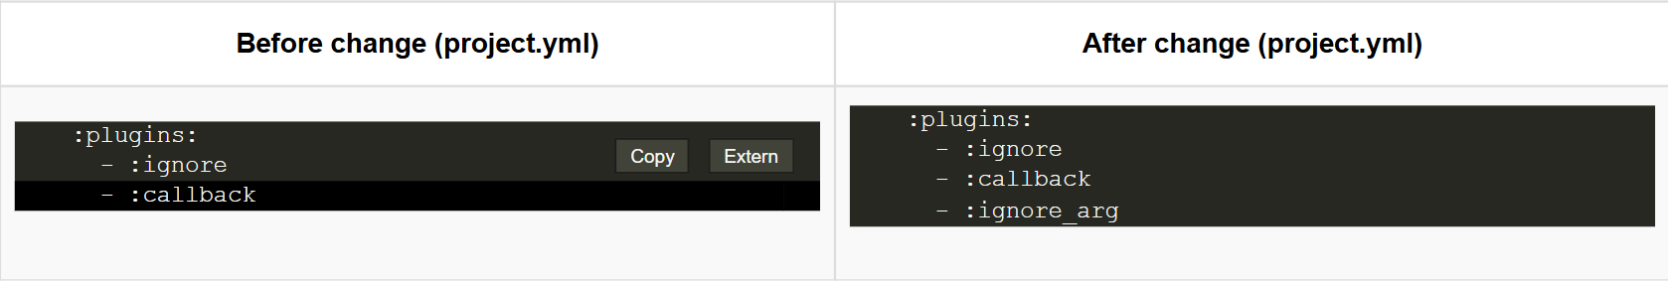
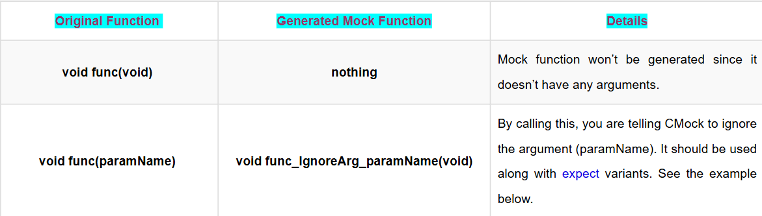
Ignore Arguments

Slide 24
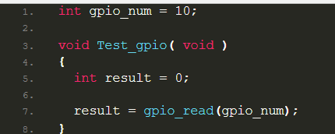
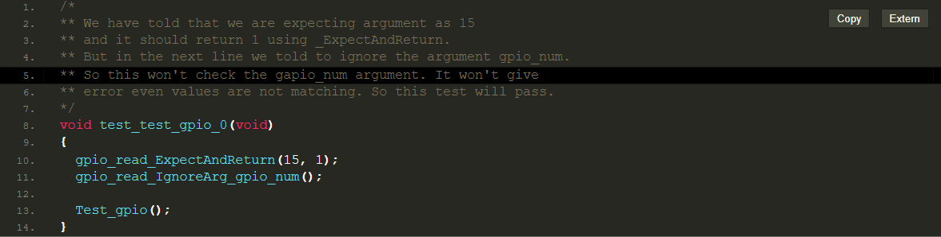
Example:
Let’s assume I am going to test this function. Here, gpio_read() takes one argument which is gpio_num. We are going to ignore that gpio_num and return 1. The test case will be as below.

Slide 25
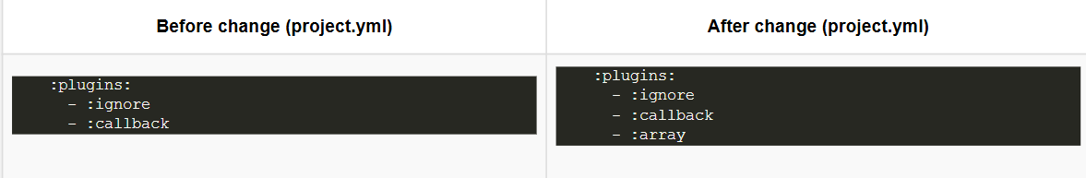
Note: When you use this ignore function, it will ignore the particular argument until this current test case. You may call multiple instances of this to ignore multiple arguments after each expectation if desired. So based on your arguments and return value, you can use the respected variant of the IgnoreArg mock functions.
Array When you have an array argument, then you may need to use this feature. This feature is not enabled by default. You have to add array under plugin in the project.yml file. Please refer below.
Now, CMock provides an ExpectWithArray function your each mocked function that contains pointer arguments. For each pointer argument, the ExpectWithArray function takes an additional argument that specifies the number of array elements to compare

Slide 26
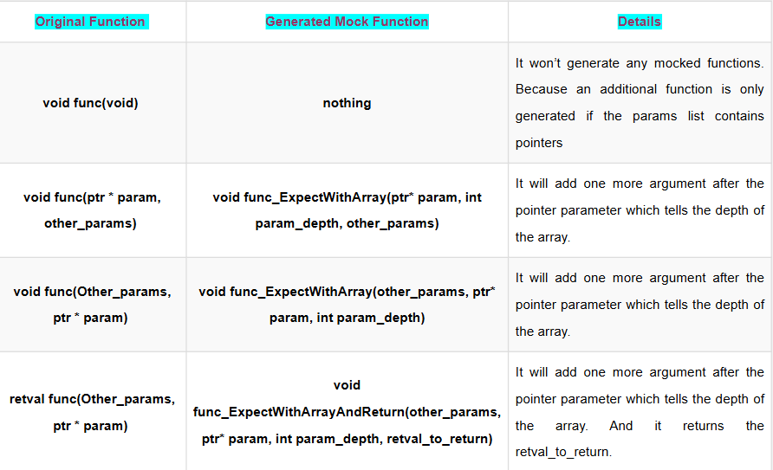

Slide 27
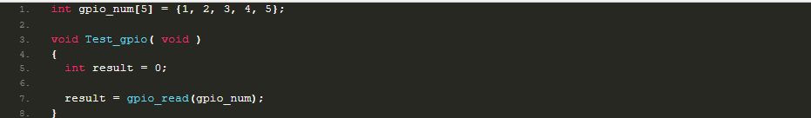
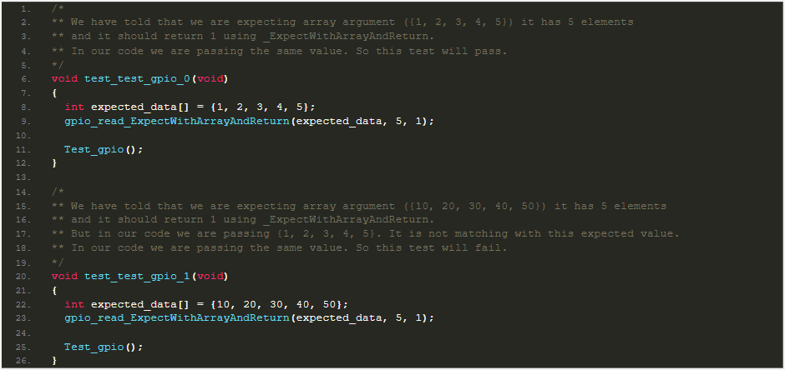
Example:
Let’s assume I am going to test this function.
Here, gpio_read() takes one argument which is gpio_num (int array). The test case will be as below.
So based on your arguments and return value, you can use the respective variant of the Array mock functions.

Slide 28
VARIANTS 4 & 5 OF 6
Ignore & ReturnThruPtr
Ignore
ReturnThruPtr
Enabled by default — no plugin needed
Requires return_thru_ptr plugin
Don't care how a function is called — or how many times. func_Ignore() / func_IgnoreAndReturn() need be called just once per test to cover every subsequent call.
Writes data back through a pointer argument — ideal when a function is expected to fill in a value, struct, or memory block for the caller.
gpio_read_IgnoreAndReturn(1);
Test_gpio(); // 4 real calls inside,
// all covered by one line
gpio_read_Expect(0);
gpio_read_IgnoreArg_gpio_num();
gpio_read_ReturnArrayThruPtr_gpio_num(
expected_data, 3);
Mocking in Embedded C | CMock
10

Slide 29
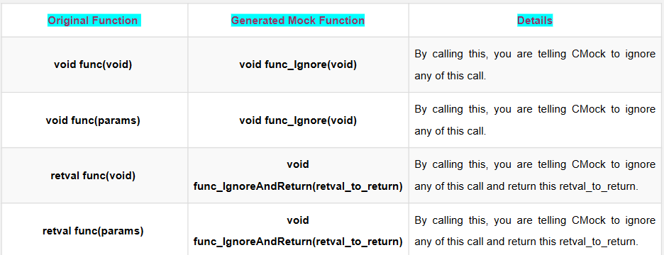
Ignore
If you don’t want to care about any functions then you can use this feature. This feature is enabled by default.
Note: These Ignore only needs to be called once per test. It will then ignore any further calls to that particular mock.

Slide 30
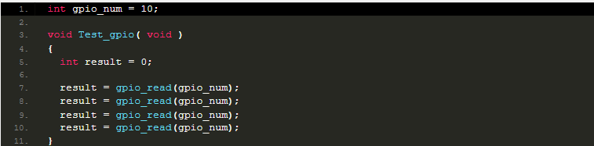
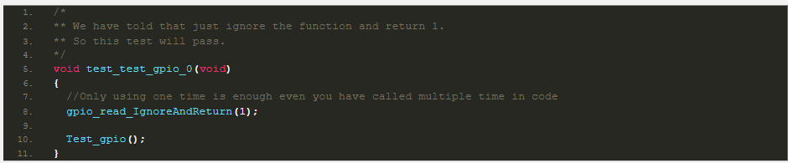
Example:
Let’s assume I am going to test this function.
Here, gpio_read() takes one argument which is gpio_num. We are going to ignore these calls and return 1. The test case will be as below.
So based on your arguments and return value, you can use the respective variant of the Ignore mock functions.

Slide 31
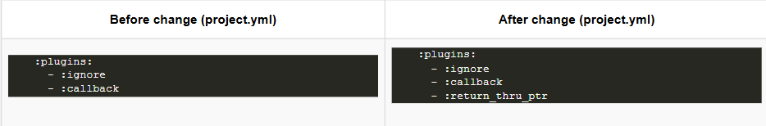
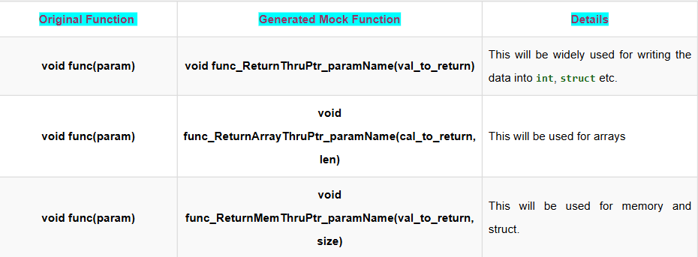
ReturnThruPtr
In embedded, sometimes you may need to pass a pointer to another module and get data from that pointer. In such a case, you can use this feature. This feature is not enabled by default. You have to add return_thru_ptr under plugin in the project.yml file. Please refer below.
Now, CMock provides an ReturnThruPtr function your each mocked function that contains pointer arguments.

Slide 32
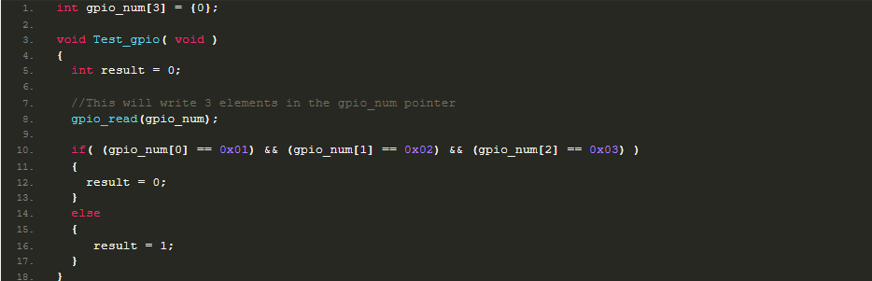
Example:
Let’s assume I am going to test this function
Here, gpio_read() takes one argument which is gpio_num (pointer). In this case, we should not care about the argument. Because it is taking pointers. We don’t know which address it is passing.

Slide 33
So we have to ignore that. But we need to write 3 elements in that pointer. Then only we can check that if else part. So we are going to use this feature and write data through the pointer. The test case will be as below.
/*
** We have told that ignore the arg and write the value.
** and it should return 1 using _ExpectWithArrayAndReturn.
** In our code we are passing the same value. So this test will pass.
*/
void test_test_gpio_0(void)
{
int expected_data[] = {1, 2, 3};
gpio_read_Expect(0); //This will tell cmock to expect the function with 0 arg.
gpio_read_IgnoreArg_gpio_num(); //This will tell cmock to ignore the arg
gpio_read_ReturnArrayThruPtr_gpio_num(expected_data, 3); //This will write the 3 elements data to that pointer when this func called..
Test_gpio();
}
So based on your arguments and return value, you can use the respective variant of the ReturnThruPtr mock functions.

Slide 34
VARIANT 6 OF 6
Callback — For Complex Logic
StubWithCallback
Example
int custom_cb(int gpio_num,
int call_count) {
if (gpio_num == 1) return gpio_num;
return 0;
}
void test_gpio(void) {
gpio_read_StubWithCallback(custom_cb);
Test_gpio();
}
Enabled by default
Register your own callback function to run in place of the mock
Your callback signature = original function's args + an extra call_count parameter
Whatever the callback returns is passed back to the code under test
Best for conditional or multi-step mock behavior
Mocking in Embedded C | CMock
11

Slide 35
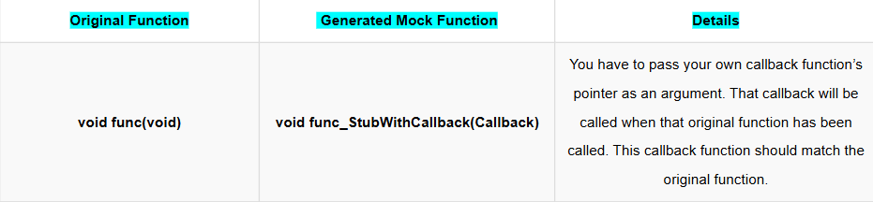
CallBack
So if you have a function that looks like this: bool org_function (uint8_t a_value);
Your callback function needs to look like this:
bool callback_function_mock (uint8_t a_value, int call_count);
You need to provide one more extra argument like the above. That will be used to track how many times the callback is called.

Slide 36
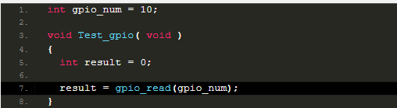
Note: The name of the callback function can be anything. But it should not match with original name.Whatever you return from your callback is what is provided to the calling function during your test — just like the custom callback was called instead of the mock function.
You will understand that better way If you see the example below.
Example:
Let’s assume I am going to test this function.
Here, gpio_read() takes one argument which is gpio number. To test this case we are going to create the custom callback and register that using gpio_read_StubWithCallback.

Slide 37
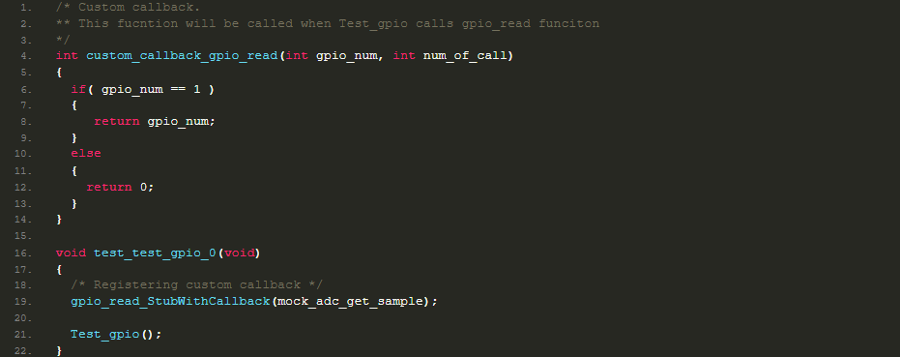
So this callback function will be called when you call the gpio_read function in the code. That custom callback function should match with the original function of arg and return type.
The test case will be as below.

Slide 38


KEY TAKEAWAYS
Mocking with CMock, in Short
Mocking isolates the code under test by replacing real dependencies with controlled fakes
CMock auto-generates mocks straight from your header files — just #include "mock_x.h"
Six variants cover every need: Expect, Ignore Arguments, Array, Ignore, ReturnThruPtr, Callback
Goal: use these mocks to drive your unit tests toward 100% code coverage
Source: EmbeTronicX — “Unit Testing in C: Mock using CMock in Embedded”

