Slide 1
Real-Time Notification System using AWS Simple Notification Service (SNS)
Objective:
The goal of this project is to design and implement a real-time notification system that leverages Amazon Web Services Simple Notification Service (AWS SNS) to send email alerts automatically in response to specific events.
List of Services Integrated:
Amazon SNS Core notification service to send email alerts.
Scope and Use Case of Services Integrated:
Amazon SNS (Simple Notification Service)
Scope: Acts as the primary notification mechanism.

Slide 2
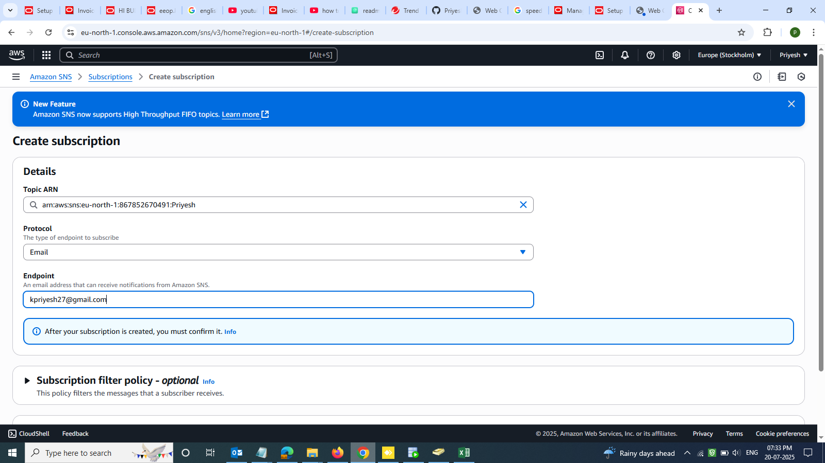
Screenshots of the outputs:
Creating SNS Subscription

Slide 3
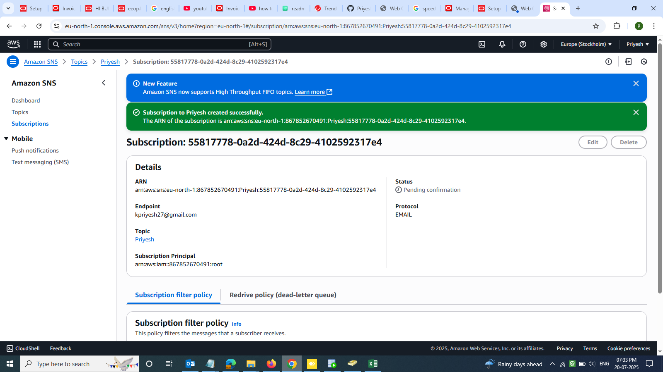
Subscription successfully updated

Slide 4
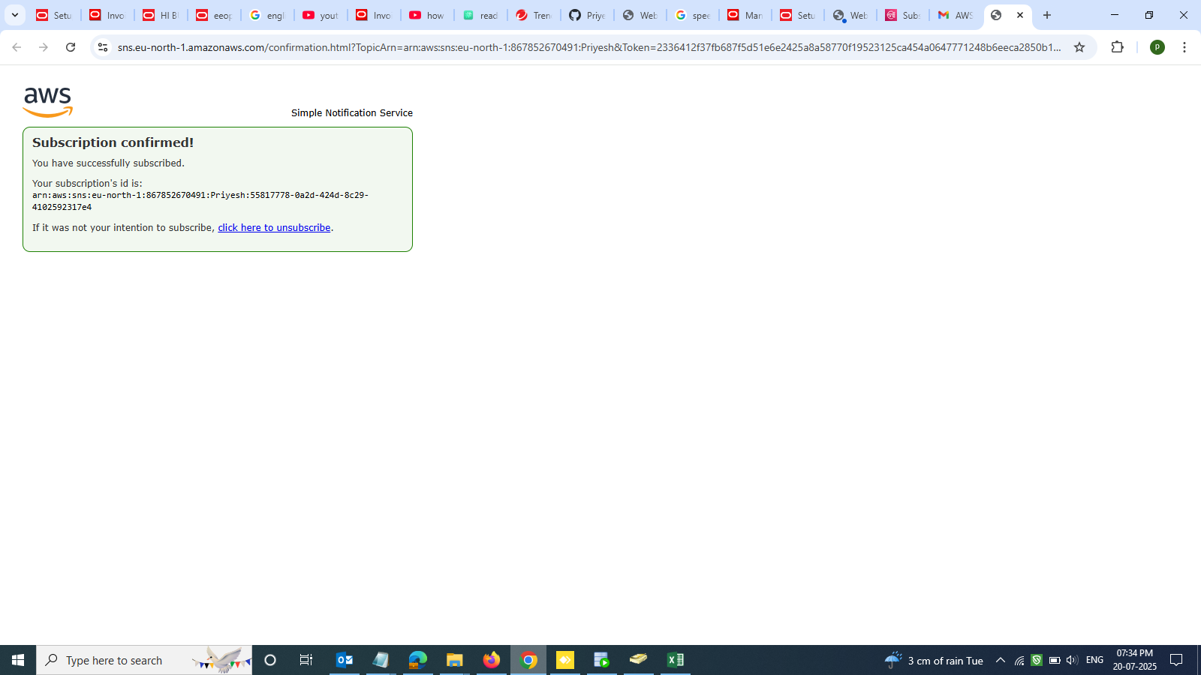
Subscription confirmation via Email

Slide 5
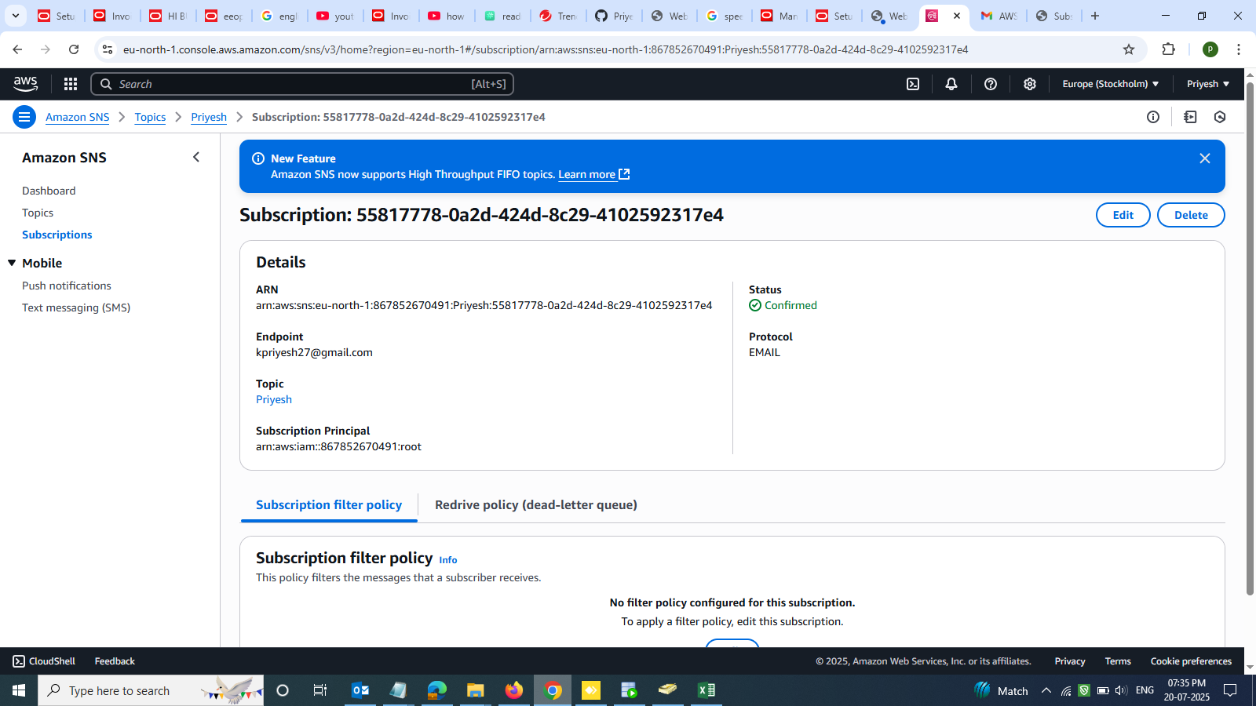
Subscription status confirmation

Slide 6
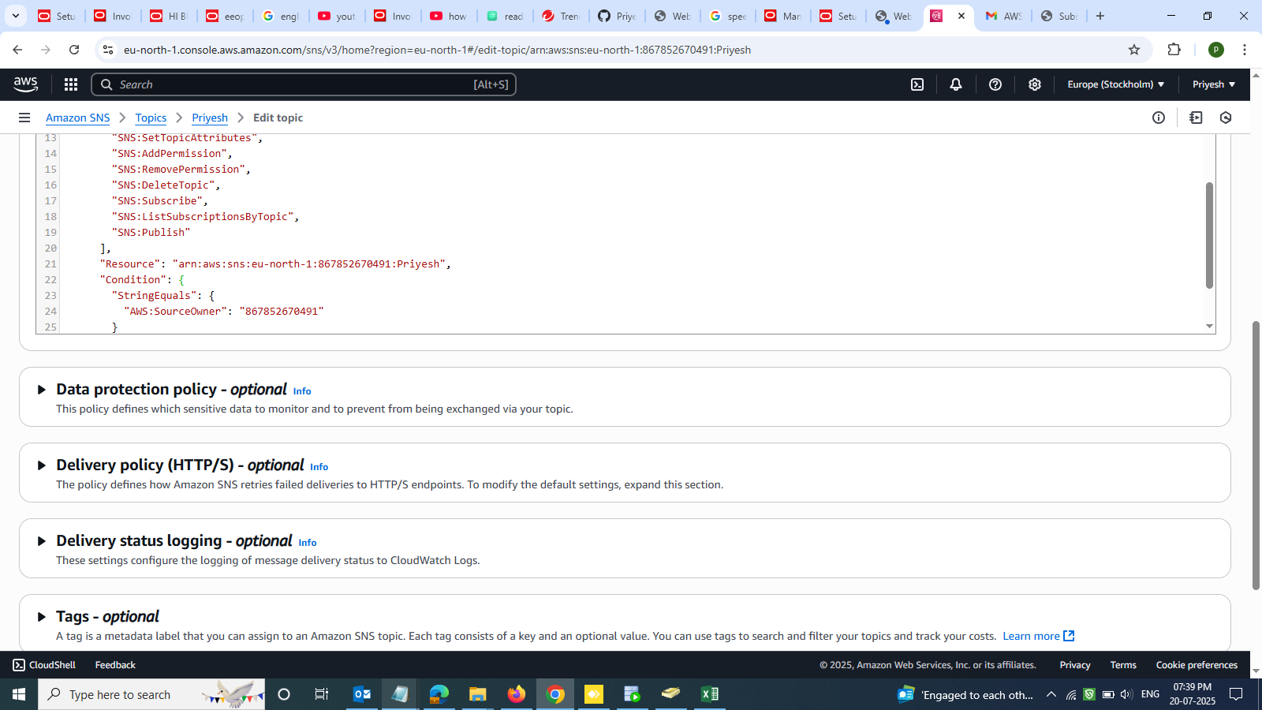
Edit Access policy in SNS

Slide 7
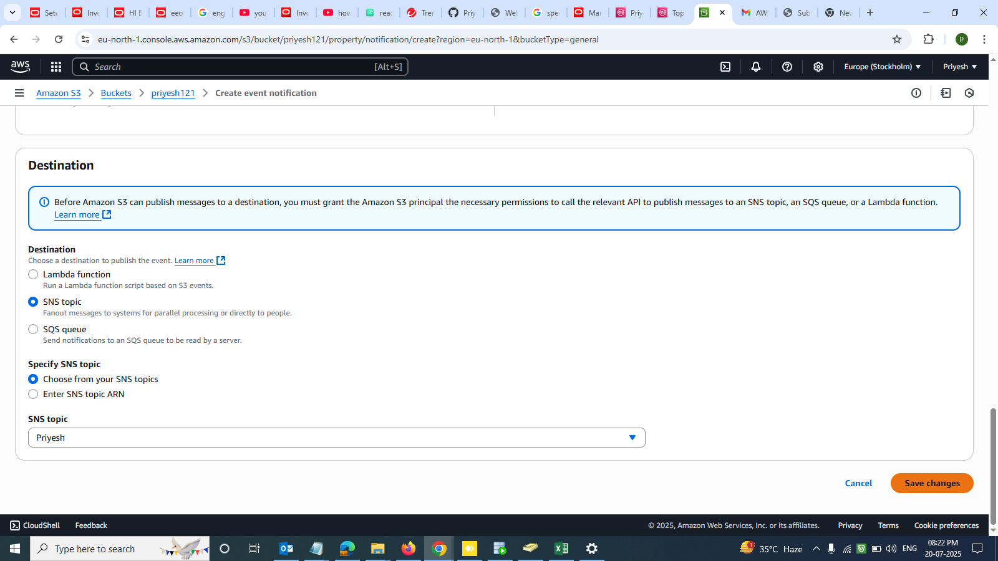
Create event notification

Slide 8
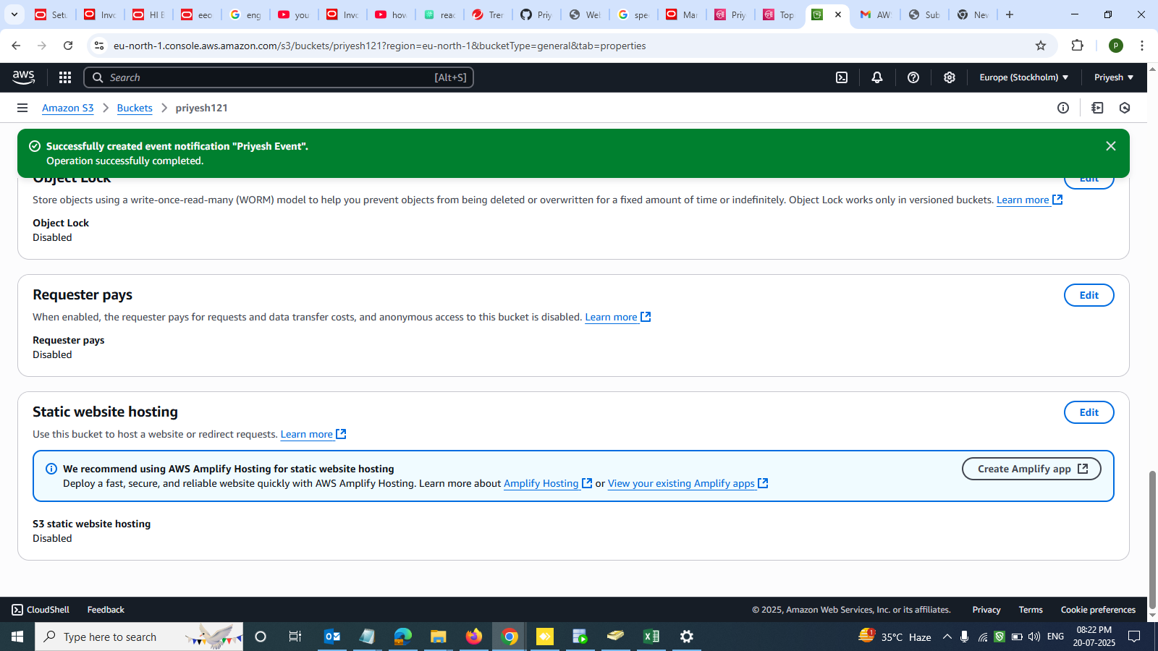
Creating Event notification in S3 Bucket

Slide 9
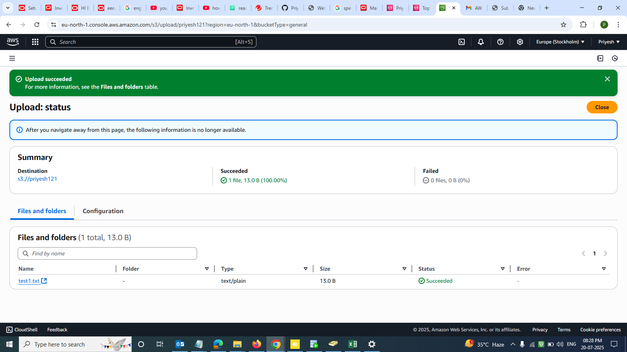
Upload a .txt document in S3

Slide 10
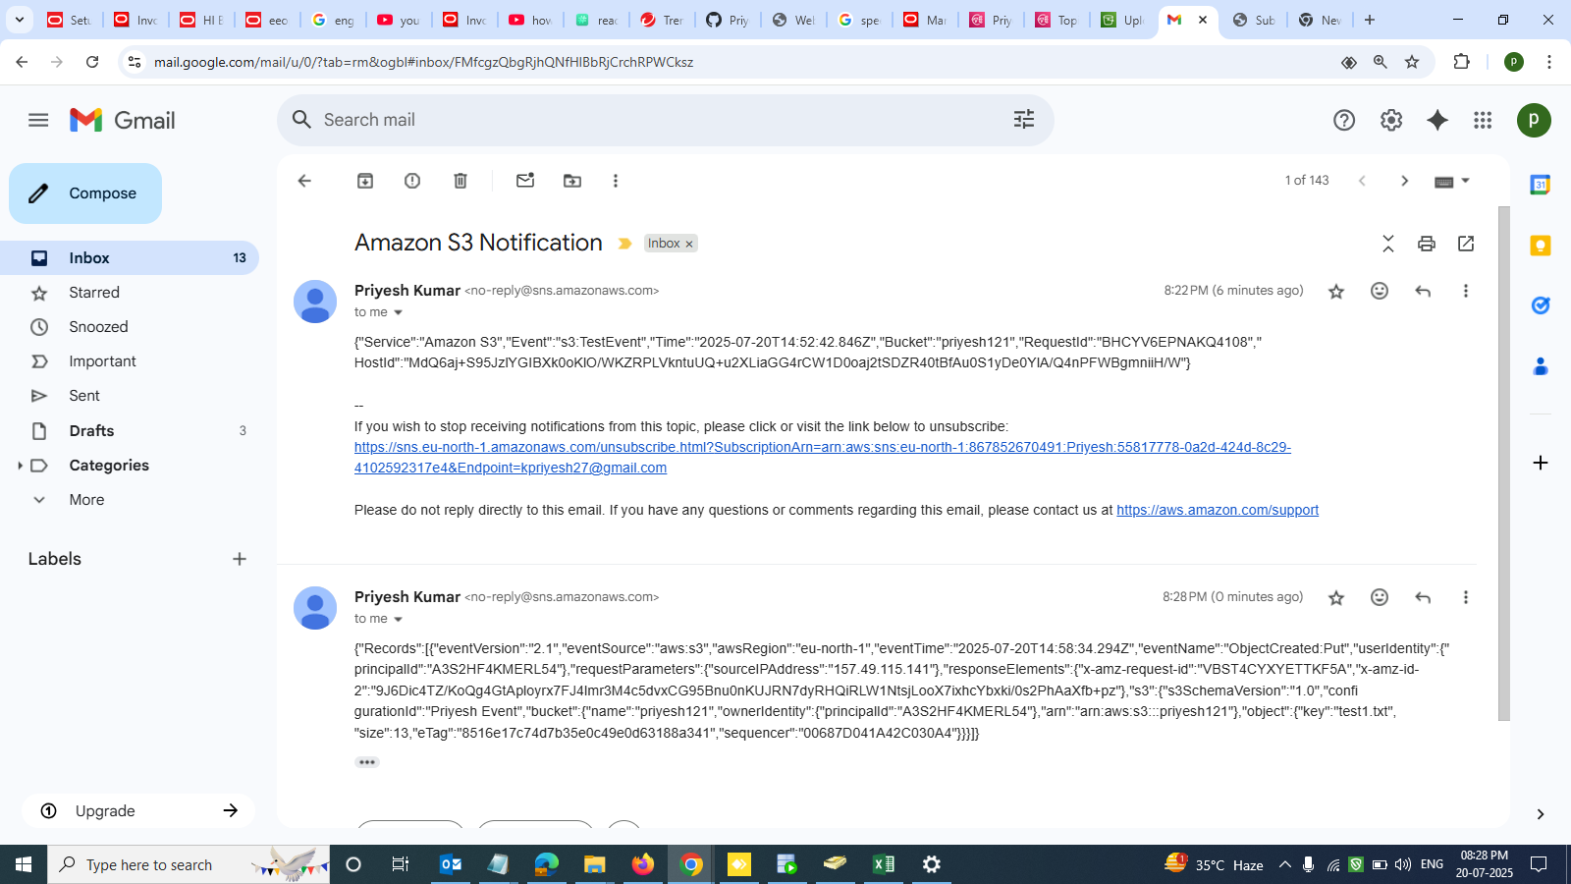
Successfully notification received on Email

Slide 11
Thankyou

