Slide 1
End-End CICD pipeline

Slide 2
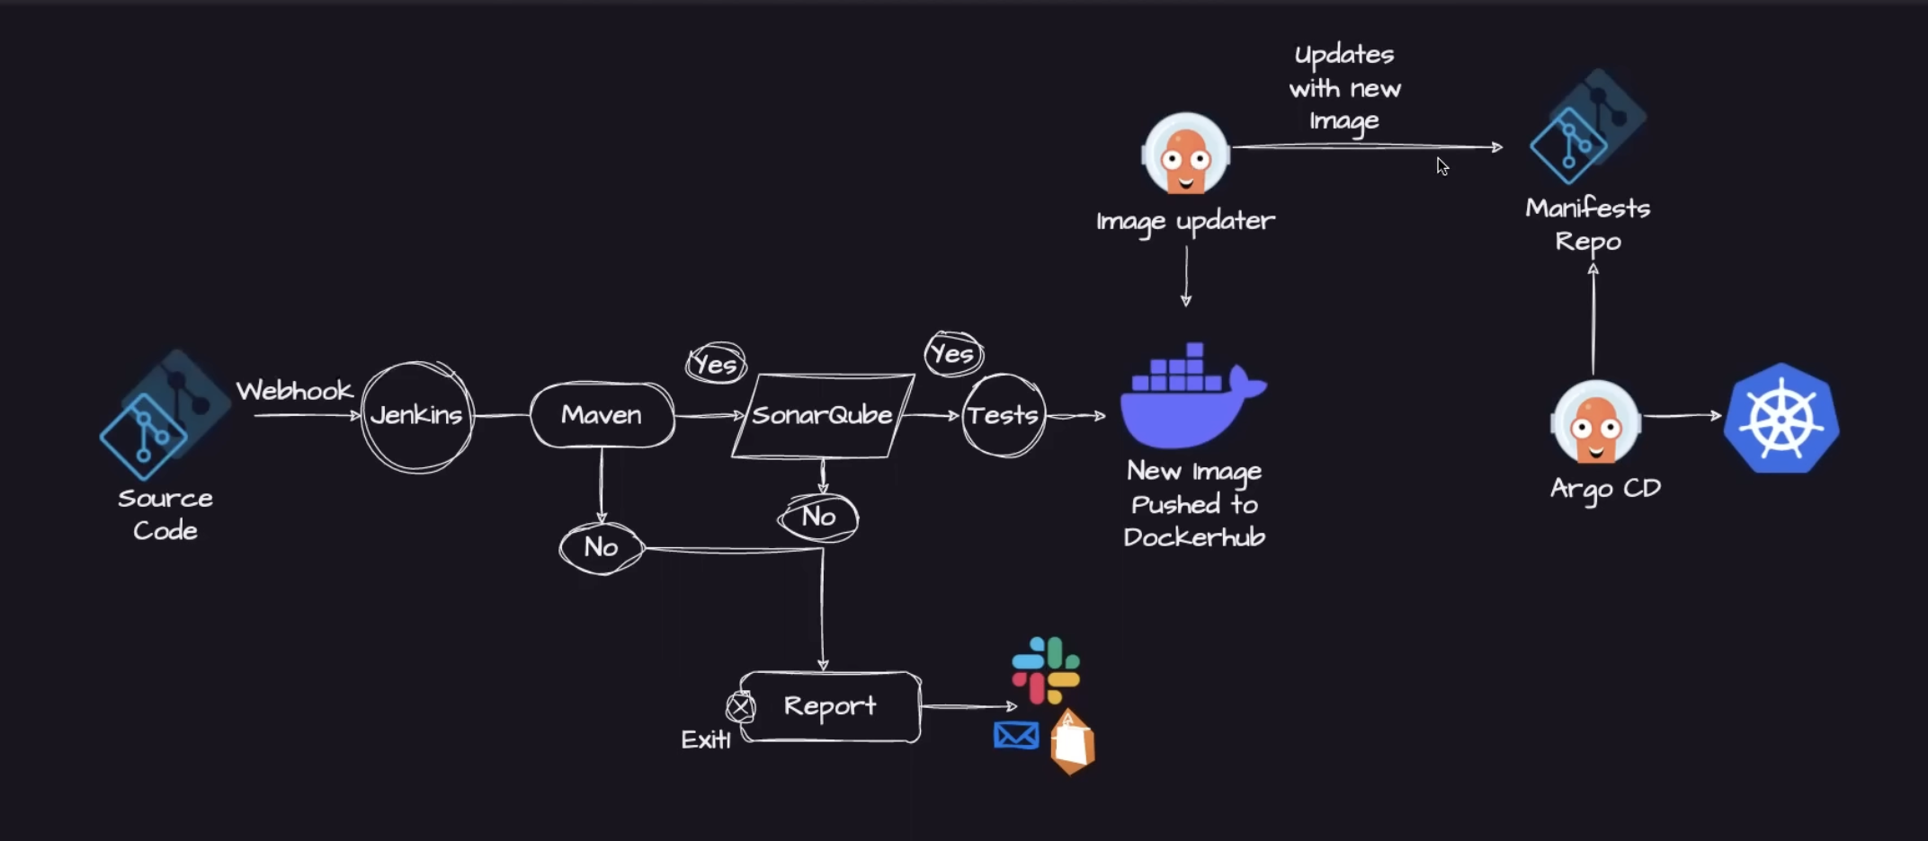
End-End Pipeline Creation

Slide 3
Git Repo:
https://github.com/muthuramanathanm/Jenkins-examples/tree/main/java-maven-sonar-argocd-helm-k8s
Step1:
Follow this steps in repo link https://github.com/muthuramanathanm/Jenkins-examples
Step 2:
Install the “docker pipeline” plugin from Manage Jenkins ->Plugins

Slide 4
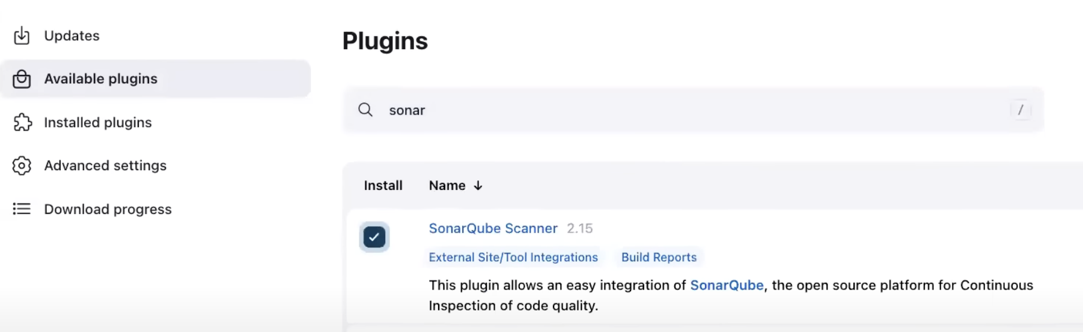
Step3 :
Install Sonar plugin from Manage Jenkins -> Plugins

Slide 5
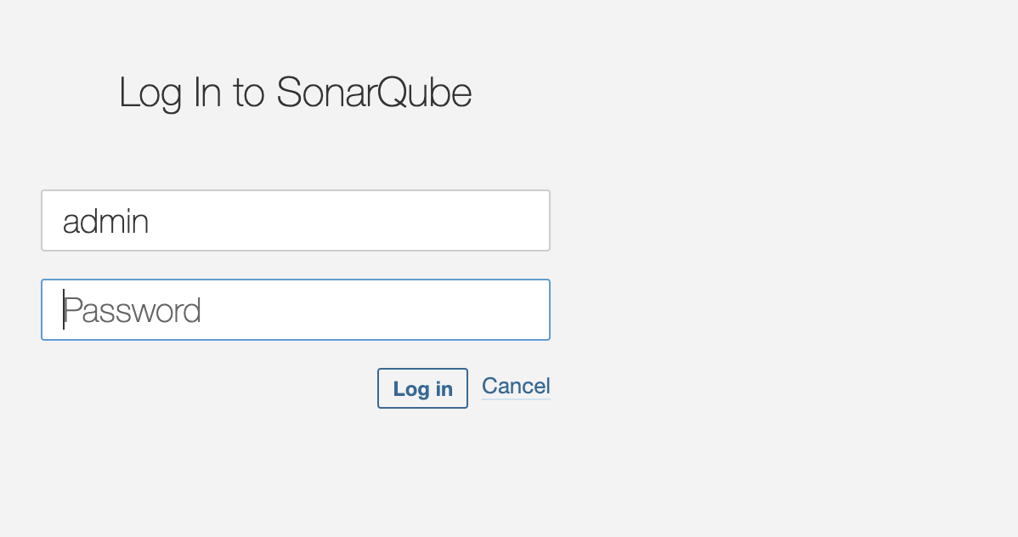
Step 4: Setup the sonar server
https://github.com/muthuramanathanm/Jenkins-examples/tree/main/java-maven-sonar-argocd-helm-k8s/spring-boot-app
Look for “Configure a Sonar Server locally” or EC2 machine
Run the sonar server (By default 9000 is port)
http://100.25.193.139:9000/
Username: admin
Password: admin

Slide 6
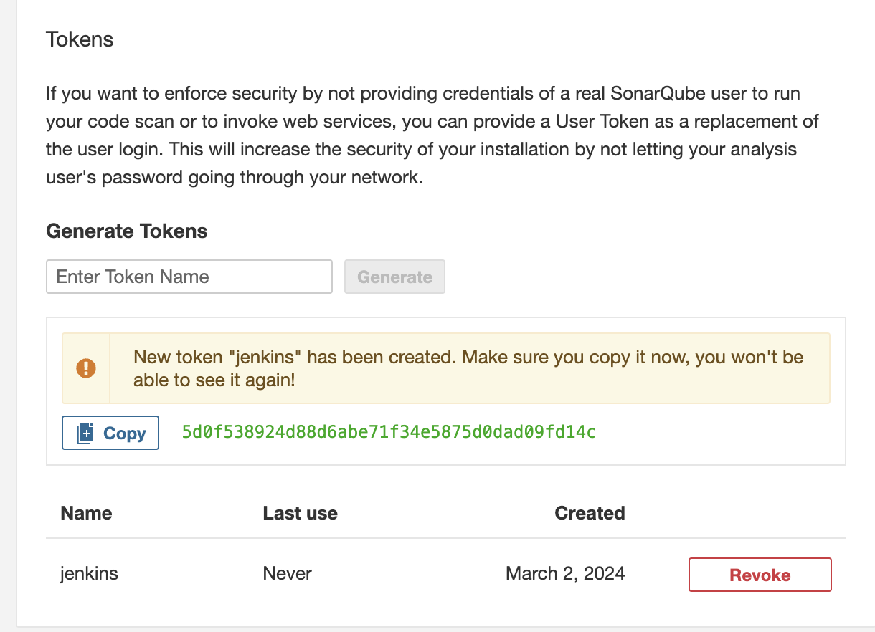
Step 5:
Jenkins need permission to access sonar server.
Sonar server -> My Account -> Secuirty -> Generate Tokens
Enter Token name as “jenkins” and click Generate button.
Note: Why we are doing this. Because Jenkins and Sonar 2 different applications and need to authenticate before access each other.

Slide 7
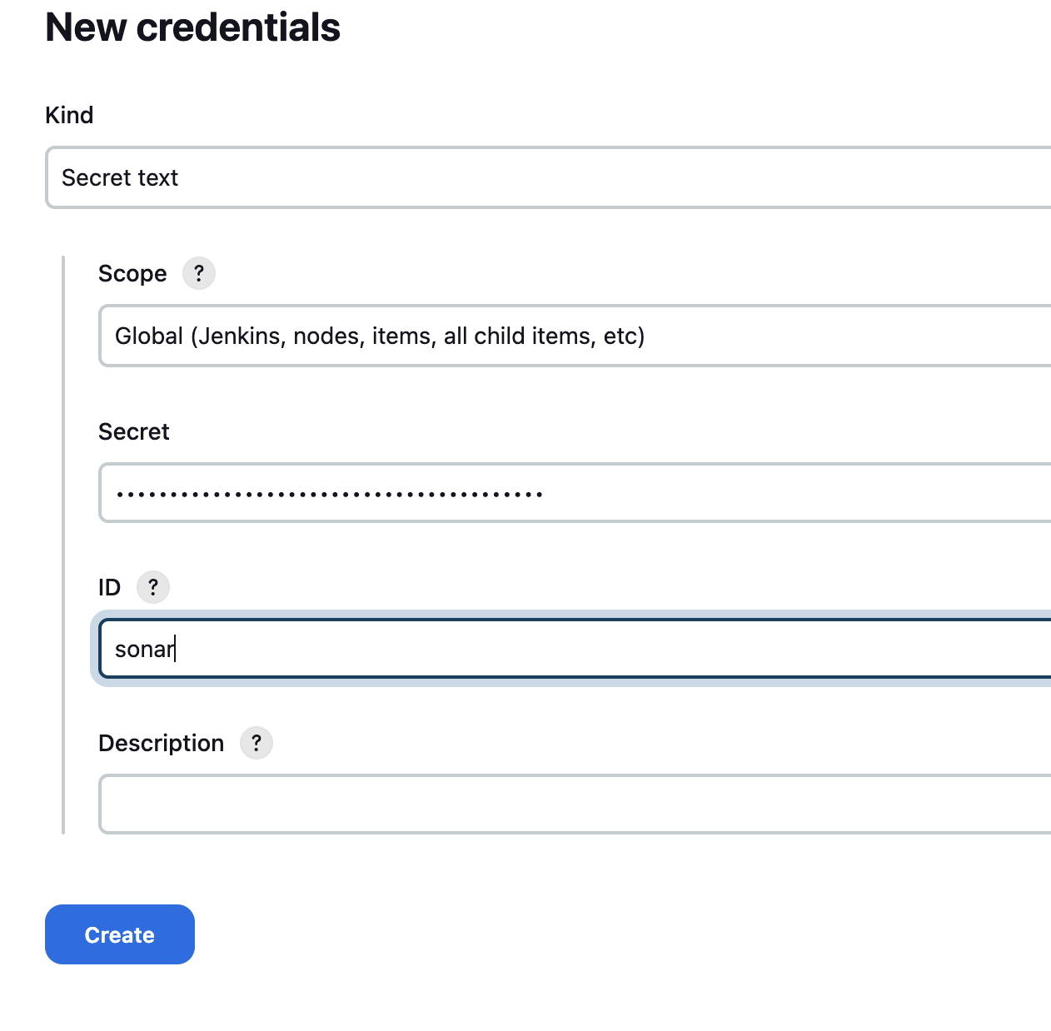
Step 6:
Go to Jenkins -> Manage Jenkins -> Credentials -> choose system
Click on Add credentials -> choose secret text from dropdown
Paste the token in secret text box

Slide 8
Step 7: Install docker
Please ignore if already installed
sudo apt install docker.io
sudo su –
usermod -aG docker Jenkins
usermod -aG docker ubuntu
systemctl restart docker
Once done. Please restart the Jenkins server
http://100.25.193.139:8080/restart

Slide 9
Step 8: Install MiniKube and start
https://minikube.sigs.k8s.io/docs/start/
Run the below command(MacOS)
curl -LO https://storage.googleapis.com/minikube/releases/latest/minikube-darwin-amd64
sudo install minikube-darwin-amd64 /usr/local/bin/minikube
minikube start
Minikube is a tool that allows you to run Kubernetes clusters locally on your machine. It is designed for developers and users who want to try out Kubernetes or develop applications locally without the need for a full-scale Kubernetes cluster.

Slide 10
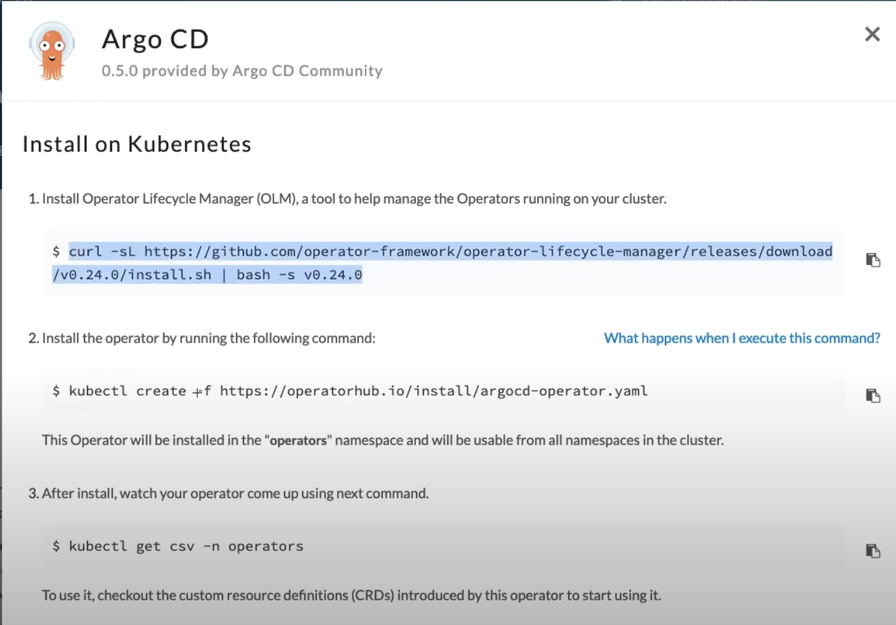
Step 9: Argo CD installed
https://operatorhub.io/operator/argocd-operator
Please Note:
If it already exist then
kubectl delete subscriptions.operators.coreos.com my-argocd-operator -n operators
> kubectl get pods -n operator

Slide 11
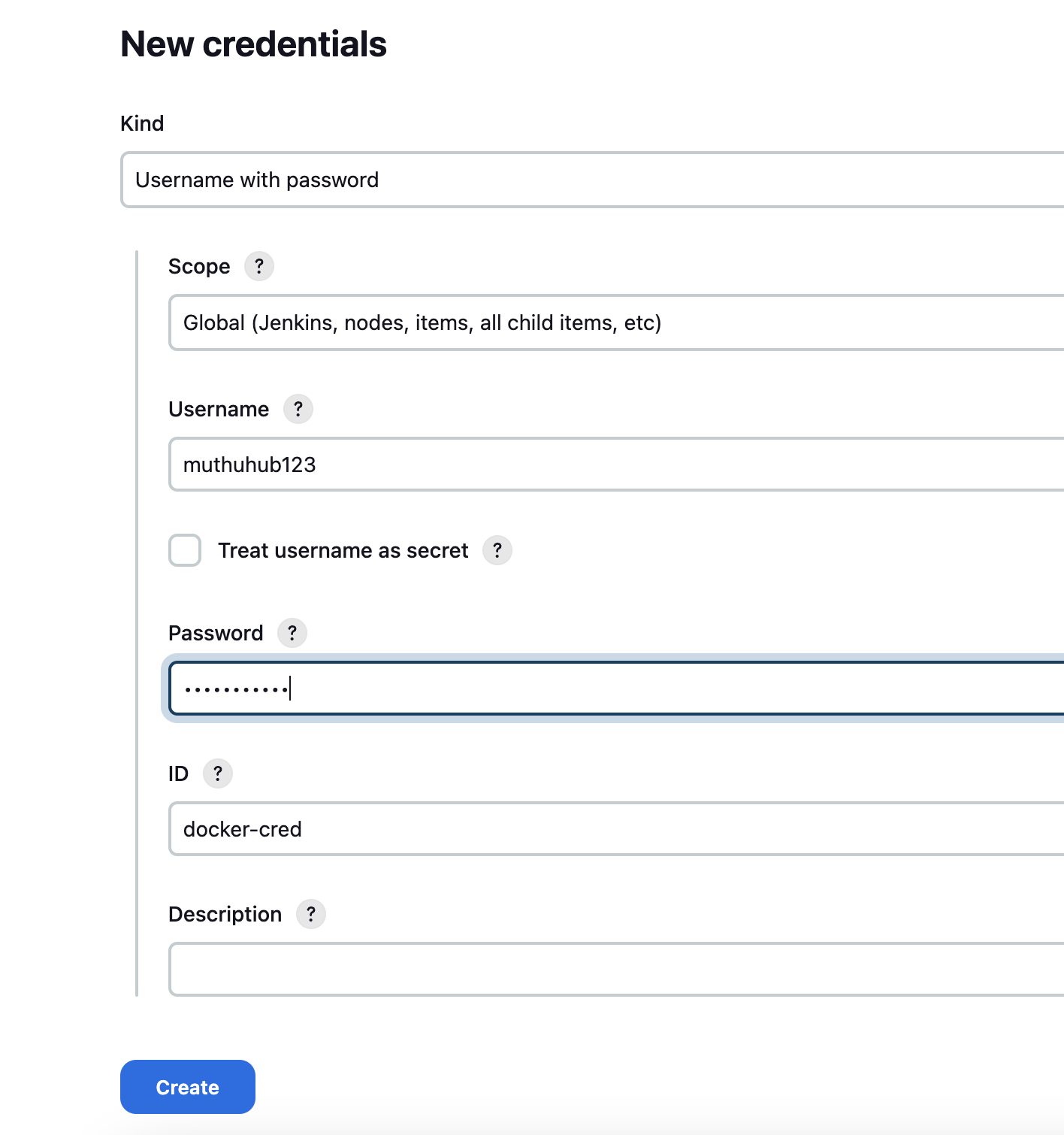
Step 10: Create Credential for Docker hub
Go to jenkins -> Manage Jenkins -> click on system
Global credentials -> Key Docker hub username and password
and ID should be docker-cred which should match with Jenkinsfile
REGISTRY_CREDENTIALS = credentials('docker-cred')

Slide 12
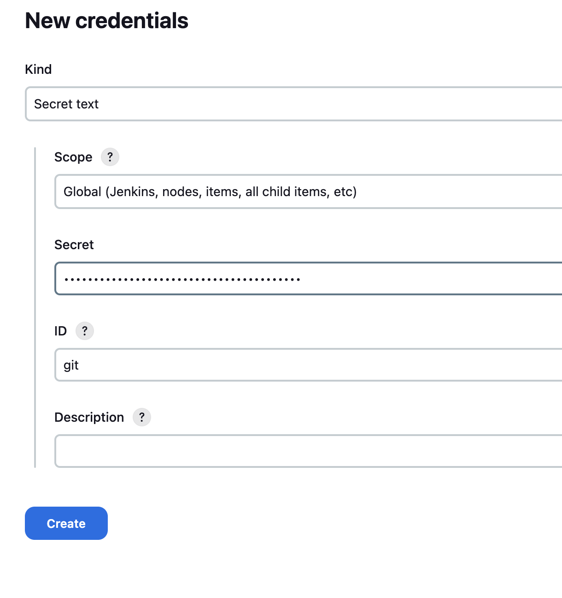
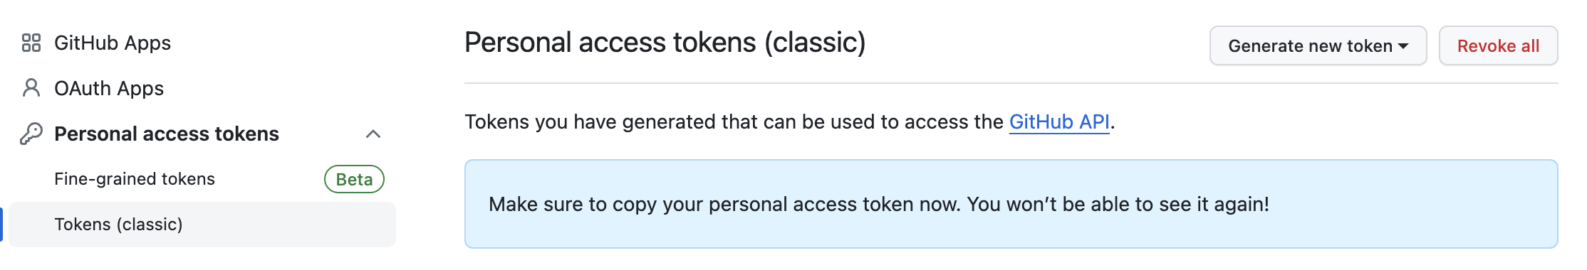
Step 11:
Create Credential for git hub
Choose secret text and copy the git hub PAT
token and paste it in secret text box.
Go to GitHub (https://github.com/settings/tokens)
-> settings
Developer settings -> personal access token(PAT) -> generate token(classic)

Slide 13
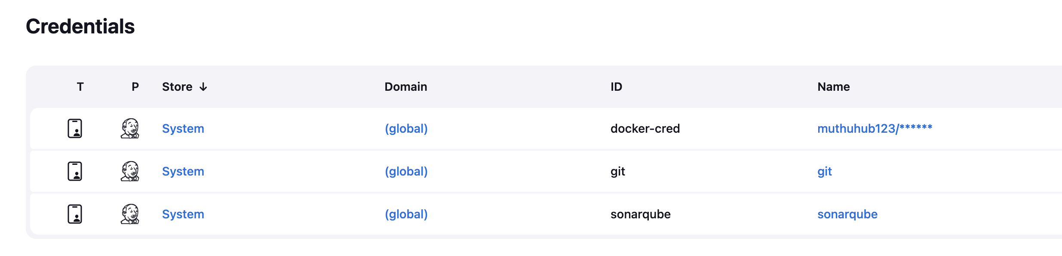
Please find the all required credentials in order to connect with other applications

Slide 14
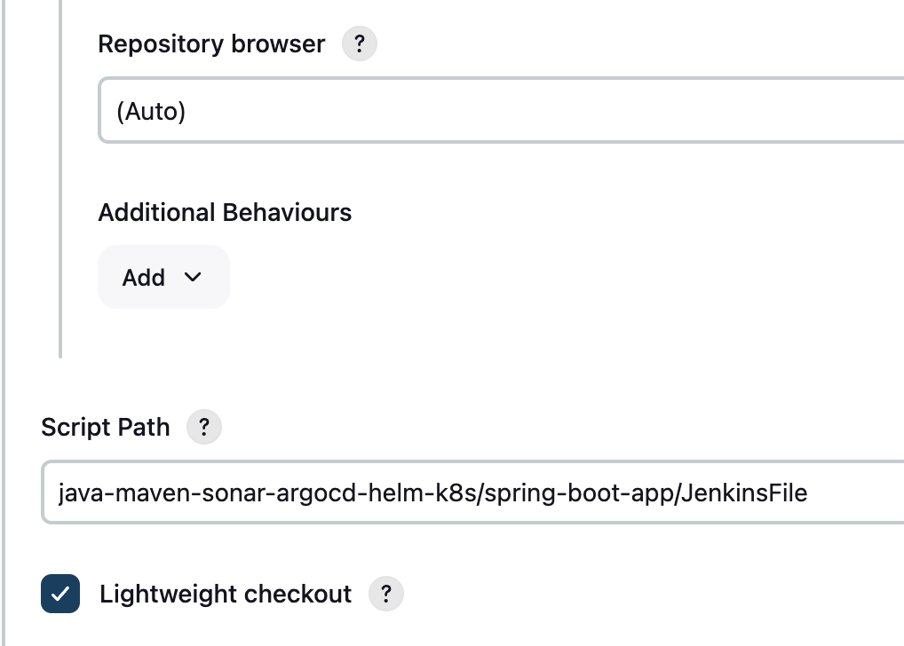
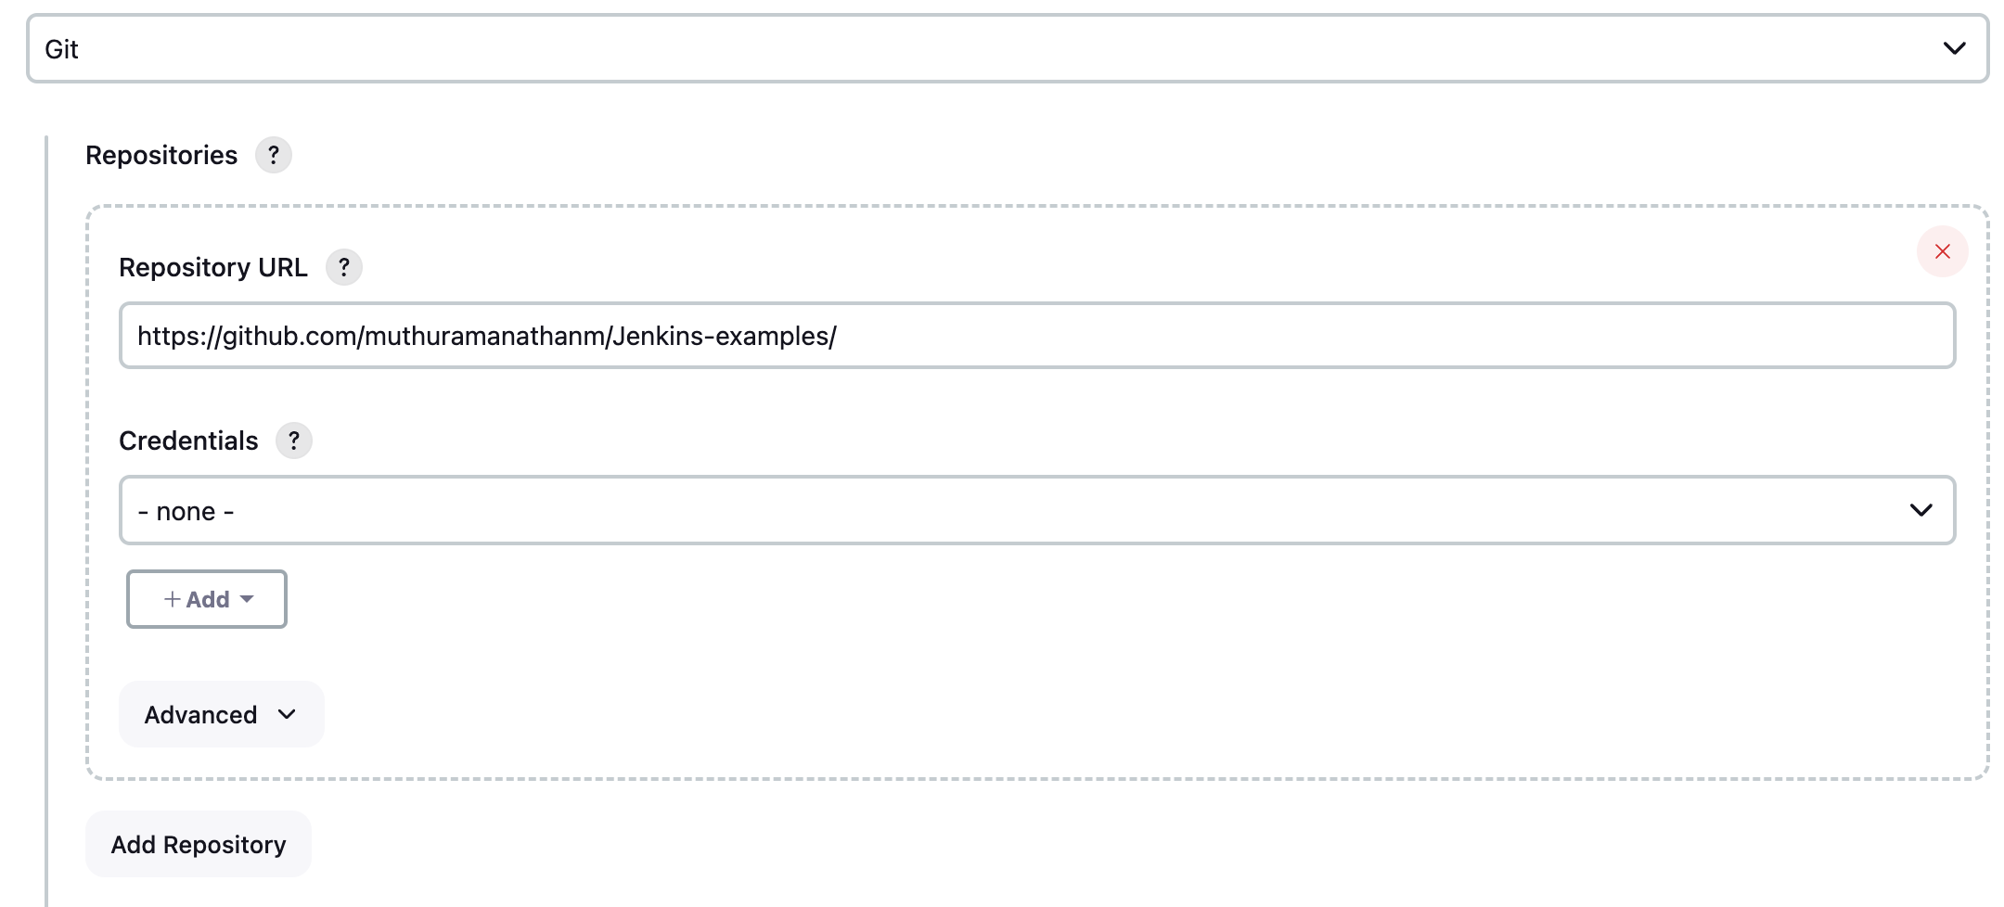
Step 12: Create pipeline project and select Git SCM checkout and click save

Slide 15
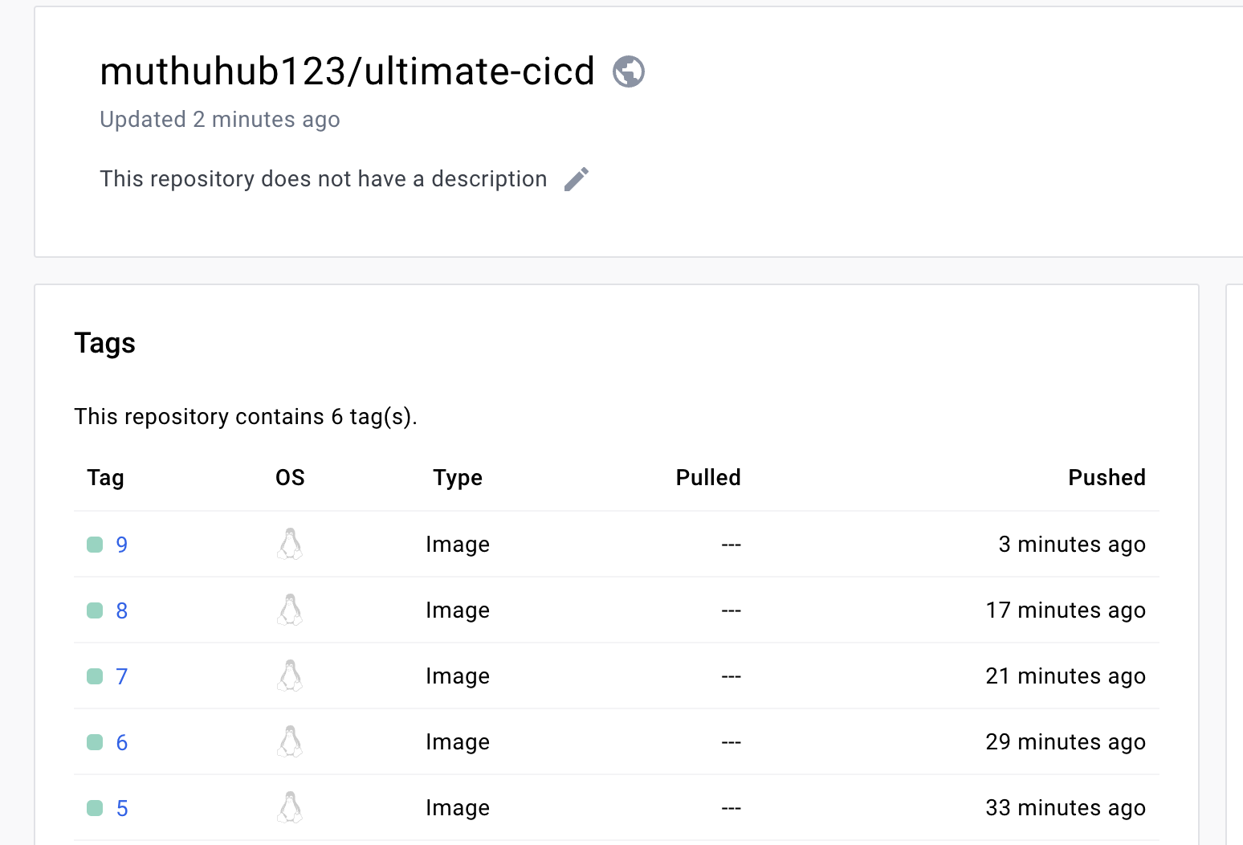
Jenkin Build Issue:
java-maven-sonar-argocd-helm-k8s/spring-boot-app-manifests/deployment.yml
image: abhishekf5/ultimate-cicd:replaceImageTag
Make sure everytime it replace buildversion with replaceImageTag.
Before build you need to change replaceImageTag.
Docker image should created in Docker hub

Slide 16
https://github.com/muthuramanathanm/Jenkins-examples/blob/main/java-maven-sonar-argocd-helm-k8s/spring-boot-app-manifests/deployment.yml
Image Version should get update as highlighted in red color:
apiVersion: apps/v1
kind: Deployment
metadata:
name: spring-boot-app
labels:
app: spring-boot-app
spec:
replicas: 2
selector:
matchLabels:
app: spring-boot-app
template:
metadata:
labels:
app: spring-boot-app
spec:
containers:
- name: spring-boot-app
image: abhishekf5/ultimate-cicd:9
ports:
- containerPort: 8080

Slide 17
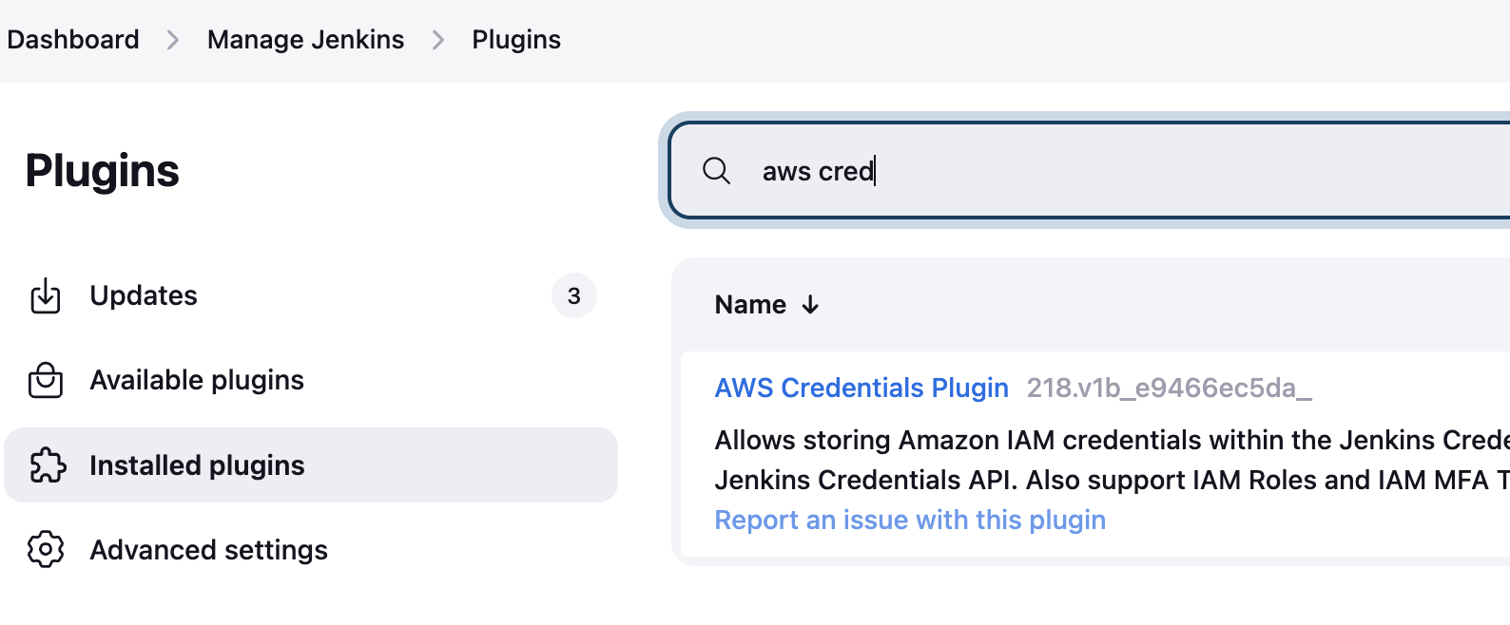
Deploy the Lambda code using Jenkins CICD
Please use the repo and create
https://github.com/muthuramanathanm/cicd_lambda_deploy
Install AWS Credentials Plugin from Manage Jenkins

Slide 18
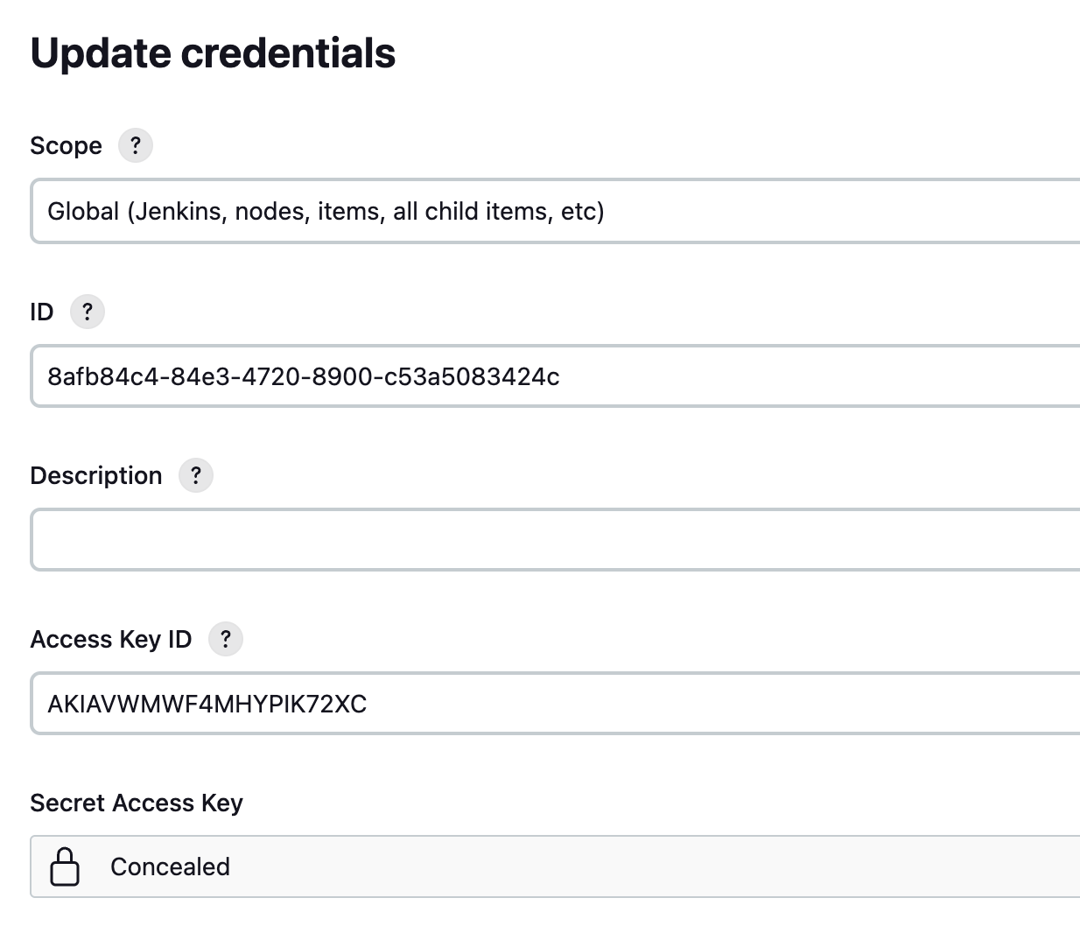
Create Global Credentials for AWS

Slide 19
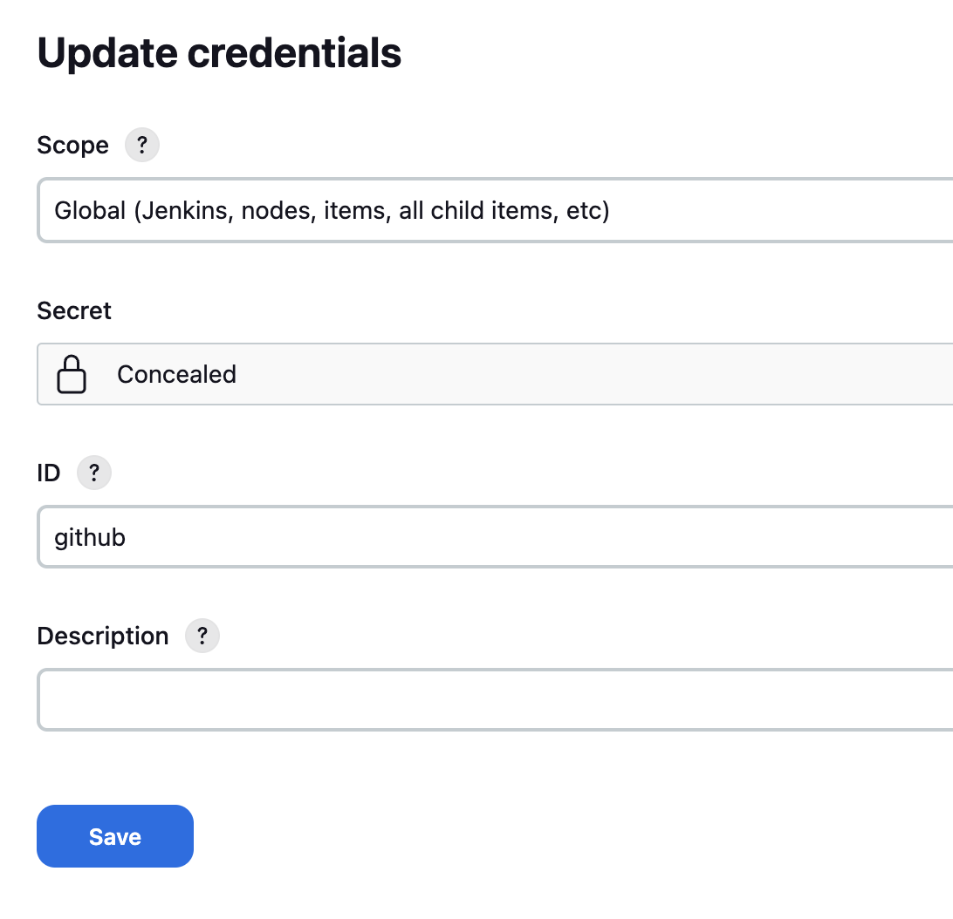
Create global credentials for Github
Secret Text should be copied from Personal Access Token(PAT) in gitRepo

Slide 20
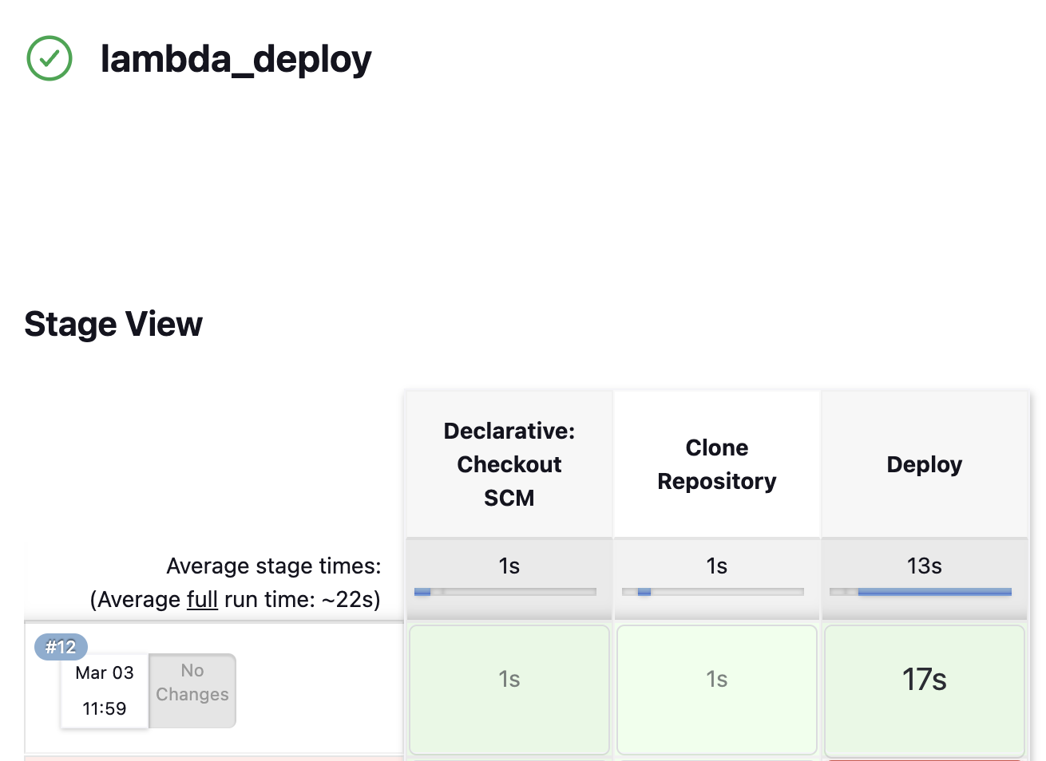
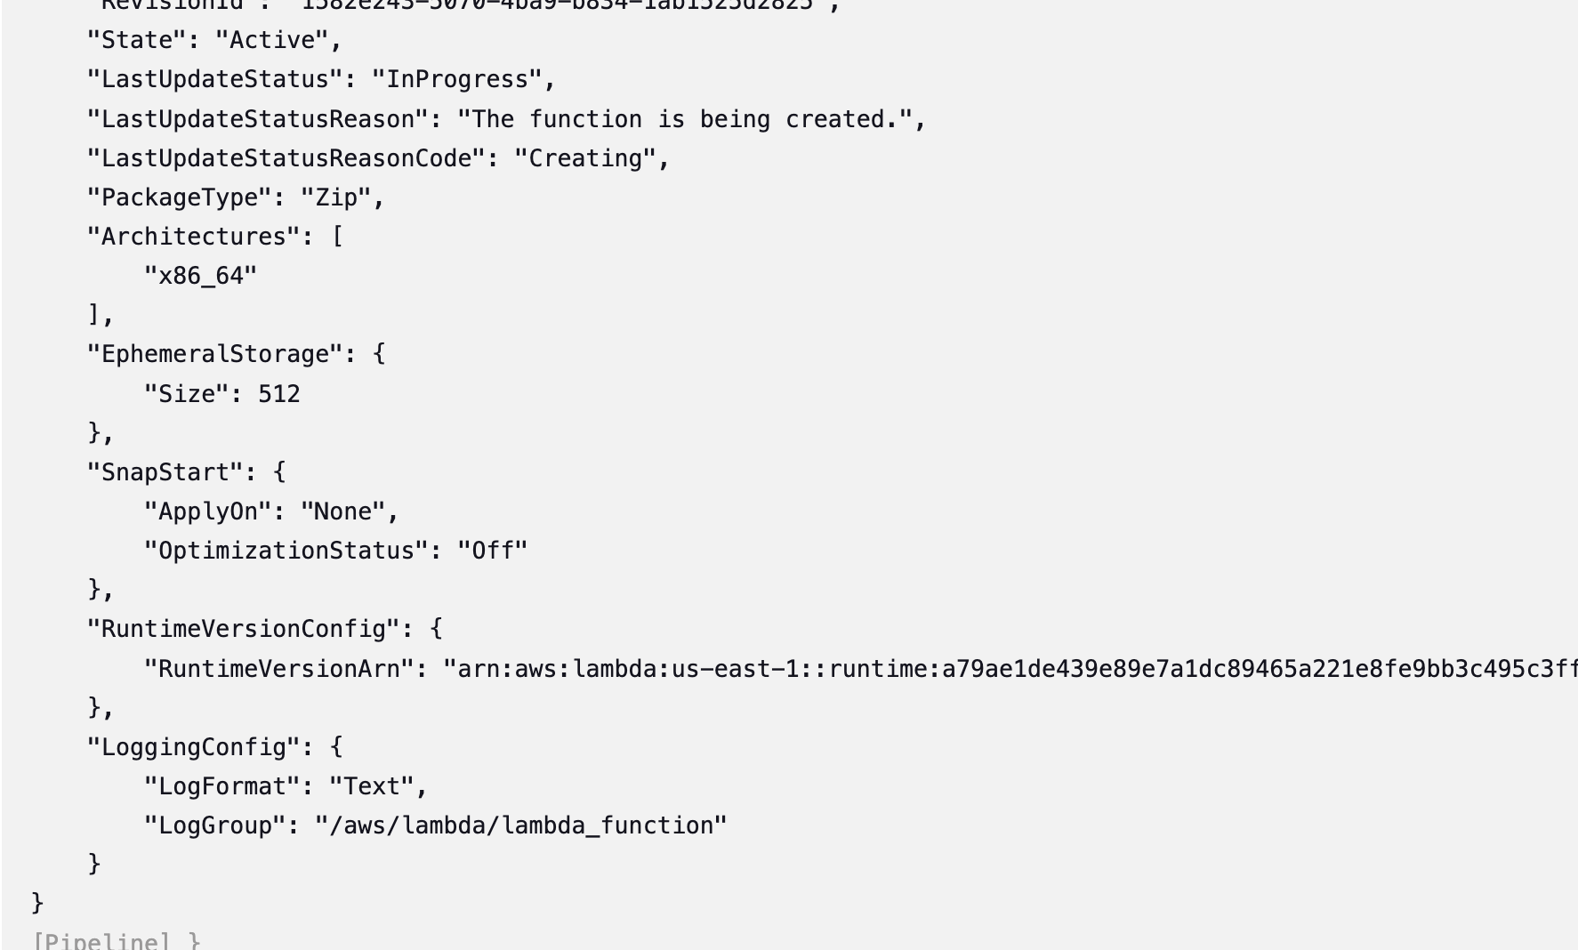
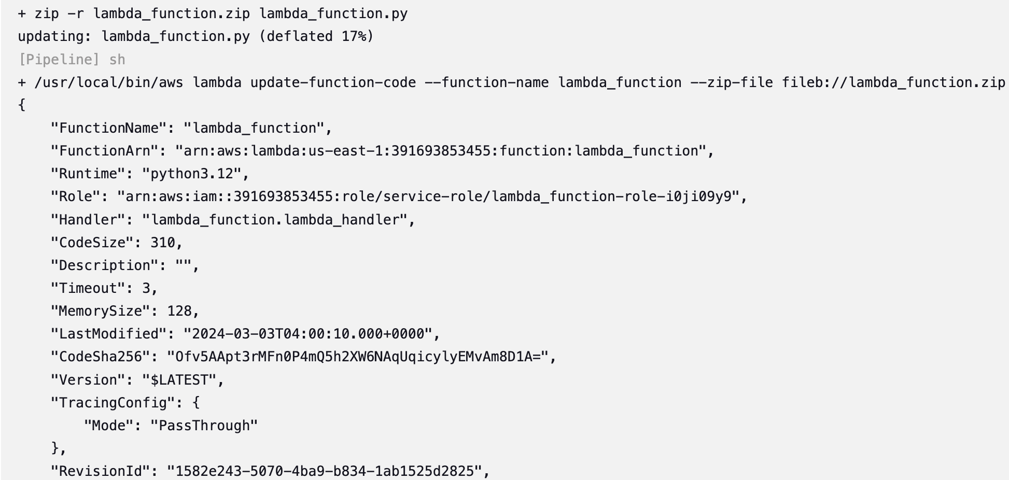
Run the Jenkins Build

