Slide 1
Ecommerce Web Application: Demonstrating Cloud load balancer capabilities
Priyesh Wani
&
Sudeep Agarwal

Slide 2

Motivation
Subject: Apologies, from Flipkart
Dear Customer,
Yesterday was a big day for us. And we really wanted it to be a great day for you. But at the end of the day, we know that your experience was less than pleasant. We did not live up to the promises we made and for that we are really and truly sorry.
Website Issues We realise that the shopping experience for many of you was frustrating due to errors and unavailability of the website at times. We had deployed nearly 5000 servers and had prepared for 20 times the traffic growth - but the volume of traffic at different times of the day was much higher than this. We are continuing to significantly scale up all our back end systems so that we do a much, much better job next time.
Regards
Flipkart

Slide 3
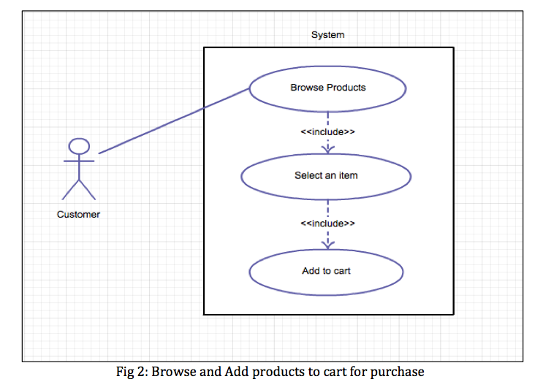
Use-Case Diagram

Slide 4
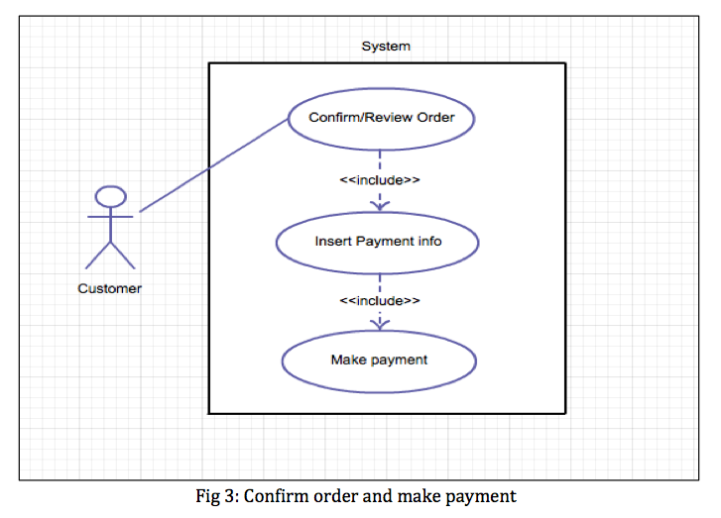
Use-Case Diagram (contd…)

Slide 5
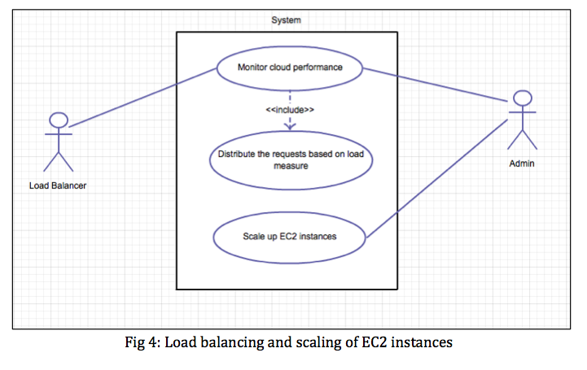
Use-Case Diagram (contd…)

Slide 6
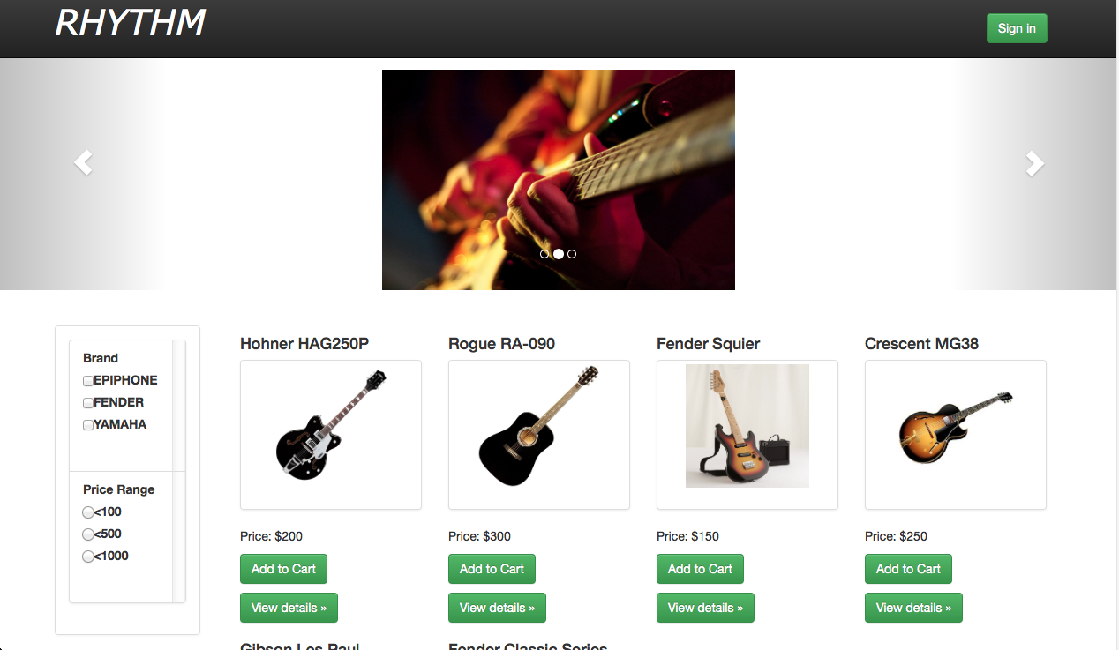
Web Application Home-page

Slide 7
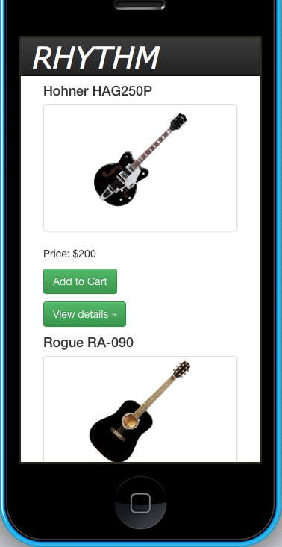
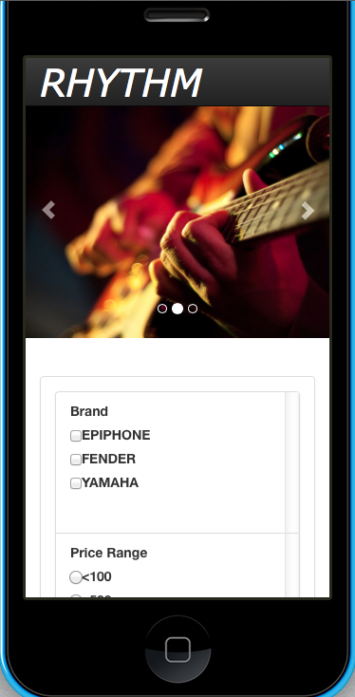
Mobile device Compatibility
Emulator:
iphone 5c

Slide 8
AWS Cloud Load Balancer
Receives incoming service requests from various clients
Calculates requested load size of the incoming load request from clients and builds a request queue
Checks the current load status of the servers in the server pool periodically using a server monitor daemon
Uses a load balancing strategy/algorithm to select appropriate server.

Slide 9
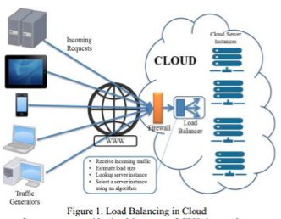

Slide 10
Silk Performer
Silk Performer is a tool used for performance based testing of web applications
It provides cloud agents to generate virtual load from locations across the globe.
The script simulates end-to-end user scenario to be executed by virtual users

Slide 11
Results

Slide 12
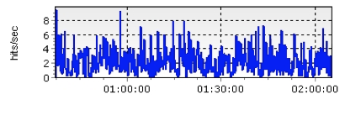

Hits Per second

Slide 13
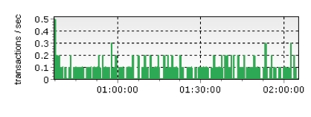

Transactions per second

Slide 14
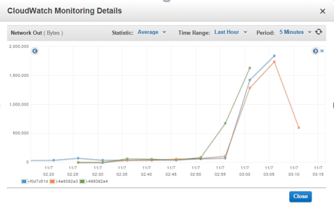
Cloud Watch Result

Slide 15
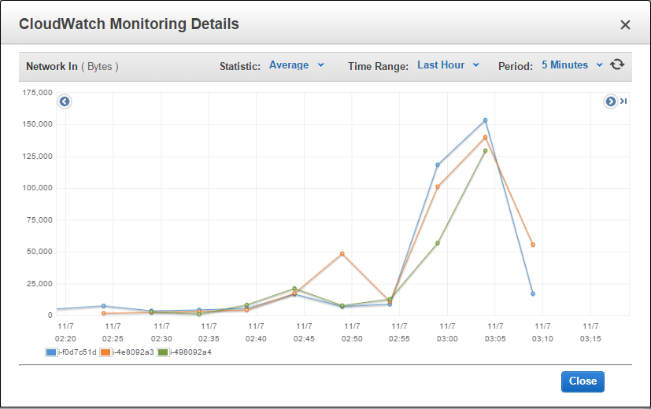
Cloud Watch Result (Contd…)

Slide 16
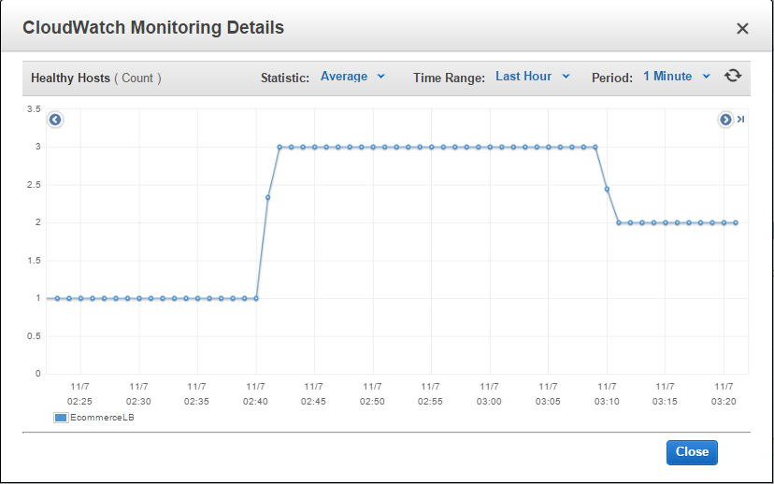
Cloud Watch Result (Contd…)

Slide 17
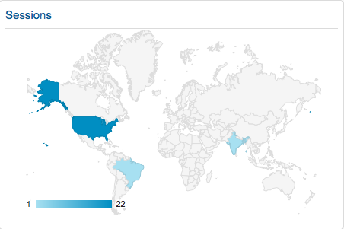
Google Analytics

Slide 18
Conclusion
From the results we can conclude that load balancing capability offered by AWS has potential benefits of scalability.
E-commerce web applications tend to have varying workloads which can be addressed by cloud load balancer.

Slide 19
Questions?

Slide 20
Thank you

