Slide 1
Distance Vector Routing Protocol
By :
Vidushi Bindroo 17115
Urja 17126
Garvita 17105

Slide 2
The purpose of this project is to implement, validate and demonstrate a simple Distance Vector protocol of the type that might be used by Peer to Peer, Wireless Sensor or Internet of Things communication devices. We use UDP Sockets and the C/C++ programming language to build a distance vector routing protocol that implements the distributed Bellman-Ford algorithm.
PURPOSE

Slide 3
What Is Distance vector routing ?
A distance-vector routing (DVR) protocol requires that a router inform its neighbors of topology changes periodically. Historically known as the old ARPANET routing algorithm (or known as Bellman-Ford algorithm).
Bellman Ford Basics – Each router maintains a Distance Vector table containing the distance between itself and ALL possible destination nodes. Distances, based on a chosen metric, are computed using information from the neighbors’ distance vectors.

Slide 4
Basic Structures
A cpp file : our main file
A .h: the interface file for the Distance Vector class and other structures
Another cpp file : the implementation of .h file

Slide 5
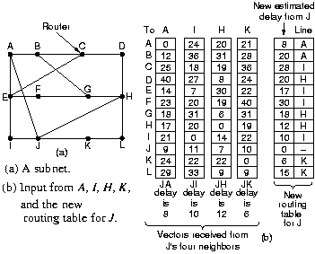
Algorithm:
A router transmits its distance vector to each of its neighbors in a routing packet.
Each router receives and saves the most recently received distance vector from each of its neighbors.
A router recalculates its distance vector when:
It receives a distance vector from a neighbor containing different information than before.
It discovers that a link to a neighbor has gone down

Slide 6
Why this Protocol ?
Stable and proven method (distance vector was the original routing algorithm)
Easy to implement and administer
Bandwidth requirements negligible for a typical LAN environment
Requires less hardware and processing power than other routing methods

