Slide 1
MongoDB Installation Guide

Slide 2
Step 1 :
Open browser and type the link given below in address bar
https://www.mongodb.com/1

Slide 3
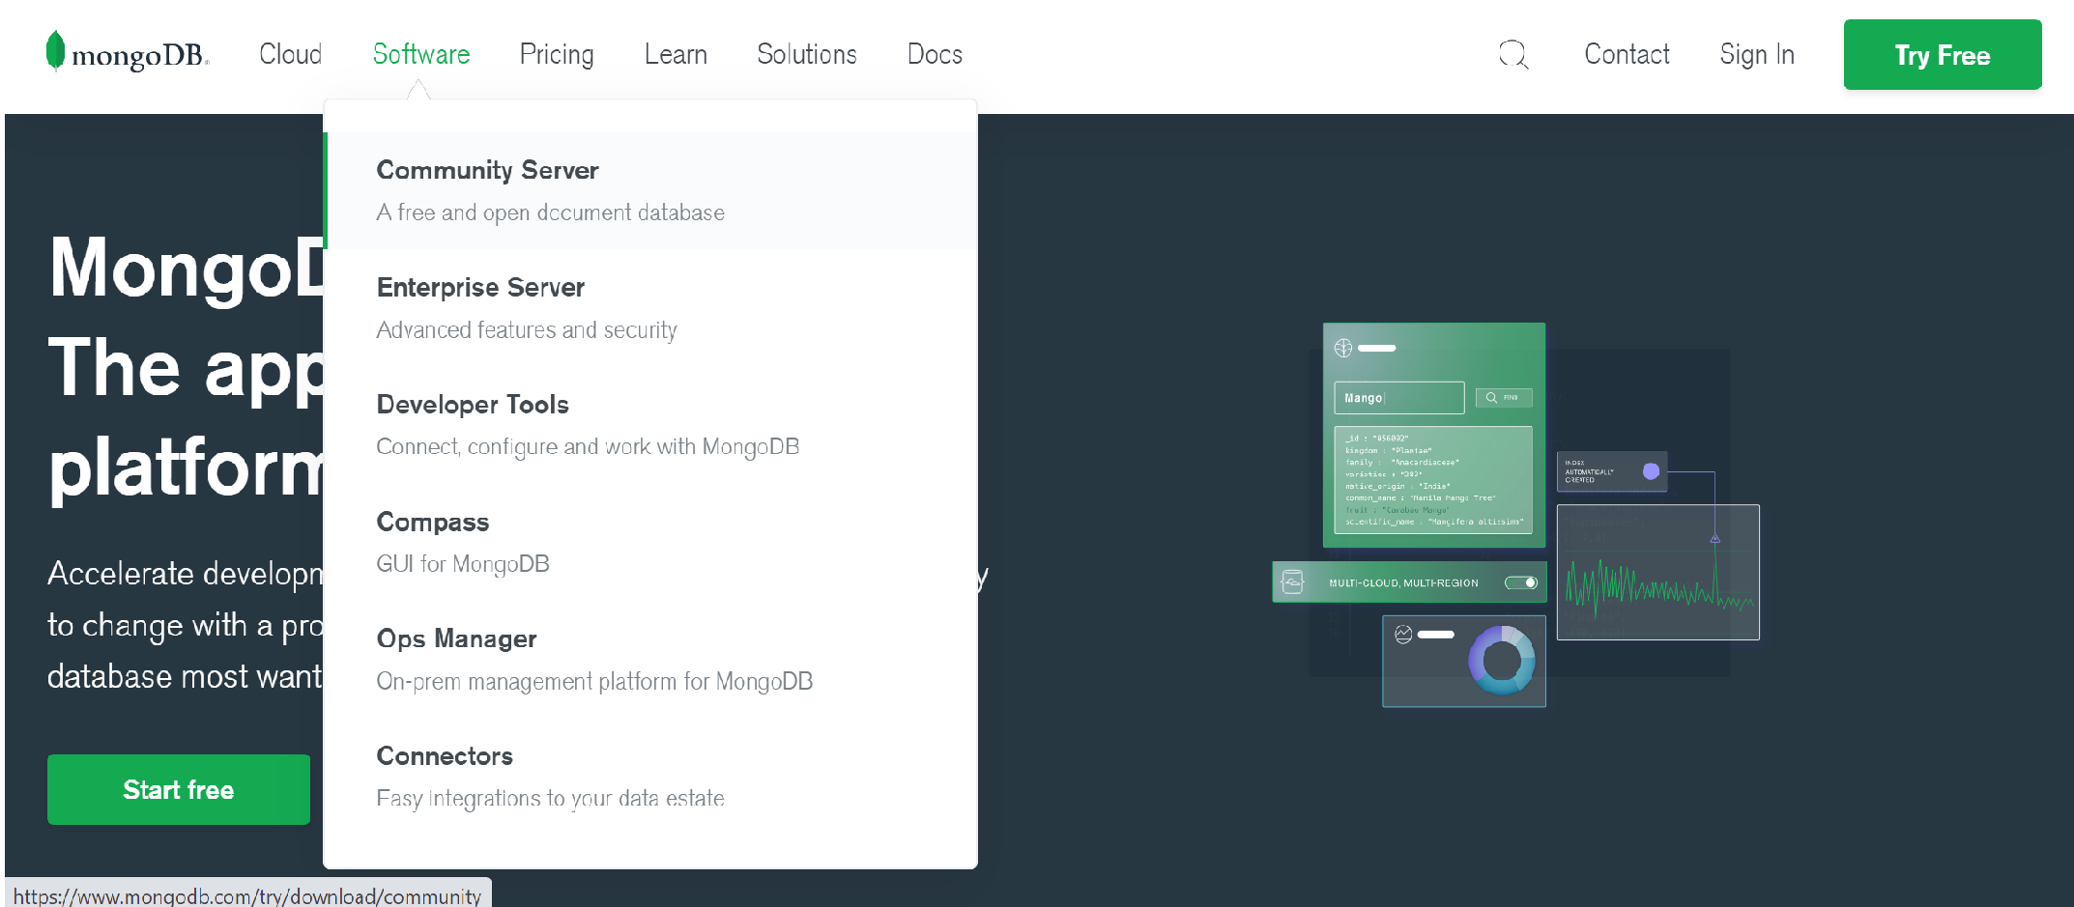
Step 2 :
Select the software and then click on Community Server.

Slide 4
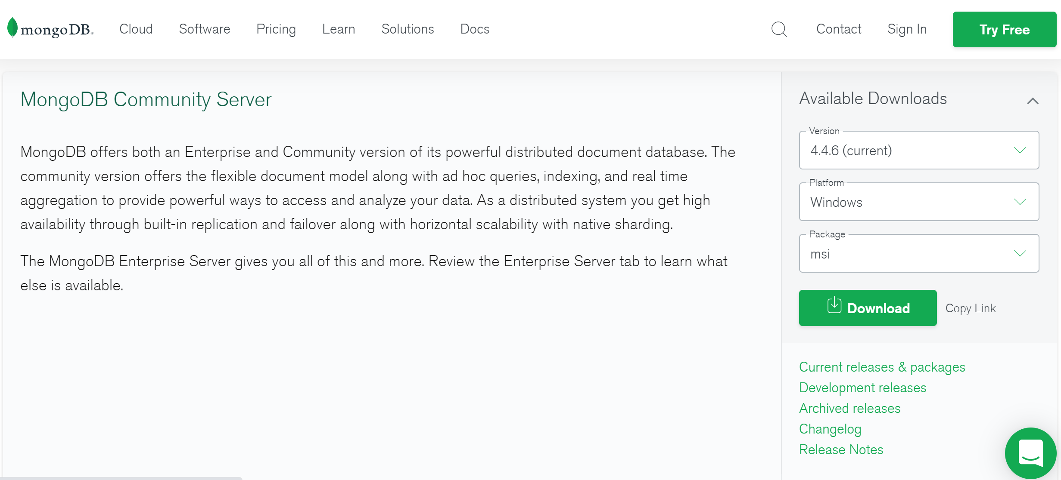
Step 3 :
Select the platform, package as msi and click on download.

Slide 5
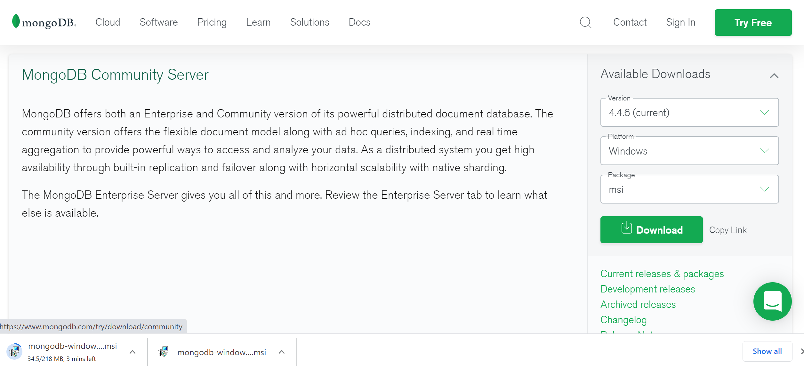
Step 4 :
After selecting suitable fields , downloading will start
5

Slide 6
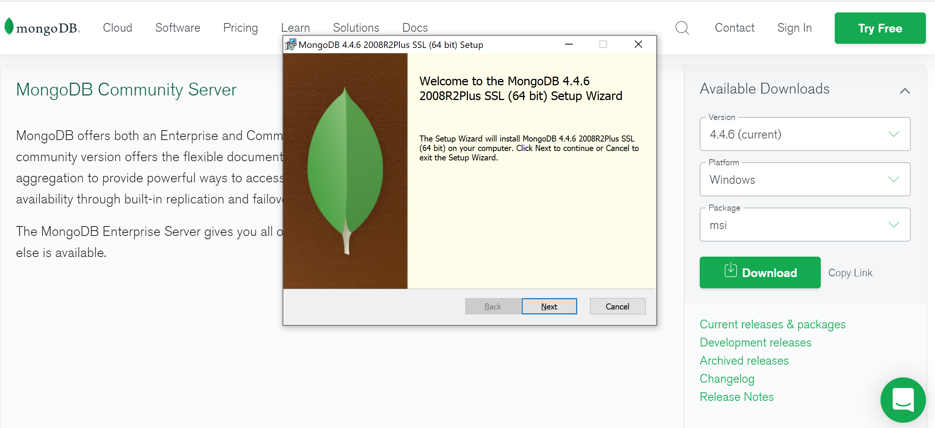
Step 5 :
Once downloaded, click on the setup file and click next.

Slide 7
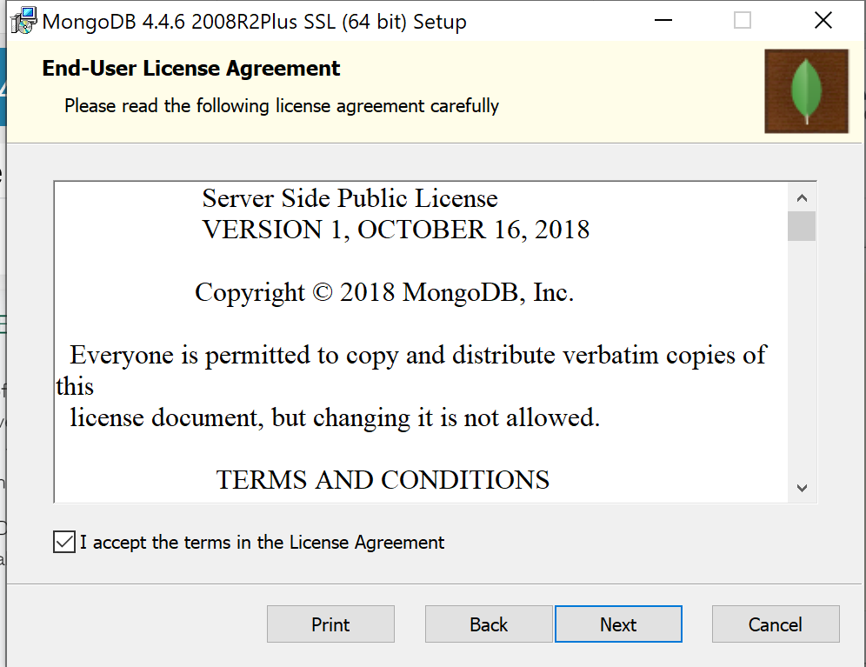
Step 6 :
On clicking next accept the terms and proceed.
7

Slide 8
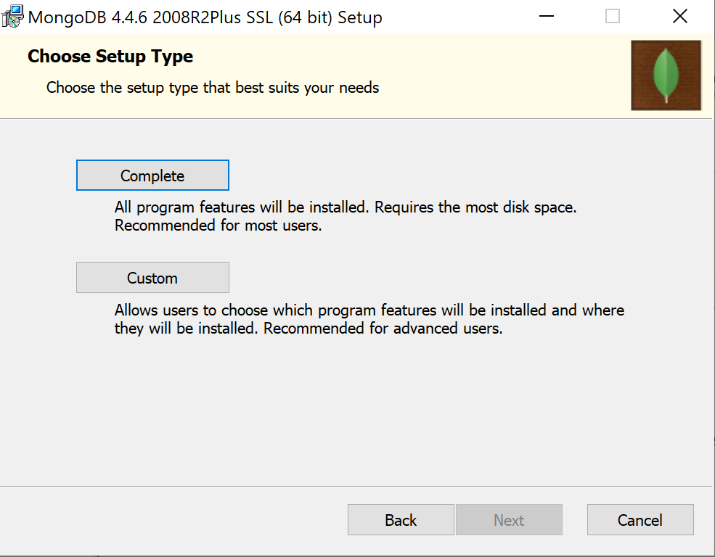
Step 7 :
Choose the setup type as Complete.
8

Slide 9
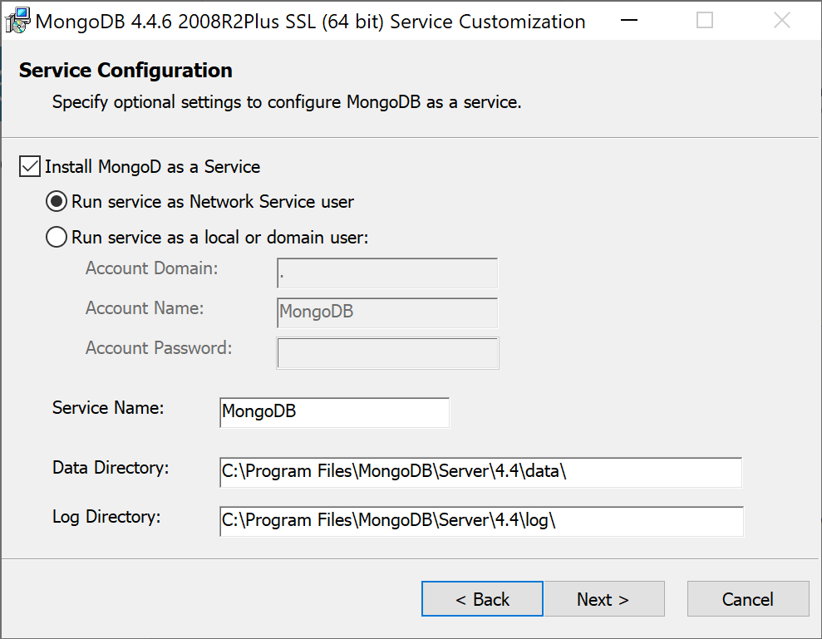
Step 8 :
On clicking complete let all the settings be default, click on next.
9

Slide 10
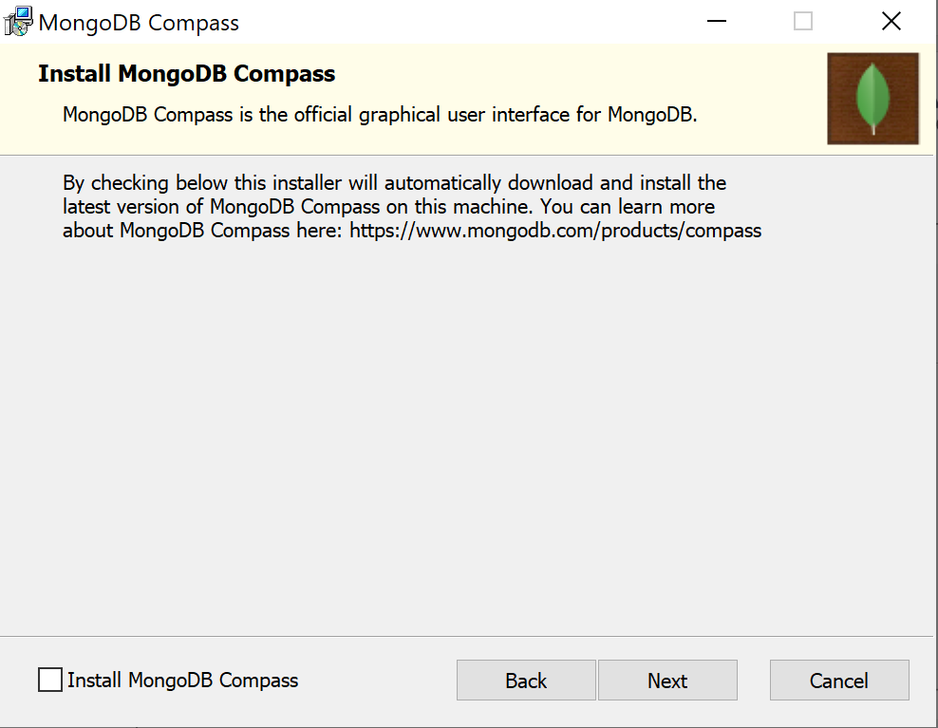
Step 9 :
Uncheck the Install MongoDB Compass option and click next.
10

Slide 11
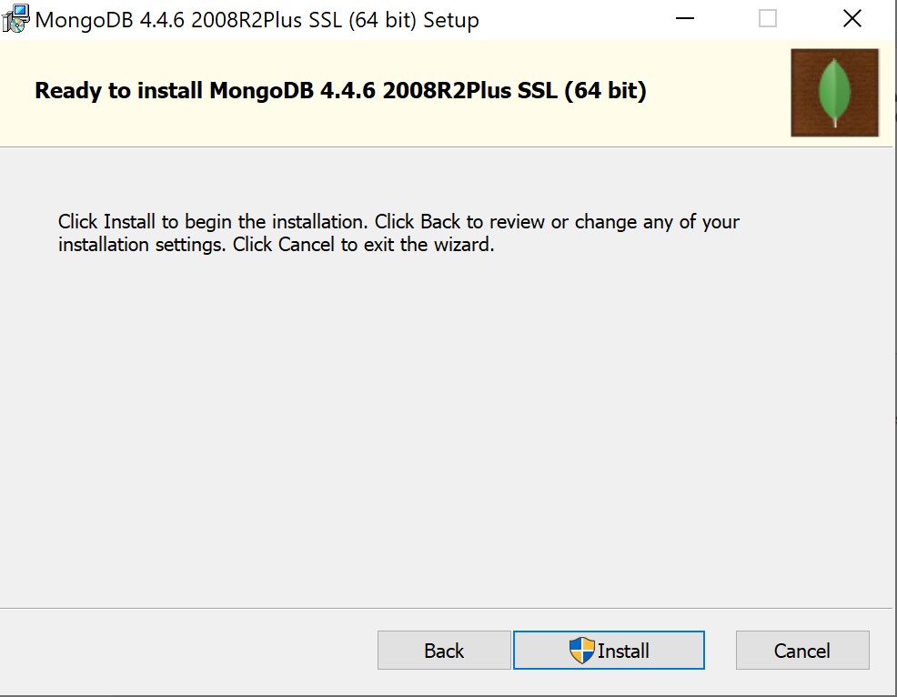
Step 10 :
Click on install in the next step.
11

Slide 12
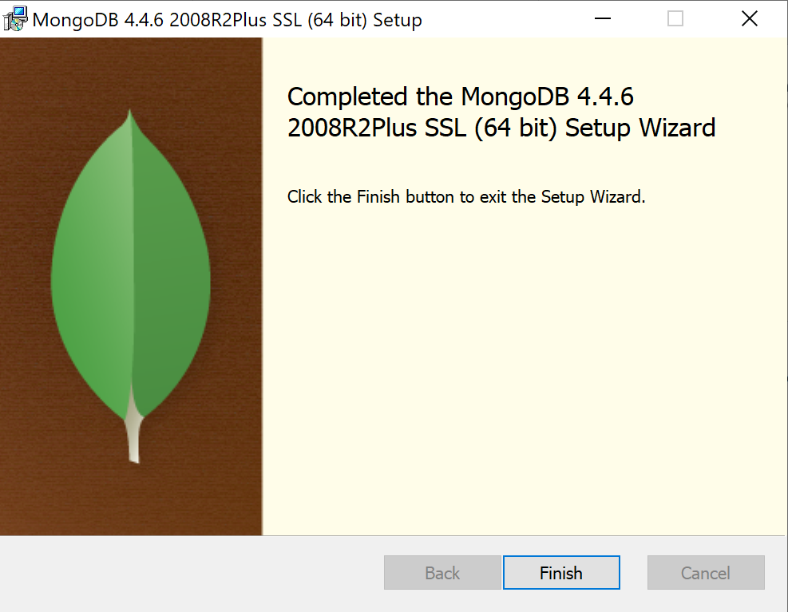
Step 11 :
Finish the wizard once installed.
12

