Slide 1

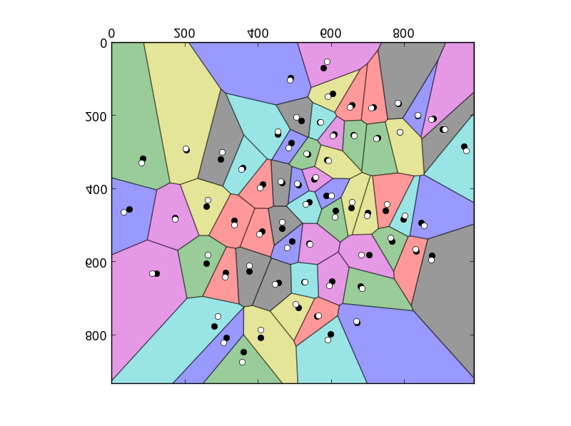
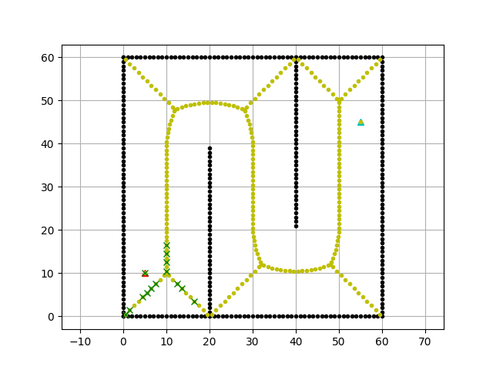
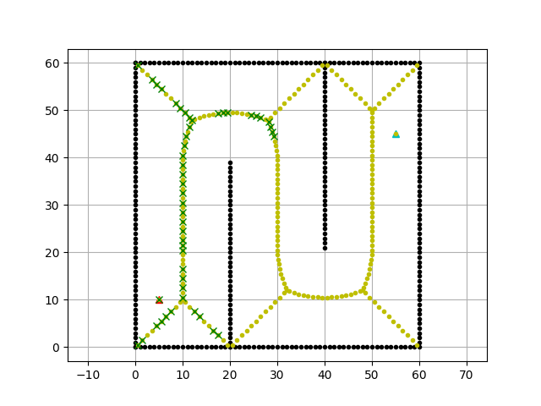
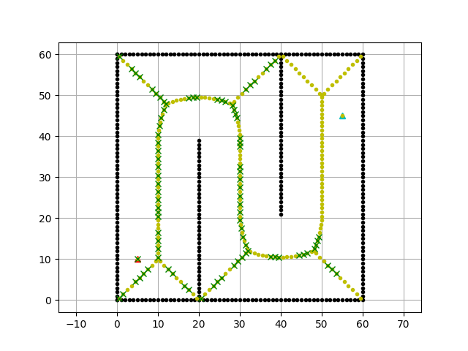
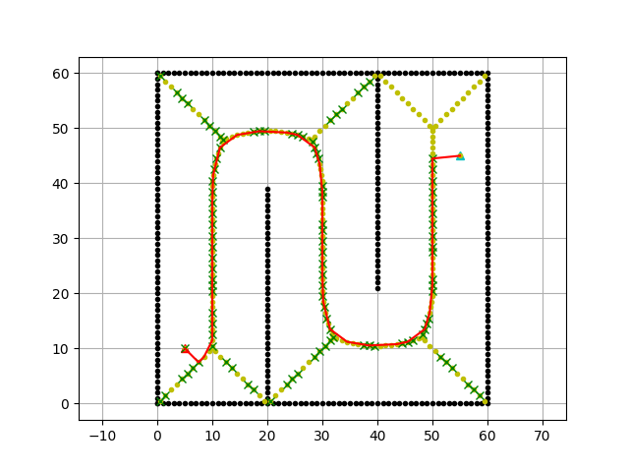
Path Planning with Voronoi Road Map
Priykrit Varma|| Shivaibhav Dewangan || Sanchit Namdeo || Aman Sahu
International Institute of Information Technology , Naya Raipur
INTRODUCTION
METHODOLOGY
CONCLUSIONS
Advantages:
Simple Geometry: VRM relies on intuitive geometric concepts like Voronoi diagrams, making it easy to grasp and implement without extensive mathematical expertise.
Scalability: VRM efficiently handles environments of varying sizes and complexities, from small-scale scenarios to large urban areas, ensuring effective navigation regardless of scale.
Optimal Connectivity:VRM constructs road networks that offer efficient routes between points of interest, minimizing travel distances and maximizing accessibility for smooth navigation.
Disadvantages:
Sensitivity to Input: VRM's performance can be sensitive to the distribution and density of input points or sites, potentially leading to suboptimal road network construction in certain scenarios.
Computational Complexity: Constructing Voronoi diagrams and extracting road maps in VRM can be computationally demanding, especially for large-scale environments or high-dimensional spaces, impacting real-time performance.
Lack of Global Optimality: VRM focuses on local connectivity between points of interest, which may result in suboptimal overall paths compared to global optimization methods, particularly in environments with complex obstacles or irregular terrain.
Path planning is the task of finding a path from a starting point to a goal point in a given environment. In the context of mobile robots, the path must also take into account the presence of obstacles.
Voronoi Road Map(VRM)
Voronoi Road Map(VRM) is a graph-based method for motion planning, particularly in robotics and autonomous vehicles, inspired by Voronoi diagrams.
The VRM algorithm constructs a network of roads or paths by dividing the space into regions based on proximity to given points, called sites or seeds.
In VRM, each site represents a potential destination or point of interest, and the Voronoi cells around these sites delineate the regions of influence for each destination.
The edges of the Voronoi cells form the roads or paths in the map, connecting neighboring cells and providing potential routes for navigation.
VRM is advantageous for path planning as it efficiently captures the connectivity and spatial relationships of the environment, enabling robots or vehicles to navigate complex terrains.
Each particle in search space adjusts its “flying” according to its own flying experience as well as the flying experience of other particles.
Each edge in the VRM represents a potential path for traversal, and the choice of path is typically determined based on factors such as distance, clearance, and optimality.
# Input: Sites - list of seed points in the plane
def construct_voronoi_diagram(sites):
voronoi_cells = {} # Dictionary to store point -> site ownership
for point in plane:
closest_site = None
closest_distance = float('inf') # Initialize with positive infinity
for site in sites:
distance = distance(point, site) # Replace 'distance' with your distance function
if distance < closest_distance:
closest_site = site
closest_distance = distance
voronoi_cells[point] = closest_site
# Optional: Extract and store Voronoi cell boundaries based on ownership
return voronoi_cells
f: Objective function to optimize.
S: Population of agents.
N: Number of dimensions.
blo, bup: State space bounds.
Xi: Particle position.
Vi: Particle velocity.
Pi: Best particle position.
G: Global best position.
W: Inertia weight.
Qp, Qg: Cognitive and social constants.
Rp, Rg: Random numbers.
RESULTS
The following figures depict the Voronoi Road Map Planner applied scenarios, showing the initial and final iterations of the algorithm. In this cases, the starting point is located at (5,10), and for Figures , the goal is positioned at (55,45), while for Figures.
To ensure adherence to specified constraints, the Voronoi Road Map Planner utilizes a penalty function. This function imposes penalties on the objective function when constraints are violated. If the path deviates from the constraints, the penalty function adjusts the objective function accordingly, discouraging unfavorable solutions.
OBJECTIVES
REFERENCES
Voronoi Road Map Planner aims to find the optimal path with the minimum distance between the start and goal points.
Each particle in the Voronoi Road Map represents a potential path solution, adjusting its position and velocity to explore the solution space.
Personal-best and global-best positions guide particle movement towards promising solutions, while inertia balances exploration and exploitation during the optimization process.
PythonRobotics: a Python code collection of robotics algorithms Atsushi Sakai, Daniel Ingram, Joseph Dinius, Karan Chawla, Antonin Raffin, Alexis Paques.
Retrieved from arXiv:1808.10703
ACKNOWLEDGEMENTS
Guided by- Dr. Shailesh Khapre
1 2 3 4
Github Link
Priykrit/Path-Planning-with-Voronoi-Road-Map (github.com)

