Slide 1
Advanced Number Theory
- Srivaths P

Slide 2
Goal
To learn:
Factorization using sieve
Modular Inverse
Euclidean algorithm

Slide 3
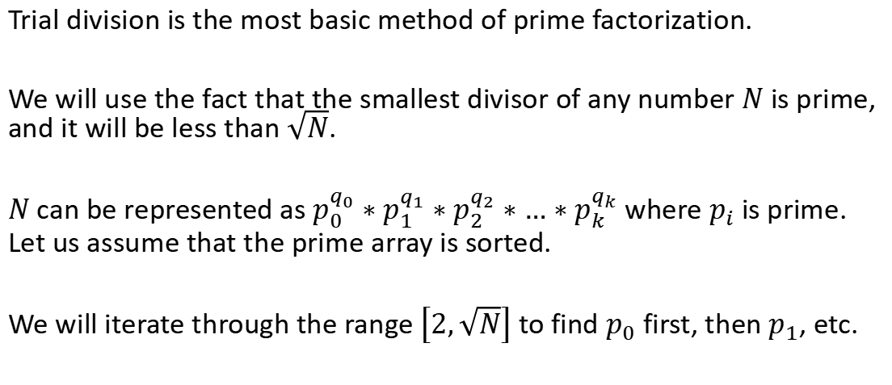
Prime Factorization – Trial Division
Trial division is the most basic method of prime factorization.
We will use the fact that the smallest divisor of any number $N$ is prime, and it will be less than $\sqrt{N}$.
$N$ can be represented as $p_{0}^{q_{0}}∗p_{1}^{q_{1}}∗p_{2}^{q_{2}}∗…∗p_{k}^{q_{k}}$ where $p_{i}$ is prime. Let us assume that the prime array is sorted.
We will iterate through the range $\left[2,\sqrt{N}\right]$ to find $p_{0}$ first, then $p_{1}$, etc.

Slide 4
Prime Factorization – Trial Division Code
vector<int> factor(int n) { vector<int> facts; for (long long d = 2; d * d <= n; d++) { while (n % d == 0) { facts.push_back(d); n /= d; } } if (n > 1) facts.push_back(n); return facts; }

Slide 5
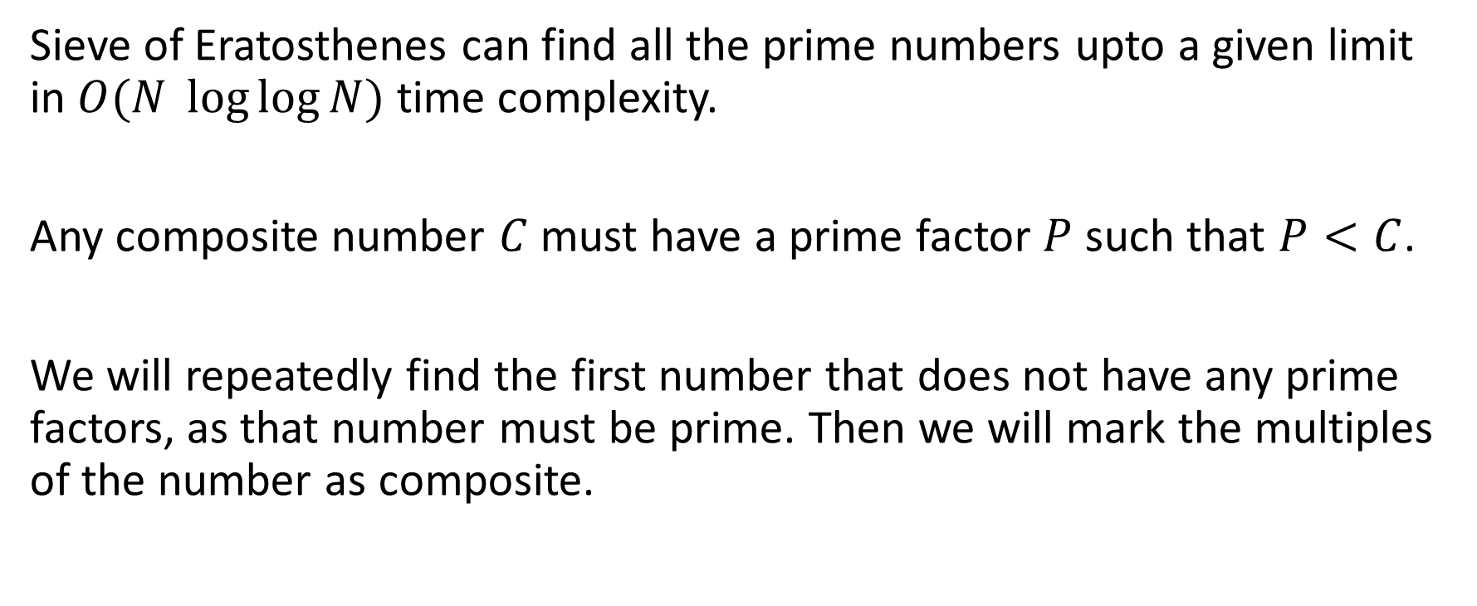
Sieve of Eratosthenes
Sieve of Eratosthenes can find all the prime numbers upto a given limit in $O(N \log{\log{N}})$ time complexity.
Any composite number $C$ must have a prime factor $P$ such that $P<C$.
We will repeatedly find the first number that does not have any prime factors, as that number must be prime. Then we will mark the multiples of the number as composite.

Slide 6
Sieve of Eratosthenes – Code
void sieve(int n) { bool primes[n+1]; fill(primes, primes+n+1, true); primes[0] = primes[1] = false; for (int i = 2; i*i <= n; i++) { if (primes[i]) for (int j = i*i; j <= n; j += i) primes[j] = false; } }

Slide 7
Sieve of Eratosthenes – Prime Factorization
To use sieve for prime factorization, we make the sieve array store the small prime factor of a number.
To retrieve the values, we can repeatedly divide the current number by the smallest prime factor.
Time complexity: O(log N) per query

Slide 8
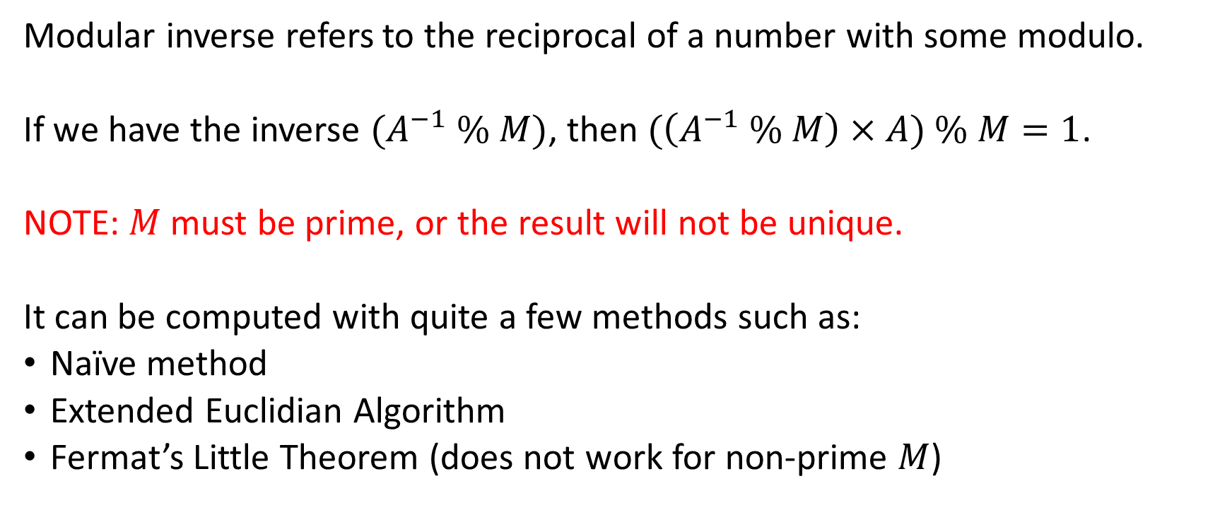
Modular Inverse
Modular inverse refers to the reciprocal of a number with some modulo.
If we have the inverse $(A^{−1} \% M)$, then $(\left(A^{−1} \% M\right)×A) \% M=1$.
NOTE: $M$ must be prime, or the result will not be unique.
It can be computed with quite a few methods such as:
Naïve method
Extended Euclidian Algorithm
Fermat’s Little Theorem (does not work for non-prime $M$)

Slide 9

Modular Inverse – Fermat’s Little Theorem
Using Fermat’s Little Theorem, we can take the modular inverse of a value in $O(\log_{2} M)$ when $M$ is prime.
$$A^{−1} \% M=A^{M−2} \% M$$
int inverse(int a, int m) { return binary_expo(a, m-2, m); }

Slide 10
Thanks for watching!
https://forms.gle/kXvEfzTkr3eacHhw6

