Slide 1



INTRODUCTION TO POWER BI
Presented to :- Deepanshu Kumar
Presented By:- Nishu Mishra
Tanu shri

Slide 2
Introduction to Business Intelligence & Power BI
• BI converts raw data into meaningful insights.
• Power BI is Microsoft's business analytics tool.
• Provides dashboards, reports, and visualizations.
• Helps users make data-driven decisions.

Slide 3
What is Power BI?
• Cloud-based data visualization and analytics tool.
• Supports self-service BI.
• Integrates with many data sources.
• AI-powered insights.
• Available on Desktop, Cloud, and Mobile.

Slide 4
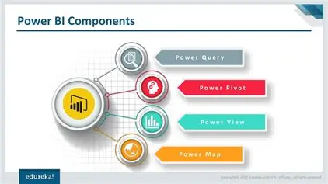
Components of Power BI

Slide 5
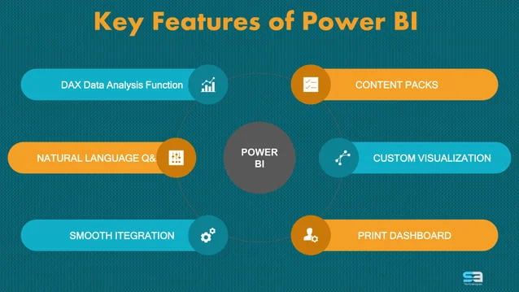
Power BI FEATURES

Slide 6
Power BI Desktop Interface Overview
• Ribbon
• Report View
• Data View
• Model View
• Visualization Pane
• Fields Pane

Slide 7
Supported Data Sources
• Files: Excel, CSV, PDF
• Databases: SQL, Oracle, MySQL
• Online Services: SharePoint, Salesforce
• Big Data: Spark, Hadoop

Slide 8
Data Transformation with Power Query
• Importing, cleaning, merging datasets.
• No coding required.
• Steps are reusable.
• Efficient for large datasets.

Slide 9
Data Modeling in Power BI
• Tables & Relationships.
• Star Schema.
• Calculated Columns.
• Measures using DAX.

Slide 10
Understanding DAX
• SUM, AVERAGE, COUNT, CALCULATE, FILTER.
• Used for KPIs, comparisons, business rules.

Slide 11
Visualizations in Power BI
• Basic: Bar, Line, Pie.
• Advanced: Maps, Waterfall.
• Custom visuals from AppSource.

Slide 12
Power BI Service & Collaboration
• Dashboards, Workspaces.
• Automatic Data Refresh.
• Sharing options & embedding.
• Row-level security.

Slide 13
Advantages & Conclusion
• Easy to use, scalable, AI-powered.
• Widely used across industries.
• Essential tool for analysts and organizations.

