Slide 1

Basic Details of the Team and Problem Statement
Ministry/Organization Name/Student Innovation: Ministry of Law and Justice
PS Code: SIH1281
Problem Statement Title: Development of gamified platform on Children's Rights to increase legal literacy and awareness among children in India
Team Name: CyberClaw
Team Leader Name: Priyosmita Das
Institute Code (AISHE): C-6286
Institute Name: Meghnad Saha Institute Of Technology
Theme Name: Smart Education

Slide 2
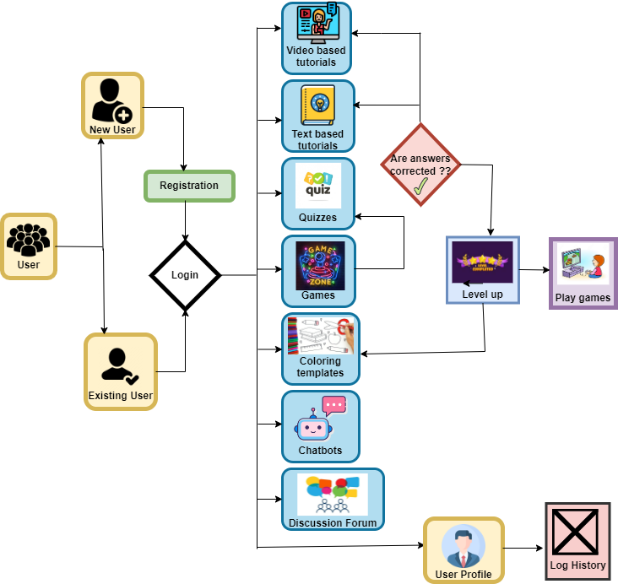




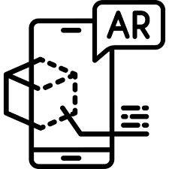

















Idea/Approach Details
Use Case Diagram
KidHeroesHub
No
Developing
Interactive Games
Artificial
Intelligence
Data
Storing
Cloud Computing
Yes
Augmented Reality
Awareness
Training
Analyzing
Child Psychology
Big Data
Analysis
Social
Initiative
Increasing
Legal Literacy
& Awareness
Cyber Security
Data
Protection
Technology stack
DESIGN
FRONT END
BACK END
GAME DEVELOPMENT
DATABASE

Slide 3



Idea/Approach Details
Inclusive School Curriculum: The platform becomes a core part of school lessons, aiding teachers in teaching children about their rights interactively.
Community Workshops: The platform is used to educate children about their legal rights by NGOs and community organizations .
Advocacy and Awareness Campaigns: The platform is used to promote legal literacy and children's rights among a broader audience.
Legal Aid Access: The platform connects children with legal help if their rights are violated.
Policy Impact: Data from platform interactions informs child rights policies, potentially leading to better legal education and protection measures.
Prototype link: https://youtu.be/dQFDoLLVdaQ?si=eJPtkyt7ZGji3tSs
Dependencies / Show Stopper :
Use cases :
Multi-Lingual Support
Content Appropriateness
Technical Accessibility
User Engagement
Solutions :
Community Engagement
Offline Features
Gamification
Strict Privacy Measures
Partnerships and
Fundraising
Scaling Reach
Advanced Content
Impact Assessment
Advocacy
Future Expansion

Slide 4
Team Structure
TEAM LEAD
Priyosmita Das
B.Tech - CSE,
3rd Year
UX / UI
DESIGN
GRAPHICS
FRONTEND
BACKEND
GAME DEVELOPMENT
Riddhika Kundu
Anushka Banerjee
Priyosmita Das
B.Tech - CSE,
3rd Year
Rupsha Bhattacharyya
B.Tech - CSE,
3rd Year
Ankit Biswas
B.Tech - CSE,
3rd Year
Rajdeep Dutta
B.Tech - CSE,
3rd Year
Priyosmita Das
B.Tech - CSE,
3rd Year
Team Mentor 1 Name : Soumya Suvra Khan(Category:Academic, Expertise:AI/ML, Domain Experience:7 years)
Team Mentor 2 Name : Aradhita Mukherjee(Category:Academic, Expertise:AI/ML, Domain Experience:5 years)

