Slide 1
Problem Statement : STUDENT LIFE CYCLE MANAGEMENT SYSTEM
Problem ID : PID047
Team ID : TM001868
University : Gujarat Technical University
College : Gyanmanjari Institute Of Technology
Team Member 1 : Soni Krish Hemang
Team Member 2 :Parmar Shailendrasinh Priyrajsinh

Slide 2
Topics covered in this presentation :
Existing problems.
“Online Portal” as a solution for the problem.
Features of the online portal.
4. E-R diagram ,Use-Case diagram and Data flow diagram of the portal.
5. Benefits to use this online portal instead of other existing portals.
6. Future development for the online portal.

Slide 3
Existing Problems :
Majority of institutes offer offline courses causing students high expense consisting of travel, rent, food and other necessary commodities.
If a student is unable to attend the lecture he/she will not be able to complete the syllabus.
Important assignments, documents and materials are damaged after a period of months, or sometimes unavailable to students when required.
Notices or quick reminders are unable to reach some students.
Many online portal exists but are paid and some have limited features, causing this problem to still exist for most of institutes.

Slide 4
Solution For The Existing Problems :
A online portal consisting of HODs, faculties, students and staff members.
Students can attend online lectures, removes additional expenses.
Assignments can be submitted online, time conservative.
Important documents and materials can be accessed anytime anywhere.
Sudden notices and reminders from faculties can reach student.
Doubts/queries from students can be submitted to respected faculty.

Slide 5
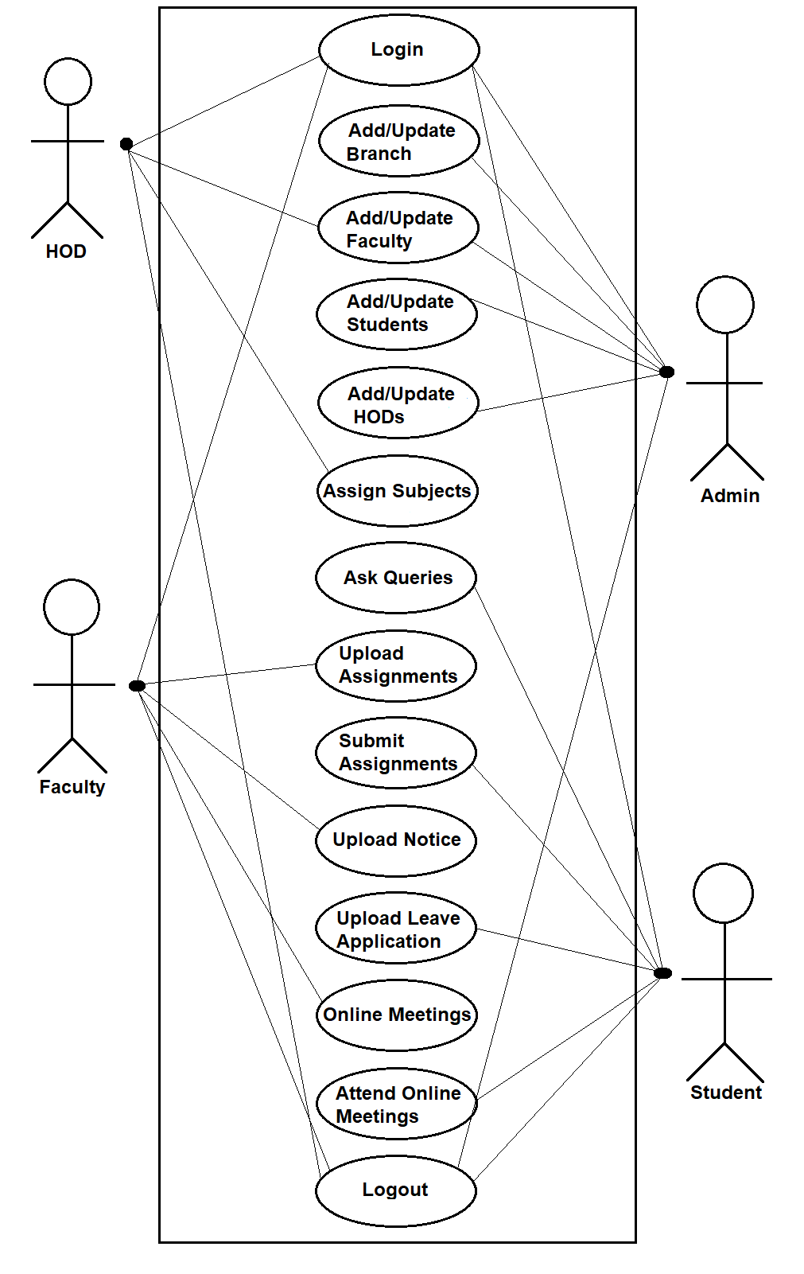
Use-Case diagram describes the functions and uses of the system.
The diagram explains how the actors work in the system.
It does not show how the system works but shows how the system is functioning.

Slide 6
Features Of The Online Portal :
Students who are unable to attend the lectures can attend via online meetings hosted by faculties.
Assignments can be uploaded by faculties and can be submitted by students.
Faculties and students can be categorized into branch and semesters.
Students can send queries to faculties.
Notices can be sent by faculties.
Leave application can be sent by students to respected faculties.

Slide 7
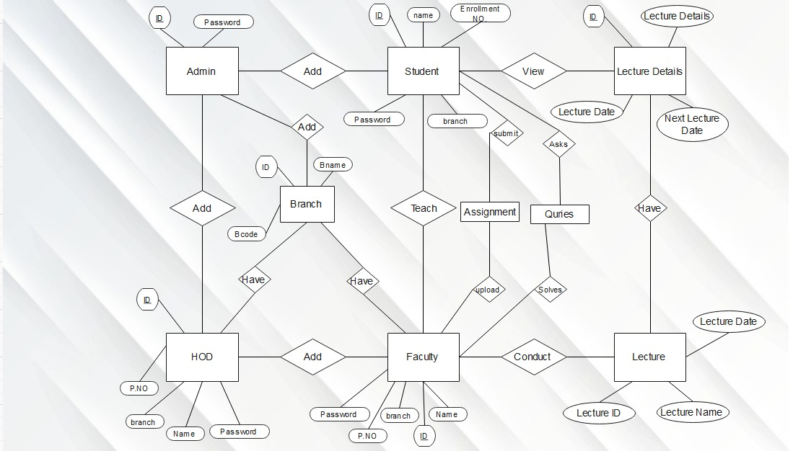
E-R Diagram

Slide 8
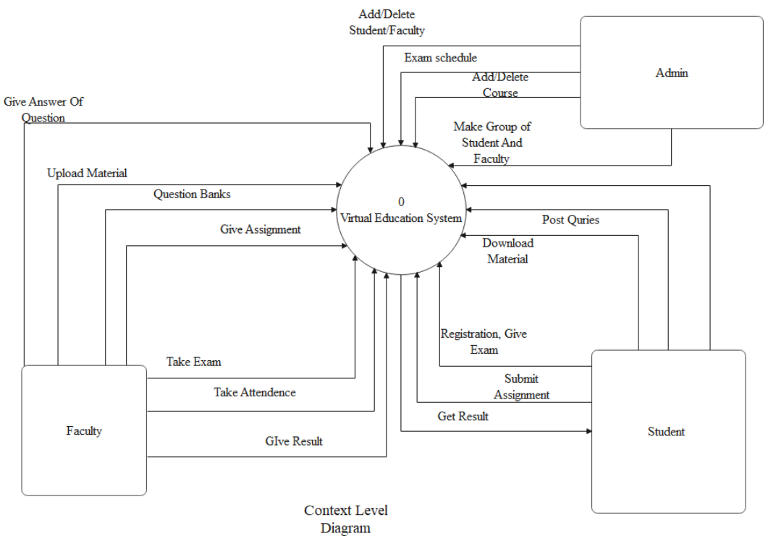
This is a Data flow diagram (DFD) in form of context level.
All the data flows either into or out of process.
Context level DFD’s portray the interactions between external entities and process.

Slide 9
Benefits of using the online portal instead of other existing portals :
The main advantage this portal has over other portals is that this is a open source.
It has features which are not available in Microsoft teams and in google classroom (individually).
It is not complex like above mentioned portals and easy to adapt.
API of zoom apk is provided so the meetings can be carried out via zoom apk.
As this is a small scale portal, there will be quick feedback and data leaks will never occur.

Slide 10
Steps for future development
Commercializing this portal to universities and institutes
Creating a domain and data-server
Adding more features
Creating a more attractive design

Slide 11
Future development for this portal :
Chat-box can be added.
Attendance sheet can be added showing their time of attending the lecture.
To make the portal more interactive for the user.
To improve the appearance of the portal.
Commercializing this project for universities and institutes.
By adding charts, reminders , notes, tables and changing actors. We can create a portal for corporate companies which can use it for projects, monthly reports, notices, event info, online meet, etc.

Slide 12
FEEDBACK

