Slide 1
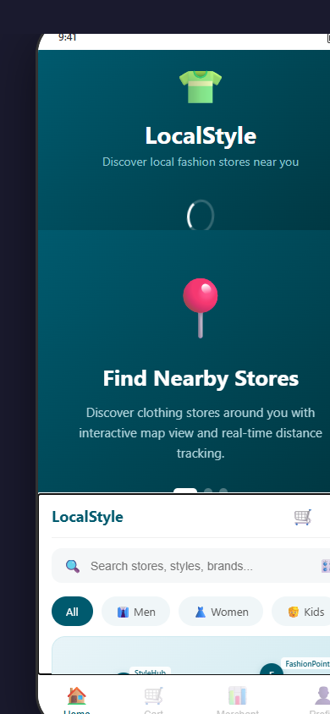
thinkQbator • FAST-TRACK BATCH
Product Readiness Submission | Slide 1 of 3
How your idea works on the field
User Journey
Metrics & Impact (Target — Year 1)
1. Customer opens app — location detected via GPS, nearby
stores shown on map/list view
2. Customer searches and filters by style, size, category, or price
3. Customer checks real-time stock and photos for specific items
4. Customer places order or reserves item for pickup/delivery,
pays via integrated payment gateway
5. Store owner gets notification, confirms and fulfills order
through merchant dashboard
50+
1,000+
60%
Stores Onboarded
Active Users
Faster Discovery
3+
10+
4.5★
Localities Covered
Pilot Stores
Avg. Rating
Deployment Details
Live interactive prototype built as a mobile-first web app. Features: GPS-based store discovery, real-time inventory, cart management, merchant dashboard, and profile management.
Mobile app (customer-facing) + Web app + Merchant dashboard
Backend server + Database + Cloud hosting
GPS/Location services for store discovery
Product inventory management system
Payment gateway integration
Notification system (push / in-app)
Search & filter technology
API integrations & basic analytics
Team: Pramod Yadav | Mohd Uzair Khan
Social Impact: Yes — Empowers small/local clothing retailers with digital visibility, helping them compete with large marketplaces and sustain local livelihoods.
thinkQbator Fast-Track Batch | Local Clothing Store Discovery | Confidential

Slide 2
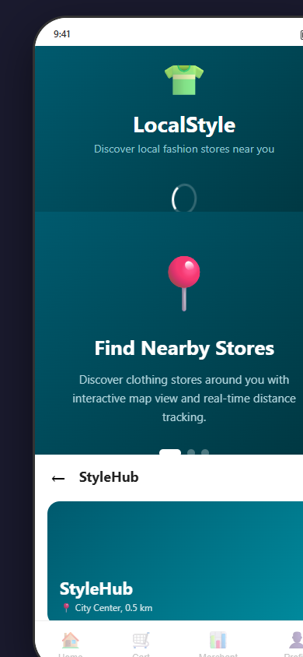
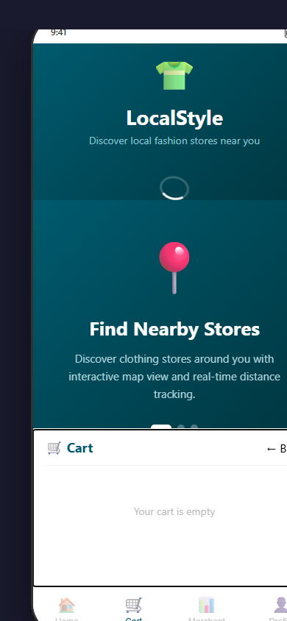
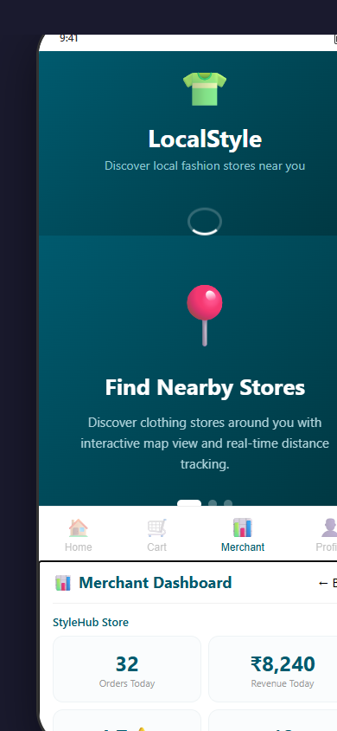
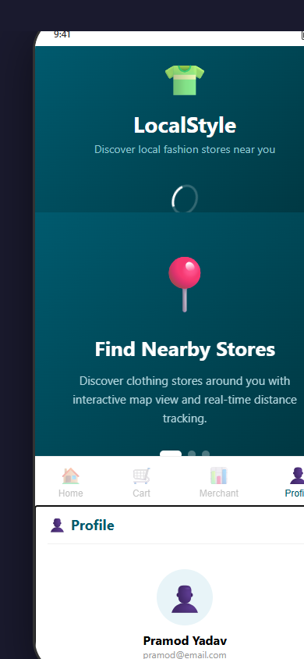
thinkQbator • FAST-TRACK BATCH
Product Readiness Submission | Slide 2 of 3
Show the product
Interactive demo prototype built with HTML/CSS/JS — open in browser to experience the full app.
Photo — App Screenshots
More Screens
Cart | Merchant Dashboard | Profile
Hyperlink
Live Demo: C:\Users\pramo\Email Automation-Checker\ppt\demo_app.html (Open in Edge/Chrome to interact)
Home screen with map + store discovery | Store detail with product inventory
Planned Features
Interactive map-based store discovery (GPS-enabled) with real-time inventory
Search & filter by style, size, category, price range; payment gateway integration
Merchant dashboard for inventory mgmt, order fulfillment & sales analytics
Push notifications for order status updates and promotions
thinkQbator Fast-Track Batch | Local Clothing Store Discovery | Confidential

Slide 3
thinkQbator • FAST-TRACK BATCH
Product Readiness Submission | Slide 3 of 3
Proof on the field
STATUS: Functional Prototype / Pre-Deployment
Customer / User Testimonial
Prototype Demo Screens
“The prototype gives a clear sense of how the app will work in real life — browsing stores nearby, checking stock, and ordering all in one place. This solves a real pain point for local shopping.”
— Early tester feedback (pilot onboarding Q3 2026)
Interactive prototype showcasing all key user flows
Next Steps
1. Functional prototype completed — demo_app.html showcases full UX flow (discovery, inventory, cart, merchant dashboard)
2. Next: Convert prototype to actual mobile app (React Native / Flutter) with real backend API and database
3. Onboard 10–15 pilot stores in a target locality; gather user feedback and iterate on product features
4. Scale to 50+ stores and 1,000+ users in Year 1; capture field photos, testimonials, and usage metrics
thinkQbator Fast-Track Batch | Local Clothing Store Discovery | Confidential

