Slide 1
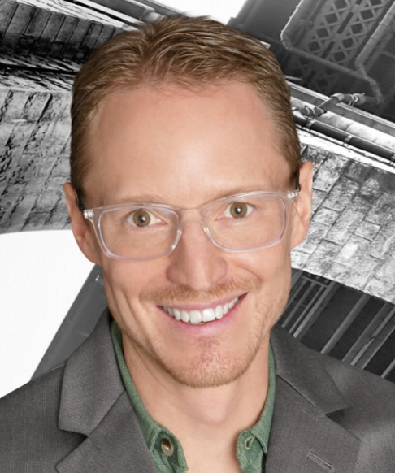

Gabe Salazar
VP
INDUSTRIES
Industry Experience
E-Commerce | Construction Materials| Technology| Distribution | Market Research | Banking
EXPERIENCE
Data Warehousing, Platform & Integration Consolidation| Construction Materials
Client was faced with managing a labor-intensive support process, compounded by the need to integrate and disentangle data from newly acquired and divested companies.
The creation of a platform by 25 contractors over 18 months led to technical debt (inconsistent implementations, complexities, tribal knowledge, missing requirements, difficult to maintain solutions and a spaghetti architecture)
Dived into a multitude of old platforms and processes to drive standardization and simplification
Consolidated and Optimized systems to a simplified cloud first integration and data warehousing implementation, resulting in over $500k per year savings in unnecessary software licensing and optimized staffing
Process Re-Engineering and Platform Simplification| Market Research Firm
Software and Integration lead on Enterprise CRM Re-Engineering Project
Years of homegrown solutions led to complex, non-standard processes, system usage and reports
Worked with IT and business stakeholders across 5 continents to redefine critical sales, approval, and reporting processes
Developed automation solutions, user interfaces, and worked with end users around the globe to validate requirements and newly implemented processes, providing a standardized solution to ensure maximum revenue recognition
Enterprise Analytics Detail Design| Food and Beverage Distribution
Principal architect leading mixed team of consultants and client resources to modernize a legacy B2B E-commerce solution from the 1990’s into a modern, cloud first mobile experience including off-line catalog management and ordering
Led various teams from mobile app development to cloud messaging to green screen ERP COBOL for a seamless transition from the decades old system into modern platforms and practices, setting the Client apart from its competition
BACKGROUND
Functional Skills
Leadership, Data Strategy, Data Analytics, Data Engineering, Web Applications, Custom Software Implementations
Qualifications:
Gabe has 25+ years of experience with data and software. Serving as a lead data architect on integration and data warehousing teams, data modeling projects, and enterprise cloud data warehouse build outs. Gabe strives to go above and beyond for clients to ensure satisfactory solutions to today’s complex business problems.
BIO & CONTACT INFO
Email
gabriel.salazar@thebridge.com
Mobile
720.839.3439
Location
Denver, CO
Gabe joined The Bridge in January 2024, bringing 25 years of IT and consulting experience to the firm. He has served as a principal architect for enterprise data warehouse buildouts and custom software implementations in a multitude of industries, platforms and technologies.

