Slide 1
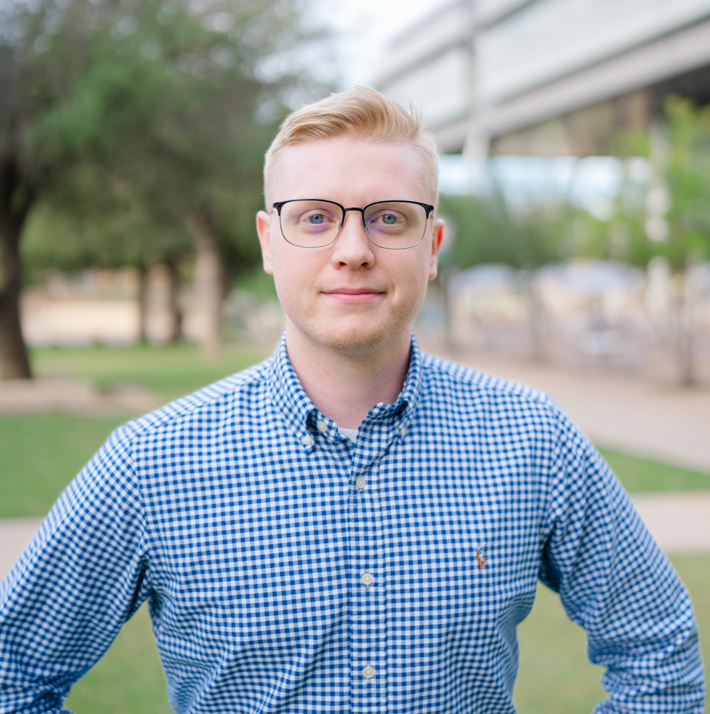
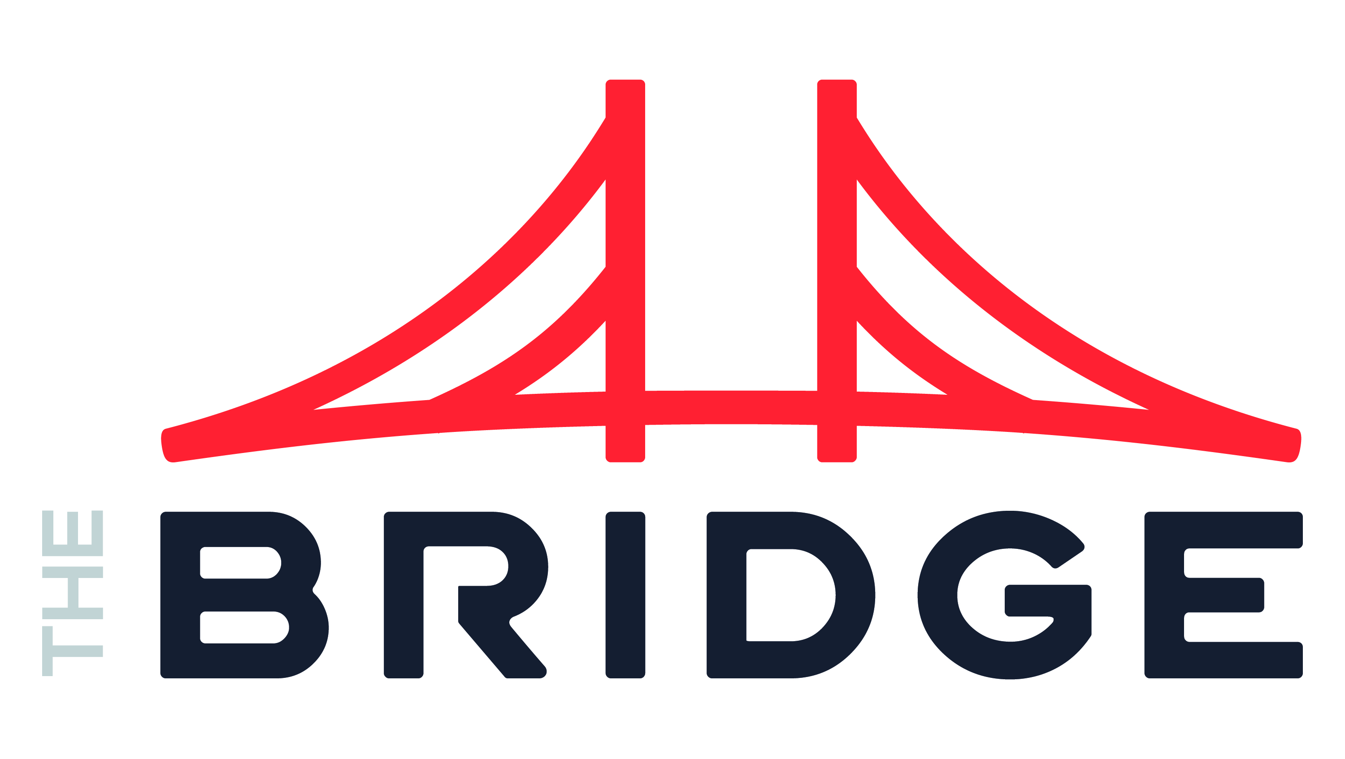
Oliver Davidson
Manager
INDUSTRIES
Industry Experience
Transportation | Sustainability | Health Care | Life Sciences | Financial Services | Technology
EXPERIENCE
Management Consultant | Slalom
Served in as an interim director of data one of the largest transportation companies in the United States. In this role, he aligned stakeholders to a single data vision and developed a roadmap to a unified data platform. Additionally, he combined the data engineering and data science team into a single group for more effective delivery.
Developed a fleet transition model for Microsoft to support the client’s initiative to be a Zero Emissions fleet by 2030. The plan included a management tool that blended data from 8 EV solutions into a single view of the operation.
Architected a modern data platform to consolidate all enterprise data for a large transit services client. This required the mapping of 50+ sources systems and creating data entities that served all parts of the organization while implementing data governance to safely enable data democratization.
Built a predictive maintenance model that presents maintenance staff insights to preemptively replace parts that would fail in service resulting in a $2.1million quarterly cost savings.
Created Revenue Cycle reporting to a large health care organization. Blended data from all clinics and hospitals in the western region to enable regional analytical views.
Worked with multiple Transportation focused Government Agencies to enable deep insights into community impact, customer satisfaction, and operational health. This often-required consolidating data points from multiple providers and technology platforms into a single model for reporting.
Software Development | ALTI
Built Analytics suite to enable large construction companies real-time project status. Implemented a demand forecasting model and early warning indicators for project staffing.
BACKGROUND
Functional Skills
Data Strategy, Data Science, Leadership, Organizational Effectiveness, Business Applications, Business Development
Qualifications:
Extensive background in data strategy and implementation. Served as an interim data director of a large transportation organization. Architected a unified data platform and communicated milestones to executives through business impact.
Education
University of North Texas
BBA in Business Analytics
BIO & CONTACT INFO
Email
Oliver.Davidson@thebridge.com
Mobile
(940) 703-9204
Location
DFW, Texas
Oliver joined The Bridge in October 2023. He previously worked at Slalom, where he supported multiple national and global organizations. He developed a passion for transportation and transit where he with some of the government agencies, technology partners, and some of the largest providers in the United States.

