Slide 1
The Battle of Neighbourhoods - Thai Restaurants
By Peeranat P.

Slide 2
Introduction
Thai people trend to move to New York more and more and one of the most famous things in Thailand is Food. Opening the restaurants or working in restaurants is seem to be great job for those who move to New York
This Project is made to help people who moving to New York to make an easier decision where is the most suitable place to open then restaurant and which restaurants should they working with.

Slide 3
Source of Data
New York data
-Neighborhoods
-Boroughs
-Latitude& Longitude
From : https://cocl.us/new_york_dataset,
Restaurants data
-Rating
-Location
From : FourSquare API

Slide 4
Methodology
Collect, clean and process New York data
Use Foursquare to find Thai restaurants and import detail (Rating, Tips, Likes)
Sort the data
Visualize the data

Slide 5
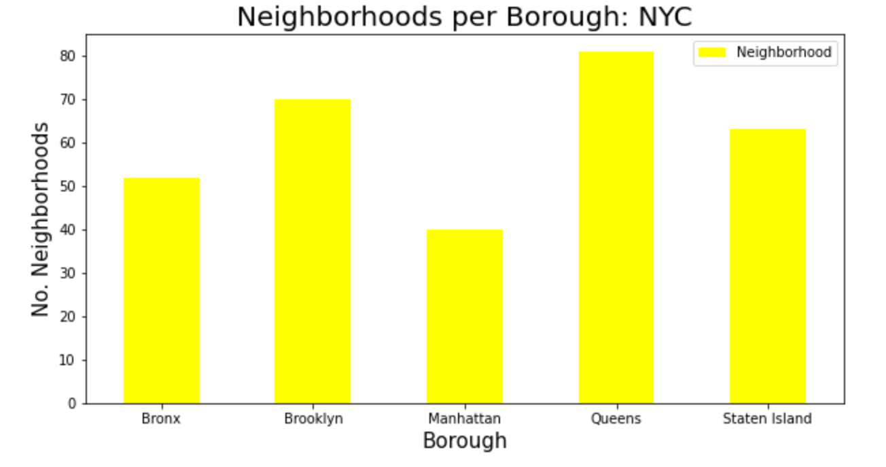
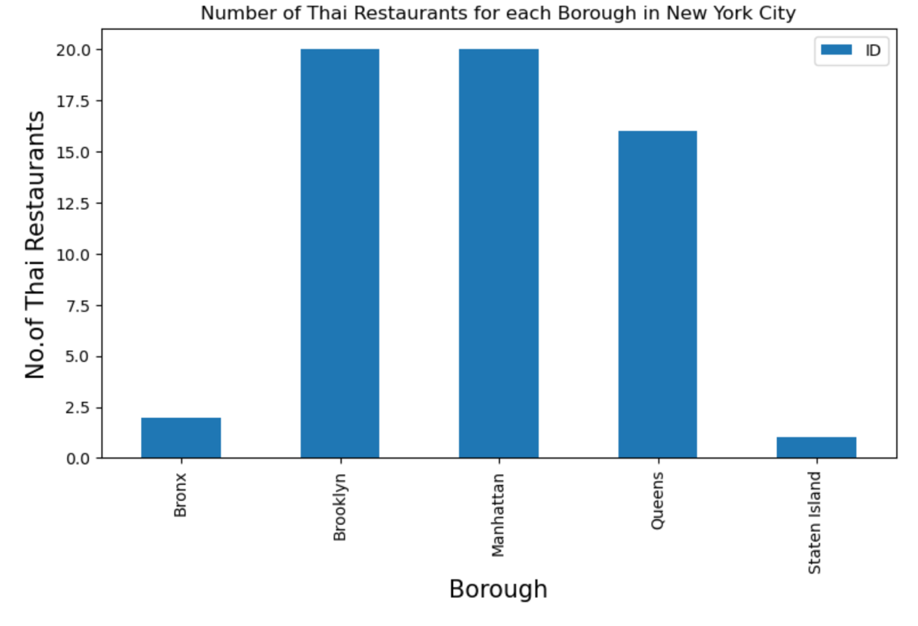
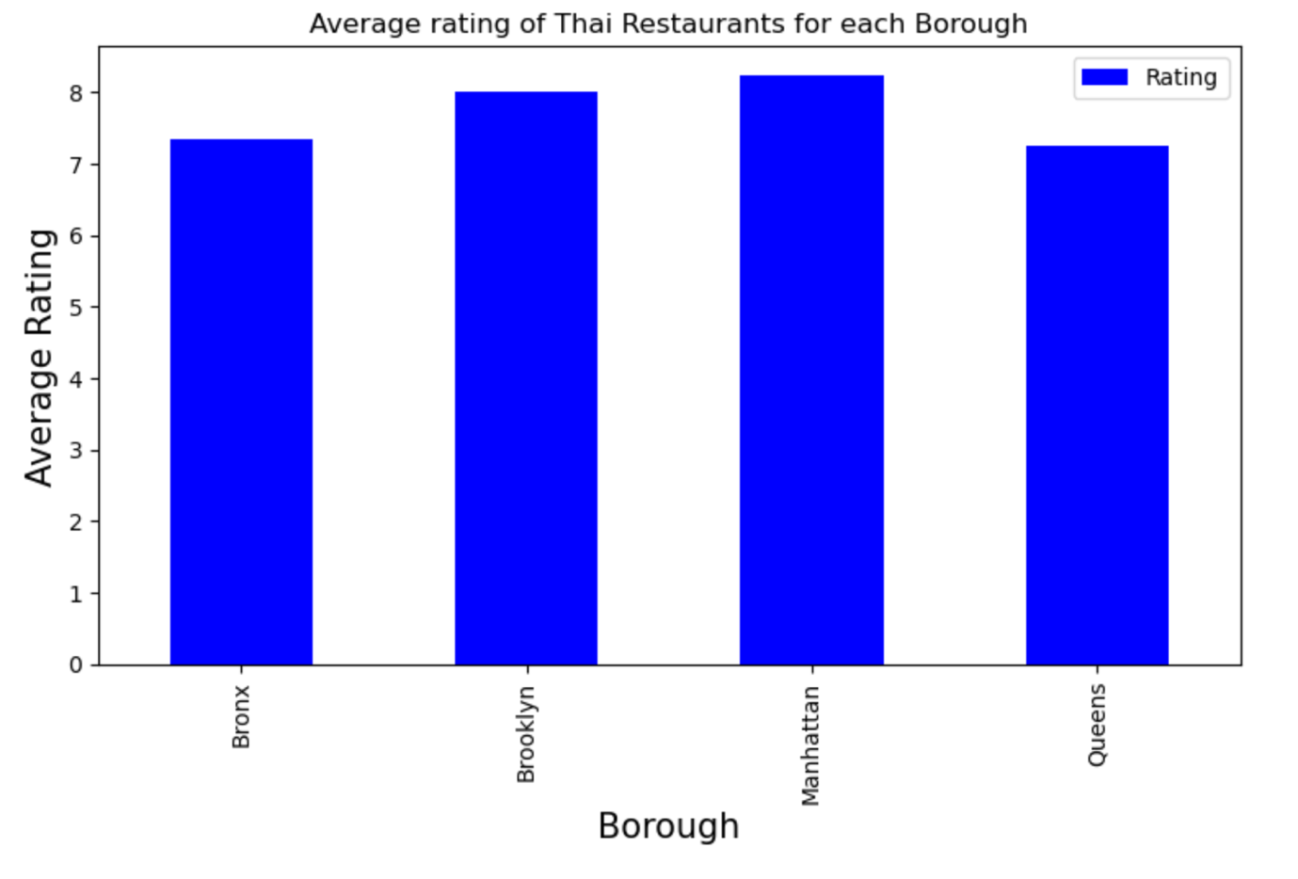
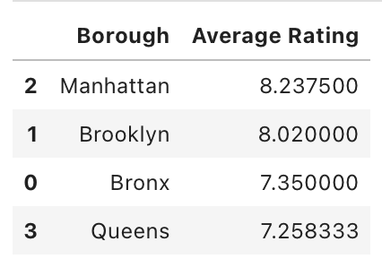

Slide 6
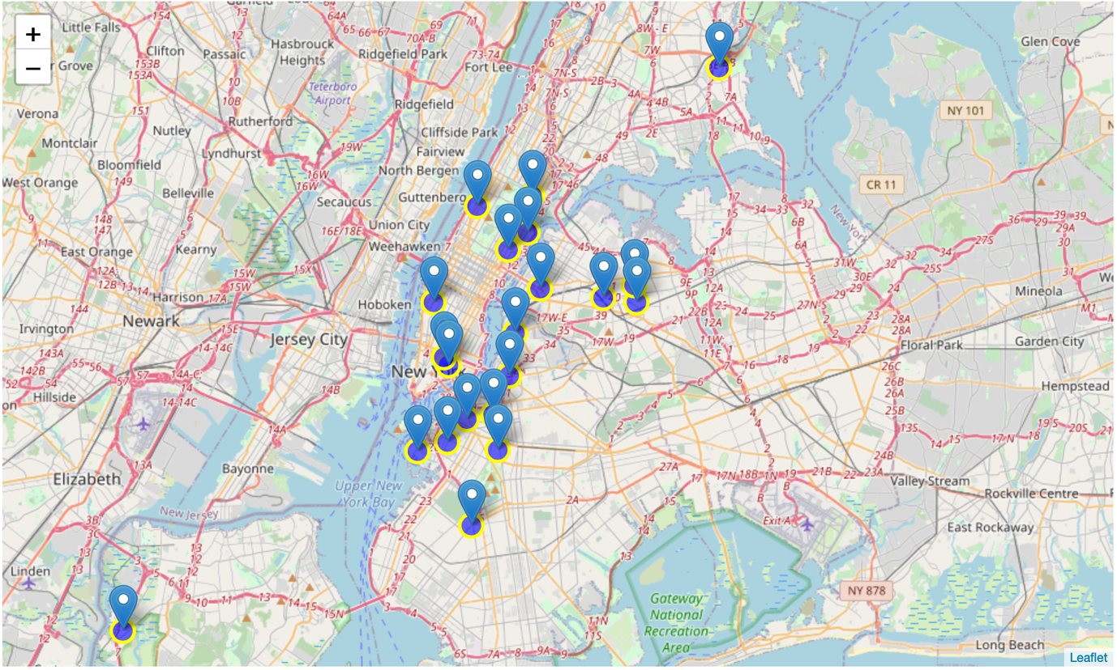
Manhattan and Brooklyn have highest average rating for Thai Restaurants

Slide 7
Results
Borough for opening the restaurants is Queens because high neighbourhoods but low number and quality of restaurants.
Manhattan and Brooklyn are the good place for opening the restaurants because of high competition
Manhattan is good borough for people who want to work in restaurants because of high number of restaurants.

