Slide 1
Data structure lecture
PRESENTED BY
MR. N. K. S. YADAV

Slide 2
Linked List
A Linked List is a linear data structure in which elements are stored in separate memory locations and are connected using pointers (links).
Unlike arrays, linked lists do not store elements in contiguous memory locations.
Each element of a linked list is called a Node.
A node contains two parts:
Data – the value stored in the node
Pointer (Link) – the address of the next node

Slide 3
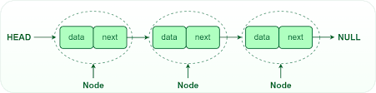
Linked List

Slide 4
Why linked list
Advantages
Dynamic size
Efficient insertion and deletion
Memory allocated when needed
Disadvantages
Extra memory for pointers
Sequential access only
Complex implementation

Slide 5
Structure of Node in C
struct node
{
int data;
struct node *next;
};
data → stores value
next → stores address of next node

Slide 6
Creating a Node Using malloc()
struct node *newnode;
newnode = (struct node*)malloc(sizeof(struct node));
malloc() → allocates memory dynamically
sizeof(struct node) → size of node

Slide 7
Types of Linked List
Singly Linked List
Doubly Linked List
Circular Linked List
Circular Doubly Linked List

Slide 8
Singly Linked List
In a Singly Linked List, each node contains:
data
pointer to next node
Head
|
v
+----+------+ +----+------+ +----+------+
|10 | o---|--->|20 | o---|--->|30 | NULL |
+----+------+ +----+------+ +----+------+

Slide 9
Basic Operations
Creation
Traversal
Insertion
Deletion
Searching

Slide 10
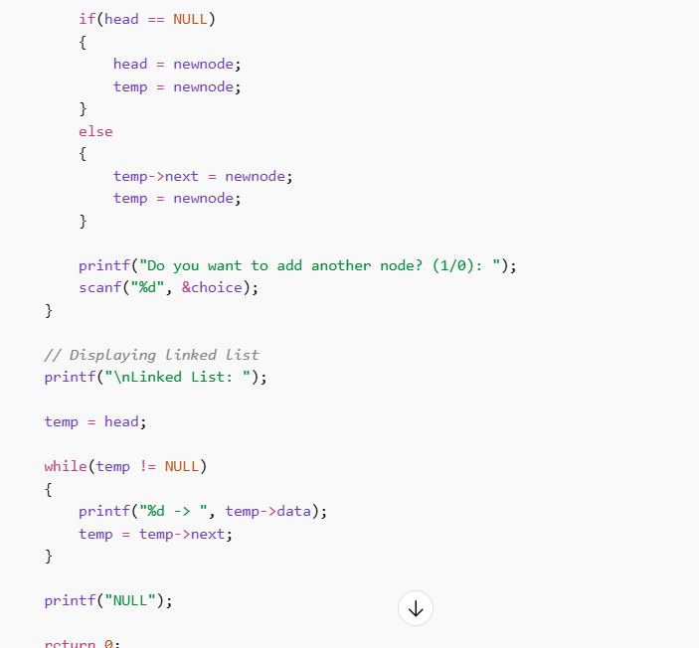
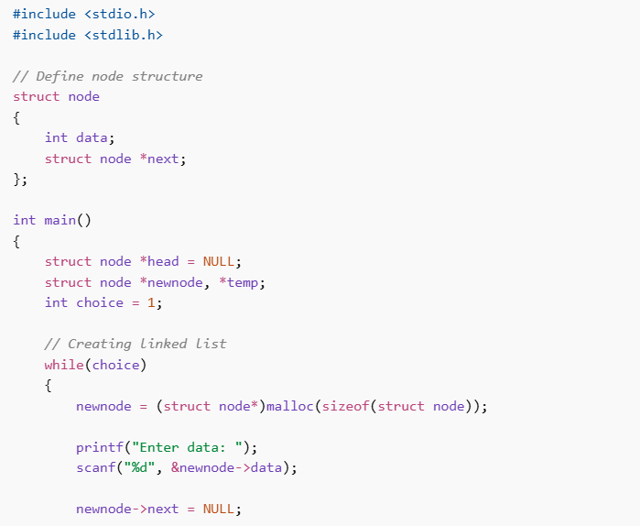
C Program to Create and Display Linked List

Slide 11
Example Output
Enter data: 10
Do you want to add another node? (1/0): 1
Enter data: 20
Do you want to add another node? (1/0): 1
Enter data: 30
Do you want to add another node? (1/0): 0
Linked List: 10 -> 20 -> 30 -> NULL

Slide 12
Insertion in Linked List
There are 3 ways of insertion
Insertion at beginning
Insertion at end
Insertion at position

Slide 13
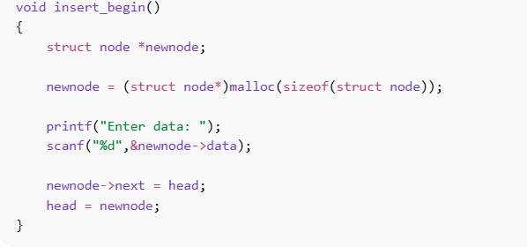
Code

Slide 14
Deletion in Linked List
Delete from beginning
Delete from end
Delete from position

Slide 15
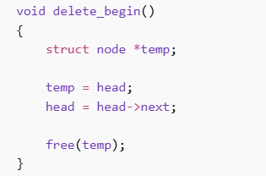
Code for deletion

Slide 16
Doubly Linked List
In Doubly Linked List, each node has two pointers.
previous pointer
next pointer
+------+-------+------+
| Prev | Data | Next |
+------+-------+------+

Slide 17
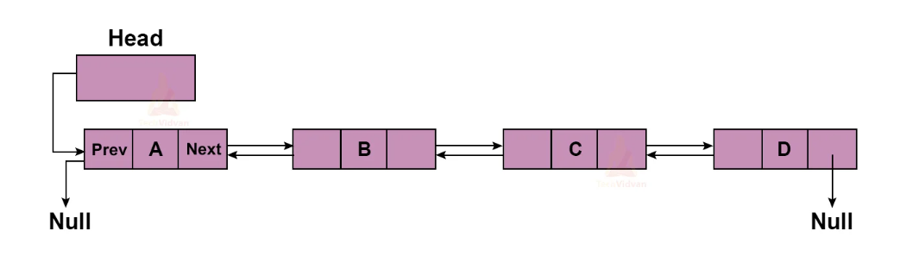
Doubly Linked List

Slide 18
Doubly Linked List
Advantages:
Traversal in both directions
Easier deletion
Disadvantages:
Extra memory for previous pointer

Slide 19
Circular Linked List
In a Circular Linked List, the last node points to the first node.
There is no NULL pointer.
Advantages:
No need to traverse from beginning
Useful in round robin scheduling

Slide 20
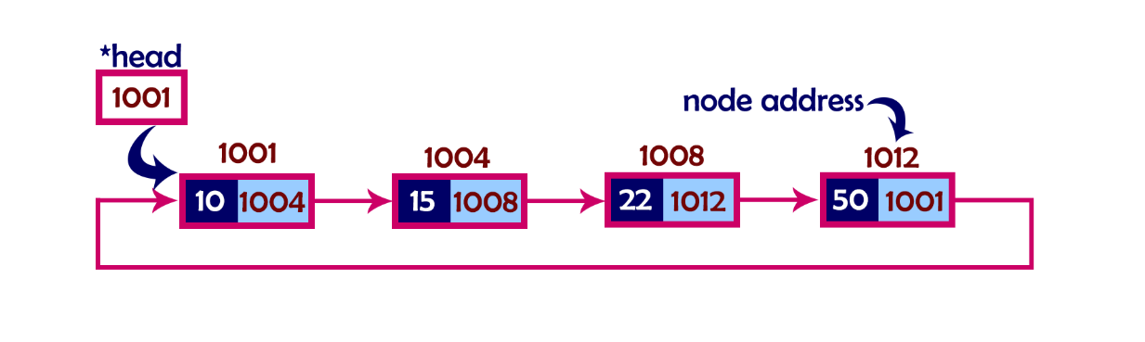
Circular Linked List

Slide 21
Circular Doubly Linked List
Combination of:
Doubly linked list
Circular linked list

Slide 22
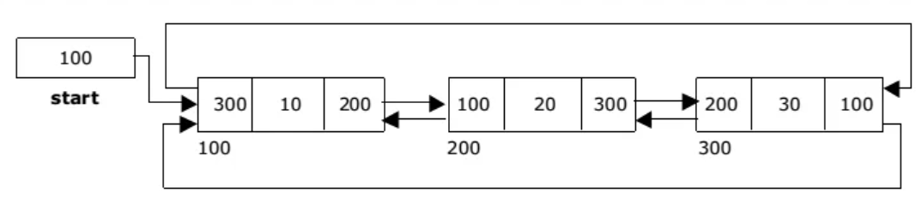
Circular Doubly Linked List

Slide 23
Thankyou!

