Slide 1
Welcome to the Session
Presented By
Mr. Nitish Kumar
(Assistant Professor)

Slide 2
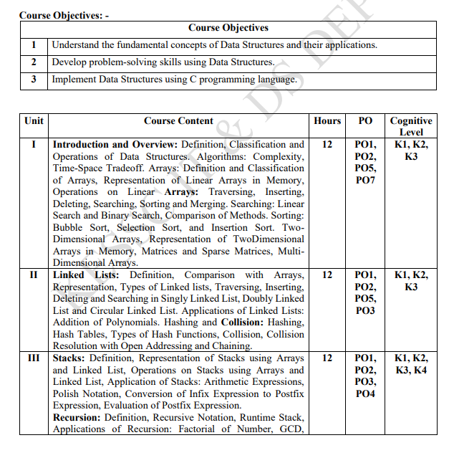
Syllabus

Slide 3
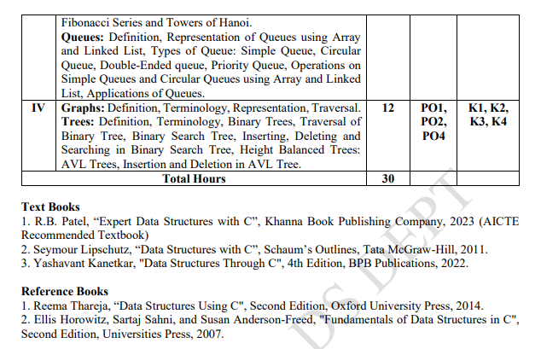
Syllabus

Slide 4
Syllabus
UNIT I: Basics of Data Structures
What is data, structure, and data structure
Types of data structures (linear & non-linear)
Basic operations on data structures
Introduction to algorithms and their efficiency
Arrays and how data is stored in memory
Searching and sorting techniques
Two-dimensional and multi-dimensional arrays
Matrices and sparse matrices

Slide 5
Syllabus
UNIT II: Linked Lists & Hashing
Limitations of arrays
What is a linked list and why we use it
Types of linked lists:
  Singly
  Doubly
  Circular
Basic operations on linked lists
Applications of linked lists (polynomial addition)
Hashing concepts and hash tables
Collision and collision handling techniques

Slide 6
Syllabus
UNIT III: Stacks, Queues & Recursion
Stack data structure and its operations
Applications of stacks (expressions & notations)
Recursion and how function calls work
Queue data structure and its types
Applications of queues in real life and systems

Slide 7
Syllabus
UNIT IV: Trees & Graphs
Tree structure and terminology
Binary trees, binary search trees and AVL trees
Tree traversal methods
Insertion, deletion, and searching in trees
Graphs and their representations
Graph traversal techniques

Slide 8
What is Data?
Data refers to raw facts and figures
Data has no meaning when it is not processed
Data can be numbers, characters, symbols, or values
Examples of Data
25
A
78.5
Roll Number
Phone Number

Slide 9
What is Structure?
Structure means organizing and arranging things in a systematic way
It helps in managing and accessing items easily
Examples
Books arranged on shelves
Files stored in folders
Students arranged by roll number

Slide 10
What is Data Structure?
A Data Structure is a way of organizing data so that it can be used efficiently for processing, searching, and updating.
Data + Structure + Operations = Data Structure
Data → What we store
Structure → How we store
Operations → What we do (search, insert, delete)

Slide 11
Examples of Data Structure
1. Mobile Contact List
Names and phone numbers → Data
Saved alphabetically → Structure
Searching a name instantly → Operation
2: Library System
Thousands of books → Data
Books arranged by subject and code → Structure
Finding a book quickly → Operation

Slide 12
Class Question
Suppose you are given the marks of 1000 students.
Your task is to design a system (DS) such that we can:
Insert new student marks
Update existing student marks
Access any student’s marks easily and quickly

Slide 13
see you
next session!

