Slide 1

Introduction to Quantitative Analysis
1
To accompany Quantitative Analysis for Management, Twelfth Edition, Global Edition,
by Render, Stair, Hanna and Hale
Power Point slides created by Jeff Heyl
Copyright ©2015 Pearson Education, Inc.

Slide 2
LEARNING OBJECTIVES
After completing this chapter, students will be able to:
Describe the quantitative analysis approach
Understand the application of quantitative analysis in a real situation
Describe the three categories of business analytics
Describe the use of modeling in quantitative analysis
Use computers and spreadsheet models to perform quantitative analysis
Discuss possible problems in using quantitative analysis
Perform a break-even analysis

Slide 3
CHAPTER OUTLINE
1.1 Introduction
1.2 What Is Quantitative Analysis?
1.3 Business Analytics
1.4 The Quantitative Analysis Approach
1.5 How to Develop a Quantitative Analysis Model
1.6 The Role of Computers and Spreadsheet Models in the Quantitative Analysis Approach
1.7 Possible Problems in the Quantitative Analysis Approach
1.8 Implementation — Not Just the Final Step

Slide 4
Introduction
Mathematical tools have been used for thousands of years
Quantitative analysis can be applied to a wide variety of problems
Not enough to just know the mathematics of a technique
Must understand the specific applicability of the technique, its limitations, and assumptions
Successful use of quantitative techniques usually results in a solution that is timely, accurate, flexible, economical, reliable, and easy to understand and use

Slide 5
Examples of Quantitative Analyses
Taco Bell saved over $150 million using forecasting and scheduling quantitative analysis models
NBC television increased revenues by over $200 million between 1996 and 2000 by using quantitative analysis to develop better sales plans
Continental Airlines saves over $40 million every year using quantitative analysis models to quickly recover from weather delays and other disruptions

Slide 6
What is Quantitative Analysis?
Quantitative analysis is a scientific approach to managerial decision making in which raw data are processed and manipulated to produce meaningful information
Raw Data
Quantitative
Analysis
Meaningful
Information

Slide 7
What is Quantitative Analysis?
Quantitative factors are data that can be accurately calculated
Different investment alternatives
Interest rates
Inventory levels
Demand
Labor cost
Qualitative factors are more difficult to quantify but affect the decision process
The weather
State and federal legislation
Technological breakthroughs

Slide 8
What is Quantitative Analysis?
Quantitative and qualitative factors may have different roles
Decisions based on quantitative data can be automated
Generally quantitative analysis will aid the decision-making process
Important in many areas of management
Production/Operations Management
Supply Chain Management
Business Analytics

Slide 9
Business Analytics
A data-driven approach to decision making
Large amounts of data
Information technology is very important
Statistical and quantitative analysis are used to analyze the data and provide useful information
Descriptive analytics – the study and consolidation of historical data
Predictive analytics – forecasting future outcomes based on patterns in the past data
Prescriptive analytics – the use of optimization methods

Slide 10
Business Analytics
BUSINESS ANALYTICS CATEGORY | QUANTITATIVE ANALYSIS TECHNIQUE (CHAPTER)
Descriptive analytics | Statistical measures such as means and standard deviations (Chapter 2) Statistical quality control (Chapter 15)
Predictive analytics | Decision analysis and decision trees (Chapter 3) Regression models (Chapter 4) Forecasting (Chapter 5) Project scheduling (Chapter 11) Waiting line models (Chapter 12) Simulation (Chapter 13) Markov analysis (Chapter 14)
Prescriptive analytics | Inventory models such as the economic order quantity (Chapter 6) Linear programming (Chapters 7, 8) Transportation and assignment models (Chapter 9) Integer programming, goal programming, and nonlinear programming (Chapter 10) Network models (Chapter 9)

Slide 11
The Quantitative Analysis Approach
FIGURE 1.1
Defining the Problem
Developing a Model
Acquiring Input Data
Developing a Solution
Testing the Solution
Analyzing the Results
Implementing the Results

Slide 12
Defining the Problem
Develop a clear and concise statement of the problem to provide direction and meaning
This may be the most important and difficult step
Go beyond symptoms and identify true causes
Concentrate on only a few of the problems – selecting the right problems is very important
Specific and measurable objectives may have to be developed

Slide 13

Developing a Model
Models are realistic, solvable, and understandable mathematical representations of a situation
Y = b₀ + b₁X
$ Sales
$ Advertising
Different types of models
Physical models
Scale models
Schematic models

Slide 14
Developing a Model
Mathematical model – a set of mathematical relationships
Models generally contain variables and parameters
Controllable variables, decision variables, are generally unknown
How many items should be ordered for inventory?
Parameters are known quantities that are a part of the model
What is the cost of placing an order?
Required input data must be available

Slide 15
Acquiring Input Data
Input data must be accurate – GIGO rule
Garbage In
Process
Garbage Out
Data may come from a variety of sources – company reports, documents, employee interviews, direct measurement, or statistical sampling

Slide 16
Developing a Solution
Manipulating the model to arrive at the best (optimal) solution
Common techniques are
Solving equations
Trial and error – trying various approaches and picking the best result
Complete enumeration – trying all possible values
Using an algorithm – a series of repeating steps to reach a solution

Slide 17
Testing the Solution
Both input data and the model should be tested for accuracy before analysis and implementation
New data can be collected to test the model
Results should be logical, consistent, and represent the real situation

Slide 18
Analyzing the Results
Determine the implications of the solution
Implementing results often requires change in an organization
The impact of actions or changes needs to be studied and understood before implementation
Sensitivity analysis determines how much the results will change if the model or input data changes
Sensitive models should be very thoroughly tested

Slide 19
Implementing the Results
Implementation incorporates the solution into the company
Implementation can be very difficult
People may be resistant to changes
Many quantitative analysis efforts have failed because a good, workable solution was not properly implemented
Changes occur over time, so even successful implementations must be monitored to determine if modifications are necessary

Slide 20
Modeling in the Real World
Quantitative analysis models are used extensively by real organizations to solve real problems
In the real world, quantitative analysis models can be complex, expensive, and difficult to sell
Following the steps in the process is an important component of success

Slide 21
How To Develop a Quantitative Analysis Model
A mathematical model of profit:
Profit = Revenue – Expenses
Revenue and expenses can be expressed in different ways

Slide 22
How To Develop a Quantitative Analysis Model
Profit = Revenue – (Fixed cost + Variable cost)
Profit = (Selling price per unit)(Number of units sold) – [Fixed cost + (Variable costs per unit)(Number of units sold)]
Profit = sX – [f + vX]
Profit = sX – f – vX
where
s = selling price per unit v = variable cost per unit
f = fixed cost X = number of units sold

Slide 23
How To Develop a Quantitative Analysis Model
Profit = Revenue – (Fixed cost + Variable cost)
Profit = (Selling price per unit)(Number of units sold) – [Fixed cost + (Variable costs per unit)(Number of units sold)]
Profit = sX – [f + vX]
Profit = sX – f – vX
The parameters of this model are f, v, and s as these are the inputs inherent in the model
The decision variable of interest is X
where
s = selling price per unit v = variable cost per unit
f = fixed cost X = number of units sold

Slide 24
Pritchett’s Precious Time Pieces
The company buys, sells, and repairs old clocks
Rebuilt springs sell for $8 per unit
Fixed cost of equipment to build springs is $1,000
Variable cost for spring material is $3 per unit
s = 8 f = 1,000 v = 3
Number of spring sets sold = X
Profits = $8X – $1,000 – $3X
If sales = 0, profits = –f = –$1,000
If sales = 1,000, profits = [($8)(1,000) – $1,000 – ($3)(1,000)]
= $4,000

Slide 25
Pritchett’s Precious Time Pieces
Companies are often interested in the break-even point (BEP), the BEP is the number of units sold that will result in $0 profit
0 = sX – f – vX, or 0 = (s – v)X – f
Solving for X, we have
f = (s – v)X
f
s – v
X =
Fixed cost
(Selling price per unit) – (Variable cost per unit)
BEP =

Slide 26
Pritchett’s Precious Time Pieces
Companies are often interested in the break-even point (BEP), the BEP is the number of units sold that will result in $0 profit
BEP for Pritchett’s Precious Time Pieces
BEP = $1,000/($8 – $3) = 200 units
0 = sX – f – vX, or 0 = (s – v)X – f
Solving for X, we have
f = (s – v)X
Sales of less than 200 units of rebuilt springs will result in a loss
Sales of over 200 units of rebuilt springs will result in a profit
f
s – v
X =
Fixed cost
(Selling price per unit) – (Variable cost per unit)
BEP =

Slide 27
Advantages of Mathematical Modeling
Models can accurately represent reality
Models can help a decision maker formulate problems
Models can give us insight and information
Models can save time and money in decision making and problem solving
A model may be the only way to solve large or complex problems in a timely fashion
A model can be used to communicate problems and solutions to others

Slide 28
Models Categorized by Risk
Mathematical models that do not involve risk or chance are called deterministic models
All of the values used in the model are known with complete certainty
Mathematical models that involve risk or chance are called probabilistic models
Values used in the model are estimates based on probabilities

Slide 29
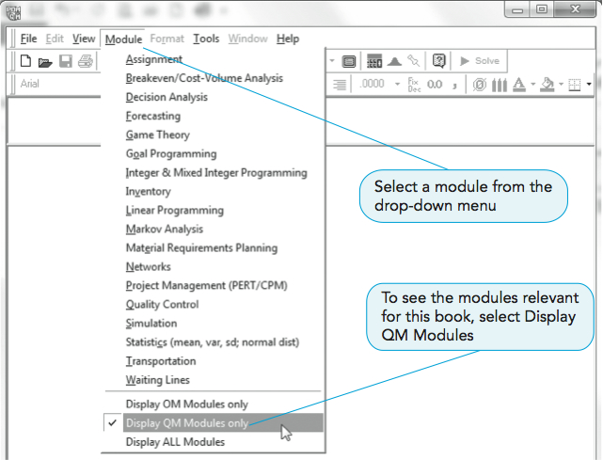
Computers and Spreadsheet Models
POM-QM for Windows
An easy to use decision support system for use in POM and QM courses
This is the main menu of quantitative models
An Excel add-in
PROGRAM 1.1 – Main Menu

Slide 30
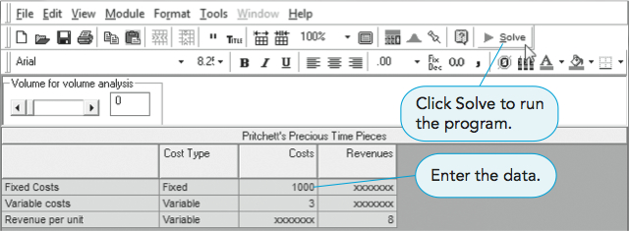
Computers and Spreadsheet Models
PROGRAM 1.2A – Entering Data

Slide 31
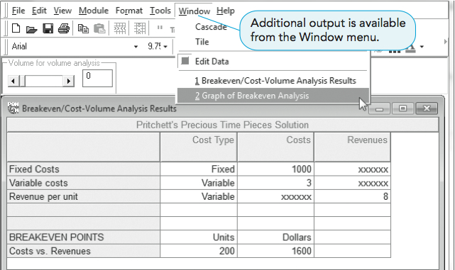
Computers and Spreadsheet Models
PROGRAM 1.2B – Solution Screen

Slide 32
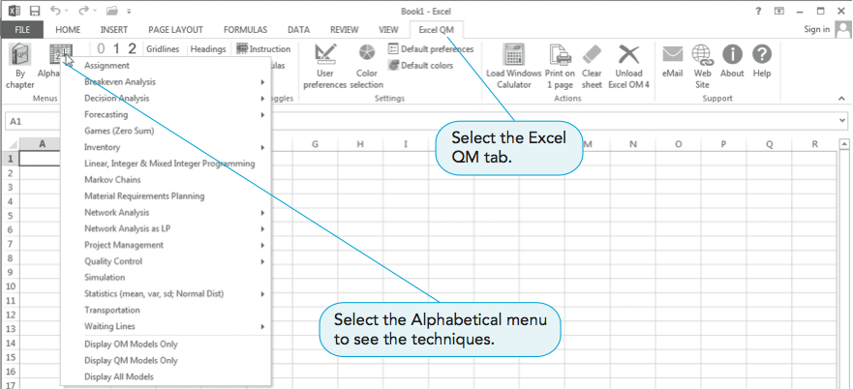
Computers and Spreadsheet Models
PROGRAM 1.3 – Excel Ribbon and Menu

Slide 33
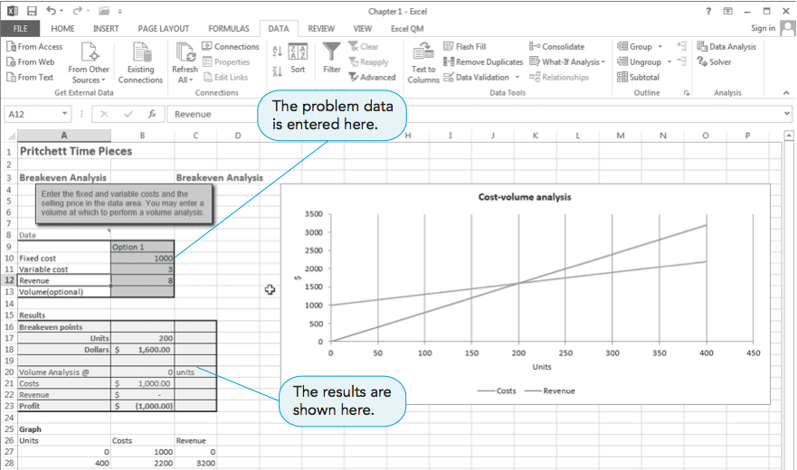
Computers and Spreadsheet Models
PROGRAM 1.4 – Entering Data

Slide 34
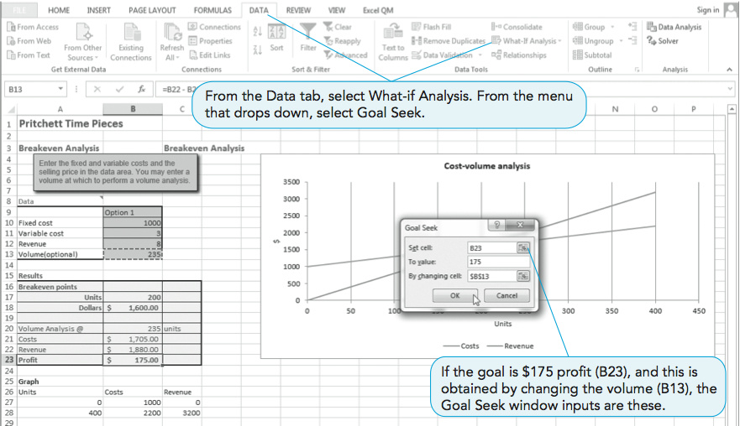
Computers and Spreadsheet Models
PROGRAM 1.5 – Using Goal Seek

Slide 35
Possible Problems in the Quantitative Analysis Approach
Defining the problem
Problems may not be easily identified
Conflicting viewpoints
Impact on other departments
Beginning assumptions
Solution outdated
Developing a model
Fitting the textbook models
Understanding the model

Slide 36
Possible Problems in the Quantitative Analysis Approach
Acquiring accurate input data
Using accounting data
Validity of the data
Developing a solution
Hard-to-understand mathematics
Only one answer is limiting
Testing the solution
Solutions not always intuitively obvious
Analyzing the results
How will it affect the total organization

Slide 37
Implementation – Not Just the Final Step
Lack of commitment and resistance to change
Fear formal analysis processes will reduce management’s decision-making power
Fear previous intuitive decisions exposed as inadequate
Uncomfortable with new thinking patterns
Action-oriented managers may want “quick and dirty” techniques
Management support and user involvement are important

Slide 38
Implementation – Not Just the Final Step
Lack of commitment by quantitative analysts
Analysts should be involved with the problem and care about the solution
Analysts should work with users and take their feelings into account

