Slide 1

Integer Programming, Goal Programming, and Nonlinear Programming
10
To accompany Quantitative Analysis for Management, Twelfth Edition, Global Edition,
by Render, Stair, Hanna and Hale
Power Point slides created by Jeff Heyl
Copyright ©2015 Pearson Education, Inc.

Slide 2
LEARNING OBJECTIVES
After completing this chapter, students will be able to:
Understand the difference between LP and integer programming.
Understand and solve the three types of integer programming problems.
Formulate and solve goal programming problems using Excel and QM for Windows.
Formulate nonlinear programming problems and solve using Excel.

Slide 3
CHAPTER OUTLINE
10.1 Introduction
10.2 Integer Programming
10.3 Modeling with 0-1 (Binary) Variables
10.4 Goal Programming
10.5 Nonlinear Programming

Slide 4
Introduction
There are other mathematical programming models that can be used when the assumptions of LP are not met
A large number of business problems require variables have integer values
Many business problems have multiple objectives
Goal programming permits multiple objectives
Nonlinear programming allows objectives and constraints to be nonlinear

Slide 5
Integer Programming
An integer programming model is one where one or more of the decision variables has to take on an integer value in the final solution
Three types of integer programming problems
Pure integer programming – all variables have integer values
Mixed-integer programming – some but not all of the variables will have integer values
Zero-one integer programming – special cases in which all the decision variables must have integer solution values of 0 or 1

Slide 6
Integer Programming
Solving an integer programming problem is much more difficult than solving an LP problem
Solution time required may be excessive
An integer programming model is one where one or more of the decision variables has to take on an integer value in the final solution
Three types of integer programming problems
Pure integer programming – all variables have integer values
Mixed-integer programming – some but not all of the variables will have integer values
Zero-one integer programming – special cases in which all the decision variables must have integer solution values of 0 or 1

Slide 7
Harrison Electric Company Example of Integer Programming
Company produces two products, old-fashioned chandeliers and ceiling fans
Both require a two-step production process involving wiring and assembly
It takes about 2 hours to wire each chandelier and 3 hours to wire a ceiling fan
Final assembly of the chandeliers and fans requires 6 and 5 hours, respectively
Only 12 hours of wiring time and 30 hours of assembly time are available
Each chandelier produced nets the firm $7 and each fan $6

Slide 8
Harrison Electric Company Example of Integer Programming
Production mix LP formulation
Maximize profit = $7X₁ + $6X₂
subject to 2X₁ + 3X₂ ≤ 12 (wiring hours)
6X₁ + 5X₂ ≤ 30 (assembly hours)
X₁, X₂ ≥ 0
where
X₁ = number of chandeliers produced
X₂ = number of ceiling fans produced

Slide 9
Harrison Electric Company Example of Integer Programming
FIGURE 10.1 – Harrison Electric Problem
6 –
5 –
4 –
3 –
2 –
1 –
X₂
6X₁ + 5X₂ ≤ 30
+ = Possible Integer Solution
+
Optimal LP Solution
(X₁= 3.75, X₂ = 1.5, Profit = $35.25
+
+
+
+
+
+
+
2X₁ + 3X₂ ≤ 12
| | | | | |
0 1 2 3 4 5 6
X₁

Slide 10
Harrison Electric Company Example of Integer Programming
Production planner recognizes this is an integer problem
First attempt at solving it is to round the values to X₁ = 4 and X₂ = 2
However, this is not feasible
Rounding X₂ down to 1 gives a feasible solution, but it may not be optimal
This could be solved using the enumeration method
Generally not possible for large problems

Slide 11
Harrison Electric Company Example of Integer Programming
CHANDELIERS (X₁) | CEILING FANS (X₂) | PROFIT ($7X₁ + $6X₂)
0 | 0 | $0
1 | 0 | 7
2 | 0 | 14
3 | 0 | 21
4 | 0 | 28
5 | 0 | 35
0 | 1 | 6
1 | 1 | 13
2 | 1 | 20
3 | 1 | 27
4 | 1 | 34
0 | 2 | 12
1 | 2 | 19
2 | 2 | 26
3 | 2 | 33
0 | 3 | 18
1 | 3 | 25
0 | 4 | 24
TABLE 10.1 – Integer Solutions to the Harrison Electric Company Problem
Optimal solution to integer programming problem
Solution if rounding is used

Slide 12
Harrison Electric Company Example of Integer Programming
CHANDELIERS (X₁) | CEILING FANS (X₂) | PROFIT ($7X₁ + $6X₂)
0 | 0 | $0
1 | 0 | 7
2 | 0 | 14
3 | 0 | 21
4 | 0 | 28
5 | 0 | 35
0 | 1 | 6
1 | 1 | 13
2 | 1 | 20
3 | 1 | 27
4 | 1 | 34
0 | 2 | 12
1 | 2 | 19
2 | 2 | 26
3 | 2 | 33
0 | 3 | 18
1 | 3 | 25
0 | 4 | 24
TABLE 10.1 – Integer Solutions to the Harrison Electric Company Problem
Optimal solution to integer programming problem
The optimal integer solution is less than the optimal LP solution of $35.25
An integer solution can never be better than the LP solution and is usually a lesser value
Solution if rounding is used

Slide 13
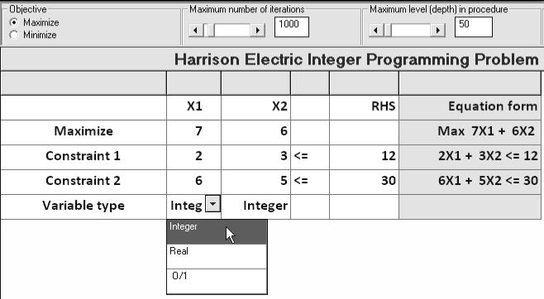
Using Software
PROGRAM 10.1A – QM for Windows Input Screen for Harrison Electric Problem

Slide 14
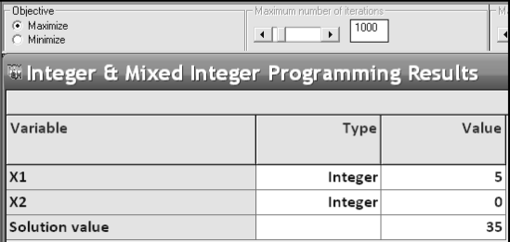
Using Software
PROGRAM 10.1B – QM for Windows Solution Screen for Harrison Electric Problem

Slide 15
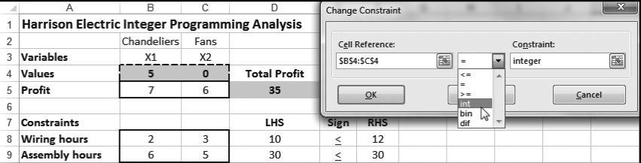
Using Software
PROGRAM 10.2 – Excel 2013 Solver Solution for Harrison Electric Problem

Slide 16

Using Software
PROGRAM 10.2 – Excel 2013 Solver Solution for Harrison Electric Problem
Solver Parameter Inputs and Selections |  | Key Formulas
Set Objective: D5 By Changing cells: B4:C4 To: Max Subject to the Constraints: D8:D9 >= F8:F9 B4:C4 = integer Solving Method: Simplex LP R Make Variables Non-Negative |  | Copy D5 to D8:D9

Slide 17
Mixed-Integer Programming Problem Example
Many situations in which only some of the variables are restricted to integers
Bagwell Chemical Company produces two industrial chemicals
Xyline must be produced in 50-pound bags
Hexall is sold by the pound and can be produced in any quantity
Both xyline and hexall are composed of three ingredients – A, B, and C
Bagwell sells xyline for $85 a bag and hexall for $1.50 per pound

Slide 18
Mixed-Integer Programming Problem Example
AMOUNT PER 50-POUND BAG OF XYLINE (LB) | AMOUNT PER POUND OF HEXALL (LB) | AMOUNT OF INGREDIENTS AVAILABLE
30 | 0.5 | 2,000 lb–ingredient A
18 | 0.4 | 800 lb–ingredient B
2 | 0.1 | 200 lb–ingredient C
Objective is to maximize profit

Slide 19
Mixed-Integer Programming Problem Example
Let X = number of 50-pound bags of xyline
Let Y = number of pounds of hexall
A mixed-integer programming problem as Y is not required to be an integer
Maximize profit = | $85X + | $1.50Y
subject to | 30X + | 0.5Y | ≤ | 2,000
 | 18X + | 0.4Y | ≤ | 800
 | 2X + | 0.1Y | ≤ | 200
 |  | X, Y | ≥ | 0 and X integer

Slide 20
Using Software
PROGRAM 10.3 – QM for Windows Solution for Bagwell Chemical Problem

Slide 21
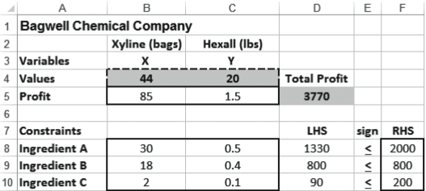
Using Software
PROGRAM 10.4 – Excel 2013 Solver Solution for Bagwell Chemical Problem

Slide 22
Using Software
PROGRAM 10.4 – Excel 2013 Solver Solution for Bagwell Chemical Problem
Solver Parameter Inputs and Selections |  | Key Formulas
Set Objective: D5 By Changing cells: B4:C4 To: Max Subject to the Constraints: D8:D10 <= F8:F10 B4 = integer Solving Method: Simplex LP R Make Variables Non-Negative |  | Copy D5 to D8:D10

Slide 23
Modeling With 0-1 (Binary) Variables
Demonstrate how 0-1 variables can be used to model several diverse situations
Typically a 0-1 variable is assigned a value of 0 if a certain condition is not met and a 1 if the condition is met
This is also called a binary variable

Slide 24
Capital Budgeting Example
Common capital budgeting problem – select from a set of possible projects when budget limitations make it impossible to select them all
A 0-1 variable is defined for each project
Quemo Chemical Company is considering three possible improvement projects for its plant
A new catalytic converter
A new software program for controlling operations
Expanding the storage warehouse
It cannot do them all

Slide 25
Capital Budgeting Example
Objective is to maximize net present value of projects undertaken
subject to Total funds used in year 1 ≤ $20,000
Total funds used in year 2 ≤ $16,000
TABLE 10.2 – Quemo Chemical Company Information
PROJECT | NET PRESENT VALUE | YEAR 1 | YEAR 2
Catalytic Converter | $25,000 | $8,000 | $7,000
Software | $18,000 | $6,000 | $4,000
Warehouse expansion | $32,000 | $12,000 | $8,000
Available funds |  | $20,000 | $16,000

Slide 26
Capital Budgeting Example
Decision variables
X₁ =
1 if catalytic converter project is funded
0 otherwise
X₂ =
1 if software project is funded
0 otherwise
X₃ =
1 if warehouse expansion project is funded
0 otherwise
Formulation
Maximize NPV = | 25,000X₁ + | 18,000X₂ + | 32,000X₃
subject to | 8,000X₁ + | 6,000X₂ + | 12,000X₃ | ≤ | 20,000
 | 7,000X₁ + | 4,000X₂ + | 8,000X₃ | ≤ | 16,000
X₁, X₂, X₃ |  |  |  | = | 0 or 1

Slide 27
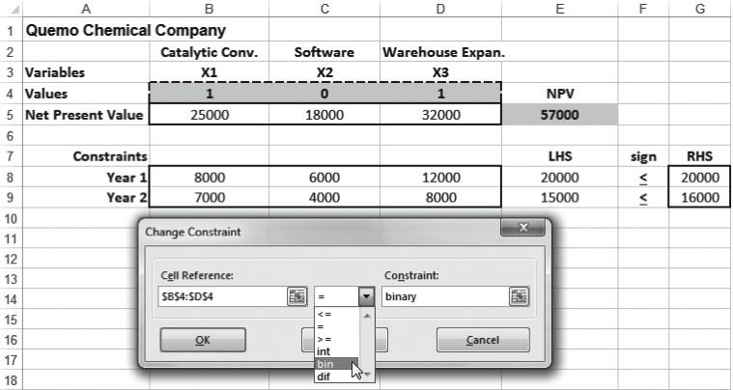
Using Software
PROGRAM 10.5 – Excel 2013 Solver Solution for Quemo Chemical Problem

Slide 28
Using Software
PROGRAM 10.5 – Excel 2013 Solver Solution for Quemo Chemical Problem
Optimal Solution
X₁ = 1, X₂ = 0, X₃ = 1
Fund the catalytic converter and warehouse projects but not the software project
NPV = $57,000

Slide 29

Using Software
PROGRAM 10.5 – Excel 2013 Solver Solution for Quemo Chemical Problem
Solver Parameter Inputs and Selections |  | Key Formulas
Set Objective: E5 By Changing cells: B4:D4 To: Max Subject to the Constraints: E8:E9 <= G8:G9 B4:D4 = binary Solving Method: Simplex LP R Make Variables Non-Negative |  | Copy E5 to E8:E9

Slide 30
Limiting the Number of Alternatives Selected
One common use of 0-1 variables involves limiting the number of projects or items that are selected from a group
Suppose Quemo Chemical is required to select no more than two of the three projects regardless of the funds available
This would require adding a constraint
X₁ + X₂ + X₃ ≤ 2
If they had to fund exactly two projects the constraint would be
X₁ + X₂ + X₃ = 2

Slide 31
Dependent Selections
At times the selection of one project depends on the selection of another project
Suppose Quemo’s catalytic converter could only be purchased if the software was purchased
The following constraint would force this to occur
X₁ ≤ X₂ or X₁ – X₂ ≤ 0
If we wished for the catalytic converter and software projects to either both be selected or both not be selected, the constraint would be
X₁ = X₂ or X₁ – X₂ = 0

Slide 32
Fixed-Charge Problem Example
Often businesses are faced with decisions involving a fixed charge that will affect the cost of future operations
Sitka Manufacturing is planning to build at least one new plant and three cities are being considered
Baytown, Texas
Lake Charles, Louisiana
Mobile, Alabama

Slide 33
Fixed-Charge Problem Example
Constraints
Total production capacity at least 38,000 units each year
Number of units produced at the Baytown plant is 0 if the plant is not built and no more than 21,000 if the plant is built
Number of units produced at the Lake Charles plant is 0 if the plant is not built and no more than 20,000 if the plant is built
Number of units produced at the Mobile plant is 0 if the plant is not built and no more than 19,000 if the plant is built

Slide 34
Fixed-Charge Problem Example
TABLE 10.3 – Fixed and Variable Costs for Sitka Manufacturing
SITE | ANNUAL FIXED COST | VARIABLE COST PER UNIT | ANNUAL CAPACITY
Baytown, TX | $340,000 | $32 | 21,000
Lake Charles, LA | $270,000 | $33 | 20,000
Mobile, AL | $290,000 | $30 | 19,000

Slide 35
Fixed-Charge Problem Example
Decision variables
X₁ =
1 if factory is built in Baytown
0 otherwise
X₂ =
1 factory is built in Lake Charles
0 otherwise
X₃ =
1 if factory is built in Mobile
0 otherwise
X₄ = number of units produced at Baytown plant
X₅ = number of units produced at Lake Charles plant
X₆ = number of units produced at Mobile plant

Slide 36
Fixed-Charge Problem Example
Formulation
Minimize cost = 340,000X₁ + 270,000X₂ + 290,000X₃
+ 32X₄ + 33X₅ + 30X₆
subject to X₄ + X₅ + X₆ ≥ 38,000
X₄ ≤ 21,000X₁
X₅ ≤ 20,000X₂
X₆ ≤ 19,000X₃
X₁, X₂, X₃ = 0 or 1
X₄, X₅, X₆ ≥ 0 and integer

Slide 37
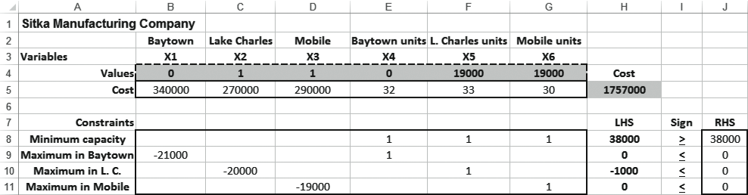
Using Software
PROGRAM 10.6 – Excel 2013 Solver Solution for Sitka Manufacturing Problem

Slide 38
Using Software
PROGRAM 10.6 – Excel 2013 Solver Solution for Sitka Manufacturing Problem
Optimal solution
X₁ = 0, X₂ = 1, X₃ = 1, X₄ = 0, X₅ = 19,000, X₆ = 19,000
Objective function value = $1,757,000

Slide 39

Using Software
PROGRAM 10.6 – Excel 2013 Solver Solution for Sitka Manufacturing Problem
Solver Parameter Inputs and Selections |  | Key Formulas
Set Objective: H5 By Changing cells: B4:G4 To: Min Subject to the Constraints: H8 >= J8 H9:H11 <= J9:J11 B4:D4 = binary E4:G4 = integer Solving Method: Simplex LP R Make Variables Non-Negative |  | Copy H5 to H8:H11

Slide 40
Financial Investment Example
Simkin, Simkin, and Steinberg specialize in recommending oil stock portfolios
One client has the following specifications
At least two Texas firms must be in the portfolio
No more than one investment can be made in a foreign oil company
One of the two California oil stocks must be purchased
The client has $3 million to invest and wants to buy large blocks of shares

Slide 41
Financial Investment Example
TABLE 10.4 – Oil Investment Opportunities
STOCK | COMPANY NAME | EXPECTED ANNUAL RETURN ($1,000s) | COST FOR BLOCK OF SHARES ($1,000s)
1 | Trans-Texas Oil | 50 | 480
2 | British Petroleum | 80 | 540
3 | Dutch Shell | 90 | 680
4 | Houston Drilling | 120 | 1,000
5 | Texas Petroleum | 110 | 700
6 | San Diego Oil | 40 | 510
7 | California Petro | 75 | 900

Slide 42
Financial Investment Example
Formulation
Maximize return = 50X₁ + 80X₂ + 90X₃ + 120X₄ + 110X₅ + 40X₆ + 75X₇
subject to
X₁ + X₄ + X₅ ≥ 2 (Texas constraint)
X₂ + X₃ ≤ 1 (foreign oil constraint)
X₆ + X₇ = 1 (California constraint)
480X₁ + 540X₂ + 680X₃ + 1,000X₄ + 700X₅ + 510X₆ + 900X₇ ≤ 3,000 ($3 million limit)
X_{i} = 0 or 1 for all i

Slide 43
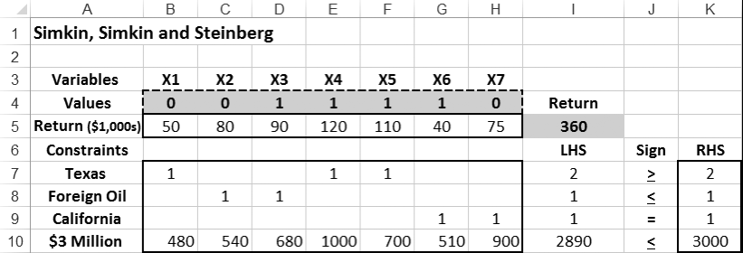
Using Software
PROGRAM 10.7 – Excel 2013 Solver Solution for Financial Investment Problem

Slide 44

Using Software
PROGRAM 10.7 – Excel 2013 Solver Solution for Financial Investment Problem
Solver Parameter Inputs and Selections |  | Key Formulas
Set Objective: I5 By Changing cells: B4:H4 To: Max Subject to the Constraints: I7 >= K7 I8 <= K8 I9 = K9 I10 <= K10 B4:H4 = binary Solving Method: Simplex LP R Make Variables Non-Negative |  | Copy I5 to I7:I10

Slide 45
Goal Programming
Firms often have more than one goal
In linear and integer programming methods the objective function is measured in one dimension only
It is not possible for LP to have multiple goals unless they are all measured in the same units
Highly unusual situation
Goal programming developed to supplement LP

Slide 46
Goal Programming
Typically goals set by management can be achieved only at the expense of other goals
Establish a hierarchy of importance so that higher-priority goals are satisfied before lower-priority goals
Not always possible to satisfy every goal
Goal programming attempts to reach a satisfactory level of multiple objectives
May not optimize but have to satisfice

Slide 47
Goal Programming
Main difference is in the objective function
Goal programming tries to minimize the deviations between goals and what can be achieved given the constraints
Objective is to minimize deviational variables

Slide 48
Harrison Electric Company Revisited
Production mix LP formulation
Maximize profit = $7X₁ + $6X₂
subject to 2X₁ + 3X₂ ≤ 12 (wiring hours)
6X₁ + 5X₂ ≤ 30 (assembly hours)
X₁, X₂ ≥ 0
where
X₁ = number of chandeliers produced
X₂ = number of ceiling fans produced

Slide 49
Harrison Electric Company Revisited
Moving to a new location and maximizing profit is not a realistic objective
A profit level of $30 would be satisfactory during this period
The goal programming problem is to find the production mix that achieves this goal as closely as possible given the production time constraints
Define two deviational variables
d₁– = underachievement of the profit target
d₁⁺ = overachievement of the profit target

Slide 50
Harrison Electric Company Revisited
Single-goal programming formulation
Minimize under or
overachievement = d₁– + d₁⁺
of profit target
subject to
$7X₁ + $6X₂ + d₁– – d₁⁺ = $30 (profit goal constraint)
2X₁ + 3X₂ ≤ 12 (wiring hours)
6X₁ + 5X₂ ≤ 30 (assembly hours)
X₁, X₂, d₁–, d₁⁺ ≥ 0

Slide 51
Harrison Electric Company Revisited
Single-goal programming formulation
Minimize under or
overachievement = d₁– + d₁⁺
of profit target
subject to
$7X₁ + $6X₂ + d₁– – d₁⁺ = $30 (profit goal constraint)
2X₁ + 3X₂ ≤ 12 (wiring hours)
6X₁ + 5X₂ ≤ 30 (assembly hours)
X₁, X₂, d₁–, d₁⁺ ≥ 0
Analyze each goal to see if underachievement or overachievement of that goal is acceptable
If overachievement is acceptable, eliminate the appropriate d⁺ variable from the objective function
If underachievement is okay, the d– variable should be dropped
If a goal must be attained exactly, both d– and d⁺ must appear in the objective function

Slide 52
Extension to Equally Important Multiple Goals
Achieve several goals that are equal in priority
Goal 1: to produce a profit of $30 if possible during the production period
Goal 2: to fully utilize the available wiring department hours
Goal 3: to avoid overtime in the assembly department
Goal 4: to meet a contract requirement to produce at least seven ceiling fans

Slide 53
Extension to Equally Important Multiple Goals
The deviational variables can be defined as
d₁– = underachievement of the profit target
d₁⁺ = overachievement of the profit target
d₂– = idle time in the wiring department (underutilization)
d₂⁺ = overtime in the wiring department (overutilization)
d₃– = idle time in the assembly department (underutilization)
d₃⁺ = overtime in the assembly department (overutilization)
d₄– = underachievement of the ceiling fan goal
d₄⁺ = overachievement of the ceiling fan goal

Slide 54
Extension to Equally Important Multiple Goals
Management is unconcerned about d₁⁺, d₂⁺, d₃–, and d₄⁺ so these may be omitted from the objective function
New objective function and constraints
Minimize total deviation = d₁– + d₂– + d₃⁺ + d₄–
subject to
$7X₁ + $6X₂ + d₁– – d₁⁺ = $30 (profit constraint)
2X₁ + 3X₂ + d₂– – d₂⁺ = 12 (wiring hours constraint)
6X₁ + 5X₂ + d₃– – d₃⁺ = 30 (assembly hours constraint)
X₂ + d₄– – d₄⁺ = 7 (ceiling fan constraint)
All X_{i}, d_{i} variables ≥ 0

Slide 55
Ranking Goals with Priority Levels
In most goal programming problems, one goal will be more important than another
Lower-order goals considered only after higher-order goals are met
Priorities (P_{i}s) are assigned to each deviational variable
P₁ is the most important goal
P₂ the next most important
P₃ the third, and so on

Slide 56
Ranking Goals with Priority Levels
Harrison Electric has set the following priorities for their four goals
GOAL | PRIORITY
Reach a profit as much above $30 as possible | P₁
Fully use wiring department hours available | P₂
Avoid assembly department overtime | P₃
Produce at least seven ceiling fans | P₄
Priority 1 is infinitely more important than Priority 2, which is infinitely more important than the next goal, and so on

Slide 57
Ranking Goals with Priority Levels
Harrison Electric has set the following priorities for their four goals
GOAL | PRIORITY
Reach a profit as much above $30 as possible | P₁
Fully use wiring department hours available | P₂
Avoid assembly department overtime | P₃
Produce at least seven ceiling fans | P₄
With ranking of goals considered, the new objective function is
Minimize total deviation = P₁d₁– + P₂d₂– + P₃d₃⁺ + P₄d₄–

Slide 58
Goal Programming with Weighted Goals
Priority levels assume that each level is infinitely more important than the level below it
However a goal may be only two or three times more important than another
Instead of placing these goals on different levels, they are placed on the same level but with different weights
The coefficients of the deviation variables in the objective function include both the priority level and the weight

Slide 59
Goal Programming with Weighted Goals
Suppose Harrison decides to add another goal of producing at least two chandeliers
The goal of producing seven ceiling fans is considered twice as important as this goal
The goal of two chandeliers is assigned a weight of 1 and the goal of seven ceiling fans is assigned a weight of 2 and both of these will be priority level 4
The new constraint and objective function are
X₁ + d₅– – d₅⁺ = 2 (chandeliers)
Minimize total = P₁d₁– + P₂d₂– + P₃d₃⁺ + P₄(2d₄–) + P₄d₅–
deviation

Slide 60
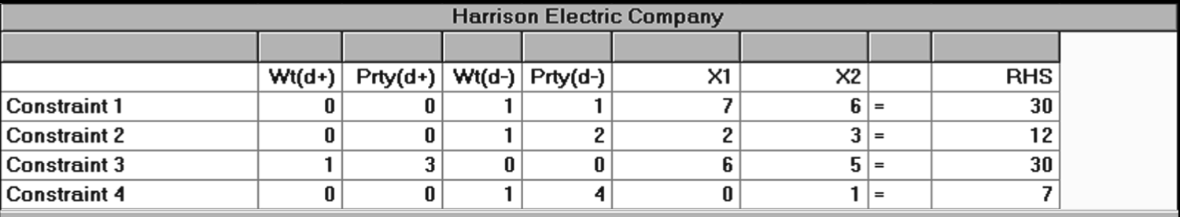
Using Software
PROGRAM 10.8A – Harrison Electric’s Goal Programming Analysis Using QM for Windows: Inputs

Slide 61
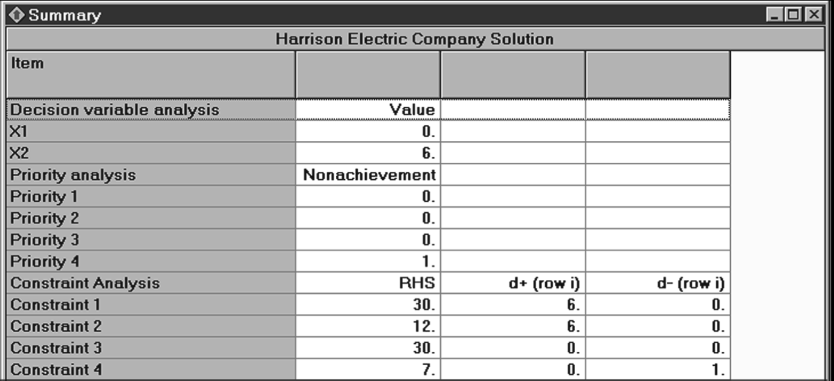
Using Software
PROGRAM 10.8B – Summary Solution Screen for Harrison Electric’s Goal Programming Problem Using QM for Windows

Slide 62
Nonlinear Programming
The methods seen so far have assumed that the objective function and constraints are linear
However, there are many nonlinear relationships in the real world that would require the objective function and/or constraint equations to be nonlinear
Computational procedures for nonlinear programming (NLP) may only provide a local optimum solution rather than a global optimum

Slide 63
Nonlinear Objective Function and Linear Constraints
The Great Western Appliance Company sells two models of toaster ovens, the Microtoaster (X₁) and the Self-Clean Toaster Oven (X₂)
They earn a profit of $28 for each Microtoaster no matter the number of units sold
For the Self-Clean oven, profits increase as more units are sold due to a fixed overhead
The profit function for the Self-Clean oven
21X₂ + 0.25X₂²

Slide 64
Nonlinear Objective Function and Linear Constraints
The objective function is nonlinear and there are two linear constraints on production capacity and sales time available
Maximize profit = 28X₁ + 21X₂ + 0.25X₂²
subject to
X₁ + X₂ ≤ 1,000 (units of production capacity)
0.5X₁ + 0.4X₂ ≤ 500 (hours of sales time available)
X₁, X₂ ≥ 0

Slide 65
Nonlinear Objective Function and Linear Constraints
When an objective function contains a squared term and the problem constraints are linear, it is called a quadratic programming problem
The objective function is nonlinear and there are two linear constraints on production capacity and sales time available
Maximize profit = 28X₁ + 21X₂ + 0.25X₂²
subject to
X₁ + X₂ ≤ 1,000 (units of production capacity)
0.5X₁ + 0.4X₂ ≤ 500 (hours of sales time available)
X₁, X₂ ≥ 0

Slide 66
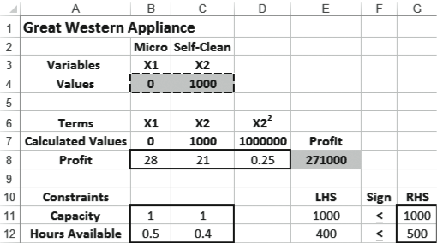
Using Software
PROGRAM 10.9 – Excel 2013 Solver Solution for Great Western Appliance NLP Problem

Slide 67
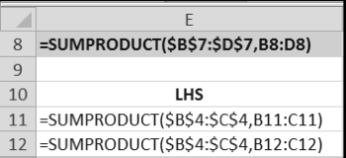

Using Software
PROGRAM 10.9 – Excel 2013 Solver Solution for Great Western Appliance NLP Problem
Solver Parameter Inputs and Selections |  | Key Formulas
Set Objective: E8 By Changing cells: B4:C4 To: Max Subject to the Constraints: E11:E12 <= G11:G12 Solving Method: GRG Nonlinear R Make Variables Non-Negative

Slide 68
Both Nonlinear Objective Function and Nonlinear Constraints
The annual profit at a medium-sized (200-400 beds) Hospicare Corporation hospital depends on
The number of medical patients admitted (X₁)
The number of surgical patients admitted (X₂)
The objective function for the hospital is nonlinear
There are three constraints, two of which are nonlinear
Nursing capacity - nonlinear
X-ray capacity - nonlinear
Marketing budget required

Slide 69
Both Nonlinear Objective Function and Nonlinear Constraints
Objective function and constraint equations
Maximize profit = $13X₁ + $6X₁X₂ + $5X₂ + $1/X₂
subject to
2X₁² + 4X₂ ≤ 90 (nursing capacity in thousands of labor-days)
X₁ + X₂³ ≤ 75 (x-ray capacity in thousands)
8X₁ – 2X₂ ≤ 61 (marketing budget required in thousands of $)

Slide 70
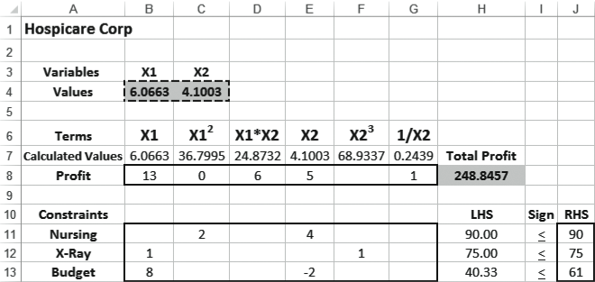
Using Software
PROGRAM 10.10 – Excel 2013 Solution to the Hospicare NLP Problem

Slide 71


Using Software
PROGRAM 10.10 – Excel 2013 Solution to the Hospicare NLP Problem
Solver Parameter Inputs and Selections |  | Key Formulas
Set Objective: H8 By Changing cells: B4:C4 To: Max Subject to the Constraints: H11:H13 <= J11:J13 Solving Method: GRG Nonlinear R Make Variables Non-Negative |  | Copy H8 to H11:H13

Slide 72
Linear Objective Function and Nonlinear Constraints
Thermlock Corp. produces massive rubber washers and gaskets like the type used to seal joints on the NASA Space Shuttles
It combines two ingredients, rubber (X₁) and oil (X₂)
The cost of the industrial quality rubber is $5 per pound and the cost of high viscosity oil is $7 per pound
Two of the three constraints are nonlinear

Slide 73
Linear Objective Function and Nonlinear Constraints
Objective function and constraints
Minimize costs = $5X₁ + $7X₂
subject to
3X₁ + 0.25X₁² + 4X₂ + 0.3X₂² ≥ 125 (hardness constraint)
13X₁ + X₁³ ≥ 80 (tensile strength)
0.7X₁ + X₂ ≥ 17 (elasticity)

Slide 74
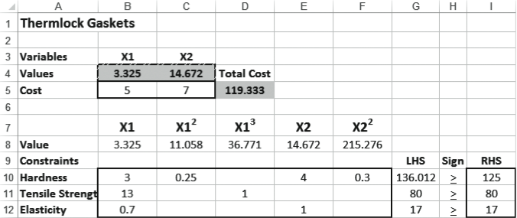
Using Software
PROGRAM 10.11 – Excel 2013 Solution to the Thermlock NLP Problem

Slide 75



Using Software
PROGRAM 10.11 – Excel 2013 Solution to the Thermlock NLP Problem
Solver Parameter Inputs and Selections |  | Key Formulas
Set Objective: D5 By Changing cells: B4:C4 To: Min Subject to the Constraints: G10:G12 >= I10:I12 Solving Method: GRG Nonlinear R Make Variables Non-Negative |  | Copy G10 to G11:G12

