Slide 1
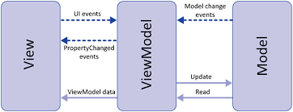

Xamarin development using MVVM
Application
Service Adapter
Device Adapter
iOS
Android
Service

Slide 2
Model Classes
View Classes
ViewModel Classes
BL Classes
Workman
Job
Customer
Device
ModelDiagram
UserManual
SMEinfo
Timelog
ContainerView
LoginView
TicketDetailView
CustomerDeviceHistView
ModelDiagramView
UserManualView
CameraView
RecordObservationView
SMEListView
SMEConversationView
TimelogView
ContainerViewModel
LoginViewModel
TicketDetailViewModel
CustomerDeviceHistViewModel
ModelDiagramViewModel
UserManualViewModel
CameraViewModel
RecordObservationViewModel
SMEListViewModel
SMEConversationViewModel
TimelogViewModel
SessionAdapter
ServiceAdapter
DeviceAdapter
NavigationManager
Factory Classes
ViewFactory
ViewModelFactory

