Slide 1

Tic Tac Toe

Slide 2
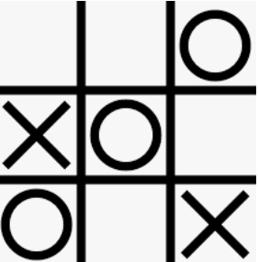
The Game
For any programming task you need to understand “requirements”.
Requirements are them broken down into smaller tasks that, when put together, accomplish the goal.

Slide 3
Requirements
Game is played on a 3x3 board/grid
Two player game
Ask for two names and store them in a list.
Turn based game
Players go one after the other.
3x3 board/grid limits turns to 9
Rules
Player must choose a valid position on the board/grid.
Player can only choose a position not already populated.
A player wins when they populate with their ‘mark’ a:
Row, Column, or Diagonal

Slide 4
Requirement 1: Game board/grid
The game board/grid has 9 positions that can be played.
This can be represented by a list:
tic_tac_toe_board = [1,2,3,4,5,6,7,8,9]

Slide 5
Requirement 2: Two player game
We need to keep track of two users. We will allow them to enter a name. Each player has a ‘mark’ to play on the board:
player_mark = [‘X’,’O’]
players = []
players.append(input(“Enter name for user 1 : “)
players.append(input(“Enter name for user 2 : “)

Slide 6
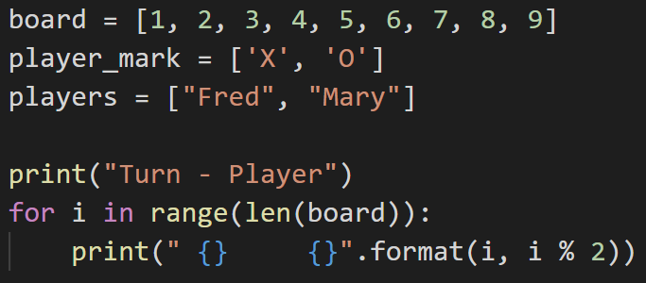
Requirement 3: Turn based game
Players take turns, and there are a limit of 9 turns based on board size.
range() returns a collection from 0-(N-1)
Exactly what we need for indexes into a list and guarantee a 9 turn game.
Modulo (%) returns remainder of division.
N%2 returns ONLY a 1 or 0

Slide 7
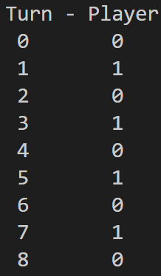
Requirement 3.2: Turn based game
Basic for loop for turn player position:

Slide 8
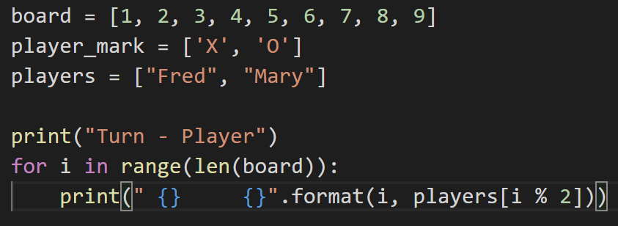
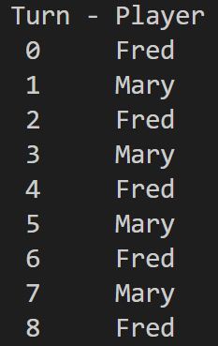
Requirement 3.3: Turn based game
Basic for loop for turn player and player name (using indexes):

Slide 9
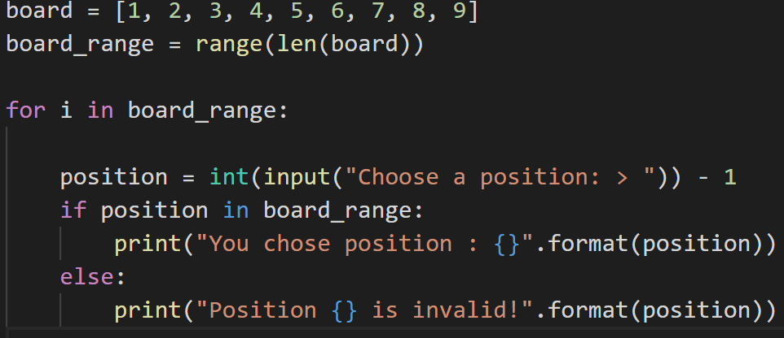
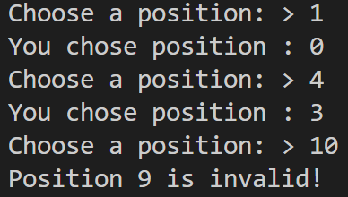
Requirement 4: Turn based game
Making sure the player chooses a valid position

Slide 10
Requirement 4: Valid position
Making sure the player chooses a valid position

Slide 11
Requirement 4: The win
Checking for a win requires a bit of work.
You must scan the entire board after each turn to see if someone has one. This is the hardest part of the program.
For details on calculating the win, see the file in this directory:
NestedForLoops.pptx

Slide 12
Questions?

