Slide 1
Implementing Refactorings in Spoofax
Philippe Misteli - 4932129
IN4333 “Language Engineering Project”
28.06.2019

Slide 2
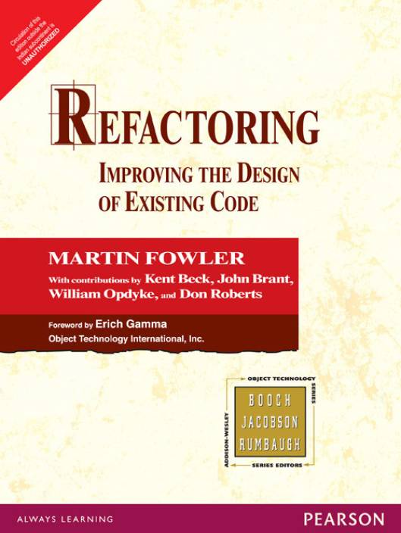
Notes:
Martin Fowler, 1999
Out of the Smalltalk Community

Slide 3
Refactoring Definition
Structural Change
Unchanged observable behaviour

Slide 4
Refactoring Goal
Improve Code Quality
Lower Maintenance Costs
Notes:
Maintenance 40% of software project effort

Slide 5
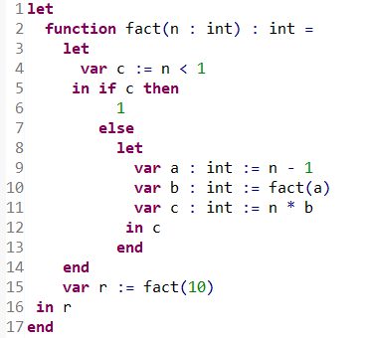
Tiger Programming Language
Notes:
Functional Programmign Language
Everything is an Expression
Lexically Scoped
Nested let bindings
Single Module

Slide 6
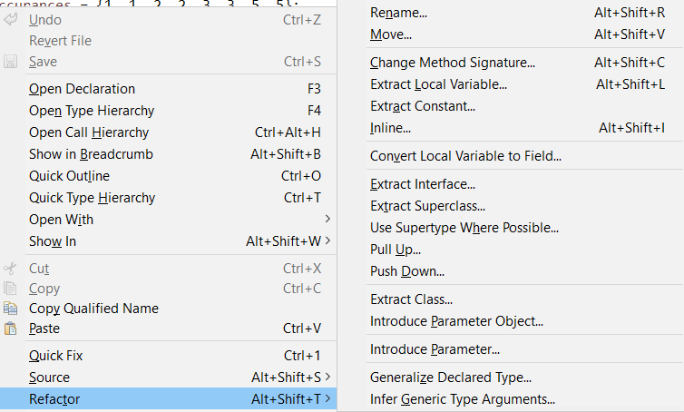



Refactoring as an Editor Service
Notes:
PYPL Puploarity Index for IDEs

Slide 7
Implementation in Spoofax
Program Database
Scope Graph
Parse Tree
AST
Accuracy
SPT
Transformation
Stratego
Notes:
Technical Criteria for Refactoring Tool from Fowler, Chapter 14

Slide 8

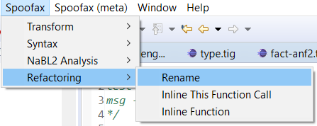
User Interface
.rfac Config File
Notes:
Select identifier
Use Menu
Parameters stored in rfac file

Slide 9
Renaming Named Language Constructs
Variables
Functions
Function Arguments
Types
Fields

Slide 10
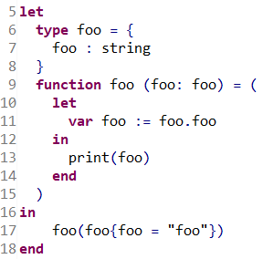
Renaming The Foo Challenge

Slide 11
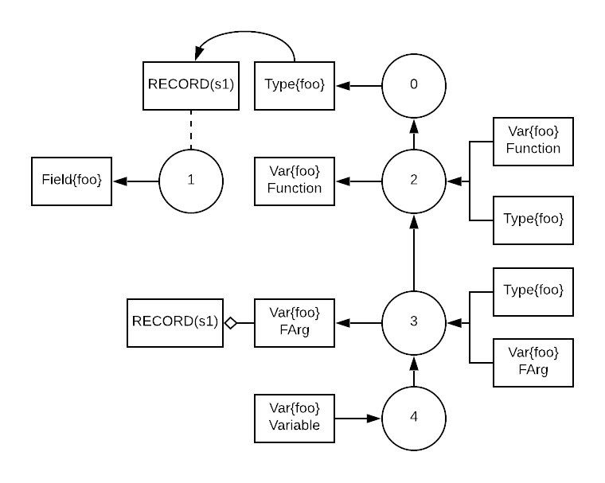
Renaming The Foo Challenge

Slide 12
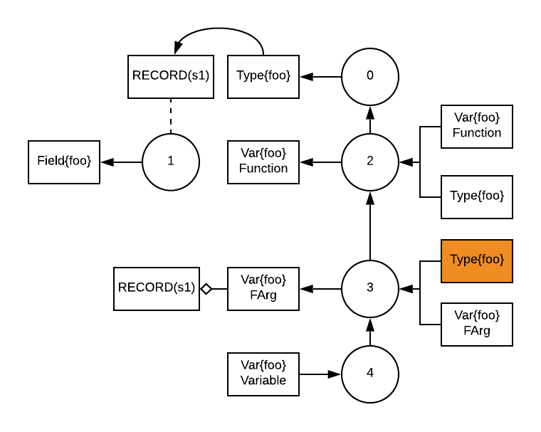
Renaming Step 1: Select Occurrence
Notes:
Collect-One strategy

Slide 13
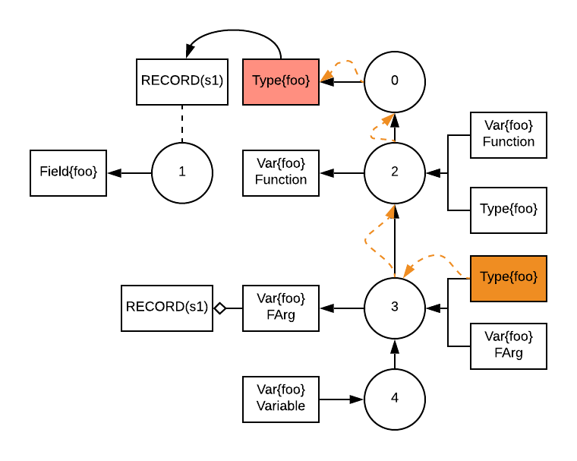
Renaming Step 2: Find Declaration
Notes:
Collect-One strategy

Slide 14
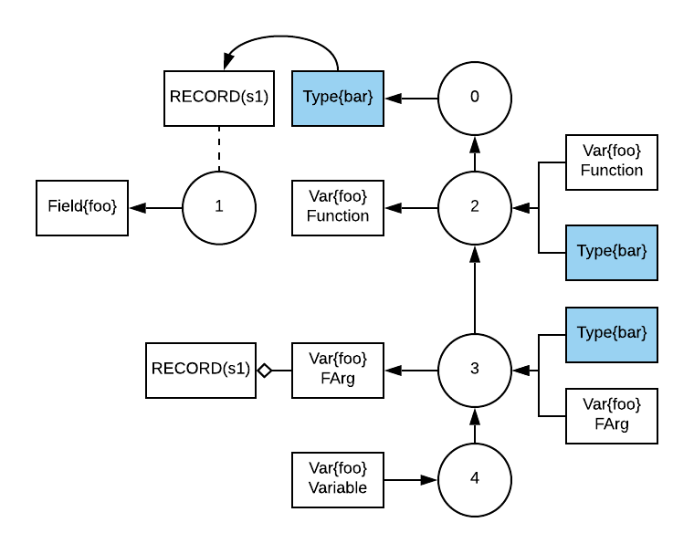
Renaming Step 3: Rename Occurrences
Notes:
Collect-One strategy

Slide 15
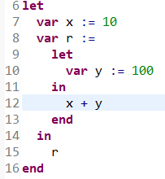
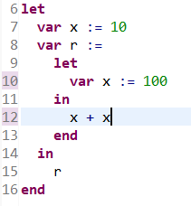
Renaming Problem: Capture

Slide 16
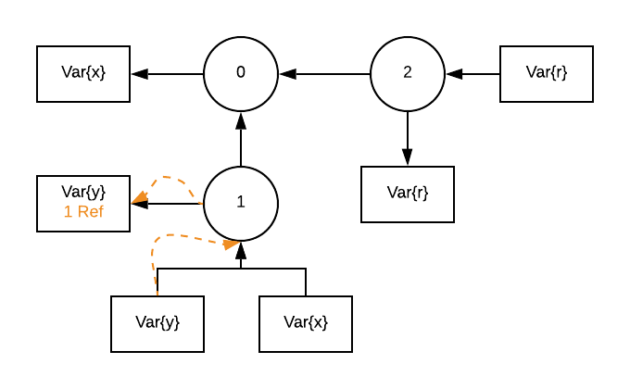
Renaming Solution: Capture

Slide 17
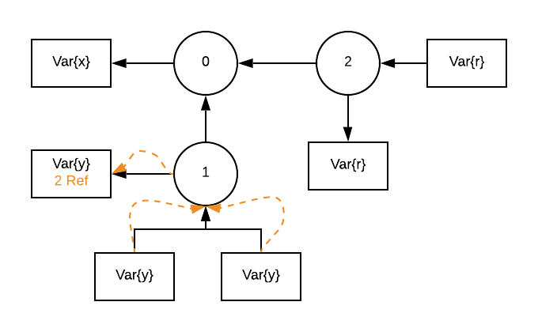
Renaming Solution: Capture

Slide 18
Renaming DEMO

Slide 19
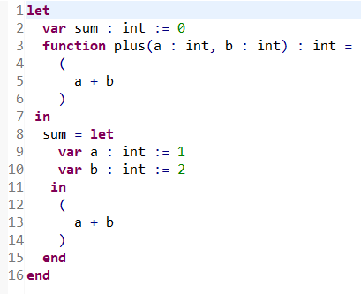
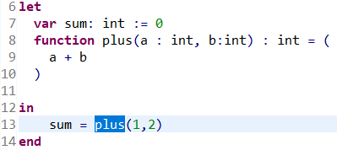
Inline Function Inline Specific Call

Slide 20
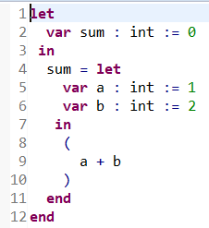
Inline Function Inline Call and Delete Declaration

Slide 21
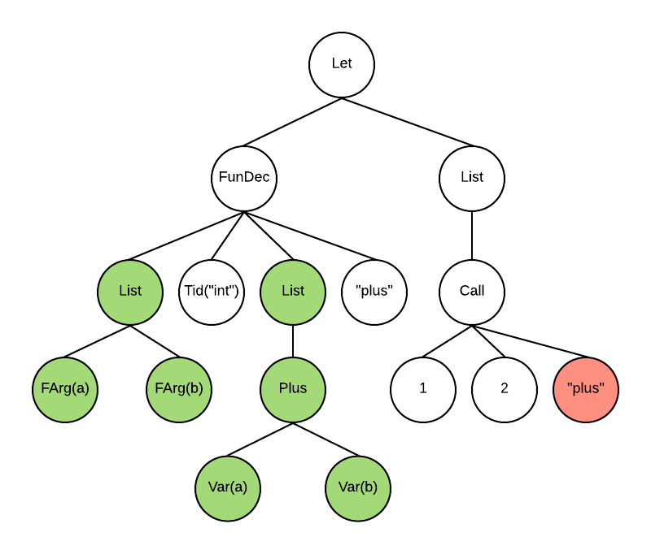
Inline Step 1: Find Function Declaration

Slide 22
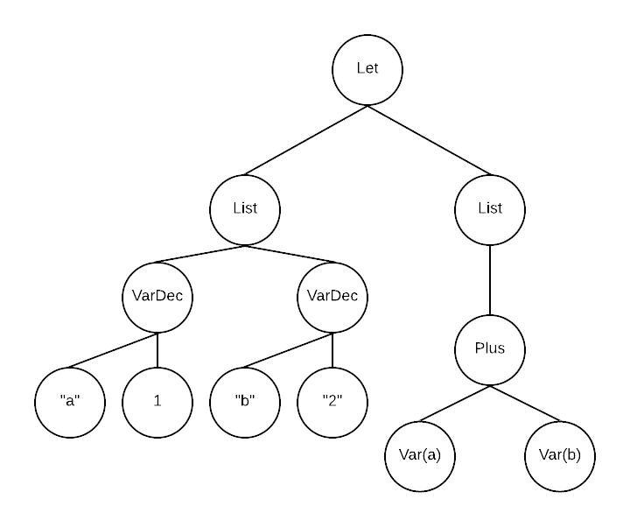
Inline Step 2: Replace Call

Slide 23
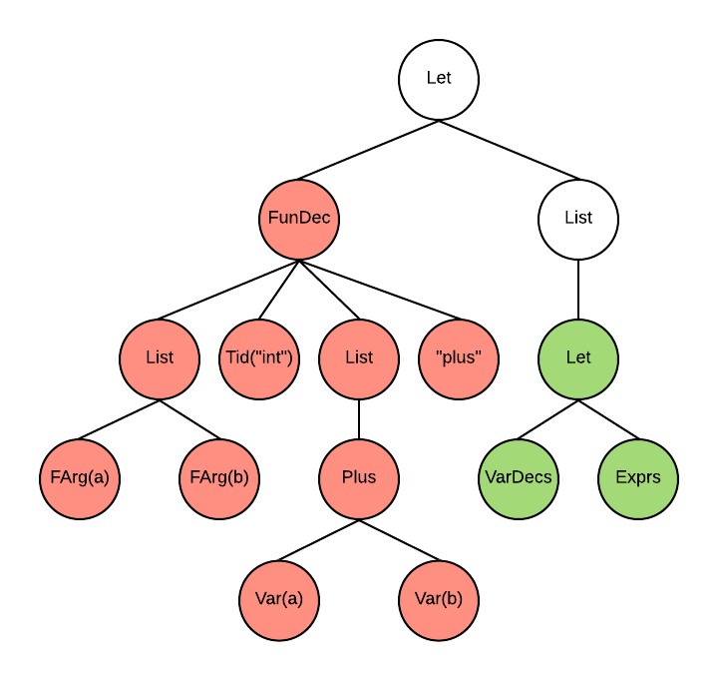
Inline Step 3: Delete Declaration

Slide 24
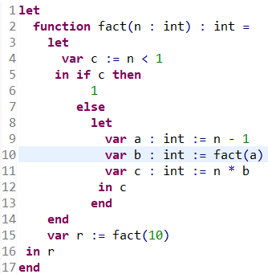
Inline Problem: Recursive Calls

Slide 25
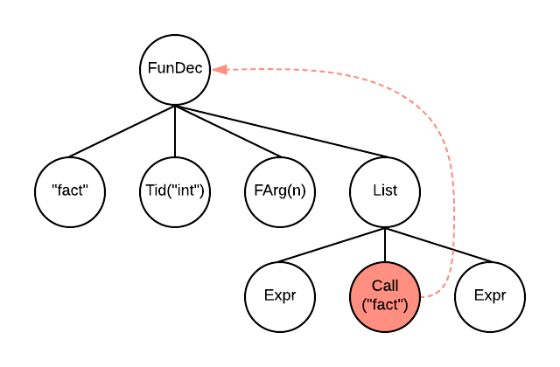
Inline Solution: Recursive Calls

Slide 26
Inline Function DEMO

Slide 27
Conclusion
Stratego Transformations
Nabl2 API
Scope Graph
Eclipse UI Integration
Transformations in SPT

