Slide 5
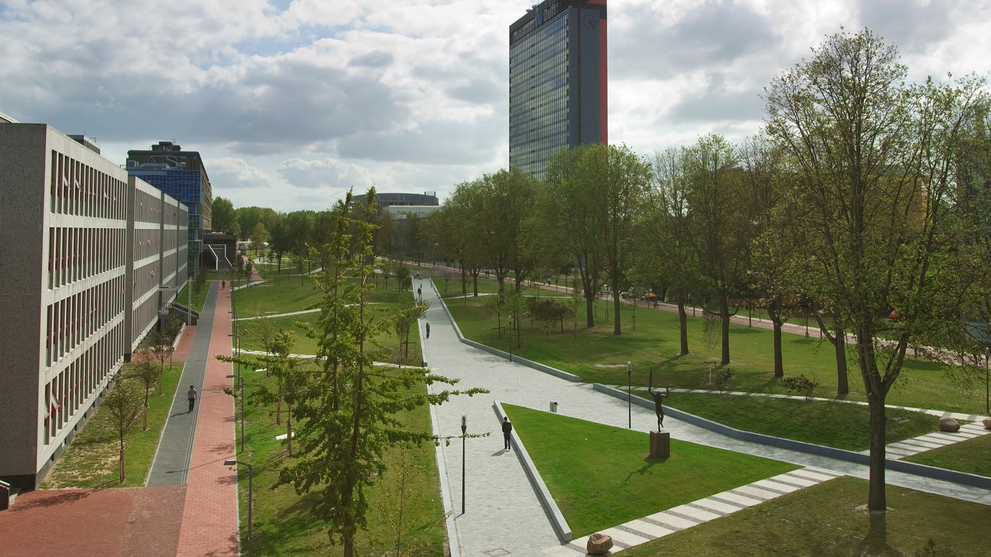
Insert a picture

Slide 6

Insert a picture

