Slide 1
Implementing Refactorings in Spoofax
Phil Misteli - 4932129
IN4333 “Language Engineering Project”
28.06.2019

Slide 2
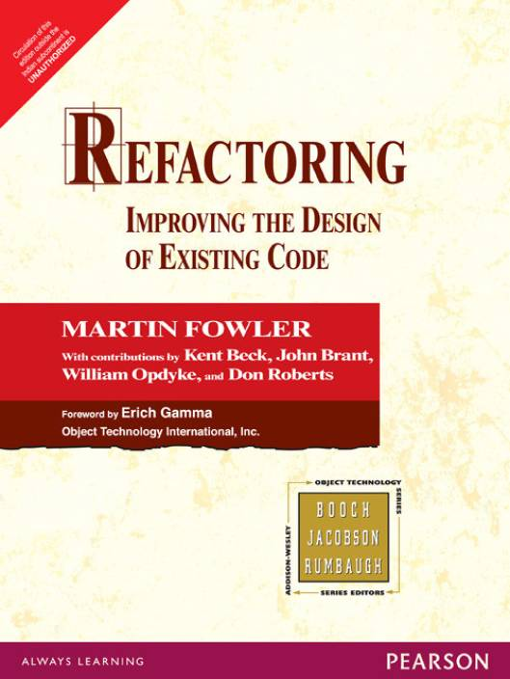
Notes:
Martin Fowler, 1999
Out of the Smalltalk Community

Slide 3
Refactoring Definition
Structural Change
Unchanged observable behaviour

Slide 4
Refactoring Goal
Improve Code Quality
Lower Maintenance Costs
Notes:
Maintenance 40% of software project effort

Slide 5
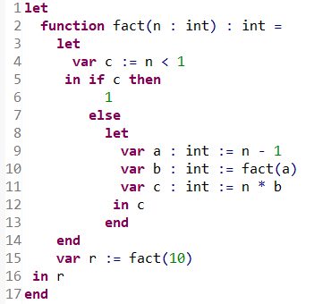
Tiger Programming Language
Notes:
Functional Programmign Language
Everything is an Expression
Lexically Scoped
Nested let bindings
Single Module

Slide 6
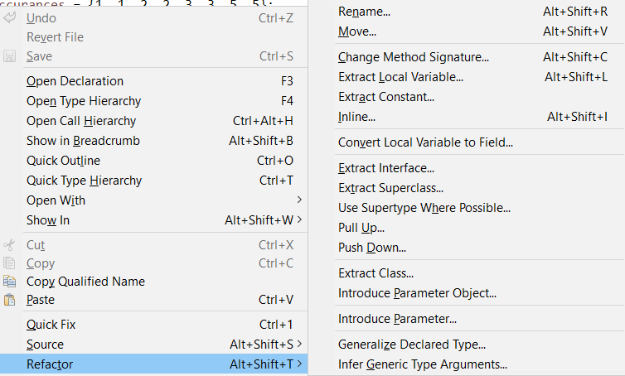



Refactoring as an Editor Service
Notes:
PYPL Puploarity Index for IDEs

Slide 7
Implementation in Spoofax
Program Database
Scope Graph
Parse Tree
AST
Accuracy
SPT
Transformation
Stratego
Notes:
Technical Criteria for Refactoring Tool from Fowler, Chapter 14

Slide 8

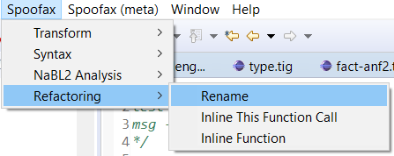
User Interface
.rfac Config File
Notes:
Select identifier
Use Menu
Parameters stored in rfac file

Slide 9
Renaming Named Language Constructs
Variables
Functions
Function Arguments
Types
Fields

Slide 10
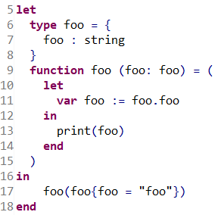
Renaming The Foo Challenge

Slide 11
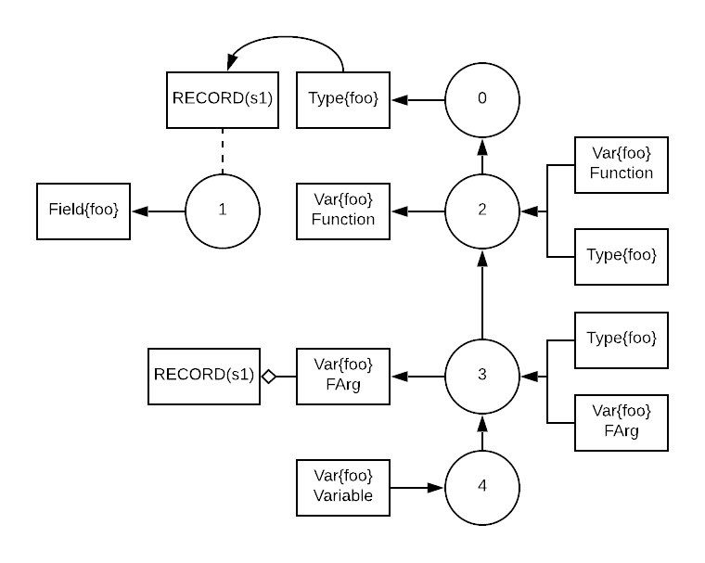
Renaming The Foo Challenge

Slide 12
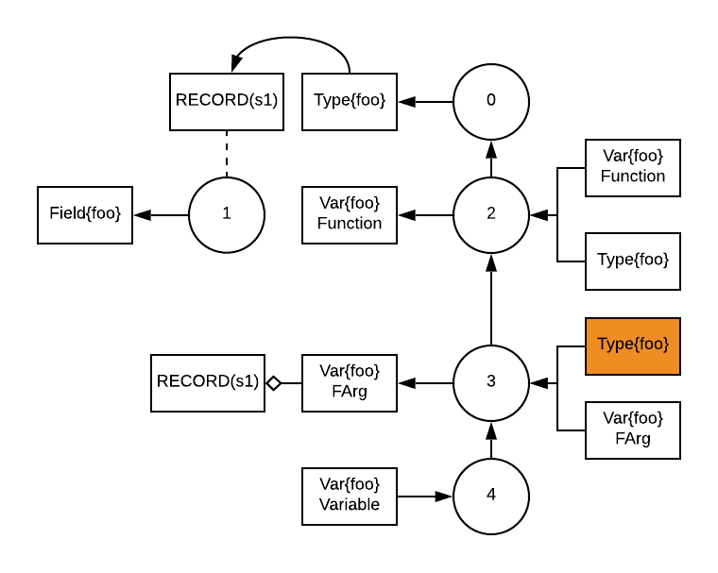
Renaming Step 1: Select Occurrence
Notes:
Collect-One strategy

Slide 13
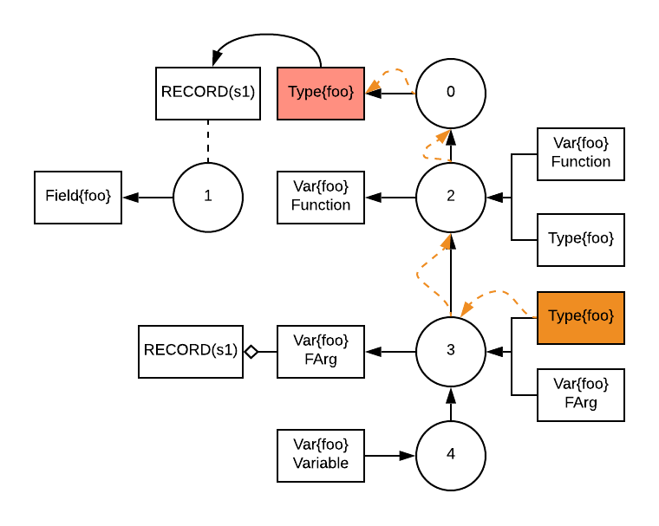
Renaming Step 2: Find Declaration
Notes:
Collect-One strategy

Slide 14
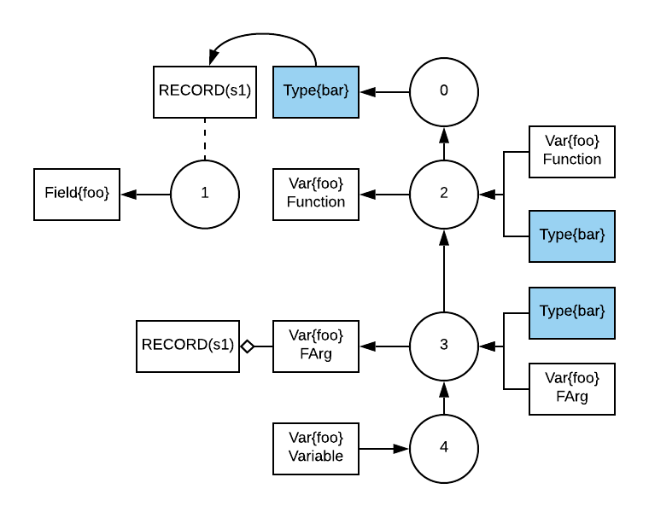
Renaming Step 3: Rename Occurrences
Notes:
Collect-One strategy

Slide 15
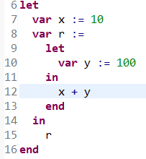
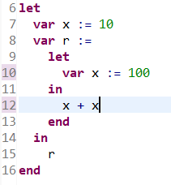
Renaming Problem: Capture

Slide 16
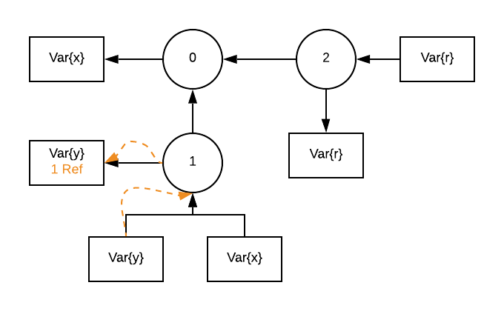
Renaming Solution: Capture

Slide 17
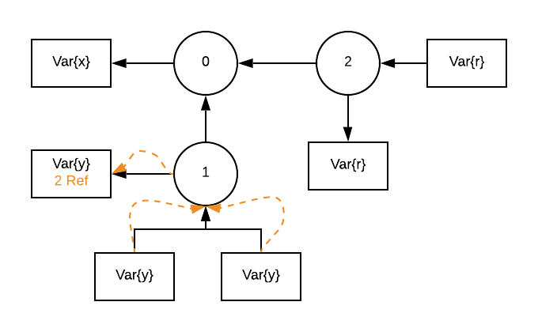
Renaming Solution: Capture

Slide 18
Renaming DEMO

Slide 19
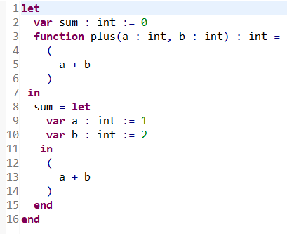
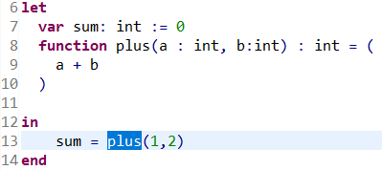
Inline Function Inline Specific Call

Slide 20
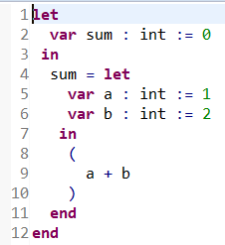
Inline Function Inline Call and Delete Declaration

Slide 21
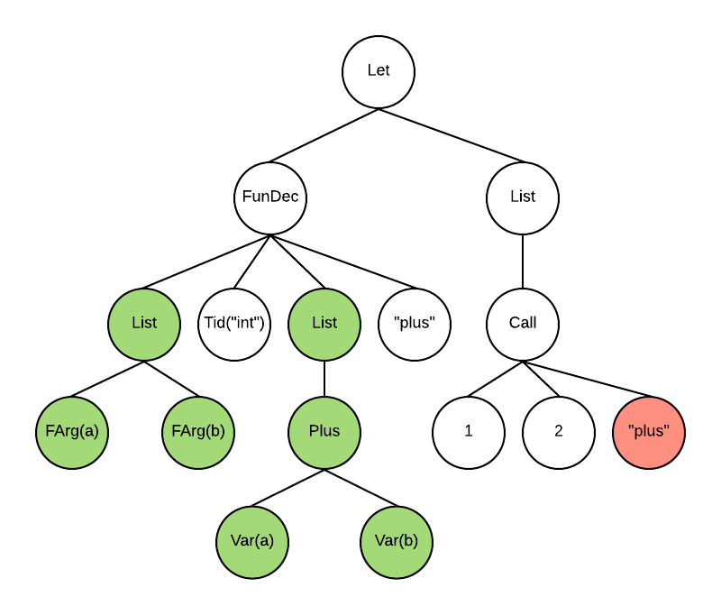
Inline Function Step 1: Find Function Declaration

Slide 22
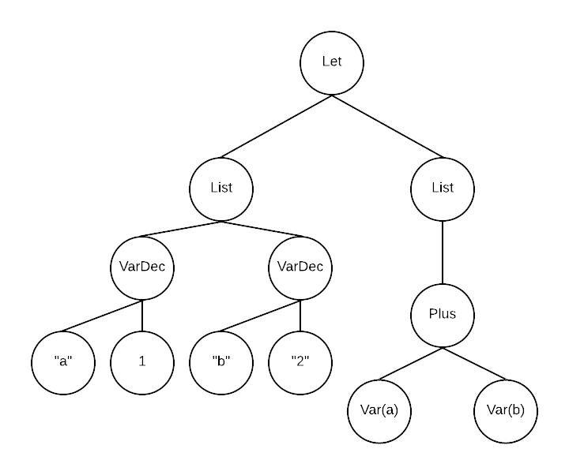
Inline Function Step 2: Replace Call

Slide 23
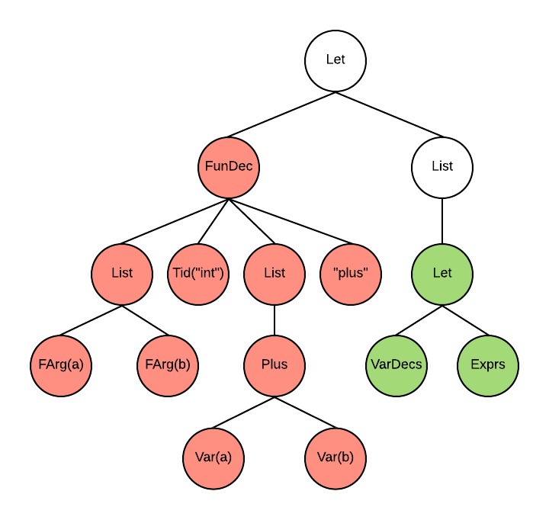
Inline Function Step 3: Delete Declaration

Slide 24
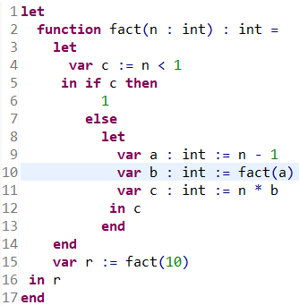
Inline Function Problem: Recursive Calls

Slide 25
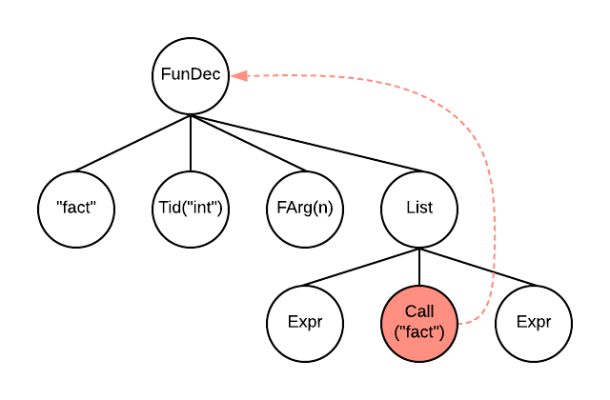
Inline Function Solution: Recursive Calls

Slide 26
Inline Function DEMO

Slide 27
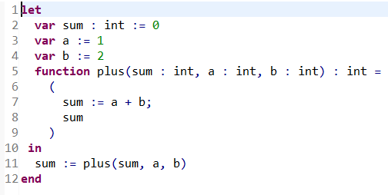
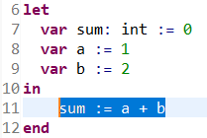
Extract Function

Slide 28
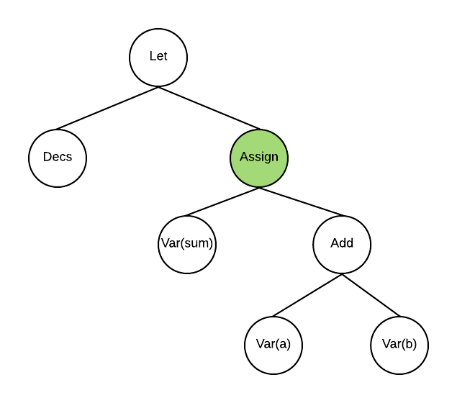
Extract Function Step 1: Check Selected Term

Slide 29
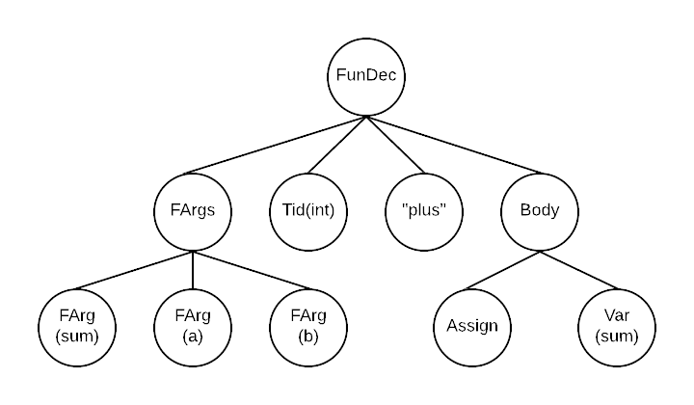
Extract Function Step 2: Create Function Definition
Notes:
Gather all Vars in expression
Filter out vars that are declared in the expression
Turn Vars to Fargs
Check if outside variable is written to
Determine return type
Copy body

Slide 30
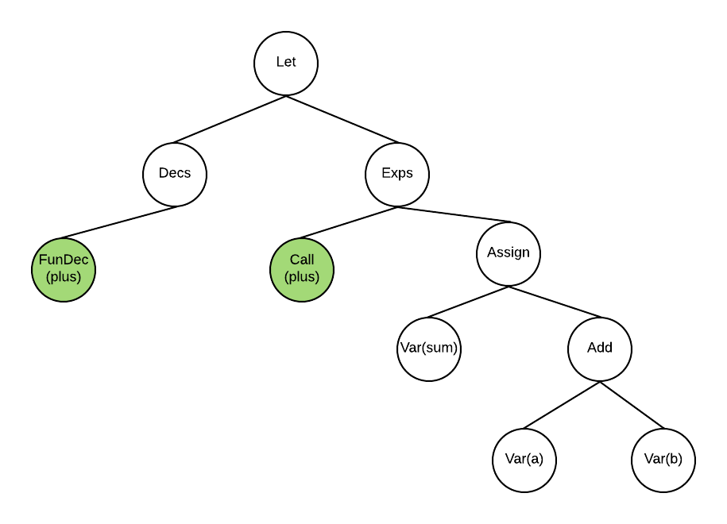
Extract Function Step 3: Insert Call

Slide 31
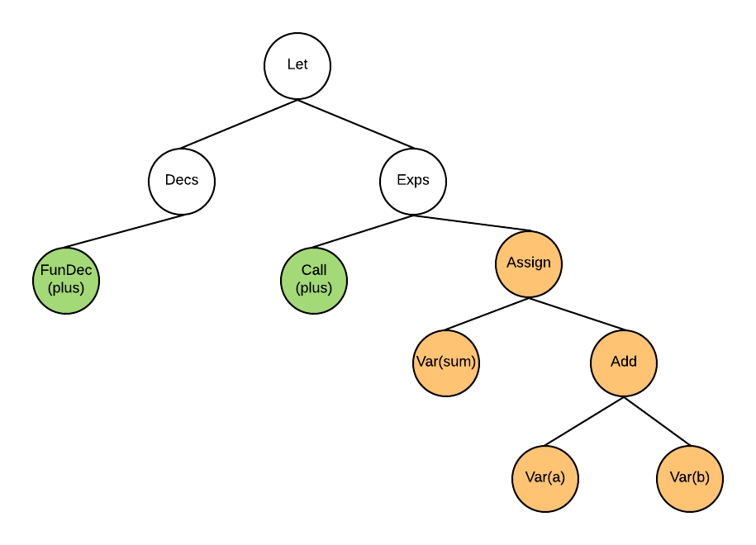
Extract Function Step 4: Delete Extracted Expression

Slide 32
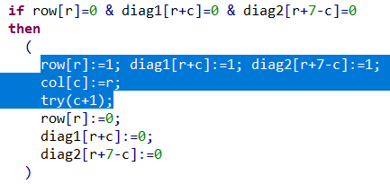
Extract Function Problem: Partial List Selection

Slide 33
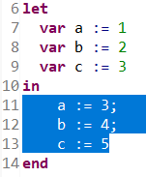
Extract Function Problem: Multiple Writes

Slide 34
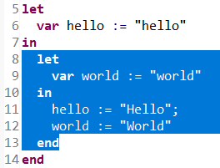
Extract Function Problem: Internal Variables

Slide 35
Extract Function DEMO

Slide 36
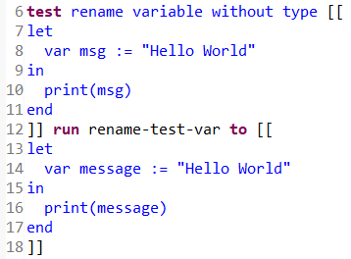
Testing in SPT

Slide 37
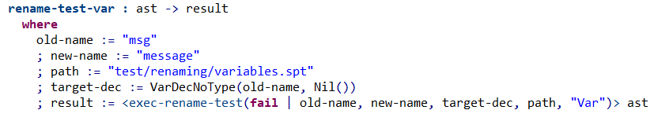
Testing in SPT

Slide 38
Conclusion
Stratego Transformations
Nabl2 API
Scope Graph
Eclipse UI Integration
Tricky
Transformations in SPT

