Slide 1
База данных конструктора легких таков в игре Hearts of Iron 4

Slide 2
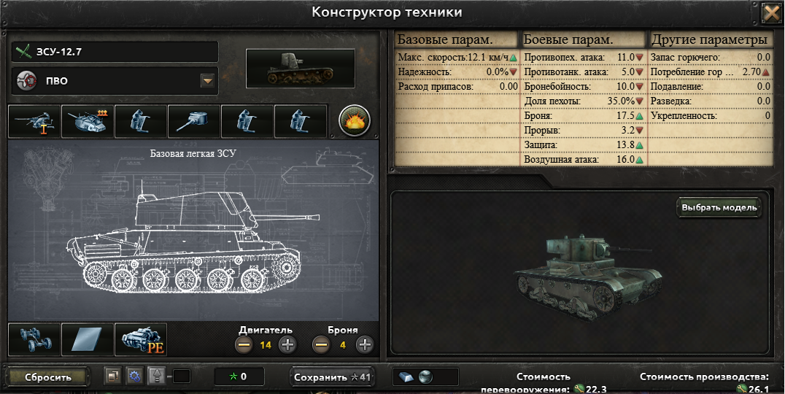


Актуальность

Slide 3
Структура
tank_sample
id
name
role
templates
id
module
amount
modules
id
name
slot
roles
id
role
modules_characteristics
id
type
value
slot_types
id
slot_type
Characteristics_type
id
name

Slide 4

Запрос №1
SELECT id, value FROM modules_characteristics WHERE type = 11 AND value > 0

Slide 5
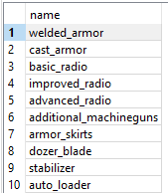
Запрос №2
SELECT name FROM modules WHERE id IN (SELECT id from modules_characteristics WHERE value > 0 EXCEPT SELECT id from modules_characteristics WHERE value < 0) LIMIT 10

Slide 6

Запрос №3
SELECT * FROM modules WHERE name LIKE '%chassis%'

Slide 7
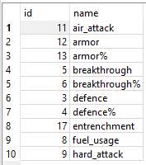
Запрос №4
SELECT * FROM characteristic_type ORDER BY name LIMIT 10

Slide 8
Запрос №5
UPDATE modules_characteristics SET value = 0 WHERE value < 0

Slide 9
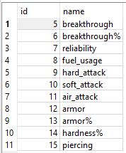
Запрос №6
SELECT * FROM characteristic_type WHERE id BETWEEN 5 AND 15

Slide 10

Запрос №7
SELECT COUNT(value) AS result FROM modules_characteristics WHERE type = 2

Slide 11

Запрос №8
SELECT SUM(value) FROM modules_characteristics WHERE type = (SELECT id FROM characteristic_type WHERE name = 'speed')

Slide 12
Запрос №9
DELETE FROM templates

Slide 13
Запрос №10
INSERT INTO roles(role) VALUES ('Turbocoffin')

