Slide 1

Financial Analytics
By rohan Mukherjee

Slide 2
introduction
The dataset contains information about 500 companies listed in Indian stock exchange with their market cap. In crore and quarterly sales in crore. A relationship between key metrics of the data has been established in this report to analyze which companies made the highest number of sales in the last quarter and which are lucrative in the market .

Slide 3
Main kpi (key performance indicator)
MAR CAP CRORE – MARKET CAPITAL OF A COMPANY IN CRORES. IT IS THE TOTAL VALUE OF A COMPANY’S OUTSTANDING SHARES OF STOCK.
SALES QTR CRORE – QUARTERLY SALES OF A COMPANY IN CRORES. IT REFERS TO THE AMOUNT OF REVENUE A COMPANY GENERATES IN A THREE MONTH PERIOD, TYPICALLY REFERRED TO AS QUARTER.
P/S RATIO: THE P/S RATIO, ALSO KNOWN AS THE PRICE-TO-SALES RATIO, IS A FINANCIAL METRIC USED TO EVALUATE A COMPANY’S STOCK PRICE RELATIVE TO ITS REVENUE. IT IS CALCULATED BY THE MARKET CAPITALIZATION OF A COMPANY BY ITS REVENUE (OR SALES) IN A GIVEN PERIOD.

Slide 4
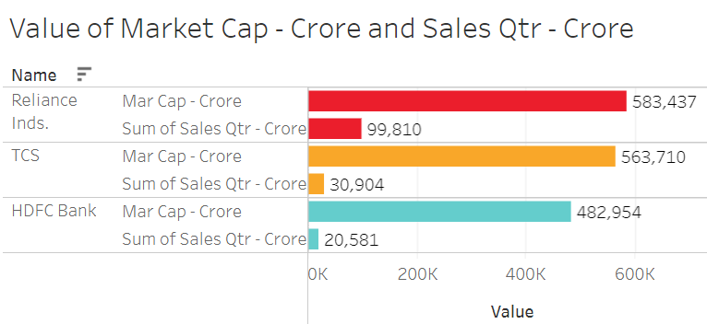
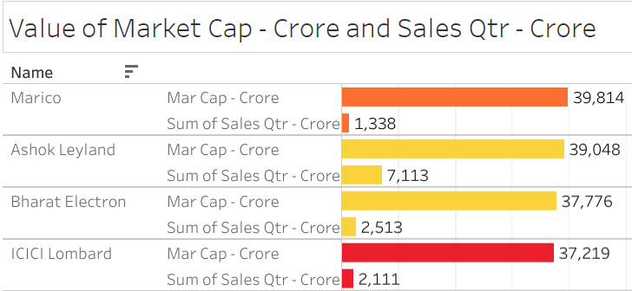
Market capital of a company
Market Capital refers to the total value of all company’s shares of a stock.
It is calculated by multiplying the price of a stock by its total number of outstanding shares.
Here we can see Reliance Inds. has the highest Market Cap of 583,437 crores followed by TCS with Market Cap of 563,710 Crores.
Market capitalization: Large-cap companies have a market cap of Rs 20,000 crore or more. Meanwhile, the market cap of mid-cap companies is between Rs 5,000 crore and less than Rs 20,000 crore. Small-cap companies have a market cap of below Rs 5,000 crore.

Slide 5
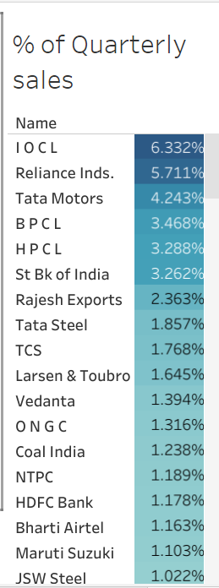
Quarterly Sales of a company
Quarterly sales of company determines how much revenue a company has generated over the past 3 months in a year.
It depends on many factors such as the quality of goods and services a company is providing to its customers and proper utilization of investors funds have taken place by the management of that particular company.
Highest number of sales determines the profit potentiality of a company.
Here, sales have been ranked in highest percentage of order in last quarter.
IOCL company had the highest sales percentage of 6.332% and it clearly means that the company is the best performer compared to the rest.

Slide 6
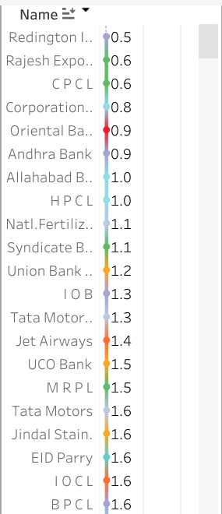
P/S ratio
The P/S or percentage to sales ratio shows how much investors are willing to pay per dollar or rupees of a stock of a particular company.
It is calculated by dividing the Market price or cap of a company to the number of sales made by that company in a period.
A low ratio could imply that the stock is undervalued, while a ratio that is higher than average could indicate that the stock is overvalued.
One of the downsides of the P/S ratio is that it doesn’t take into account whether the company makes any earnings or whether it will ever make earnings as many factors are responsible for determination of a company’s potential to generate profits.
Price-to-sales (P/S) ratios of one to two are regarded as good, and P/S ratios of less than one are considered exceptional. P/S ratios, like other stock valuation indicators, vary greatly by industry
For example, we can see that Reddington India has the lowest P/S ratio of 0.5 which is exceptional and investors are willing to buy the shares of that particular company.

Slide 7
Top Reasons for Decline in sales of a company
Not paying attention to a customers needs.
Poor working conditions.
Mismanagement or leadership failure.
Scaling the business when not ready.
Not paying attention to the competitors.
Poorly trained staff.

Slide 8
HOW TO IMPROVE THE SALES OF A COMPANY?
Embrace Technology and Digital Transformation.
Understand & Optimize Revenue Generation.
Tailor Incentives to Strategies that Increase Sales.
Maximize Your Forecasting Accuracy.
Make Customer Experience Your Top Priority.

Slide 9
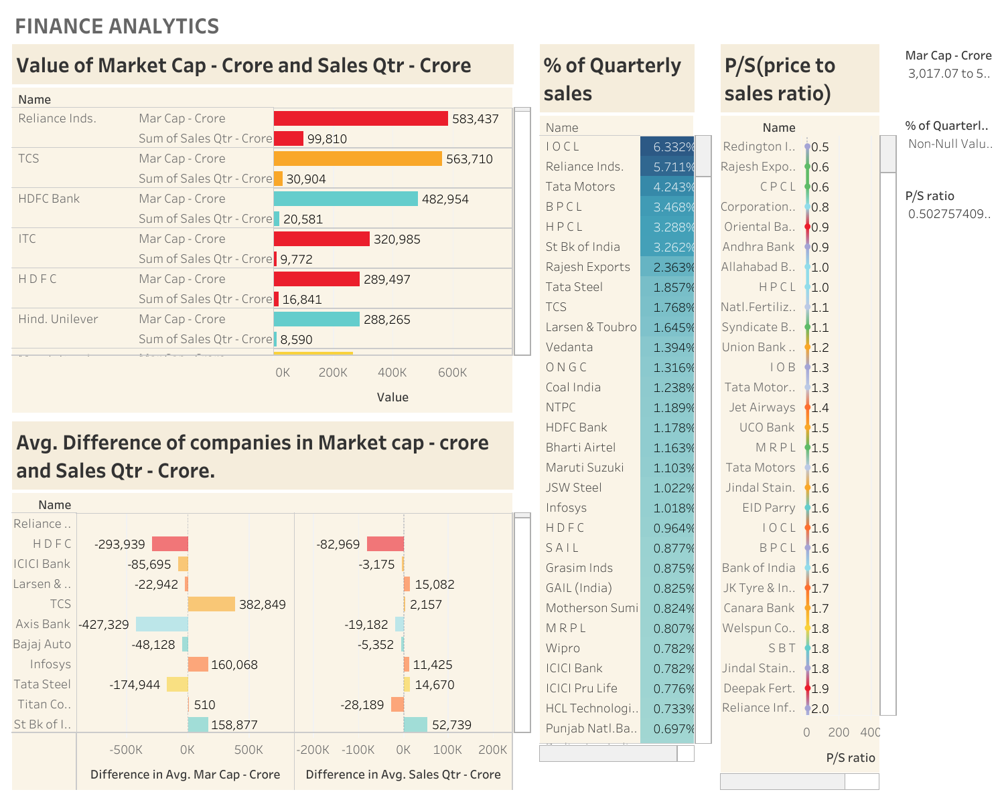

Slide 10
conclusion
Everyone has a role in a company’s growth. Sales is responsible for revenue. Marketing is responsible for awareness and lead generation. Product is responsible for creating compelling industry leading products. Finance is responsible for managing the growth, the debt, cashflow etc. Everyone has a role in the overall plan. Targeting one group for growth will fail.
All too often companies look to only one functional group for growth. Many times that’s the sales team. Sometimes it’s product, other times it’s marketing. Pulling only one functional lever won’t grow a company. We need them all.

Slide 11
thank you
Tableau dashboard link

Slide 12

Google App store data analysis
By Rohan Mukherjee

Slide 13
INTRODUCTION
Google Play, also known as the Google Play Store and formerly the Android Market, is a digital distribution service operated and developed by Google. It serves as the official app store for certified devices running on the Android operating system and its derivatives, as well as ChromeOS, allowing users to browse and download applications developed with the Android software development kit (SDK) and published through Google.
Google Play has also served as a digital media store, offering games, music, books, movies, and television programs.^{[4]} Content that has been purchased on Google Play Movies & TV and Google Play Books can be accessed on a web browser and through the Android and iOS apps.
Applications are available through Google Play either for free or at a cost. They can be downloaded directly on an Android device through the proprietary Google Play Store mobile app or by deploying the application to a device from the Google Play website.

Slide 14
MAIN KPI(KEY PERFORMANCE INDICATOR
FREE APPS – Apps that can be downloaded and installed without paying any amount.
PAID APPS – Apps that can be downloaded only after spending money on google play store.
TOP APP INSTALLS – Apps which had the highest amount of installs on Google Play store.
TOP APP REVIEWS – Apps which had the highest reviews by the customers who had installed the apps.
LAST YEARLY TOTAL UPDATED INSTALLS – Total number of apps that were installed as per yearly basis from past.

Slide 15
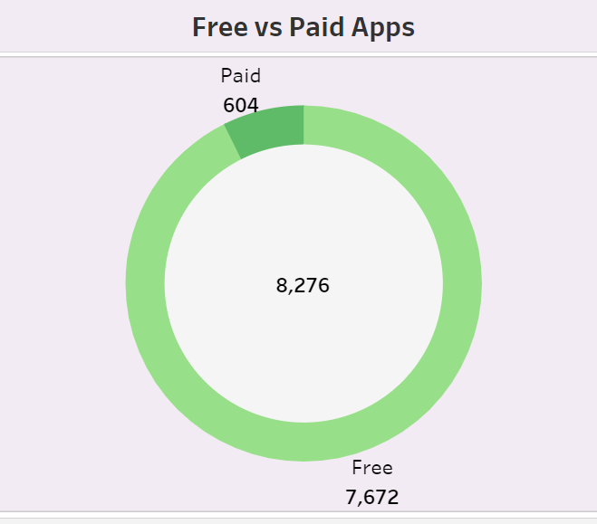
FREE APPS VS PAID APPS
There are around 8,276 Google Play store apps data in the dataset out of which only 604 are paid apps while the rest 7,672 are paid apps.
A donut chart has been prepared for proper visualization of the data.

Slide 16
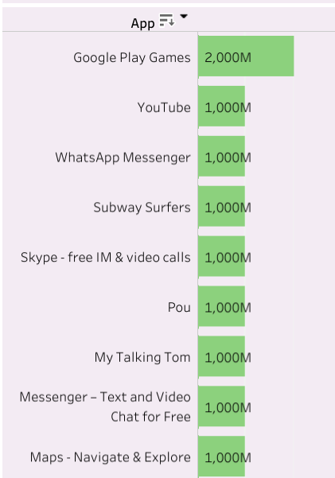
TOP APP INSTALLSS
Top app installs are those apps which have been downloaded and installed by users maximum amount of times when they visited the Google play store.
Among the apps shown in the figure, Google Play Games is the top most installed app beating others in rank with installs of about 2000M(million) followed by YouTube, WhatsApp Messenger, Subway Surfers, Skype – free IM and video calls with 1000M(million) of installs.

Slide 17
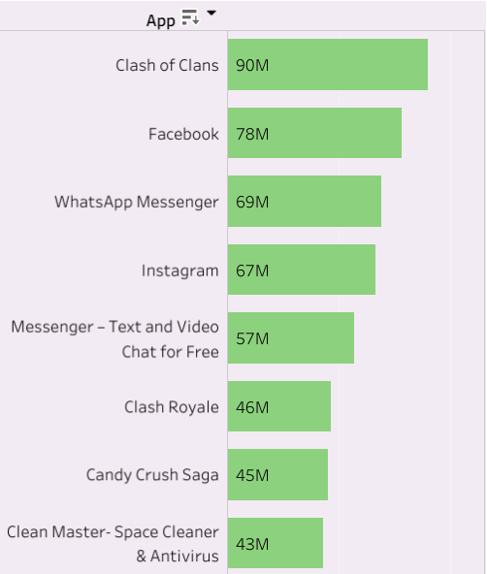
TOP APP REVIEWS
Top App reviews consists of the apps which receive highest amount of reviews by the users who enjoyed the app and found it most entertaining and productive.
From the figure we can see Clash of clans is the highest reviewed app by the users in the Google play store.

Slide 18
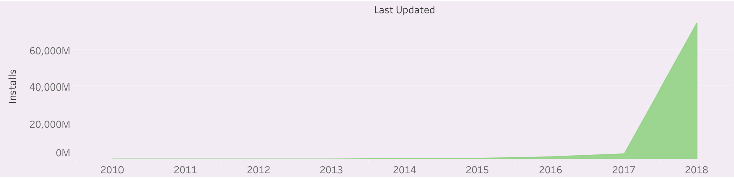
LAST YEARLY TOTAL UPDATED INSTALLS
Total App installs increased on yearly basis if we look at the data of the area chart.
It means users are finding the Google play store beneficial and productive and hence the installs increased over the past years starting from 2010 to 2018.

Slide 19
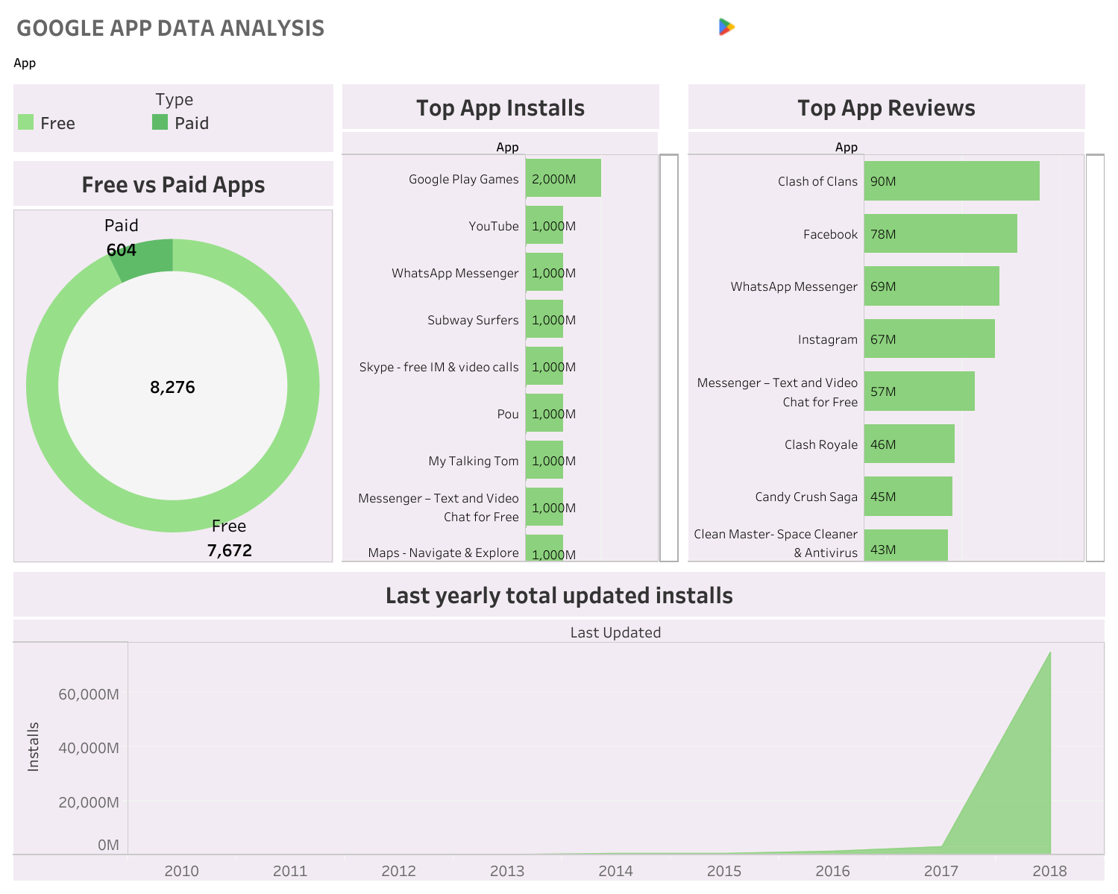

Slide 20
CONCLUSION
Whenever users visited the store they opted for free applications on the Google play store more than the paid apps.
The app installs increased over the years and entertainment apps were among the users favorite which shows they look for apps that relieves them from stress and which also makes them feel good about themselves when they use those apps.

Slide 21
THANK YOU
Tableau dashboard link

