Slide 1
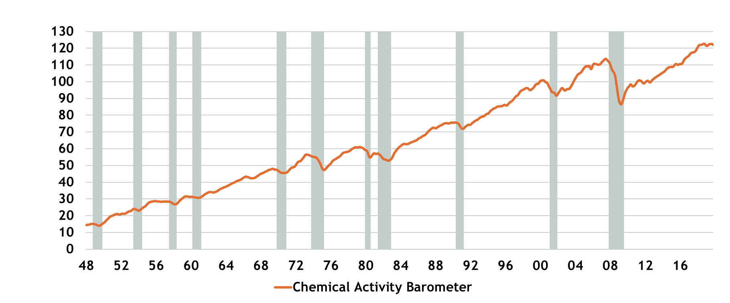
Chemical Activity Barometer (CAB): 1948-2019
Index where 2012 =100 (3MMA)
Source: American Chemistry Council

