Slide 1
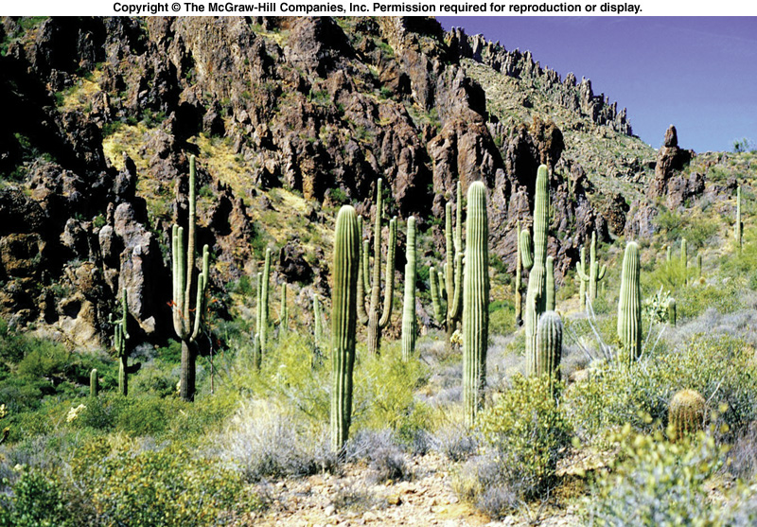
UNITY & DIVERSITY OF LIFE

Slide 2
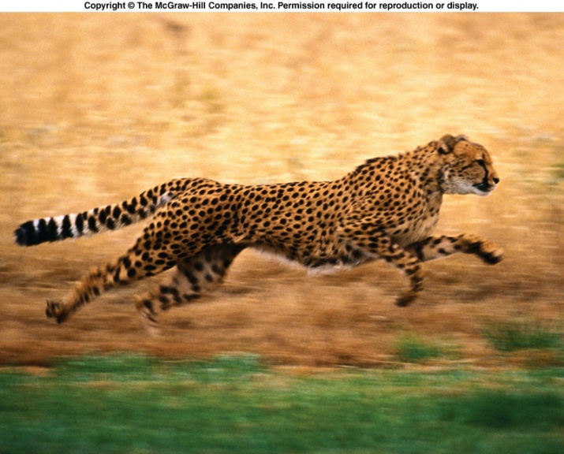
A Singular Theme
Basic structures and mechanisms that sustain life are common to all living creatures
All forms of life are connected to one another
  Life forms are connected to all those present as well as their predecessors (those who existed before)
So, literally…..

Slide 3
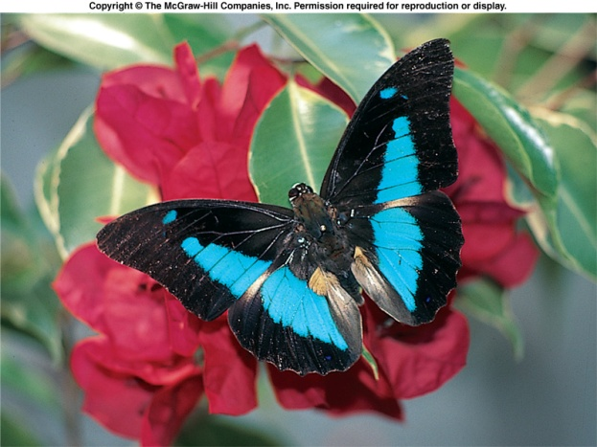
All My Relations
Mitakuye Oyasin “All my relations”
  A Lakota Sioux prayer that reminds us that we are connected with all aspects of creation and that we share a common kinship in the Hoop of Life
Kinship (T-i:migi) is also a value of the Tohono O’odham Himdag
Thus, the theme of this class is to honor the unity within the great diversity of life

Slide 4
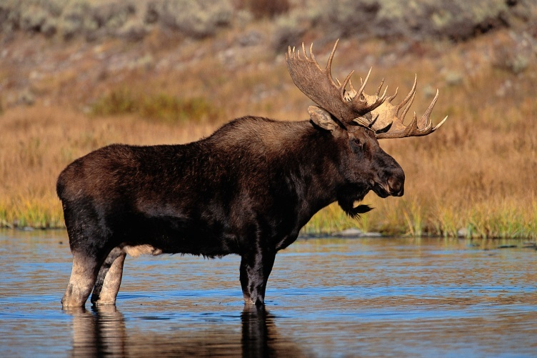
Structure and Function
Structure=form
Function=use
  Structure and function of organisms is correlated at all levels of biological organization

Slide 5
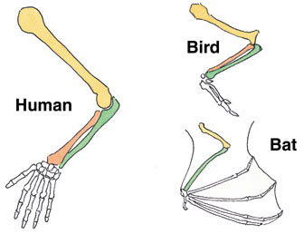
Homologous Patterns
Common patterns in bones are signs of biological unity
Do these bones have a common structure?
Do these bones have a common function?
Notes:
Pg 7 bones

Slide 6
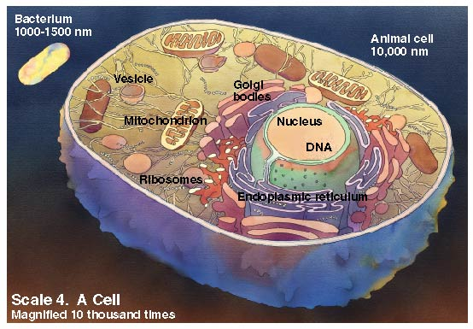
Cells
Every living thing is a cell or is made of cells
Basic structural unit of all living things
All cells contain nearly the same molecules and undergo similar interactions
  Gather fuel & building materials
  Produce useable energy
  Grow and duplicate

Slide 7
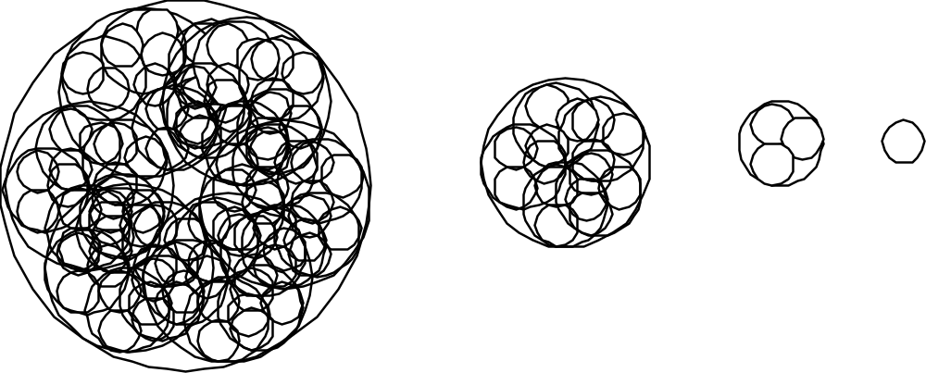
Levels of organization in the living world: large scale to small scale
Ecology I: Species, Populations, Communities and Ecosystems

Slide 8
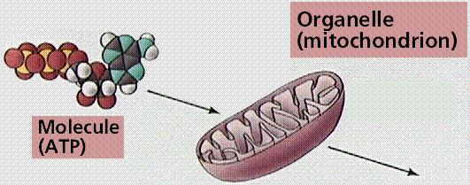
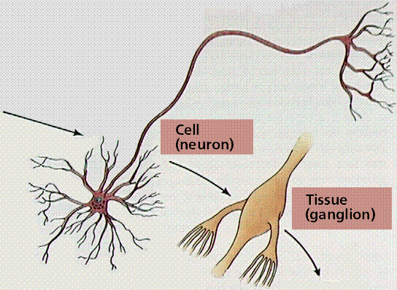
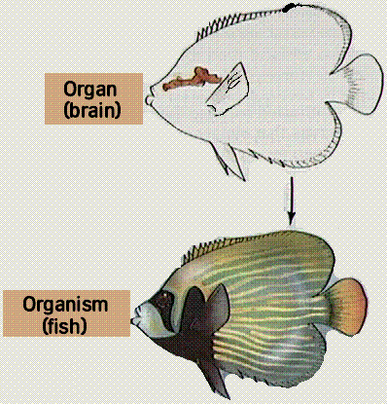
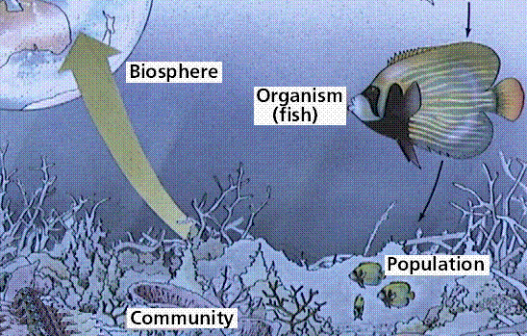
Levels of Organization of Life

Slide 9
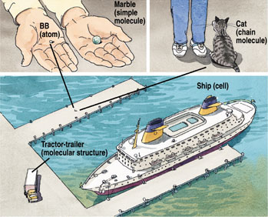
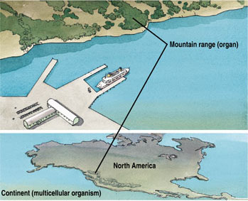
Relative Sizes
Notes:
Pg 8

Slide 10
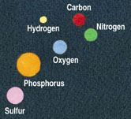
Atoms
There are over a hundred elements
All organisms are mainly comprised of only six:
  Carbon
  Hydrogen
  Oxygen
  Nitrogen
  Phosphorous
  Sulfur
Notes:
Pg 10 atoms

Slide 11
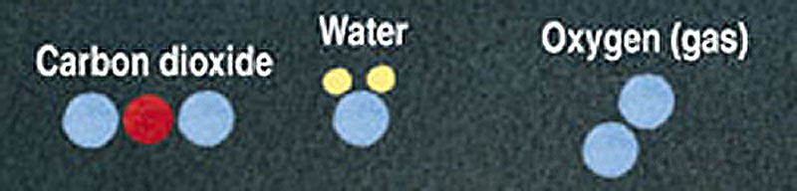
Molecules
Atoms bonded together
CO₂: source of life’s carbon atoms
O₂: crucial to energy generation in most life forms
H₂O: aids chemical events inside cells

Slide 12
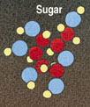
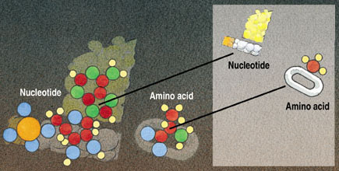
Simple Molecules
Sugars, nucleotides, amino acids
Food and/or building materials
Notes:
Pg 10 sugar, nucleotide, amino acid

Slide 13
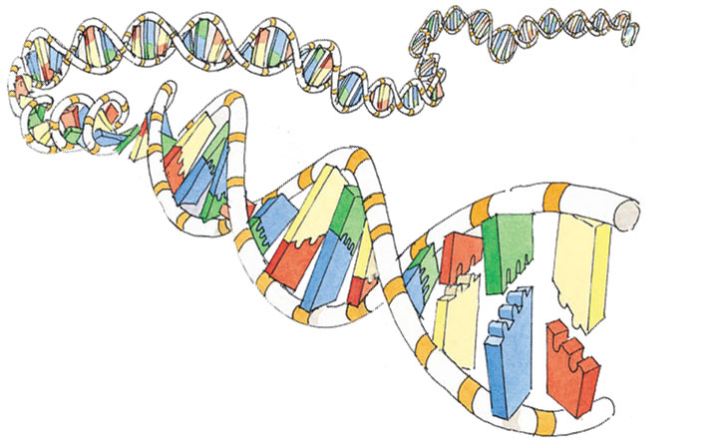
Chain Molecules
Long strings of simple molecules linked together
Protein: amino acid chain
DNA and RNA: nucleotide chains
Notes:
Pg 11 chain molecules

Slide 14
The Way Life Works
Central Characters
DNA: information
  Continuity of life is based on inheritable information of DNA
Notes:
Pg 21

Slide 15
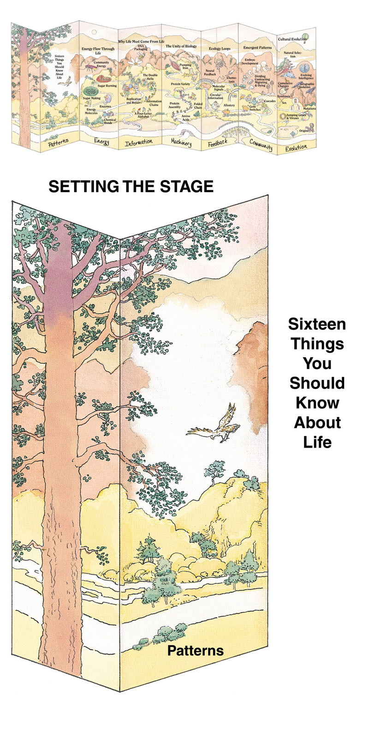
Your Itinerary
Patterns

Slide 16
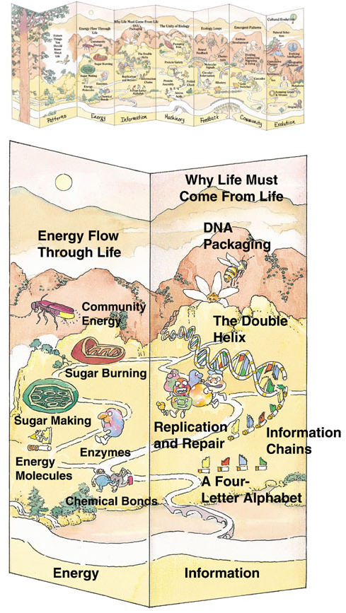
Energy and Information

Slide 17
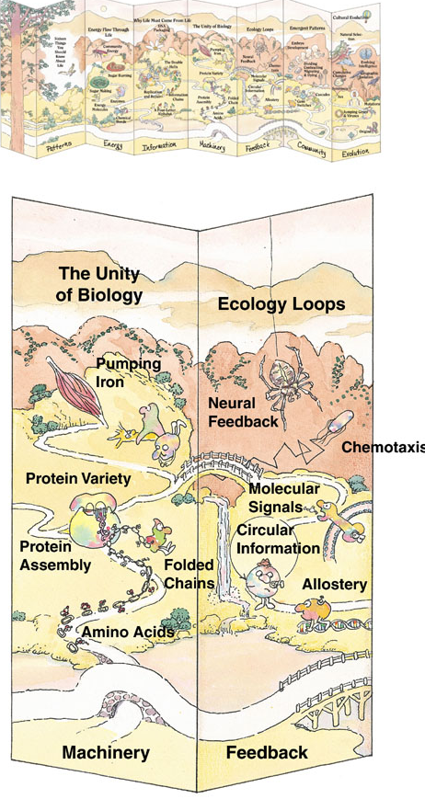
Machinery and Feedback

Slide 18
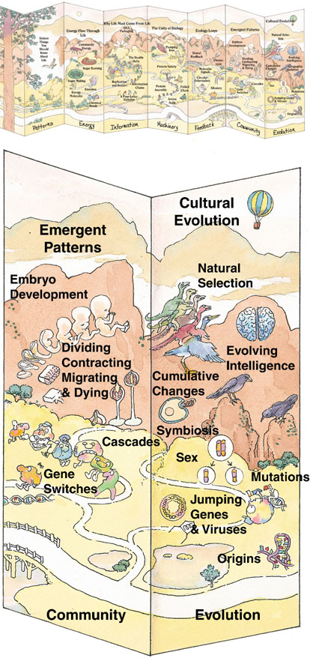
Community and Evolution

