Slide 1
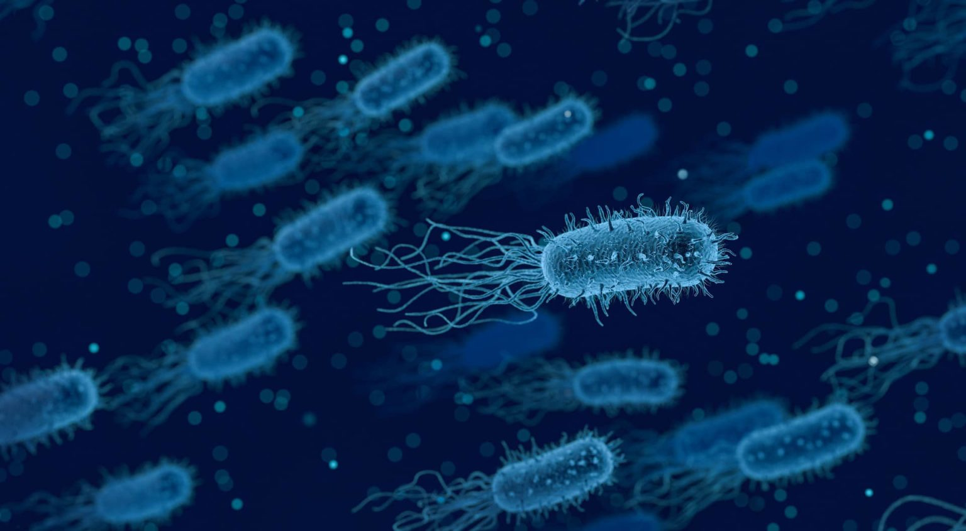
THE DISCOVERY OF MICROORGANISM

Slide 2
INTRODUCTION:
Discovered by Robert Hooke and Antonie van Leeuwenhoek.
Hooke presented the first published depiction of a microoganism, the micro-fungus Mucor in “Micrographia” in 1665.
Existence suspected from ancient times: Jain scriptures from 6th century BC
1st century BC - book On Agriculture by Marcus Terentius Varro.

Slide 3
1677- Observed "little animals”- Leeuwenhoek
1796- First scientific small pox vaccination- Edward Jenner
1861- Disproved spontaneous generation- Louis Pasteur
1862- Supported Germ Theory of Disease- Louis Pasteur
1867- Practiced antiseptic surgery- Joseph Lister
1876- First proof of Germ Theory of Disease with
B.anthracis discovery- Robert Koch
1881- Growth of Bacteria on solid media - Robert Koch
1882- Developed acid-fast stain - Paul Ehrlich

Slide 4
1884- Developed Gram Stain - Christian Gram
1885- First Rabies vaccination - Louis Pasteur
1892- Discovered viruses - Dmitri Iosifovich Ivanovski
1899- Recognized viral dependence on cells for
reproduction - Martinus Beijerinck
1928- Discovered Penicillin - Alexander Flemming
1977- Developed a method to sequence DNA - W. Gilbert & F.
Sanger

Slide 5
Eras in microbiology:
Discovery era
Anton Van Leeuwenhoek
Transition period
Controversies over Spontaneous Generation theory
Golden age of microbiology
Louis Pasteur
Robert Koch

Slide 6
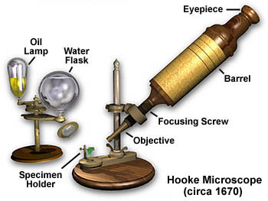
Robert Hooke (1635 – 1700):
Invented the first microscope
Observed cork cells
Coined the term “cell” ( Latin: cellulae – small compartment)

Slide 7
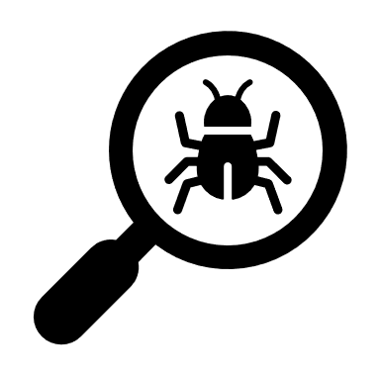
Antony van Leeuwenhoek:
Father of microbiology
Observed, described, studied and conducted scientific experiments with microorganisms - simple single lensed microscopes
Ground pieces of glass into fine lenses, placed them between two silver or brass plates
Magnified about 200 times
Protozoa, algae, yeasts and bacteria – first described by him.

Slide 8
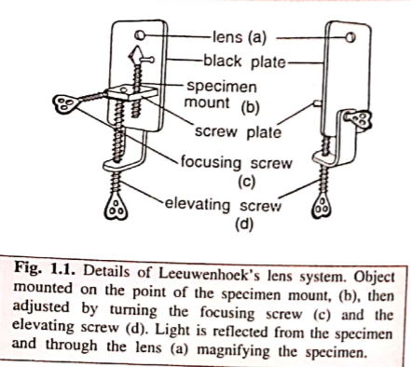
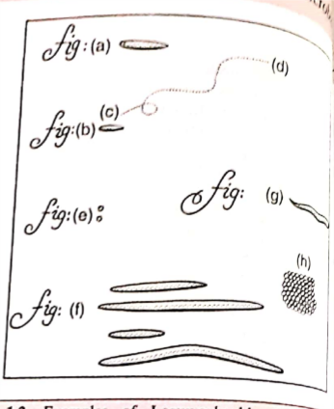
Published paper in Royal Society in 1677 . Contained special description of microorganisms.
Material examined was the scrappings of his own teeth mixed with pure rain water. Called it “animalcules”.

Slide 9
Spontaneous Generation Theory/ Abiogenesis:
Held that living creatures could arise from non-living matter and that such processes were commonplace and regular.
Synthesized by Aristotle who compiled the work of earlier natural philosophers, various ancient explanations for the appearance of organisms.
Francesco Redi and Lazzaro Spallanzani – challenged the theory.
Louis Pasteur and John Tyndall – Disproved it.

Slide 10
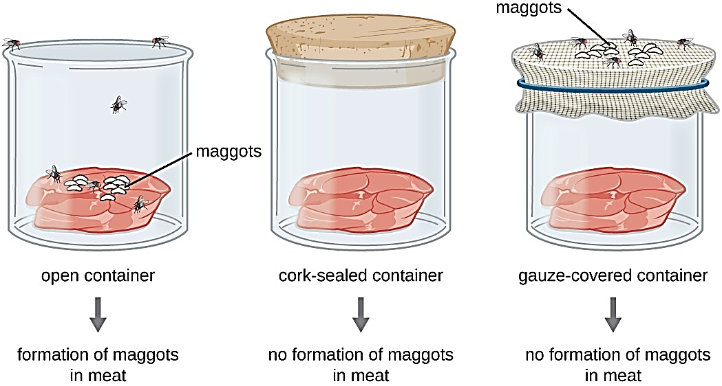

Slide 11
Louis Pasteur (1822-1895):
Disproved Spontaneous Generation Theory and proved “ The Germ Theory of Diseases”.
Means ‘germs are responsible for the disease and not the inert matter’.
Developed ‘Pasteurization’ – a process in which water and certain packaged and non-packaged foods (such as milk and fruit juice) are treated with mild heat, usually to less than 100 °C , to eliminate pathogens and extend shelf life.

Slide 12
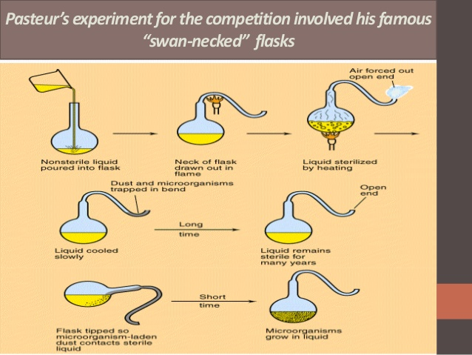
Disproval of Spontaneous Generation Theory:
Goose Neck Experiment

Slide 13
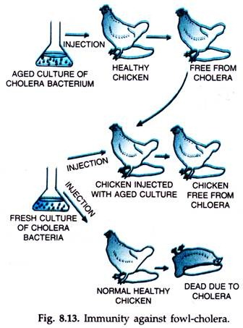
Demonstrated immunization using chicken cholera in 1880.
Developed rabbies vaccine from rabbit.

Slide 14
John Tyndall:
Proved that dust carried germs and broth remained sterile indefinitely in the absence of dust.
Discovered ‘Tyndallization’ - Sterilization of a fluid by heating it repeatedly to a point slightly below that of boiling - more resistant spores are destroyed.
Caused deterioration in its nutrient content.
Increased shelf-life than Pasteurization.

Slide 15
Robert Koch:
Isolated B.anthracis from cattle – causing ‘anthrax’
Found the causes to various diseases such as tuberculosis, cholera and typhus.
Made it easier to see bacteria under a microscope by staining it.
Found that he could transmit anthrax from one animal to another by taking a small sample of blood from the infected animal and injecting it into a healthy one.

Slide 16
Also found that he could grow the bacteria in a nutrient broth - inject it into a healthy animal - cause illness.
Thus devised criteria for establishing a causal link between a microorganism and a disease - Koch's postulates.
Nobel Prize in 1905 for his work and research on the study of diseases.

Slide 17
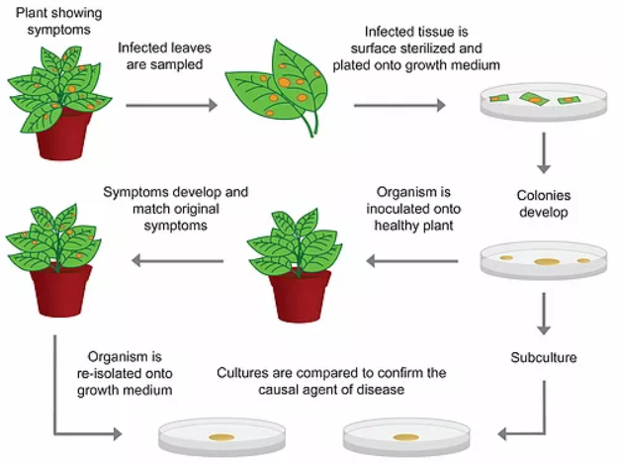

Slide 18
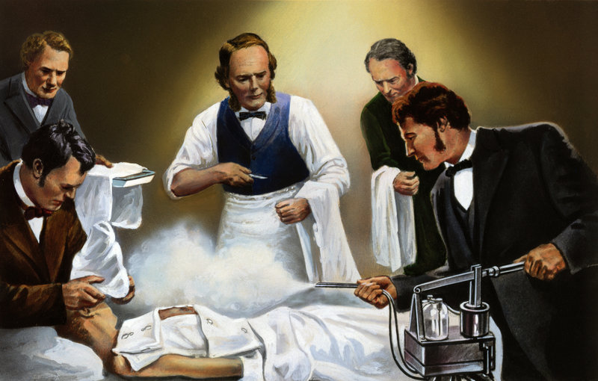
Joseph Lister:
Practiced antiseptic surgery
Pure culture of Bacterium lactis – Serial dilution technique
Discovered ‘carbolic acid’ and surgical dressings

Slide 19
M.W. Beijerinck:
Founded the discipline of virology with his discovery of viruses.
Father of soil microbiology
Discovered new types of bacteria from soil and described biological nitrogen fixation, fermentation, Azotobacter (a group of soil microorganisms), denitrifying bacteria and tobacco mosaic virus.
Described virus as ‘contagium vivum fluidum’
Enrichment of culture.

Slide 20
Alexander Fleming:
Discovered penicillin - the first antibiotic from Penicillium notatum which inhibits Staphylococcus aureus.
Shared the Nobel Prize in Physiology or Medicine with Florey and Chain.
Selman A. Waksman:
Discovered ‘Streptomycin’- an antibiotic from soil bacterium Streptomyces griseus.
Coined the term ‘antibiotics’ – chemical substance of microbial

Slide 21
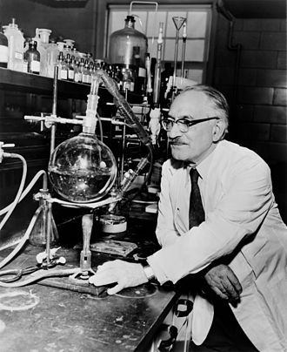
origin which in small quantities exert antimicrobial activity.
Book – ‘Principles of Soil Microbiology’.
Discovered important clinically applied antibiotics
Actinomycin in 1940
Streptomycin in 1944
Neomycin in 1949
.

Slide 22
Sergei Winogradsky:
First to develop the concept of chemolithotrophy - essential role played by microorganisms in geochemical processes.
First isolation and description of both nitrifying and nitrogen-fixing bacteria.
Microorganisms involved in various biological cycles
Discovered anaerobic nitrogen fixing bacterium Clostridium pasteurianum

Slide 23
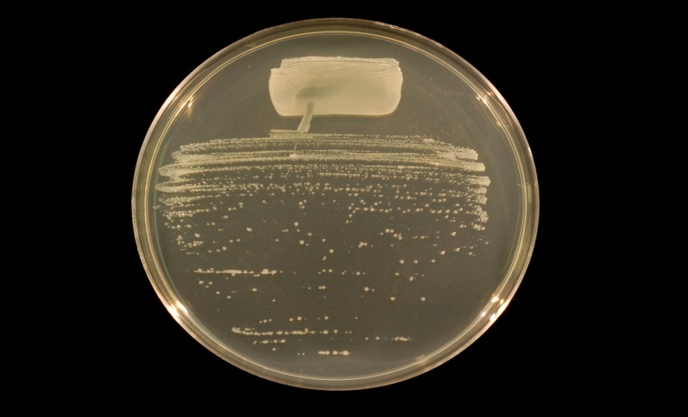
Discovery of Rhizobium:
By Martinus Beijerinck.
Isolated and cultivated a microorganism from the nodules of legumes in 1888. Named it Bacillus radicicola.
Now placed in Bergey’s Manual of Determinative Bacteriology under the genus Rhizobium.

Slide 24
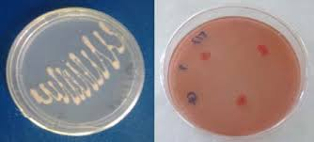
Discovery of Azospirillum:
The genus Spirillum was first reported by Beijerinck (1925).
Later reclassified as Azospirillum, because of its ability to fix atmospheric nitrogen (the group of Dr. Johanna Döbereiner in 1970).

Slide 25
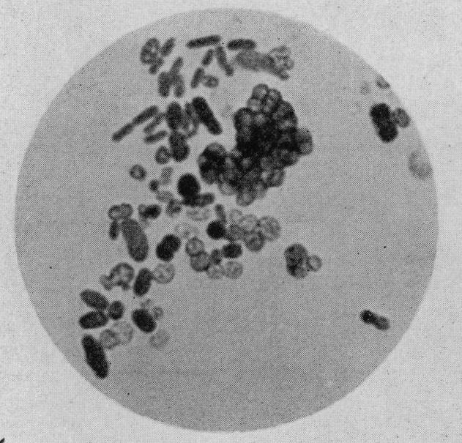
Discovery of Azotobacter:
First representative of the genus was Azotobacter chroococcum - the first aerobic, free-living nitrogen fixer.
By Martinus Beijerinck in 1901.

Slide 26
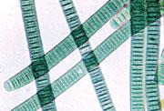
Discovery of blue green algae:
Dating back to the 12th century
Cyanobacteria are thought to have converted the early oxygen-poor, reducing atmosphere into an oxidizing one, causing the Great Oxygenation Event and the "rusting of the Earth“.
Konstantin Mereschkowski

Slide 27
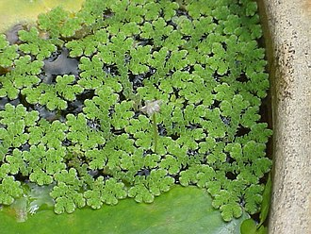
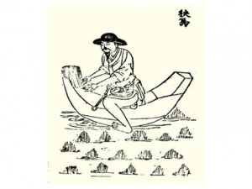
Discovery of Azolla:
Azolla caroliniana
Green fertilizer for rice also dates back thousands of years.
Farmers in the Yangtze River valley found rice in whose irrigation
water Azolla is grown – increase in production.

Slide 28
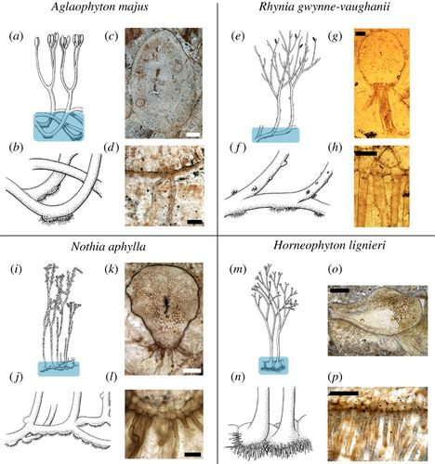
Discovery of Mycorrhizae:
By Franciszek Kamienski.
First credible evidence for arbuscules - by Remy et al. in the aerial axes of the primitive plant Aglaophyton majus.

Slide 29
Reference:
www.brittanica.com
www.enotes.com
www.biologydiscussion.com
P.D. Sharma, Microbiology, Rastogi Publications
Cecie Starr and Ralph Taggart, Biology- The Unity and Diversity of Life, Wadsworth Publishing Company.
Eldon D. Enger, Frederick C. Ross, David B. Bailey, Tata McGraw- Concepts in Biology-Hill Edition

