Slide 1


Slide 2
INDUSTRIAL MICROBIOLOGY
PRODUCTION OF ALCOHOL, VINEGAR, ANTIBIOTICS, VITAMINS, VACCINES, ORGANIC ACIDS, AMINO ACIDS

Slide 3
Industrial microbiology:
A branch of applied microbiology.
It refers to the use of microorganisms in commercial enterprises.
The microorganisms are processed under controlled temperature, pH to produce valuable products .

Slide 4
HISTORY
👍 As early as 6000 BC the Babylonian and Sumerians used yeast to make alcohol.
👍During first world war,a British scientist chain Weizmann developed fermenter for the production of acetone.
👍In 1950 Hindustan private Antibiotic limited,pune made the first pilot fermenter in India.
👍 Pasteur developed a new way of approach to industrial microbiology.

Slide 5
DEVELOPMENTAL PHASE IN INDUSTRIAL MICROBIOLOGY
1.Relatively ancient,involves fermentation of alcoholic beverages,bread .
2.Large scale cultivation of yeast cell for brewing and baking industries.known as fermentation industry,vessels, medium were introduced.
3.Involves the batch culture of microbes under aerobic condition.pencillin production largely occur.
4.Use of microorganisms as a bulk sources of protein for animal and human food called single cell protein(scp).
5.Biotechnology , recombinant DNA technology is applied in microorganisms for developing useful products.

Slide 6
WHY MICROBES?
*Microbes are the mini chemical factory.
*Posses a broad variety of enzymes.
*High metabolic activity,so it can grow and multiply rapidly.
*Possess a large surface area for the quick absorption of nutrients.
*Grow on inexpensive substrate.Byproduct of reaction will be the substrate of another.
*A substrate is a substance that converts into a product in the presence of enzymes.
Amenable to genetic manipulation.
Should not be pathogenic to humans and animals.

Slide 7
FERMENTATION
Chemical conversion of sugar to acid,ethanol,gases.
Fermentation are done in large vessel called Fermenter, microbes are grown under controlled temperature,PH.
Science of fermentation called zymology.

Slide 8
FERMENTATION STEPS
Fermenter selection
Microbial strain selection
Fermenter media selection
Fermenter process
Upstream process
Downstream process
Quality control and assurance
Product recovery
Packaging

Slide 9
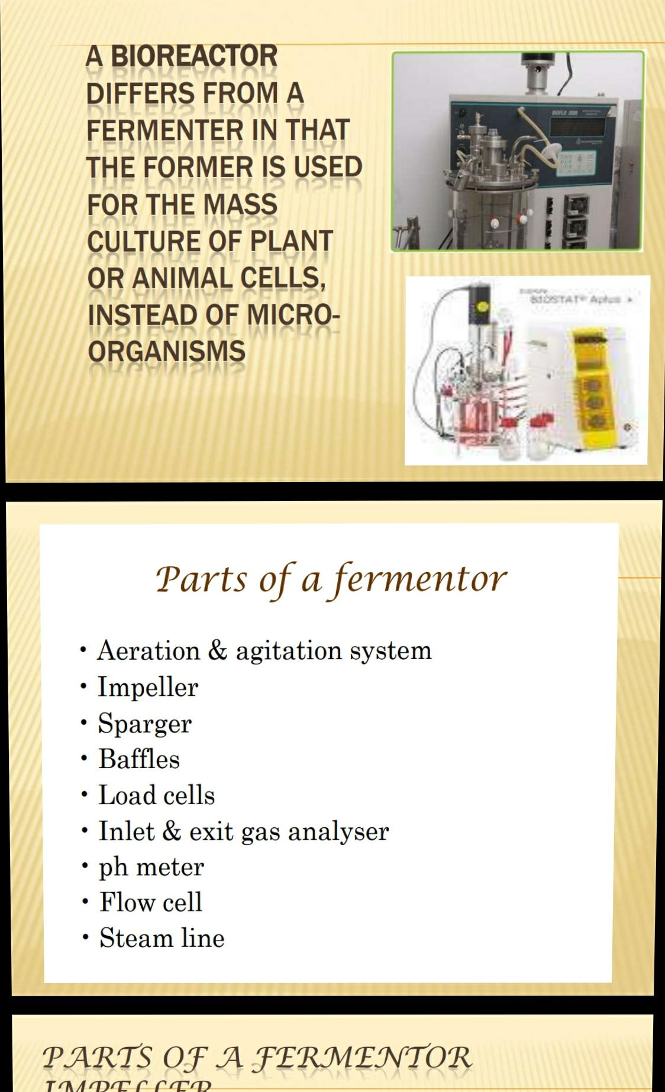

Slide 10
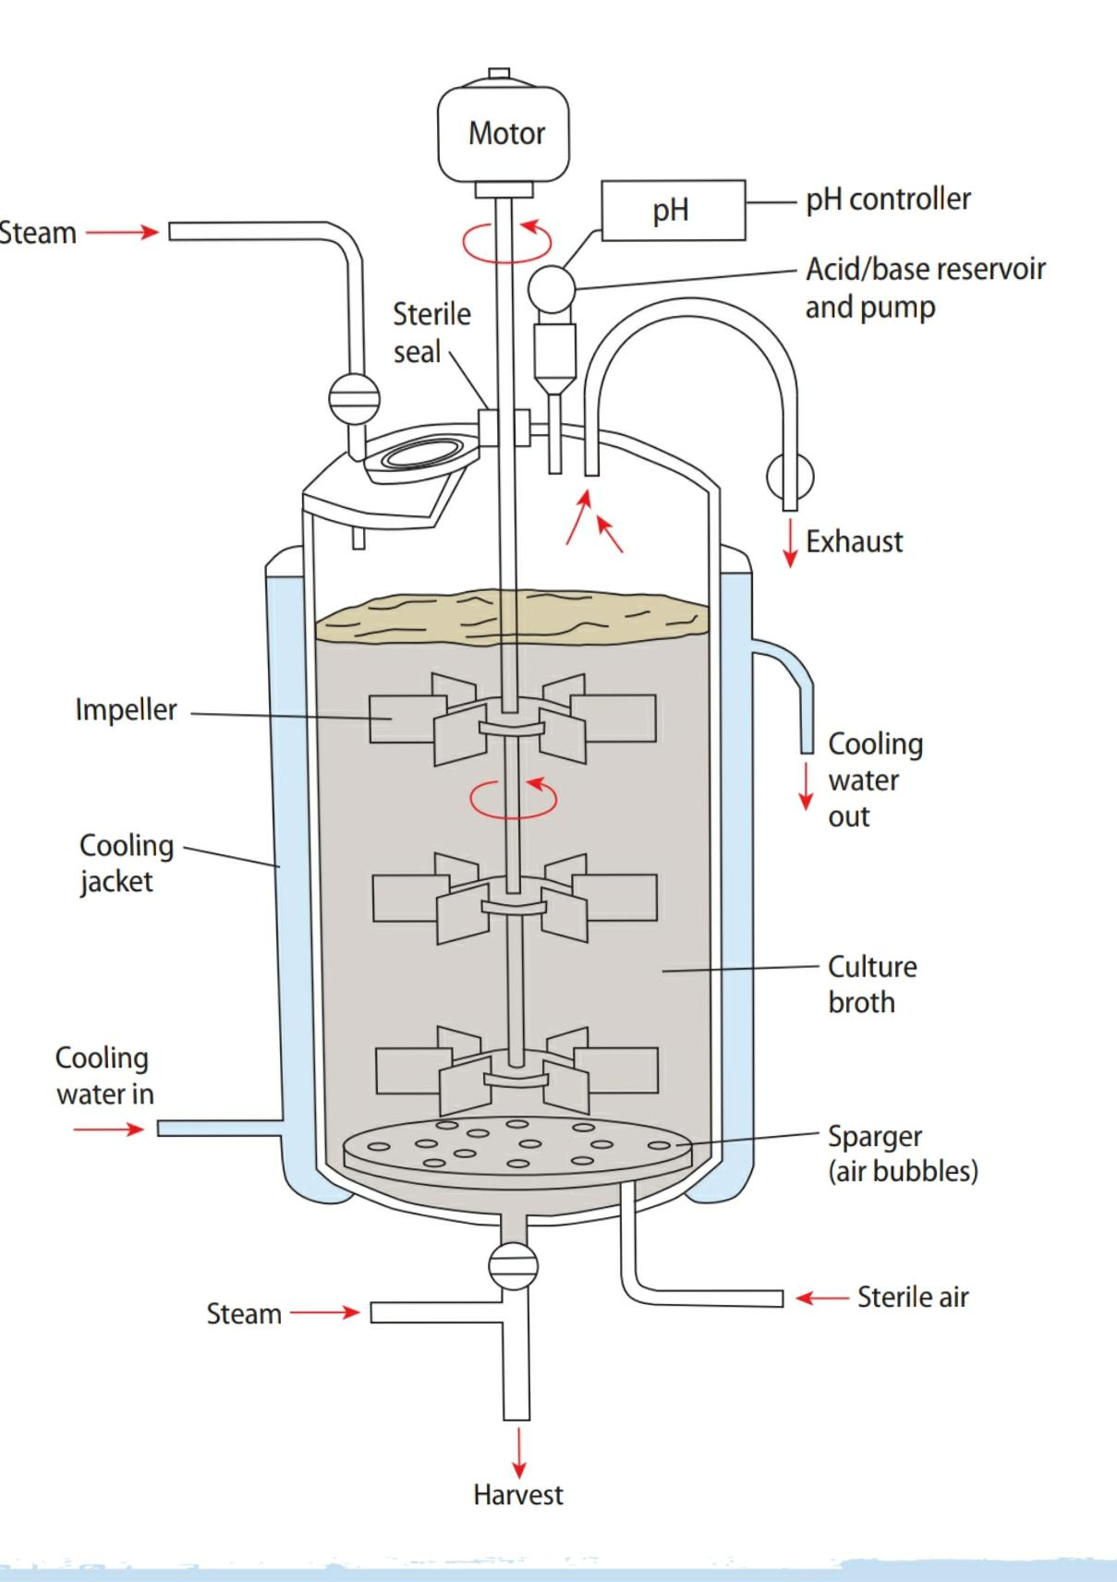
FERMENTER AND THE PROCESS

Slide 11
COMPONENTS OF FERMENTER
Vessel:to carry out the process
Impeller:proper mixing,heat transfer, prevents sedimentation.
Sparger:device that introduce air into medium.
Baffles:to prevent vortex and to improve aeration efficiency.
Temperature control
PH control
Feed parts:to add nutrients

Slide 12
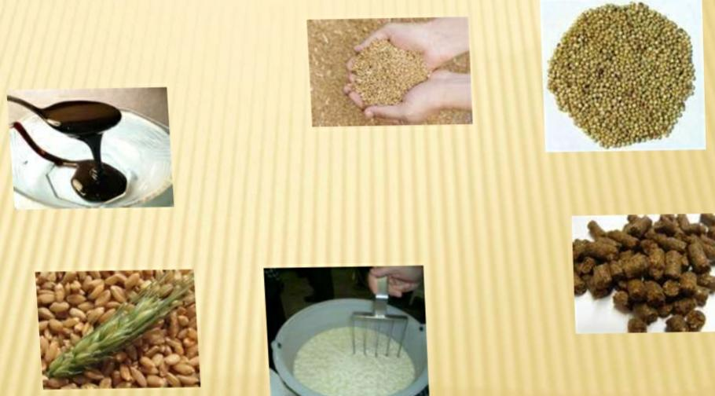
FERMENTATION MEDIA
Carbon source-wheat,rice
Nitrogen source-yeast extract

Slide 13
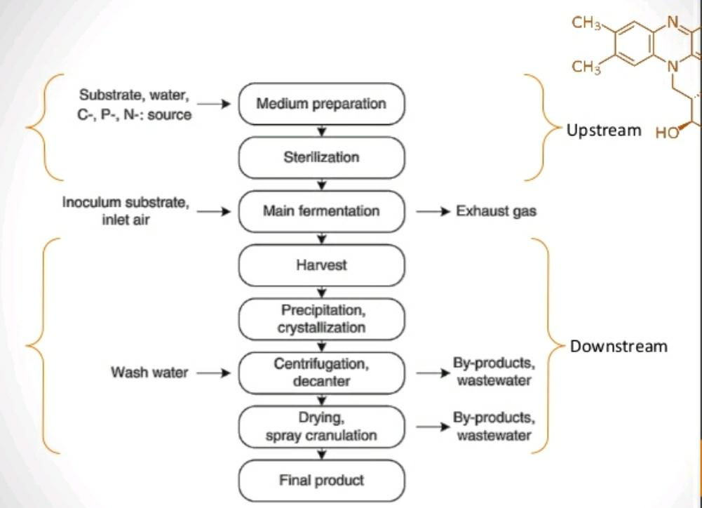

Slide 14
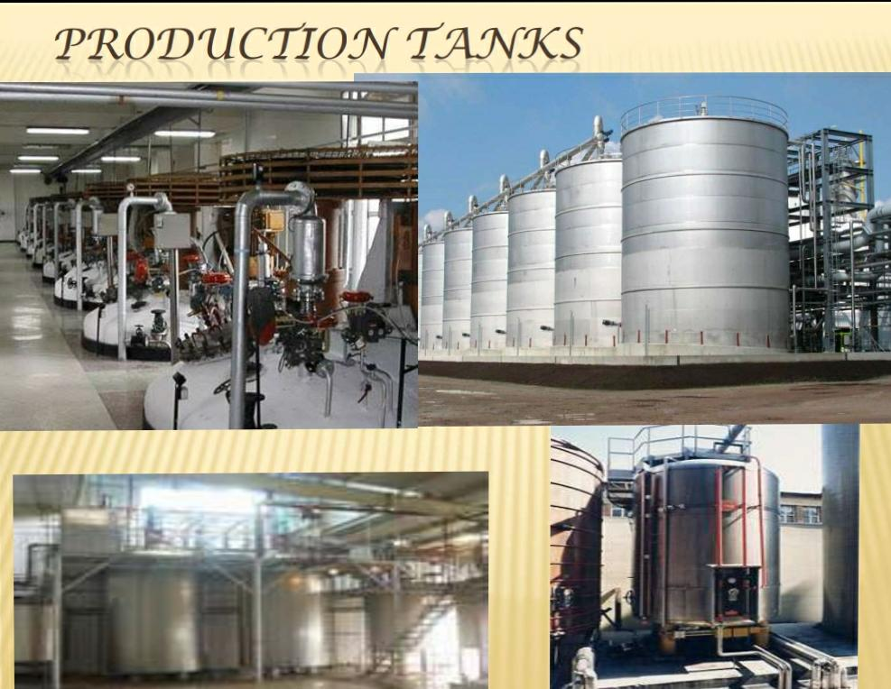

Slide 15
BATCH FERMENTATION
Is a process which large volumes of nutrient medium is inoculated initially.
About 2 or 4% microorganisms are added initially.
After fermentation,microbes are removed and materials are isolated.
Growth phases:
Lag phase(adopt to new environment)
Exponential phase(increase in number)
Stationery phase
Decline phase

Slide 16
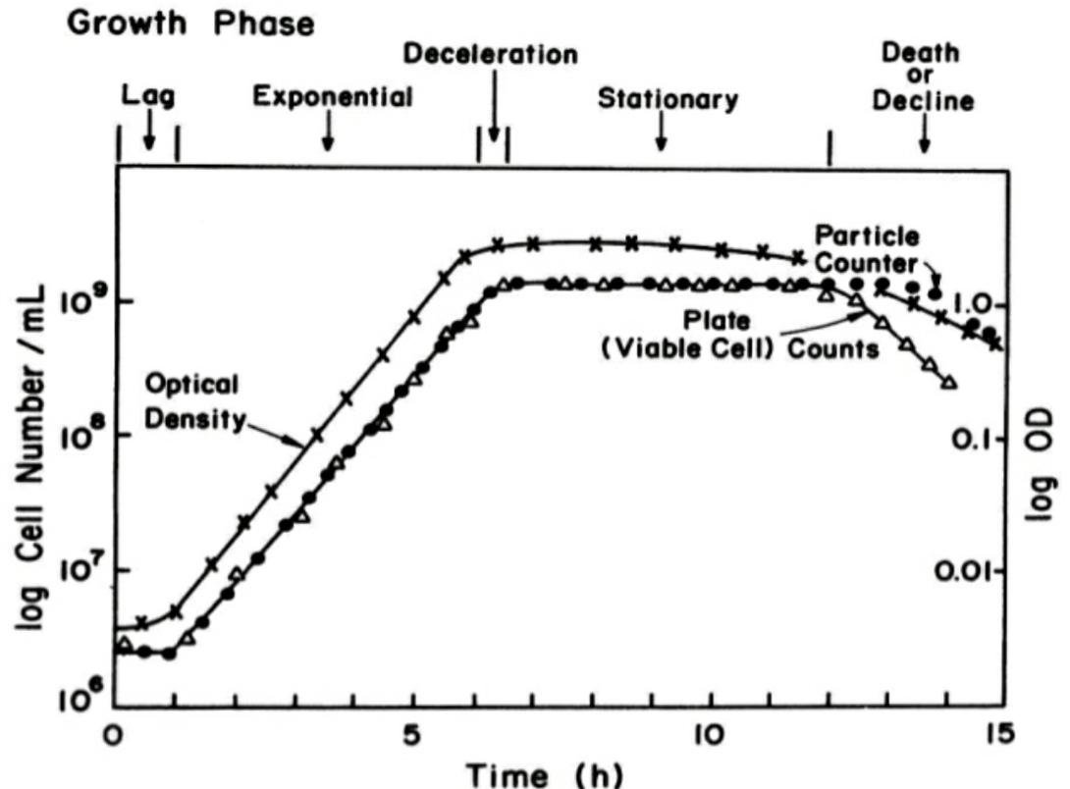

Slide 17
CONTINUOUS FERMENTATION
The medium is added continuously to the tank to replace that which has been fermented at same rate.
Chemostat: used to provide constant flow, keeping microorganisms in the logarithmic phase of growth.
Turbidostat: instrument measure the turbidity of the microbial population to indicate the level of growth.
Remain in a logarithmic phase.

Slide 18
FED BATCH FERMENTATION
*substrate are added in increments as fermentation progress.
*Critical elements are added in small doses and it continued during production phase.

Slide 19
PRODUCTION OF ANTIBIOTICS
The study of antibiotics began from, discovery of penicillin in 1929 by Alexander Flemming.
Proved that broth culture of penicillin nirayum has antibacterial property to gram positive bacteria by inhibit their cell wall synthesis.
Most of penicillin are 6-aminopencillanic acid derivative.
Beta –lactum ring responsible for antibacterial property.
Streptomycin is an effective against mycobacterium tuberculosis and gram negative bacteria.

Slide 20
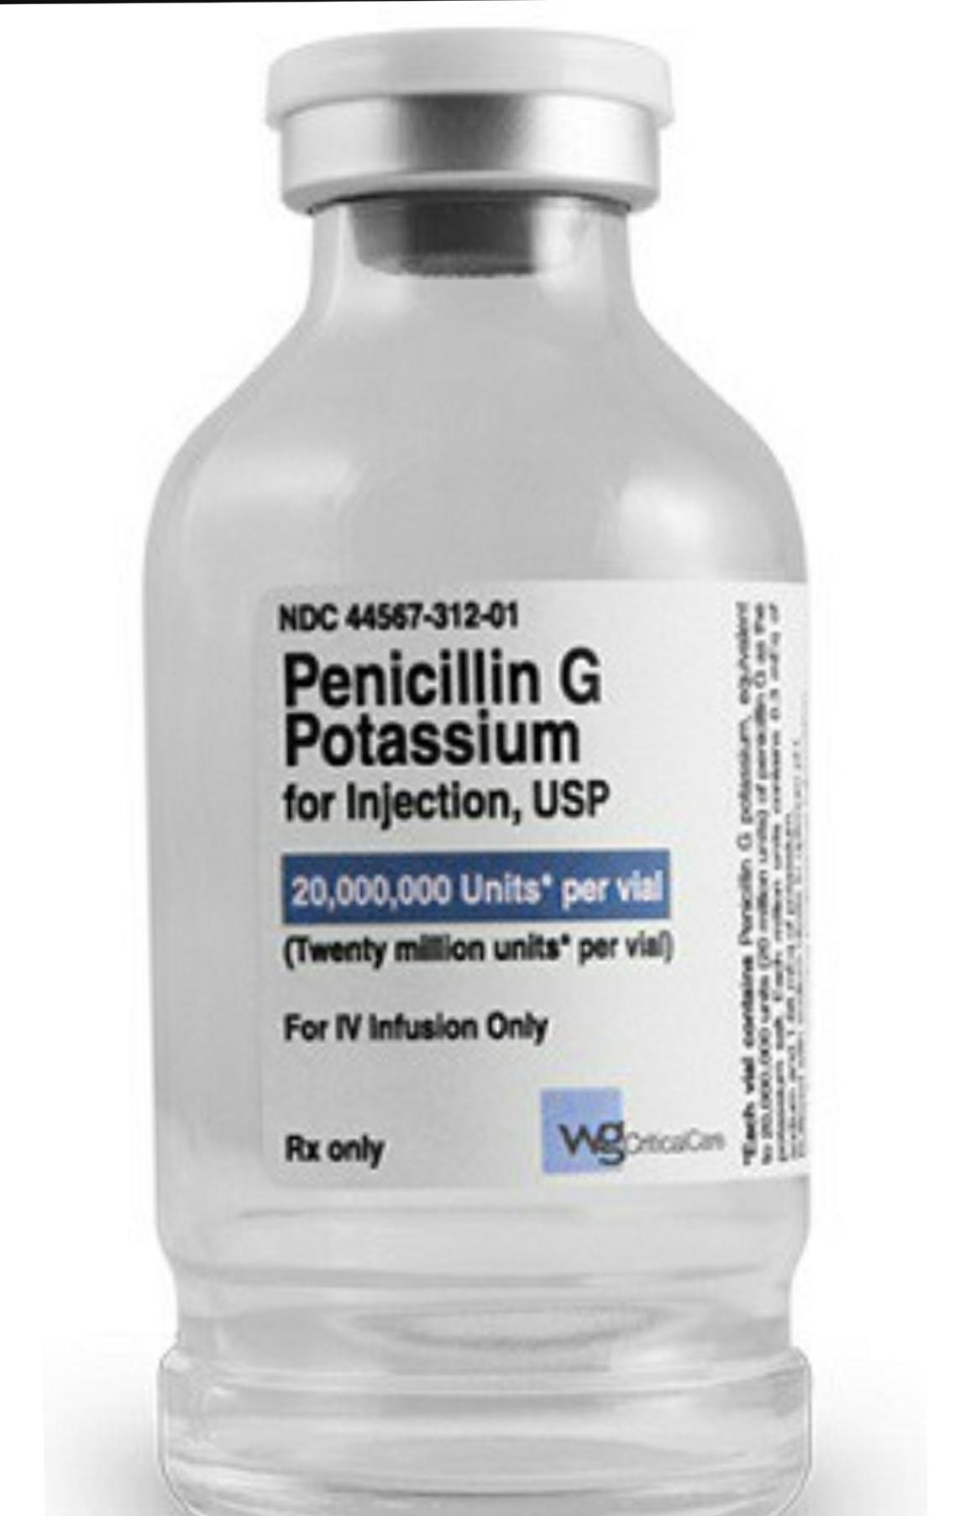
PENCILLIN
penicillium chrysogenum spore suspension are inoculated onto wheat bran nutrient solution.
Agitated for 1_2 days for to have a mycelial growth.
Medium:lactose, caco3, glucose.
PH:7.3 ,temp:73-81F
5-7 days for batch fermentation.
,Three phases:
1: mycelial growth
2: consumption of lactose, mycelial mass increases, pH constant.secreting pencillin to the medium.
3:Antibiotic concentration decreases.
Pencillin is a secondary metabolite so it produced during stationary phase.
*Using rotating vacuum filter,penicillin is separated from fungal cell.Fungal biomass is dried and used as a animal feed.
Quality assurance and packaging

Slide 21
Biosynthesis of pencillin
Condensation of 3 aminoacid to form tripeptide
Biosynthesis of pencillin G
Transamidation
These biosynthesis is encoded by gene penDE
Pencillin is the first commercial product by aerobic submerged fermentation.

Slide 22
Streptomycin:
used against TB
Produced from streptomycin griseus.(Actinomycetes)
Inoculation to initiate the the fermentation in production tank.
Medium:Soyabean meal,(N-source),glucose(C-source)
Carried out at 28 ℃,PH-7.3usally used :Hockenhul medium
Process lasts for 5-7 days.
*Three phases;
1:Rapid growth of microbe,it’s proteolytic activity produces NH3 to medium from soyabean meal causes increase in PH.
2:Little additional production of mycelium.streptomycin accumulate s.glucose and NH3 is consumed thus PH is constant.
. 3: Carbohydrates become depleted, production ceases.
Recovery: streptomycin is absorbed onto charcoal and eluted with HCL Percipitated with acetone and purified by chromatography.

Slide 23
PRODUCTION OF STEROIDS
Why steroid productions are different from other production?
Why chemical synthesis is so difficult?

Slide 24
Chemical conversion of deoxycholic acid to cortisone require 37 steps and extreme reaction condition,oxygen is needed to be introduced at 11 position.
It is a difficult process
Microbes can introduce oxygen at this position in a single reaction.
Steroid transformation is actually occurring than production.

Slide 25
Involoved in regulations of sexuality.
Rhizopus Nigerians, aspergillus species used in steroid production.
Microbial biotransformation include hydrogenation, dehydrogenation, oxidation and addition of side chain.
PRODUCTION
Rhizopus Nigricans is grown in a fermentation tank
Glucose or sucrose as carbon source and corn steep liquor as nitrogen source.
Steroid to be transformed is first dissloved with desired solvent is Incorporated.
In few hours or days steroid is transformed.
Steroid is hydroxylase at number 11 to form 11-alpha hydroxyprogesterone.
RECOVERY
Extraction with methyl chloride,purified chromatography and recovered by crystallization.

Slide 26
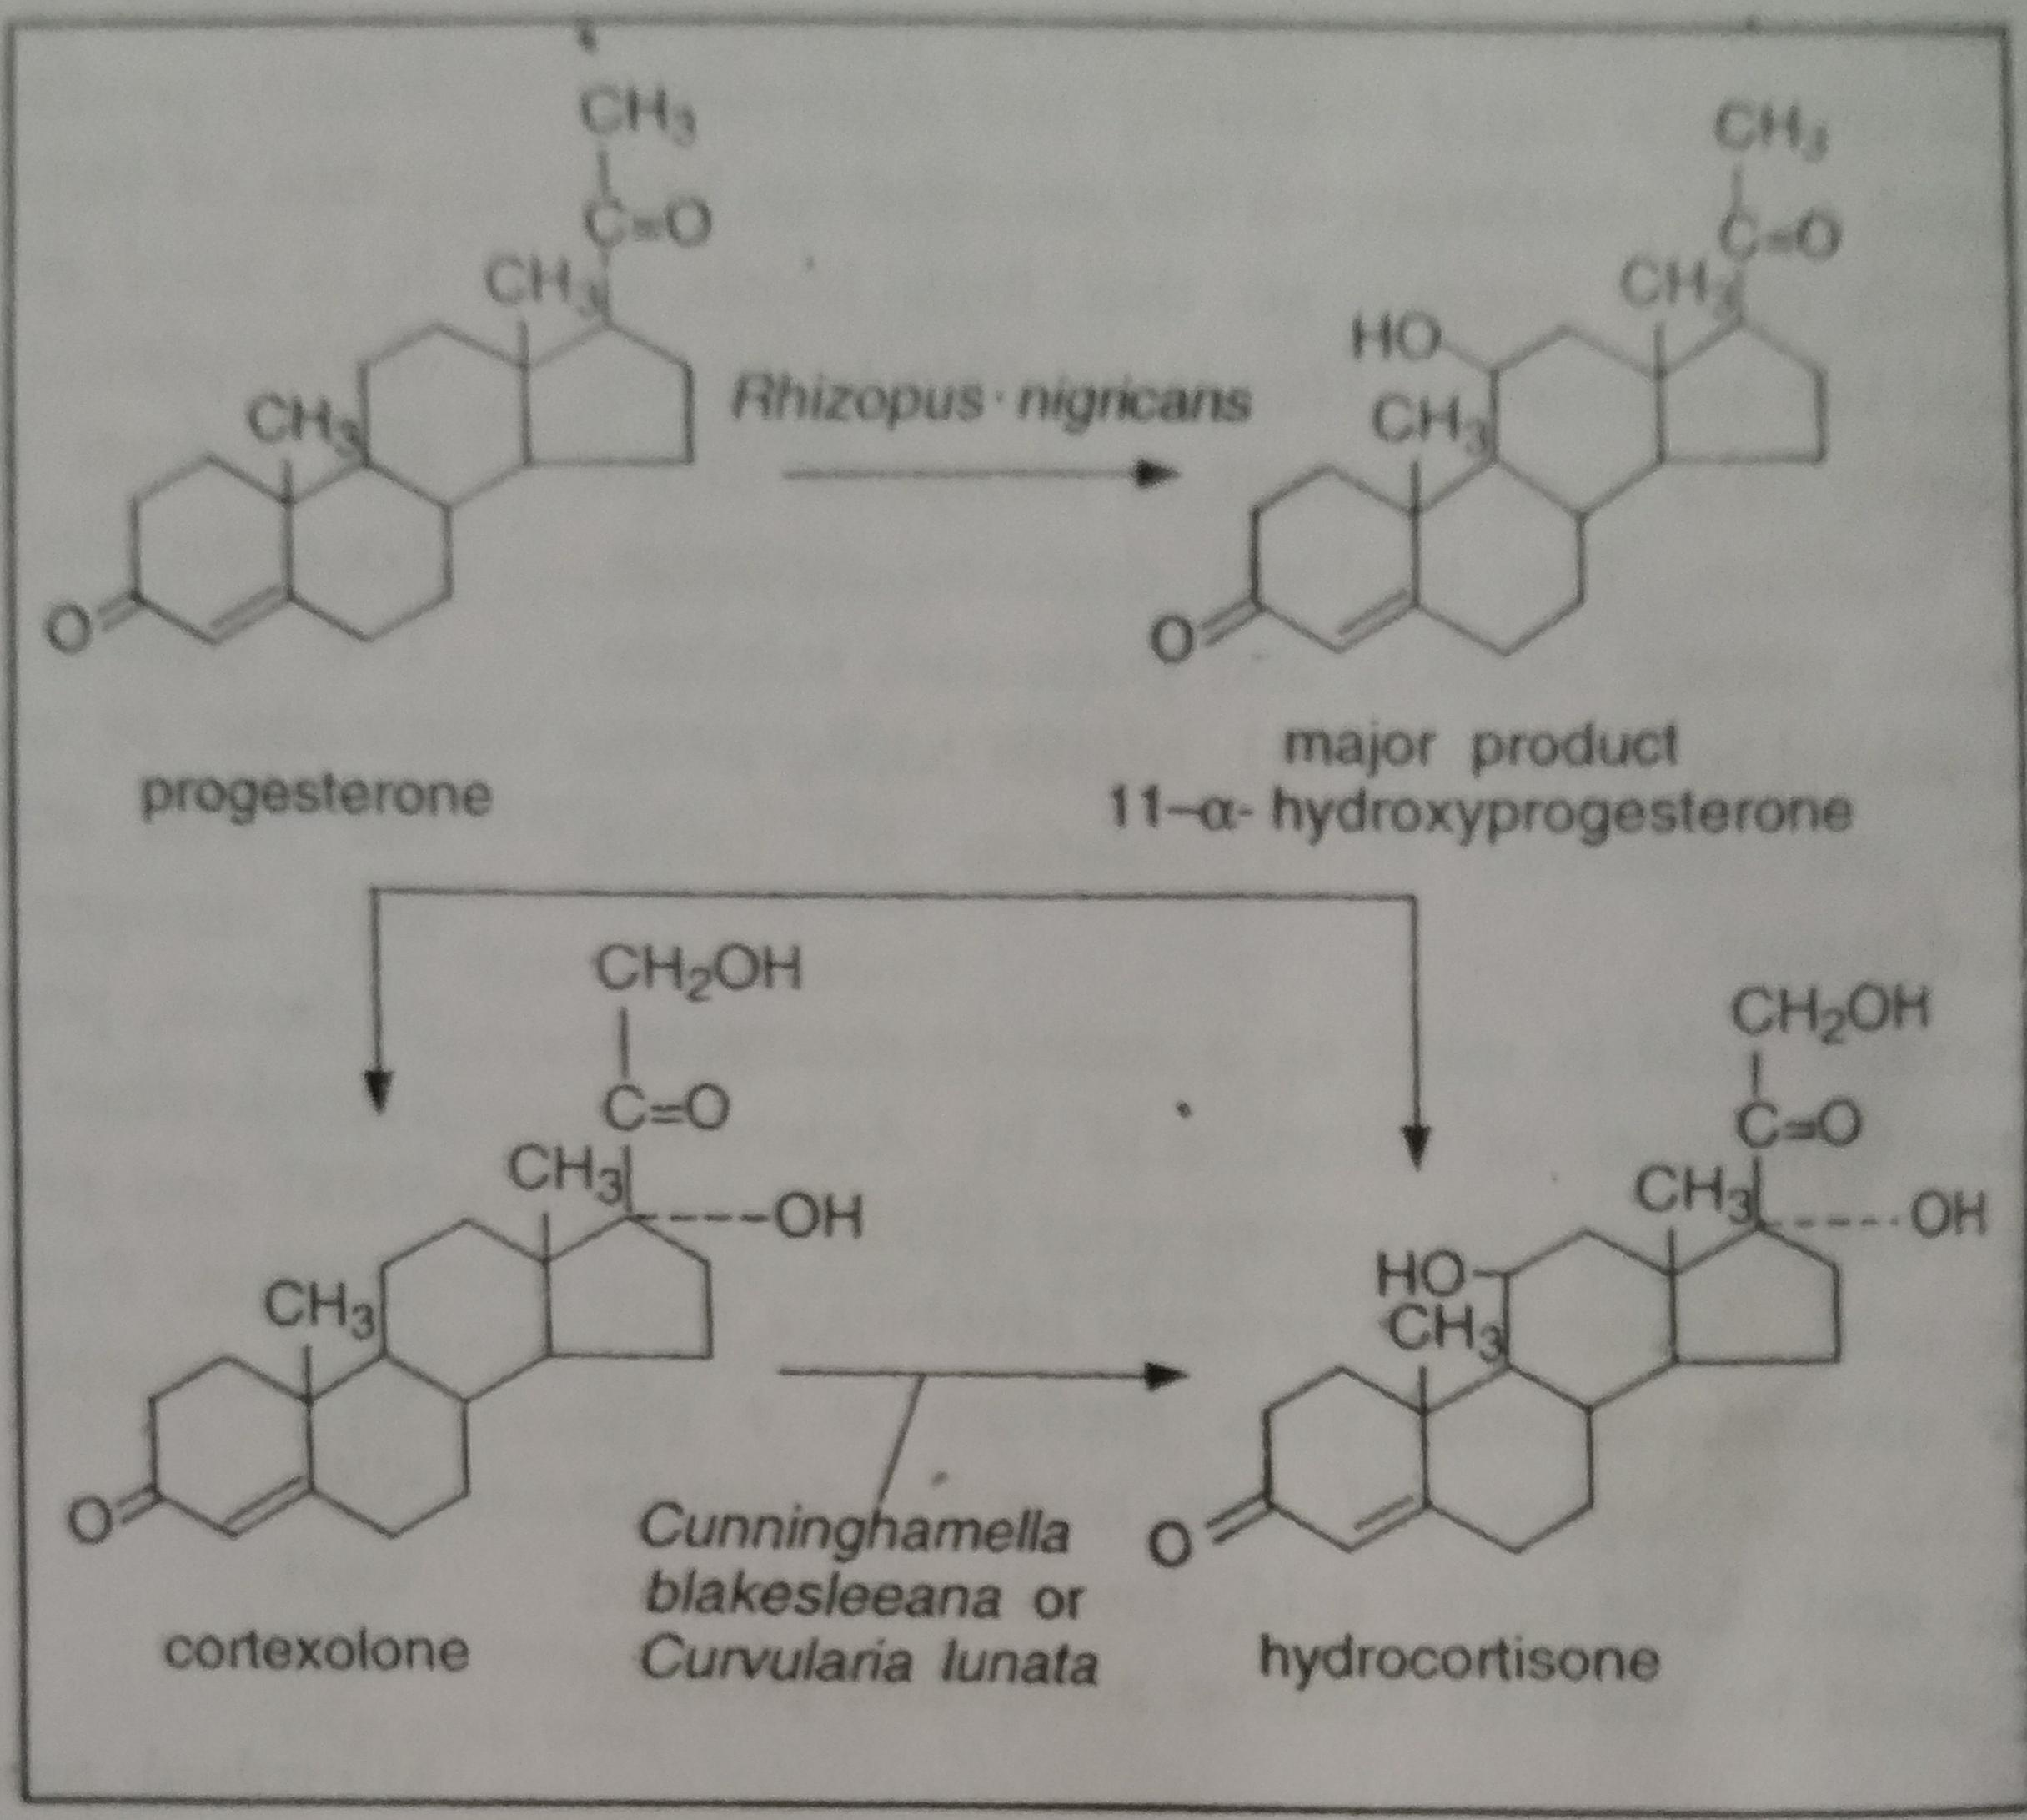

Slide 27
PRODUCTION OF VITAMINS
Commercially produced by using microorganisms like sterptomyces,acetobacter anaerobically or aerobically.
VITAMIN B12
Also called cyanocobalamine.
Discovered by George Whipple
Major sources :egg,meat,poultry
Soluble in water,ethanol
Red coloured vitamin
One of 8 B vitamin
Production requires 3-5 days

Slide 28
INDUSTRIAL PRODUCTION BY FERMENTATION
INNOCULUM: pure streptomyces olivaceus is inoculated and grown in 100-250ml of inoculum medium.
MEDIUM:carbohydrate,protien,cobalt.sterillization of medium by batch or continous culture
Temperature:80 F
PH:5 with H2SO4 and reducing agent Na2SO4
Optimum aeration,excess aeration may causes foaming
Yield: 1-2 mg per litre in fermented broth
RECOVERY:Cobalamine associated mycelium boiling mixture liberate cobalamine quantitatively from mycelium .filteration is done to remove mycelium ,filtrerated broth then treated with cyanide.
Adsorption chromatography is done by activated charcoal.
Elution:process of extracting material from another by washing with solvent like water.
Evaporation upto dryness.
.

Slide 29
USES
Regulates the overproduction of igE
Reduces depression
Stimulate the normal functioning of nervous system.
animal protein can be replaced by less expensive vegetable proteins.
If the vegetable protein is fortified with vitB12 has a role in biological nitrogen fixation.
DEFICIENCY
Causes muscle pain
Memory loss
Causes infertility

Slide 30
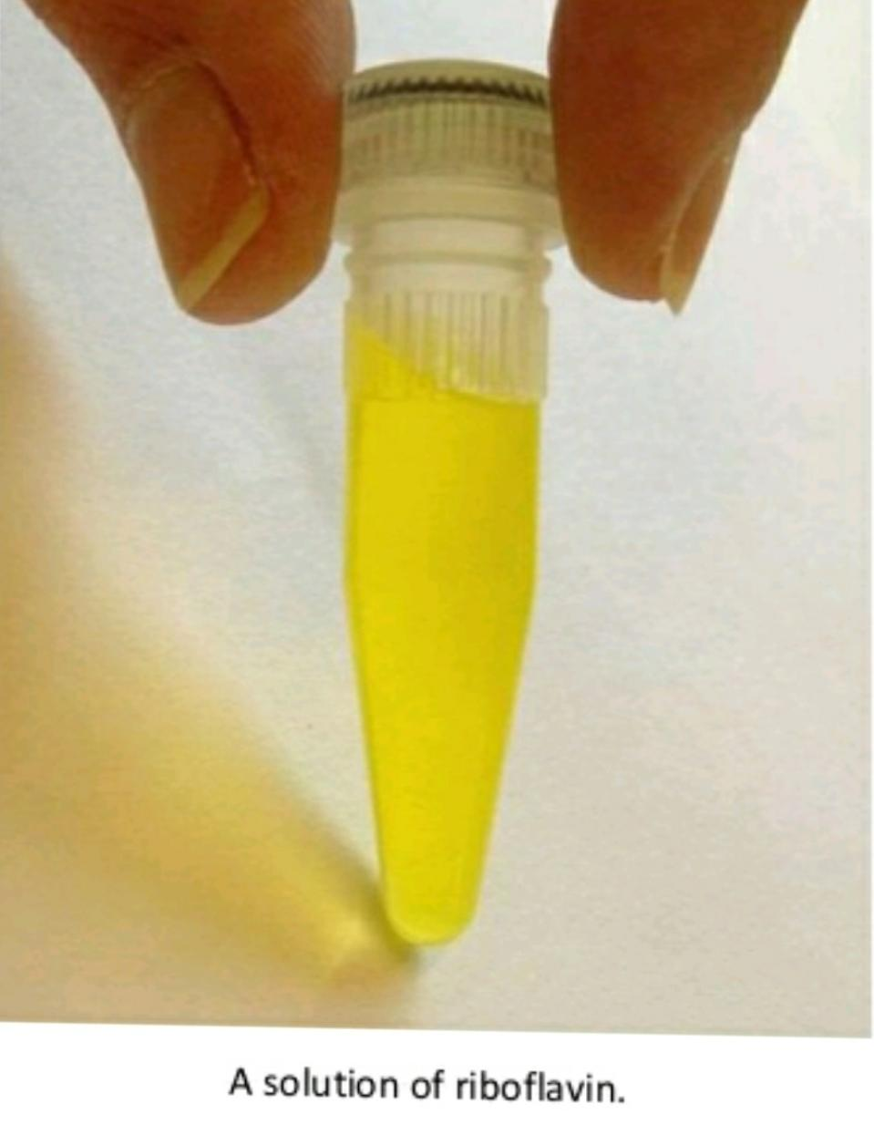
RIBOFLAVIN,VITAMIN B2
Kuhn,Guriga and Eager isolated riboflavin from the whey of milk.
Ashbya gossypi is used as microbes.
It has 400 time more production rate.
Clostridium sps,candida sps belong to ascomycetes can be employed also.
Fermentation can be done in a single step so that can save cost.
Medium:corn steep,molasses, collagen,siya oil .
Fermentation: submerged aerobic,3 days at 20-28℃
PH:6-7.5
3-6g/litre production

Slide 31
RECOVERY
Done by two process
Evaporation of whole broth
Drying by drum drier.
USES
Help in the breakdown of carbohydrate , protein and there by provide energy
Good for overall health
Promote growth
DEFICIENCY
Causes nutritional disorders
Crack in skin corner of mouth
Fissure of lips

Slide 32
PRODUCTION OF AMINO ACID
3 major aminoacid produced industrially
L-Lysine
L-glutamic acid
DL –methionine
L-lysine
Submerged aerobic fermenter
Batch or fed batch fermentation process
Microrganism: cornybacterium glutanicum
Medium: carbon source :cane molasses, nitrogen source : soyabeen ,mineral salts, antifoaming agents :PEG
Optimum PH:7.2,temperature:35-37 c
Recovery : by ion exchange method , lysine is adsorbed and eluted by washing it with ammonia solution.

Slide 33
L.Glutamic acid
Corynebacterium herculis produces glutamic acid.
Medium contain glucose, ammonium acetate.
Recovery:after 30-35 hours.
All most all process steps are same for all.
Application of L-Lysine
Flavour enhancer
Poultry feed
As nutritional supplement

Slide 34
PRODUCTION OF ORGANIC ACID
Production of Lactic acid:
First discovered by Scheele(1789)from sour milk.
Fermentation: racemic mixture is formed due to enzyme racemase. Due to it it becomes optically inactive.
Homofermentative process: Involves the bacterium Lactobacillus delbruckii.
Utilizes the Emp pathway to produce pyruvic acid which then reduced to lactic acid by lactate dehydrogenase.

Slide 35
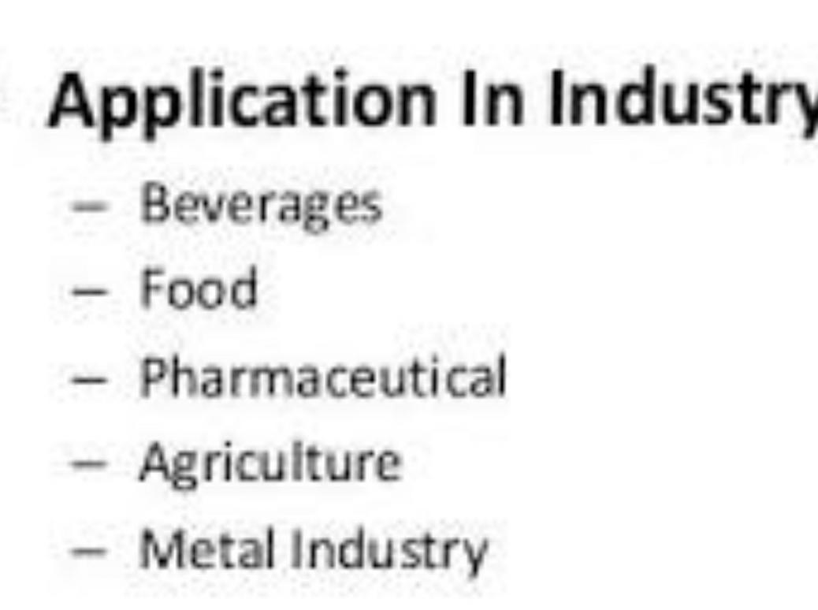
Heterofermentative:involves production of ethanol ,lactic acid ,CO2 by Leuconostoc mesensteroids.
Medium,:sugar molasses,lactic acid is corrosive and thus metals are avoided.
Recover:by caco3 and H2SO4 ,it formed as crystal.
USES

Slide 36
PRODUCTION OF CITRIC ACID
First produced by John and Edmund.
Fermentation:Aspergillus Niger is used
Koji process-Japanese process sweet potato starch as solid substrate.
Submerged fermentation:fungal mycelium grows through out.
Medium: carbon source:molasses,PH:2,temperature :30c
Batch or fed batch is used.

Slide 37
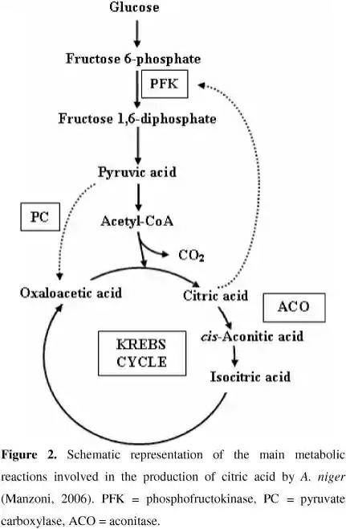
Recovery: treated with H2SO4 to precipitate ca as cas04,then treated with carbon.

Slide 38
USES
Sold as anhydrous crystalline .
Used in soft drinks,jams ,jelly,wine,candies,frozen fruit.
Used in blood transfusion and as a effervescent product.
In cosmetics.

Slide 39
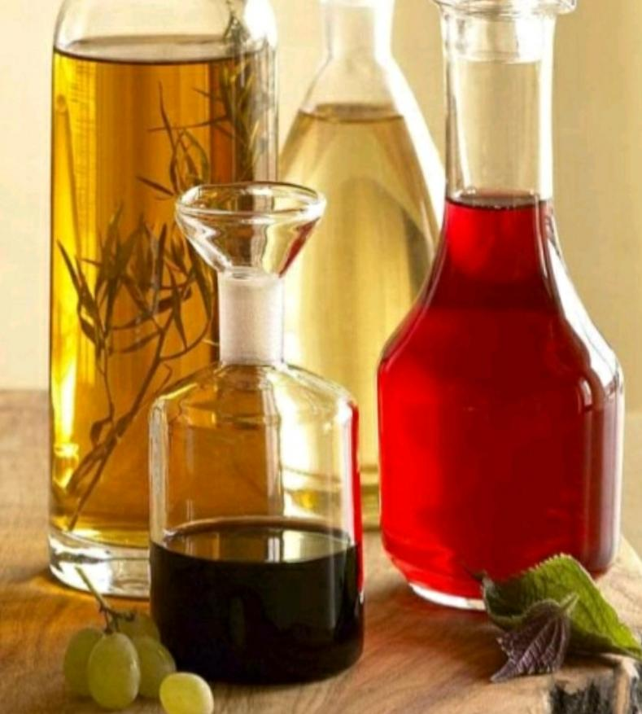
PRODUCTION OF VINEGAR
French word vinaigre means sour wine.
Major two events, conversion of sugar to ethanol by yeast (saccharomyces cervisiae,ethanol is oxidized to acetic acid by acetobacter and glucanobacter called acetification.
SUBSTRATE: It Can Be A Fruit Juice,starchy vegetables,malted cereals such as wheat, barley,corn,or it can be sugar cane,honey.

Slide 40
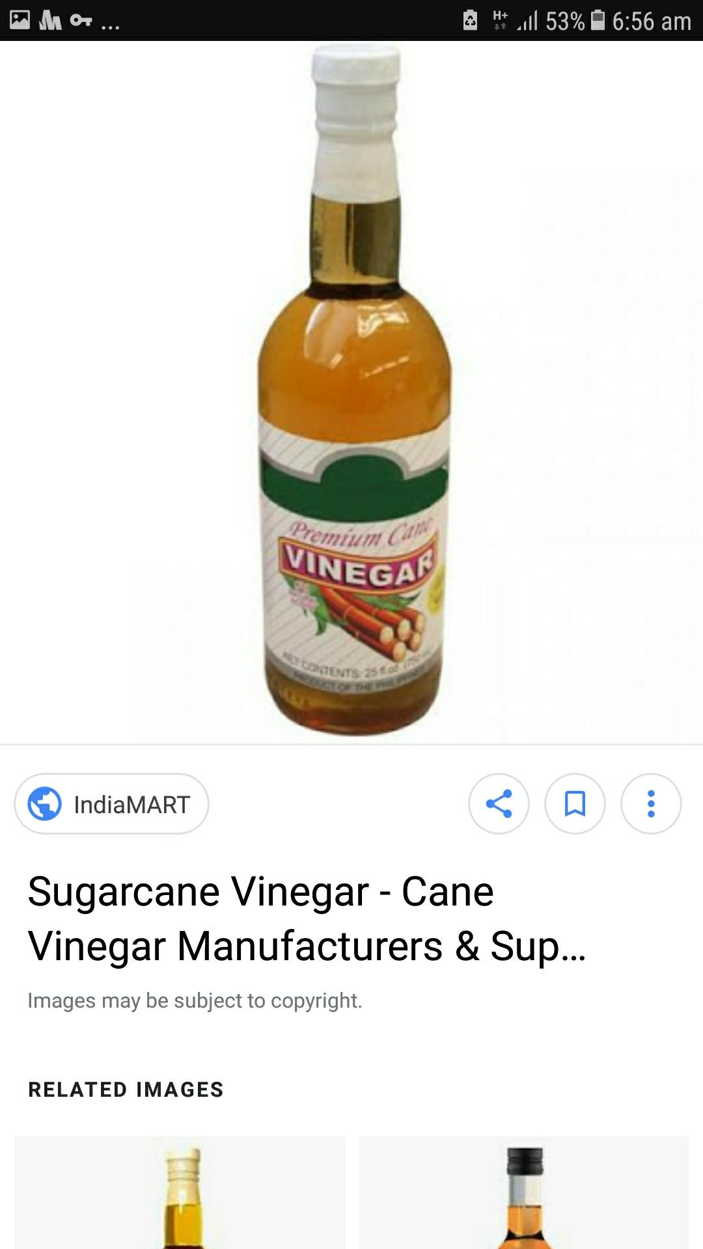
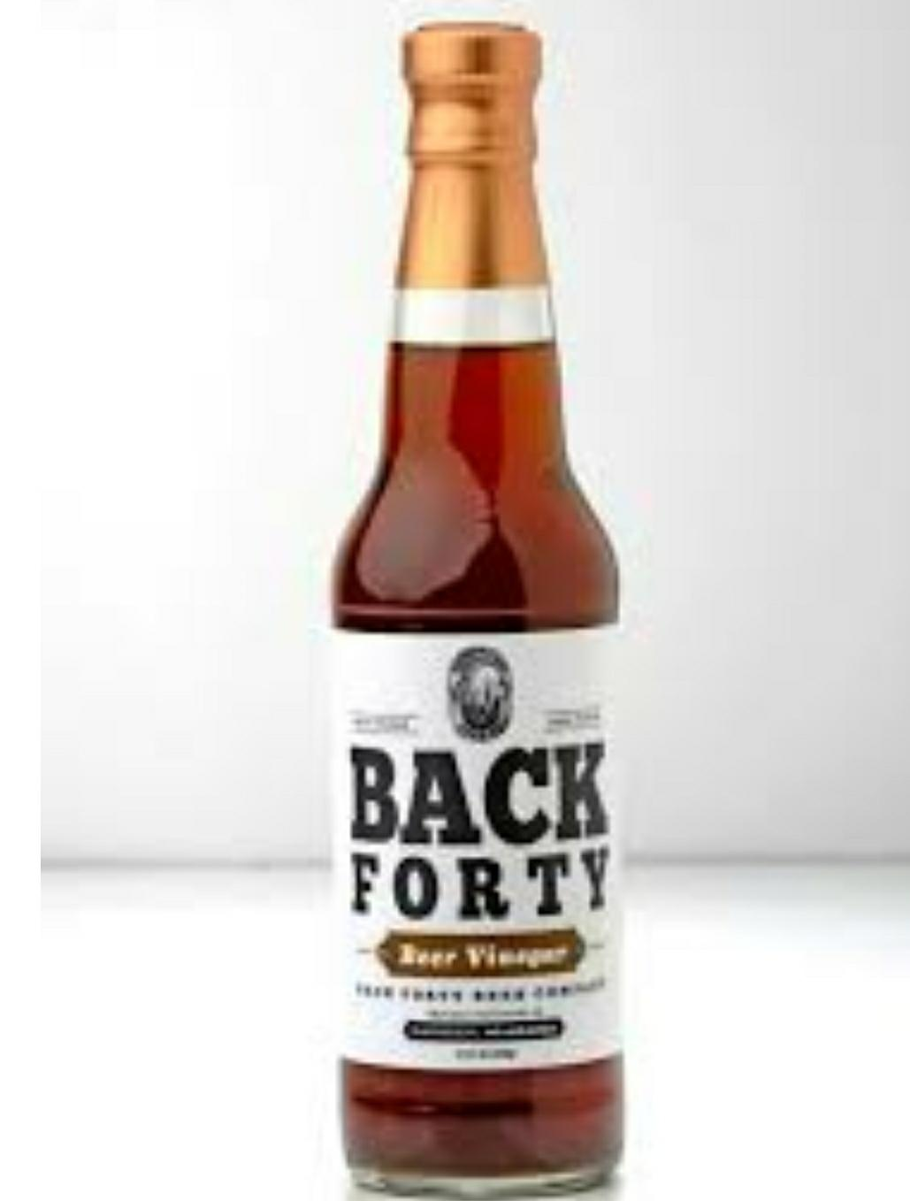
CANE VINEGAR
BEER VINEGAR

Slide 41
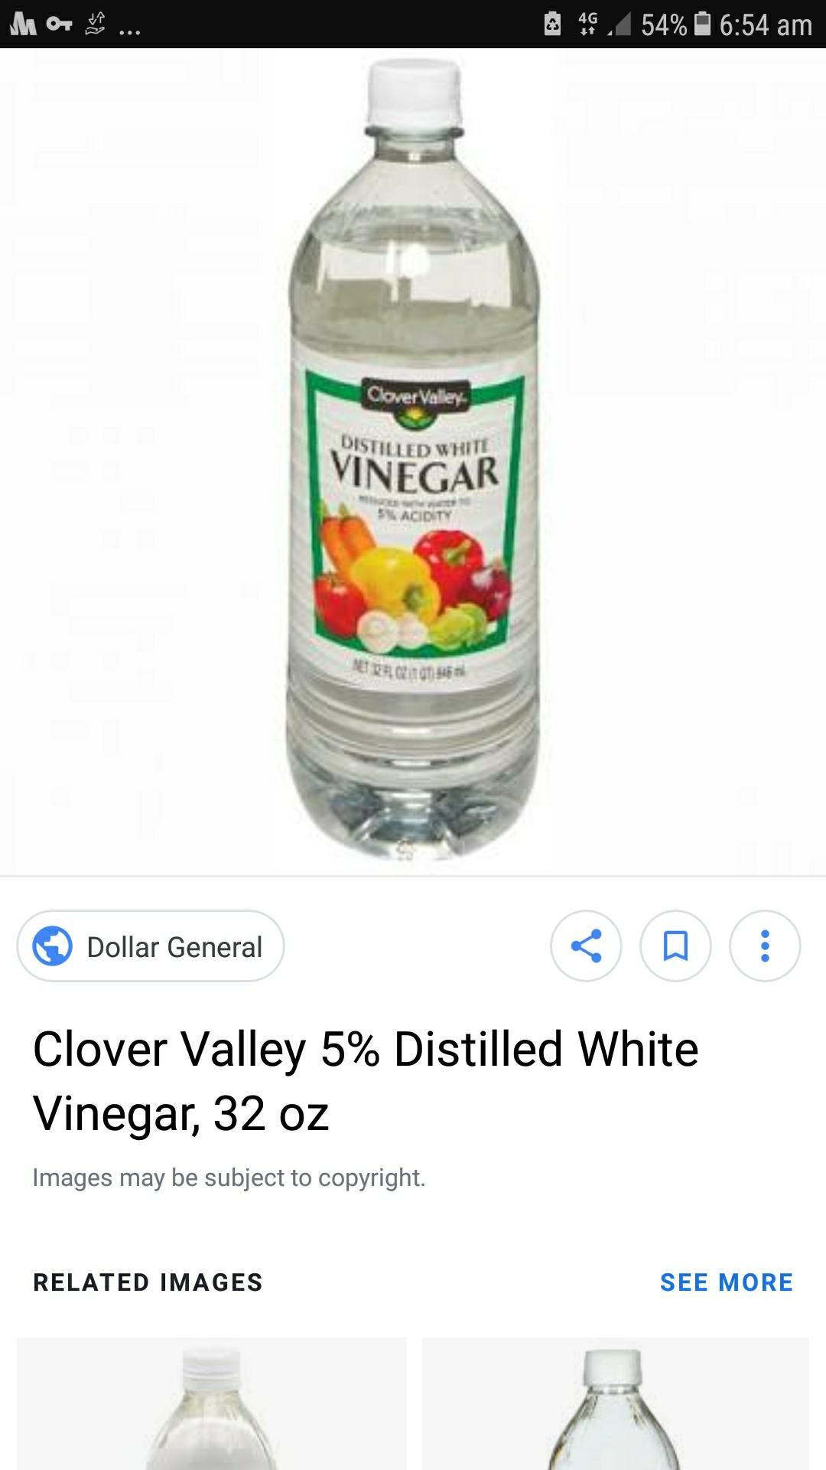
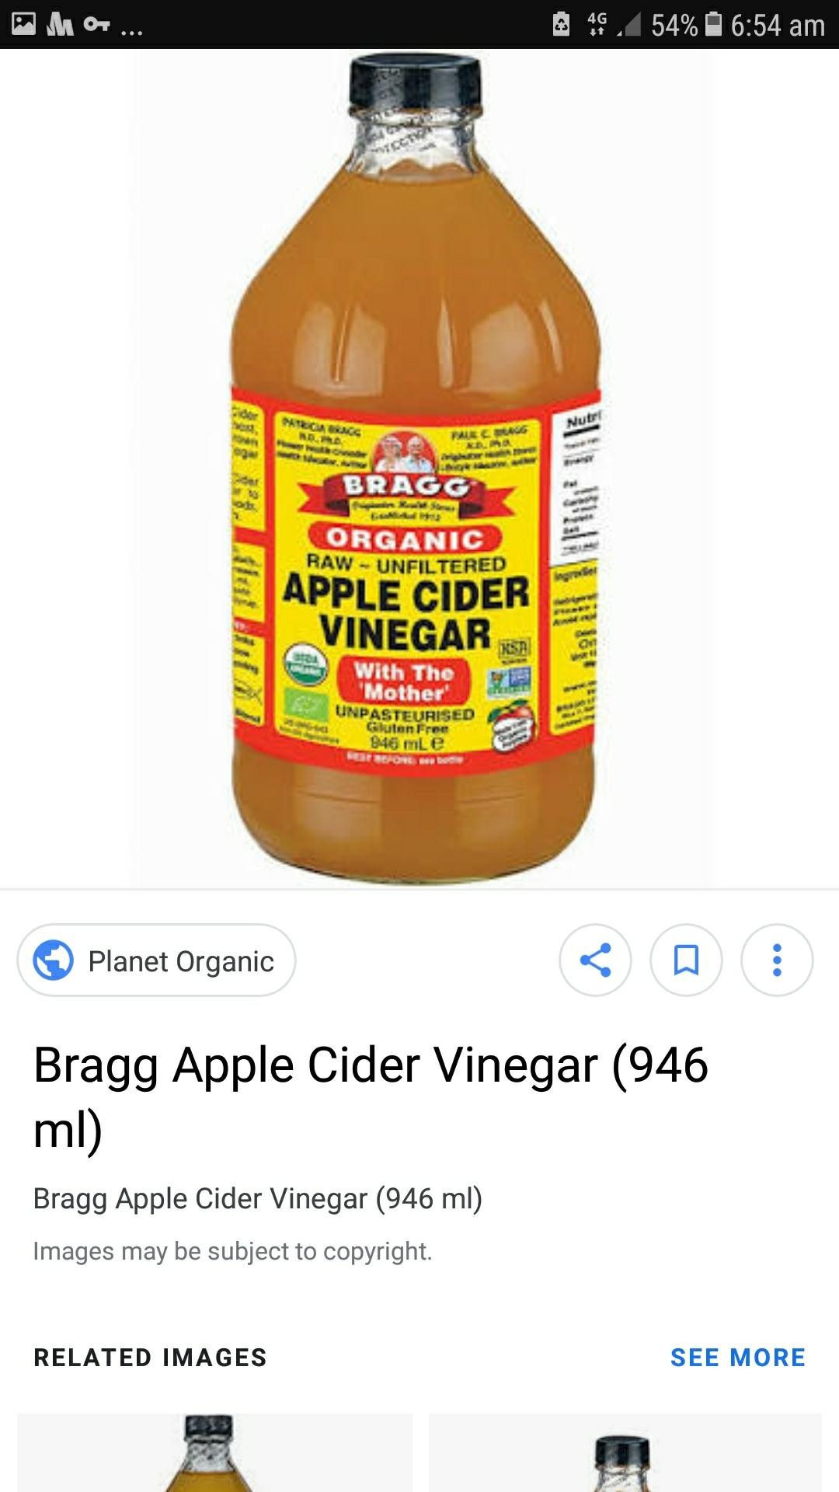

Slide 42
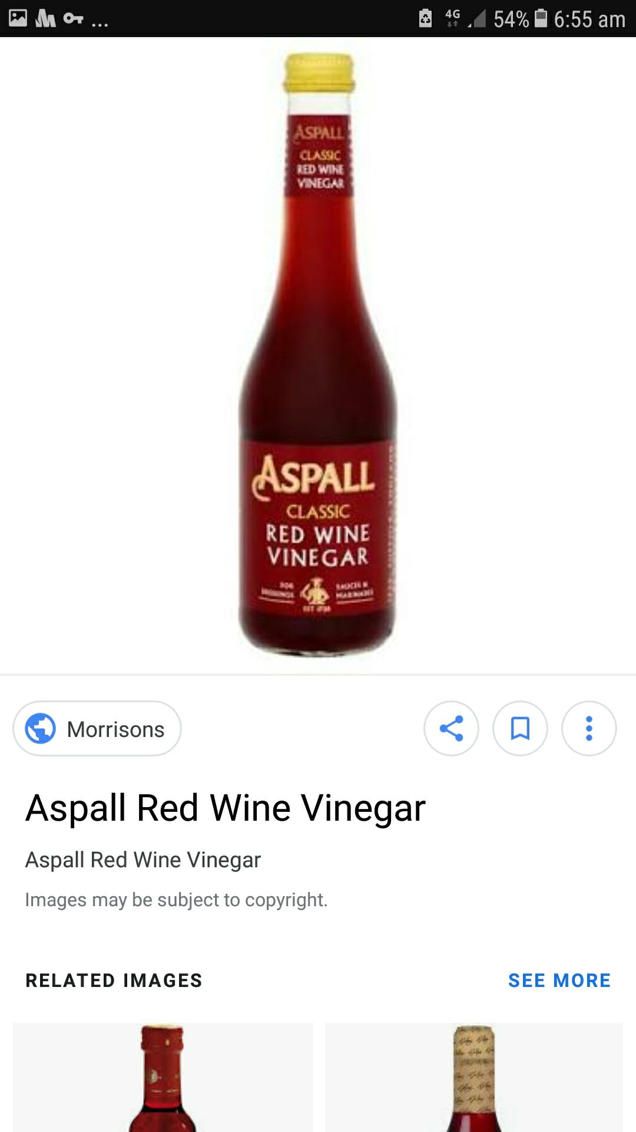
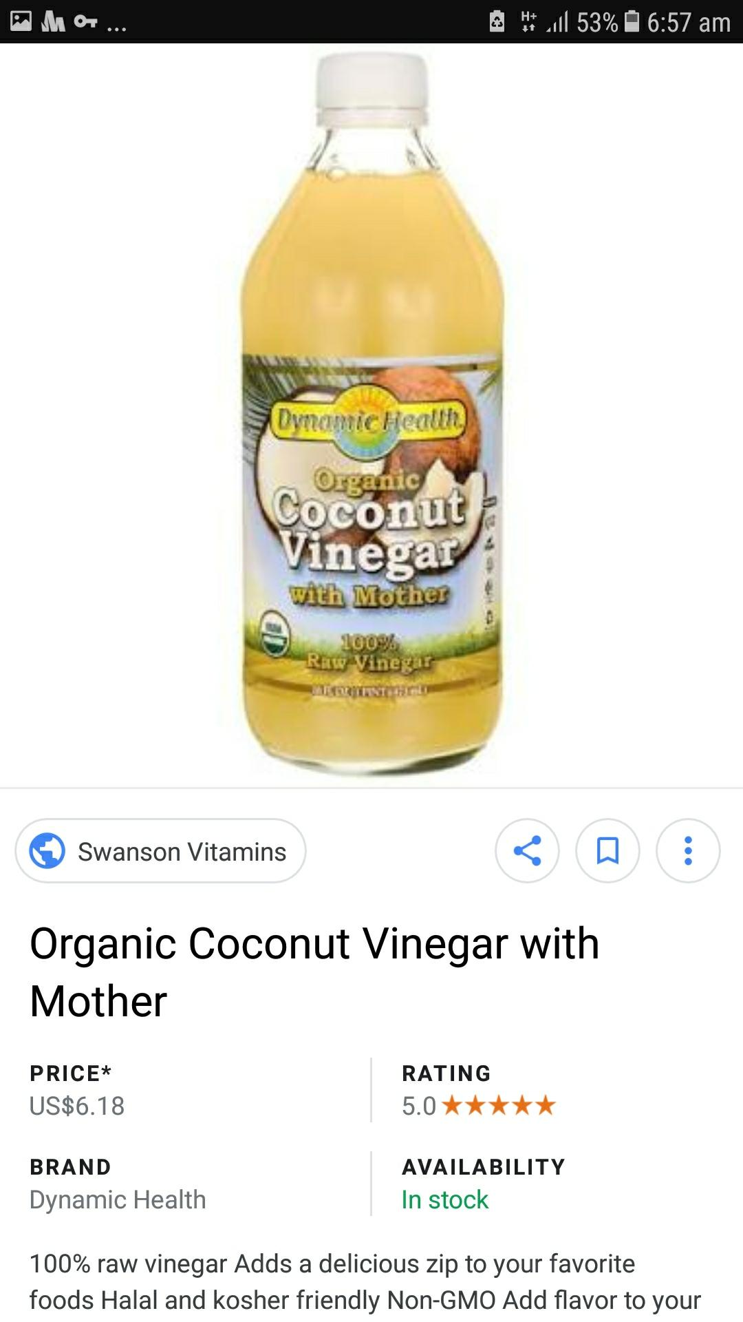

Slide 43
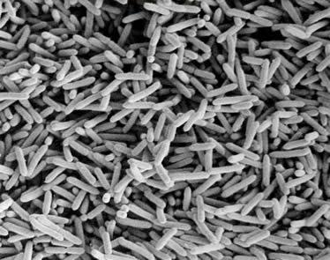
VINEGAR BACTERIA

Slide 44
METHODS OF PREPARATION
SLOW METHOD
Oldest method,still used in some European countries.
An initial natural alcoholic fermentation achieve 11-13% alcohol.
Acetic bacteria are seeded to convert acetic acid.
Introduced by France.

Slide 45
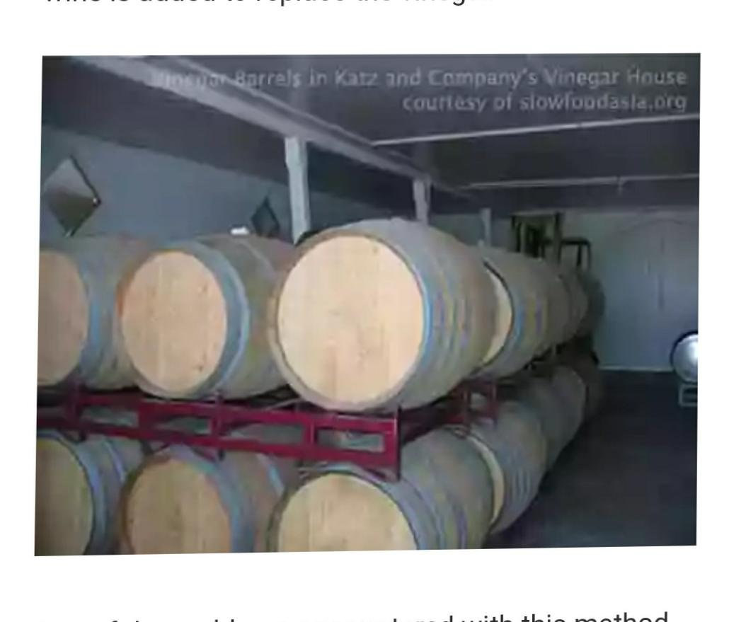
Slow process

Slide 46
2:QUICK PROCESS (ORLEANS PROCESS)
A barrel is filled about 1/4 th full with raw vinegar from previous run to supplement active vinegar bacteria.
Then substrate is added.
Takes several months to complete at 21-29℃.
Improved quality of vinegar is produced.
Introduced by German.

Slide 47
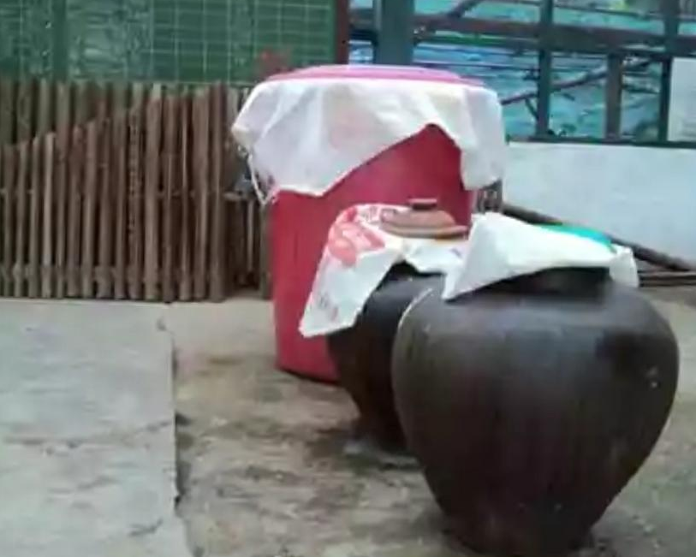
3: NATURAL FERMENTATION
Fermentation take place naturally.
Sugar or coconut sap is placed in earthen jars.

Slide 48
Vinegar Generator: used to increase the rate of acid production.
Alcohol liquid is trickled over the surface of film of acetic acid bacteria.
The film of bacteria is on the wood chips.
In modern ,production of vinegar through sub merged culture reactor.
The final product is kept to a age for final taste.

Slide 49
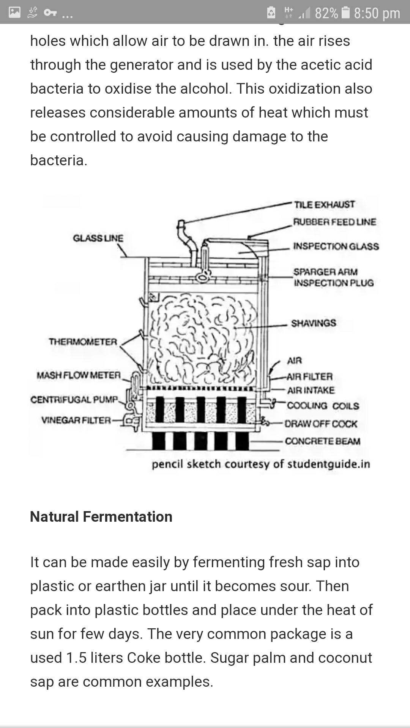

Slide 50
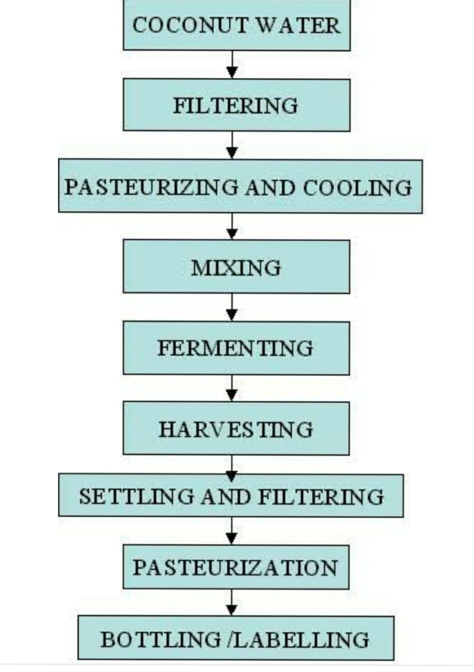

Slide 51
USES
To preserve food.
As deodorant
To make salad
As a facial toner.
To trap fruit flies
To boil better eggs
To wash fruits and vegetables
To whiten teeth.

Slide 52
MEDICINAL USE OF VINEGAR
Anti infective:
Used for ulcer and sore throat from the Hippocrates.
Oxymel composed of honey and vinegar used for cough.

Slide 53
ANTI TUMOUR
Japanese rice vinegar used for inhibition of proliferation of human cancer cell.
Controls blood sugar level and diabetes.
Aids to weight loss.

Slide 54
PRODUCTION OF ALCOHOL
Known as the nature of process.
Louis Pasteur showed yeast is fundamental to process.
Saccharomyces cerivisea,candida brassicae been employed.
97% conversion to ethanol by both sucrose and glucose.

Slide 55
Limitations of yeast
Whole biomass can’t be converted to ethanol.
There exit a limitation.
Zymomonas has merit over yeast in having the osmotic tolerance to higher sugar concentration.

Slide 56
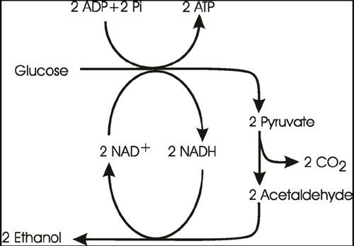

Slide 57
Preparation of medium
Starch contained substrate.
Juice from sugar cane or molasses or sugar beet.
Waste product from wood or processed wood.
Yeast doesn’t contain amylases.

Slide 58
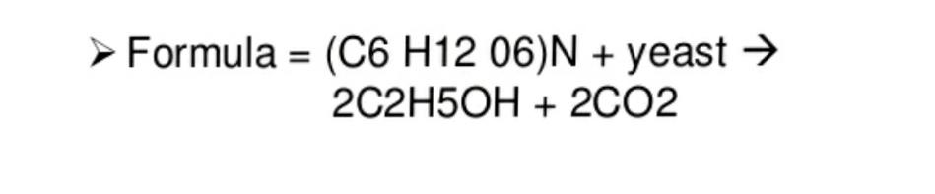
Fermentation
Is a action of yeast in sugar solution and breakdown to alcohol and co2.
Co2 escapes and fermented beverages exist .Eg:wine,beer

Slide 59
Recovery
By distillation 95% is obtained.
Require an azeotropic mixture of ethanol,water, benzene,so after distillation absolute alcohol is obtained.
Water evaporate at 100℃ and ethyl alcohol at78℃.
This is used to separate ethyl alcohol from water and residue.
It is of Dutch origin.

Slide 60
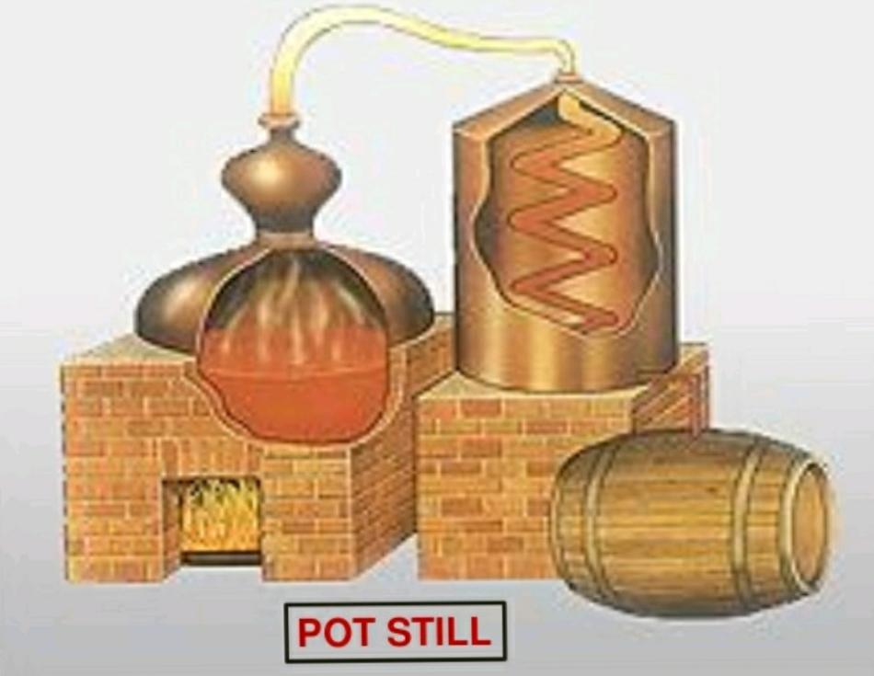

Slide 61
NEUBERGS FERMENTATION
Categorized as third fermentation .
Yeast utillize pyruvate during fermentation and result into an intermediary product called acetaldehyde.
This is trapped in hydrogen sulfite and result in acetaldehyde precipated form and glycerol liquid form.

Slide 62
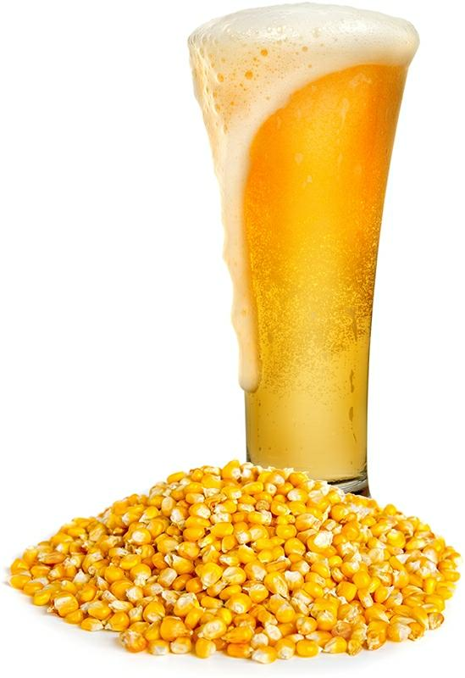
PRODUCTION OF BEER
For more than 6000 years.
Brewing origin from Mesopotamia.mainly from grains about 40%.
Grains are easy for transportation,easy at separation of wort.

Slide 63
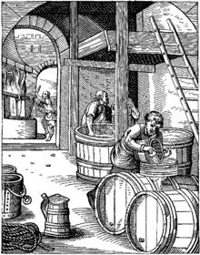
Beer is usually a batch fermentation.
Product of fermentation of barley grain by yeast.
Process is known as brewing.

Slide 64
MALTING
Barley seeds are allowed to germinate.
Naturally occurring amylases convert the grain starch to sugars of maltose.
Process called malting and digested grain as malt.

Slide 65
2:MASHING
Mash the grain with water and remove the fluid portion called wort.
Dried petals of humulus lupulus called hops are added to flavour, colour, also to prevent contamination of wort due to two antimicrobial substance in petals.
Now add yeast in large amount after filtering.

Slide 66
About yeast
Common saccharomyces cerevisiae.
Impart uniform cloudiness.
Top yeast: cloudiness is carried to top of fermentation vat by forming co2 and product is ale.
Bottom yeast: ferment the beer more slowly and produce light beer with alcohol less than ale and product is lager beer.
Eg: saccharomyces carlsbergensis,uk.

Slide 67
After one week, young beer, transferred to vat for 1°, 2° ageing about 6 months.
Keg beer:left in beer.
Canning, pasteurize at 140°F for 13 min.
Rest used as animal feed , pressed to form scp.
4% alcoholic content.

Slide 68
Sake
Commonly rice wine
From steamed rice.
Convert to sugar by Aspergillus oryzae
Ferment by saccharomyces up to 14% alcohol.

Slide 69
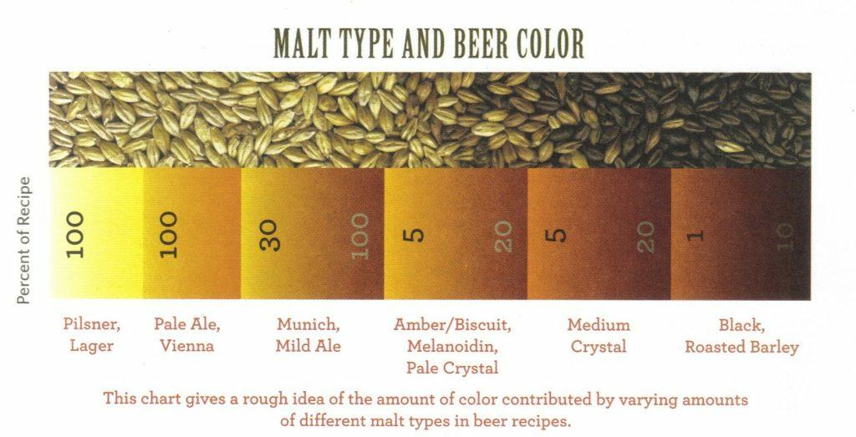

Slide 70
PRODUCTION OF WINE
Fermentation of fruit juice by yeast.
Commonly two kind of grapes,red wine from red grapes,white wine from white grapes.
Common saccharomyces ellipsoideus,a variety of saccharomyces cerivisea.

Slide 71
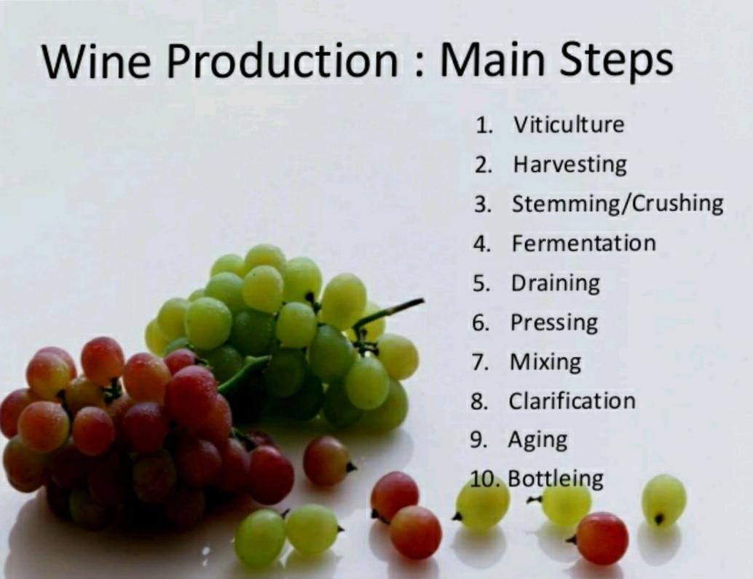

Slide 72
Stemming is the removal of stem of grapes
Crushing is the pressing to squeeze the fresh juice
.Crushed grape called must.
So2 is used to control the process.
Sodium or potassium meta bisulphate is added to check the undesirable microorganism.

Slide 73
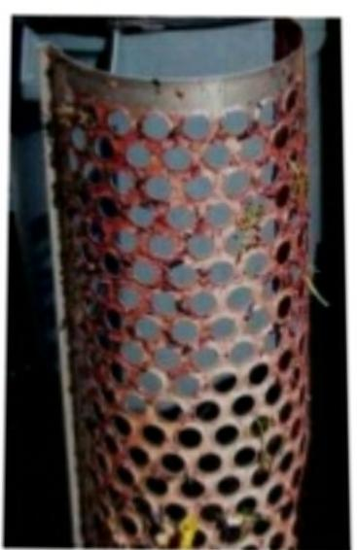
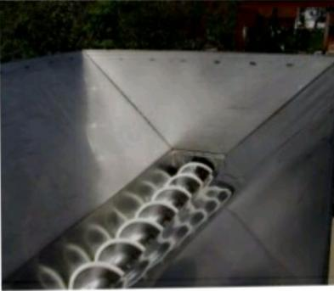

Slide 74
Draining: liquid wine is drained from vat without being pressed and go into barrel.called free run wine.
Pressing: remaining pulp ,after draining,is pressed to squeeze out.
Mixing:free run wine and press wine from same source is mixed to obtain desirable balance.
Clarification: stabilising of fermentation, remaining solid are removed.

Slide 75
For red wine, fermentation 8s carried at 24-27℃ for 3-5 days.
White wine takes 1-2 weeks at 10-21℃.
MICROBIAL DETERIORATION
Acetification, glucose may oxidise may given sweet sour taste to wine.done by acetobacter aceti.
The fermentation to glycerol called amerture.

Slide 76
TYPES OF WINE
Still wine :wine in which no co2 is produced during fermentation.
Carbonated wine:wine in which considerable amount of co2 is produced.
Sherry: popular in France,made from ripe and dried grapes with high sugar content,grapes infected with Botrytis cinerea are selected for sherry production.
Dry wine:most or all sugars is metabolised.
Sweet wine: fermentation is stopped before entire sugar is consumed.
Fortified wine:brandy,rum are added to get 22% alcohol.

Slide 77
DISTILLED SPIRITS
Considerably more alcohol than beer and wine.
Shown by proof number which is twice the actual percentage of alcohol.
Process is same but after fermentation alcohol is collected by distillation.
During maturation, chemicals like aldehyde, ethers and volatile acid are added.
Then alcoholic content is standardized by diluting it with water.

Slide 78
DISTILLED LIQUID TYPES
RUM: obtained by distillation from alcoholic fermented sugar cane,syrup,molasses.
WHISKEY:obtained after distillation from saccharified and fermented grain mashes.prepared by using wheat,corn,rye .
BRANDY: obtained from grape wine after distillation.also from apple,peach, apricot.
NEUTRAL SPIRIT:as vodka made from potato starch and left unflavoured and gin flavoured with juniper oil.

Slide 79
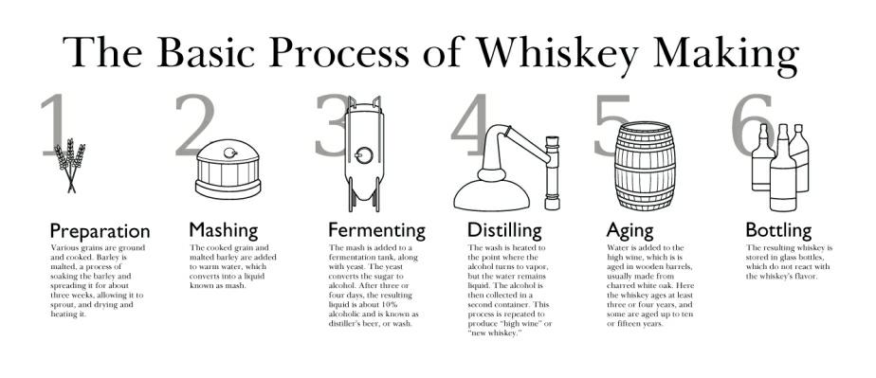

Slide 80
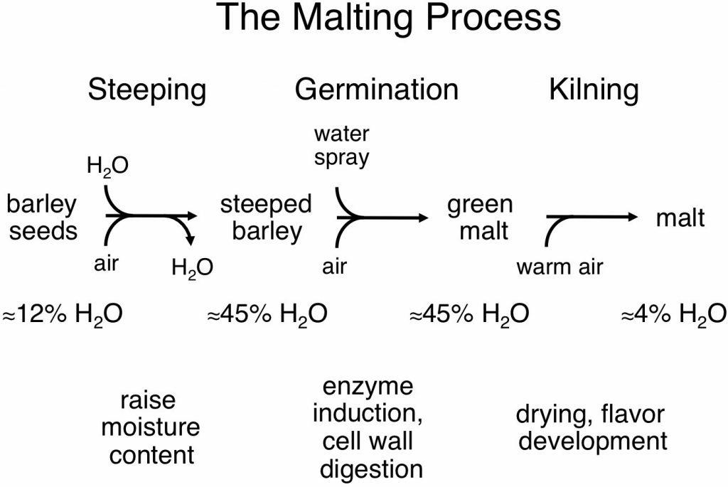

Slide 81
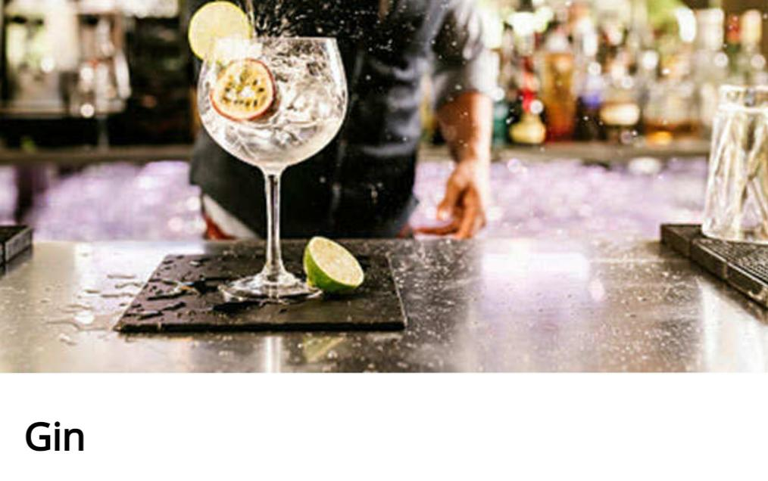
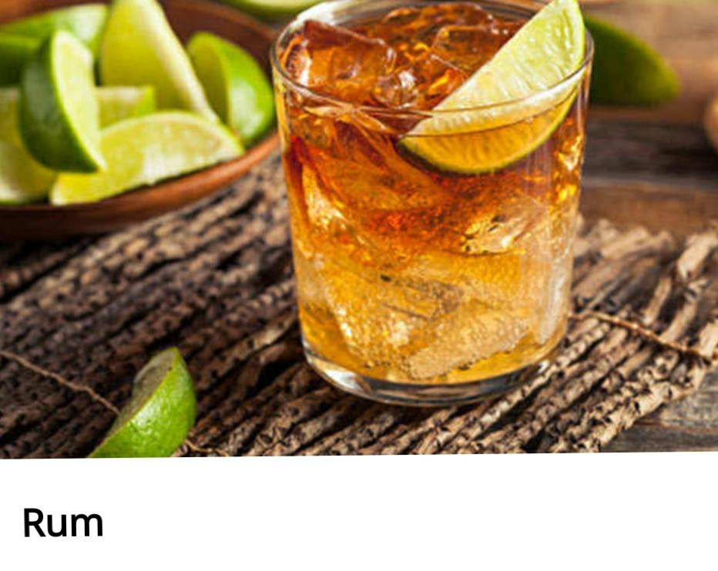

Slide 82
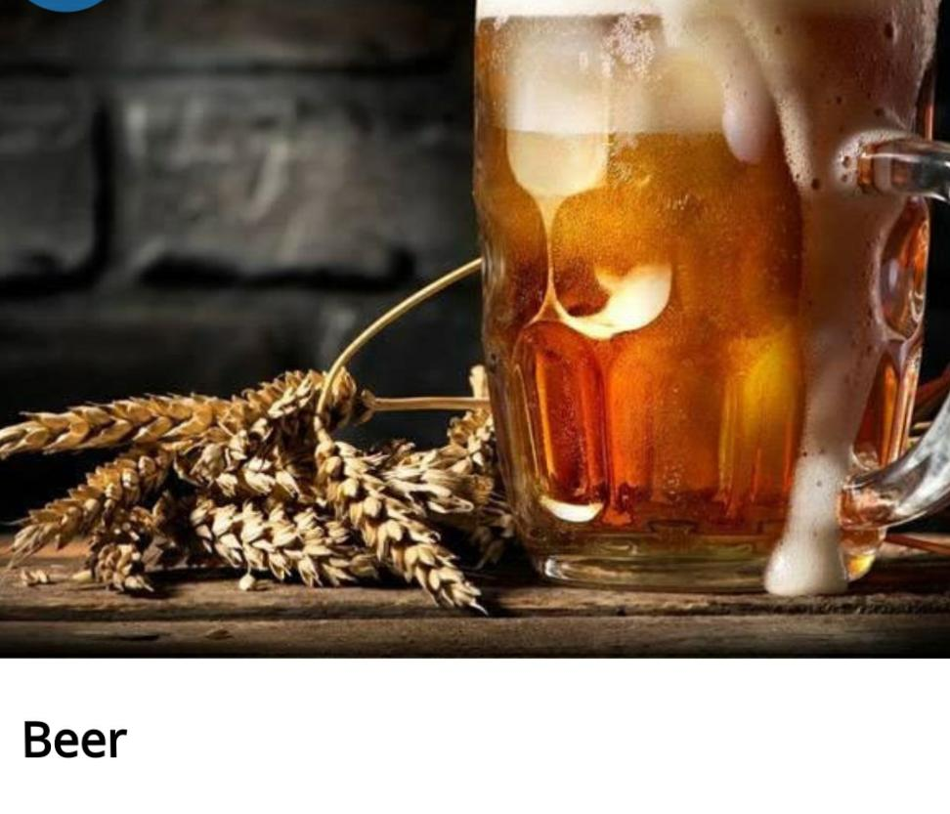
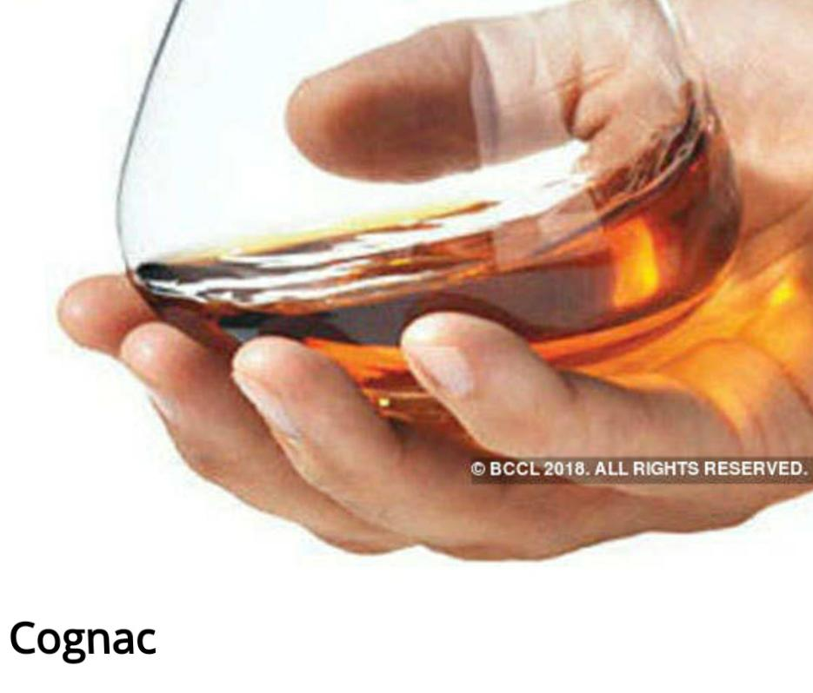

Slide 83
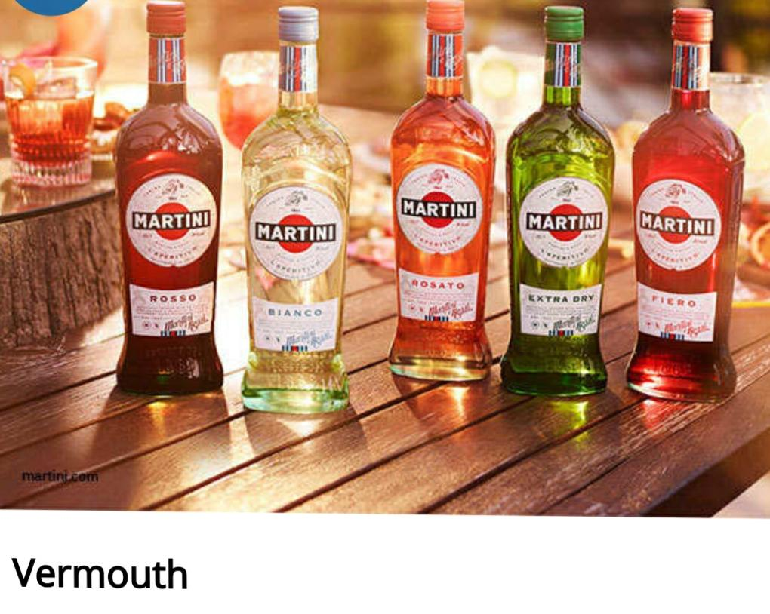
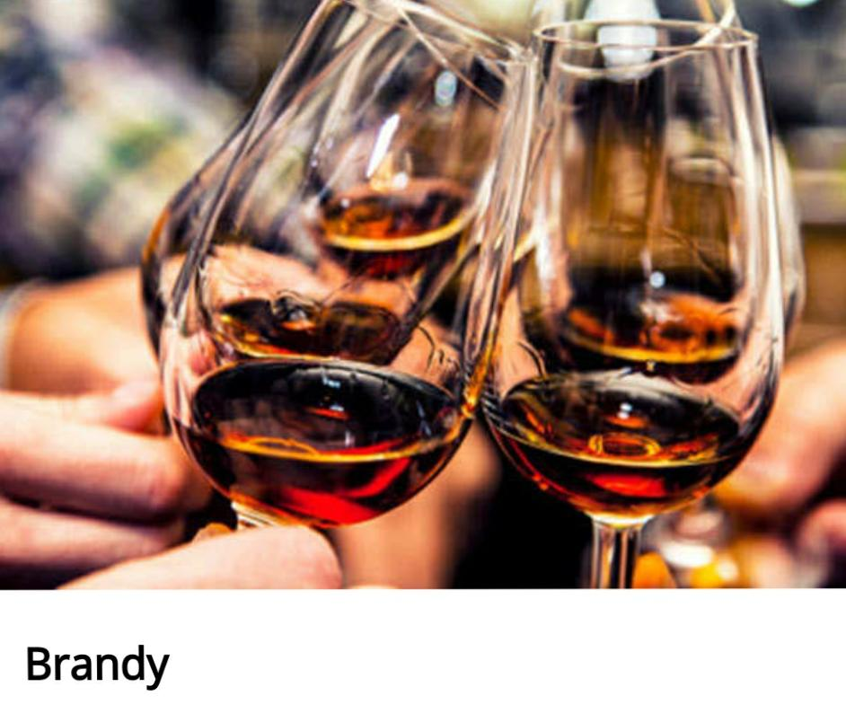

Slide 84
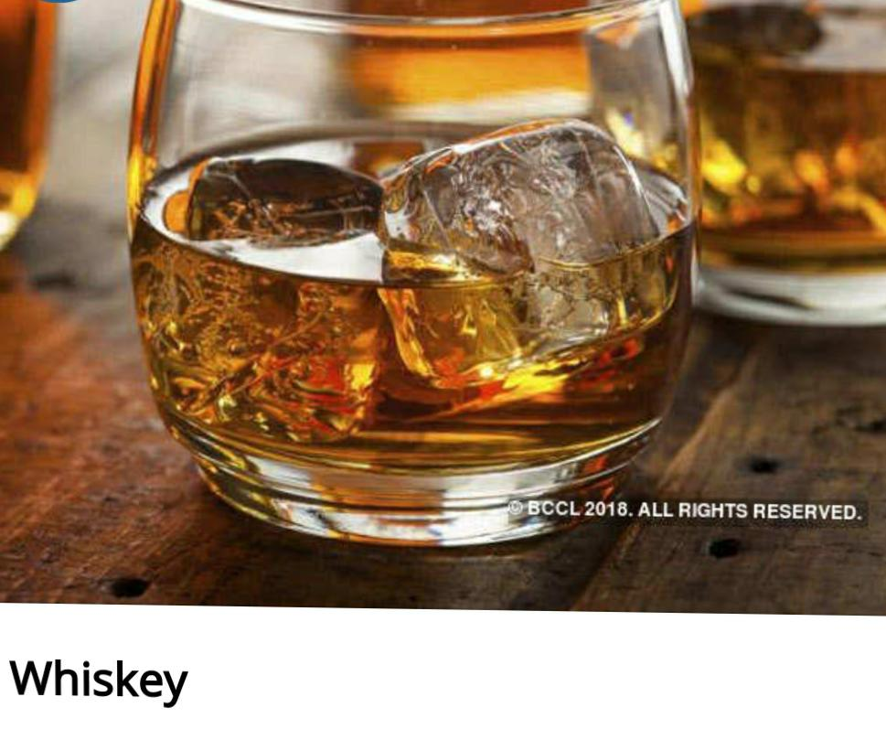

Slide 85
PRODUCTION OF VACCINES
First vaccine in 1796 by Edward Jenner.
Used live cowpox virus to vaccinate to small pox.

Slide 86
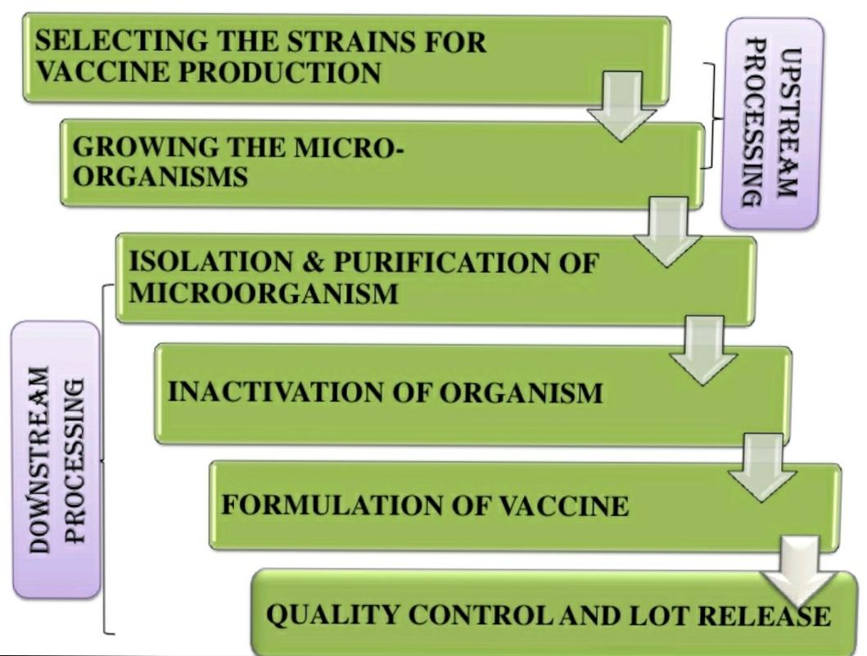

Slide 87
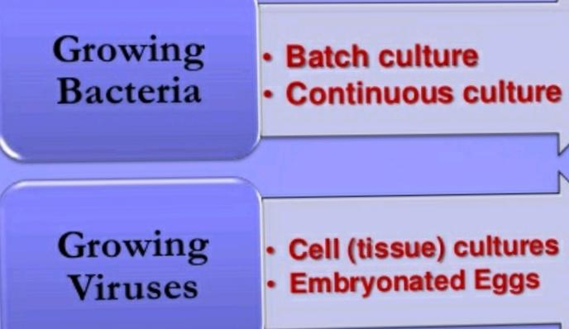
Strain are selected either from viruses or bacteria and called seeds,must be free from impurities and pass the sterility test.
2:

Slide 88
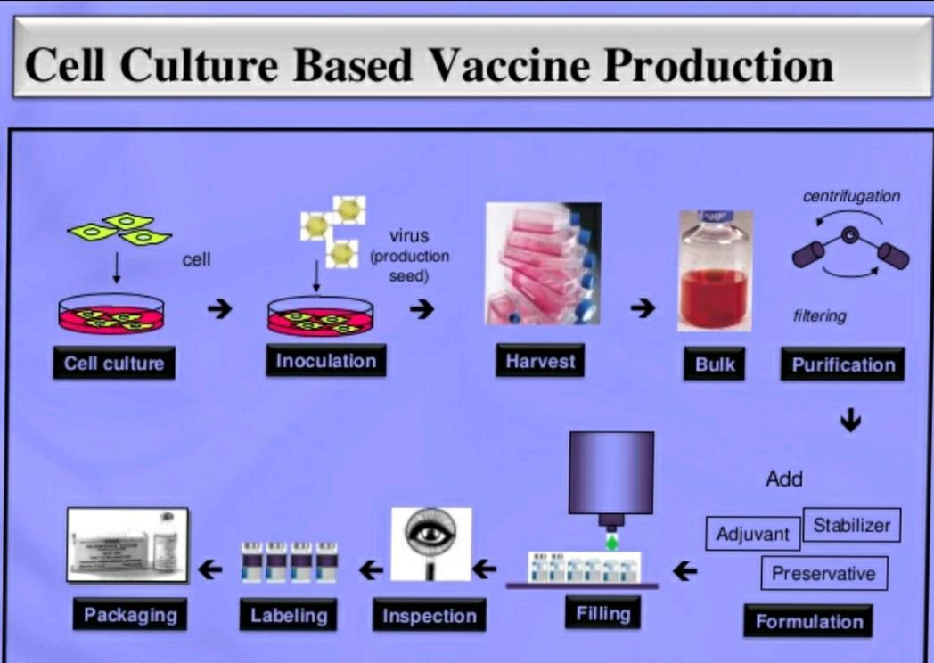

Slide 89
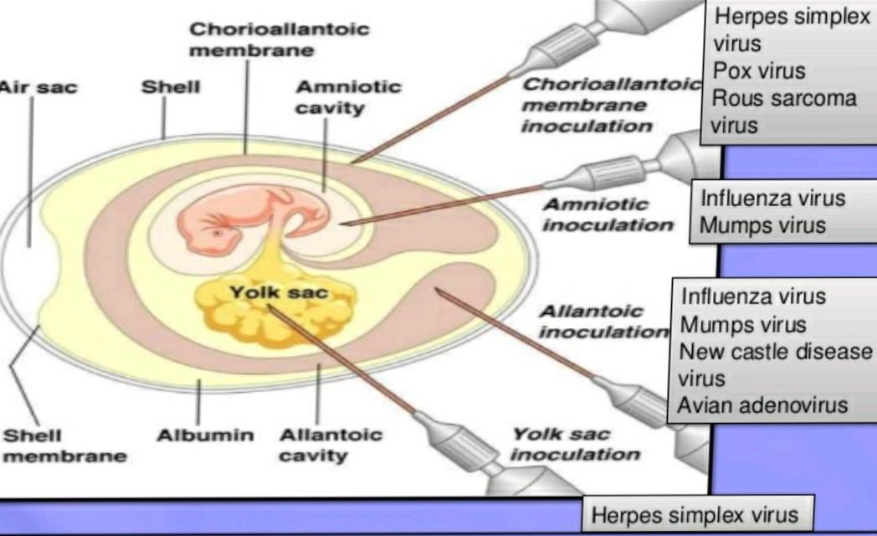
After fertilization of 5-14 days,drilled in shell innoculate virus.
Incubation at 33℃ for 2-3 days.

Slide 90
3: Isolation can be done by chromatography, filtering, centrifugation.
4: Inactivation by chemical treatment,by heat,U.V, detergent triton x 100.
5: Formulation by adding adjuvant, stabilizer, preservatives.
6:Quality test like sterility, safety test.

Slide 91


