Slide 1

SEX LINKAGE AND RECOMBINATION

Slide 2

Is the red or green color that you see like that of what other people see?

Slide 3
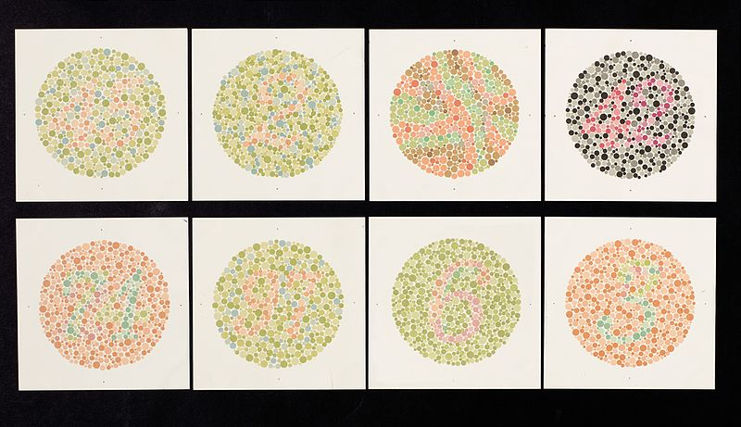
If you can determine the numbers in this Ishihara chart, you do not belong to the small population of people who are color-blind.

Slide 4

How do people acquire this trait? Why is it more common in males than in females?

Slide 5
Unlike you, your biological brother has a widow’s peak and a cleft chin. If your genes are inherited from the same parents, why do you look different?

Slide 6
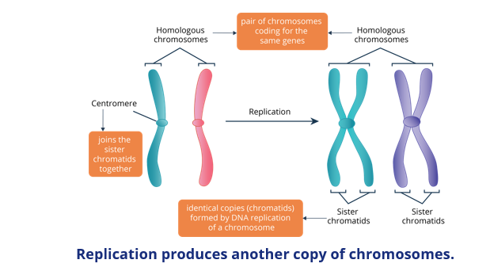

Slide 7
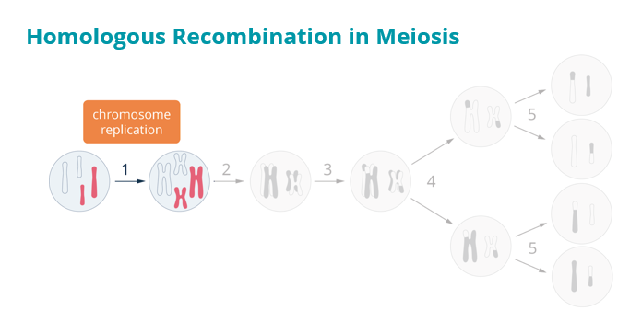

Slide 8
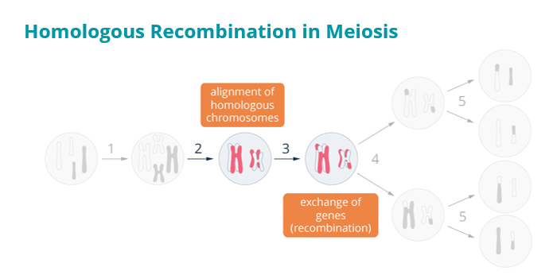

Slide 9
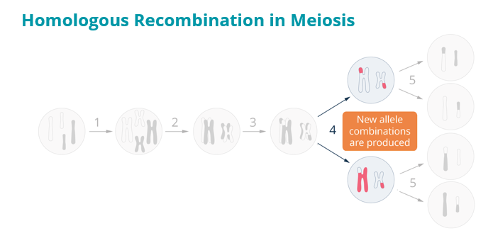

Slide 10
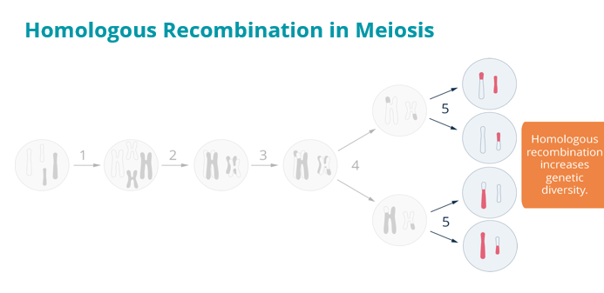

Slide 11
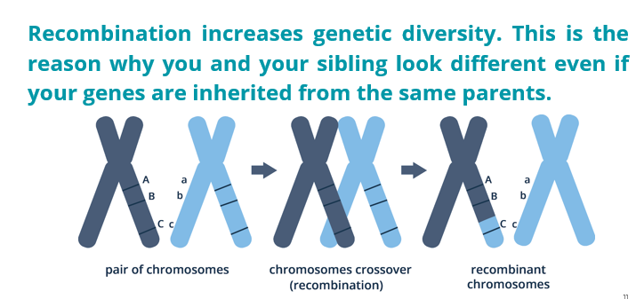

Slide 12
How are sex-linked traits inherited?

Slide 13
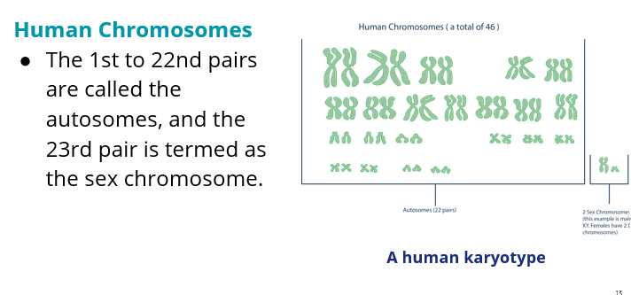

Slide 14
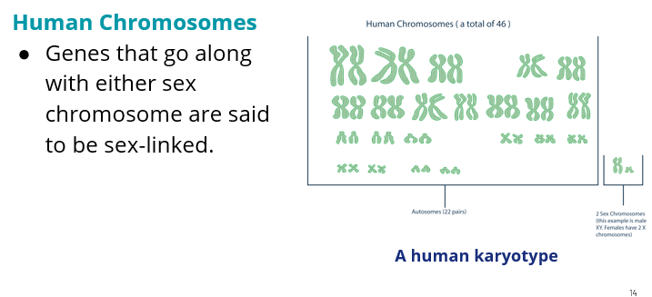

Slide 15
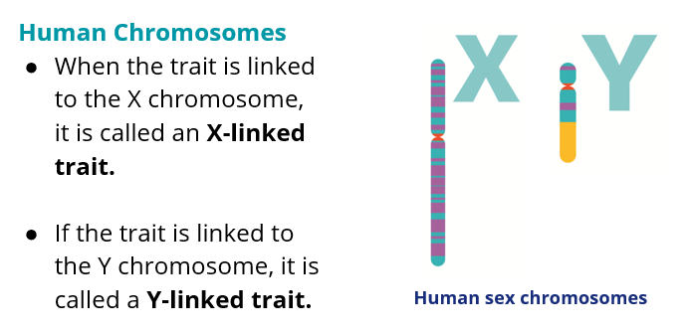

Slide 16
Your female friend does not exhibit a sex-linked trait, but her brother does. What can possibly account for this?

Slide 17
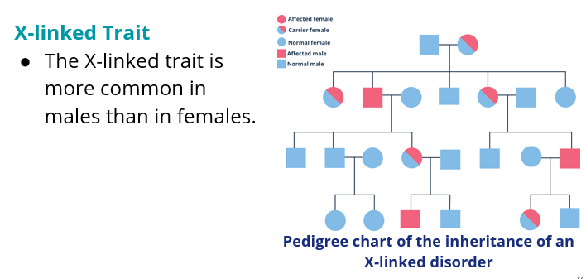

Slide 18
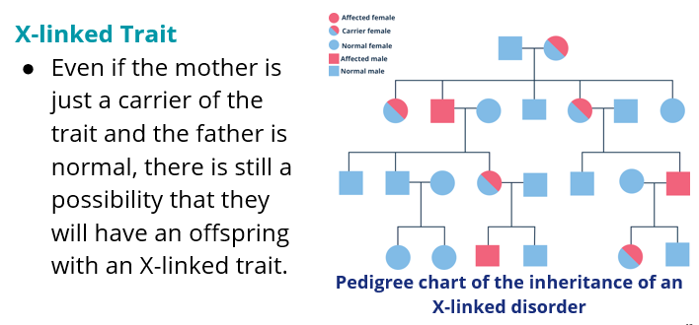

Slide 19
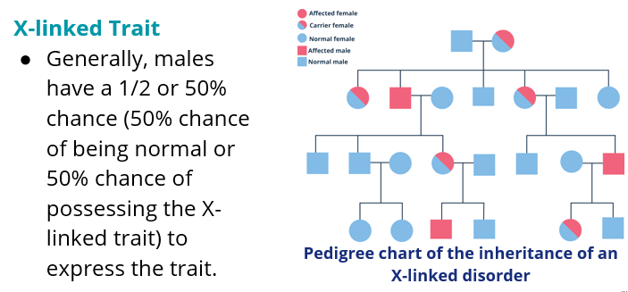

Slide 20
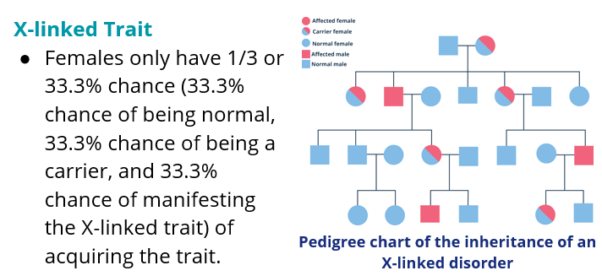

Slide 21
Abby is wearing a blue shirt, but she insists that it is red. How is this possible?

Slide 22
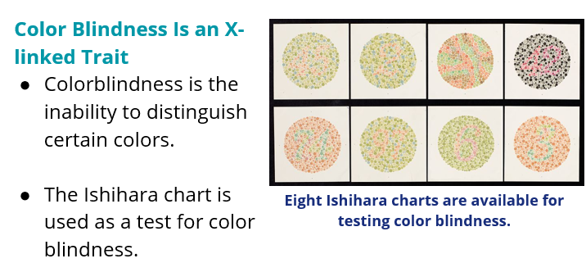

Slide 23
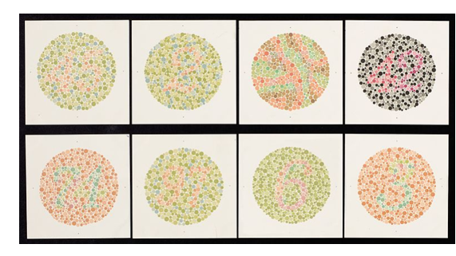

Slide 24
Sex Linkage
Y-linked Trait
The Y-linked trait is only common in males since only males have the Y chromosome.
An example is the hypertrichosis pinnae auris trait, which is characterized by having a hairy ear.

Slide 25
Why is sex-related inheritance not following Mendel’s laws?

Slide 26
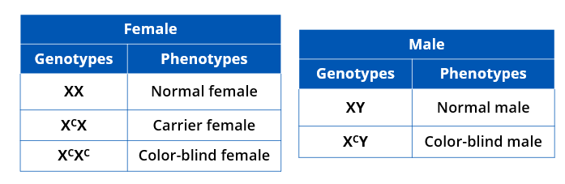
Possible color blindness genotypes and phenotypes of males and females

Slide 27
Sex-Related Inheritance
As opposed to Mendelian inheritance wherein the heterozygous genotype expresses the dominant trait, the heterozygous genotype of an X-linked trait in females will result in a carrier female.

Slide 28
Try This…
Anna, who is a carrier for hemophilia, marries Juan, a man without hemophilia. Identify the phenotype of their possible offspring.

Slide 29
Try This…
Marie, a single mom, claimed that John was the father of her child. John denied it, claiming that Marie’s current boyfriend was the father. Marie is color-blind, while John has normal vision, and the daughter is color-blind. Is it possible that he is the father?

Slide 30
Try This…
Someone removed the ID bracelets of four babies in a maternity ward. The parents want to be sure that they have the right ones back. A particular dad is hemophilic, while his wife is normal. The first baby is a hemophilic female; the second is a normal female; the third is a hemophilic male, and the fourth is a normal male. Which baby must be theirs? Explain.

Slide 31

Sex-influenced Trait
Sex-influenced traits are controlled by autosomal genes.
The genes are found on both sexes, but one expresses it more than the other.
Human pattern baldness is a sex-influenced characteristic.

Slide 32
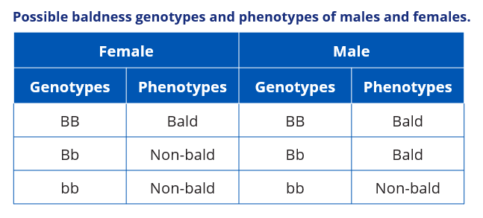
Sex Linkage

Slide 33
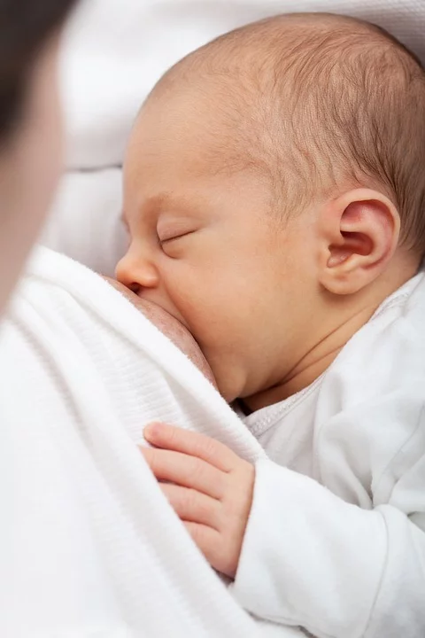
Sex-limited Trait
Sex-limited traits are also controlled by autosomal genes.
The genes are also found on both sexes, but only one sex expresses it.
Lactation is a
female-limited trait.

Slide 34
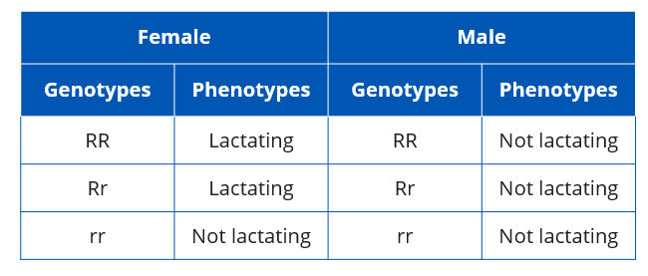
Possible lactation trait genotypes and phenotypes of males and females.

Slide 35
Check Your Understanding
Compute for the probability of the indicated offspring given the parental genotypes or phenotypes.
a color-blind daughter from a normal father and a carrier mother
a color-blind son from a normal father and a carrier mother
a normal son from a normal father and a genetically normal mother

Slide 36
References
Johnson, G.B., and Raven, P.H. 2001. Biology: Principles & Explorations. Austin: Holt, Rinehart, and Winston.
Klug, W.S., Spencer, C.A., and Cummings, M.R. 2016. Concepts of Genetics. Boston: Pearson.
Mader, S.S. 2014. Concepts of Biology. New York: McGraw-Hill Education.
Reece, J.B. and Campbell, N.A. 2011. Campbell Biology. Boston: Benjamin Cummings/Pearson.
Starr, Cecie, Ralph Taggart, Christine A. Evers, and Lisa Starr. Biology: the Unity and Diversity of Life. Boston, MA: Cengage, 2019.
Quipper Philippines

