Slide 1
MICROBIAL TAXONOMY

Slide 2
Taxonomy
Greek taxis, arrangement or order, and nomos, law, or nemein, to distribute or govern
Taxonomy is orderly arranging organisms under study into groups of larger units.
Consists of 3 interrelated parts –
Classification Nomenclature Identification
Why???

Slide 3
Significance of Taxonomy
Scientists can gain knowledge, make predictions and frame hypotheses about organisms
Arrange the organisms into meaningful groups, with precise names
Scientists can identify the organisms accurately

Slide 4
Components of Taxonomy
Classification
Arrangement of organisms into groups
(taxa’s or taxon)
Nomenclature
Assignment of names to taxa
Identification
Determination of taxon to which an isolate belongs
–
–

Slide 5
Systematics
Study of organisms with the ultimate object of characterizing and arranging them in an orderly manner

Slide 6
Appearance of life
First prokaryotes arise at least 3.5 to 3.8 bya
Fossilized remains found in stromatolites and sedimentary rocks
Stromatolites – layered rocks formed by incorporation of mineral sediments into microbial mats
Predominantly anaerobic organisms

Slide 7
Evolution of Prokaryotes
Recent theories based largely on characterization of rRNA sequences
Work of Carl Woese et al. in 1970s divided into two distinct groups early on
Bacteria
Archaea
Cyanobacteria (oxygenic prototroph's) arise ~2.5 to 3.0 bya

Slide 8
Evolution of Eukaryotes
Arise from prokaryotes ~ 1.4 bya two major hypothesis
First hypothesis
Nuclei, mitochondria, and chloroplasts arose by invagination of plasma membranes
Endosymbiotic hypothesis
Arose from a fusion of ancient bacteria and archaea
Chloroplasts arose from free-living phototrophic bacterium that entered symbiotic relationships with primitive eukaryotes
Mitochondria arose by similar mechanism

Slide 9
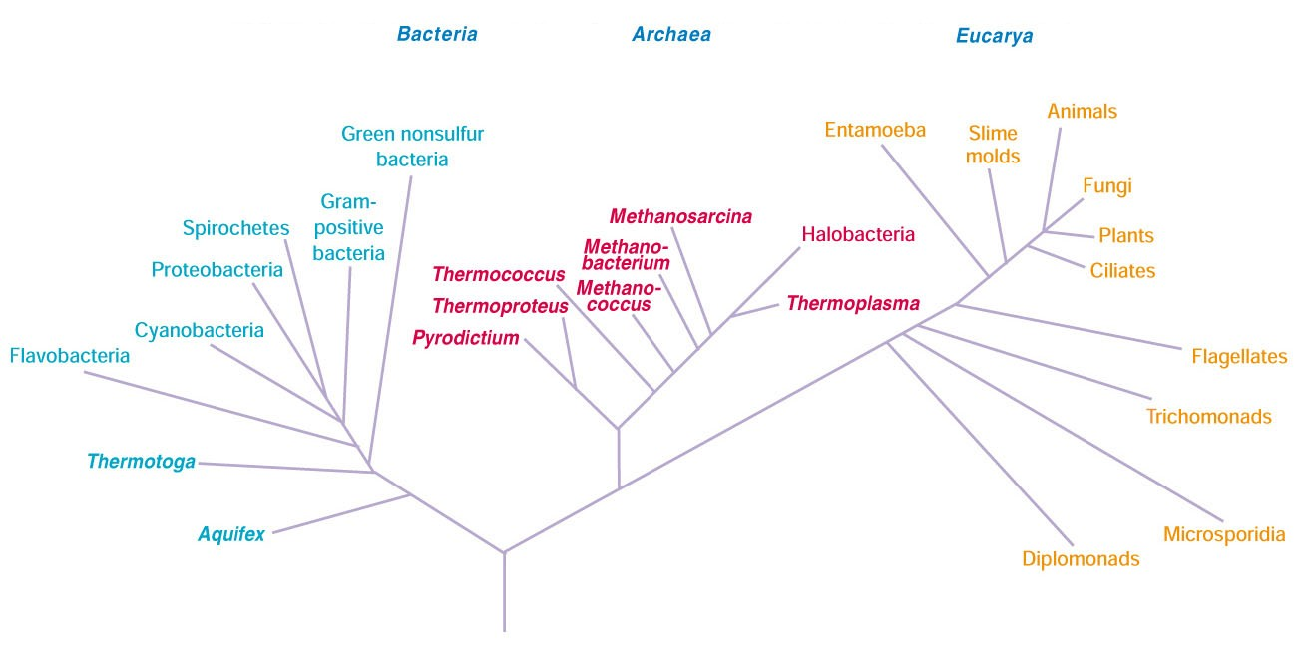
Universal Phylogenetic Tree
Prokaryotic, archaeal rRNA,
isoprenoid glycerol diether or
diglycerol tetra ether lipids
Eukaryotic,eucaryotic rRNA,diacyl glycerol diester lipids

Slide 10
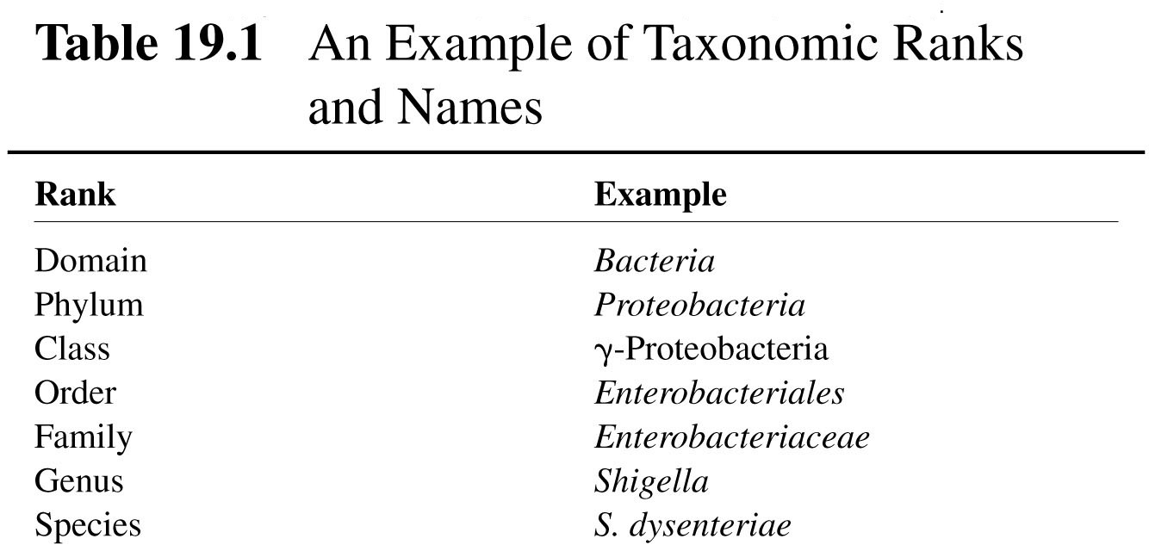
Taxonomic Ranks
Microbiologists often use informal names
e.g., purple bacteria, spirochetes, methane-oxidizing bacteria

Slide 11
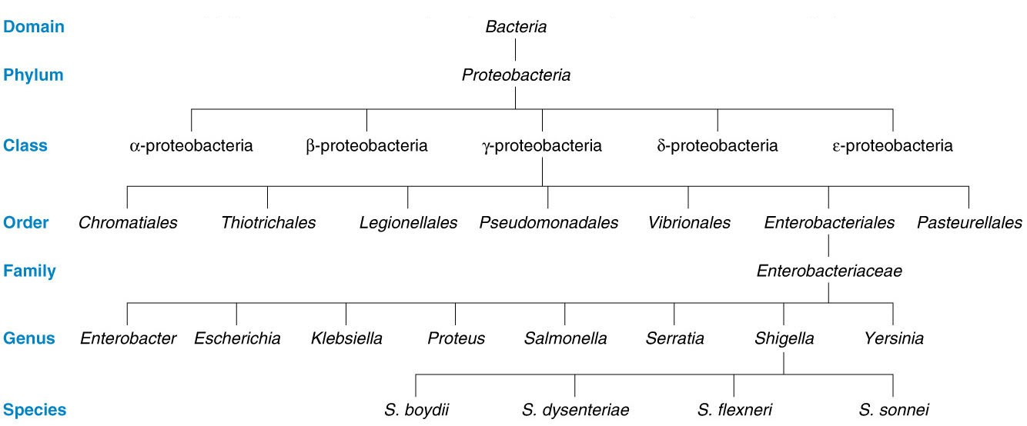
Hierarchical Arrangement in Taxonomy

Slide 12
DEFINITION
GENUS
Collection of strains that share many stable properties and differ significantly from other groups of strains
SPECIES
Collection of strains with similar G + C composition and ≥ 70% sequence similarity
STRAIN
Population of organisms that is distinguishable from others within a particular taxonomic category

Slide 13
Strain Types
Strains within species may differ slightly from one another in many ways
Biovars
Variant prokaryotic strains characterized by biochemical or physiological differences.
Morphovars
Differ morphologically
Serovars
Have distinctive antigenic properties

Slide 14
Binomial System Of Nomenclature
Devised by Carolus Linnaeus
Each organism has two names
Genus name – italicized and CAPITALIZED
(e.g., Escherichia)
Species epithet – italicized but not capitalized
(e.g., coli)
can be abbreviated after first use (e.g., E. coli)

Slide 15
SYSTEMS
Classification systems
Phenetic Classification
Natural Classification

Slide 16
NATURAL CLASSIFICATION
DEFINITION
Arranges organisms into groups whose members share many characteristics and most desirable system because reflects biological nature of organisms.
TWO METHODS FOR CONSTRUCTION
Phenetical Phylogenetical
grouped together based grouped based on
on overall similarity probable evolutionary
relationships

Slide 17
PHENETIC CLASSIFICATION
Group organisms together based on mutual similarity of phenotypes
It can reveal evolutionary relationships, but not dependent on phylogenetic analysis
i.e., doesn’t weight characters
Best systems compare as many attributes as possible

Slide 18
NUMERICAL TAXONOMY
Defn: Used to create phenetic classification systems
Multistep process
code information about properties of organisms
e.g., 1 = has trait; 0 = doesn’t have trait
use computer to compare organisms on ≥ 50 characters
determine association coefficient
construct similarity matrix
identify phenons and construct dendograms

Slide 19
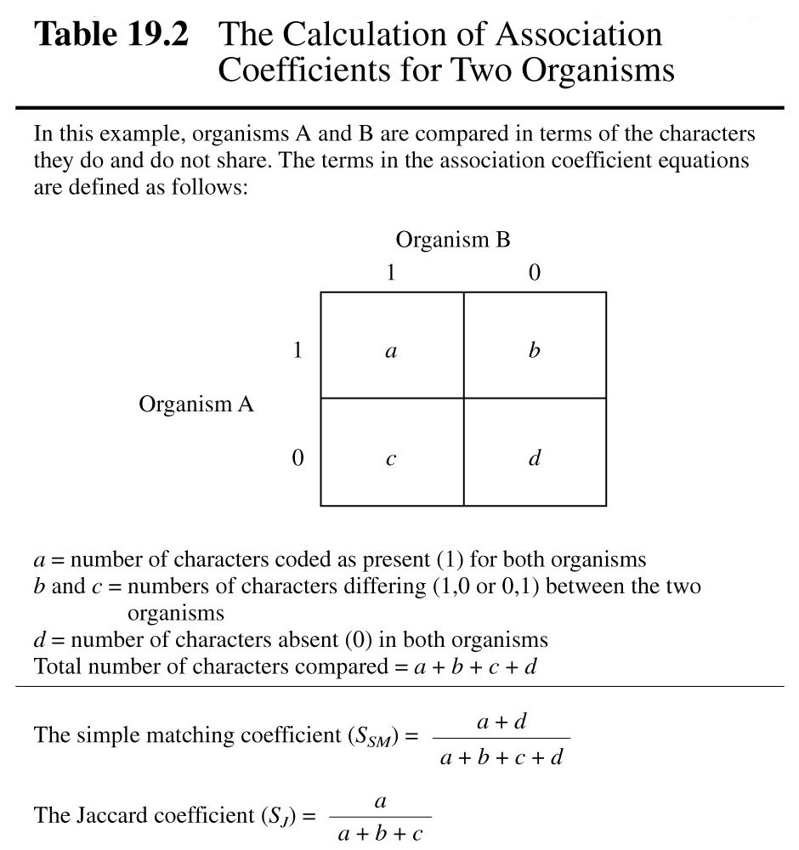
ASSOCIATION COEFFICIENTS
Simple Matching Coefficient
Proportion of characters that match regardless whether attribute is present or absent
Jaccard coefficient
Ignores characters that both lack

Slide 20
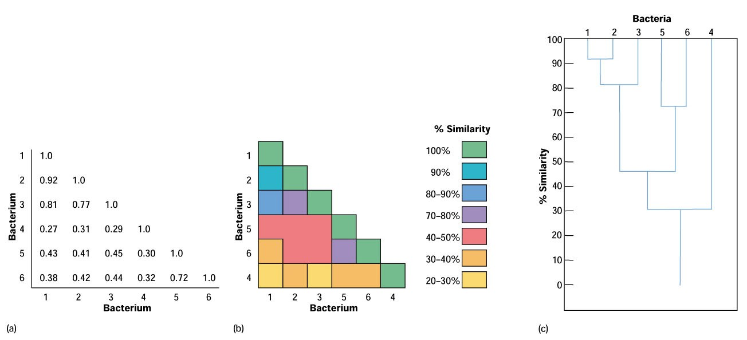
CLUSTERING & DENDOGRAMS IN NUMERICAL TAXONOMY
Dendogram – treelike diagram used to display results
Phenon – group of organisms with great similarity
Phenons with 80% similarity = bacterial species

Slide 21
PHYLOGENETIC CLASSIFICATION
Also called Phyletic Classification Systems
PHYLOGENY
Evolutionary development of a species based on direct comparison of genetic material and gene products

Slide 22
Major Characteristics - In Taxonomy
Classical Characteristics
Molecular Characteristics

Slide 23
CLASSICAL CHARACTERISTICS
Morphological characteristics
Physiological and metabolic characteristics
Ecological characteristics
Genetic analysis

Slide 24
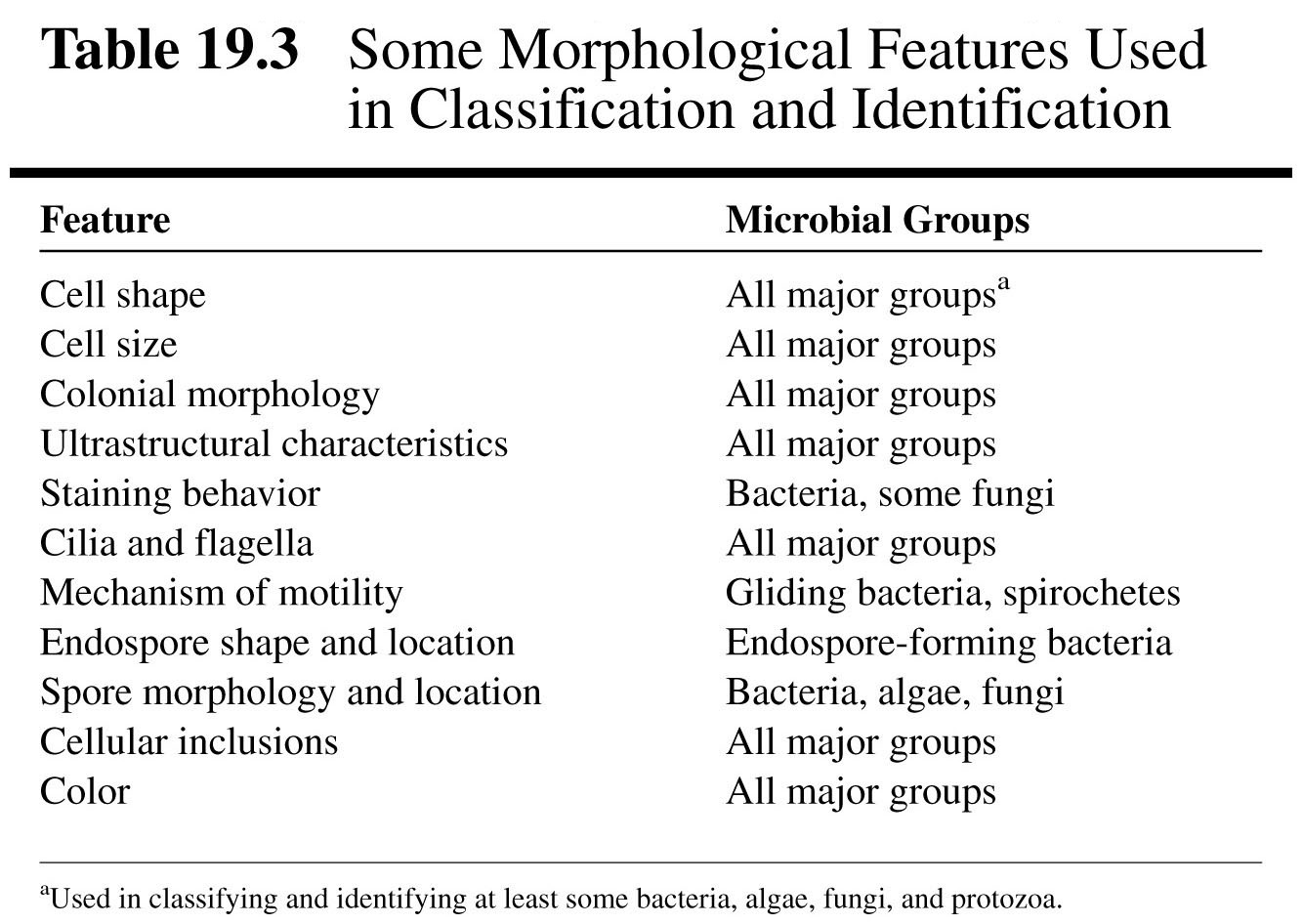
1.Morphological Characteristics

Slide 25
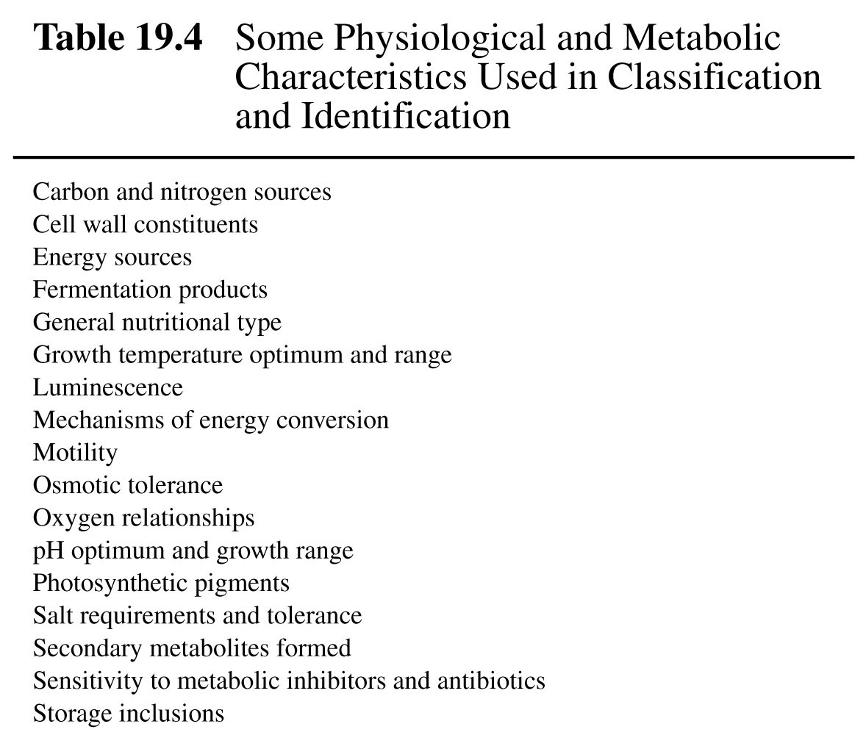
2.Physiological & Metabolic Characteristics

Slide 26
3.Ecological Characteristics
Life-cycle patterns
Symbiotic relationships
Ability to cause disease
Habitat preferences
Growth requirements

Slide 27
4.Genetic analysis
Study of chromosomal gene exchange by
transformation and conjugation
These processes rarely cross genera
Plasmid-borne traits can introduce errors into analysis

Slide 28
Molecular characteristics
Comparison of proteins
Nucleic acid composition
Nucleic acid hybridization
Nucleic acid sequencing

Slide 29
Comparison Of Proteins
Protein amino acid sequence reflects gene sequence
DNA → mRNA → protein
Comparison of proteins from different organisms can be used for taxonomical classification
Amino acid sequencing
Comparison of electrophoretic mobility
Immunological techniques
Comparison of enzymatic properties

Slide 30
Nucleic Acid Composition
Usually expressed as the G + C content (% G + C)
G + C = (G + C / G + C + A + T) x 100
Can be determined in a number of ways
1.Hydrolysis of DNA and analysis of bases using HPLC
2.Measurement of melting point (T_{m})

Slide 31
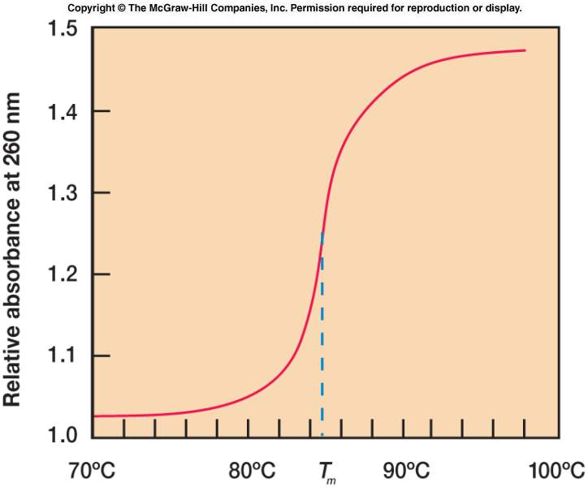
Measuring the T_{m} of DNA
GC pairs connected by 3 H bonds
AT pairs connected by 2 H bonds
Higher GC content → higher T_{m}
Absorbance of 260 nM light (UV) by DNA increases during strand separation
Absorbance reaches plateau at maximum strand separation
Midpoint of rising curve is the T_{m}

Slide 32
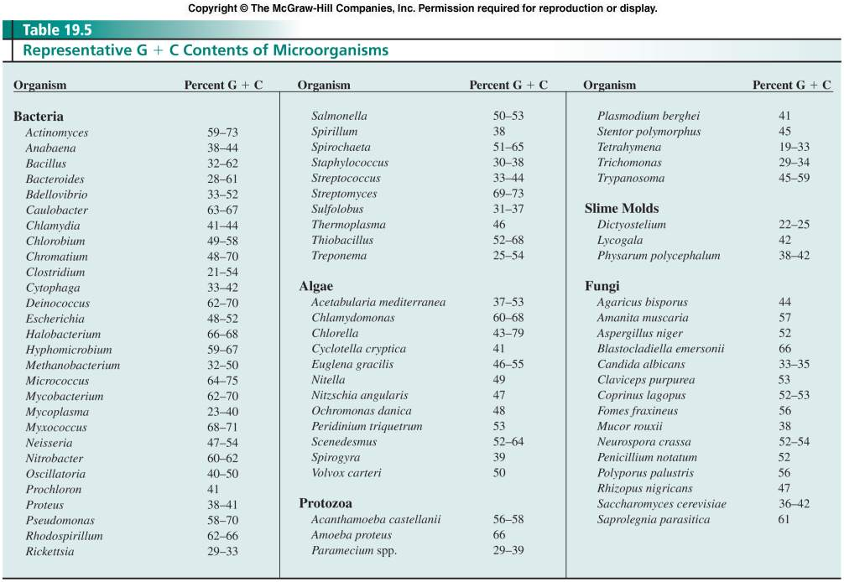
Nucleic acid composition

Slide 33
Nucleic Acid Hybridization
Measure of sequence homology
DNA heated above T_{m} to form single stranded DNA
ssDNA incubated with radioactive ssDNA from other organism

Slide 34
Nucleic acid hybridization
dsDNA heated to form ssDNA
ssDNA bound to nitrocellulose membrane
Membrane incubated with radioactive ssDNA from different organism
Filter incubated at temp lower than T_{m}
Filter washed and amount of bound DNA measured
Percent DNA bound indicates relatedness of organisms
DNA-rRNA hybridization can be used on more distantly related organisms

Slide 35
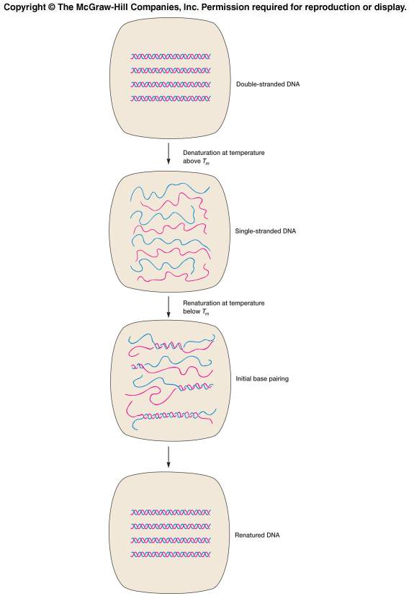
Nucleic acid hybridization

Slide 36
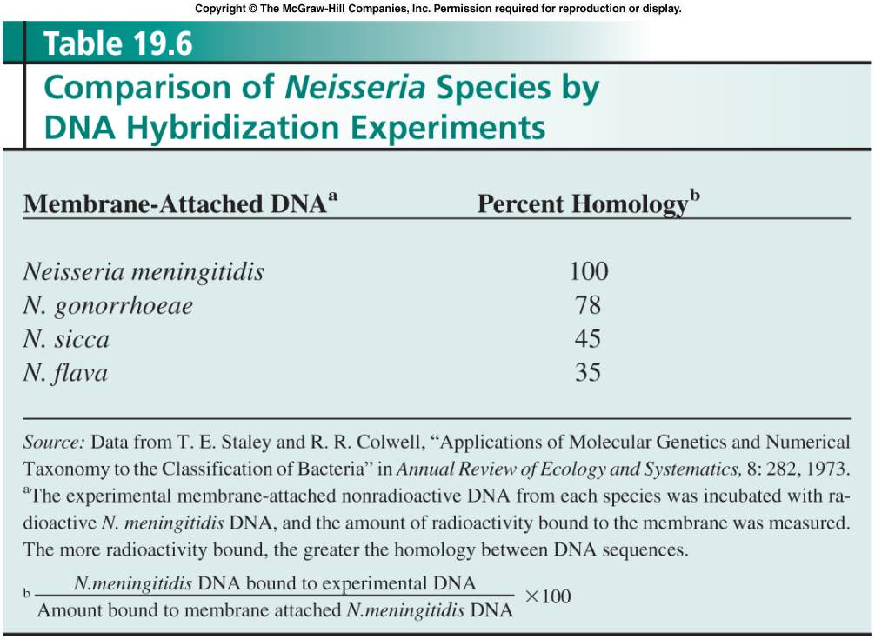
Nucleic acid hybridization

Slide 37
Nucleic acid sequencing
Sequencing of nucleic acid only way to provide direct comparison of genomes
Sequence of 16 S rRNA gene often used to compare organisms
16 S rRNA gene amplified by PCR
PCR product sequenced and sequence compared with that of known organism

Slide 38
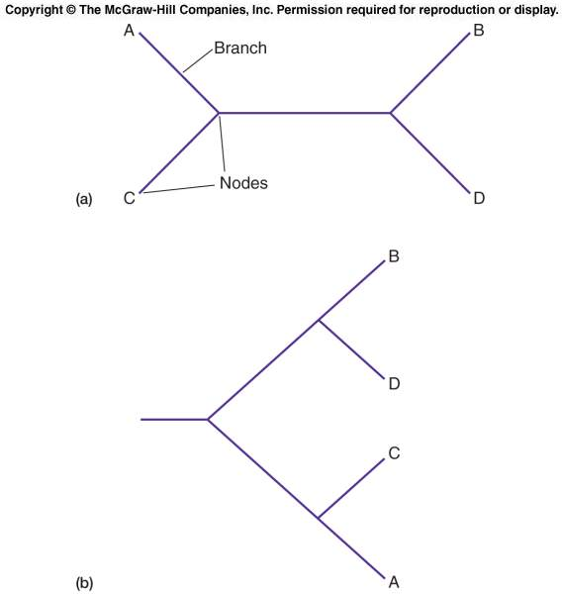
Phylogenetic trees
Graphs that indicate phylogenetic (evolutionary) relationships
Made up of nodes connected by branches
Nodes represent taxonomical units e.g. species
Trees can be rooted or unrooted
Rooted trees show the evolutionary path of the organisms

Slide 39
Thank You

