Slide 1
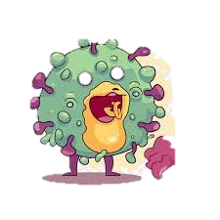
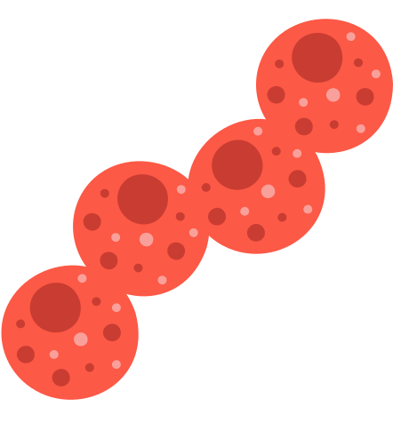
Phylum
ChlamYdiaE
Prepared by: Lara Mae Q. Porferio (BS Biology-4)

Slide 2
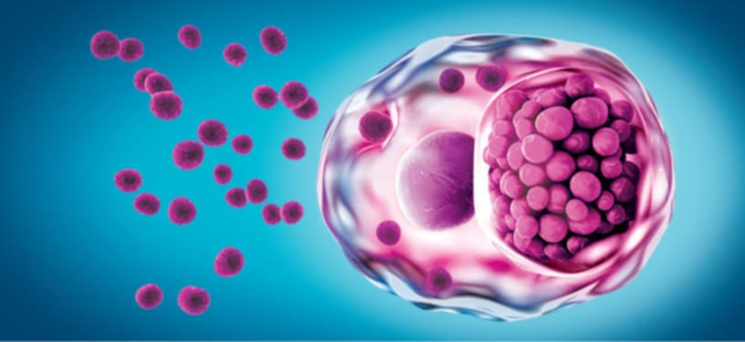
Characteristics
-obligate intracellular parasites
Hosts: humans, animals, and even protozoa
-are extremely limited metabolically, relying on their host cells for key metabolites since chlamydiae cannot catabolize carbohydrates or synthesize ATP.
-nonmotile, coccoid bacteria
-Size: 0.2 to 1.5 µm

Slide 3

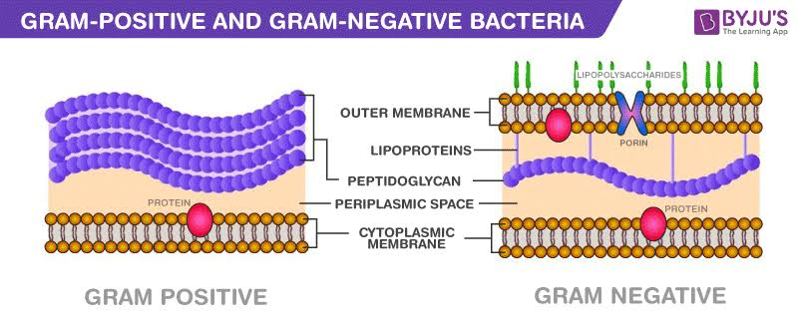
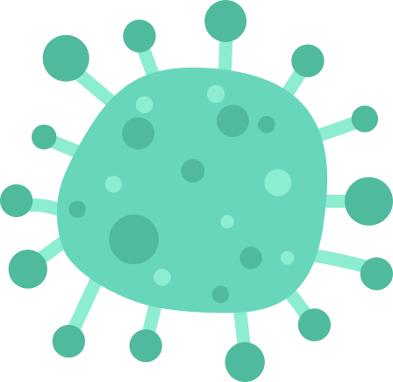
-gram-negative, but cell wall differs since it lacks muramic acid and a peptidoglycan layer..
-they gram stain poorly, so Geimsa stain is used

Slide 4
Biphasic Life Cycle
1. Elementary Body
0.2 to 0.6 µm in diameter
contain electron-dense nuclear material and a rigid cell wall
infectious; have minimal metabolic activity and cannot take in ATP or synthesize proteins. They are designed exclusively for transmission and infection

Slide 5
2. Reticulate Body
0.5 to 1.5 µm in diameter
have less dense nuclear material, more ribosomes than EBs, and their walls are also more flexible
noninfectious; specialized for reproduction rather than infection.

Slide 6
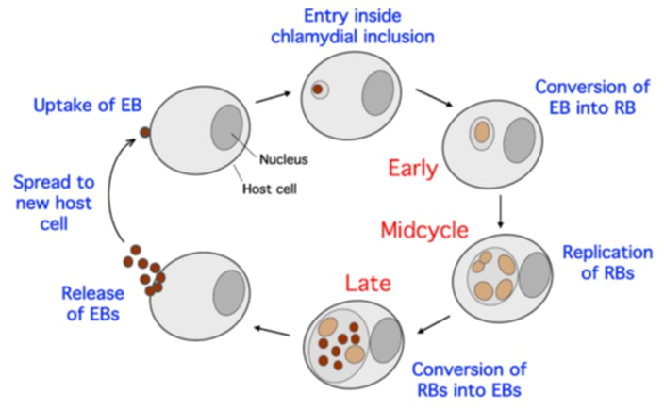
Reproduction

Slide 7
Reproduction Process
1. Attachment of an elementary body (EB) to the host cell surface
2. The host cell phagocytoses the EB. which is held in inclusion bodies where the EB reorganizes to form a reticulate body (RB).
3. About 8 to 10 hours after infection, the reticulate body undergoes binary fission and RB reproduction continues until the host cell dies.
Although they undergo binary fission, Chlamydia is one of only a few bacteria that lacks the cell division protein FtsZ.
4. After 20 to 25 hours, RBs begin to differentiate into infectious EBs and continue this process until the host cell lyses and releases the chlamydiae EBs 48 to 72 hours after infection.

Slide 8
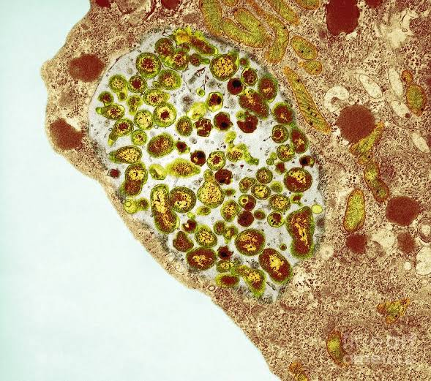
Survival Rate Outside Host
-Chlamydia EBs can survive short-term in moist environments like water or damp surfaces but are vulnerable to drying, heat, UV light, and extreme pH.

Slide 9
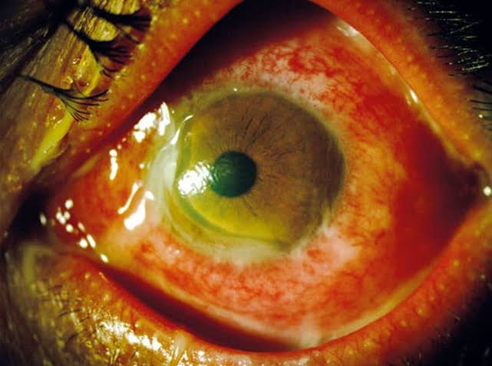
Species
1. Chlamydia trachomatis
-Divided into serotypes
1.1 Serotypes A-C: leading cause of infectious blindness worldwide
Disease: Trachoma/ Chlamydia conjunctivitis
-highly contagious
Mode of Transmission:
- Direct contact, clothes, insect

Slide 10
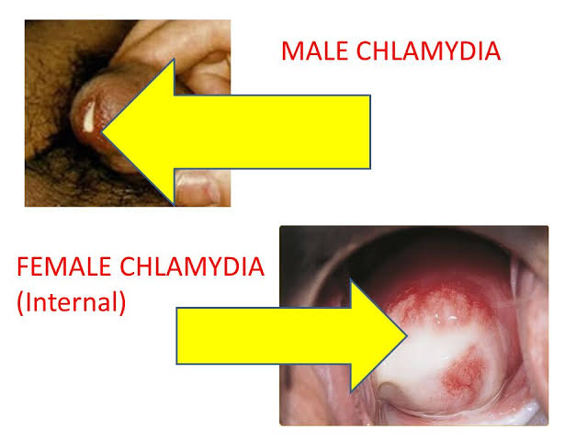
Species
Serotypes D-K: result in genital infection, infant conjunctivitis, pneumonia
Mode of Transmission: Sexual
Disease:
Men: Urethritis and prostatitis
Women: Cervicitis, Pelvic Inflammatory Disease
- An infected pregnant woman can transmit this bacteria to her infant and will result to infant conjunctivitis and pneumonia

Slide 11
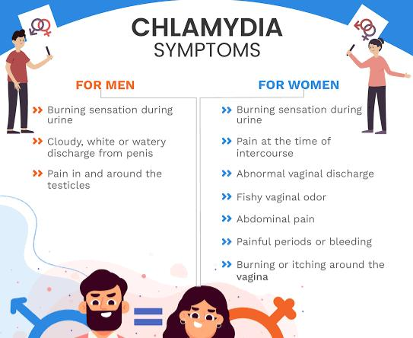

Slide 12
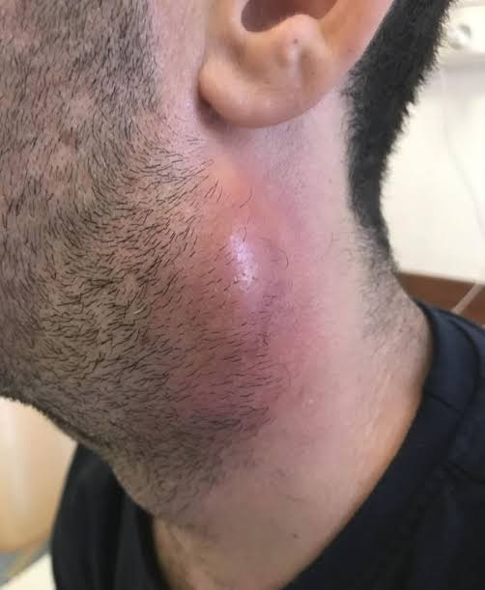
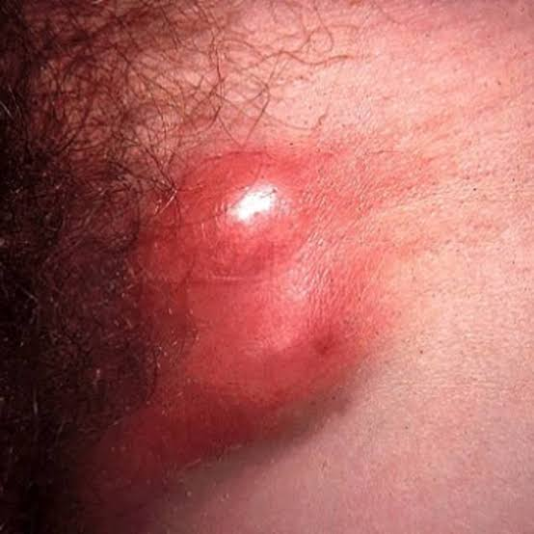
Species
Serotypes L1-L3: cause an infection in lymph nodes which is known as lymphogranuloma venereum

Slide 13

Species
Treatment:
Azithromycin or doxycycline.
Prevention:
Safe sex practices, regular STI screening, sanitation in trachoma-endemic areas.

Slide 14

Chlamydial Trachomatis: TRUE or FALSE
1. You can’t catch chlamydia from a toilet seat
TRUE

Slide 15
Chlamydial Trachomatis: TRUE or FALSE
2. Chlamydia only affects females
FALSE

Slide 16
Chlamydial Trachomatis: TRUE or FALSE
3. Oral contraception can protect against chlamydia
FALSE

Slide 17
Chlamydial Trachomatis: TRUE or FALSE
4. You can’t get chlamydia through oral or anal sex
FALSE

Slide 18
Chlamydial Trachomatis: TRUE or FALSE
5. Chlamydia infections can be prevented
TRUE

Slide 19
Chlamydial Trachomatis: TRUE or FALSE
6. You can tell if you have chlamydia
FALSE

Slide 20
Chlamydial Trachomatis: TRUE or FALSE
7. Chlamydia infections can’t go away on their own
TRUE

Slide 21
Chlamydial Trachomatis: TRUE or FALSE
8. You can only get chlamydia once
FALSE

Slide 22
Chlamydial Trachomatis: TRUE or FALSE
9. Getting tested for chlamydia is easy
TRUE

Slide 23
Chlamydial Trachomatis: TRUE or FALSE
10. Chlamydia is difficult to treat
FALSE

Slide 24
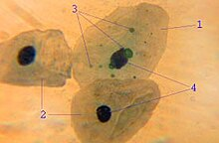
Species
2. Chlamydophila pneumoniae
Disease: Chlamydial pneumonia
Mode of Transmission: primarily a human pathogen directly transmitted from human to human by droplet (respiratory) secretions.

Slide 25
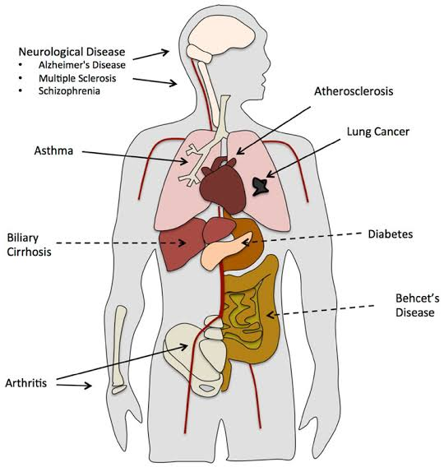
Species
Symptoms:
-Infections with C. pneumoniae are common but sporadic; about 50% of adults have antibody to the chlamydiae.
-Clinically, infections are generally mild, pharyngitis, bronchitis, and sinusitis.
-potentially linked to chronic diseases (asthma, atherosclerosis).

Slide 26

Species
Treatment:
Azithromycin, doxycycline, or levofloxacin.
Prevention:
Handwashing, avoiding close contact with infected individuals, wearing masks

Slide 27
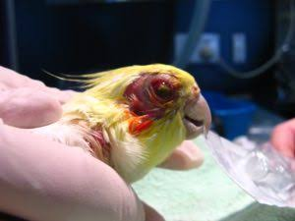
Species
3. Chlamydia psittaci
Disease: Psittacosis (ornithosis) is a worldwide infectious disease of birds that is transmissible to humans.
-was first described in association with parrots and parakeets, but the disease is now recognized in many other birds among them
Mode of Transmission:
By handling infected birds or by inhaling dried bird excreta that contains viable C. psittaci

Slide 28
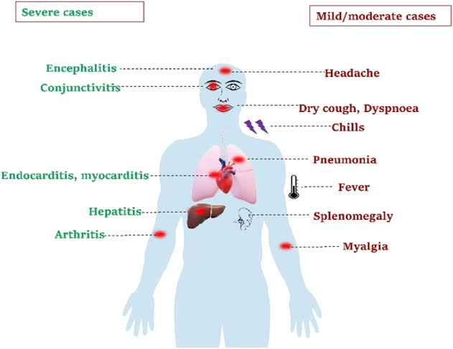
Species
3. Chlamydia psittaci
After entering the respiratory tract, the chlamydiae are transported to the cells of the liver and spleen. They multiply within these cells and then invade the lungs, where they cause inflammation, hemorrhaging, and pneumonia.
Treatment: Antibiotics (Doxycycline or Azithromycin).
Prevention: Avoid exposure to bird droppings; practice hygiene in bird-handling environments.

