Slide 1
Microbial nutrition

Slide 2
Microbial Growth Conditions
1. Macronutrients
2. Micronutrients
3. Growth factors
4. Environmental factors: temperature; pH; Oxygen et al.
Nutrient requirements
Microorganisms require about ten elements in large quantities, because they are used to construct carbohydrates, lipids, proteins, and nucleic acids. Several other elements are needed in very small amounts and are parts of enzymes and cofactors.

Slide 3
Microbial Nutrition
Nutrients: Substances in the environment used by organisms for catabolism and anabolism.
1. Macronutrients: required in large amounts, including: carbon, oxygen, hydrogen, nitrogen, sulfur, phosphorus (Components of carbonhydrates, lipids, proteins, and mucleic acids ); potassium, calcium, magnesium and iron (cations and part of enzymes and cofactors).
2. Micronutrients: Microbes require very small amounts of other mineral elements, such as iron, copper, molybdenum, and zinc; these are referred to as trace elements. Most are essential for activity of certain enzymes, usually as cofactors.
contaminants in water, glassware, and regular media components often are adequate for growth.

Slide 4
Growth Factors
(1)amino acids, (2) purines and pyrimidines, (3) vitamins
Amino acids are needed for protein synthesis,
purines and pyrimidines for nucleic acid synthesis.
Vitamins are small organic molecules that usually make up all or part enzyme cofactors, and only very small amounts are required for growth.

Slide 5
Classification of microorganism on the basis of Nutrition- Nutritional classification
Carbon
Hydrogen
Oxygen
Other elements macro & micro
Energy source
Electron source
Organic compound electron electron acceptor
Organic compound
Energy
electron acceptor
(reduce)
(oxidize)
(oxidize)
(reduce)

Slide 6
Nutritional classification- based on how microorganism satisfy Carbon, Energy & Electron
Carbon source
Autotrophs CO2 sole or principal biosynthetic
carbon source
Heterotrophs Reduced, preformed, organic
molecules from other organisms
Energy Sources
Phototrophs Light
Chemotrophs Oxidation of organic or
Inorganic compounds
Electron Sources
Lithotrophs Reduced inorganic molecules
Organotrophs Organic molecules

Slide 7
Nutritional types of microorganisms
Major Nutritional Types | Energy source | Hydrogen/ electron | carbon source | Representative Microorganisms
Photolithotrophic autotrophy (Photolithoautotrophy) (photoautotrophs) | Light energy | Inorganic hydrogen/electron (H/e–) donor | CO2 carbon source | Algae Purple and green sulfur bacteria Cyanobacteria
Photoorganotrophic heterotrophy (Photoorganoheterotrophy) (Photoheterotrophs) | Light energy | Organic H/e– donor | Organic carbon source | Purple nonsulfur bacteria Green nonsulfur bacteria
Chemolithotrophic autotrophy (Chemolithoautotrophy) (Chemoautotrophs) | Chemical energy source (inorganic) | Inorganic H/e– donor | CO2 carbon source | Sulfur-oxidizing bacteria Hydrogen bacteria Nitrifying bacteria Iron-oxidizing bacteria
Chemoorganotrophic heterotrophy (Chemoorganoheterotrophy) (Chemoheterotrophs) | Chemical energy source (organic) | Organic H/e– donor | Organic carbon source | Protozoa, Fungi, Most nonphotosynthetic bacteria (including most pathogens)

Slide 8
large majority of microorganisms
1) Photoautotrophs 2) Chemoheterotrophs
Photoautotrophs
light energy
CO2 as their carbon source
algae and cyanobacteria employ water as the electron donor and release oxygen
Purple and green sulfur extract electrons from inorganic donors like hydrogen, hydrogen sulfide, and elemental sulfur.
Chemoheterotrophs
organic compounds as sources of energy, hydrogen, electrons, and carbon
Frequently the same organic nutrient will satisfy all these requirements
Yeast, all pathogenic microorganisms are chemoheterotrophs

Slide 9
other two nutritional classes have fewer microorganisms but often are very important ecologically
Photoheterotrophs
purple and green bacteria are photosynthetic
organic matter as their electron donor and carbon source
common inhabitants of polluted lakes and streams
Chemoautotrophs
oxidizes reduced inorganic compounds such as iron, nitrogen, or sulfur molecules to derive both energy and electrons
Carbon dioxide is the carbon source
contribute greatly to the chemical transformations of elements (e.g., the conversion of ammonia to nitrate or sulfur to sulfate)
Clostridium ljungdahlii
Exceptions-Mixotropic- depending on environment condition

Slide 10
Uptake of nutrients
Nutrient molecules frequently cannot cross selectively permeable plasma membranes through passive diffusion and must be transported by one of three major mechanisms involving the use of membrane carrier proteins.

Slide 11
1, Phagocytosis – Protozoa
2, Permeability absorption – Most microorganisms
passive transport (simple diffusion)
facilitated diffusion
active transport
group translocation

Slide 12
passive diffusion
A few substances, such as glycerol, H₂O, O₂ can cross the plasma membrane by passive diffusion. Passive diffusion is the process in which molecules move from a region of higher concentration to one of lower concentration as a result of random thermal agitation.
no carrier protein;
no energy.

Slide 13
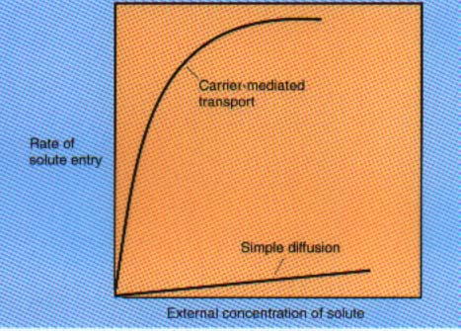
Facilitated diffusion
The rate of diffusion across selectively permeable membranes is greatly increased by the use of carrier proteins, sometimes called permeases, which are embedded in the plasma membrane. Since the diffusion process is aided by a carrier, it is called facilitated diffusion.
The rate of facilitated diffusion increases with the concentration gradient much more rapidly and at lower concentrations of the diffusing molecule than that of passive diffusion.

Slide 14
Facilitated diffusion
higher con.→ lower con.
Facilitated diffusion: carrier protein, permeases.
Each carrier is selective and will transport only closely related solutes.
Seem not to be important in procaryotes, much more prominent in Eucaryotic cells.

Slide 15
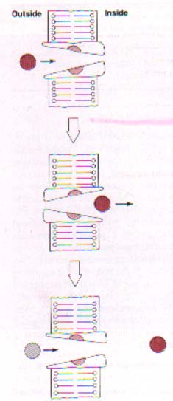
A model of facilitated diffusion
The membrane carrier can change conformation after binding an external molecule and subsequently release the molecule on the cell interior. It then returns to the outward oriented position and is ready to bind another solute molecule.
Because there is no energy input, molecules will continue to enter only as long as their concentration is greater on the outside.

Slide 16
Active transport
Active transport is the transport of solute molecules to higher concentrations, or against a concentration gradient, with the use of metabolic energy input.
lower concentration→ higher con.
Permeases, energy

Slide 17
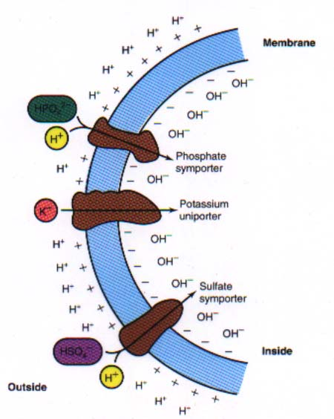
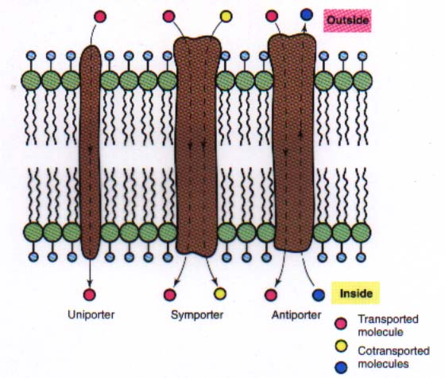
Proton gradients
Symport: linked transport of two substances in the same direction.
Antiport: linked transport of two substances in the opposite direction.
Uniport: one substance enter

Slide 18
Group translocation
A process in which a molecule is transported into the cell while being chemically altered.
The best-known group translocation system is the phosphoenolpyruvate: sugar phosphotransferase system (PTS), which transports a variety of sugars into procaryotic cells while simultaneously phosphorylating them using phosphoenolpyruvate (PEP) as the phosphate donor.

Slide 19
Phosphoenolpyruvate (2-phosphoenolpyruvate, PEP) is the carboxylic acid derived from the enol of pyruvate and phosphate. It exists as an anion. PEP is an important intermediate in biochemistry. It has the highest-energy phosphate bond found (−61.9 kJ/mol) in organisms, and is involved in glycolysis and gluconeogenesis.

Slide 20
The phosphoenolpyruvate: sugar phosphotransferase systems (PTS) are complex enzyme systems functioning in the detection, transport and phosphorylation of various sugar substrates, including monosaccharides, disaccharides, amino sugars, polyols, and other sugar derivatives.

Slide 21
PTS: sugar phosphortransferase system
PEP+sugar(outside)→pyruvate+sugar-P(inside)
The following components are involved in the system:
phosphoenolpyruvate, PEP;
EI (enzyme I), Hpr (the low molecular weight heat-stable protein): cytoplasmic, common to all PTSs.
EII (enzyme II) : EIIa: cytoplasmic and soluble
EIIb: hydrophilic but frequently is attached toEIIc.
EIIc: a hydrophobic protein that is embedded in the membrane.
Only specific sugars and varies with PTS.

Slide 22
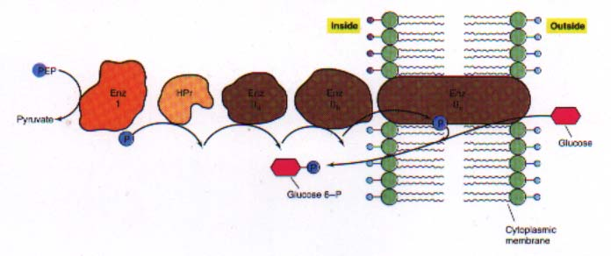
The phosphoenolpyruvate: sugar phosphotransferase system of E. coli.

Slide 23
Simple comparison of transport systems
Items | Passive diffusion | Facilitated diffusion | Active transport | Group translocation
carrier proteins | None | Yes | Yes | Yes
transport speed | Slow | Rapid | Rapid | Rapid
against gradient | None | None | Yes | Yes
transport molecules | No specificity | Specificity | Specificity | Specificity
metabolic energy | No need | Need | Need | Need
Solutes molecules | Not changed | Changed | Changed | Changed

Slide 24
Iron uptake
Cytochromes and many enzymes
Extreme insolubility of ferric iron(Fe³⁺) and its derivatives. Difficult
Siderophores: low M.W., be able to complex with ferric iron and supply it to the cell.
Microorganisms secrete siderophores when little iron is available in the medium.
iron-siderophore complex bind the receptor of cell surface: Fe³⁺ release; complex enter by ABC transporter.

Slide 25
Siderophores (S)
Receptor
Fe ²⁺/S
Fe ²⁺/S

