Slide 1
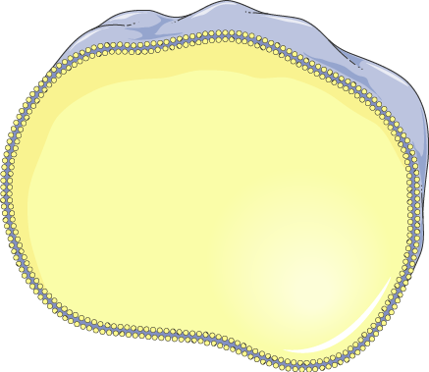
Membrane transport, Intracellular Compartmentalization, and Vesicular transport
Subject: Cell and Molecular Biology
Reporter no.2: Jhea Ballon

Slide 2
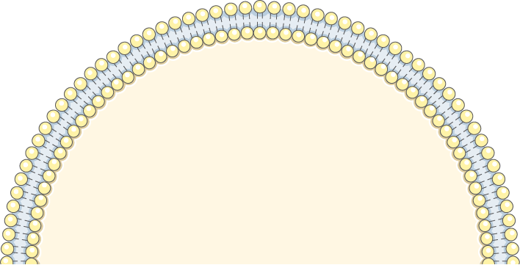
01
Membrane Transport

Slide 3
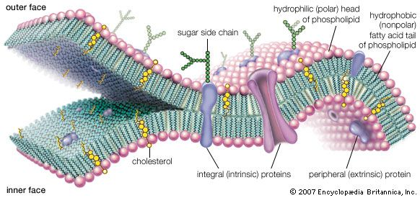
Membrane transport
Movement of substances across the cell membrane.
It encompasses mechanisms that control the passage of solutes, such as ions and small molecules, through biological membranes.
This process is essential for maintaining cellular homeostasis and metabolic functions.

Slide 4
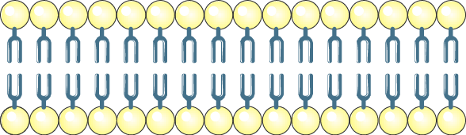
Plasma membrane
Hydrophilic head group
Hydrophobic tail

Slide 5
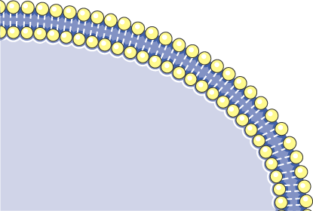
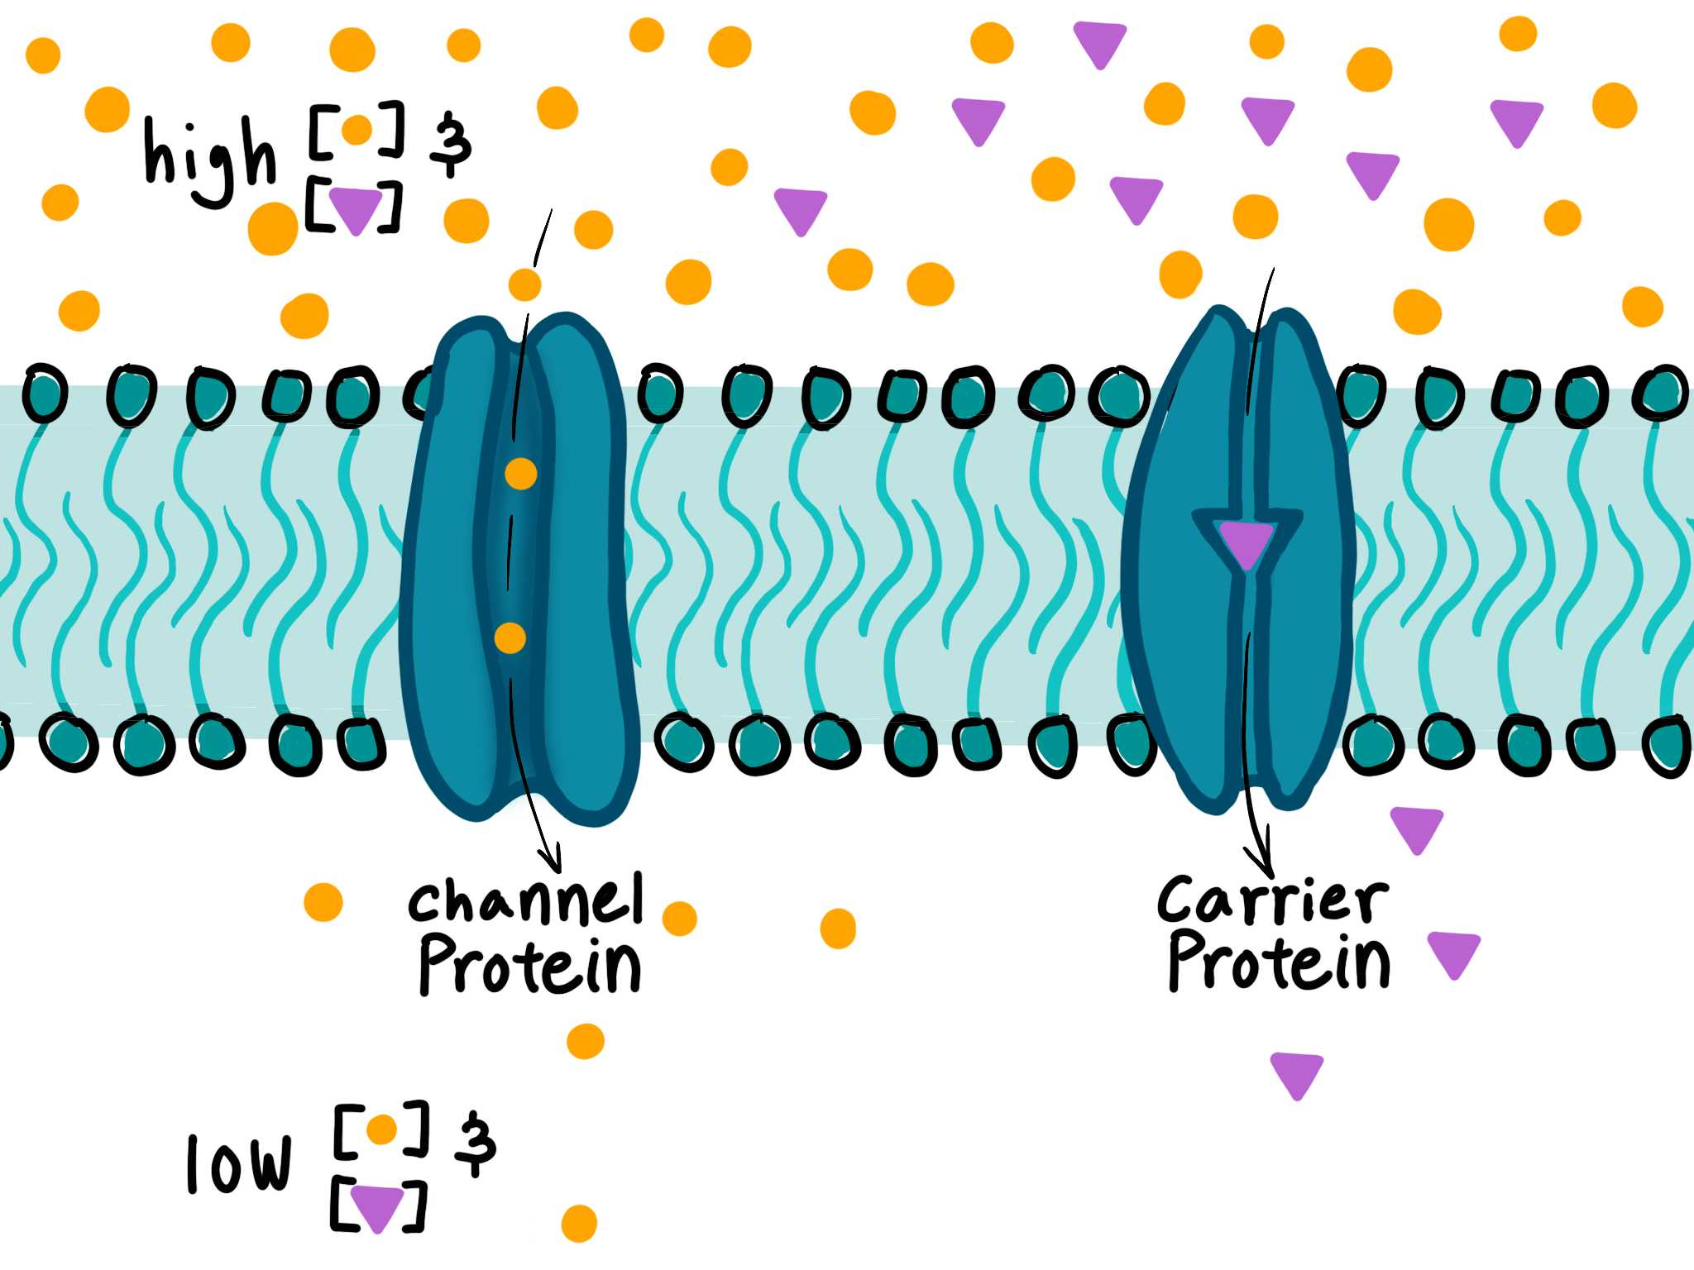
Types of Membrane Transport
Passive Transport
Active Transport
Passive Transport
This process occurs without energy expenditure, relying on concentration gradients for movement.

Slide 6
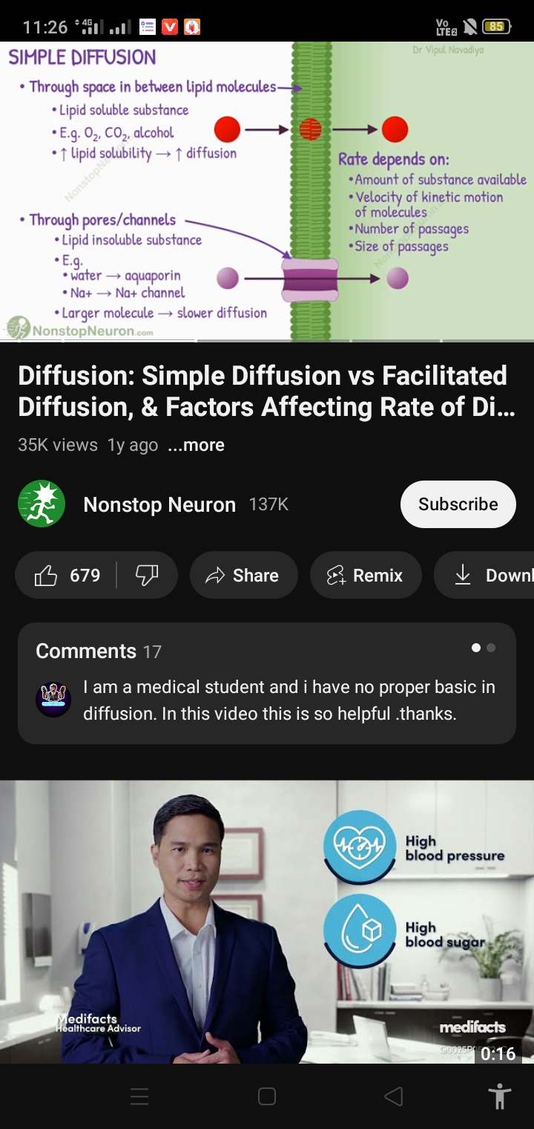
DIFFUSION
It can be further categorized into:
Simple Diffusion- The spontaneous movement of molecules from high to low concentration.

Slide 7
DIFFUSION
It can be further categorized into:
Facilitated Diffusion- Uses transport proteins (e.g., ion channels) for molecules that cannot directly pass the membrane without energy.
2 types of Facilitated Diffusion:
Channel-mediated diffusion- In this type, ions move through water-filled channels embedded in the membrane.
These channels can either be:
Leak channels, which are always open, allowing a steady flow of ions, or
Gated channels, which open only in response to specific signals or stimuli, such as changes in voltage or the binding of a molecule.
2. Carrier-mediated diffusion

Slide 8
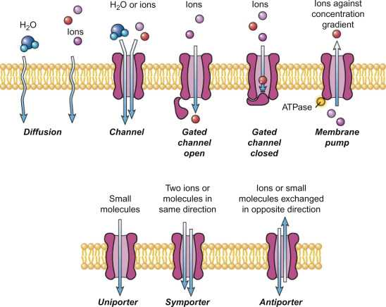
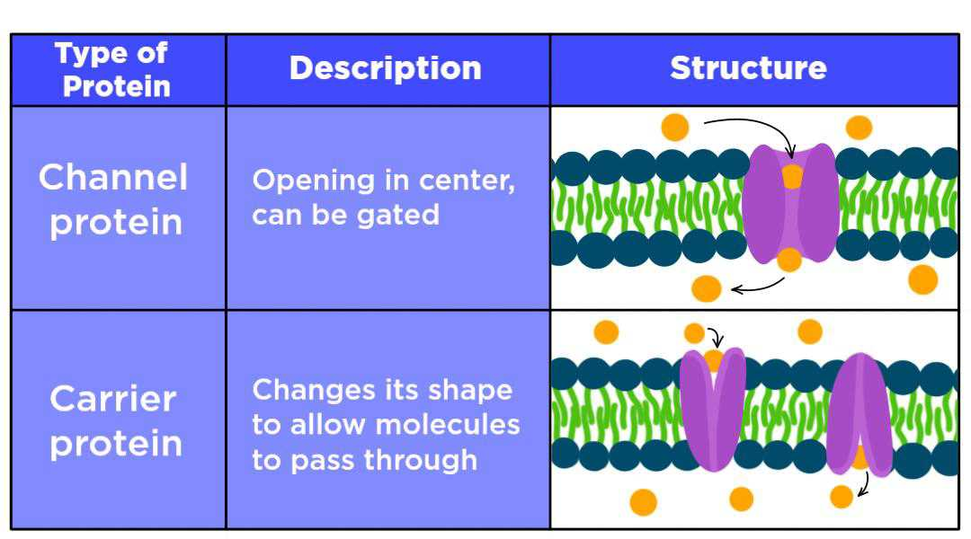

Slide 9
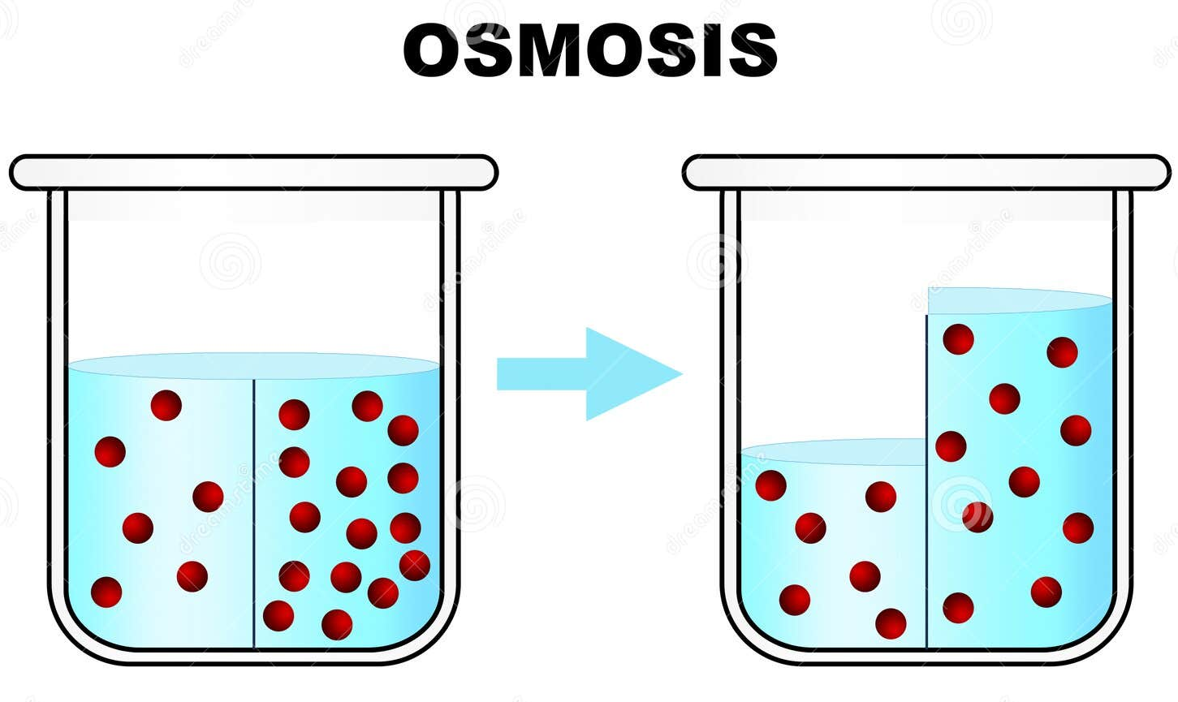
DIFFUSION
It can be further categorized into:
Osmosis- is a specific type of diffusion that refers to the passive movement of water molecules through a selectively permeable membrane.
Water molecules can move through the membrane in two ways:
By slipping between the phospholipids in the cell membrane.
Through specialized water channels called aquaporins, which make the movement of water faster and more efficient.

Slide 10
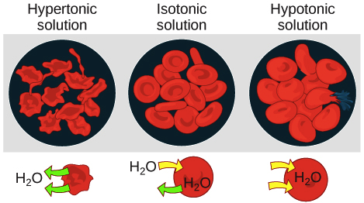
Types of Osmosis
Hypertonic
Isotonic
Hypotonic
The external environment has a higher solute concentration than the cell, causing water to move out of the cell, which may result in cell shrinking (crenation in animal cells or plasmolysis in plant cells).
The solute concentration is the same inside and outside the cell, resulting in no net movement of water.
The external environment has a lower solute concentration than the cell, causing water to move into the cell, which may result in cell swelling or bursting (lysis).

Slide 11
2. Active Transport
This mechanism requires energy to move molecules against their concentration gradient. is a process where particles are moved from an area of low concentration to an area of high concentration.
Types of Active Transport:
CARRIER
VESICULAR TRANSPORT

Slide 12
CARRIER
1. Primary Active Transport
Direct use of ATP to transport molecules.
Example: Sodium-potassium pump.
- When ATP is used, it breaks into ADP and a phosphate group (P), which changes the shape of the pump, allowing it to move these ions.
- This helps maintain the balance of sodium and potassium, which is very important for processes like nerve signals and muscle contractions.

Slide 13
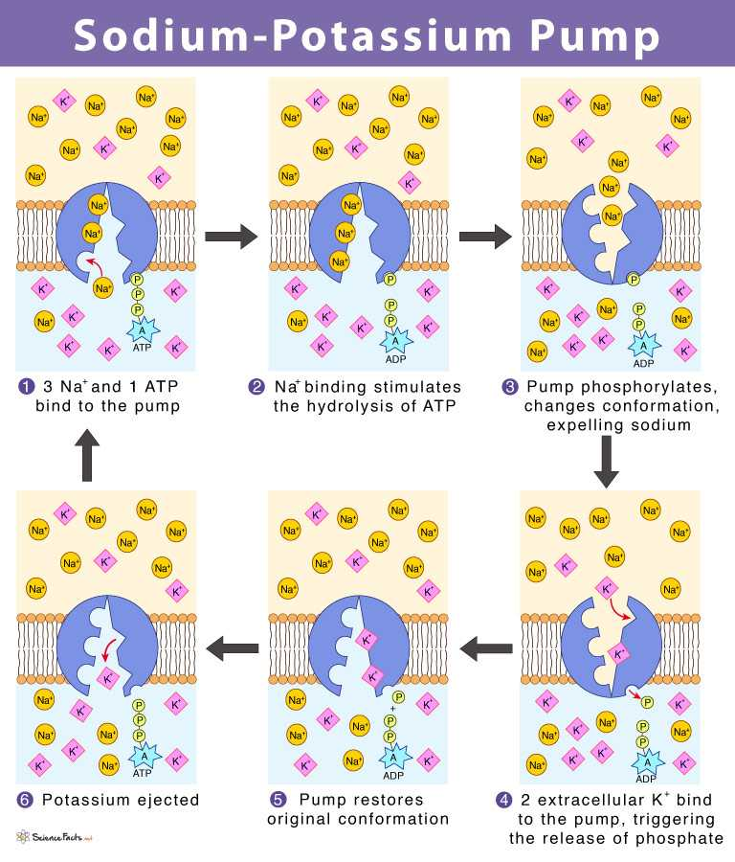

Slide 14
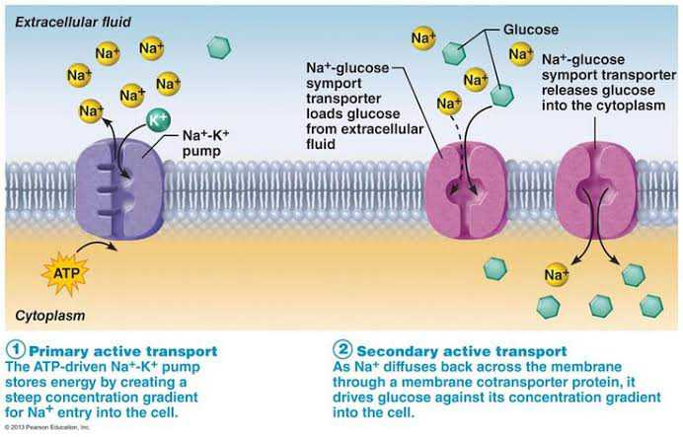
2. Secondary ActiveTransport
Uses the electrochemical gradient established by primary active transport to move other molecules.

Slide 15
Types of Secondary Active Transport
Symport- Both the driving ion (Na⁺) and the transported molecule move in the same direction across the membrane (e.g., glucose-Na⁺ symporter in the intestines).
Antiport- The driving ion and the transported molecule move in opposite directions across the membrane (e.g., sodium-calcium exchanger).
Uniport- A single type of molecule is transported down its concentration gradient, but this process does not typically rely on an electrochemical gradient (e.g., facilitated diffusion of glucose in some cases).

Slide 17
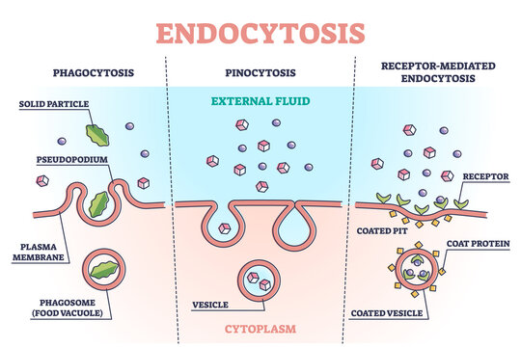
VESICULAR TRANSPORT
It helps the cell move big particles across the membrane using small sacs called vesicles.
1. Endocytosis- is the process where the cell's membrane folds inward to engulf large particles or molecules and bring them inside the cell. This creates a small bubble-like sac called a vesicle.
Types of Endocytosis:
Phagocytosis (Cell Eating): The cell takes in large particles like bacteria or dead cells.

Slide 18
VESICULAR TRANSPORT
Types of Endocytosis:
Pinocytosis (Cell Drinking)- is the process by which a cell takes in small particles or fluids from its surroundings. This is often referred to as "cell drinking.“
Receptor-Mediated Endocytosis- This is a specific type of endocytosis where the cell targets certain substances.

Slide 19
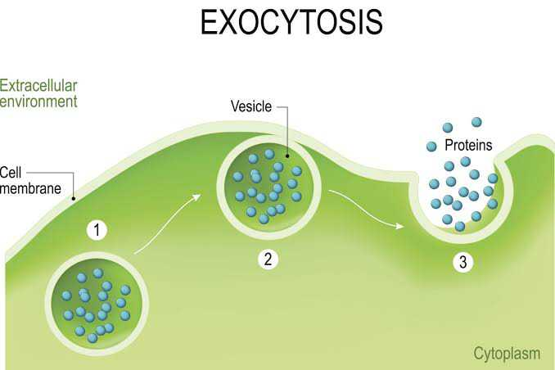
VESICULAR TRANSPORT
2. Exocytosis
- Exocytosis is the process by which cells expel materials.

Slide 20
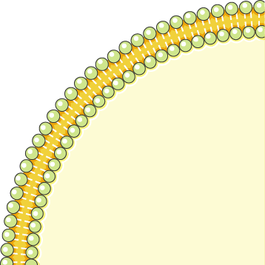
Importance of Membrane Transport
Membrane transport is vital for various physiological functions, including nutrient uptake, waste removal, and cell communication. It plays a critical role in maintaining cell size and volume, regulating ion concentrations, and enabling metabolic processes.

Slide 21
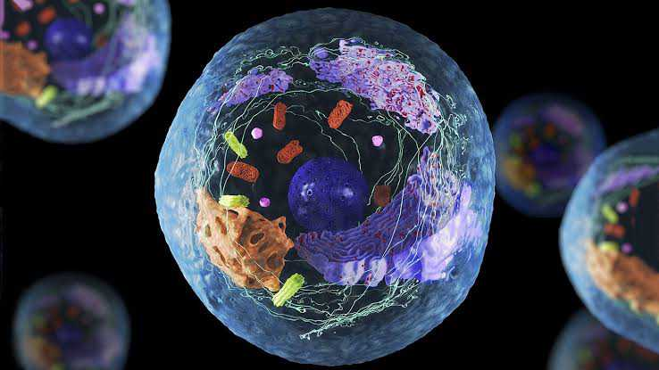
02
INTRACELULAR COMPARTMENTALIZATION

Slide 22
Intracellular Compartmentalization
refers to the organization of cellular components into distinct membrane-bound regions or structures within the cell.
Importance of Compartmentalization
The segregation of cellular functions into distinct compartments improves efficiency within the cell.
Compartmentalization allows simultaneous biochemical reactions to occur in isolated environments, optimizing conditions for specific enzymes and reactions.

Slide 23
Intracellular Compartmentalization
Types of Cellular Compartments
Membrane-bound Organelles:
Nucleus
mitochondria
endoplasmic reticulum
Golgi apparatus
Lysosome
Non-membrane Bound Structures:
Ribosomes
cytoskeletal elements
Examples of Compartmentalization
Specific examples include the acidic environment of lysosomes, which is essential for enzyme activity,
and the separation of DNA and RNA synthesis in the nucleus.

Slide 24
Importance of Intracellular Compartmentalization
01 | Efficiency | Different tasks can happen at the same time without getting in each other's way.
02 | Specialization | Each compartment is designed for specific jobs.
03 | Regulation | Compartmentalization helps the cell control its activities more effectively.
04 | Protection | Harmful reactions can take place in certain compartments like lysosomes or peroxisomes without risking damage to the rest of the cell.

Slide 25
THANK YOU FOR LISTENING ☺
Subject: Cell and Molecular Biology
Reporter no.2: Jhea Ballon

