Slide 1


Cell Energy:
Here Comes the Sun!

Slide 2


Cell Energy
Why do you get hungry?
Feeling hungry is your body’s way of telling you that your cells need energy!

Slide 3

From Sun to Cell
Plants capture energy from the sun and change it into food through a process called
PHOTOSYNTHESIS

Slide 4

Food that plants make supplies them with energy.
This food also becomes a source of energy for organisms that eat plants.

Slide 5
Photosynthesis:
Photosynthesis: process by which plants, algae, and some bacteria use
Sunlight
carbon dioxide
and water
to make food

Slide 6

Chlorophyll is the main pigment used in photosynthesis
It gives plants their green color
Chlorophyll is found in chloroplasts.

Slide 7


Plants use the energy captured by chlorophyll to change
CARBON DIOXIDE and WATER
Into FOOD
CO2 + =

Slide 8
The food is in the form of the simple sugar GLUCOSE, which is a carbohydrate
The energy in glucose is used by the plant’s cells
6CO2 + 6 H20 + light energy = C6H12O6 + 6O2

Slide 9
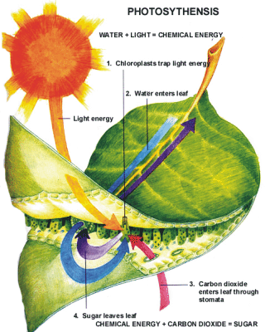

Slide 10
Getting Energy from Food
Animal cells have different ways of getting energy from food such as:
*Cellular respiration: uses oxygen to break down food
*Fermentation: the breakdown of food without the use of oxygen

Slide 11

Cellular Respiration
Respiration means “breathing”
Most complex organisms, from cows to humans, obtains energy through respiration

Slide 12
During cellular respiration, food (such as glucose) is broken down into carbon dioxide and water, and energy is released
Most of the energy released maintains body temperature

Slide 13
Some of the energy is used to form ATP (which supplies energy that fuels cell activities)
Most of the process of cellular respiration takes place in the cell membrane of prokaryotic cells

Slide 14
In the cells of eukaryotes, cellular respiration takes place in the mitochondria
The equation for cellular respiration is almost a complete opposite of photosynthesis!
C6H1206 + 602 -> 6CO2 + 6H20 + ENERGY (ATP)

Slide 15
Connection Between Photosynthesis and Respiration
Photosynthesis transforms energy from the sun into glucose, cells use carbon dioxide to make glucose, and the cells release oxygen
During cellular respiration, cells use oxygen to break down glucose and release energy and carbon dioxide
Each process makes the materials that are needed for the other process to occur elsewhere

Slide 16

Fermentation
Have you ever felt that burning sensation in your leg muscles when you run?

Slide 17
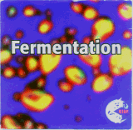
When muscle cells just can’t get enough oxygen for cellular respiration, they use the process of fermentation to get energy

Slide 18

One kind of fermentation happens in your muscles and produces lactic acid (this is why you get muscle cramps—a buildup of acid!)

Slide 19

Another type of fermentation occurs in some types of bacteria and in yeast

Slide 20
In a general sense, fermentation is the conversion of a carbohydrate such as sugar into an acid or an alcohol. More specifically, fermentation can refer to the use of yeast to change sugar into alcohol or the use of bacteria to create lactic acid in certain foods. Fermentation occurs naturally in many different foods given the right conditions, and humans have intentionally made use of it for many thousands of years.
earliest uses of fermentation were most likely to create alcoholic beverages such as mead, wine, and beer.

Slide 21

Fermentation is a way that cells get energy from their food without using oxygen
Yeast forms carbon dioxide during fermentation. The bubbles of carbon dioxide gas cause the dough to rise and leave small holes in the bread after it’s baked.

