Slide 1
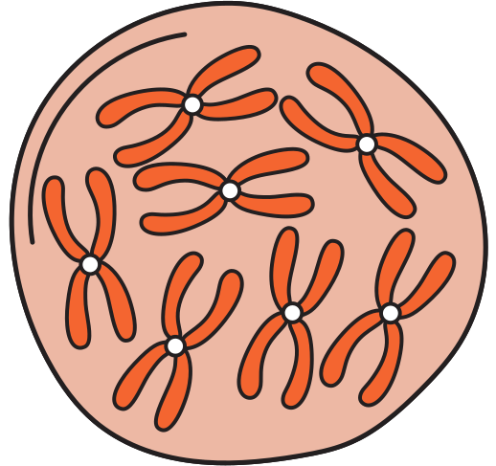
TRANSCRIPTIONAL CONTROL OF GENE EXPRESSION
BY: DACANAY, KIZZIE MAE

Slide 2
GENE EXPRESSION
is the way our cells use the instructions in our DNA to create something useful, usually proteins.
The process of gene expression happens in two main steps:
Transcription- the process by which the information in a strand of DNA is copied into a new molecule of messenger RNA (mRNA).
Translation- the process by which a cell makes proteins using the genetic information carried in messenger RNA (mRNA).

Slide 3
GENE EXPRESSION
It ensures the right proteins are made in the right amount, at the right time, and in the right cells. If something goes wrong in this process, it can cause diseases, like cancer, developmental problems, or metabolic disorders.

Slide 4
WHAT ARE THE KEY COMPONENTS OF
TRANSCRIPTIONAL CONTROL?

Slide 5
COMPONENTS OF Transcriptional Control
1. | PROMOTER
2. | Transcription Factors
3. | Enhancers and Silencers
4. | RNA Polymerase II

Slide 6
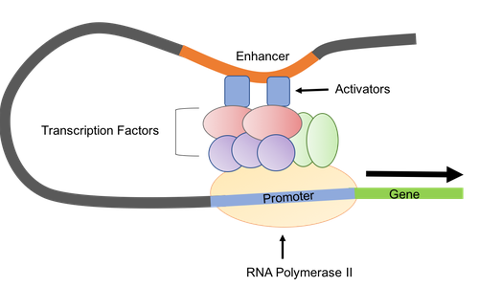
PROMOTER
A promoter is a DNA sequence located near the beginning of a gene. It is the binding site for RNA polymerase, the enzyme that synthesizes RNA. The strength and structure of the promoter affect how efficiently transcription begins.

Slide 7
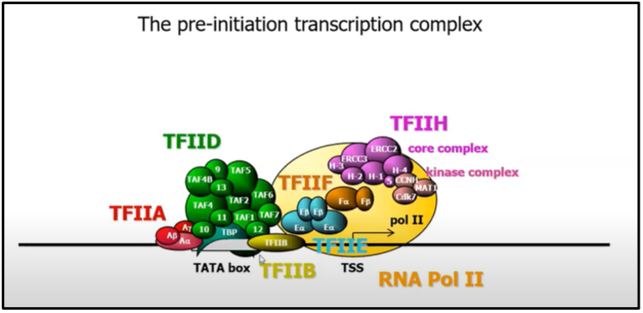
TRANSCRIPTION FACTORS
These are proteins that bind to specific DNA sequences near the promoter region. They can either enhance (activators) or inhibit (repressors) the transcription of a gene by influencing RNA polymerase's ability to bind to the promoter.

Slide 8
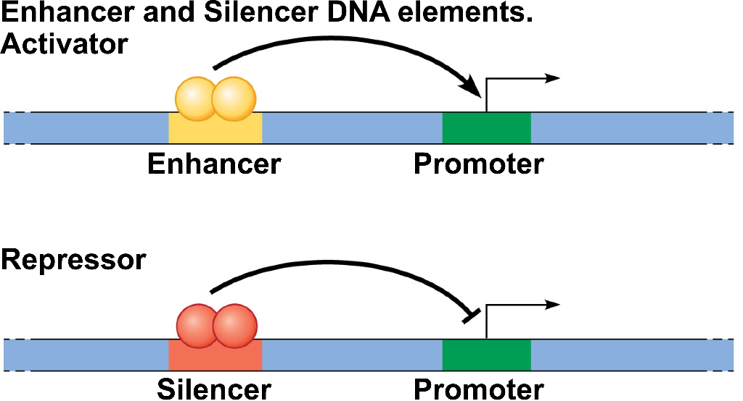
ENHANCERS AND SILENCERS
Enhancers are regulatory DNA sequences that, when bound by specific transcription factors, can increase the likelihood of transcription from a promoter.
Silencers are sequences that inhibit transcription when bound by repressor proteins.

Slide 9
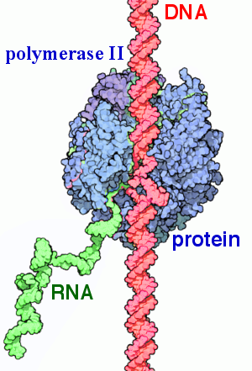
RNA POLYMERASE II
The enzyme responsible for synthesizing mRNA from the DNA template during transcription. It requires the assembly of various transcription factors and the appropriate regulatory elements to initiate transcription.

Slide 10
IMPORTANCE OF TRANSCRIPTIONAL CONTROL:
Cell Differentiation: Transcriptional control allows for the specialization of cells.
Response to Environmental Changes: Cells can quickly adapt to changing conditions (e.g., stress, nutrient availability) by turning genes on or off as needed.
Development and Growth: Proper transcriptional regulation is essential for normal development and growth, as it ensures that genes are expressed at the right times and levels.

Slide 11
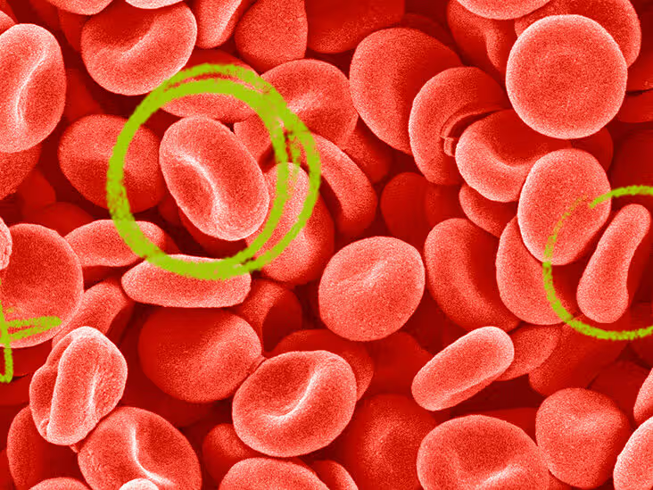
HEMOGLOBIN
Copying the Instructions (Transcription)
Inside certain cells in the bone marrow, the DNA contains genes that have the instructions to make hemoglobin. Two important genes are involved: one for the alpha part and one for the beta part of hemoglobin. The cell makes a copy of these instructions in the form of messenger RNA (mRNA).

Slide 12
HEMOGLOBIN
2. Sending the Instructions (mRNA Processing and Transport)
Once the mRNA copy is made, it gets prepared to leave the nucleus, where DNA is stored, and heads to the ribosomes (the cell’s protein factories) in the cytoplasm.

Slide 13
HEMOGLOBIN
3. Making the Hemoglobin (Translation)
In the ribosomes, the mRNA is "read" like a set of instructions. The cell uses these instructions to link amino acids together in the right order to form the alpha and beta globin proteins (the building blocks of hemoglobin).

Slide 14
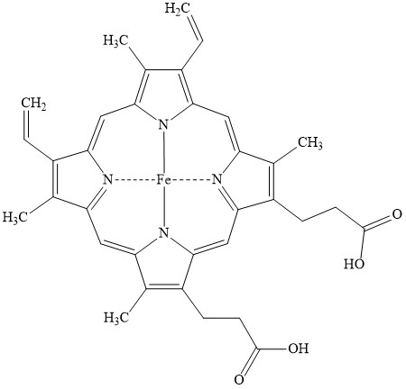
HEMOGLOBIN
4. Putting It All Together
After the alpha and beta parts are made, they fold up and come together to form the complete hemoglobin protein. Each hemoglobin protein also attaches to a special component called heme, which contains iron and allows hemoglobin to bind oxygen.

Slide 15
HEMOGLOBIN
5. Regulation
The body carefully controls when and how much hemoglobin is made. For example, babies make a special type of hemoglobin before they’re born that’s different from what adults have, so they can get oxygen more easily from their mothers.

Slide 16
WHAT HAPPENS WHEN THIS PROCESS GOES WRONG?

Slide 17
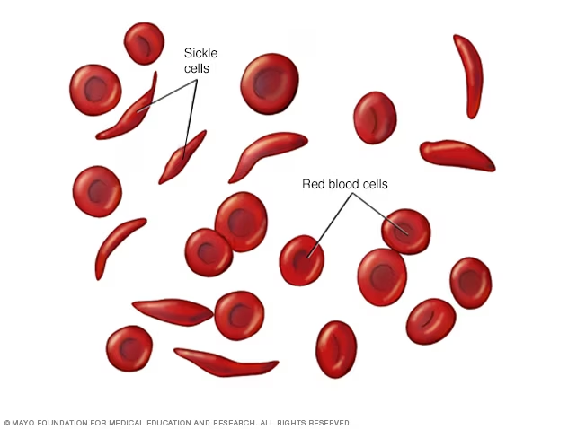
SICKLE CELL ANEMIA

Slide 18
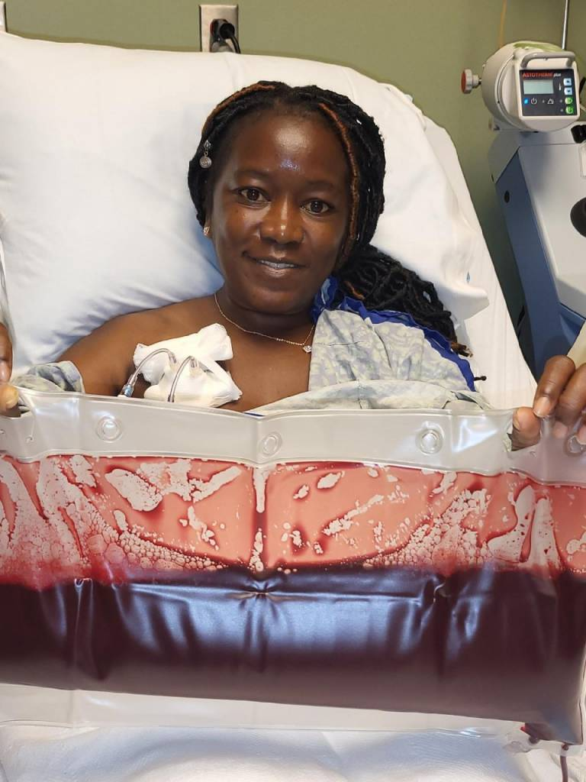
SICKLE CELL ANEMIA (SYMPTOMS)
1. Pain Crises (Sickle Cell Crisis)
2. Anemia
3. Swelling
4. Frequent Infections
5. Delayed Growth
6. Vision Problems

Slide 19
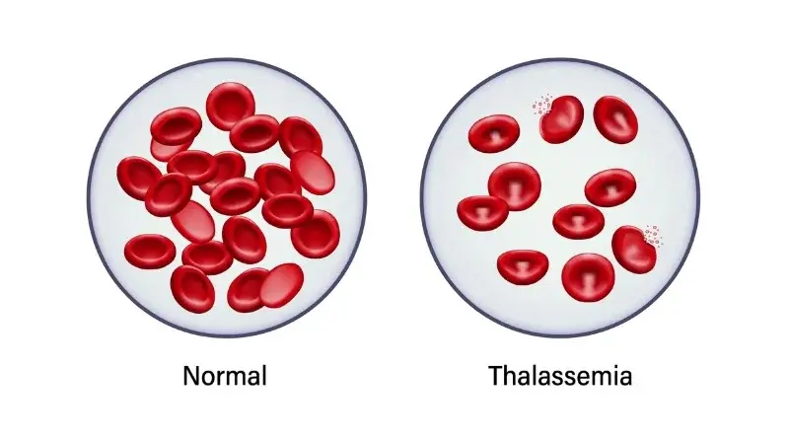
BETA-THALASSEMIA

Slide 20
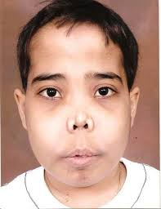
BETA-THALASSEMIA
Anemia
Bony abnormalities
enlarged organs
Juandice
Frequent infections
Delayed growth and development

Slide 21
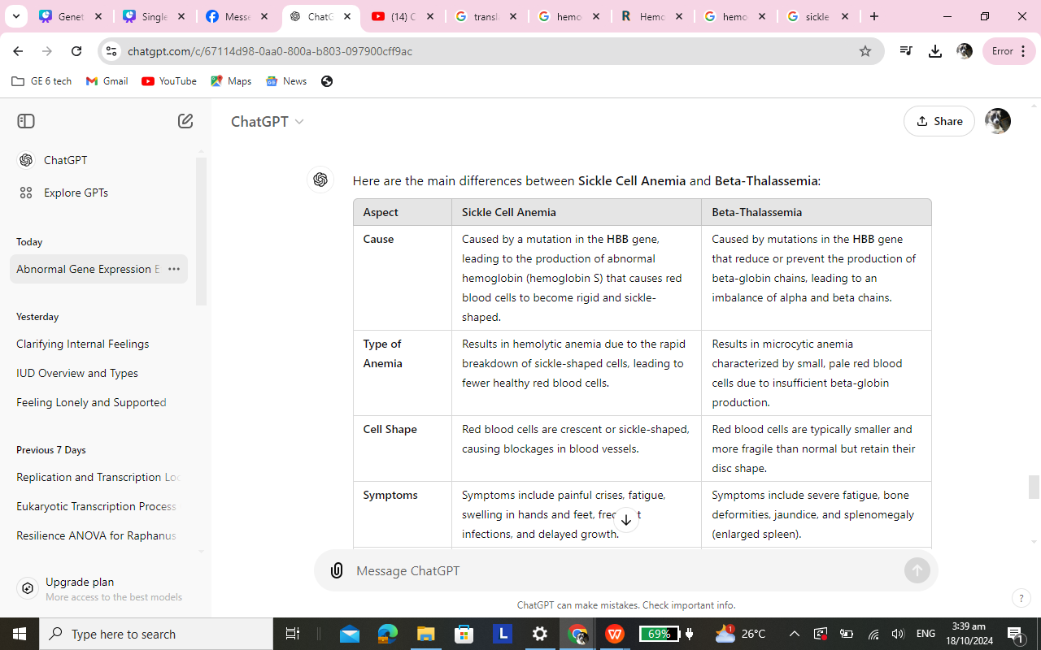

Slide 22
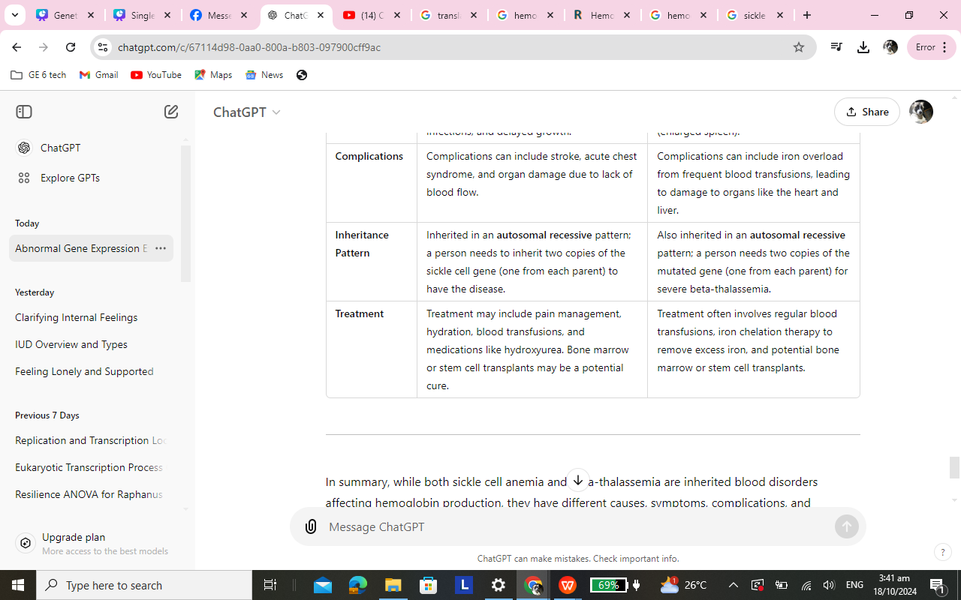

Slide 23
THANK YOU...

