Slide 1
Text Mining Unstructured Corporate Filing Data Equity L/S with Filing-based Factor
Yizhang Li, Ruxu Huang, Shuai Wang

Slide 2
Why we look into text data part of 10-K/10-Q? Under-Reaction!
Background:
1. Often before a company files its form 10-K/10-Q with the SEC, it already discloses nearly all of the key numerical information to the public.
2. Key measures of financial performance are often disclosed in earnings announcements and conference calls weeks or even months before the filing of 10-K/10-Q.
3. Few investors actually read the voluminous 10-K/10-Q filings
4. 10-K/10-Q itself is more complex than ratios

Slide 3
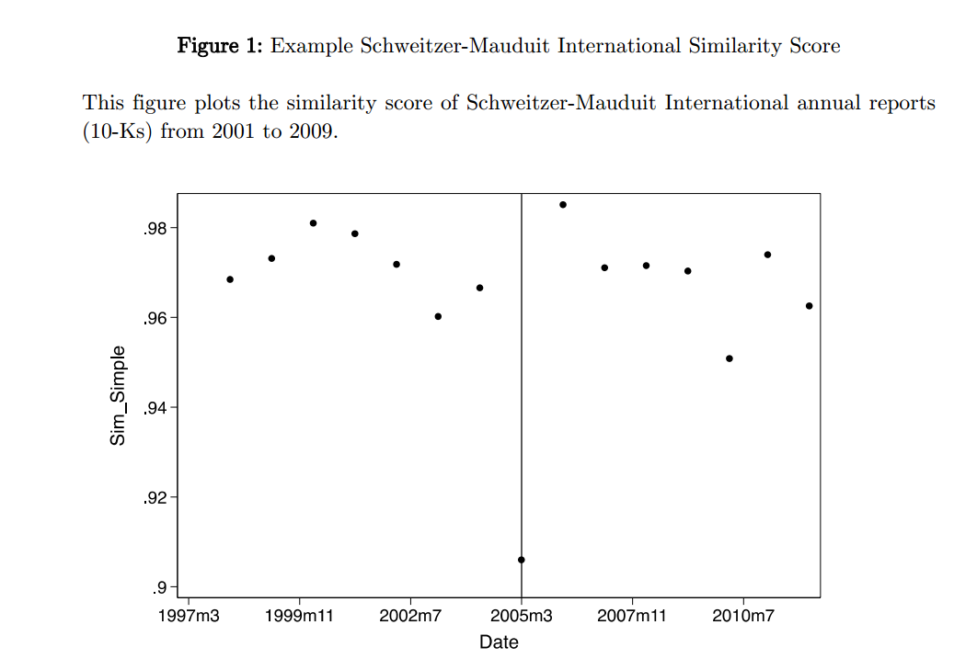
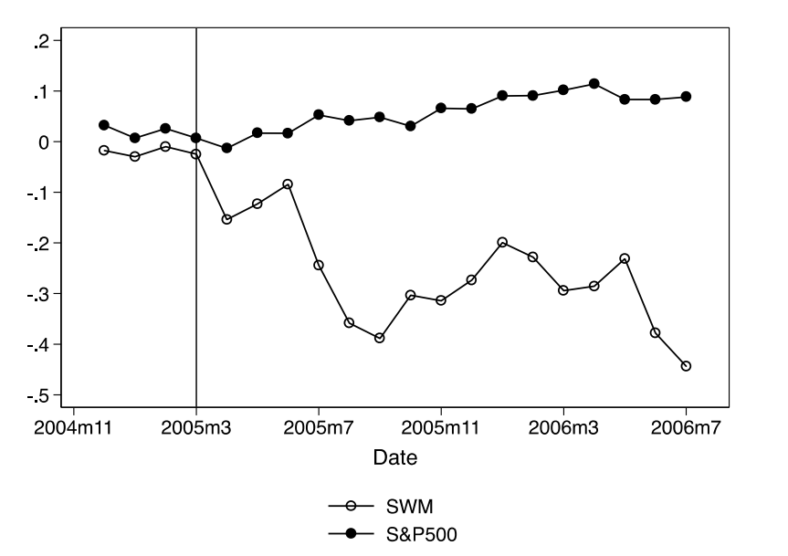
Idea from Lazy Prices (Cohen et.al 2019)
Firms are using simple default choices in their 10-K/10-Q
They simply repeat the information that they previously reported to the markets.
Cohen et.al show that portfolio shorts “changers” and buys “non-changers” earns up to 1.88% per month
Example: Schweitzer-Mauduit International, Inc. ( SWM)
SWM added a paragraph about experiencing weakness in tobacco paper sales in its 2005’s 10-K

Slide 4
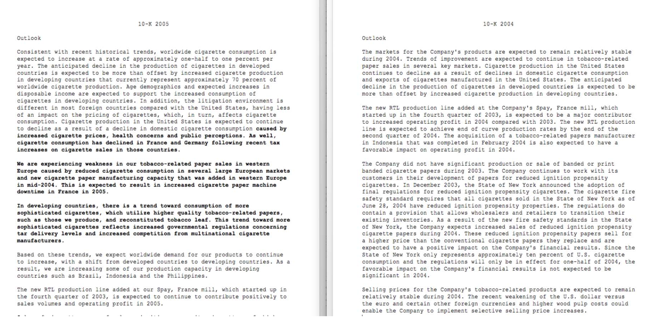
Appendix: SWM 10K in 2005

Slide 5
We take advantage of Natural Language Processing (NLP) algorithms to systematically analyze corporate filings from the EDGAR database.
Python
Index files
Crawler
Python
downloader
Raw txt/html file
10-K/10-Q
EDGAR Website
R
Parse files into Sections (json)
MD&A/Risk Factors/Disclosures/Legal Proceedings
Python
Distance-Based Signal
OOS Backtesting
In-Sample Test

Slide 6
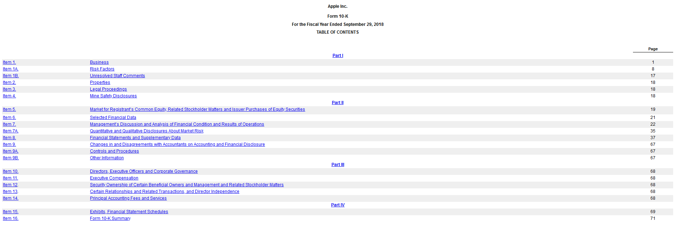
10-K in EDGAR

Slide 7
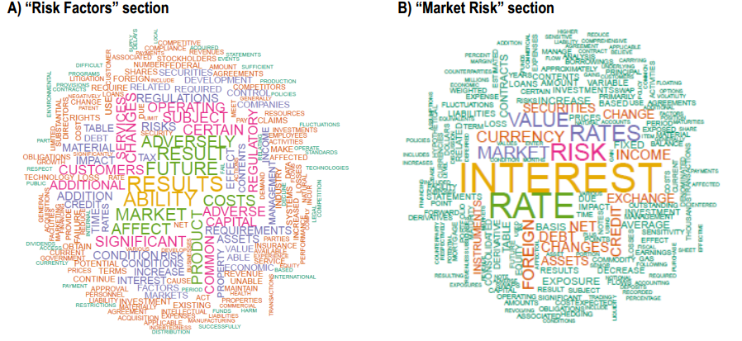
Word Cloud for different sections

Slide 8
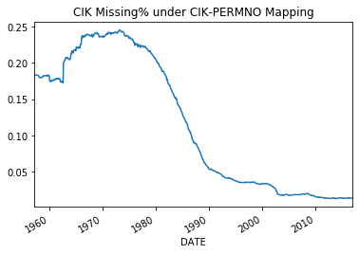
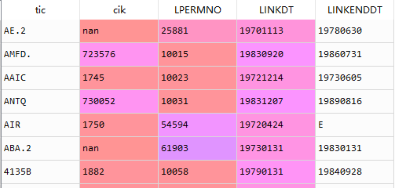
Data (Monthly 1993 – 2018)
Parsed 10K/10Q Data: 57GB in JSON, Key(CIK DATE)
Firm Characteristics: Gu’s Website (CRSP. Compustat, IBES), Key(PERMNO DATE)
Monthly Return: CRSP
Linking Table: Merged Conpustat Database CIK-GVKEY-CUSIP-PERMNO
Focus on S&P500

Slide 9
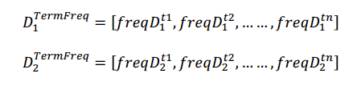

Data Preprocessing for 10-K/10-Q
Step 1: Use NLTK(Python) to tokenize the doc
Step 2: Remove numbers and punctuation
Step 3: Remove stop words and convert words to lower cases
Step 4: Stem (i.e if the word ends in 'ed', remove the 'ed’)
Step 5: Use CountVectorizer/TfidfVectorizer/WordEmbedding(50-D) to calculate TF-IDF/Bag-of-Word/Average Embedding Matrix
MD&A | Operate | Bond | Finance | Debt | Plan
AAPL | 2 | 1 | 1 | 1 | 1
MSFT | 1 | 1 | 1 | 1 | 1
AMZN | 2 | 3 | 4 | 5 | 7
Term Frequency–Inverse Document Frequency
TF measures how frequently a term occurs in a document.
TF(t) = (Number of times term t appears in a document) / (Total number of terms in the document).
IDF measures how important a term is: "is", "of", and "that", may appear a lot of times but have little importance.
IDF(t) = In(Total number of documents / Number of documents with term t in it).

Slide 10
Signal Calculation: Measure changes in language
For each month, within our universe S&P500:
For any stock that filed 10-K/10-Q
We calculate the cosine distance between its most recent 10-Q(K) and its previous 10-Q(K)
For any other stock, we use forward-filling.
CIK | filename | file_date | Disclosures | Legal Proceedings | MD&A | Risk Factors
1000045 | 0000950144-05-008668 | 2005/8/12 | 3 |  | 2
1000045 | 0000950144-05-011577 | 2005/11/10 | 3 |  | 2
1000045 | 0001144204-06-005708 | 2006/2/14 | 3 |  | 2
1000045 | 0001193125-06-139517 | 2006/6/29 | 17 | 11 | 16 | 8
1000045 | 0001193125-06-172516 | 2006/8/14 | 4 |  | 3 | 2
1000045 | 0001193125-06-234357 | 2006/11/14 | 4 |  | 3 | 2
1000045 | 0001193125-07-031642 | 2007/2/14 | 4 |  | 3 | 2
1000045 | 0001193125-07-135810 | 2007/6/14 | 17 | 11 | 16 | 8
How we contruct our basic portfolios?
Dollar Neutral
For every month-end, we just sort our stocks based on the similarity signal.
L/S equal number of stock (Top X%) with different weighting scheme
EW within group
Cap-Weighted within group
Signal-Weighted
But these kind of L/S portfolios have unintended risk exposures

Slide 11
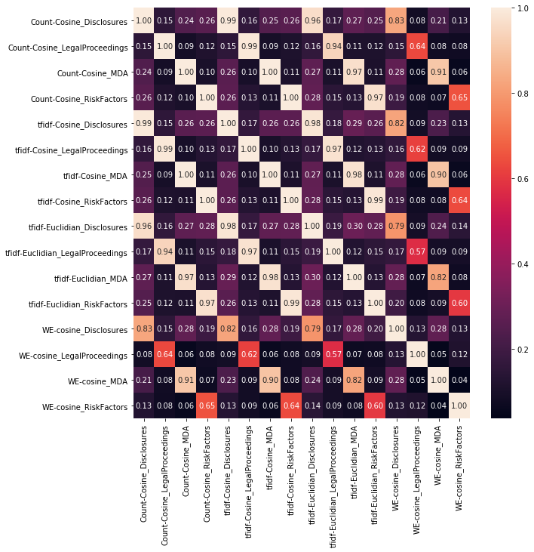
Before backtesting:
Summary Stats
2. Correlation Heatmap
TFIDF-Cosine | Disclosures | Legal Proceedings | MDA | Risk Factors
mean | 0.3057 | 0.3660 | 0.2384 | 0.4971
std | 0.3172 | 0.3237 | 0.2643 | 0.3900
min | 0.0000 | 0.0000 | 0.0000 | 0.0000
25% | 0.0490 | 0.0614 | 0.0869 | 0.0324
50% | 0.1338 | 0.2763 | 0.1424 | 0.6252
75% | 0.5855 | 0.6506 | 0.2321 | 0.8832
max | 0.9857 | 0.9938 | 0.9970 | 0.9877
Signal Corr | Disclosures | Legal Proceedings | MDA | Risk Factors
Disclosures | 1.000 | 0.185 | 0.270 | 0.277
Legal Proceedings | 0.185 | 1.000 | 0.113 | 0.150
MDA | 0.270 | 0.113 | 1.000 | 0.121
Risk Factors | 0.277 | 0.150 | 0.121 | 1.000

Slide 12
3. Fama-Macbeth Regression
Whether our factors have significant premium after control for other factors
S&P500 | Estimate | SE | T-Stat | P-Value
(Intercept) | 0.011 | 0.003 | 3.876 | 0.0001 | ***
MD&A | 0.002 | 0.001 | 1.932 | 0.0534 | .
Size | -0.000 | 0.000 | -4.053 | 0.0001 | ***
mom1m | -0.017 | 0.009 | -1.799 | 0.0721 | .
mom12m | -0.006 | 0.005 | -1.161 | 0.2457
beta | -0.003 | 0.003 | -0.939 | 0.3475
LogBM | 0.000 | 0.001 | 0.096 | 0.9234

Slide 13
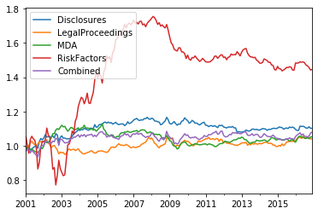
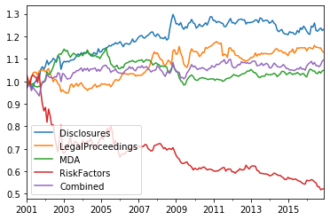
1. Dollar Neutral L/S
Long Top X% - Short Bottom X% (EW/CW/SW)
Unintended Exposure!
Cap-Weighted
Signal-Weighted

Slide 14
2. Pure Factor Mimicking Portfolio
Portfolio Construction (TFIDF-Cosine)
L/S weights sum to 1
Obj: min portfolio variance
Constraints 1: Exposure on each risk factor equals to 0
Constraints 2: Exposure on Similarity Signal equals to 1
 | rtn | vol | Sharpe | Calmar
Disclosures | 6.07% | 7.86% | 0.772 | 0.279
Legal Proceedings | 6.21% | 8.19% | 0.759 | 0.258
MDA | 8.75% | 7.71% | 1.135 | 0.518
RiskFactors | 5.29% | 28.75% | 0.184 | 0.059
Combined | 14.07% | 16.45% | 0.856 | 0.312

Slide 15
Appendix

Slide 16
Appendix: Signal
Date | 1800 | 773840 | 4904 | 12927 | 16732 | 18230 | 93410 | 21344 | 21665 | 1047862 | 24741 | 315189 | 936340 | 715957
1996/1/31
1996/2/29 | 0 | 0 | 0 | 0 | 0 | 0 | 0 | 0 | 0 | 0 | 0 | 0 | 0 | 0
1996/3/31 | 0 | 0 | 0.000371 | 0.046002 | 0 | 0.883201 | 0.057689 | 0.919276 | 0 | 0 | 0.110644 | 0 | 0.861682 | 0
1996/4/30 | 0 | 0 | 0 | 0 | 0 | 0 | 0 | 0 | 0 | 0 | 0 | 0 | 0 | 0
1996/5/31 | 0 | 0.146745 | 0 | 0 | 0 | 0 | 0 | 0.184703 | 0 | 0 | 0 | 0 | 0.040677 | 0
1996/6/30 | 0 | 0 | 0 | 0 | 0 | 0 | 0 | 0 | 0 | 0 | 0 | 0.05697 | 0 | 0
1996/7/31 | 0 | 0 | 0 | 0 | 0 | 0 | 0 | 0 | 0 | 0 | 0 | 0 | 0 | 0
1996/8/31 | 0 | 0.038109 | 0 | 0 | 0 | 0 | 0 | 0.194728 | 0 | 0 | 0 | 0.946817 | 0 | 0
1996/9/30 | 0 | 0 | 0 | 0 | 0 | 0 | 0 | 0 | 0 | 0 | 0 | 0 | 0 | 0
1996/10/31 | 0 | 0 | 0 | 0 | 0 | 0 | 0 | 0 | 0 | 0 | 0 | 0 | 0 | 0
1996/11/30 | 0 | 0.097749 | 0 | 0 | 0 | 0 | 0 | 0.909809 | 0 | 0 | 0 | 0 | 0.040546 | 0
1996/12/31 | 0 | 0 | 0 | 0 | 0 | 0 | 0 | 0 | 0 | 0 | 0 | 0 | 0 | 0
1997/1/31 | 0 | 0 | 0 | 0 | 0 | 0 | 0 | 0 | 0 | 0 | 0 | 0.943595 | 0 | 0
1997/2/28 | 0 | 0 | 0 | 0 | 0 | 0 | 0 | 0 | 0 | 0 | 0 | 0 | 0 | 0
1997/3/31 | 0 | 0 | 0 | 0.858796 | 0 | 0 | 0 | 0.931201 | 0 | 0 | 0.053918 | 0.070836 | 0.843747 | 0.910711

Slide 17
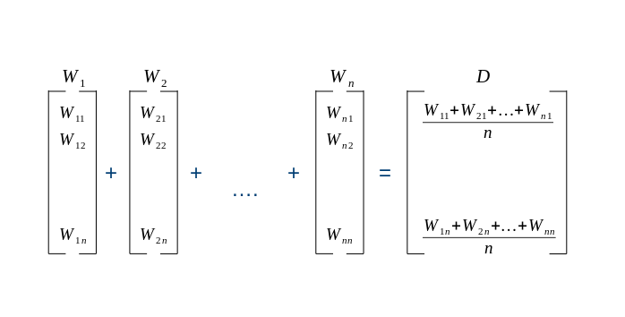
Appendix: Average Word Embedding

Slide 18
